Slide 1
2026 High Intensity tests
C. Antuono, L. Sito, C. Zannini
Many thanks to: E. de la Fuente, N. Mounet, S. Kostoglou, G. Rumolo, R. T. Garcia

Slide 2
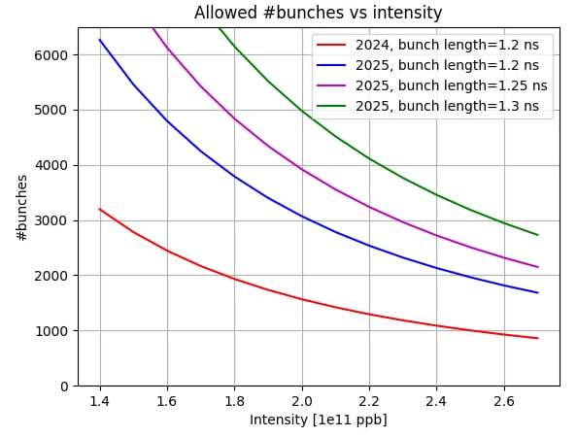
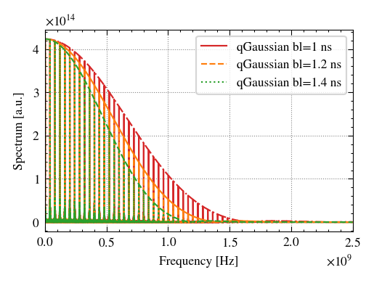
Beam induced heating as a function of bunch length
The bunch length is a main driver for the beam induced heating
E.g. As we saw for the warm module case, lower bunch length are more critical
The lower the bunch length the more frequencies we can explore
Courtesy of L. Sito
For high intensity test the bunch length should be as close as possible to nominal

Slide 3
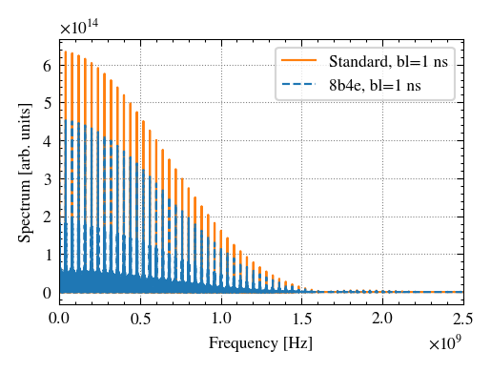
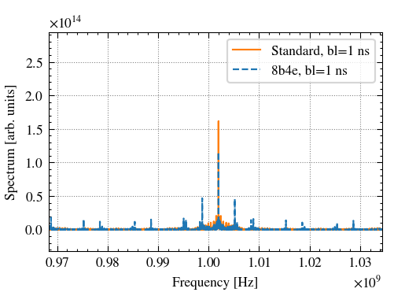
Is it 8b4e representative for HL-LHC beam induced heating?
The contribution from main lines is lower due to the lower total intensity for the 8b4e (less bunches)
However, additional lines allow to probe more frequencies
Courtesy of L. Sito
The 8b4e is very interesting to probe additional frequencies, while standard to probe the higher intensity on main lines
Full 8b4e in terms of heat is approximately equivalent to full 25ns beam with 1.95e11 ppb

Slide 4
Thank you!

