Slide 1
HL-LHC Roman Pot: impact on beam stability from impedance
C. Antuono, L. Sito, N. Mounet
Thanks to : D. Druzhkin, L.Giacomel, R. De Maria, N. Minafra, C. Zannini

Slide 2
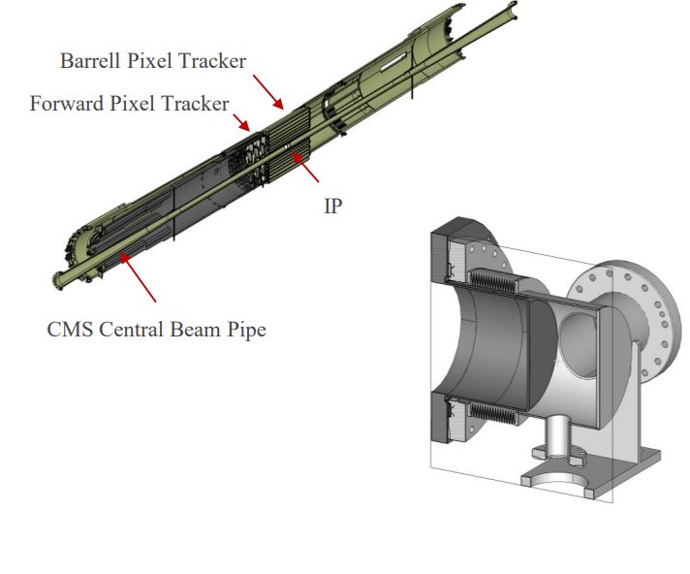
LHC and HL-LHC Roman Pot (PPS): introduction
Impedance study carried out by L. Sito and fully detailed and presented at the CEI section meeting
PPS are installed on both sides of IP5 and have run successfully during Run 2 and Run 3
PPS2 is the upgraded version of PPS for running from Run 4 to Run 6
  Updated impedance study for the HL beam parameters
It is a detector which intercepts particles that after “collision” have been only slightly deflected
It operates in different scenarios:
  From 40 mm (parking position) up to 1 mm (operational position)
Three stations (XRP) with 2 Pots each at every side of IP5
  XRP-196,220,243
  Total of 12 Pots, 6 per beam
Courtesy of L. Sito
I am going to present the stability assessment for HL-LHC PPS2

Slide 3

HL-LHC Roman Pot (PPS2): scenarios
PPS2s operate in different scenarios:
  parking position: to be considered at flat top
    start of levelling ($β^{∗}=1 m$)
    All Pots at 40 mm
  operational position: to be considered during collision
    end of levelling ($β^{∗}=15 cm$)
    Pots in XRP-196 at 7.7 mm
    Pots in XRP-220 at 3 mm
    Pots in XRP-243 at 1 mm
Stability assessment usually done only at flat top
Given the presence of:
12 non-colliding bunches
Non negligible impedance of PPS2s
stability assessment performed also during collision

Slide 4
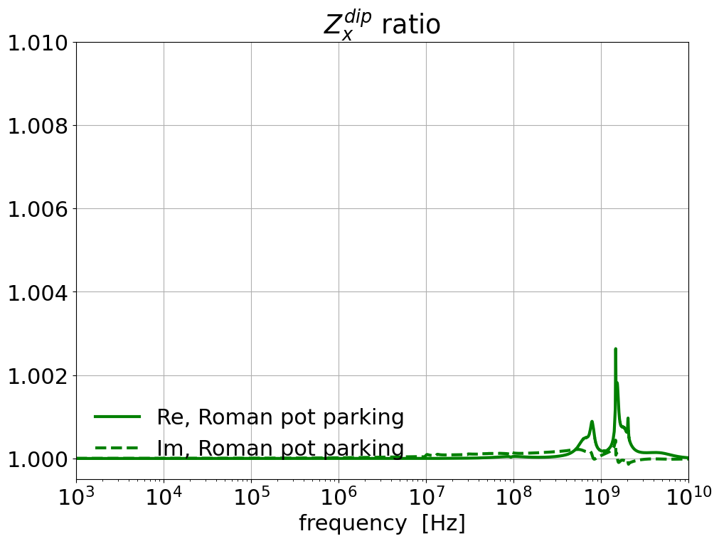
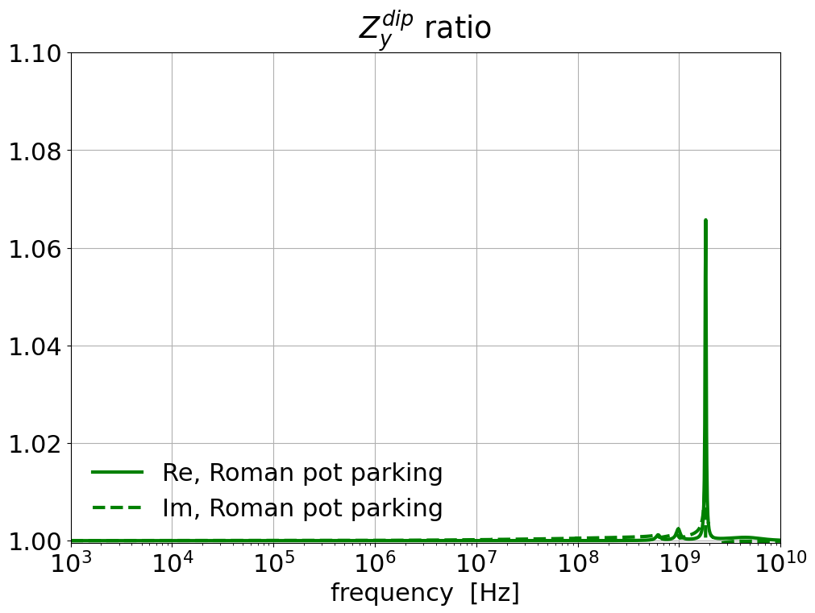
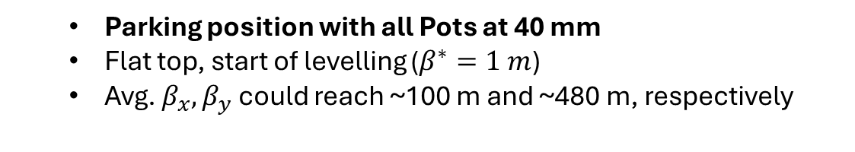
PPS2s at Flat Top
  Parking position with all Pots at 40 mm
  Flat top, start of levelling ($β^{∗}=1 m$)
  Avg. $β_{x},β_{y}$ could reach ~100 m and ~480 m, respectively
Maximum increase of octupolar threshold in x: < 0.5%
Maximum increase of octupolar threshold in y: 0.8%

Slide 5
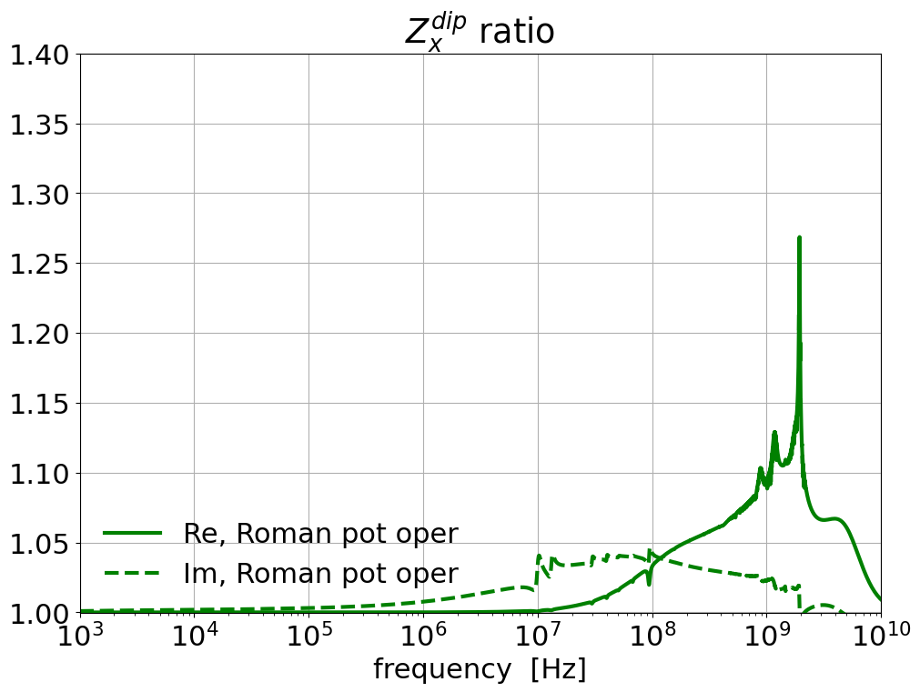
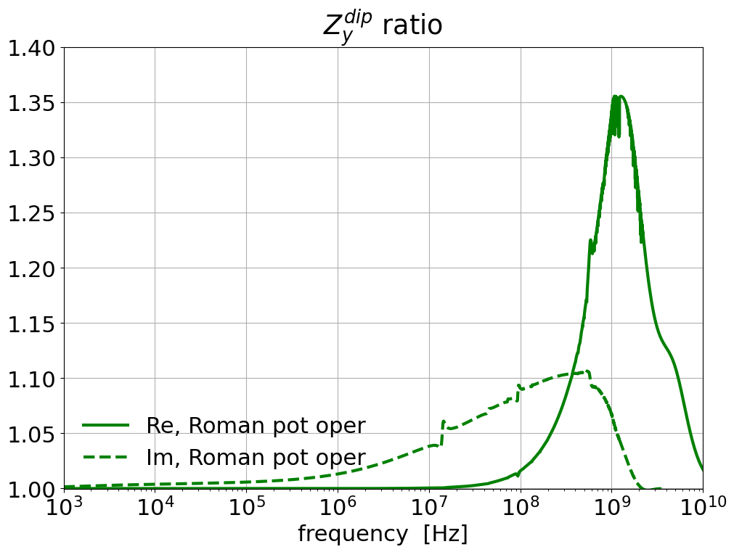
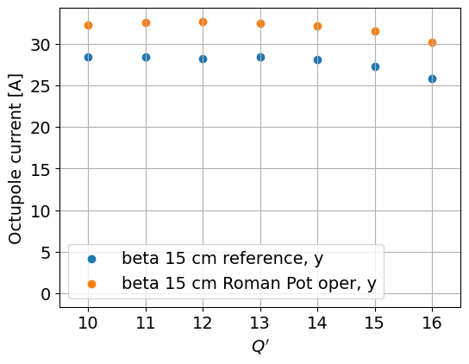
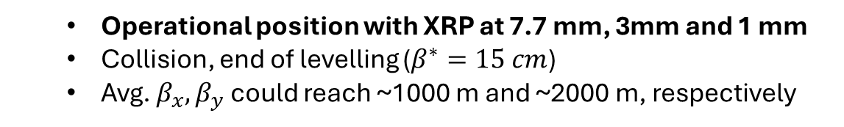
PPS2s in collision
  Operational position with XRP at 7.7 mm, 3mm and 1 mm
  Collision, end of levelling ($β^{∗}=15 cm$)
  Avg. $β_{x},β_{y}$ could reach ~1000 m and ~2000 m, respectively
Maximum increase of octupolar threshold in x : 2%
Maximum increase of octupolar threshold in y : 17%
When adding the Crab Cavities still a ~(-160 Amps) of octupolar current are needed to keep the non–colliding bunches stable
  Impact of Roman Pots in terms of max. oct. threshold decreases to 4%

Slide 6
Thank you!

