Slide 1
Longitudinal beam dynamics
High energy muon acceleration
E. Lamb, D. Amorin, S. Albright, R. Calaga, H. Demerau,
A. Grudiev, L. Thiele, U. Von Rienen
Thanks to: A. Pastinante, B. Karlsen-Baeck

Slide 2

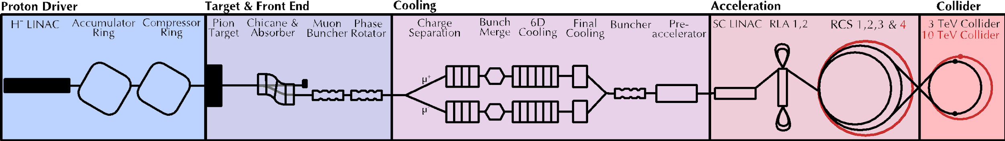
Introduction
Longitudinal beam dynamics for the RCS chain
Short, intense proton bunch
Protons produce pions which decay into muons which are captured
Ionisation cooling of muon in matter
Acceleration to collision energy
Collision
2

Slide 3
Challenges for RCS chain
Short muon lifetime – injection and extraction on accelerating buckets, and high synchronous tune
Small acceptance due to 1.3GHz Tesla cavity
Counter-rotating bunches with induced voltages that sum in the same cavities

Slide 4
Contents
New optics
Realistic injection
Counter-rotating beams

Slide 5
New optics

Slide 6

High synchronous tune $Q_{s}$
Slide on why synchrotron tune matters for stable motion

Slide 7
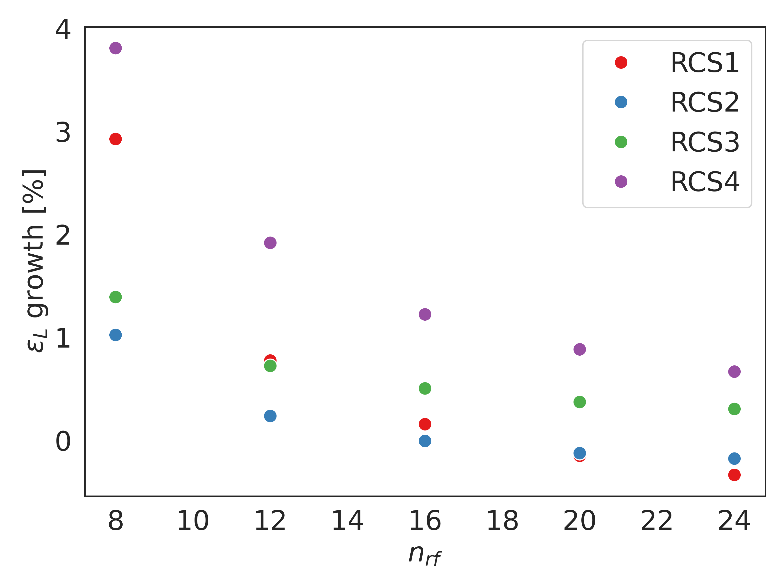
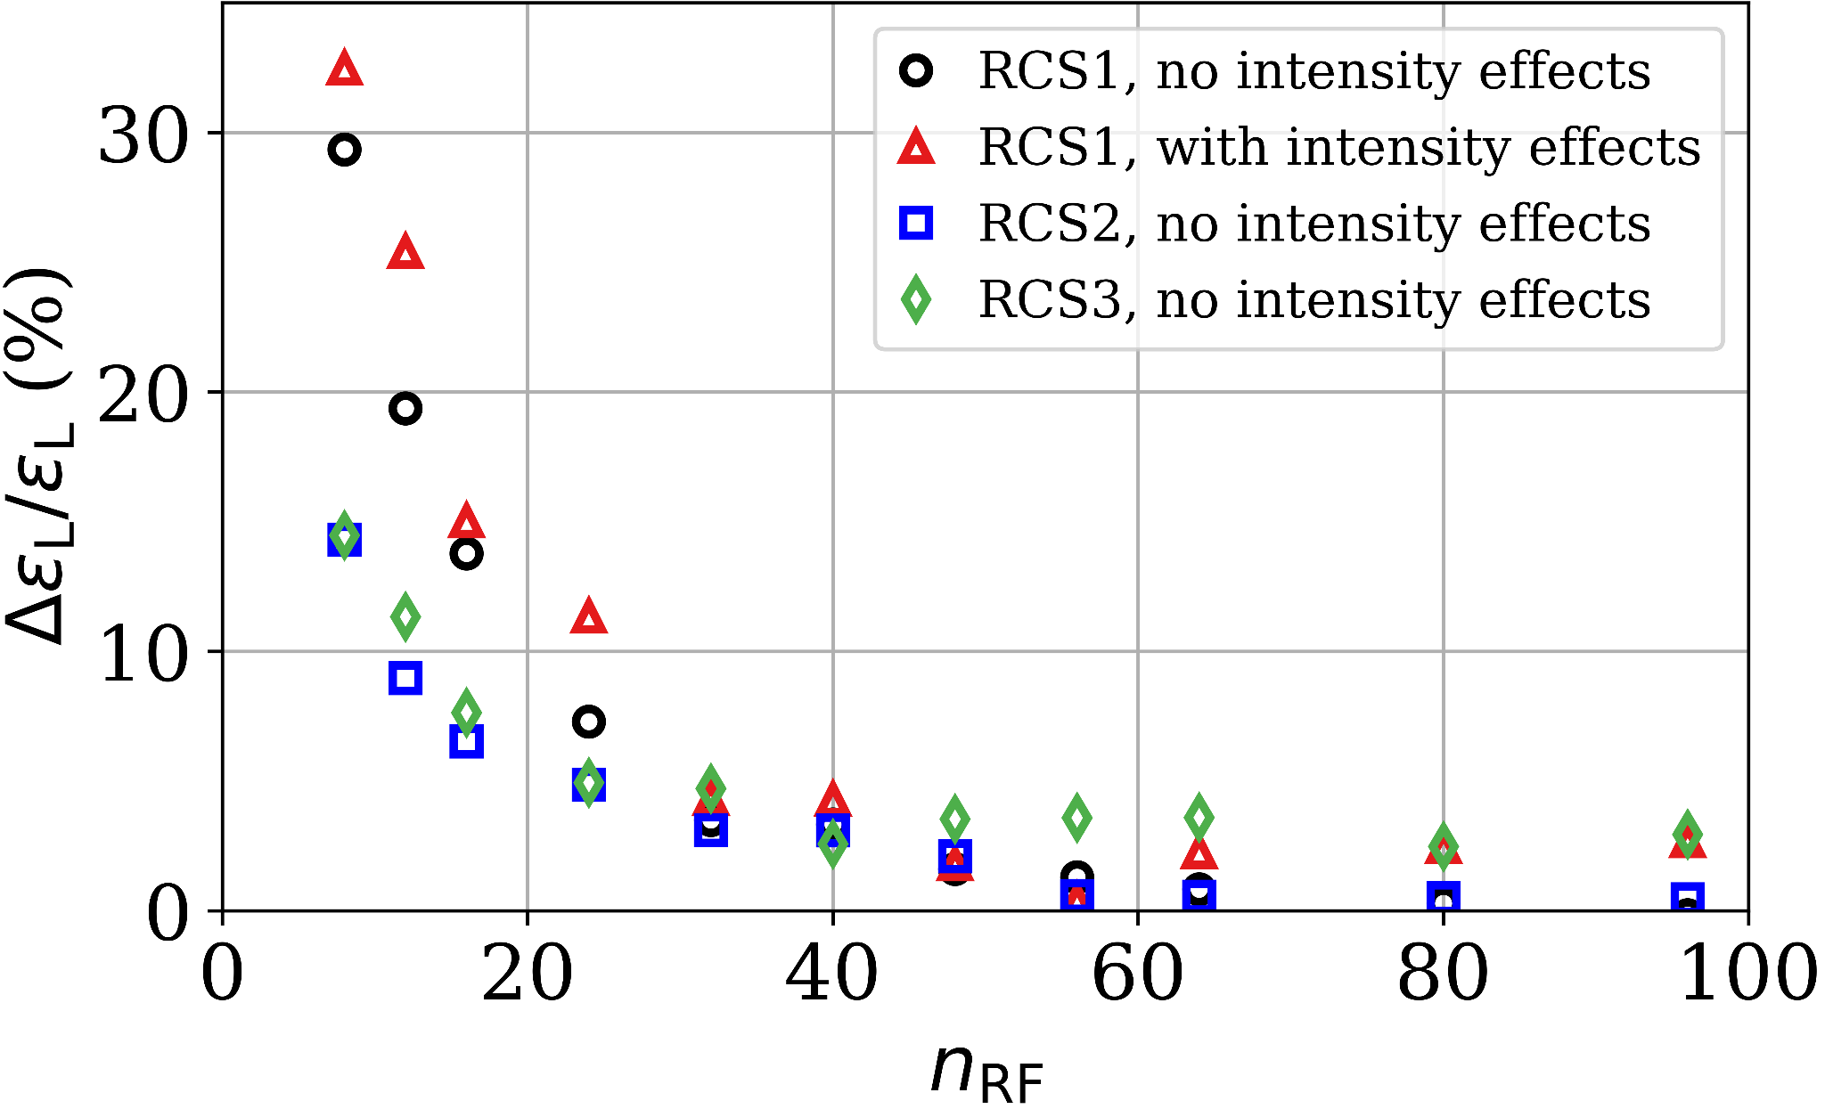
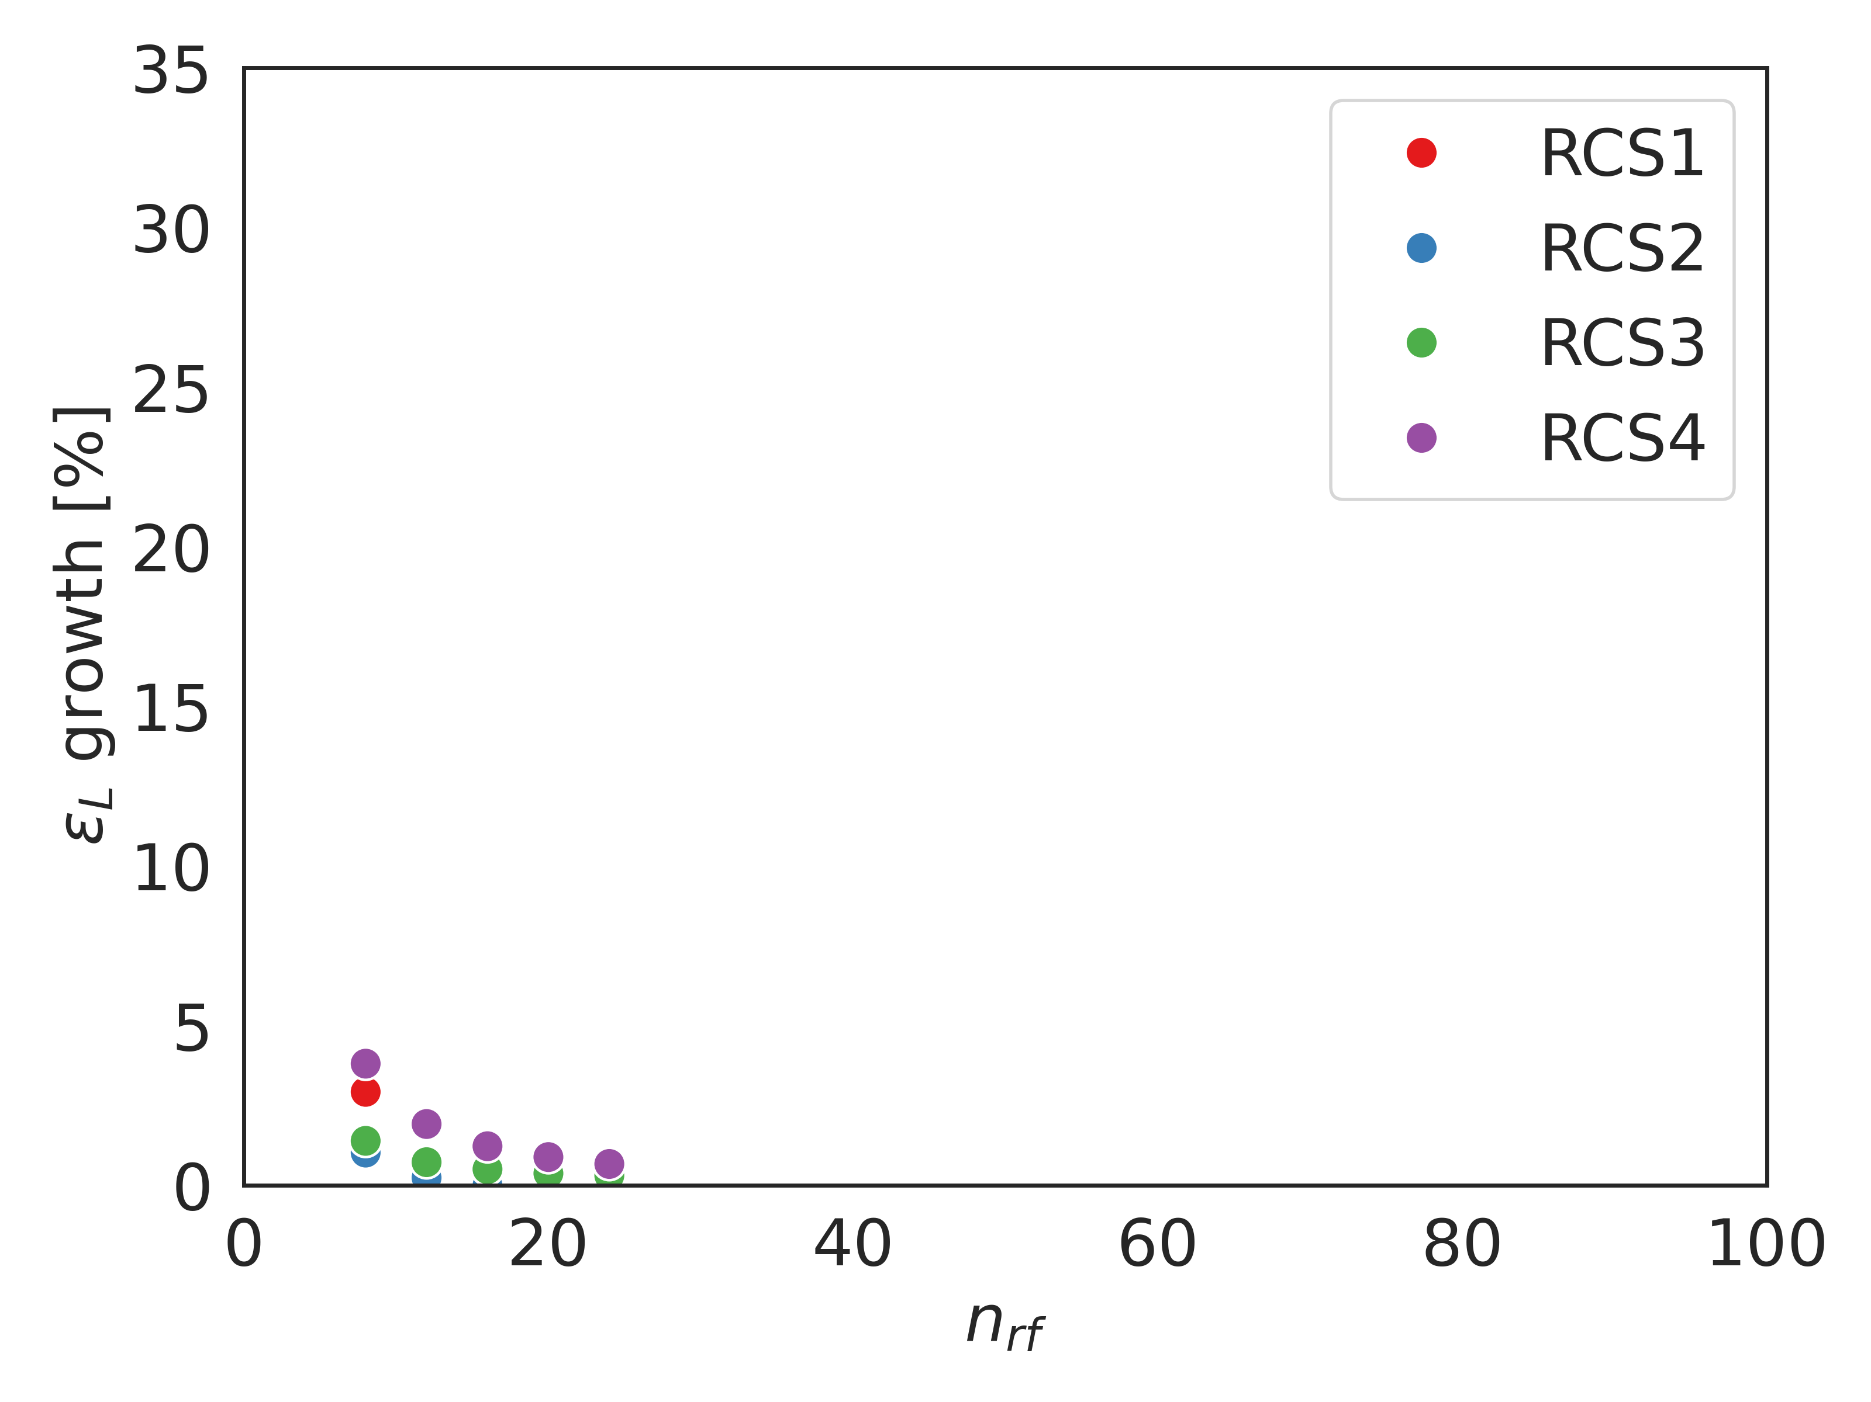
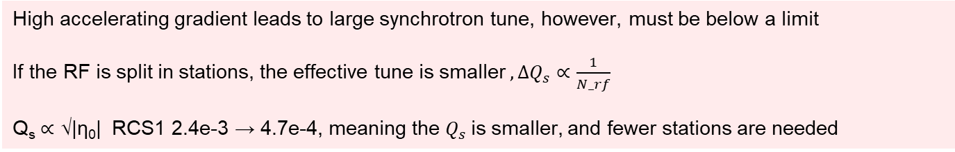


New optics – $Q_{s}$
Single bunch, fundamental mode and higher order modes (longitudinal plane)
High accelerating gradient leads to large synchrotron tune, however, must be below a limit
If the RF is split in stations, the effective tune is smaller $, {ΔQ}_{s}∝\frac{1}{N_rf}$
Q_{s} ∝ √|η₀| RCS1 2.4e-3 → 4.7e-4, meaning the $Q_{s}$is smaller, and fewer stations are needed
$$Q_{s}<\frac{1}{π}$$
Notes:
Zoom box

Slide 8
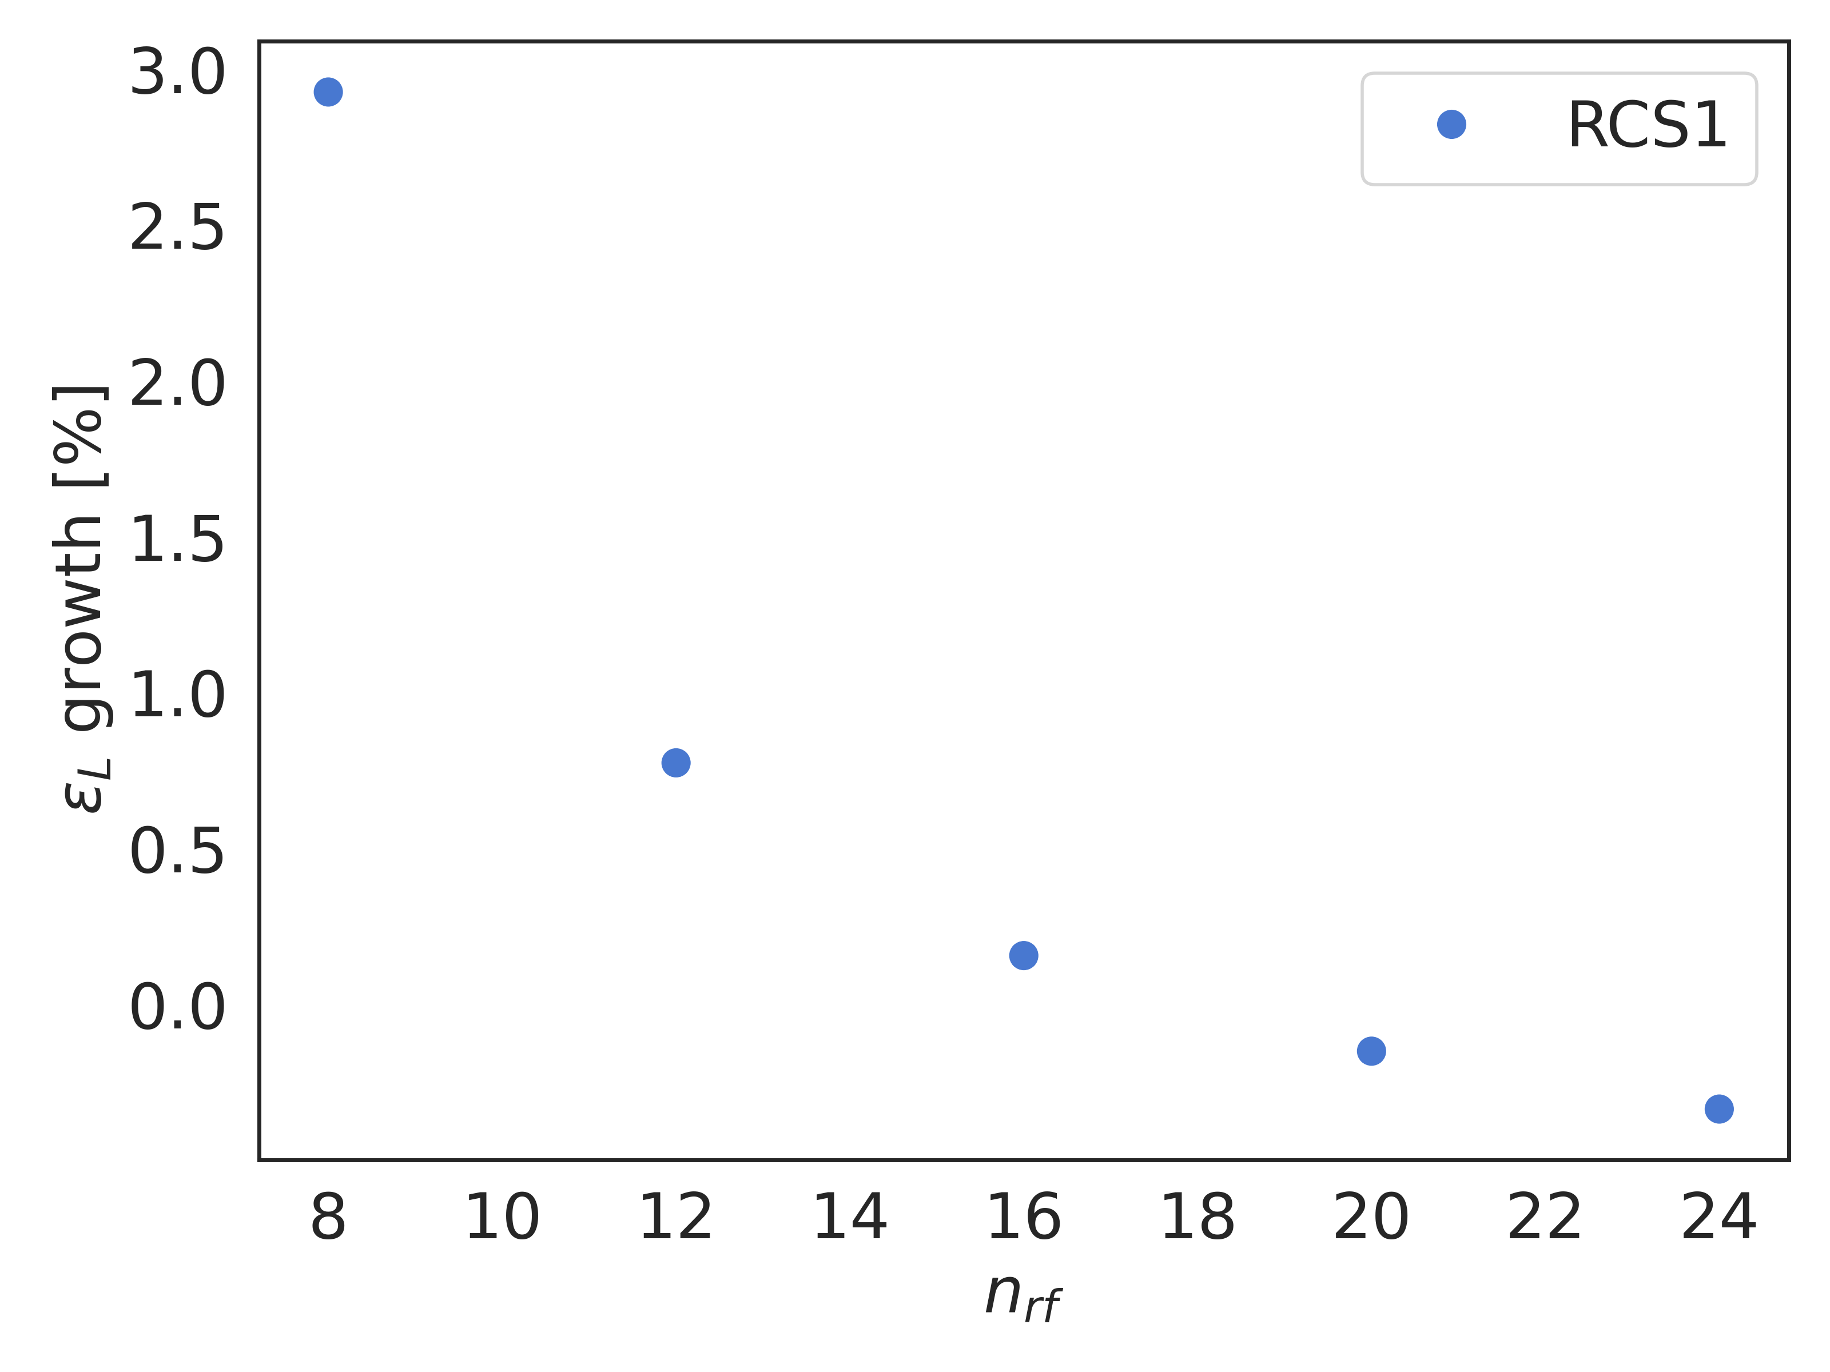
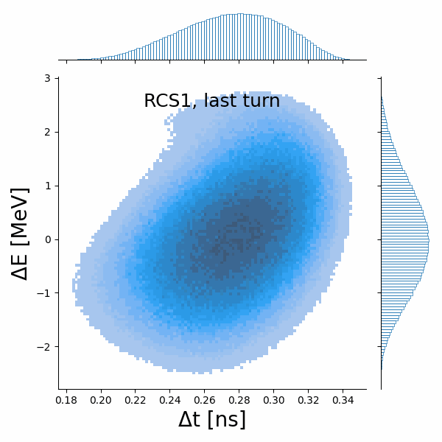
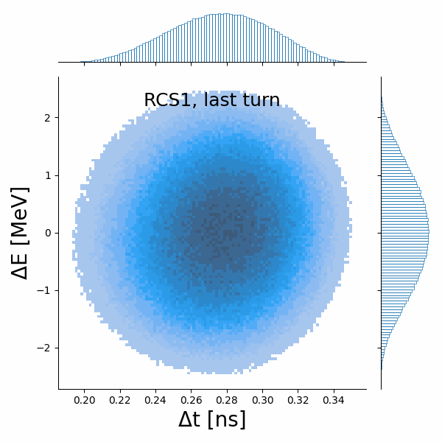

New optics ${− Q}_{s}$
Both the emittance and the bunch distribution are improved with a higher number of RF stations
Notes:
Shading bigger, do the distribution in red and blue

Slide 9
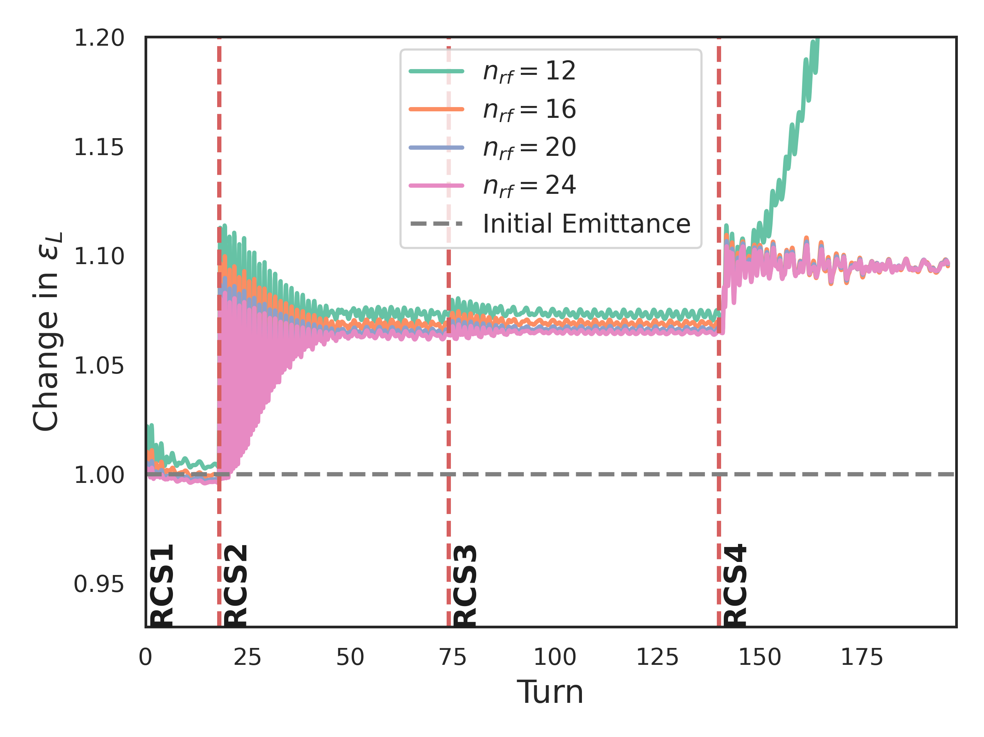
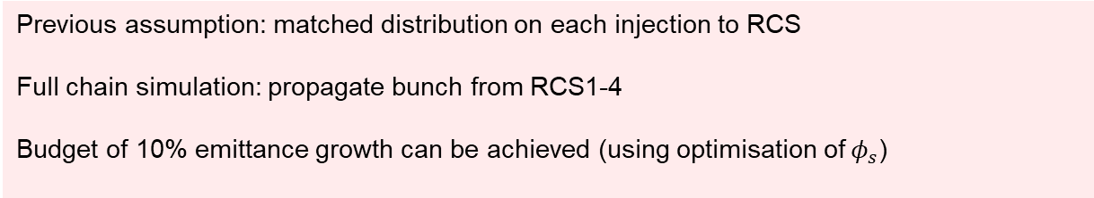
New optics – emittance growth
Propagate distribution
Match at each injection
Previous assumption: matched distribution on each injection to RCS
Full chain simulation: propagate bunch from RCS1-4
Budget of 10% emittance growth can be achieved (using optimisation of${ φ}_{s}$)

Slide 10
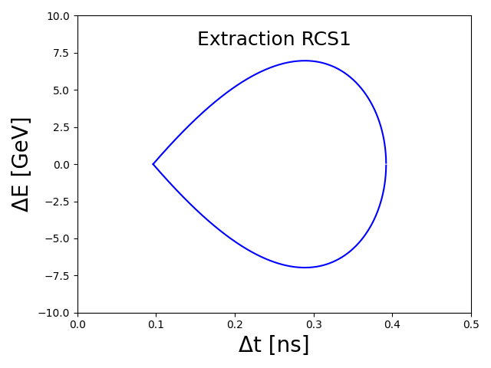
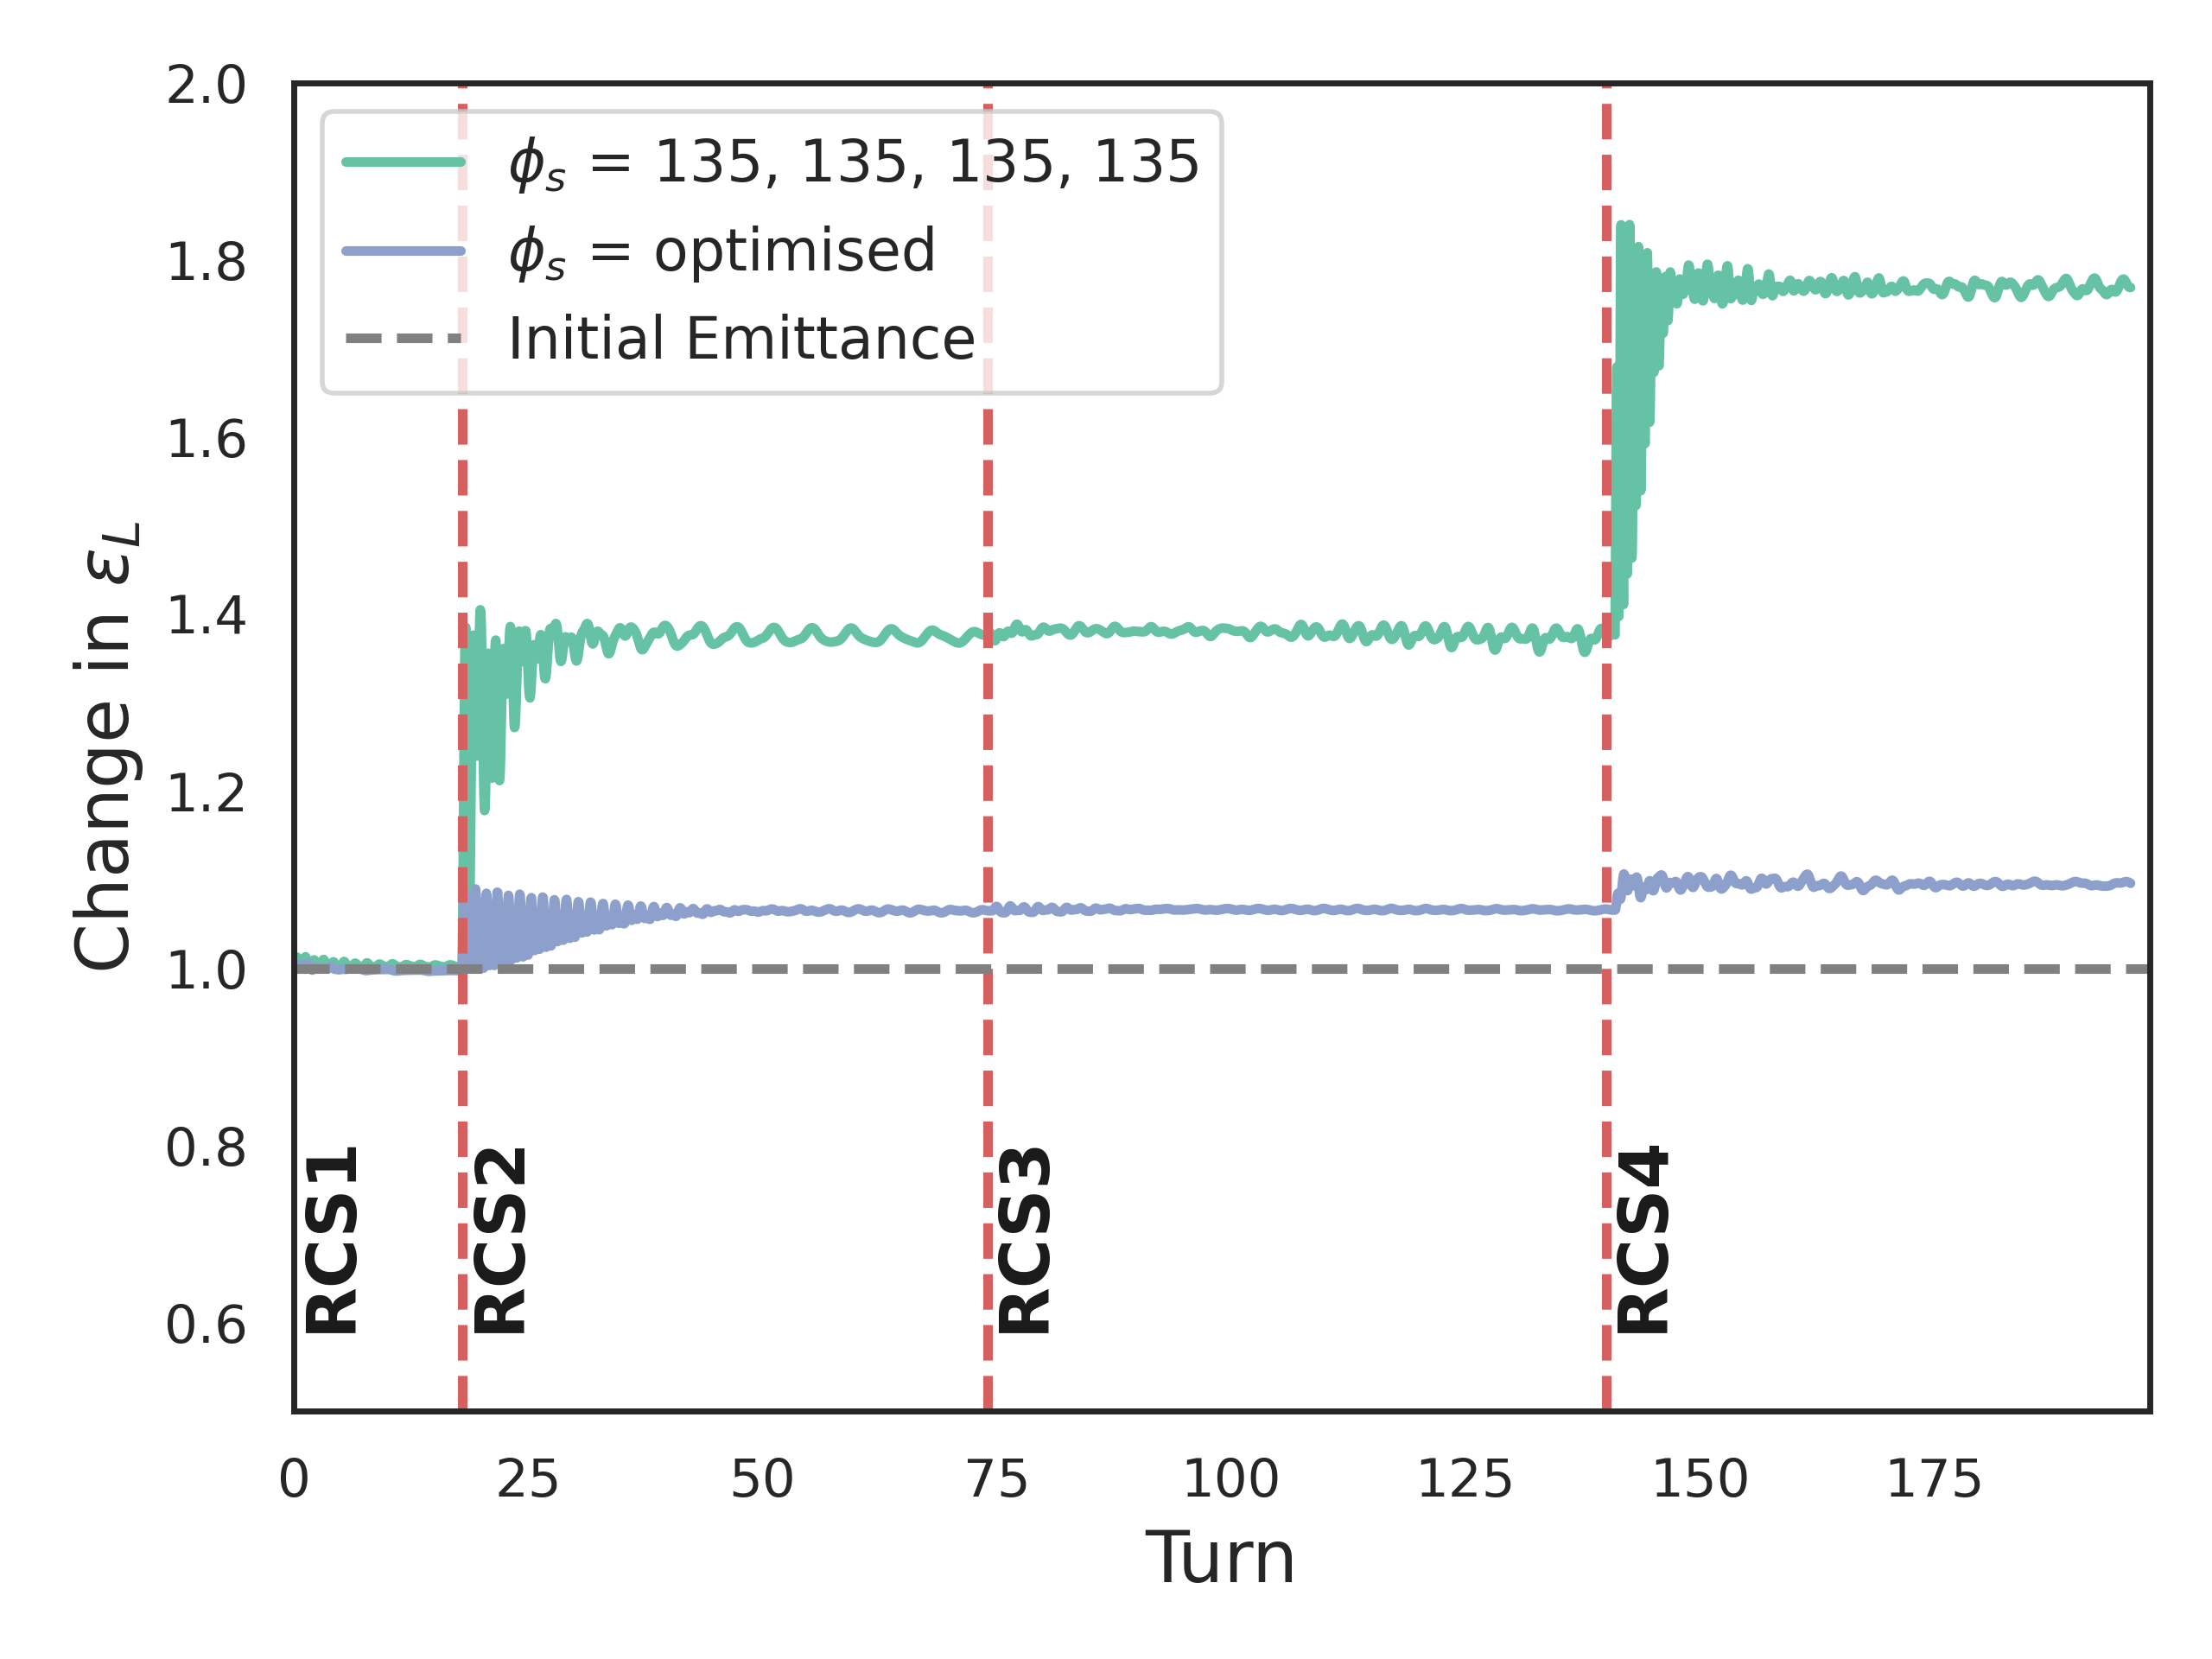
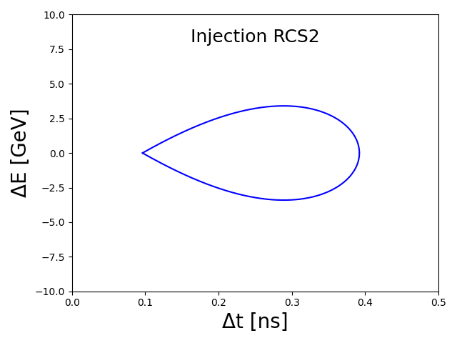

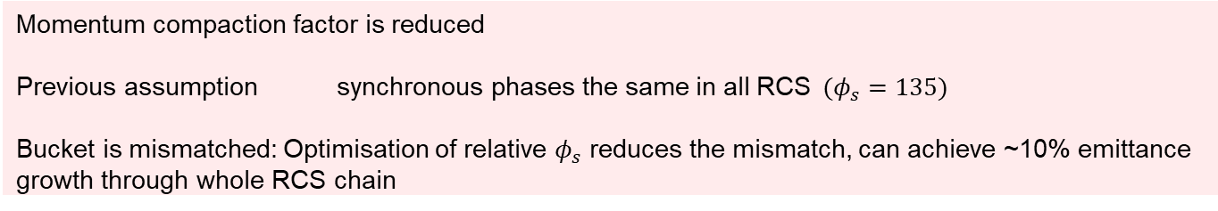
Optimisation of $φ_{s}$
Single bunch, fundamental and higher order modes, propagation through machine
Momentum compaction factor is reduced
Previous assumption synchronous phases the same in all RCS$(φ_{s}=135)$
Bucket is mismatched: Optimisation of relative $φ_{s}$ reduces the mismatch, can achieve ~10% emittance growth through whole RCS chain
Notes:
Each rcs on own with same synch ohase = emittance blow up, compare buckets and impr

Slide 11
Realistic injection

Slide 12
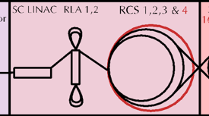
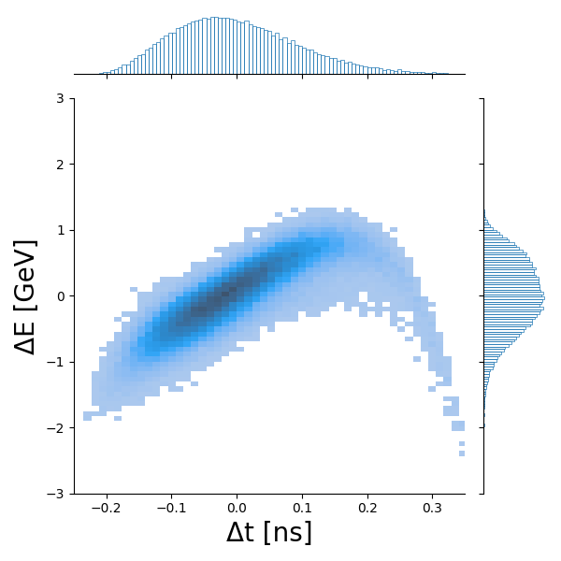
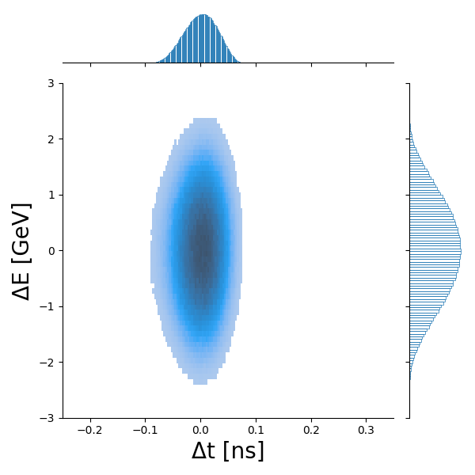
Injection of distribution from RLA2
RF Frequency of 1.3GHz – short bucket
Long distribution coming from RLA2
From RLA2
Desired distribution
Notes:
Frequency, make axes bigger , distribution for optimised phases

Slide 13
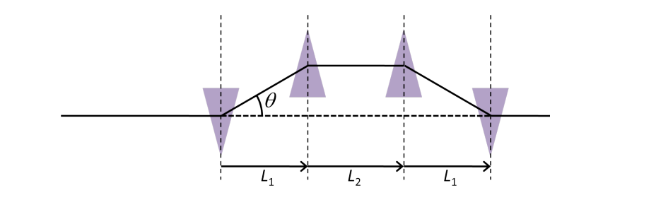
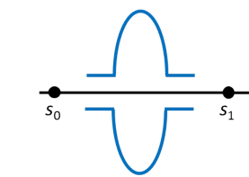
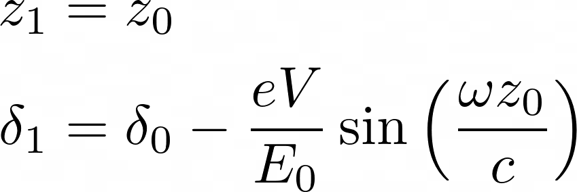
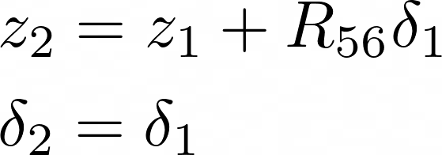
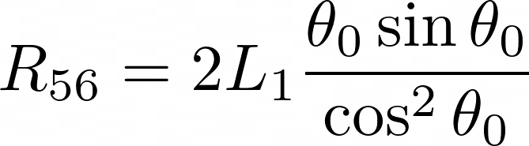
Bunch Compression
Bunch compression is a single pass device
Contains an RF cavity to ‘chirp’ the bunch to give a correlation of position with momentum offset
In a linear approximation, can be modelled with a matrix
[4]
Cavity
Chicane

Slide 14

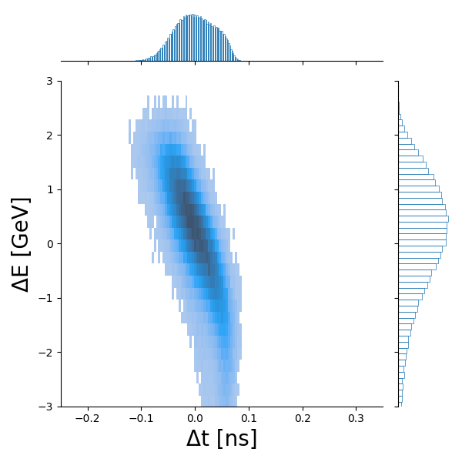
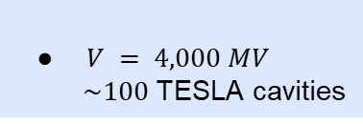
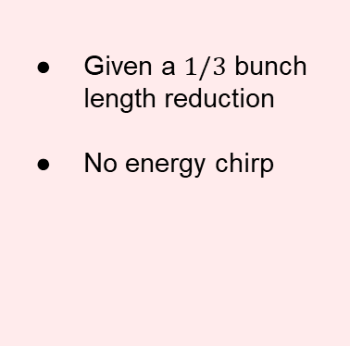
Bunch Compression
Given a $1/3$ bunch length reduction
No energy chirp
After bunch compression matrix
$V = 4,000 MV$
$\sim 100$TESLA cavities
From RLA2
Notes:
How much length of cavities and chicane do we need (l1/l2), magnets also (eg bending radius of RCS1)

Slide 15
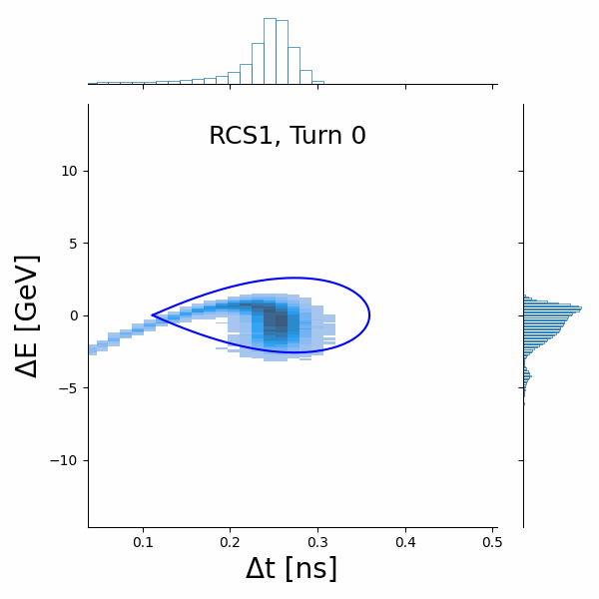
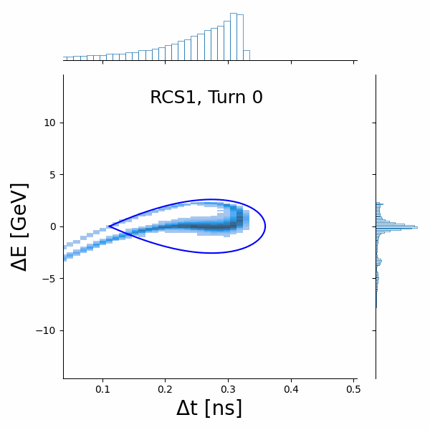
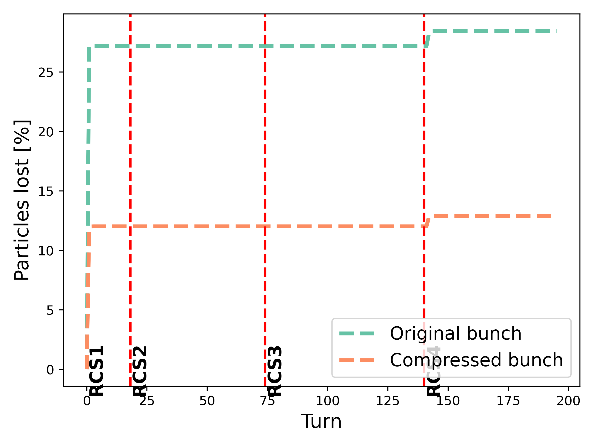
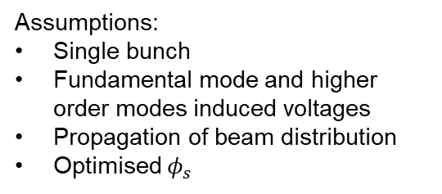
Injection of distribution from RLA2
Assumptions:
Single bunch
Fundamental mode and higher order modes induced voltages
Propagation of beam distribution
Optimised $φ_{s}$
Notes:
Change colours and line width/text size, 90% emittance

Slide 16
Bunch rotation
Show one plot of phase jump and how can improve rla2

Slide 17
Counter-rotation

Slide 18
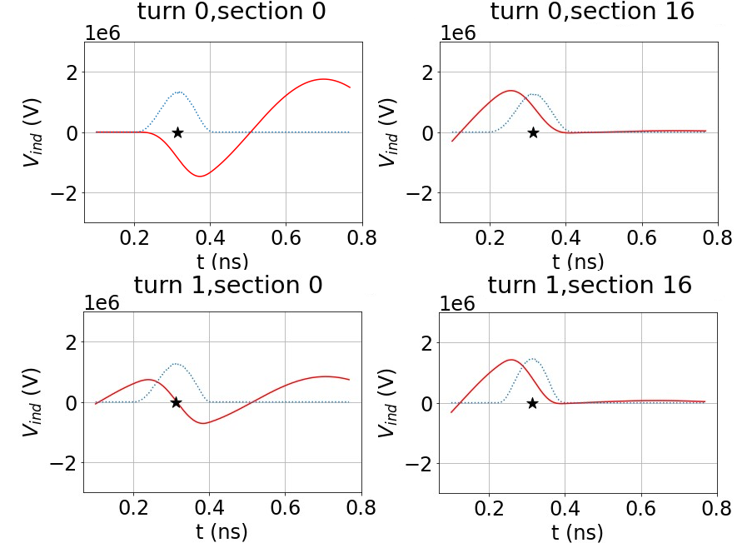
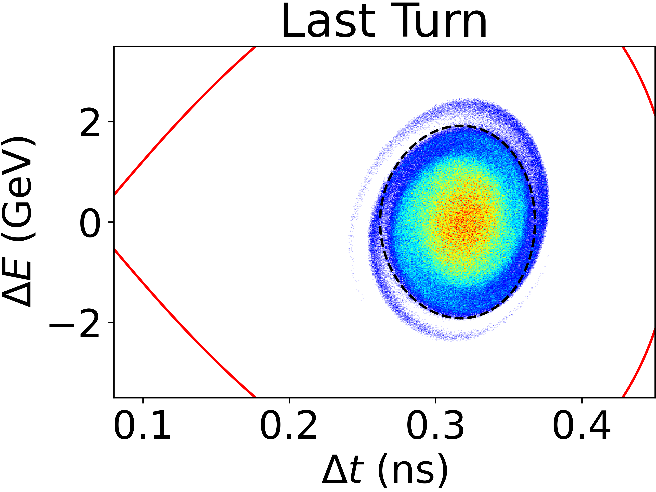
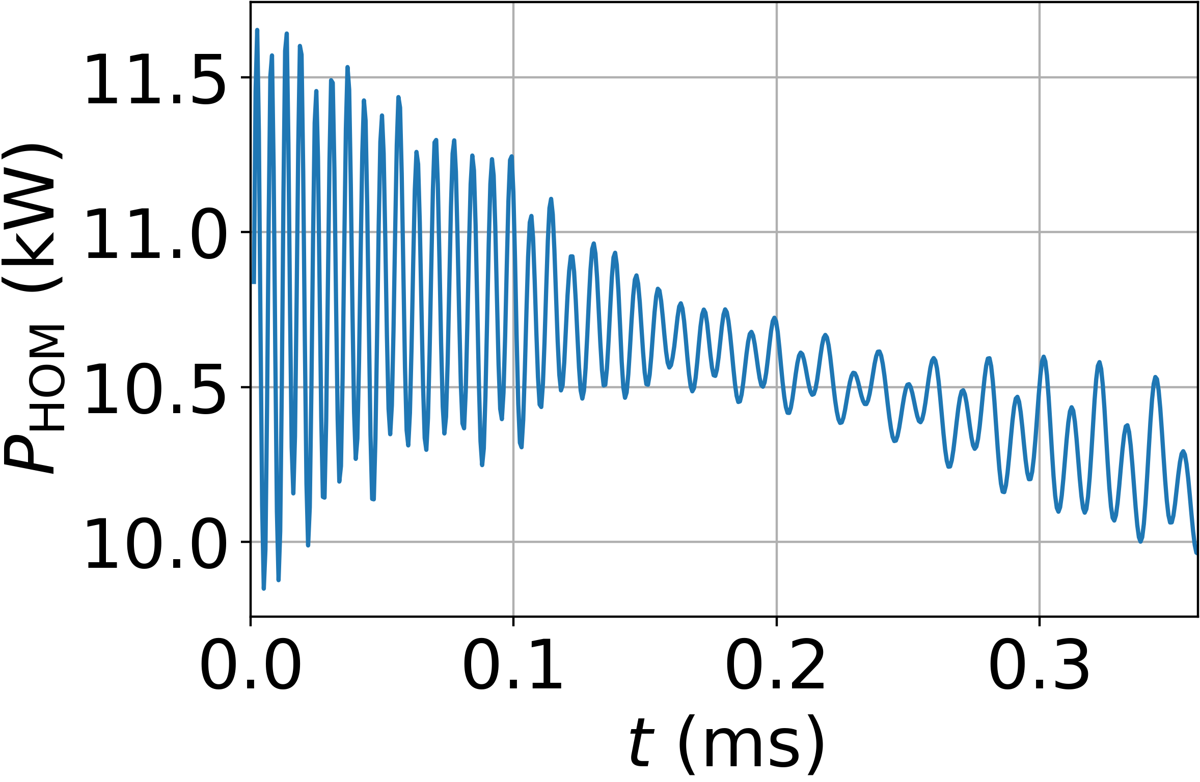

Counter-rotating beams
F. Batsch showed preliminary results for counter-rotating beams at IMCC 2024
$$V=1.4⋅V_{RF}$$
Q_{L} = 0.94$⋅$10⁶
Notes:
Showed how induced voltages chain

Slide 19
Counter-rotating beams
Introduction to toy model and blond simulation for cr
Notes:
Toy model, to check results and for a comparison with BLonD, frozen distribution, ring, difference in timing with animation, induced voltages sum because they arrive at the same phase

Slide 20
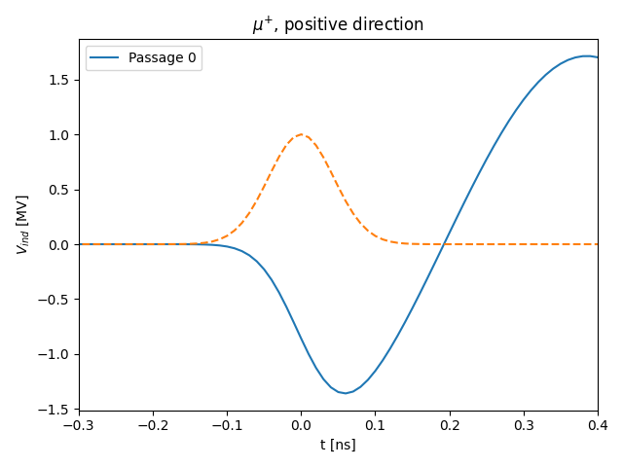
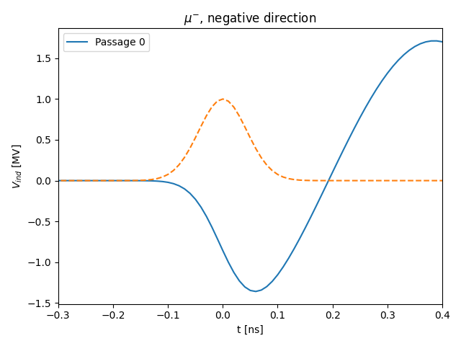
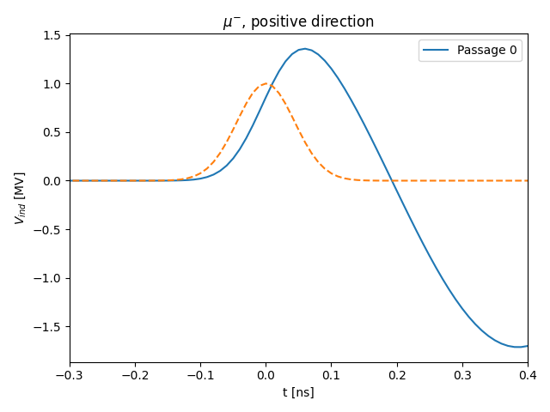

Counter-rotating beams
oppositely charged bunches
travelling in opposite directions
arrive at the same phase
and induce voltages that add constructively

Slide 21


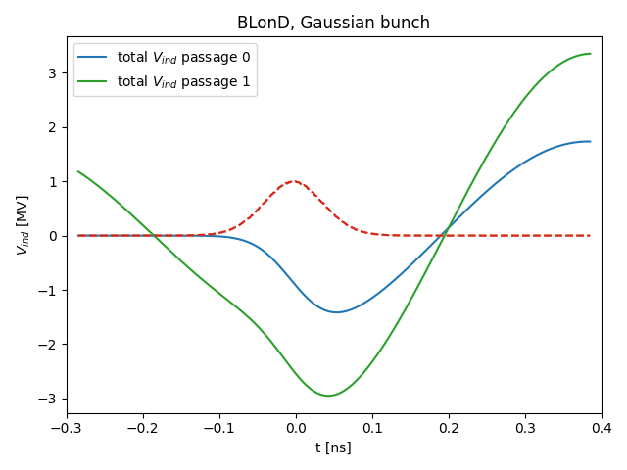
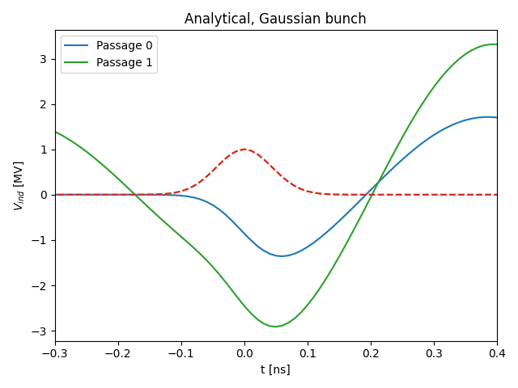
Counter-rotating beams
Minimises generator current for steady state, assuming dc current
BLonD
Toy Model
Passage 0: convolution with line density
Passage 1: shift array by time between bunch arrivals, sum to convolution with line density
Passage 0: analytical formula
Passage 1: shift array by time between bunch arrivals decay, sum to analytical formula
Notes:
Frozen in BLonD

Slide 22

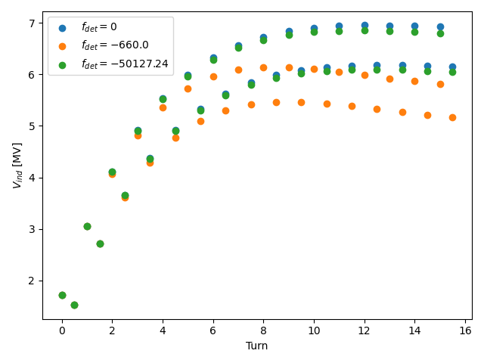
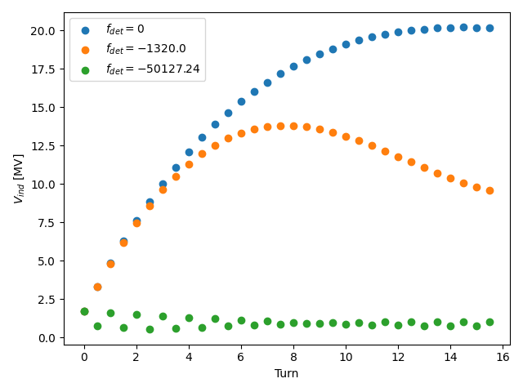
Counter-rotating beams
Minimises generator current for steady state
Toy Model
Toy Model
Notes:
To remove 50khz, with the toy model can estimate the induced voltage with detuning

Slide 23
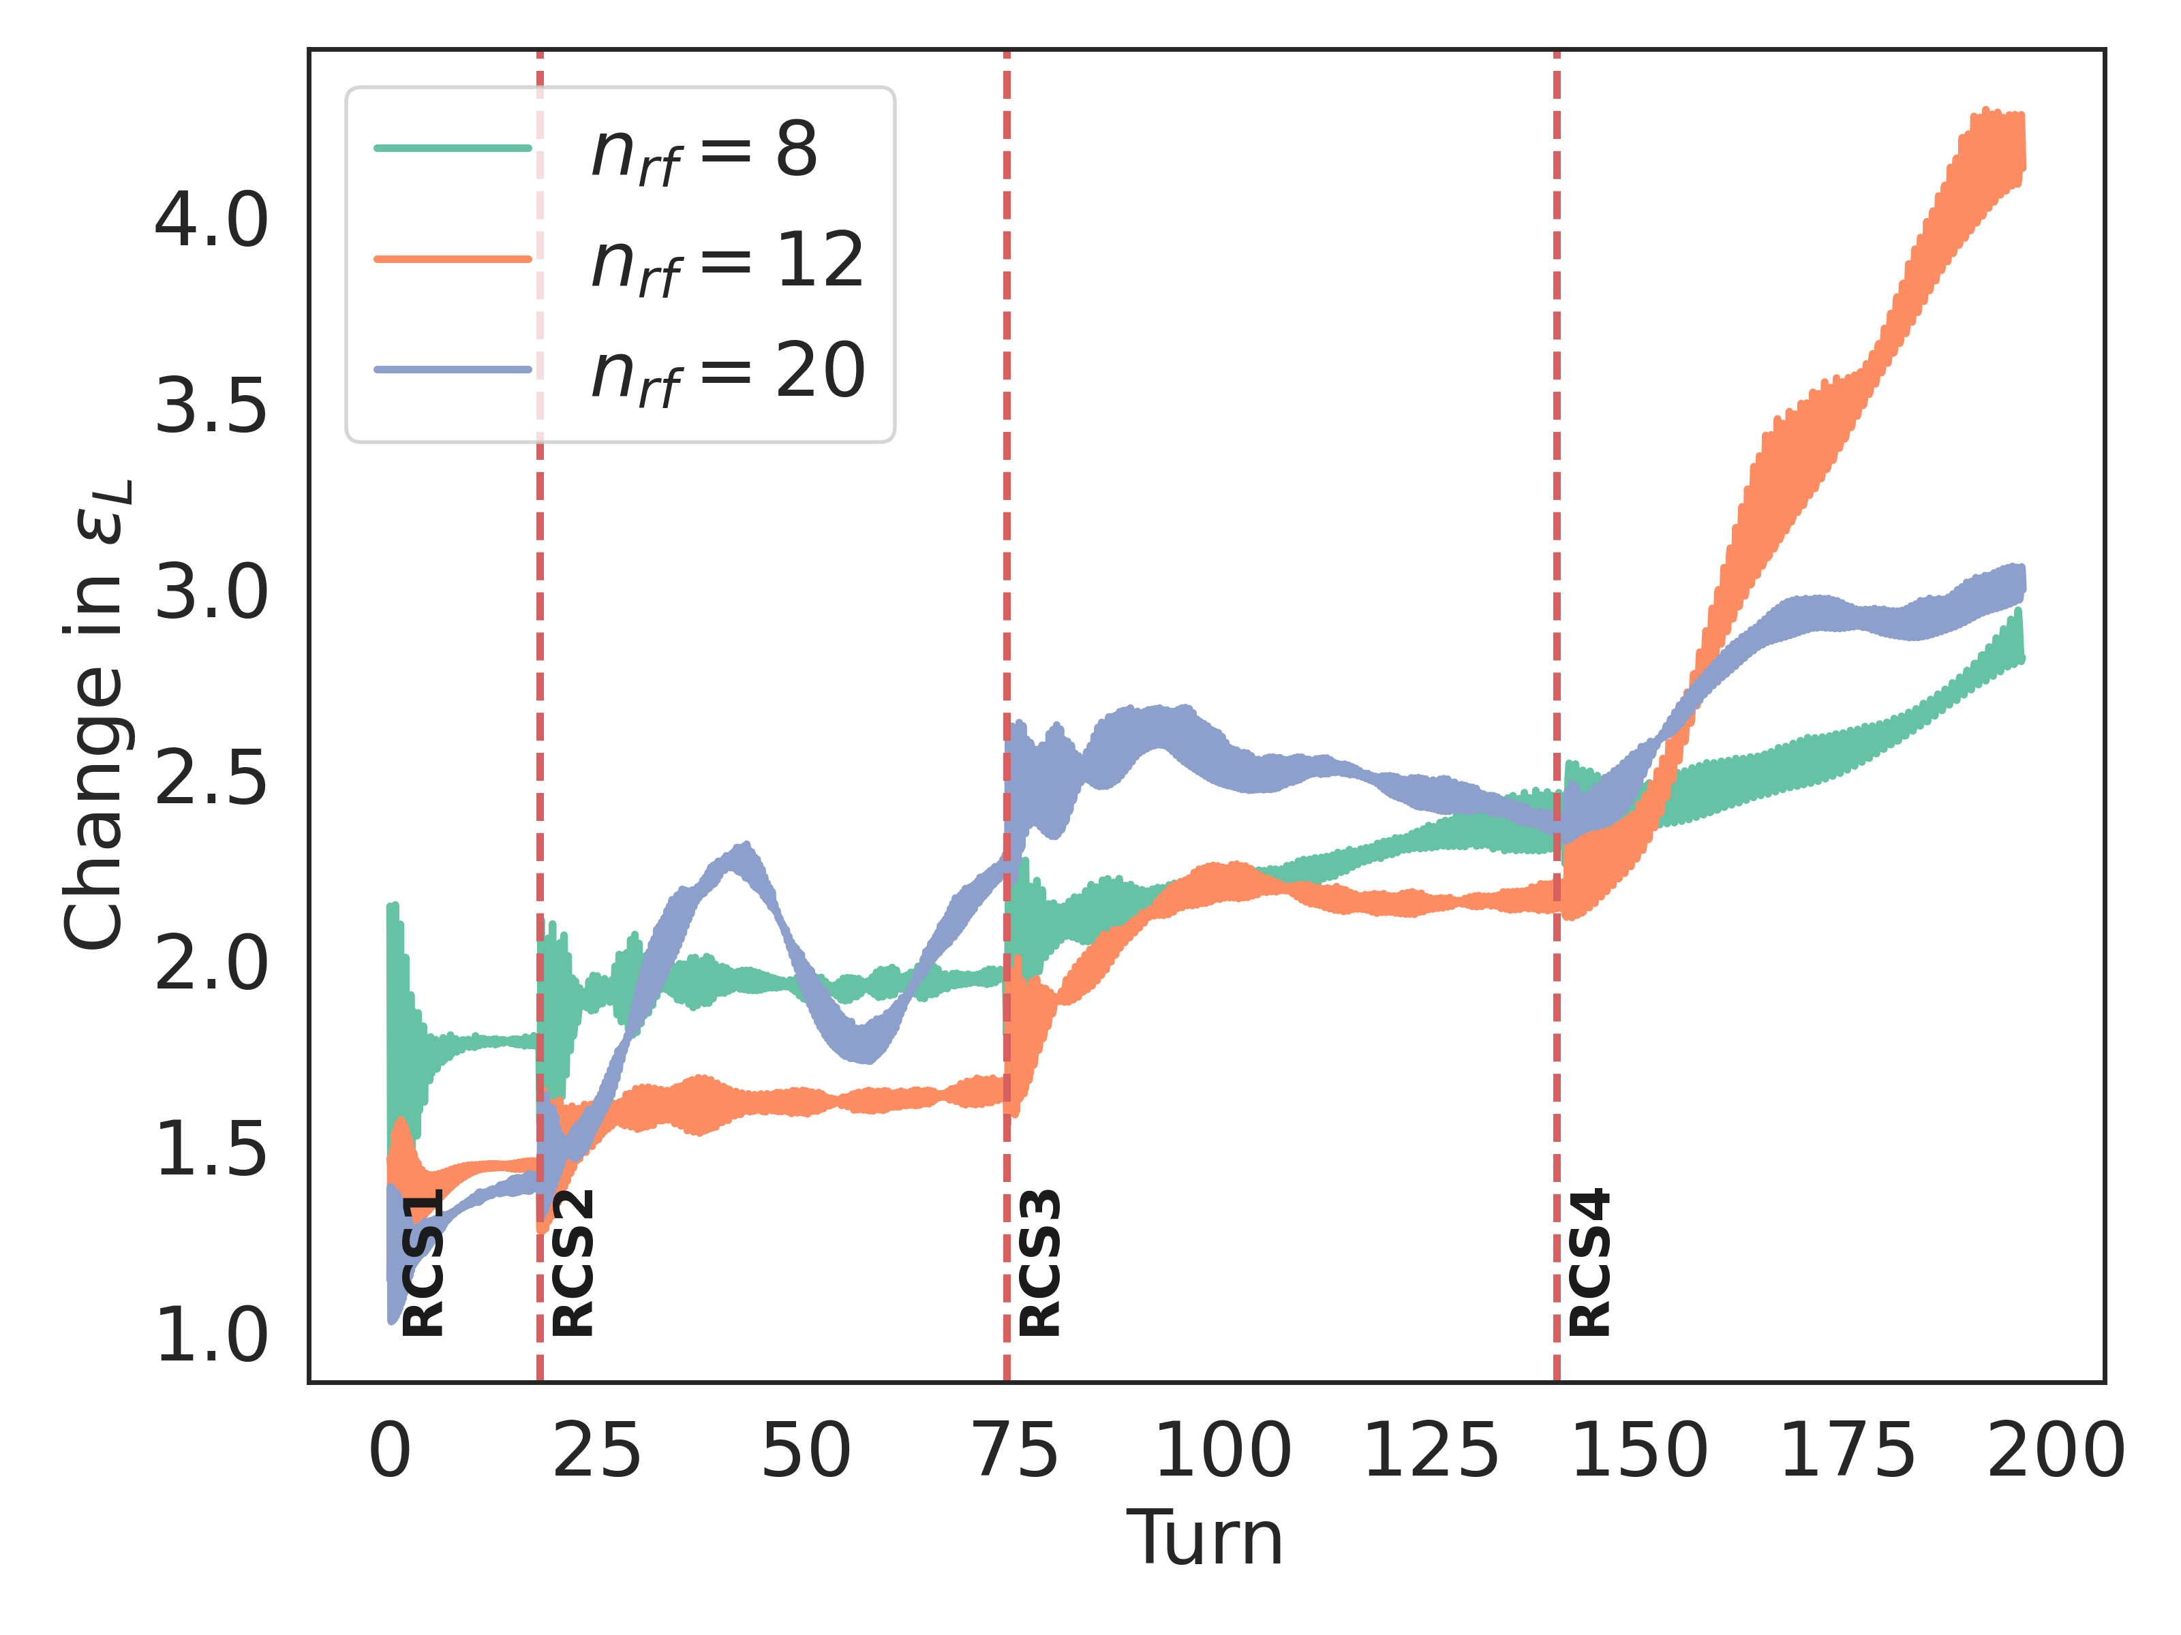
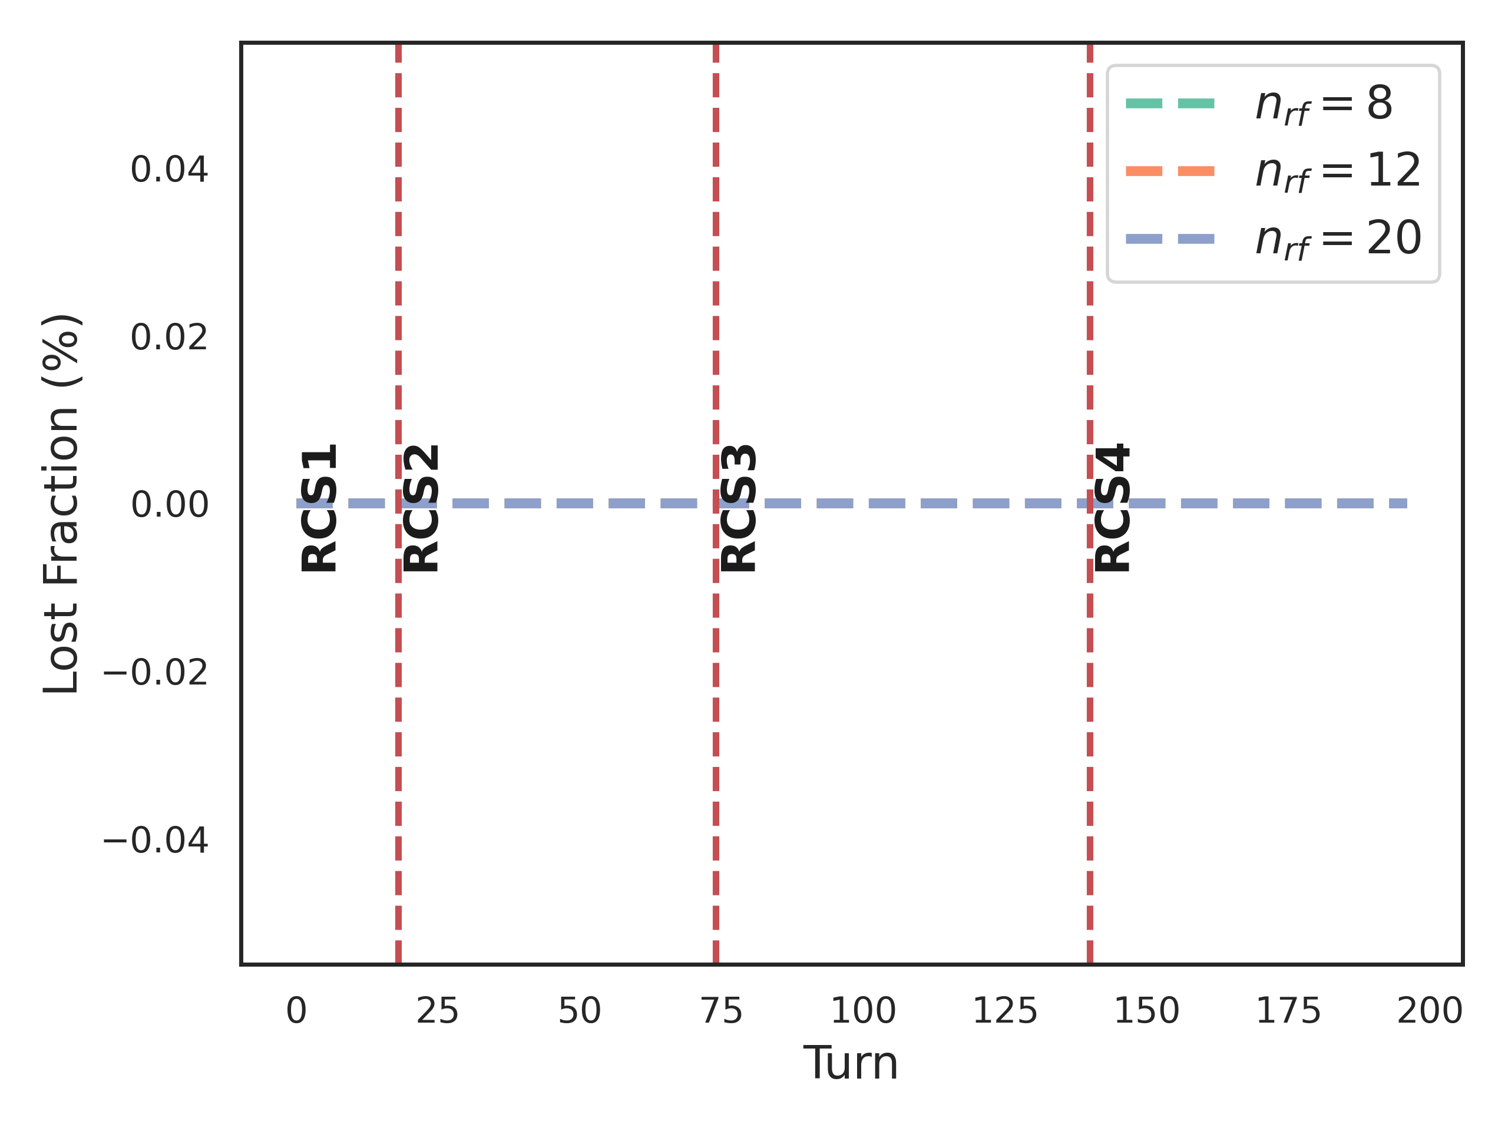
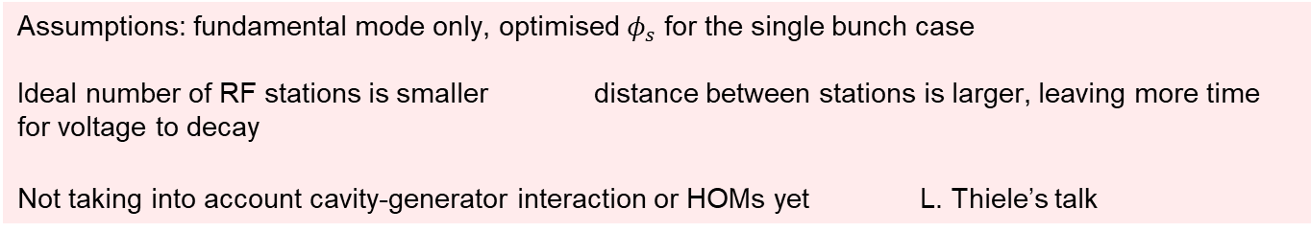
Counter-rotating beams
Assumptions: fundamental mode only, optimised $φ_{s}$ for the single bunch case
Ideal number of RF stations is smaller distance between stations is larger, leaving more time for voltage to decay
Not taking into account cavity-generator interaction or HOMs yet L. Thiele’s talk
Notes:
RLA2 , add HOMs,

Slide 24
Conclusions
New optics reduces the number of RF stations needed, but still on the order of 10
Synchronous phase optimisation is required to maintain matching along the RCS chain, but emittance requirements limits the optimisation, single bunch 10% emittance growth
A bunch compressor does not adequately improve the transmission from RLA2 to the end of RCS1
A semi-analytical model of counter-rotating beams agrees with BLonD simulations
Counter-rotating beams 100% emittance growth and 8 RF stations
Inclusion of transient beam loading and HOMs needed to simulate full emittance growth L. Thiele presentation

Slide 25
References
CAS proceedings 1993
Analytical formula for Gaussian bunch and a resonator
http://blond-admin.github.io/BLonD/modules/impedances.html#module-blond.impedances.induced_voltage_analytical
Monopole, Dipole and Quadrupole Passbands of the TESLA 9-cell Cavity, R. Wanzenberg, DESY, Notkestr. 85, 22603 Hamburg, Germany, September 14, 2001
CERN, “Beam longitudinal dynamics code (blond).” http://blond.web.cern.ch.
A. Aaksoy, ‘Beam Dynamics for RLA2 for the Muon Collider’
https://indico.cern.ch/event/1456536/contributions/6131257/attachments/2955755/5197393/mucol_rla_28-10-24_aaksoy.pdf
Takuya Akiba, Shotaro Sano, Toshihiko Yanase, Takeru Ohta, and Masanori Koyama. 2019.
Optuna: A Next-generation Hyperparameter Optimization Framework. In KDD.
Wolski, A. (2016, October). Nonlinear dynamics: Part 1. CAS: Introduction to Accelerator Physics, Budapest, Hungary

