Slide 1
SRF system for the muon collider RCS chain
Leonard Thiele (University of Rostock, CERN),
S. Albright, R. Calaga, H. Damerau, A. Grudiev, I. Karpov, E. Lamb, U. van Rienen

Slide 2
Content
Introduction
Distribution of RF system
Tuner requirements
  Fast change to cope with orbit length adjustment
  Fast change to follow t_rev adjustment in RCS1
RF power requirements
  FPC requirements
HOM
  power extraction
  R/Q limit/extraction limits
Transient beam loading

Slide 3
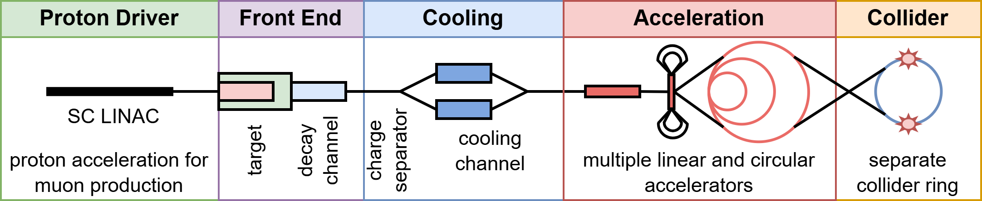
Introduction
Greenfield or CERN-site-based
HE: Chain of rapid cycling synchrotrons (RCS)
Fast acceleration
  Ensure muon survival
  Large voltage per turn
  Low number of turns
Emittance must be preserved (luminosity)

Slide 4
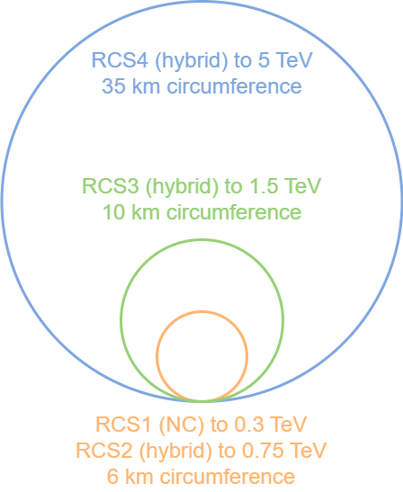
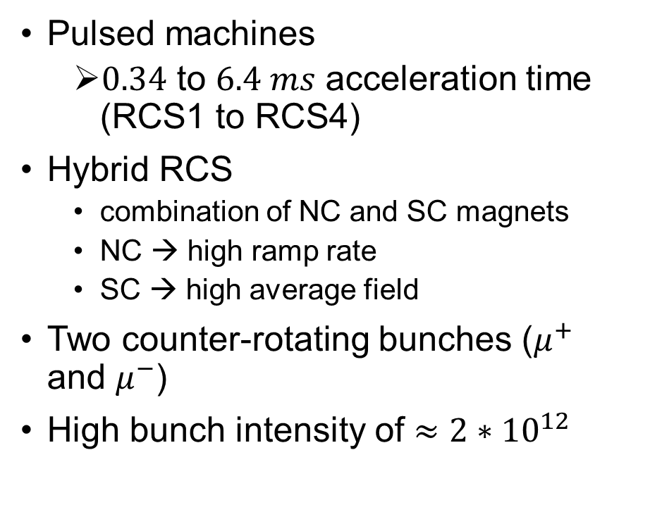
Introduction
Pulsed machines
  $0.34$ to $6.4 ms$ acceleration time (RCS1 to RCS4)
Hybrid RCS
  combination of NC and SC magnets
  NC → high ramp rate
  SC → high average field
Two counter-rotating bunches ($μ^{+}$ and $μ^{−}$)
High bunch intensity of $≈2∗{10}^{12}$

Slide 5
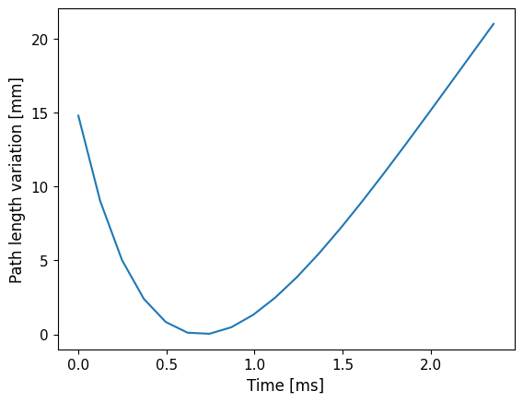
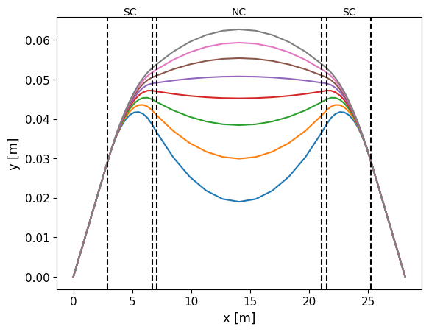
Orbit length change in hybrid RCS
Orbit changes during the acceleration
Bending radius in static SC magnets differs due to increasing bunch energy
RF frequency needs to be an integer harmonic
Needs to be adjusted to the path length change
REPLACE PLOT WITH CURRENT VERSION

Slide 6
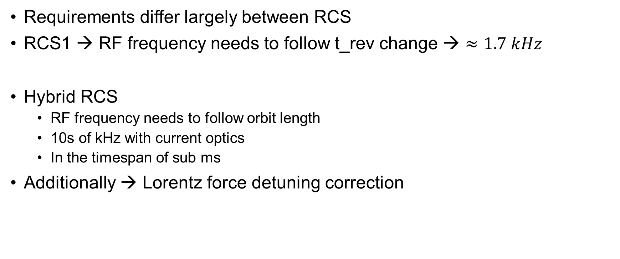
Cavity tuning system
Requirements differ largely between RCS
RCS1 → RF frequency needs to follow t_rev change → $≈1.7 kHz$
Hybrid RCS
  RF frequency needs to follow orbit length
  10s of kHz with current optics
  In the timespan of sub ms
Additionally → Lorentz force detuning correction

Slide 7
Distribution of RF system
Acceleration is unstable due to high synchrotron tune → large Voltage per turn
Separate RF system into multiple stations
  Multiple smaller kicks and drifts
  Reduction of synchrotron tune
Exact number needs to be determined with beam dynamics simulation
From cost perspective → as few stations as possible (limit hardware distribution)
Details see E. Lamb

Slide 8
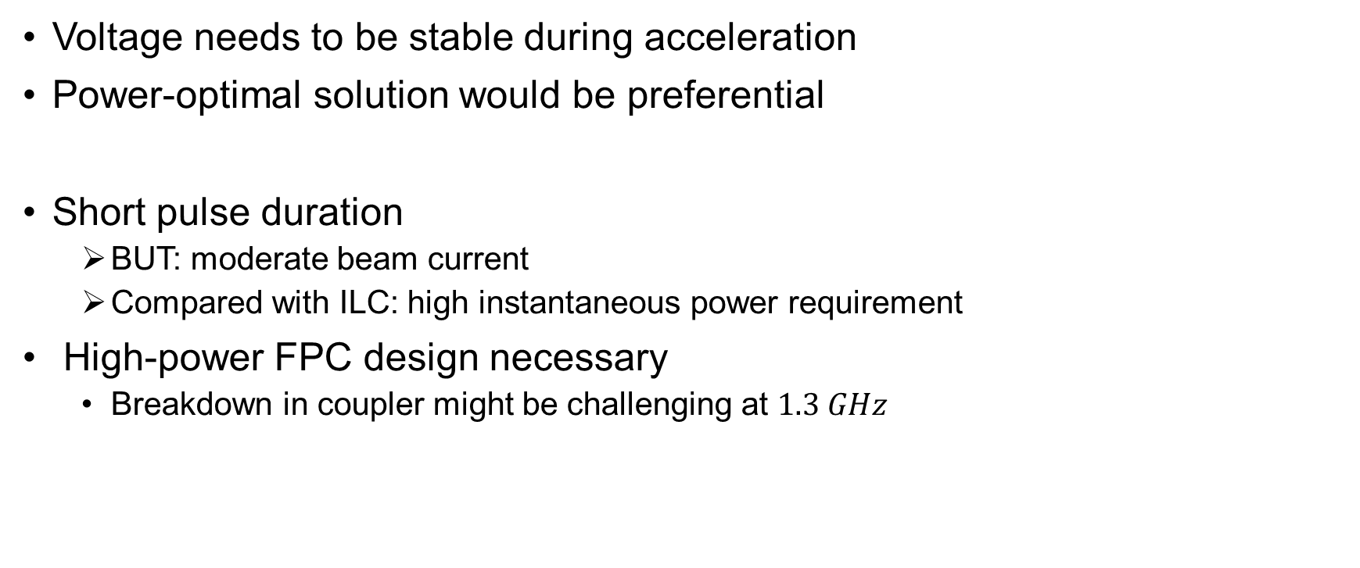
Rf system powering
Voltage needs to be stable during acceleration
Power-optimal solution would be preferential
Short pulse duration
  BUT: moderate beam current
  Compared with ILC: high instantaneous power requirement
High-power FPC design necessary
  Breakdown in coupler might be challenging at $1.3 GHz$

Slide 9
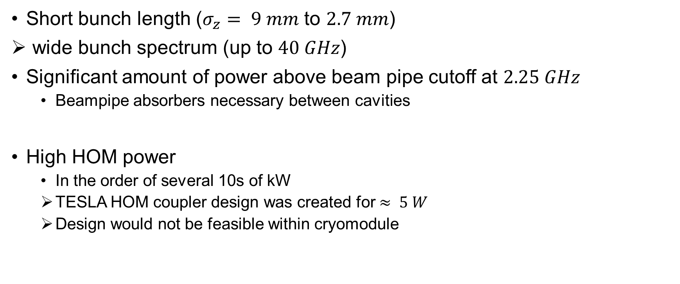
Higher order mode power
Short bunch length ($σ_{z}= 9 mm$ to $2.7 mm$)
wide bunch spectrum (up to $40 GHz$)
Significant amount of power above beam pipe cutoff at $2.25 GHz$
  Beampipe absorbers necessary between cavities
High HOM power
  In the order of several 10s of kW
  TESLA HOM coupler design was created for $≈ 5 W$
  Design would not be feasible within cryomodule

Slide 10
Higher order mode R/Q
Small aperture of TESLA cavity + high bunch charge
  Significant amount of induced voltage
  Potential to cause beam instability or emittance growth
Single turn limit needs to be established → see D. Amorims talk
  Transverse, long.
Damping requirement needs to be established
Confirmation of frequency/aperture requirement

Slide 11
Acceleration parameter differences in rings
Parameters vary significantly between rings
Large difference in number of required RF stations R/Q limits
Makes different cavity designs for different rings preferential

Slide 12
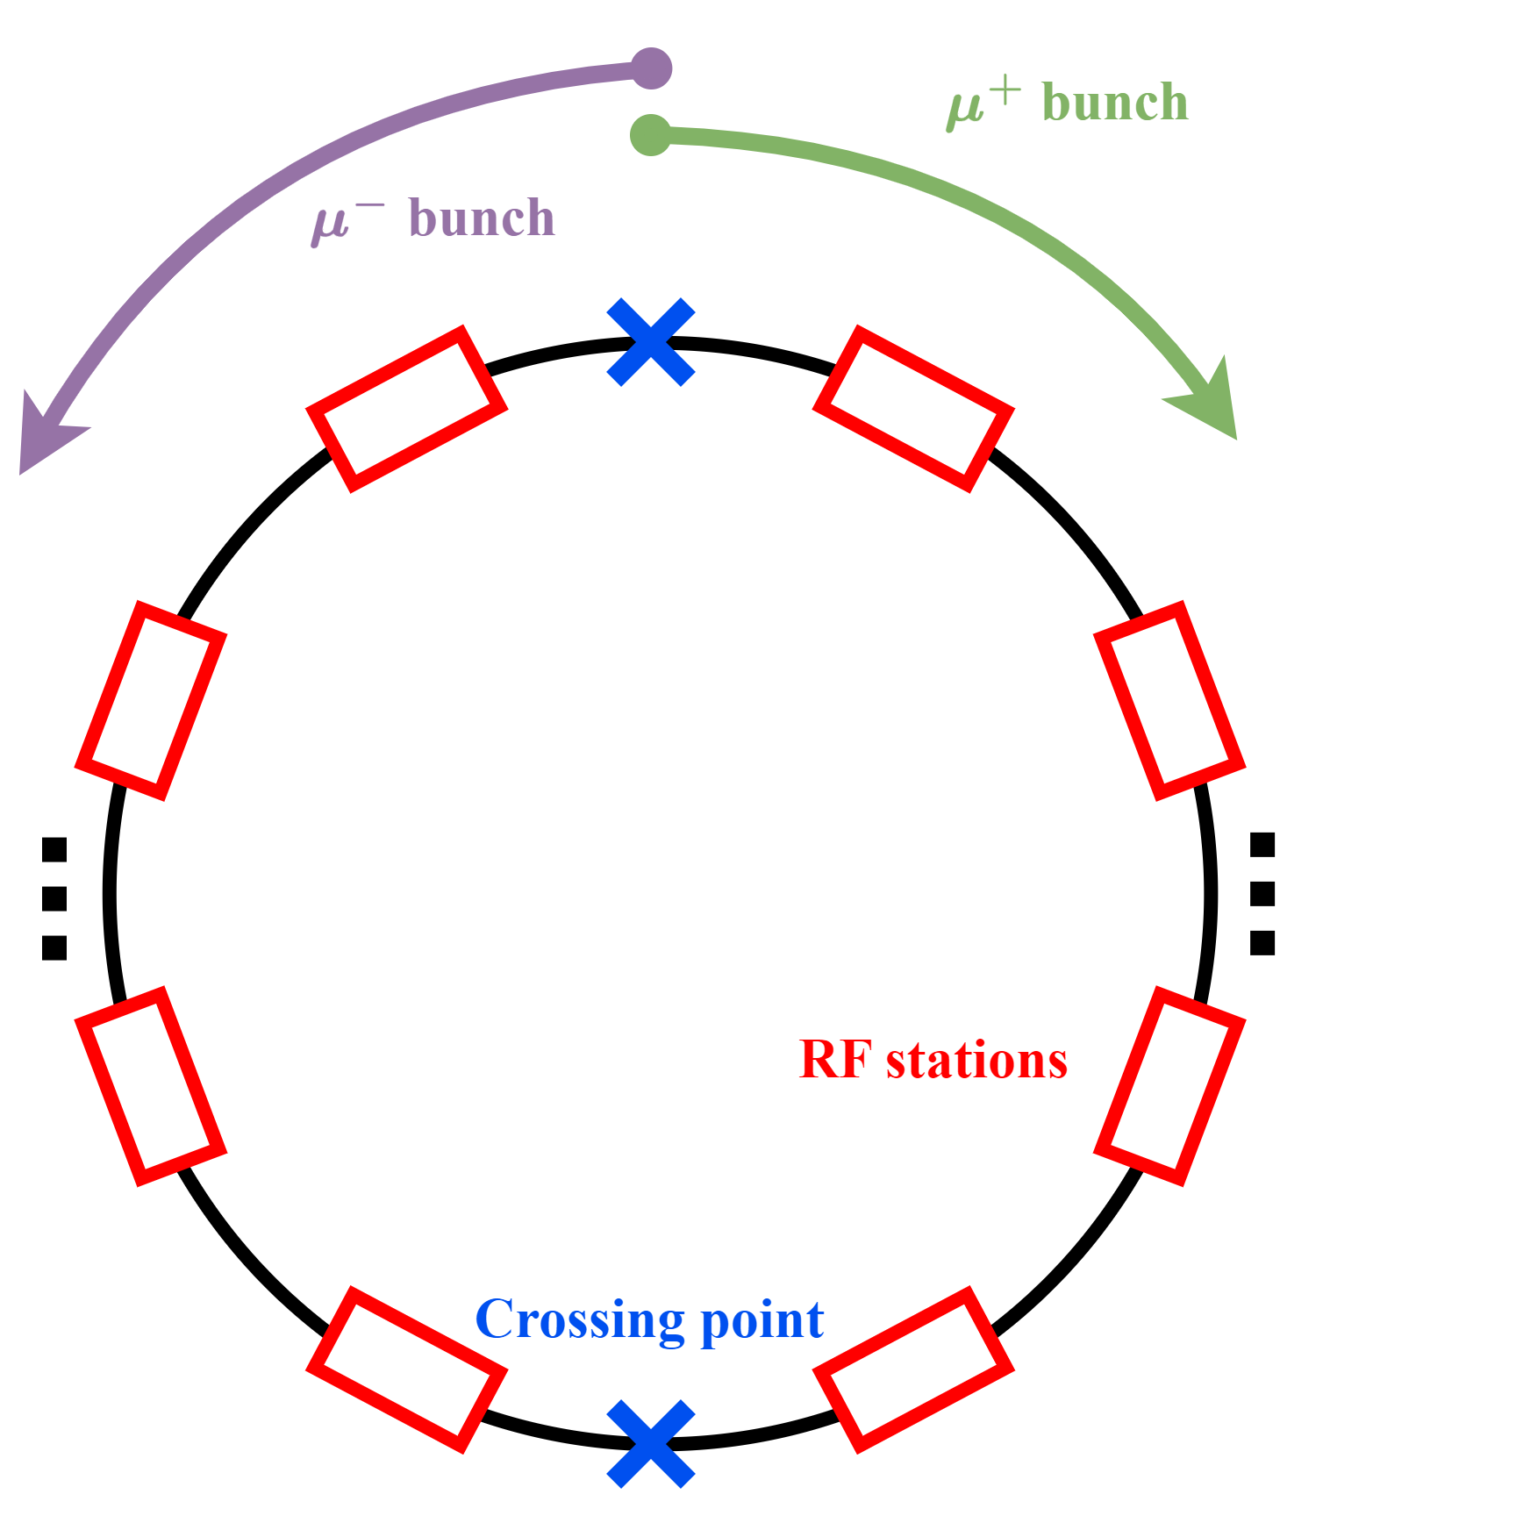
Transient beam loading
High bunch charge + unevenly filled ring
Voltage changes within one turn and during acceleration
Different for each RF station
Change will affect beam dynamics of CR bunch
Can negatively affect emittance → needs to be avoided
Could be mitigated with fast feedback or feedforward

Slide 13
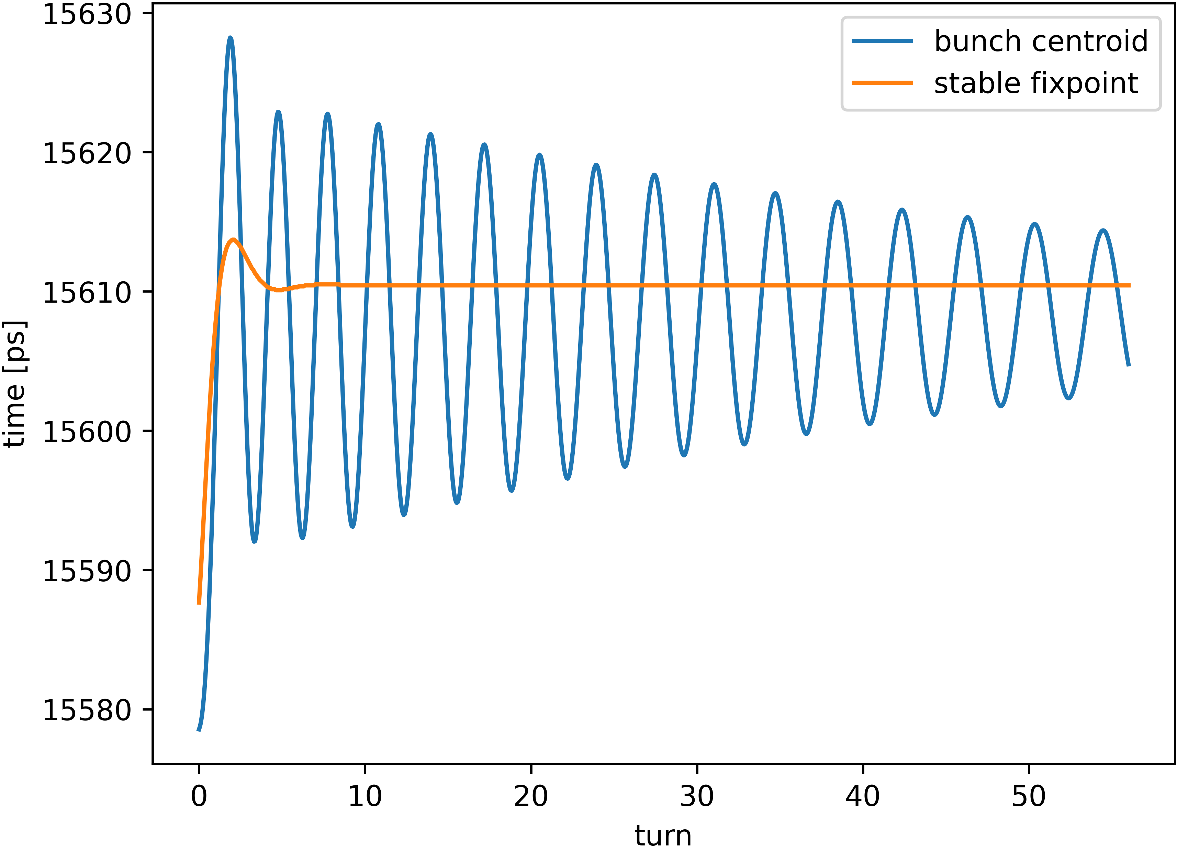
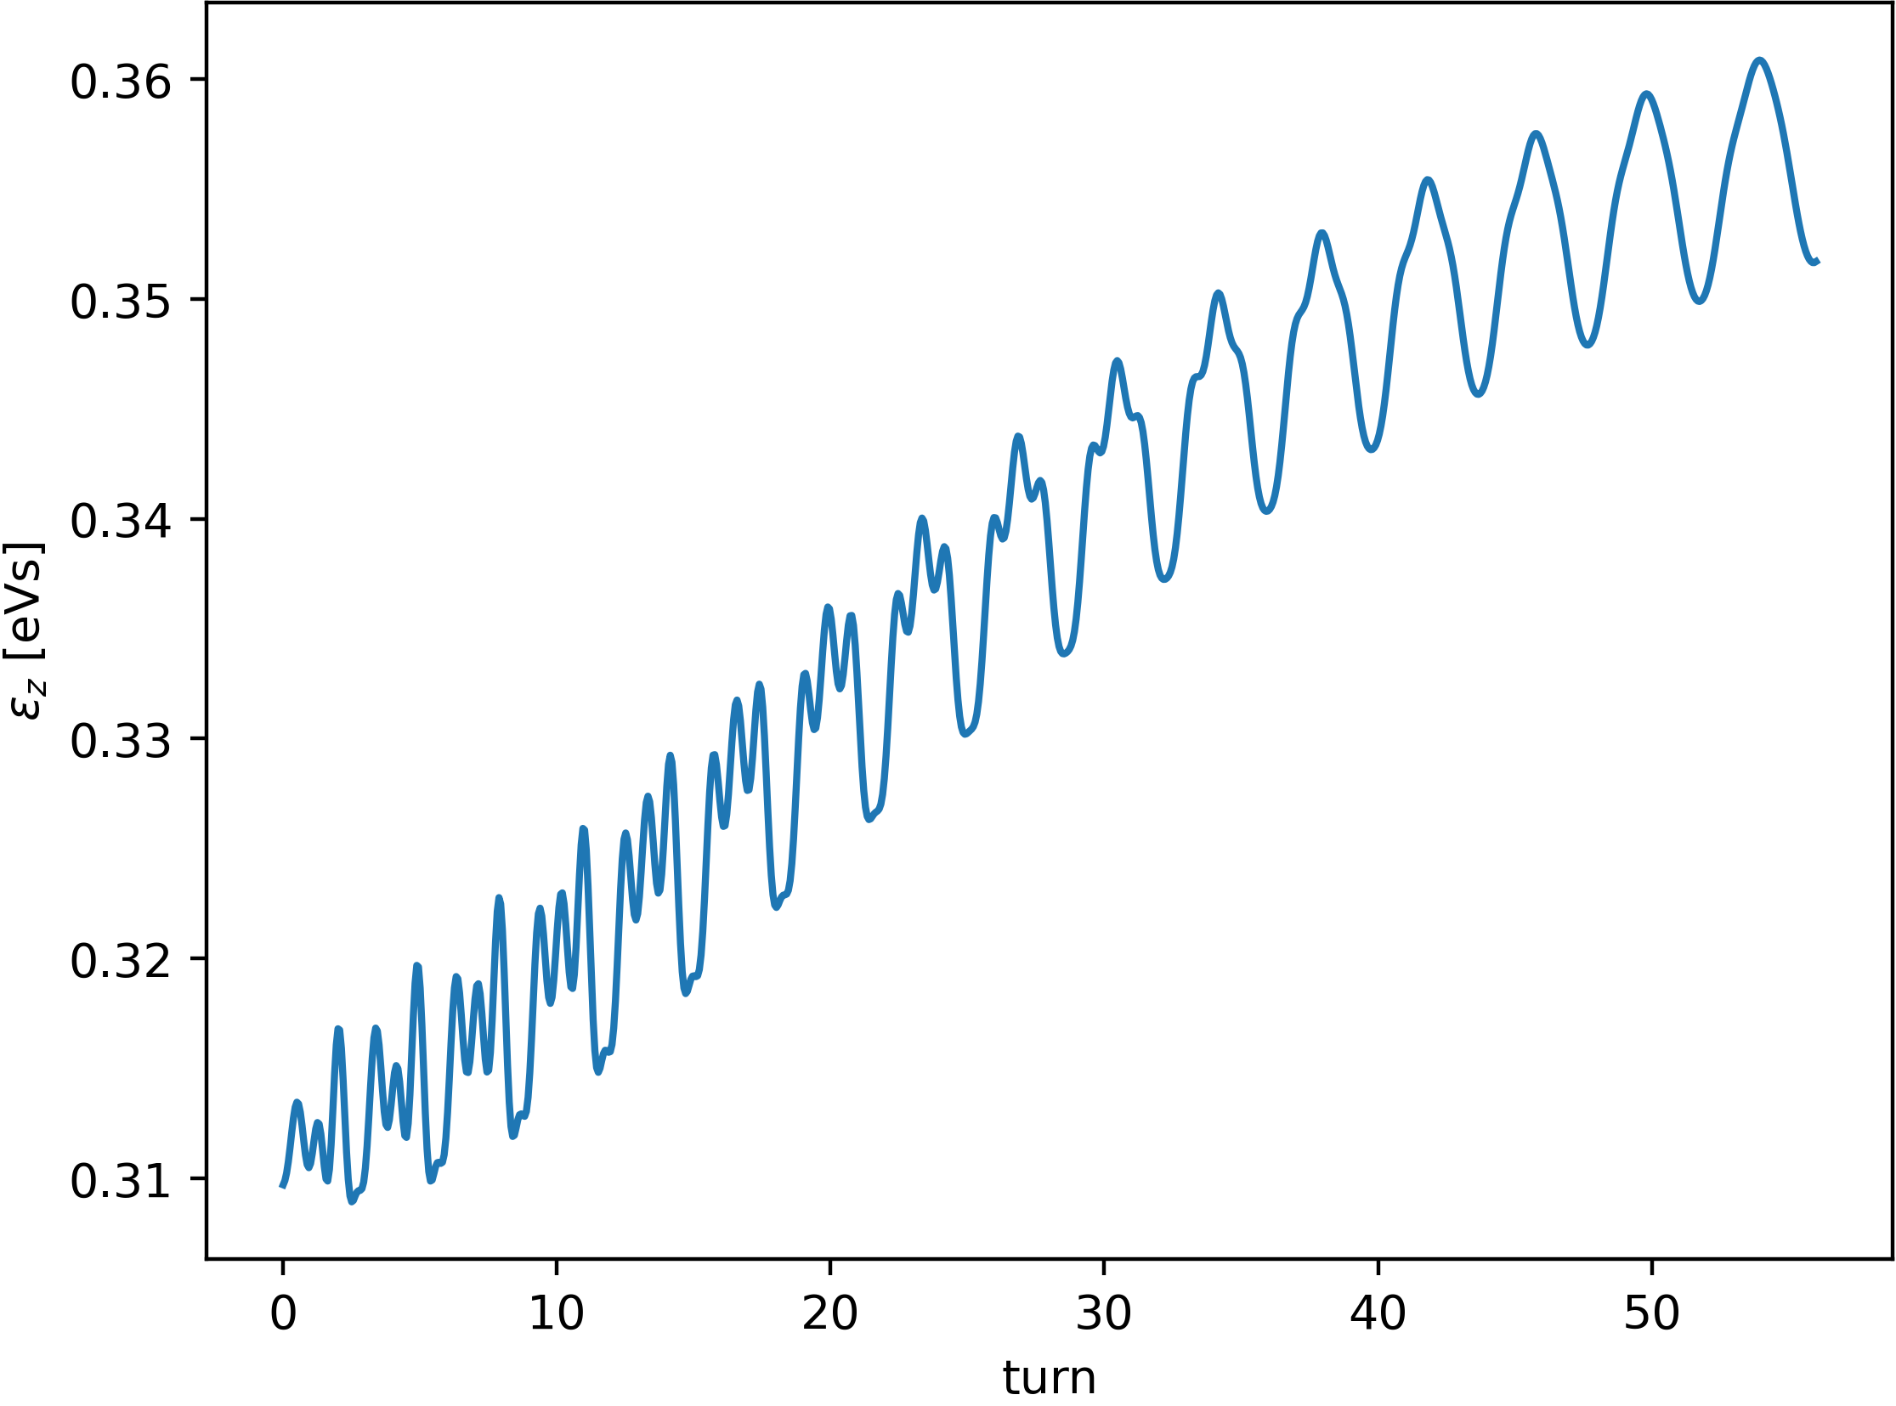
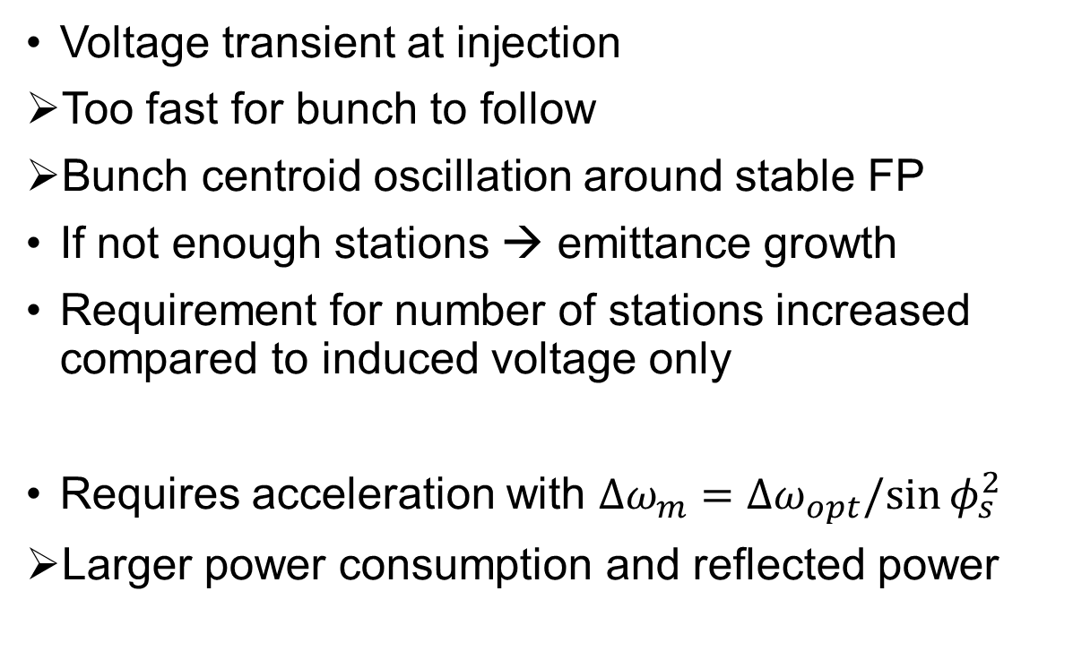
Transient beam loading
Voltage transient at injection
Too fast for bunch to follow
Bunch centroid oscillation around stable FP
If not enough stations → emittance growth
Requirement for number of stations increased compared to induced voltage only
Requires acceleration with $Δω_{m}=Δω_{opt}/sin⁡φ_{s}^{2}$
Larger power consumption and reflected power
Preliminary plots

Slide 14
Conclusion
RF system is separated into multiple stations
  Reduction of synchrotron tune
  Challenging for installation → distribution of hardware
Most challenging
  HOM couplers
  R/Q stability limits for cavities (both planes)
  Fast tuner
  Transient beam loading

Slide 16

TESLA cavity
High gradient → $30 MV/m$
  Ensure compactness of system
$1.3 GHz$ 9-cell structure
Wide-spread technology (XFEL, ILC)

Slide 17
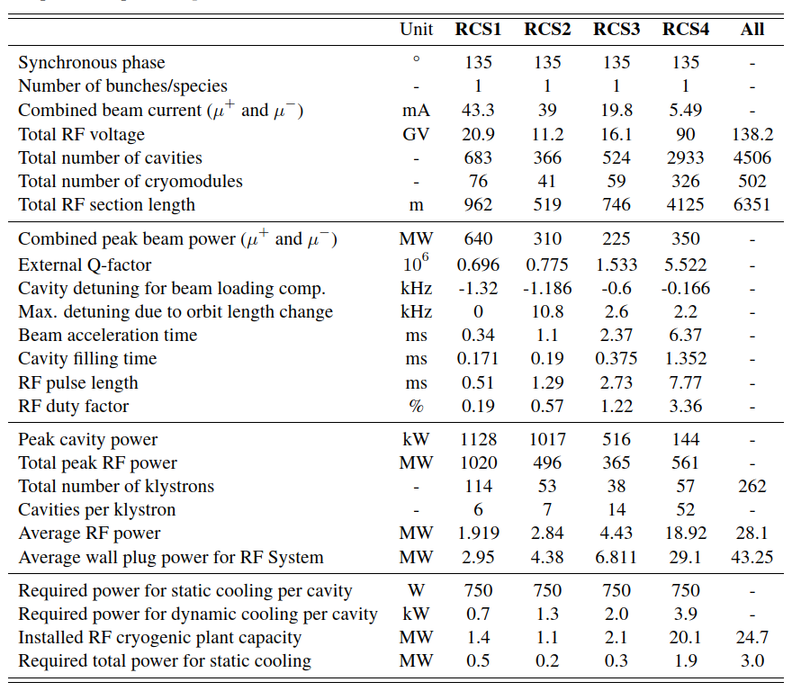
RCS RF system parameters

Slide 18
Cryogenic plant

