Slide 1

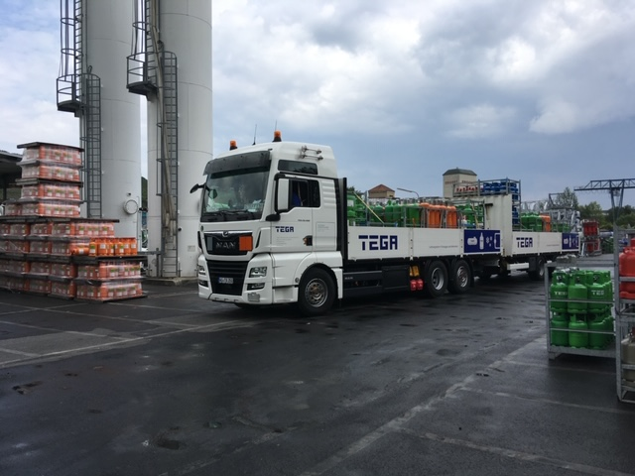
Aktueller Stand der Kältemittelsituation
28.03.2023
Actions required for Change Management in F-Gas Supply Chain
Dr. Alexander Wendt / TEGA / Head of International Sales

Slide 2

Agenda
TEGA - History
Refrigerants Change Requirement #1: ODS directive
Refrigerants Change Requirement #2: F-gas directive
Refrigerants Change Requirement #3: PFAS ban?
Actions required for Change Management in F-gas Supply Chain
TEGA products & services
TEGA offer for facilitating required Changes in F-gas Supply Chain

Slide 3
TEGA - History
1950: founded as Hauke Propan GmbH in Würzburg, Germany
1959: acquired by Linde AG
1969: addition of refrigerants to LPG product portfolio
2018: acquired by Irish DCC group
TEGA is subsidiary of DCC Energy Germany GmbH and Linde is TEGA’s distribution partner for refrigerants supply in Europe.

Slide 4
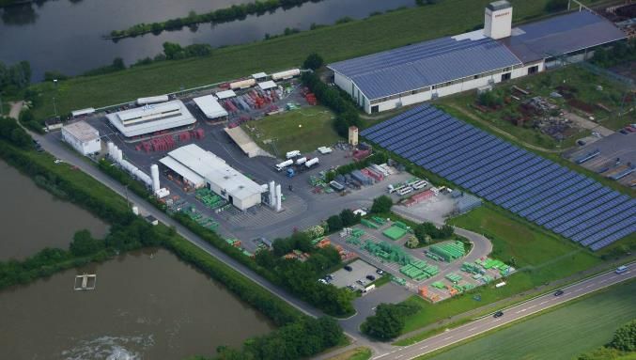
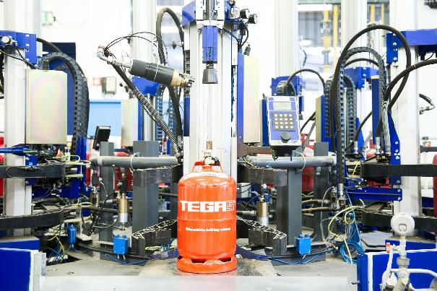
TEGA - Filling and blending plant
Location: Marktbreit (near Würzburg)
For more than 30 years filling and blending of refrigerants, mostly depending on the wishes of the customers.
Our plant is one of the largest in Europe. We supply refrigerants all over the world.
TEGA is one of the few European companies with many years of expertise in the handling and mixing of flammable and non-flammable refrigerants.

Slide 5
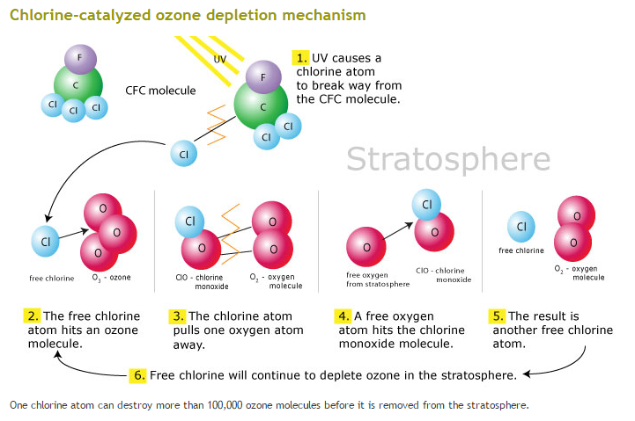
Change Requirement Refrigerants #1: ODS Directive
Prohibition of CFCs (e.g. R 11, R 12) and HCFCs (e.g. R 22) ………
……… due to ozone depleting potential.

Slide 6
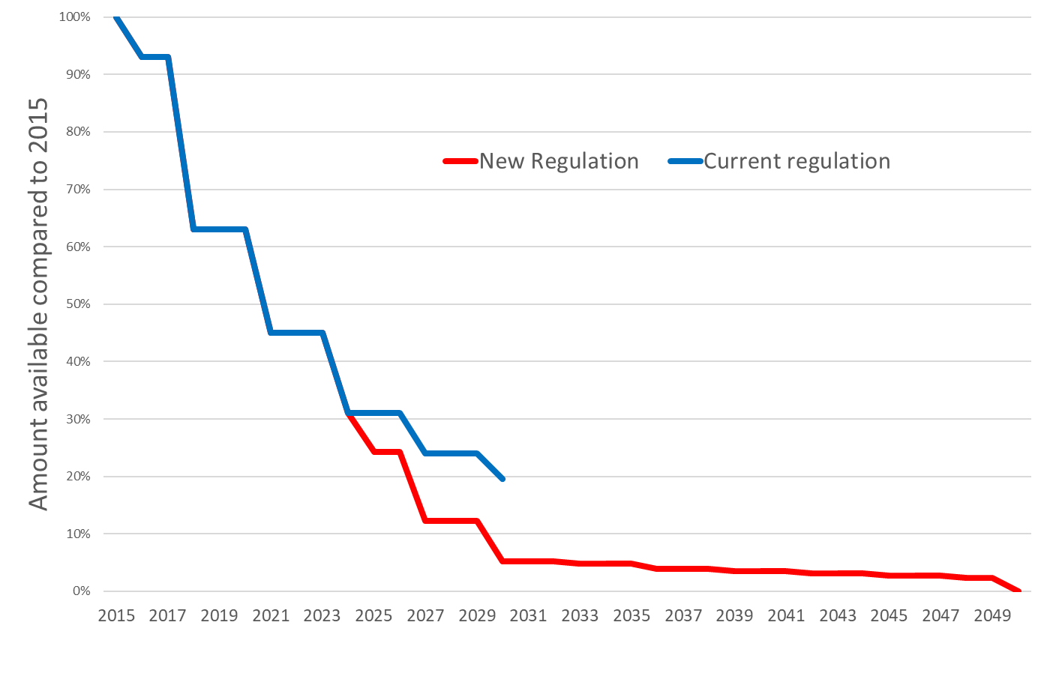

Change Requirement Refrigerants #2: F-gas Directive
F-gas Directive is acting against global warming
by restriction of high-GWP greenhouse gases
Old regulation
Its quota phase-down shown on this graph tackles
in particular HFCs with high global warming potential,
such as R 134a, which will become extremely tight
in supply in the EU latest 2027
In Switzerland, other rules apply which
will be part of next presentation by Linde
Source: https://eur-lex.europa.eu/eli/reg/2024/00573/oj

Slide 7
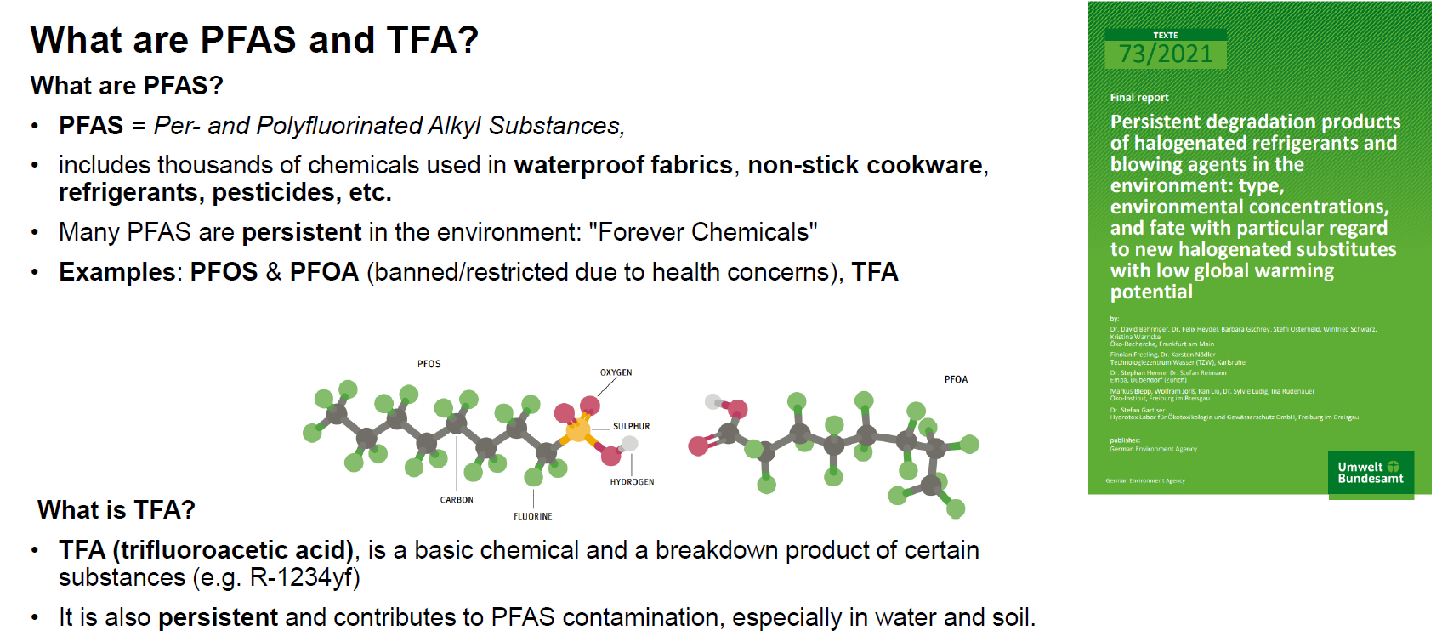
Change Requirement Refrigerants #3: PFAS ban?
Further PFAS examples are R 134a, R 1234ze or R 1224yd

Slide 8
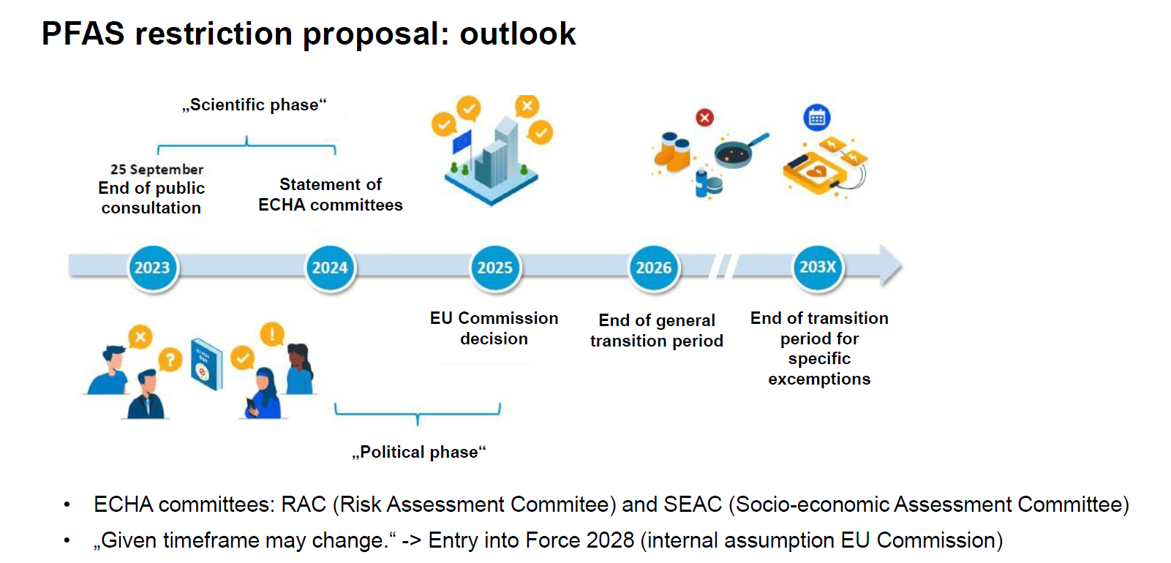
Change Requirement Refrigerants #3: PFAS ban?
Denmark, Germany, the Netherlands, Norway and Sweden proposed PFAS restriction in Europe
for their toxicity* and persistence in the environment => ECHA started evaluation process (REACH)
*only limited data on toxicity so far available

Slide 9
Actions required for Change Management
Checking about F-gas availability vs forecasted demand
2) Checking about optimization of circular economy
=> regeneration instead of incineration of used F-gases
3) Replacing high-GWP F-gases by lower-GWP alternatives

Slide 10
Actions in case of long-term F-gas supply required
TEGA would suggest in such case to approach EU commission for special permission or license to get supply of certain F-gases exempted from quota requirement and from PFAS ban as long as no suitable alternatives have been identified and properly tested for the respective technology.
Such approach will require description to authorities
about socio-economic importance of your technology
why the respective F-gas is such a critical element
which replacement efforts have already been taken and are in your plans
which time horizon you are estimating to get a replacement accomplished
which quantities of F-gases you are estimating to require during this period
how you manage treatment of used F-gases (regeneration / disposal)

Slide 11
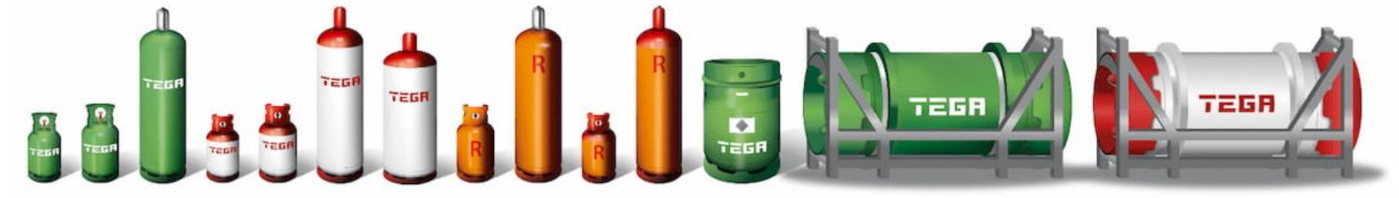
TEGA – Products and Services
Broad product portfolio of natural refrigerants, HFCs, HFOs and HFO-blends
Extensive stock capacities providing high reliability of supply
Diversity in container sizes from cylinders, drum containers to bulk supply in tank trucks (12.5 / 27.2 / 61 / 79 / 400 / 900 litres and 10 t / 20 t in bulk)
Access to one of the largest storekeeper-networks in Germany and Austria
Production of customized refrigerant blends
Return and regeneration or disposal of used refrigerants
Established link to authorities for special permits and licenses

Slide 12
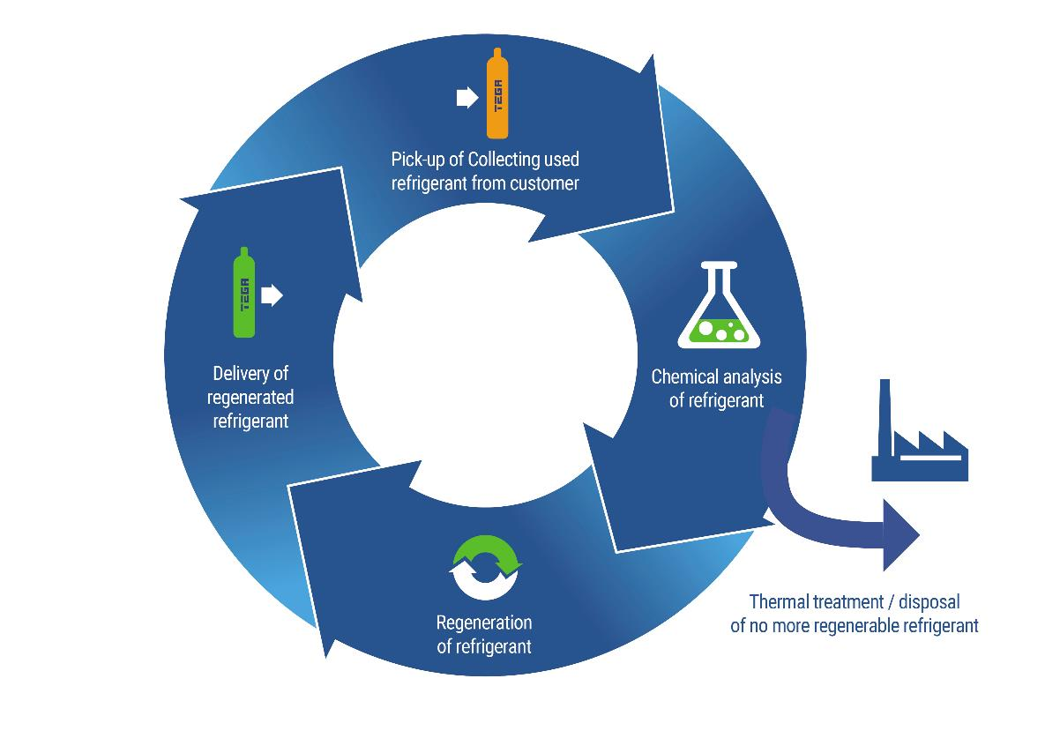
TEGA regeneration process for refrigerants
Sustainable circular economy:
Regeneration of used refrigerants
Disposal of waste refrigerants
Supply of regenerated refrigerants
Extension of life-cycle for various refrigerants

Slide 13
Thanks for the opportunity of discussing future collaboration
TEGA looks forward to receiving your feedback on specific needs regarding change management in F-gas supply chain
www.tega.de

Slide 14
Back-up Slides

Slide 15
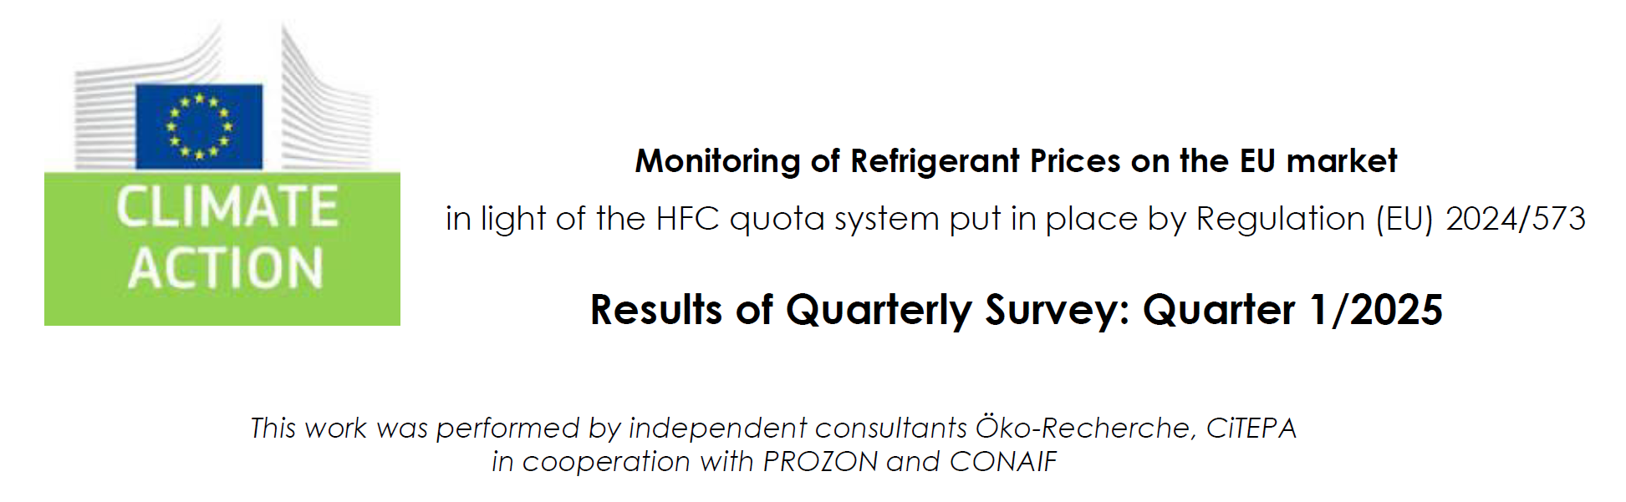
HFC Market Price Development in EU
This graph shows the rel. development
in purchase prices of 4 HFCs

