Slide 1

Optimization of GHG usage for particle detectors
Maria Cristina Arena, A. Bouzaiene, M. Busato, D. Galassi, R. Guida, S. Juks, B. Mandelli, G. Rigoletti, P. Vanslambrouck, M. Verzeroli

Slide 2

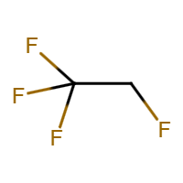
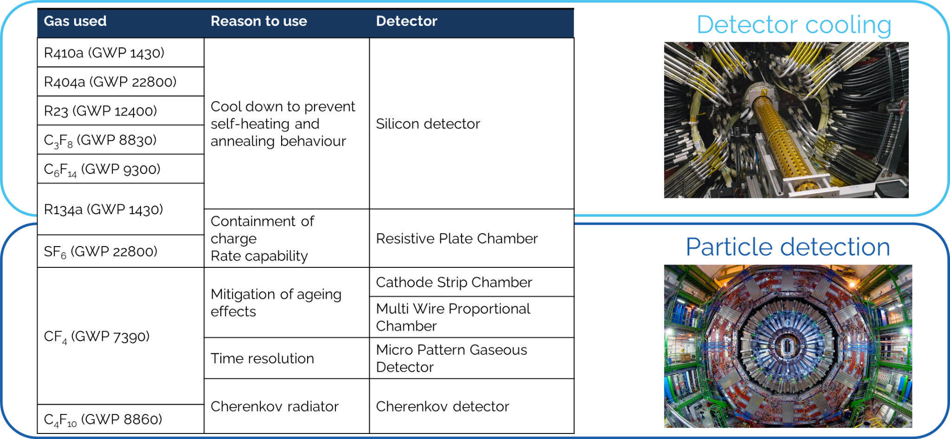


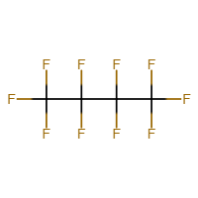
Use of fluorinated gases at the CERN LHC
R134a
SF₆
CF₄
C₄F₁₀
Towards Sustainable Gas Mixtures For Future Detectors (WG3) – M. C. Arena, on behalf of the Gas Team

Slide 3
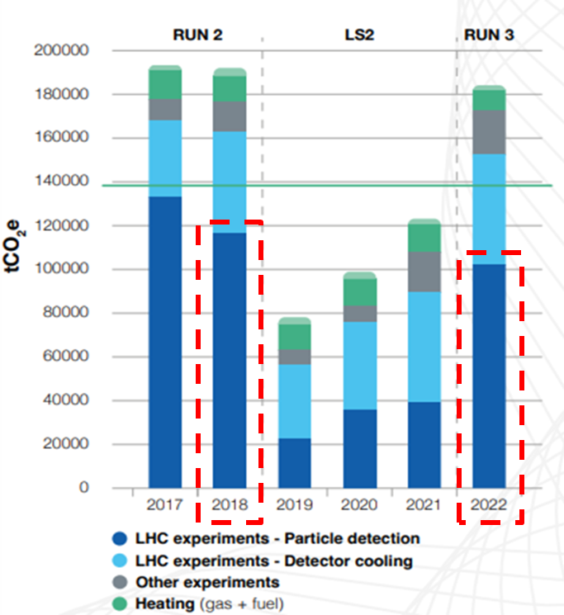
GHGs emissions at CERN
Fluorinated compounds represent the 78% of total Organization’s emissions which will be reduced by 28% by the end of RUN 3 (wrt 2018)
R134a → emissions reduced by 25% during RUN3 thanks to the operation of the CMS R134a recovery plant & new 30% CO₂ ATLAS RPC gas mixture
CF₄ → emissions reduced by 20% thanks to the increase of recuperation efficiency of CMS CF₄ recovery plant.
https://doi.org/10.25325/CERN-Environment-2023-003
Towards Sustainable Gas Mixtures For Future Detectors (WG3) – M. C. Arena, on behalf of the Gas Team

Slide 4
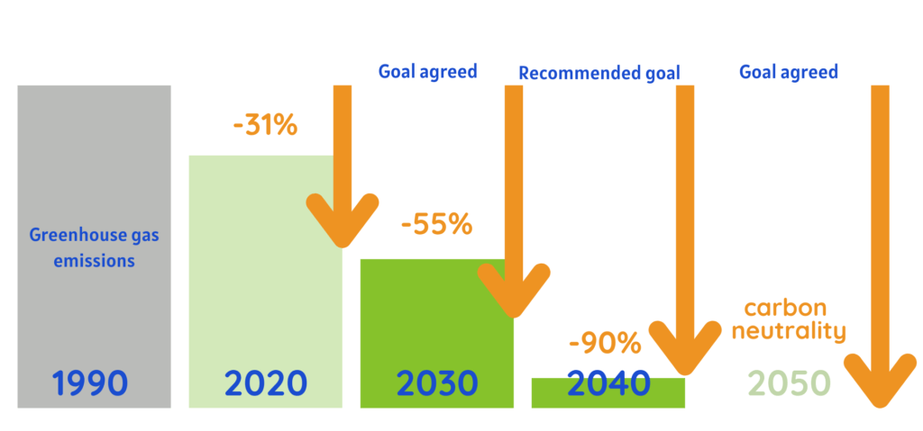
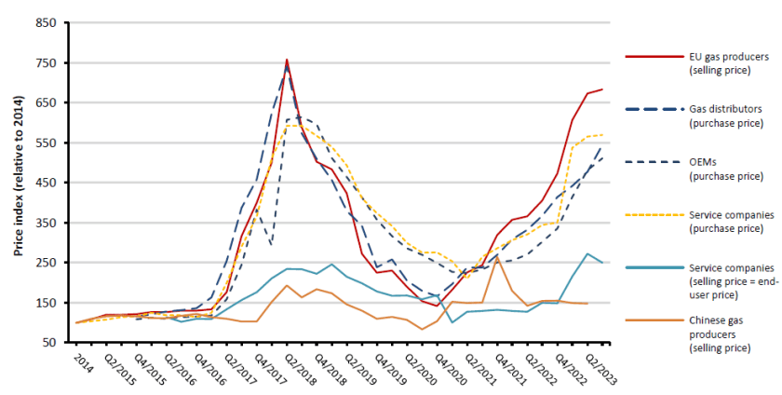
F⁻ EU regulations
New EU legislation of 2024 is strongly limiting the use of these gases through different approaches:
Promoting the use of more eco friendly alternatives
Controlling and preventing emissions
Reducing the availability of hydrofluorocarbons
Sharp reduction in available HFC supply quota → spike of prices
Higher prices with lower demand due to transition to low GWP alternatives
It will become harder and more expensive to get, mainly used for servicing old systems until fully phased out.
Gas Team strategies to reduce GHG emissions started even before the first EU legislation of 2014!

Slide 5
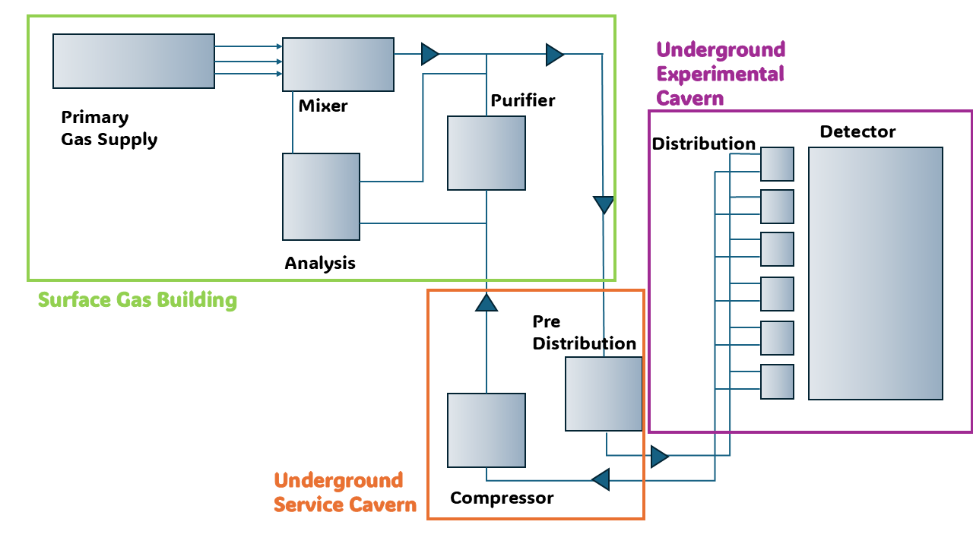
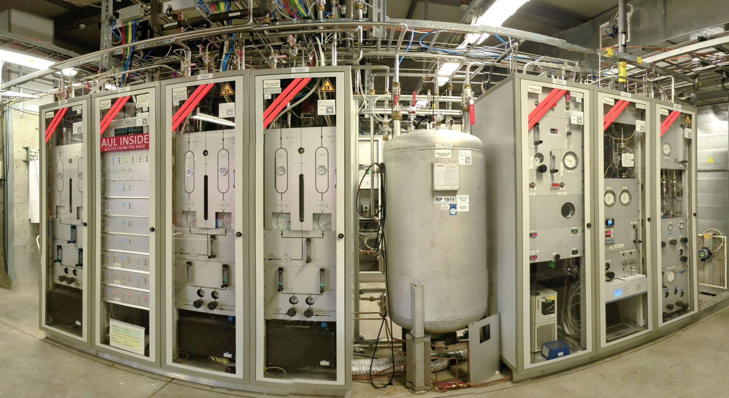
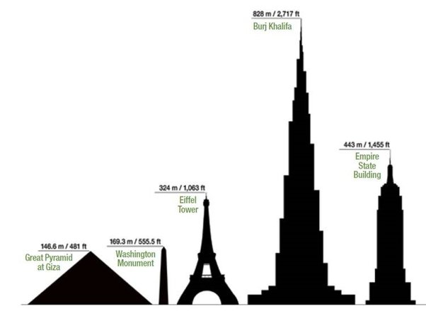

EP-DT-FS Gas Team
The Gas systems team is responsible for
Design and construction of gas systems for particle detectors at CERN
Operation, maintenance and upgrades of gas systems installations
Provide support to analyse gas samples
More than 30 large gas systems installations
Industrial grade plants to control gas to the detectors (mixture, temperature, pressure, flow, etc.)
Modular design: increase construction efficiency, decrease operational costs
Schematic view of the LHC gas systems
Burj Khalifa
828 m
All gas systems racks
500-600 m
Each installation consists of
~10-10² sensors
~few to 10² actuators
~2-3 km of pipes
ATLAS RPC gas system in surface gas room
Tour Eiffel 324 m
https://doi.org/10.1007/978-981-13-1313-4_19
Towards Sustainable Gas Mixtures For Future Detectors (WG3) – M. C. Arena, on behalf of the Gas Team

Slide 6
Layout of LHC gas systems
OPEN LOOP → 100% of gas loss
GAS RECIRCULATION → ~ 10% of gas loss
GAS MIXER
DETECTOR
EXHAUST
GAS MIXER
DETECTOR
EXHAUST
GAS RECUPERATION → 0% of gas loss*
GAS MIXER
DETECTOR
EXHAUST
RECOVERY PLANT
*due to gas system operation
Towards Sustainable Gas Mixtures For Future Detectors (WG3) – M. C. Arena, on behalf of the Gas Team

Slide 7
Strategies to reduce GHGs emissions at CERN
Strategies
Gas recuperation systems
Alternative gases
Disposal and abatement
Gas recirculation
Optimization of gas system technologies
To C₂H₂F₄
Pressure swing
Particular attention to operation
Membrane separation
To SF₆
Improved control and monitoring
Distillation
To CF₄
Towards Sustainable Gas Mixtures For Future Detectors (WG3) – M. C. Arena, on behalf of the Gas Team

Slide 8
Gas recirculation systems

Slide 9


Why not 100% of recirculation?
Some detectors cannot work at 100% of gas recirculation due to their air/H₂O permeability (NOT leaks!)
This means that these components would be accumulated in the gas mixture leading to detector ageing or lower performances!
Many gas detectors have been validated to work at 90% of recirculation fraction due to the formation of impurities in the gas loop, such as F⁻, which can cause long-term ageing effects!
Towards Sustainable Gas Mixtures For Future Detectors (WG3) – M. C. Arena, on behalf of the Gas Team

Slide 10
Gas recirculation
Gas recirculation represents the first strategy to mitigate GHG emissions for particle detection:
For detectors’ volumes between 1 and 100 m³
16 recirculating gas systems working 24/24
ATLAS RPC gas system in surface gas room
PROS
Gas consumption reduced up to 90-100% (depending on the detector requirements)
System paid back thanks to the gas saved
CONS
Higher complexity of the system
Analyses required to monitor the quality of recirculated gas
GAS MIXER
DETECTOR
EXHAUST
GAS RECIRCULATION → ~ 10% of gas loss
Towards Sustainable Gas Mixtures For Future Detectors (WG3) – M. C. Arena, on behalf of the Gas Team

Slide 11
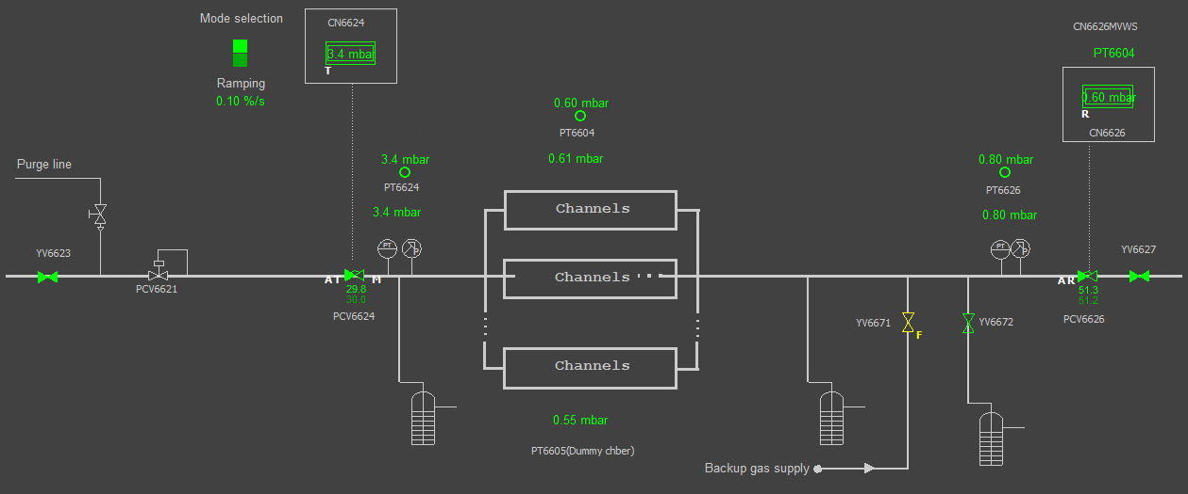
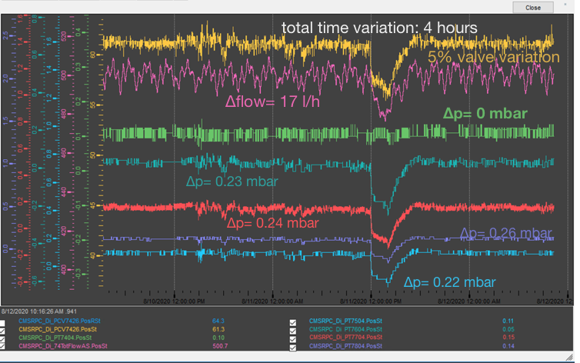
Optimization of gas system technologies
Minimize detector pressure/flow fluctuation to cope with observed inborne fragility of detector components → From < 1 mbar to ~ 0.1 mbar not an easy challenge
All upgrades required dedicated R&D, development of components, commissioning, … and today operation is more complex
Our operating conditions often have no equivalents in the industrial domain!
Pressure regulation by using Detector pressure or “reference volumes”
New restart procedure
Additional regulation valves
Two sets of PID
https://doi.org/10.1016/j.nima.2023.168444
As slow as possible opening at input
New modules with regulation valves
with new valve
Towards Sustainable Gas Mixtures For Future Detectors (WG3) – M. C. Arena, on behalf of the Gas Team

Slide 12
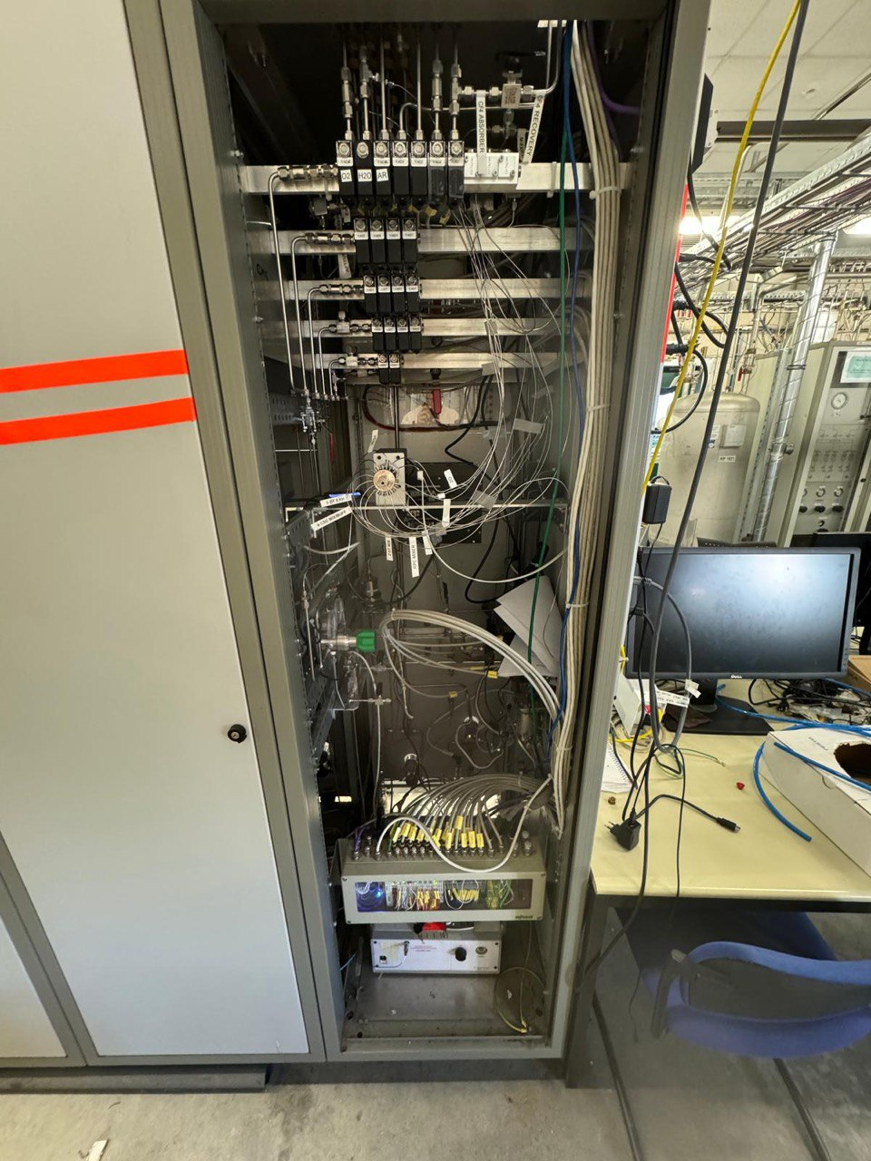
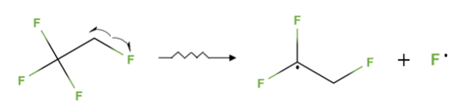
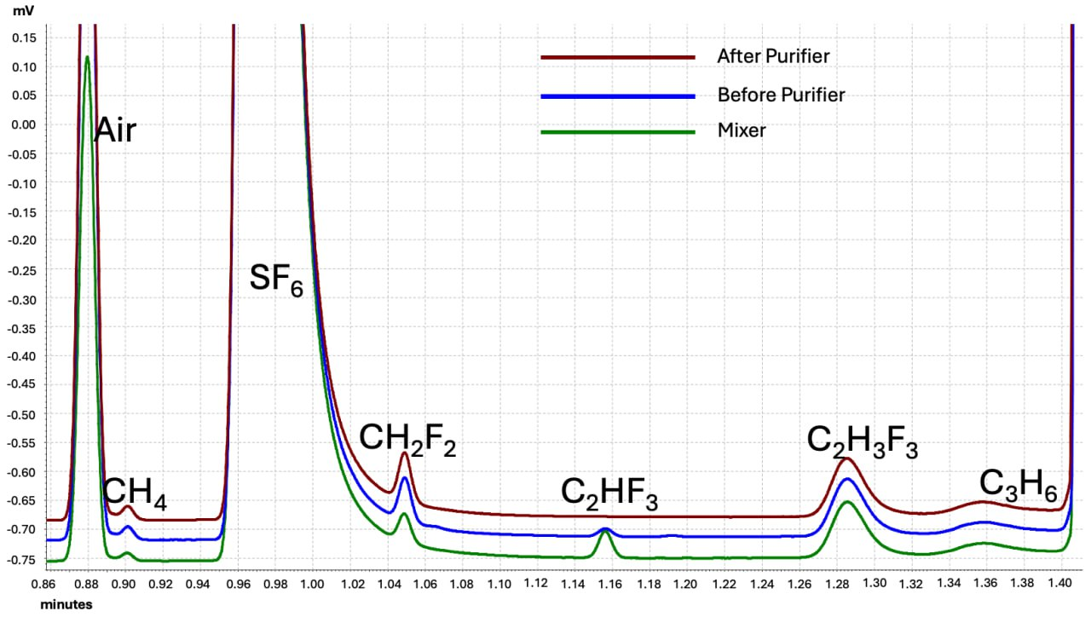
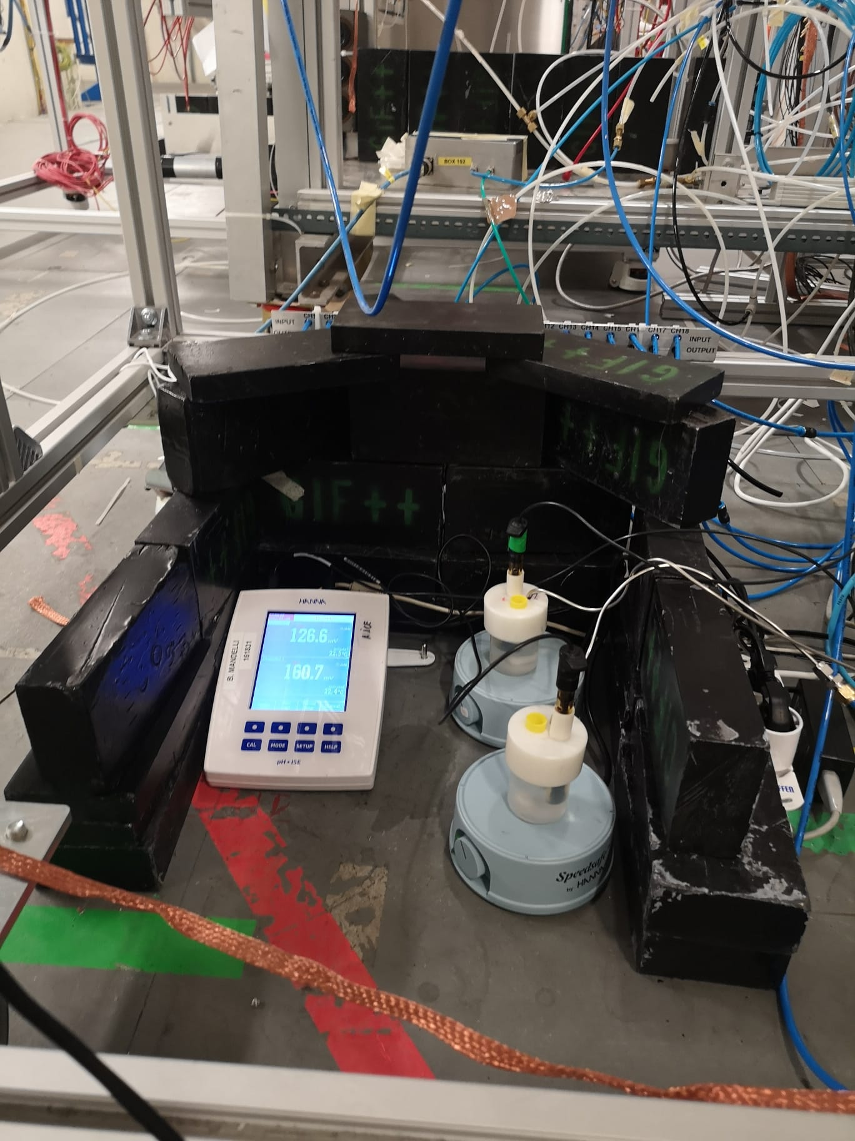
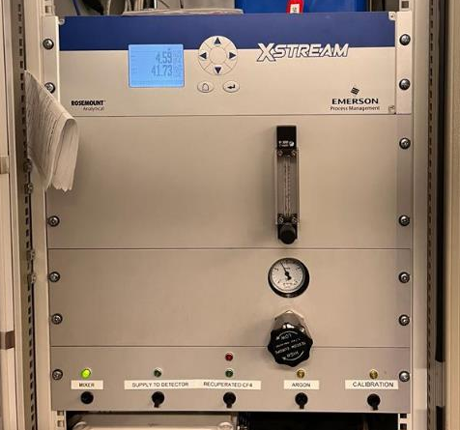
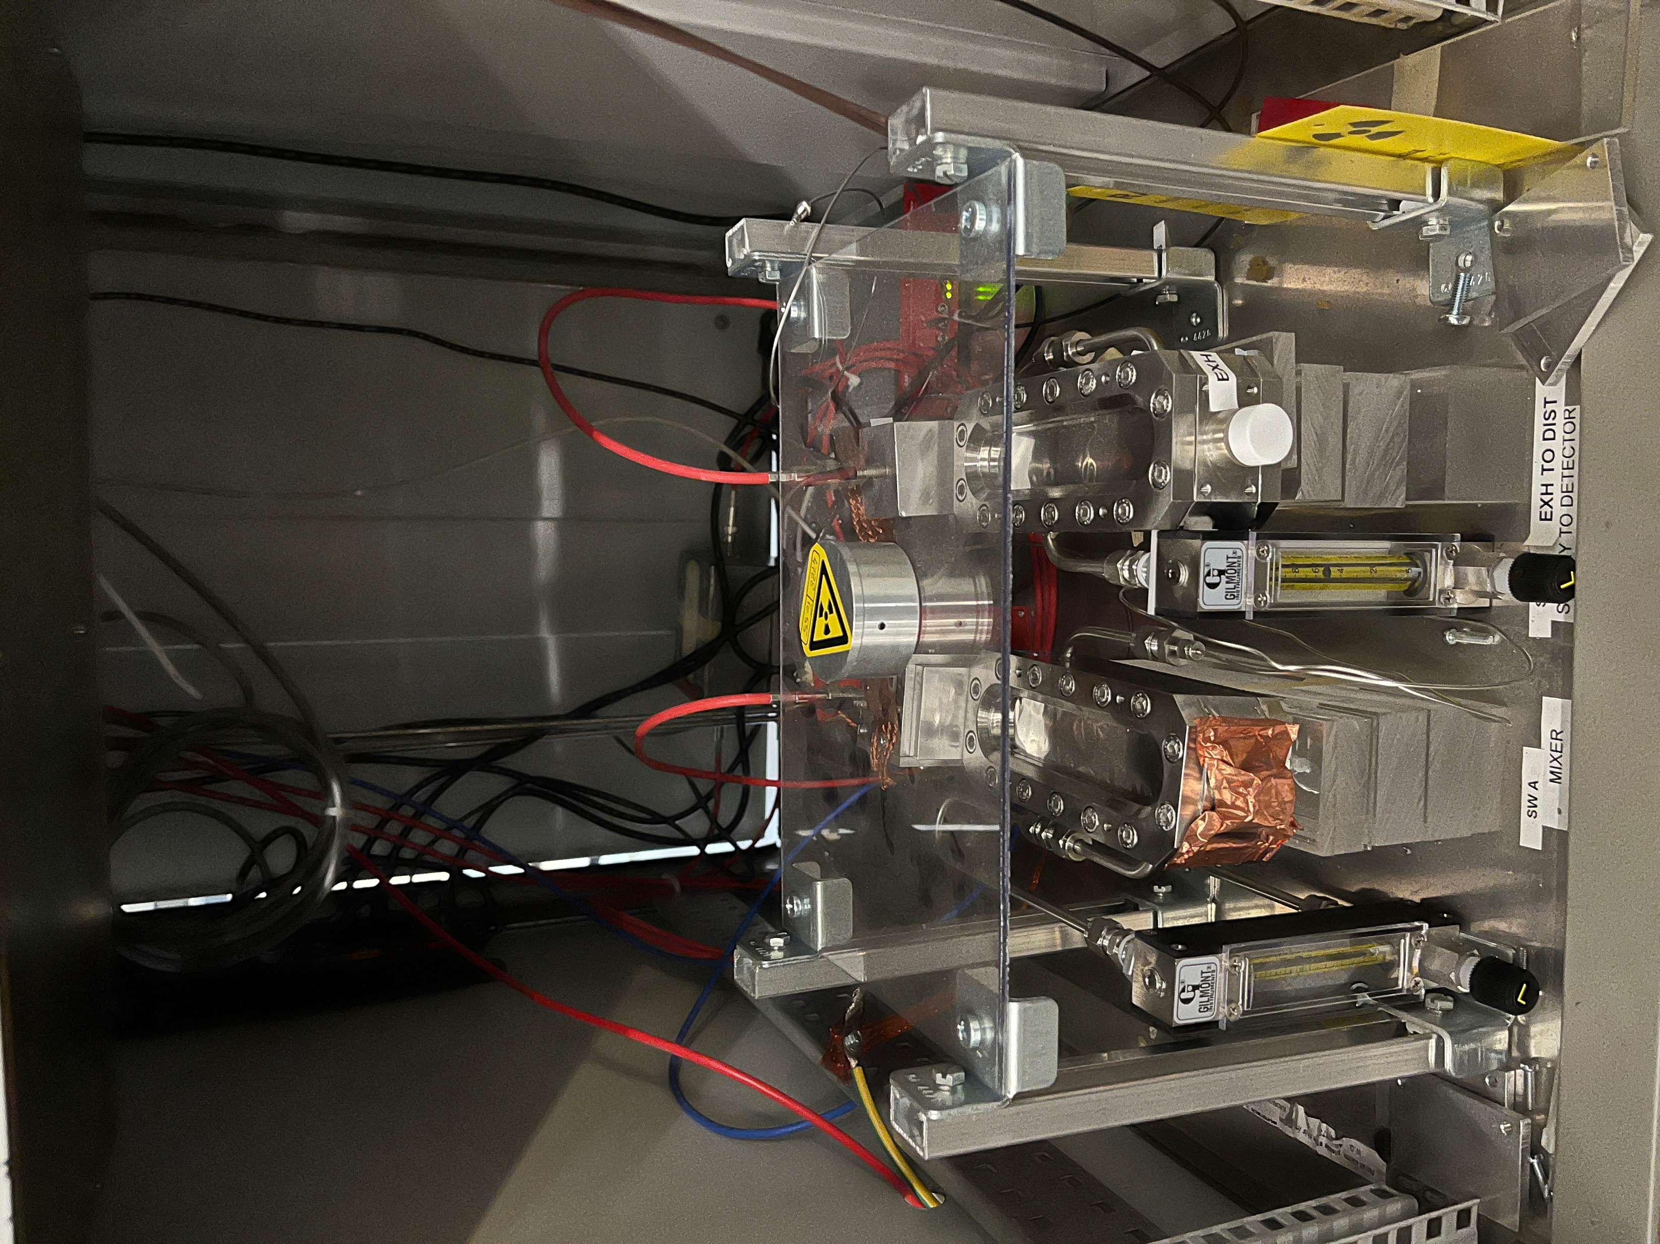
Analyses to monitor gas recirculation systems
Operating these systems is challenging & impurities are formed in the gas loop (e.g. F⁻) → filtering and monitoring systems are crucial!
µGC analyses
Potentiometric analysis to monitor F- production in LHC systems
Monitoring systems
Online monitoring setups
https://doi.org/10.1088/1748-0221/14/09/C09006
https://doi.org/10.1016/j.nima.2025.170515
Infrared analyser
SWPC
Towards Sustainable Gas Mixtures For Future Detectors (WG3) – M. C. Arena, on behalf of the Gas Team

Slide 13
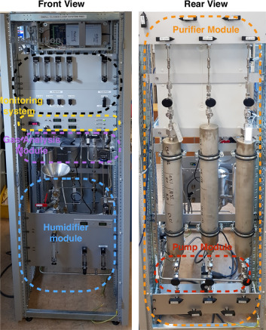
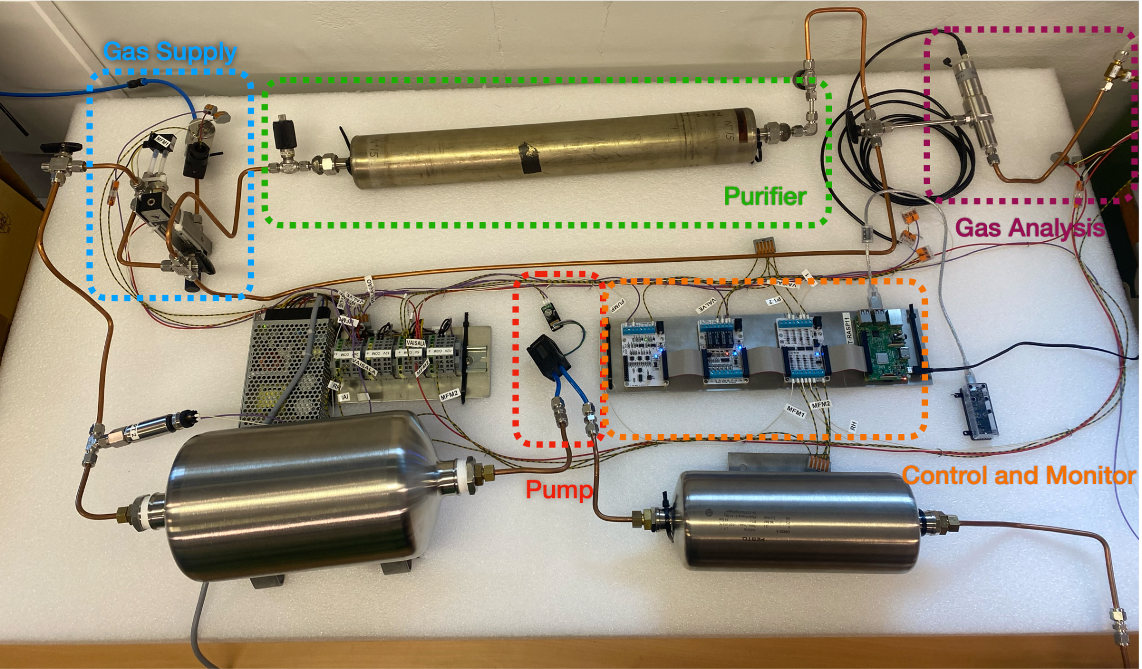
Small and micro recirculating systems
Small recirculation system
Target → Small laboratory gas detector setups
(flushing of few l/h)
Proposal → micro gas recirculation system
As with gas systems, gas is pumped around in closed loop
Requirements
  For detector volumes up to 100L
  Compact and portable: fits on a desk / in a box
  Modular: every setup has different needs (optional purifier, flow monitoring, analysers etc.)
  Starting price ~ O(10³) CHF
  Easy to build, use and maintain
  Simple control and monitoring
LHC gas system
https://doi.org/10.1016/j.nima.2023.168095
Micro recirculation system
Towards Sustainable Gas Mixtures For Future Detectors (WG3) – M. C. Arena, on behalf of the Gas Team

Slide 14
Gas recuperation systems

Slide 15
Gas recovery systems for fluorinated gases
Due to air accumulation in the gas mixture, some detectors cannot work with a 100% recirculated fraction
Usual recirculation fraction of 90% (detector requirements) → 10% sent to the exhaust
In some cases, this gas is sent to recovery plants where the GHG is separated from
the other components, stored and then re-injected in the mixer through a dedicated line
GAS RECUPERATION → 0% of gas loss*
GAS MIXER
DETECTOR
EXHAUST
RECOVERY PLANT
https://doi.org/10.1088/1748-0221/15/10/C10028
Towards Sustainable Gas Mixtures For Future Detectors (WG3) – M. C. Arena, on behalf of the Gas Team

Slide 16
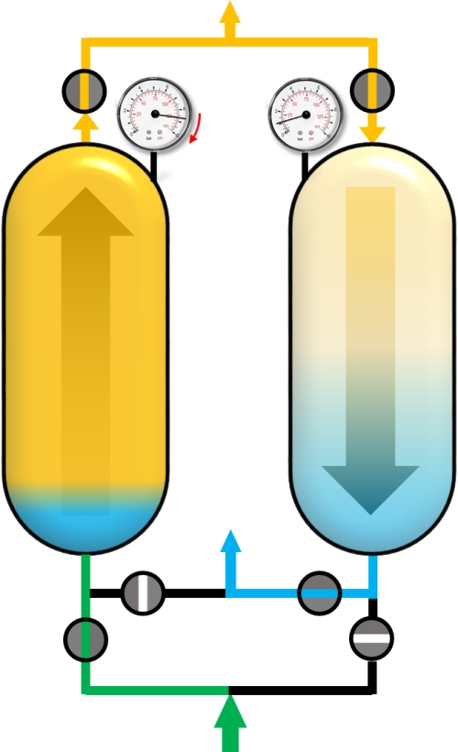
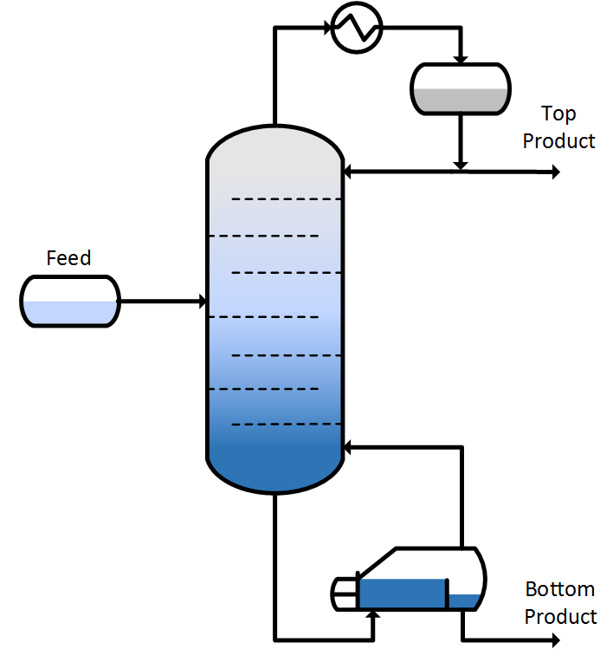
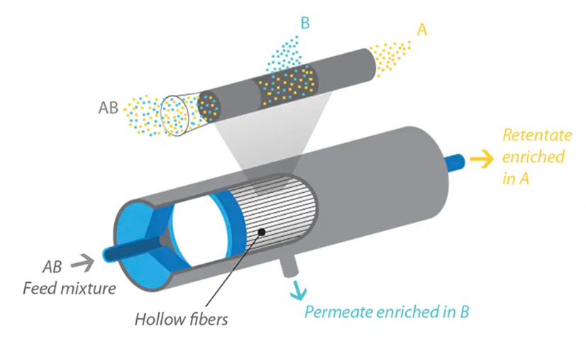
Separation techniques - overview
DISTILLATION
Based on boiling point differences
Lighter components → vapor phase
Heavier components → liquid phase
MEMBRANE SEPARATION
Driven by partial pressure gradient
Depends on membrane nature & permeability
Affected by solubility and diffusivity
DISTILLATION
R134a → CMS RPC
C4F10 → LHCb RICH1
MEMBRANE SEPARATION
CF4 → CMS CSC, LHCb RICH2
ADSORPTION (PSA/TSA)
PSA → pressure changes for regeneration
TSA → heat for regeneration
Vacuum prevents overheating
ADSORPTION (PSA/TSA)
CF4 → CMS CSC
Towards Sustainable Gas Mixtures For Future Detectors (WG3) – M. C. Arena, on behalf of the Gas Team
Ability of a membrane to separate two molecules

Slide 17
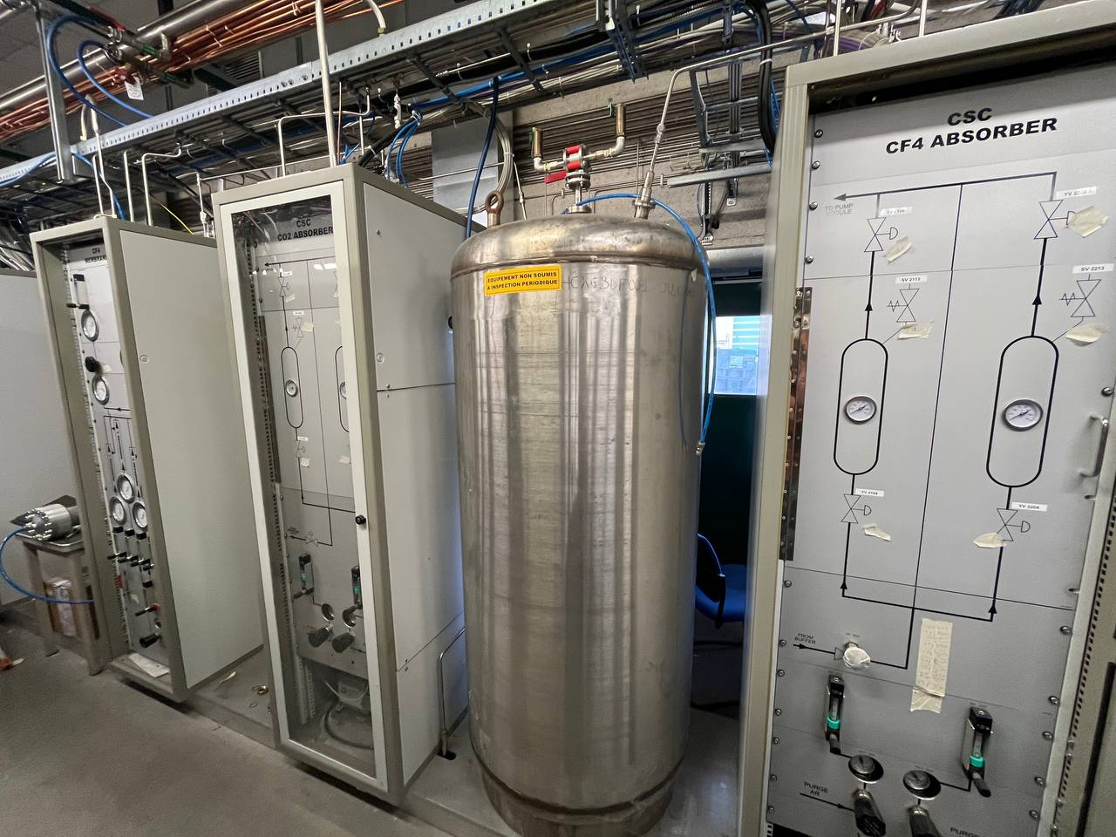
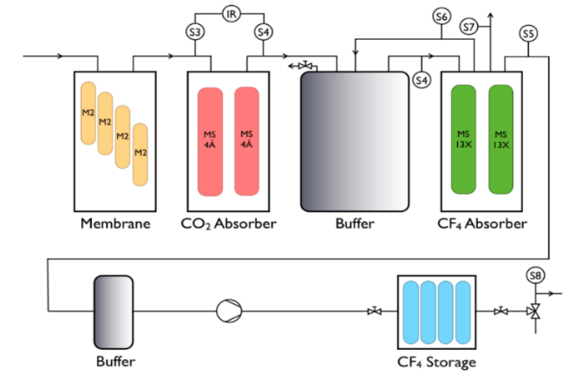
CMS CSC recovery system for CF4
MEMBRANES
BUFFER
CO₂ ADS.
First plant for CF₄ warm adsorption, non-standard gas system
CSC gas mixture: Ar/CO₂/CF₄ = 40/50/10 or 40/55/5
System is fully controlled by software
CF₄ ADS.
Towards Sustainable Gas Mixtures For Future Detectors (WG3) – M. C. Arena, on behalf of the Gas Team

Slide 18
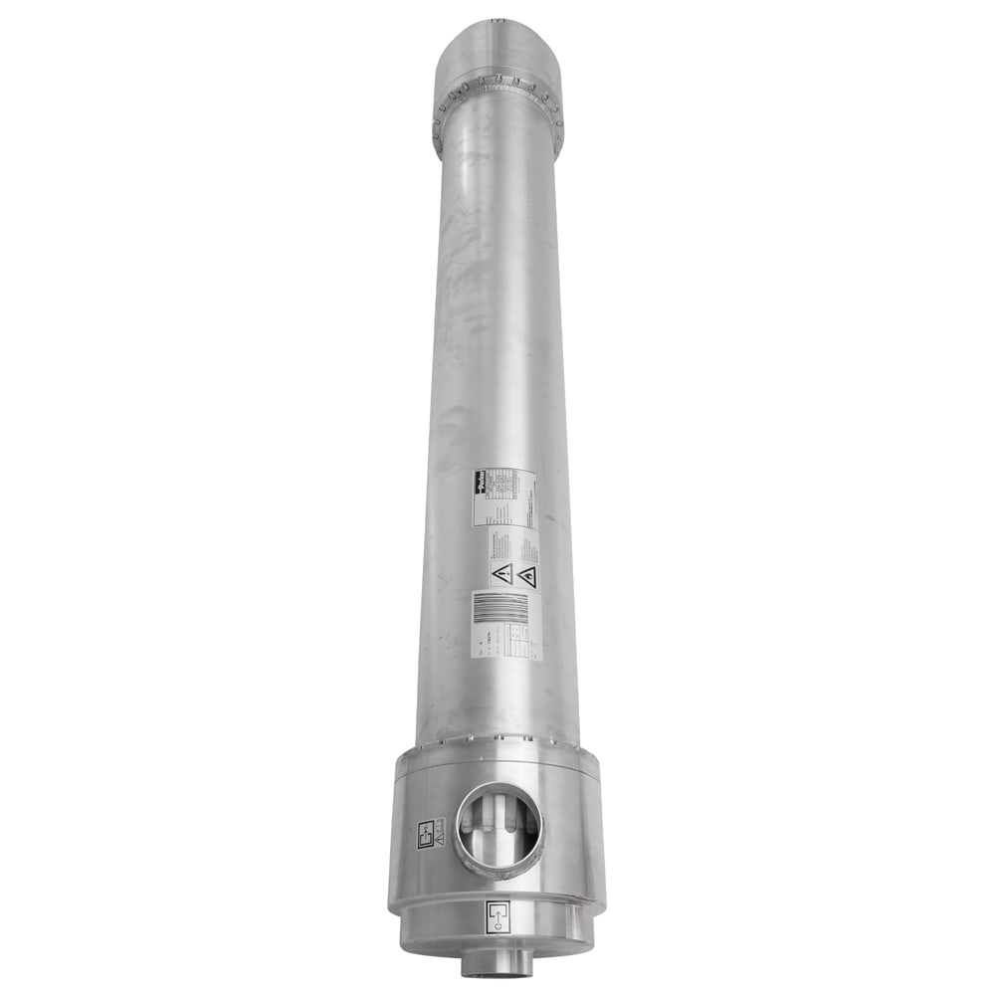
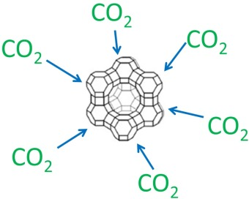
CMS CSC recovery system for CF4
Phase 1 → CO₂ separation
CO2 / Ar / CF4 =
55 / 40 / 5 or 50 / 40 / 10 + 1% of N2
Feed
Retentates
CF4 / Ar / N2 / CO2 =
83 / 15 / 2 / 500 ppm
100 l/h
6-12 l/h
Permeates
94-88 l/h
CO2 / Ar / N2 =
60 / 39 / 1
Phase 2 → Adsorption of remaining CO₂
To Phase 3
CF4 / Ar / N2 =
85 / 5 / 15
CO2 adsorption with zeolite 4A
From Membrane’s Retentates
Towards Sustainable Gas Mixtures For Future Detectors (WG3) – M. C. Arena, on behalf of the Gas Team

Slide 19

CMS CSC recovery system for CF4
Phase 3 & 4 → CF₄ adsorption, extraction and storage
To CSC mixer
CF4 Storage Battery
Patm
Phase 1 (Patm to -400 mbar): Ar and N2 venting
CF4 adsorption with zeolite 13X
Phase 2 (-400 mbar to vacuum):
CF4 extraction
Vacuum
CF4 / Ar / N2 = 92 / 7 / 1
From Phase 2
Towards Sustainable Gas Mixtures For Future Detectors (WG3) – M. C. Arena, on behalf of the Gas Team

Slide 20
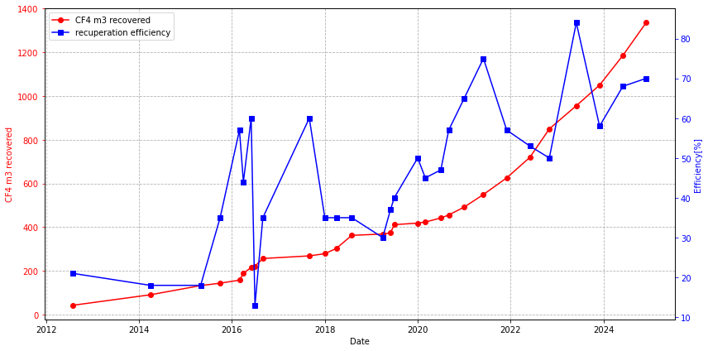
CMS CSC recovery system for CF4
Efficiency mean value: 70% in the period January-November 2024
In 2024, out of 495 m³ of CF₄ injected into the mixer, 290 m³ were recovered CF₄ (60%)
Towards Sustainable Gas Mixtures For Future Detectors (WG3) – M. C. Arena, on behalf of the Gas Team

Slide 21
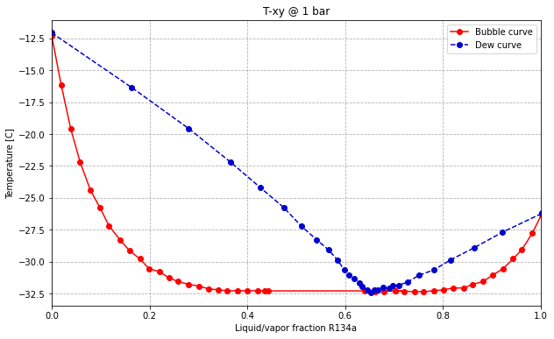
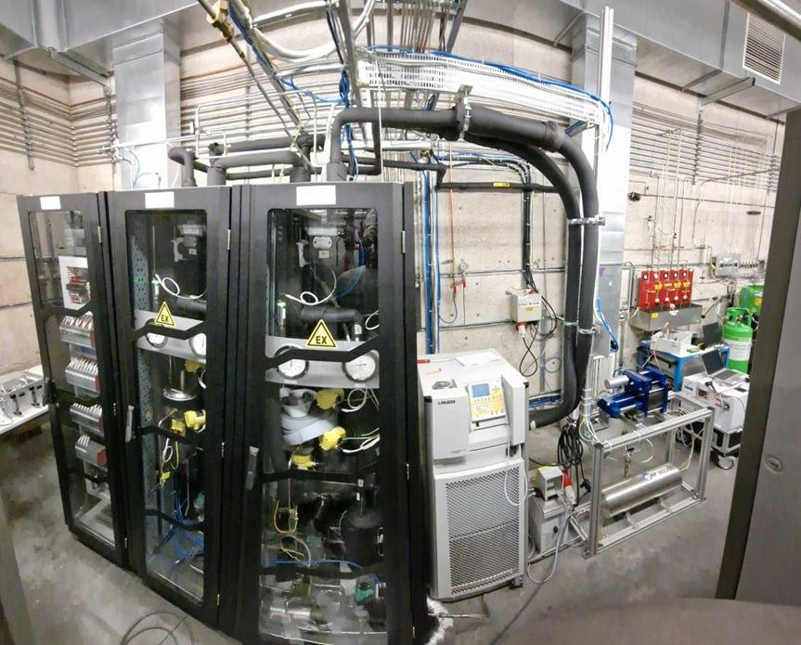
CMS RPC recovery system for C2H2F4 (R134a)
Recovery plant based on distillation process
CMS RPC gas mixture → R134a/SF₆/iC₄H₁₀ 95.2/0.3/4.5
Problem: R134a forms a minimum boiling point azeotrope with iC4H10
SEPARATION MODULES
COMPRESSOR
Slow heating of liquified azeotrope (red curve) allows to enrich the liquid of R134a and the vapor phase of azeotrope
ELECTRICAL RACK
CHILLER
Towards Sustainable Gas Mixtures For Future Detectors (WG3) – M. C. Arena, on behalf of the Gas Team

Slide 22
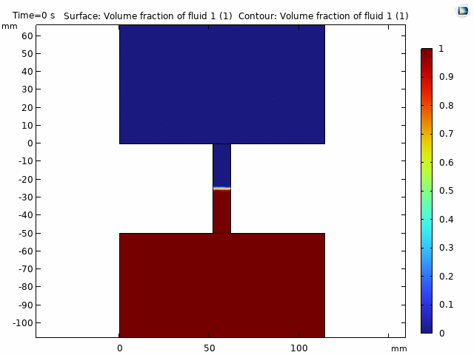
CMS RPC recovery system for C2H2F4 (R134a)
From RPC Exhaust→
R134a/iC4H10/SF6 =
95.2/4.5/0.3
Gas exhaust enriched in the azeotrope (R134a/iC4H10 = 65/35)
Liquid R134a descends into the bottom buffer thanks to gravity and vaporizes
Gas phase goes up to the top buffer leading to the distillation
Thermodynamic simulation done by M. Bruno (PoliTO)
Pure R134a to storage bottle
Towards Sustainable Gas Mixtures For Future Detectors (WG3) – M. C. Arena, on behalf of the Gas Team

Slide 23
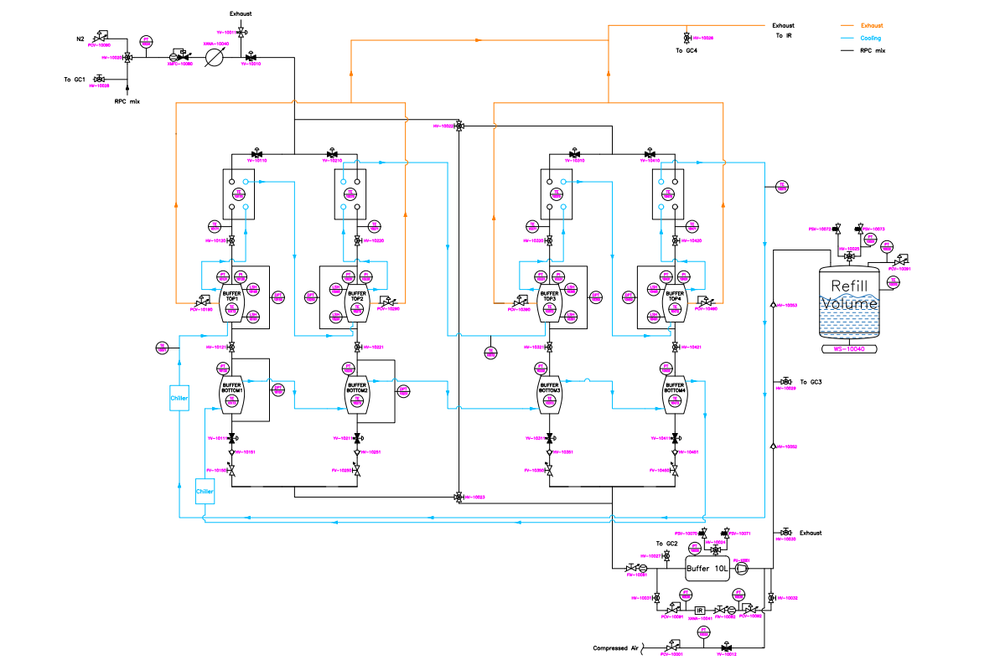
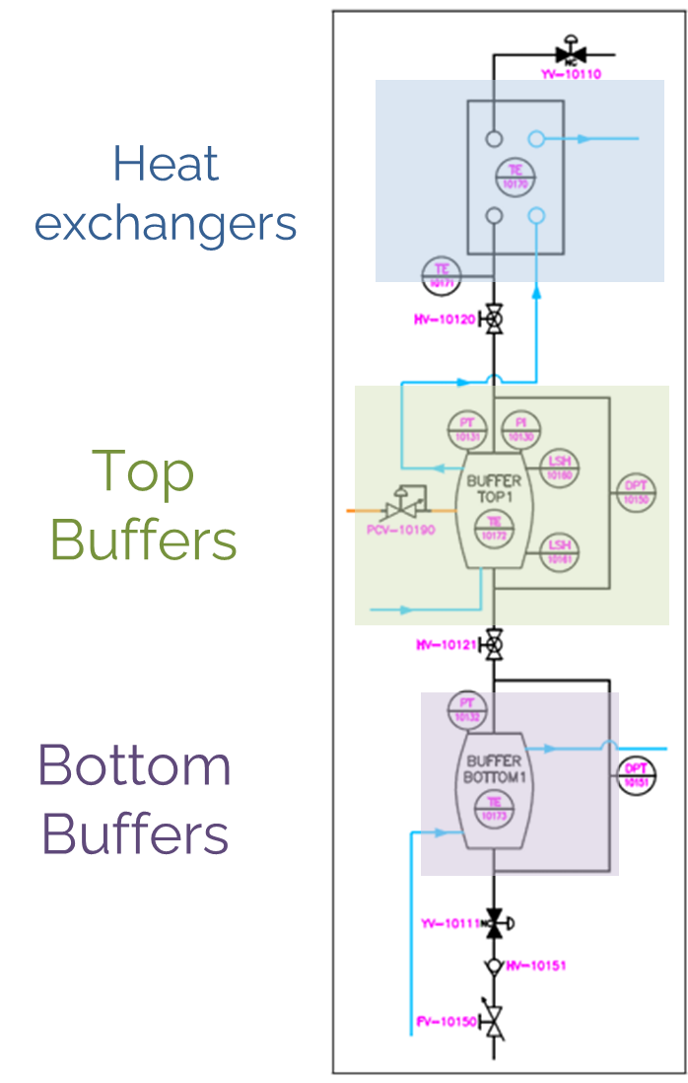
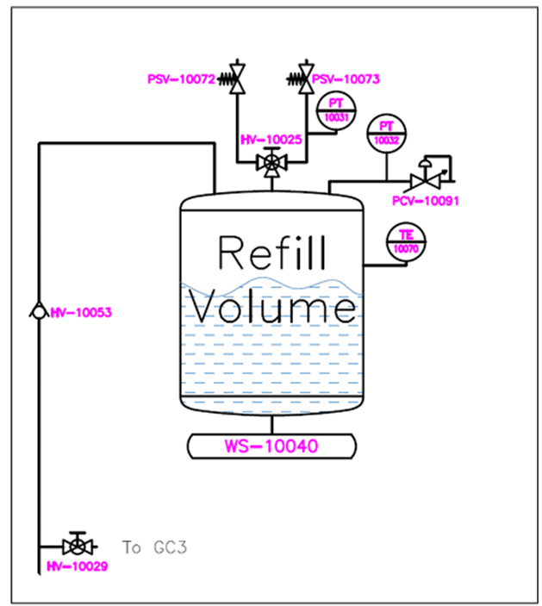
CMS RPC recovery system for C2H2F4 (R134a)
Distillation units
Storage Tank
Compressor module
Towards Sustainable Gas Mixtures For Future Detectors (WG3) – M. C. Arena, on behalf of the Gas Team

Slide 24
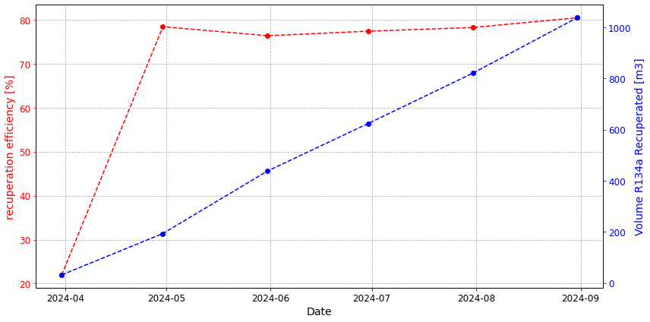
CMS RPC recovery system for C2H2F4 (R134a)
Recovery efficiency of 80% with 5000 ppm iC4H10 in the recuperated R134a (99.5% of gas purity)
Recuperated R134a is reinjected at the RPC mixer in a ratio 50/50 with fresh R134a
Towards Sustainable Gas Mixtures For Future Detectors (WG3) – M. C. Arena, on behalf of the Gas Team

Slide 25
Recovery plants - overview
Positive consequences
Operational budget and GHG emissions reduced
  CF4 recuperation for CMS-CSC
    10% CF4 in gas mixture
    With 65% recuperation efficiency
    → 1400 kg/year CF4 saved (out of 2200 kg/year needed) → -10500 tCO2eq/year (~ -60 kCHF/year, system paid back in 5 years)
  R134a recuperation for CMS-RPC
    95.2% R134a in gas mixture
    With 80% recuperation efficiency (and considering the limit imposed by current leak rate)
    → 12 t/year R134a saved (out of 24 t/year needed) → -18000 tCO2e/year (-130 kCHF/year, system paid back in 3 years)
Difficulties
Gas systems and recuperation plants must be considered as industrial installations
  More than 300 euro-racks that need to be operational 24/7
Additional resources with specific expertise are needed (i.e. chemical engineers, physicists, mechanical engineers)
  Current team profile based on technicians cannot ensure design and proper operation and maintenance following industrial standards
Towards Sustainable Gas Mixtures For Future Detectors (WG3) – M. C. Arena, on behalf of the Gas Team

Slide 26
Conclusions

Slide 27
Conclusions
Fluorinated gases are responsible for more than 80% of CERN GHG emissions
Gas team started its R&D activities to reduce the GHG emission before F⁻ EU legislation of 2014 was published!
16 recirculation systems & 4 operational recovery systems for GHGs (2 CMS and 2 LHCb) currently operational
These systems implies more control on gas quality → daily gas chromatograph analyses and online monitoring systems (e.g., SWPC and IR)
Modest investment wrt the tCO2e saved and in addition they mitigate difficulties in case of GHG shortage allowing experiment data taking! (as experienced in the past and very likely more in the future)
Towards Sustainable Gas Mixtures For Future Detectors (WG3) – M. C. Arena, on behalf of the Gas Team

Slide 28
Thanks for your kind attention!

Slide 29
Backup

Slide 30
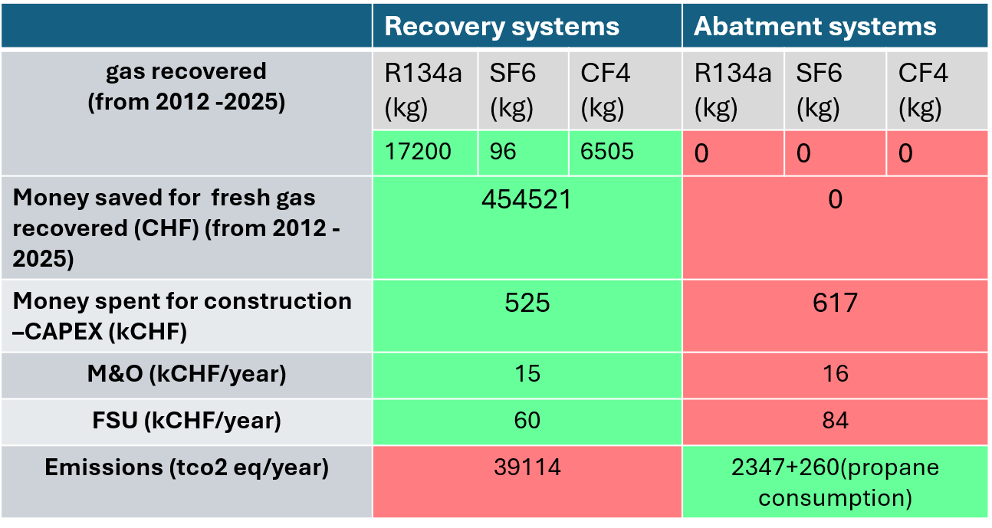
Recovery plant VS Abatment system
Towards Sustainable Gas Mixtures For Future Detectors (WG3) – M. C. Arena, on behalf of the Gas Team

