Slide 1
VUV emission in noble-gas TPCs and the role of molecular additives
(or how to talk about a ~100year-old topic, trying to say something interesting)
Diego González Díaz (Univ. Santiago de Compostela)*
*(inevitably biased… just aiming to convey the basics!)
18/06/2025, CERN DRD1 meeting

Slide 2
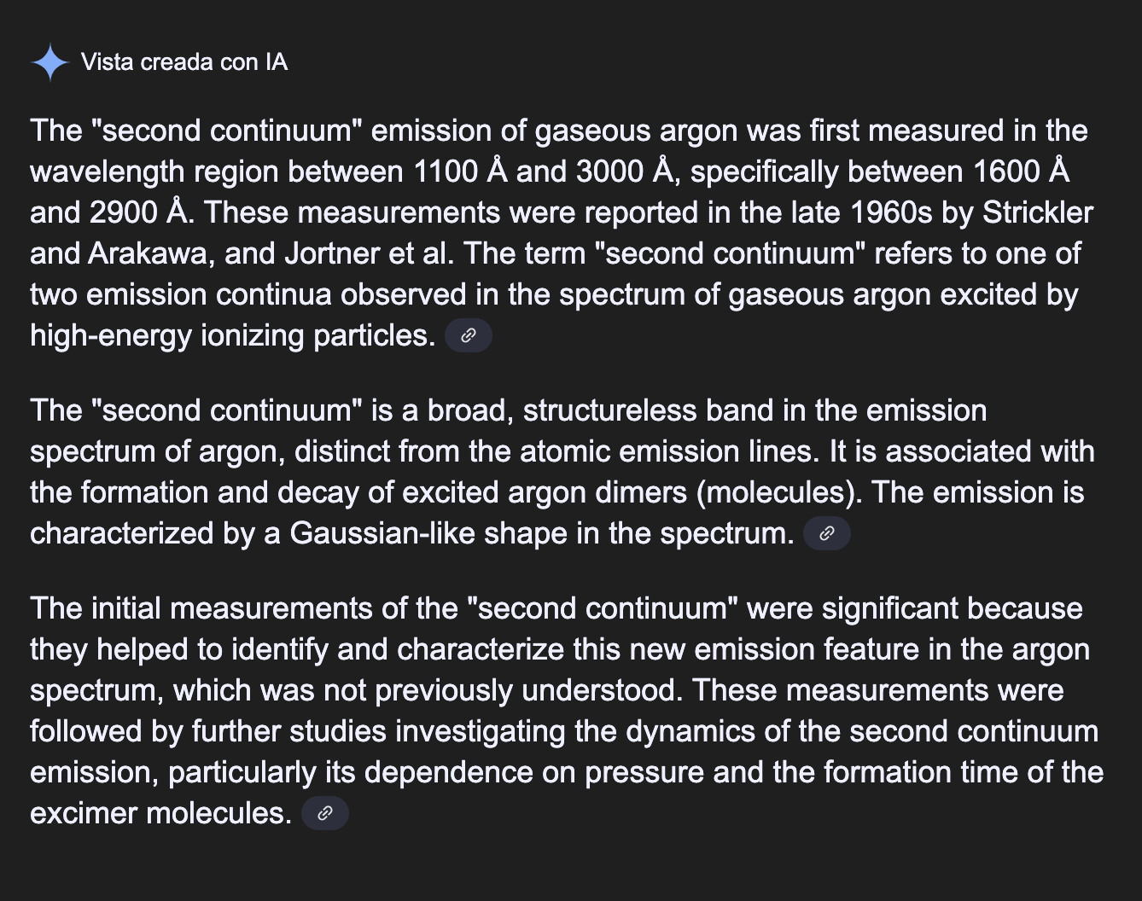
Excellent with the music… bad with the lyrics. The mentioned authors studied
the 3rd continuum indeed! (more later)

Slide 3
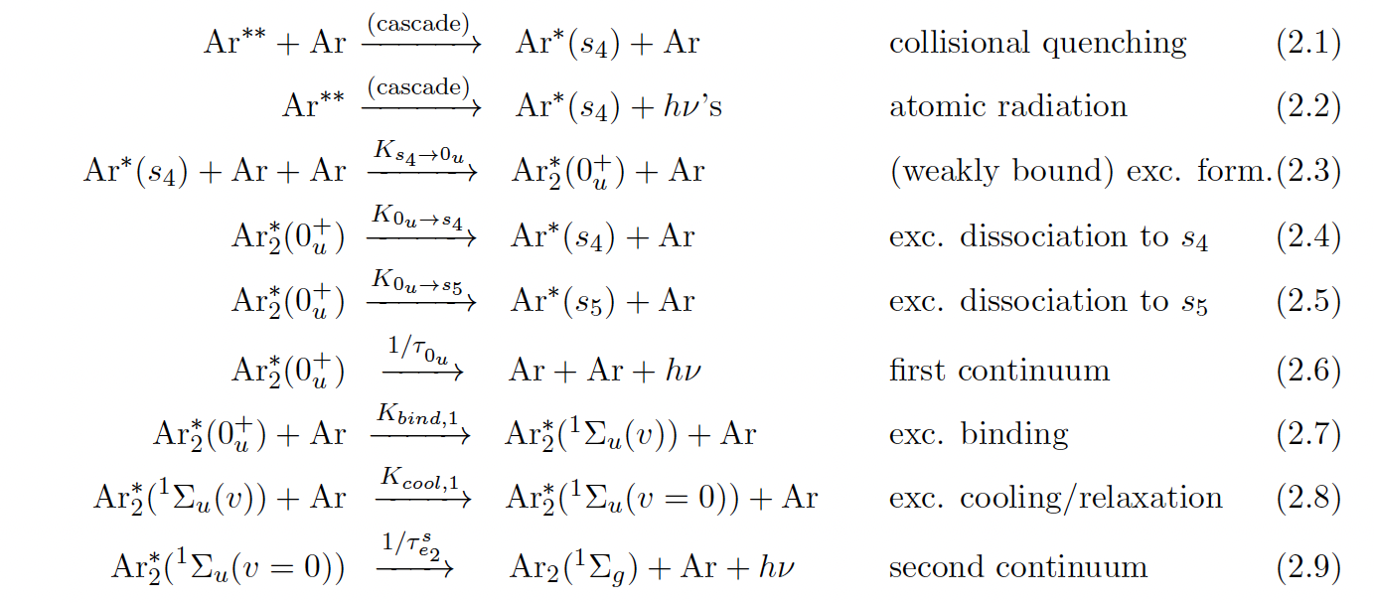
Microphysics leading to noble gas VUV scintillation
for the second excited state (s_{4,} ‘resonant’)
-
-
-> analogous for the first excited state (s₅, ‘metastable’)
R. Santorelli et al., Spectroscopic analysis of the gaseous argon scintillation with a wavelength sensitive particle detector, EPJC (2021)81:622
S. Leardini et al., Time and band-resolved scintillation in time projection chambers
based on gaseous xenon, EPJC (2022) 82:425

Slide 4
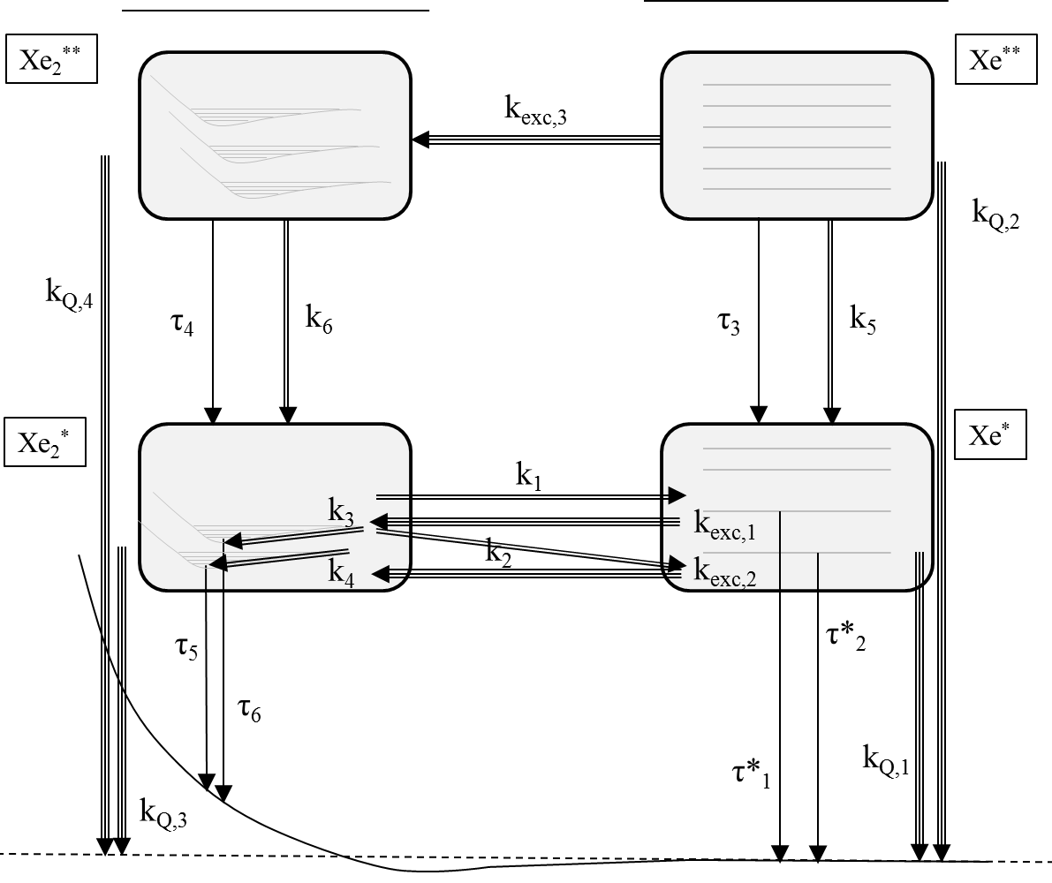
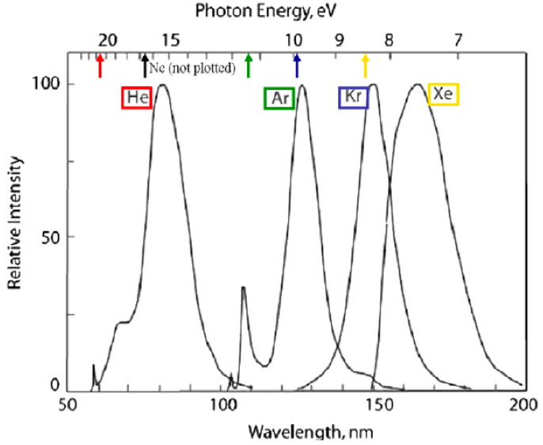
IP
C. D. R. Azevedo, Microscopic simulation of xenon-based optical TPCs in the presence of molecular additives, NIM A 877(2018)157
Other high-lying continua
(subdominant in regard to VUV)
Dominant above ~100mbar vs atomic emission / 1st continuum
why?
K₅ (self-quenching)
K₃, K₂ (excimer formation)
dominate over radiative processes
2nd continuum (170nm)
To first order, the mechanism is noble gas-independent (except for the energy-scale)
3body
2body
decay
a fairly universal footprint in noble gas –based detectors!

Slide 5
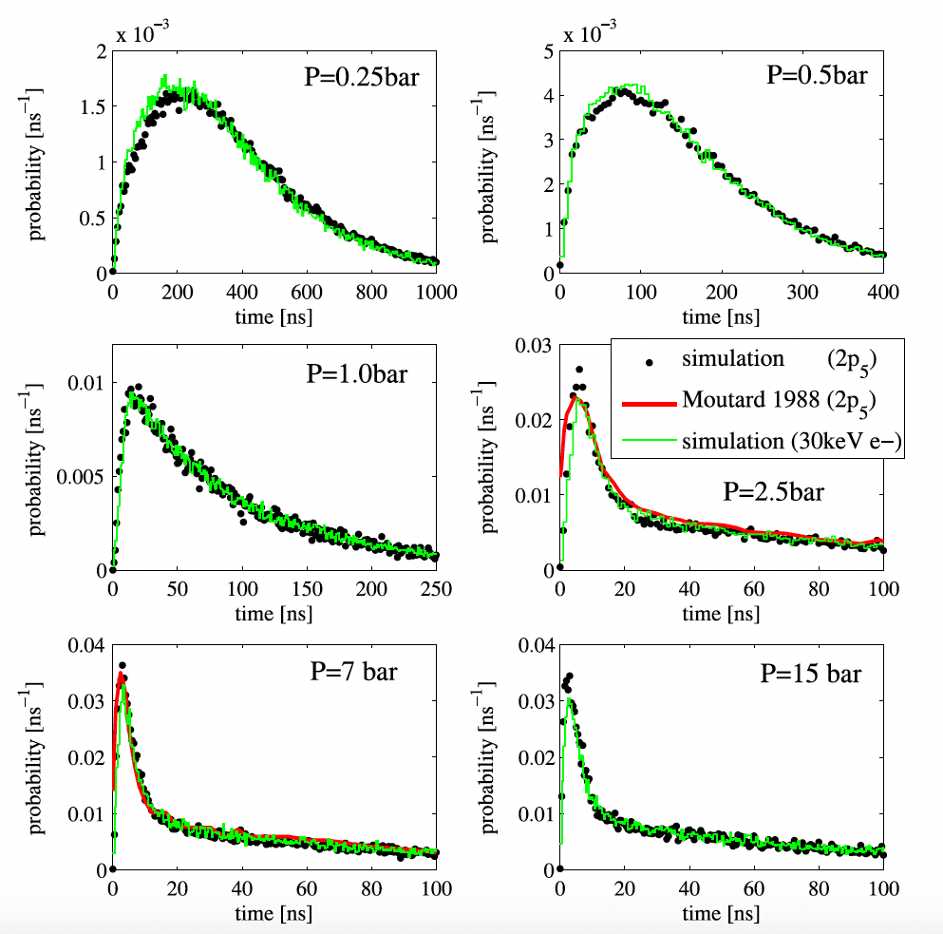
Fairly fast, at around atmospheric pressure (compared to avalanche dynamics)
C. D. R. Azevedo, Microscopic simulation of xenon-based optical TPCs in the presence of molecular additives, NIM A 877(2018)157
~10%
𝛕_{s} = 4.5ns
𝛕_{t} = 100 ns
~90%
resonant Xe* state
(associated with Xe₂* singlet)
metastable Xe* state
(associated with Xe₂* triplet)
(scintillation time constants vary from noble gas to noble gas: 𝛕_{t} = 3.2us in argon!)

Slide 6
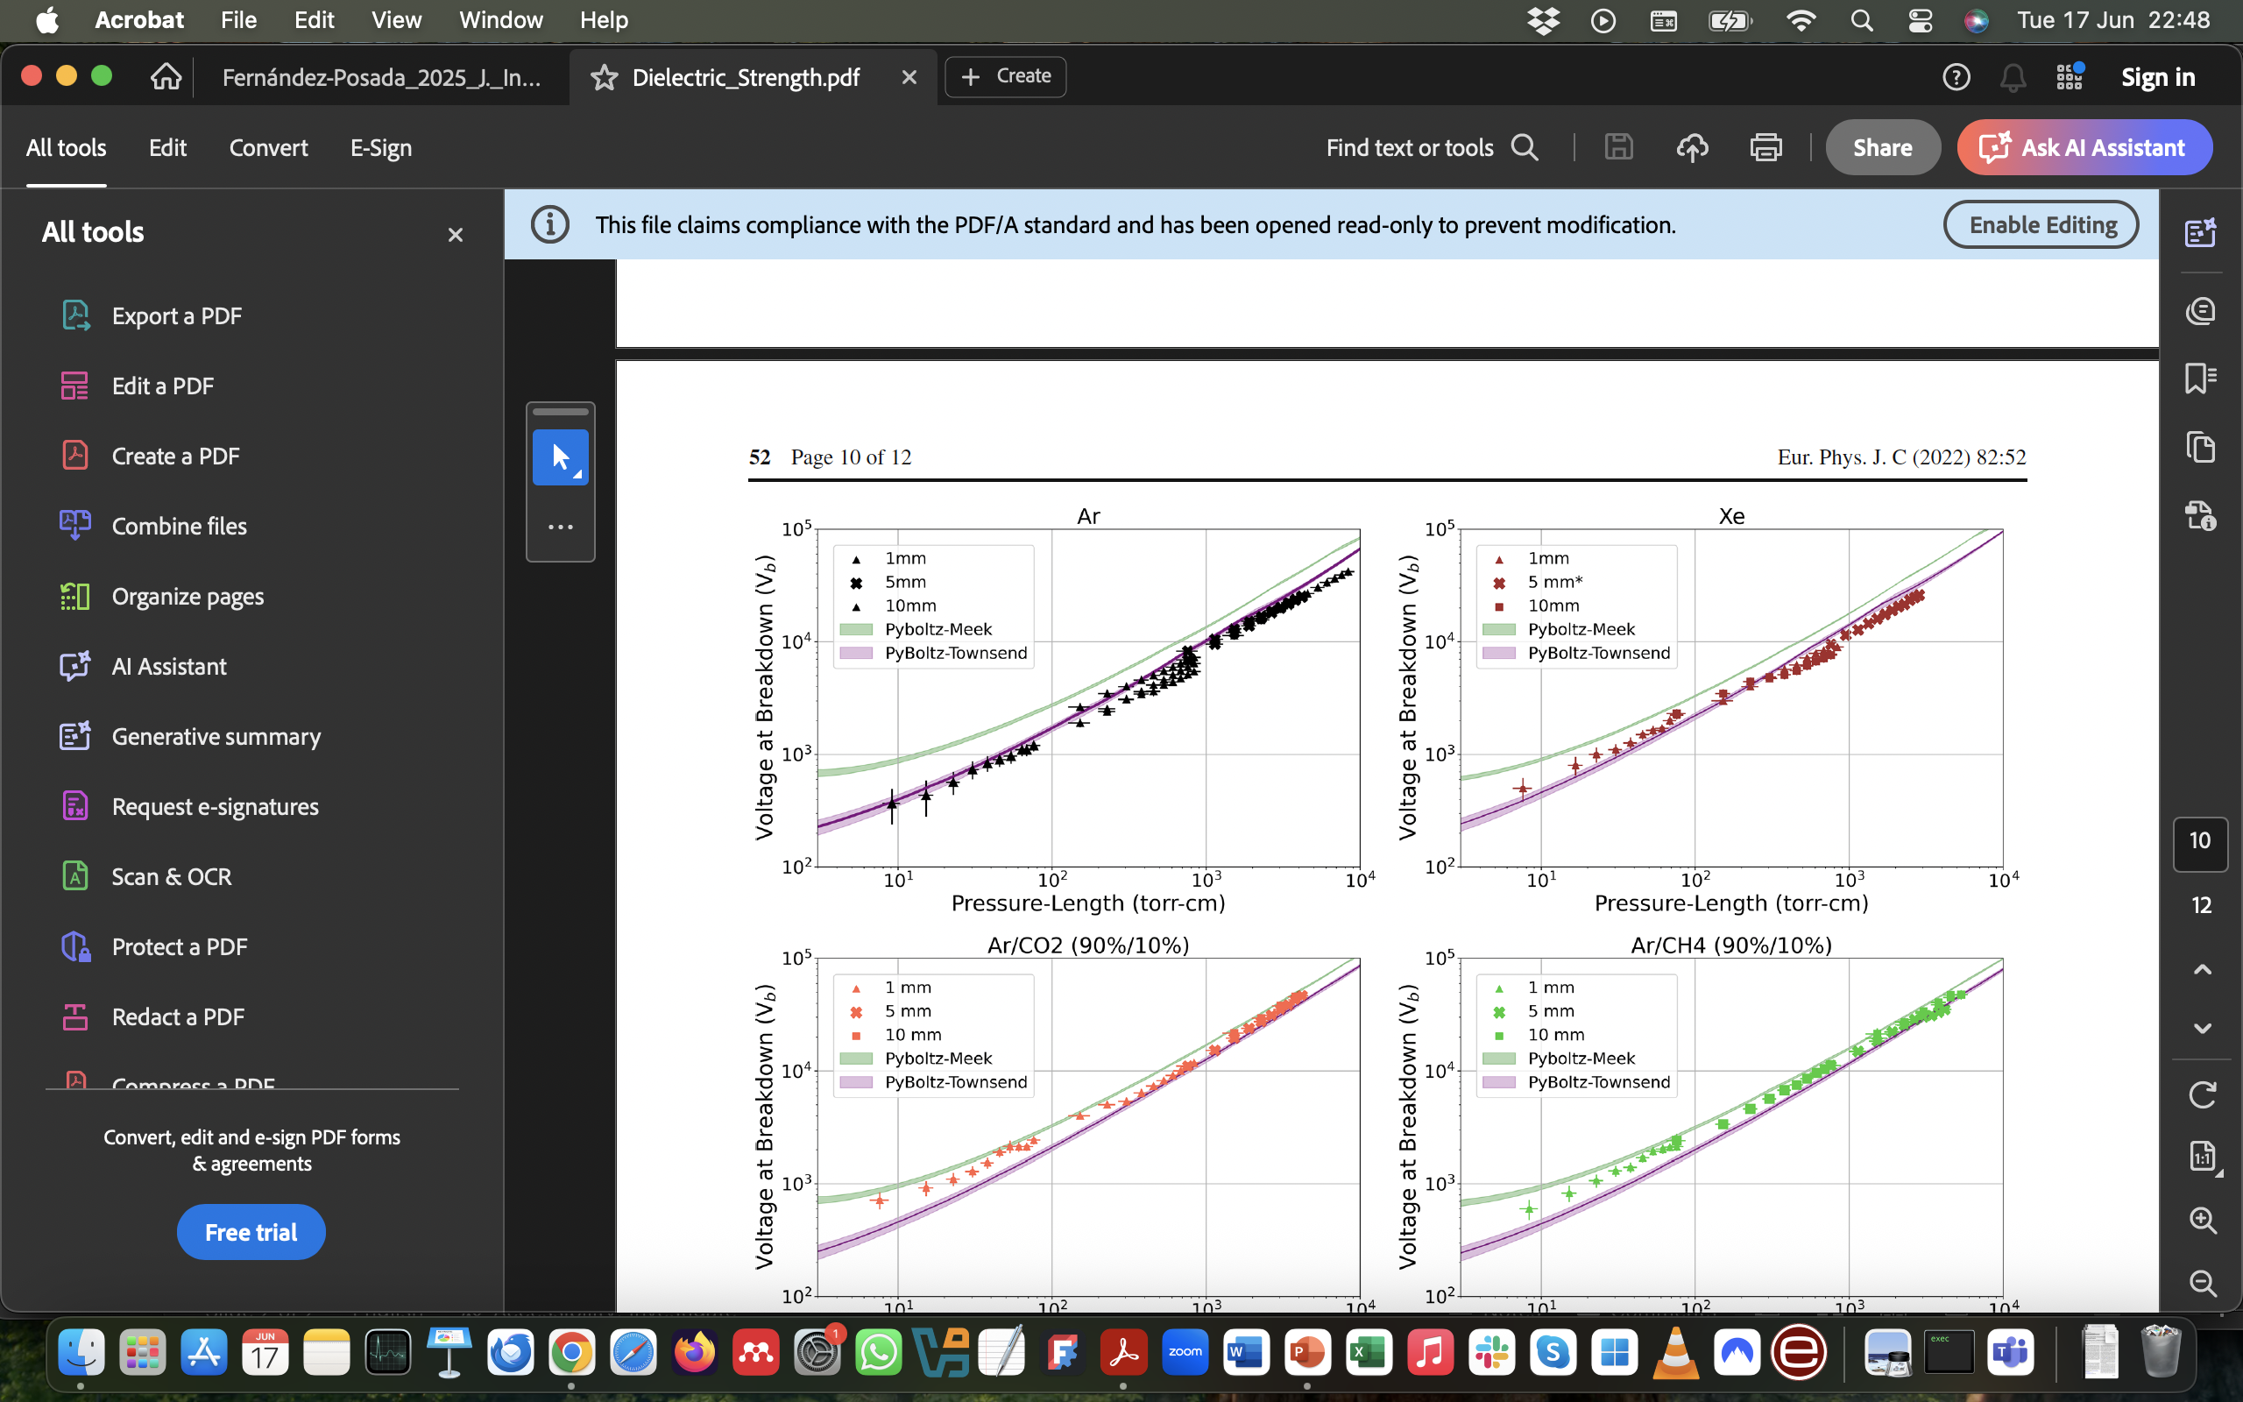
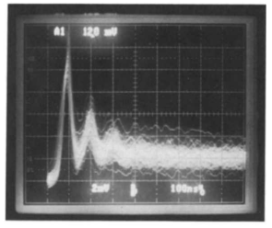
Why VUV is bad for detectors? (text-book reminder)
(2nd continua)
argon
Townsend (‘slow’)
mechanism
xenon
Ar-CH₄ (1%)
gap/v_{d}
badly quenched gas
-
+
L. Norman, et al., Dielectric strength of noble and quenched gases for high pressure time projection chambers, EPJC 2022 82:52
P. Fonte, et al, Feedback and breakdown in parallel plate chambers, NIMA305(1991), also at Fonte’s PhD

Slide 7
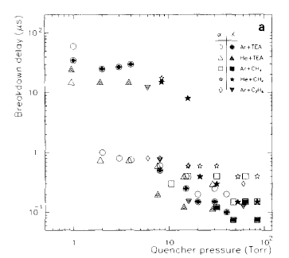
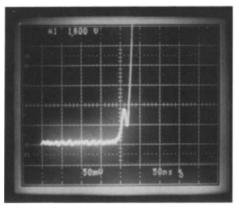
Molecular additives to the rescue!
P. Fonte, et al, Feedback and breakdown in parallel plate chambers, NIMA305(1991), also at Fonte’s PhD
Townsend breakdown
for ~1-3 % (at 1bar), Townsend breakdown suppressed!
Raether/Meek breakdown
(‘streamer mechanism’)
We say, the gas is ‘quenched’, but ‘how much’ quenched indeed?

Slide 8
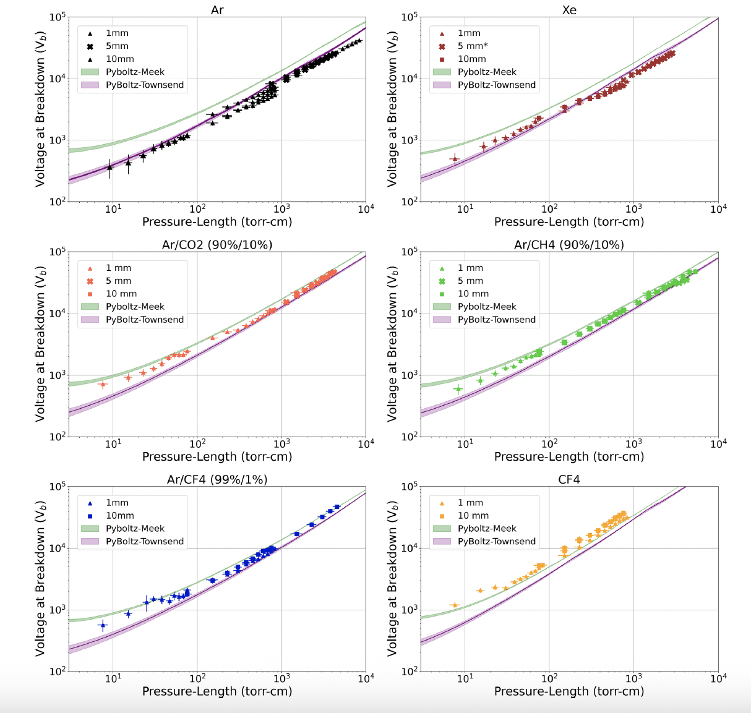
Another way to look at the transition between the two breakdown mechanisms
argon
xenon
L. Norman, et al., Dielectric strength of noble and quenched gases for high pressure time projection chambers, EPJC 2022 82:52
Townsend
unquenched
Raether-Meek
quenched
Raether-Meek mechanism tells us that Space-Charge
plays a key role, but it does not say what causes inception:
(VUV photons?, electron back-difusion?, other?)
Raether-Meek

Slide 9
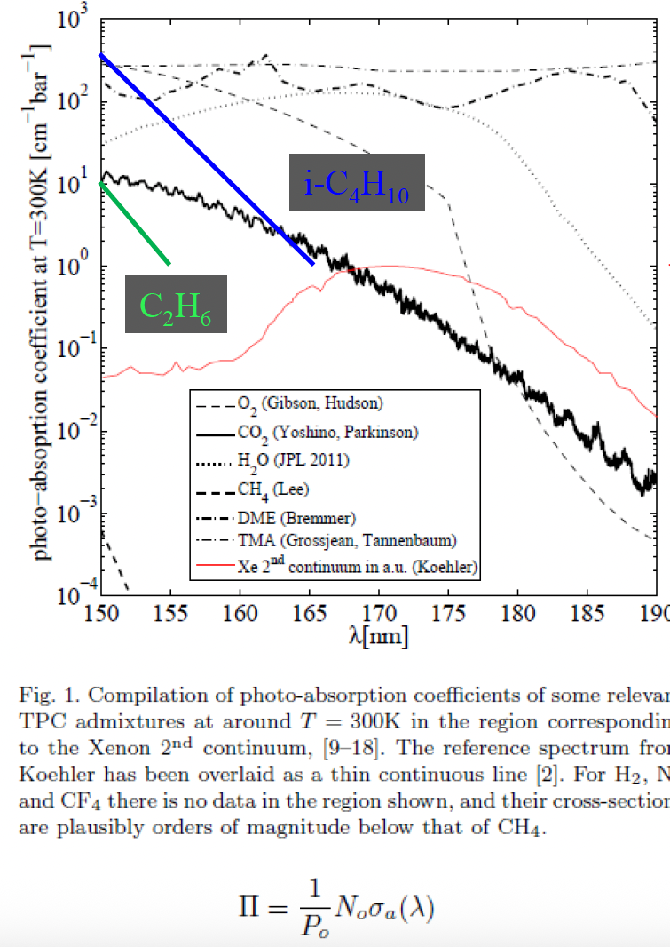

The increase in breakdown voltage as well as the change of mechanism (slow to fast), provides strong evidence that the addition of a molecular species prevents VUV photons from reaching the cathode.
How?
VUV absorption
VUV quenching
IP
2nd continuum (170nm)
(example)
K_{Q}
Ar* + CF₄ -> Ar + F + CF₃*
P_{scin} ~ 1/𝛕 · (1/𝛕 + K_{Q})

Slide 10
A good starting point
VUV-quenching of noble gases
J. E. Velazco, J. H. Colts, D. W. Setser, Rate constants and quenching mechanisms for the metastable states of argon, krypton, and xenon, J. Chem. Phys. 69(10) 1978
(+ references to and from)
VUV-absorption of noble gases
The MPI-Mainz UV/VIS Spectral Atlas of Gaseous Molecules of Atmospheric Interest:
https://www.uv-vis-spectral-atlas-mainz.org/uvvis/
(+ references within)

Slide 11
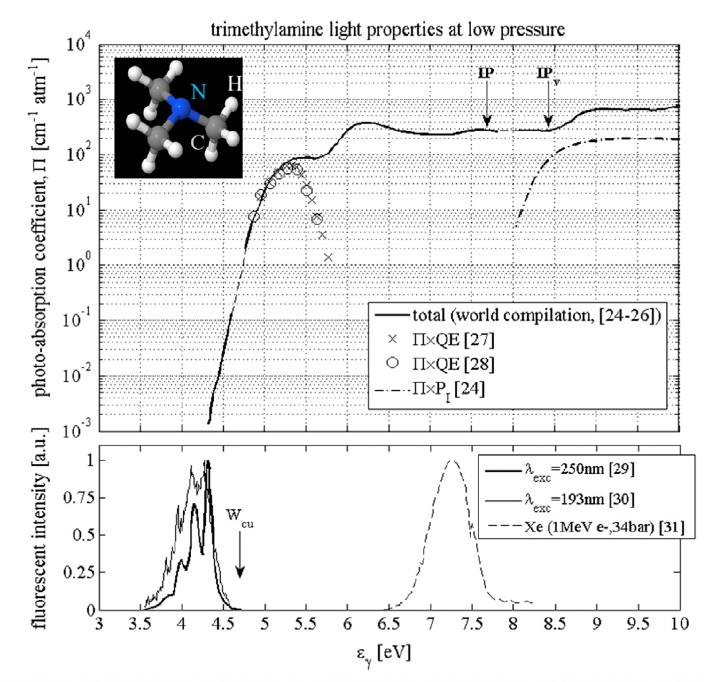
Photoabsorption vs quenching (I)
example (trimethylamine)
absorption
dissociation
Quenching prevents scintillation
Photoabsorption ‘removes’ the photon after emission (at a certain distance from the production point)
gas excitation
gas ionization
can cause streamer inception through short-range gas-photoionization, and/or may cause non-exponential avalanche response (geometry and gas-dependent)
Xe
Ar
P. Fonte, A model of breakdown in parallel-plate detectors, IEEE Trans. Nuc. Sci. 43, 3(1996)

Slide 12
Photoabsorption vs quenching (II)
Is there a clean way to decouple photo-absorption from quenching in a wavelength and time -resolved manner?. There is:
Perform measurements in avalanche conditions at varying pressure and quencher concentration with a VUV transparent anode (monochromator and PMs + filters).
Modelling!.
most parameters are a priori well known… but devil is in the details
New scintillation mechanisms might open at high gains (light from charge-recombination, high-lying states, molecular fragments).
Streamer simulations are computationally demanding (hopefully implemented soon in Garfield++).
More systematic breakdown measurements are needed, specially changing gas conditions (e.g., Xe is a priori immune to gas photoionization for most common additives).
in the meantime…

Slide 13
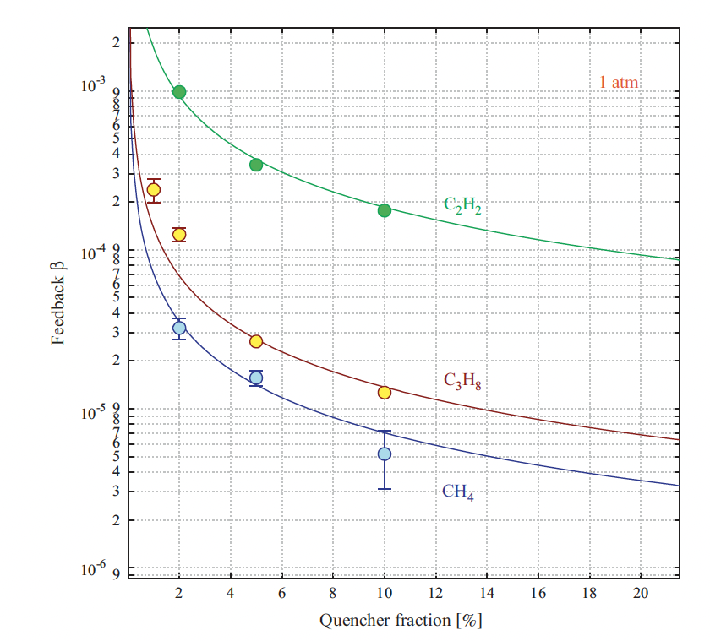
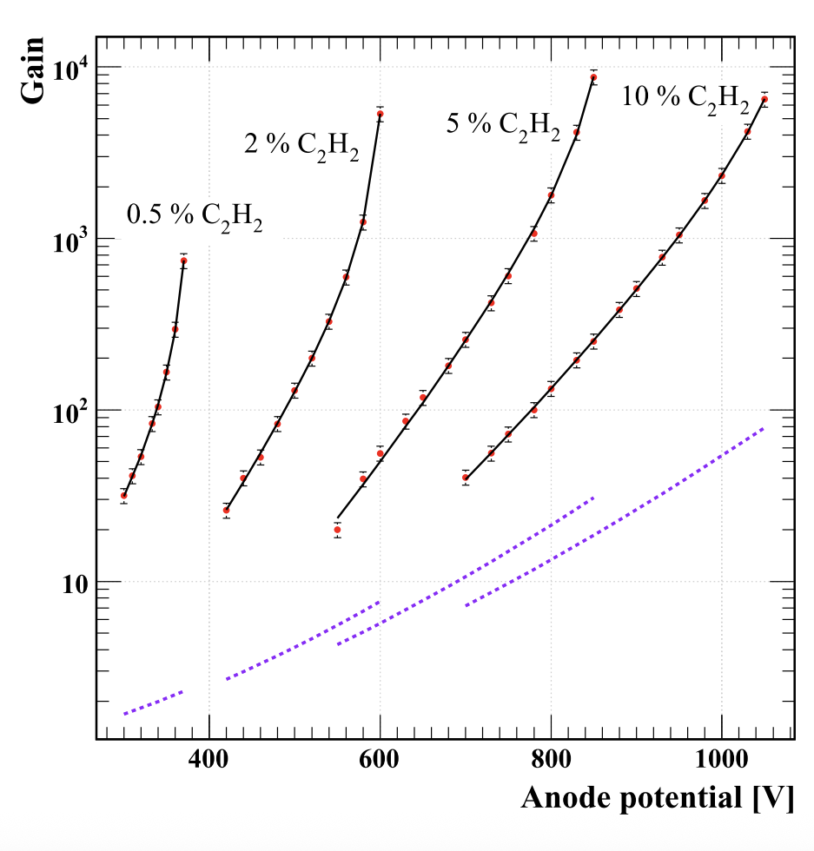
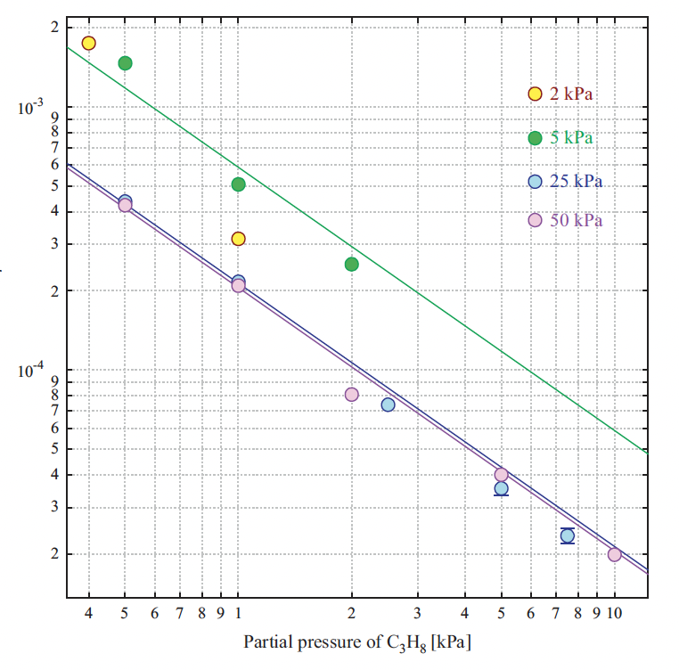
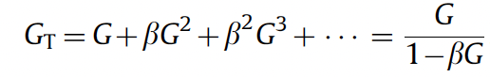
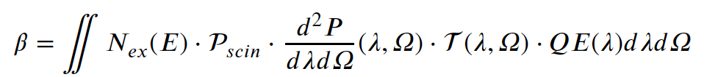
Photoabsorption vs quenching (III)
Indirect evidence of gas photoionization in Ar mixtures for open geometries (single wire)
*mean free path <100um
𝛃-factor (feedback)
Increased absorption does not increase stability
Increased quenching does!
~1/f
P_{scin} ~ 1/𝛕 · (1/𝛕 + K_{Q})
~ 1/(f·P)
Penning
simulations
C. D. R. Azevedo, Microscopic simulation of xenon-based optical TPCs in the presence of molecular additives, NIM A 877(2018)157
~1/(f·P)
O. Sahin et al., Secondary avalanches in gas mixtures NIM A, 718(2013)432
(just two pages!)
C₃H₈

Slide 14
Photoabsorption vs quenching (IV)
completing the picture…
for ~1-3 % (at 1bar), Townsend breakdown suppressed!
Increased VUV quenching will stabilize streamer mechanism and feedback processes (depending on the geometry)

Slide 15
(some) direct measurements

Slide 16
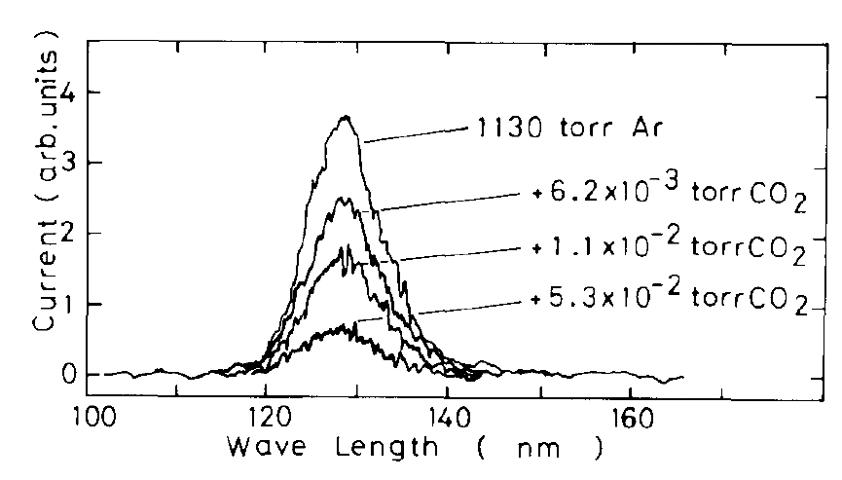
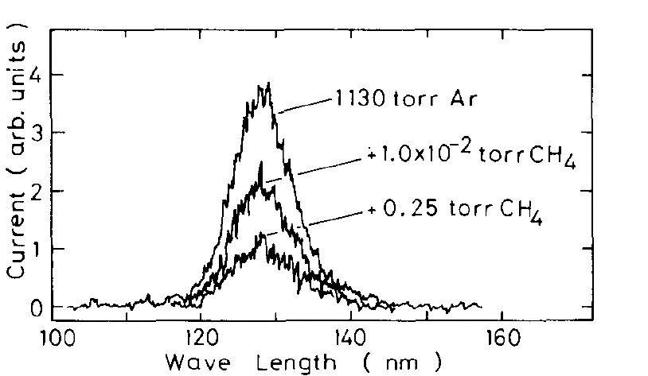
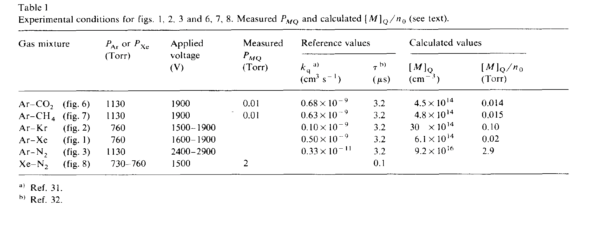
VUV quenching in gaseous detectors (argon)
(electroluminescence conditions)
Compatible with dominance of quenching for very low concentrations:
P_{scin} ~ 1/𝛕 · (1/𝛕 + K_{Q}) ~1/f
T. Takahashi et al, Emission spectra from Ar-Xe, Ar-Kr, Ar-N₂, Ar-CH₄, Ar-CO₂ and Xe-N₂ gas scintillation proportional counters, NIMA 205(1983)591

Slide 17
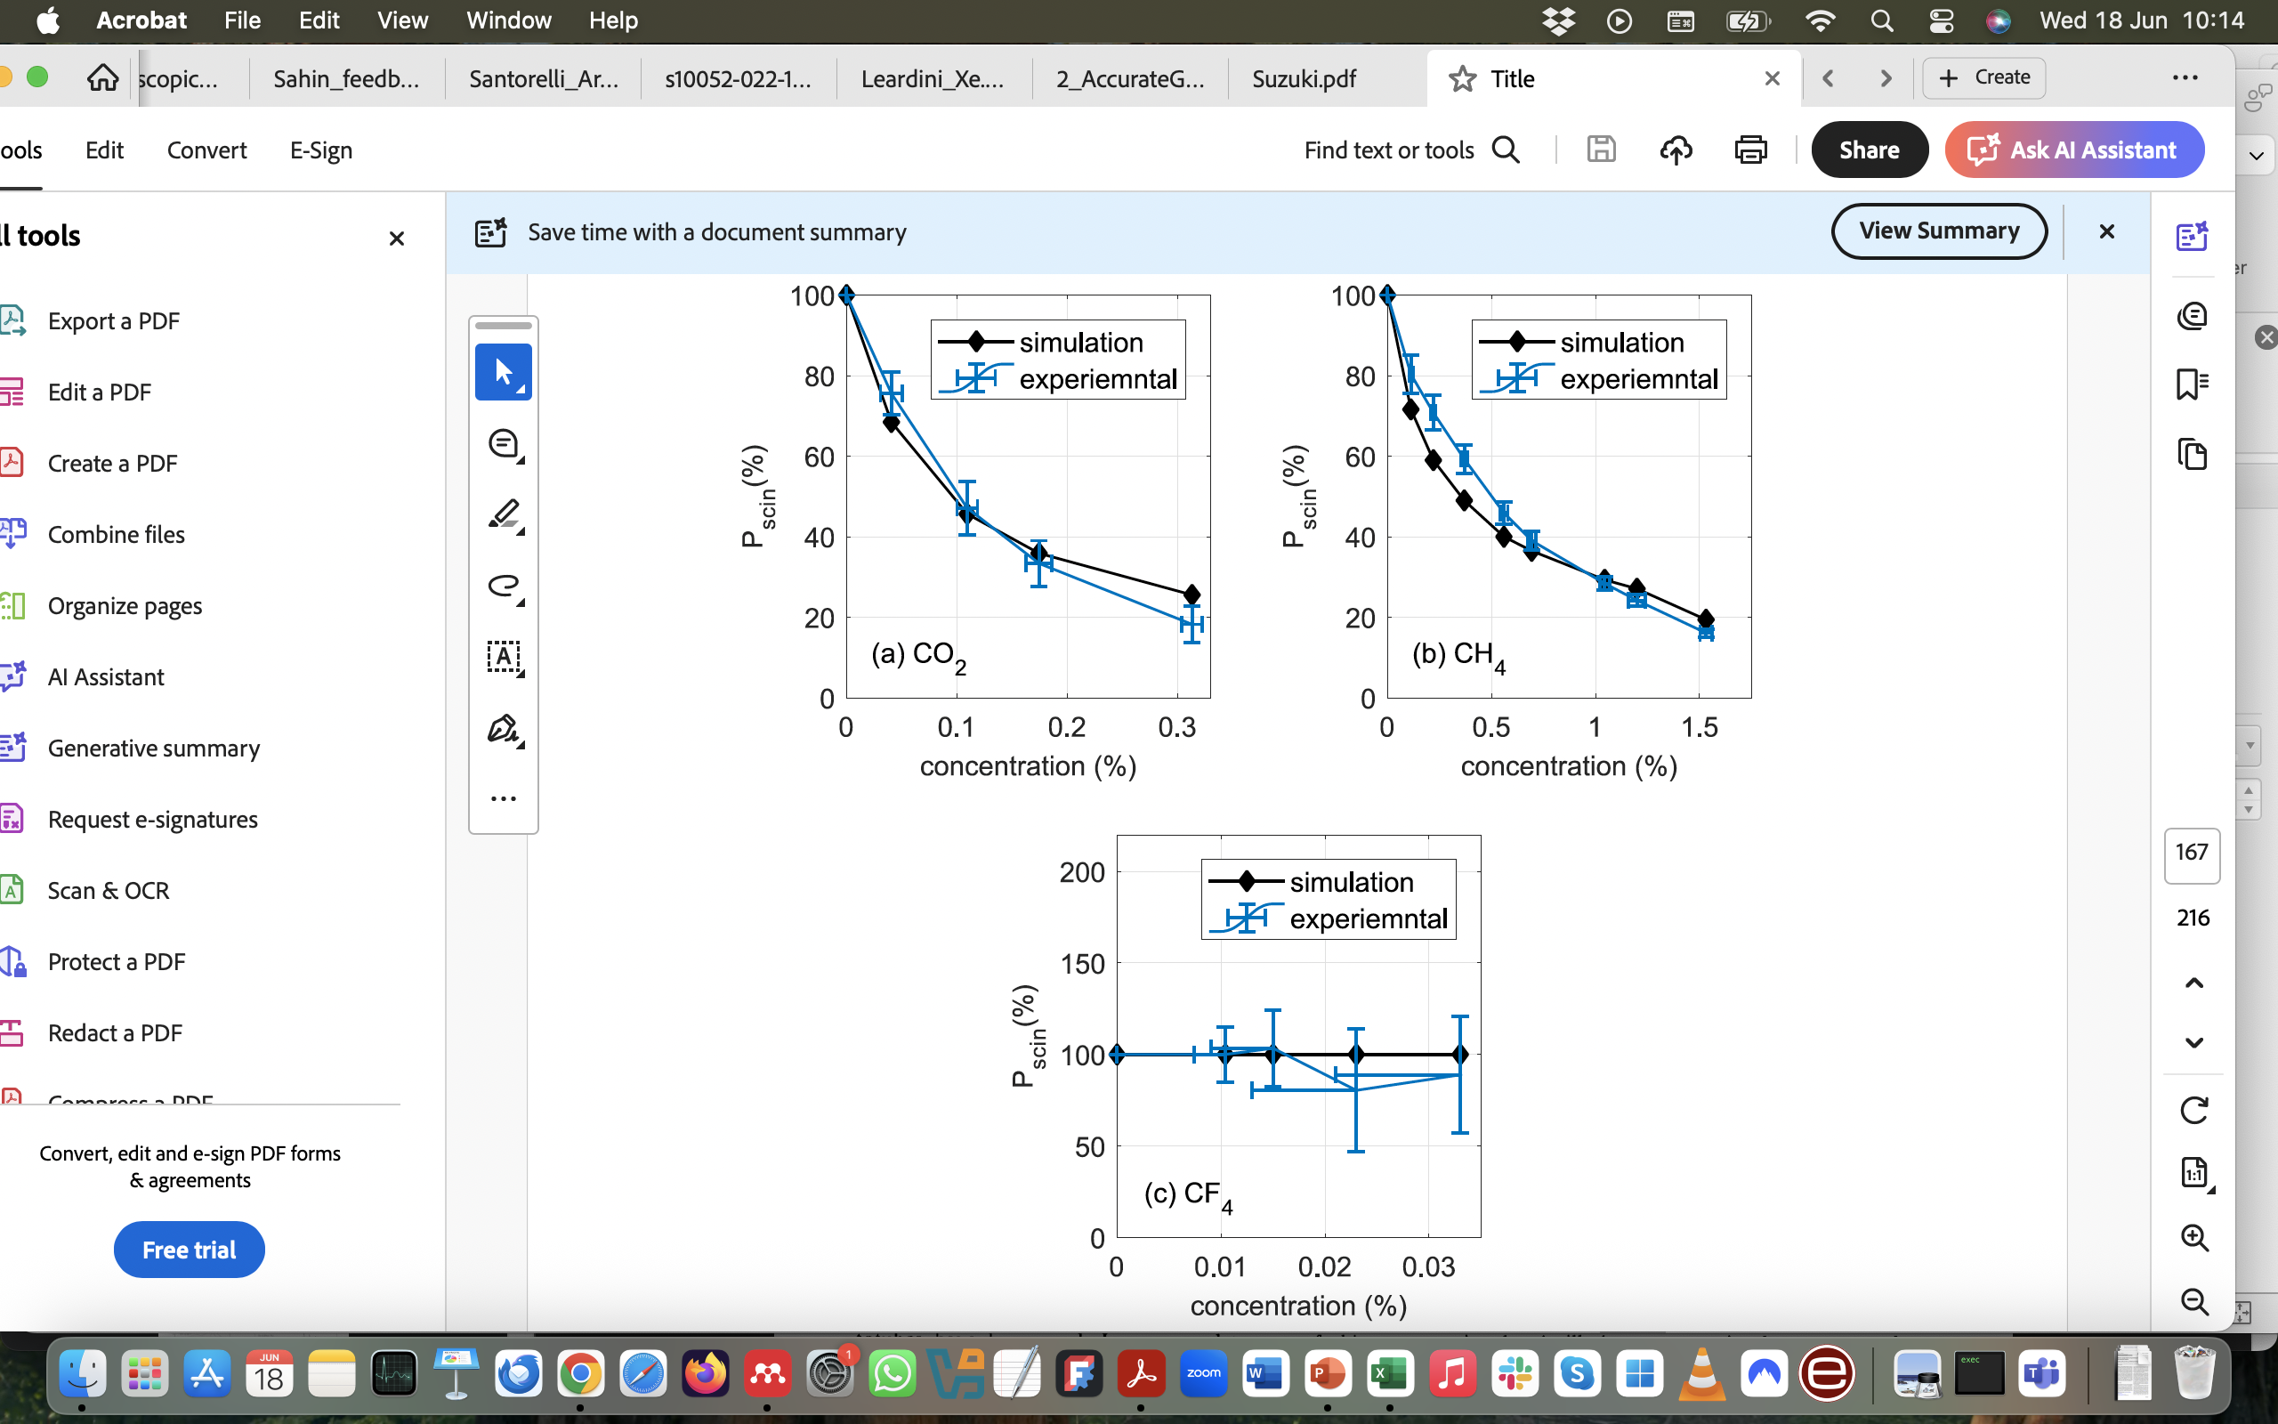
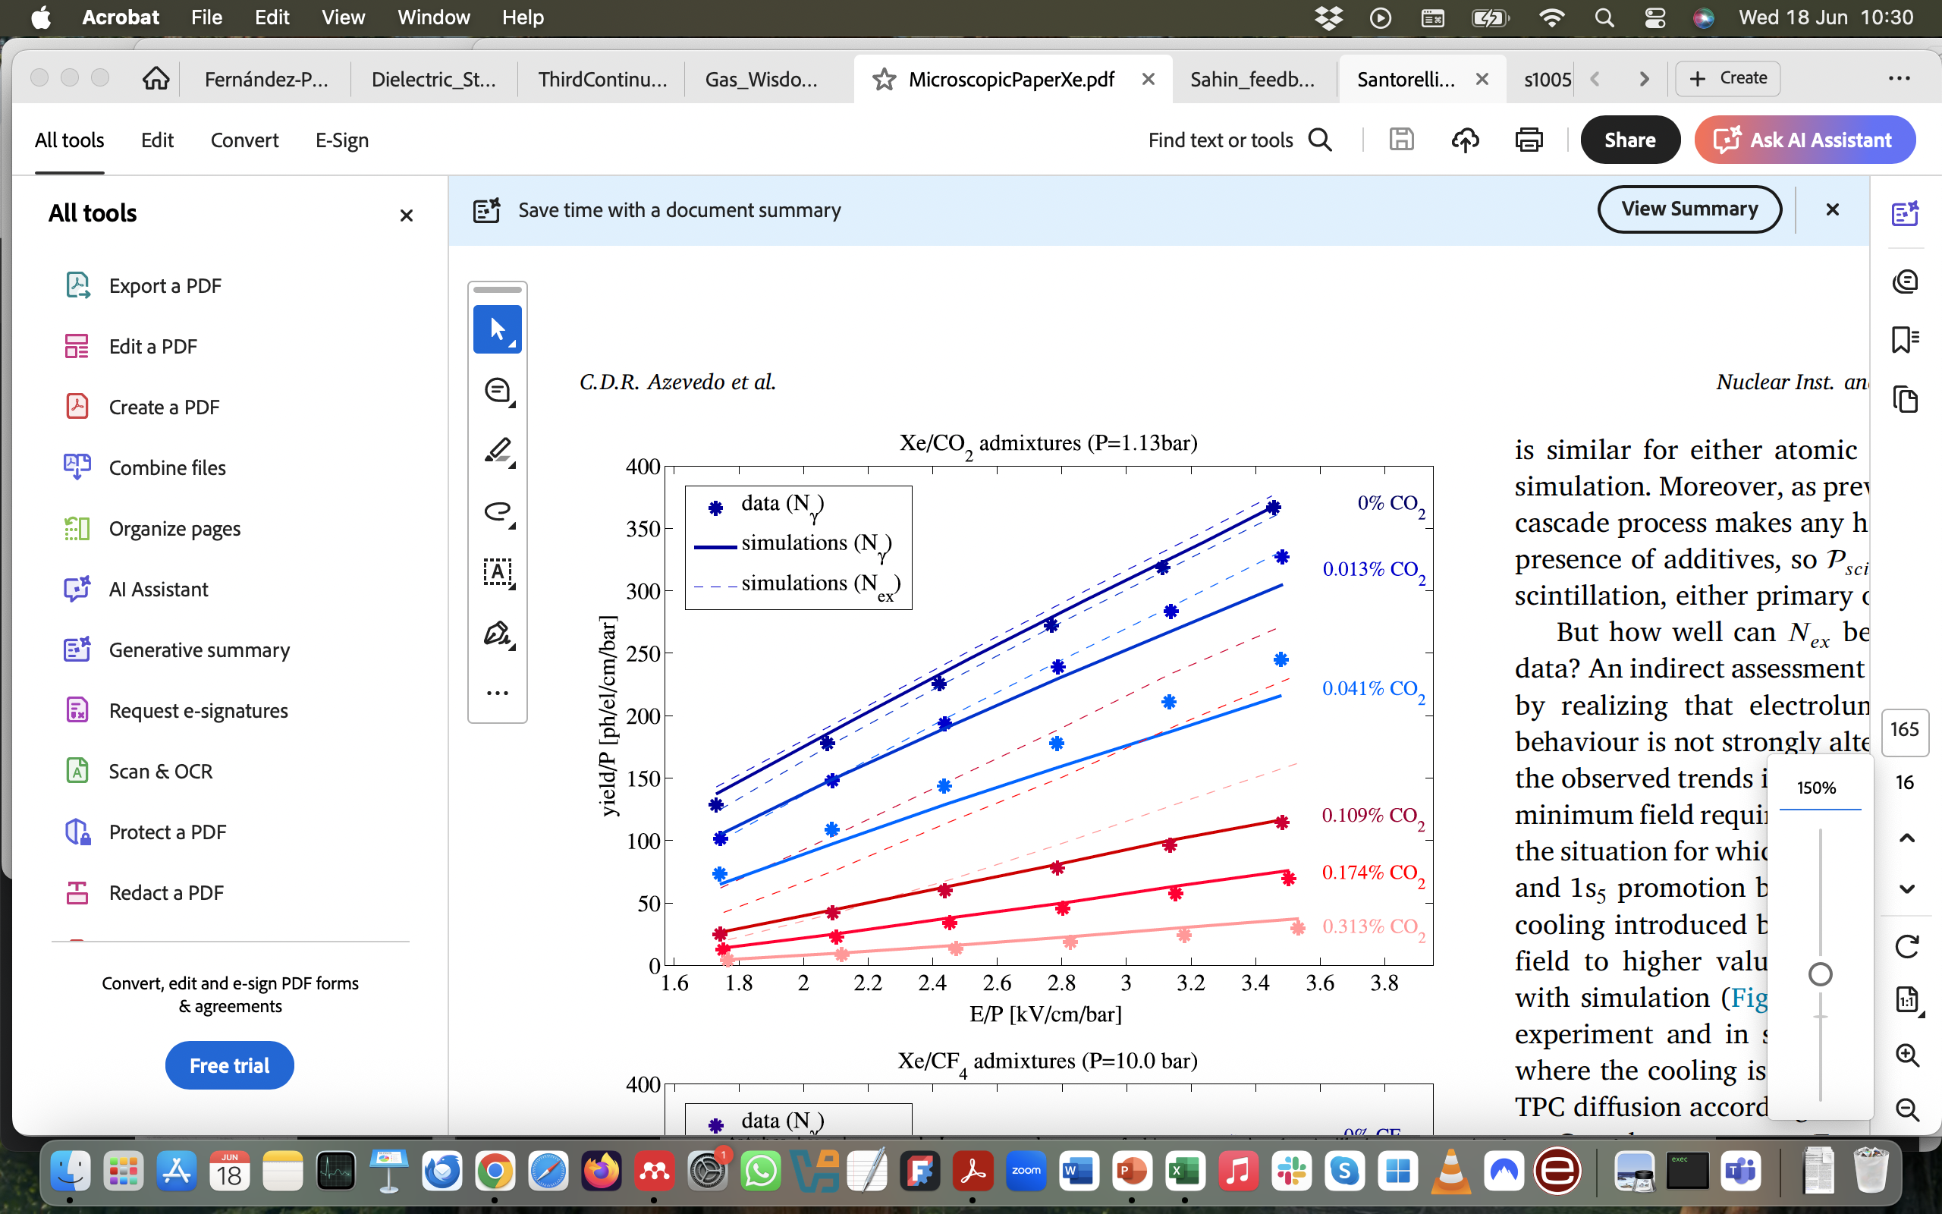
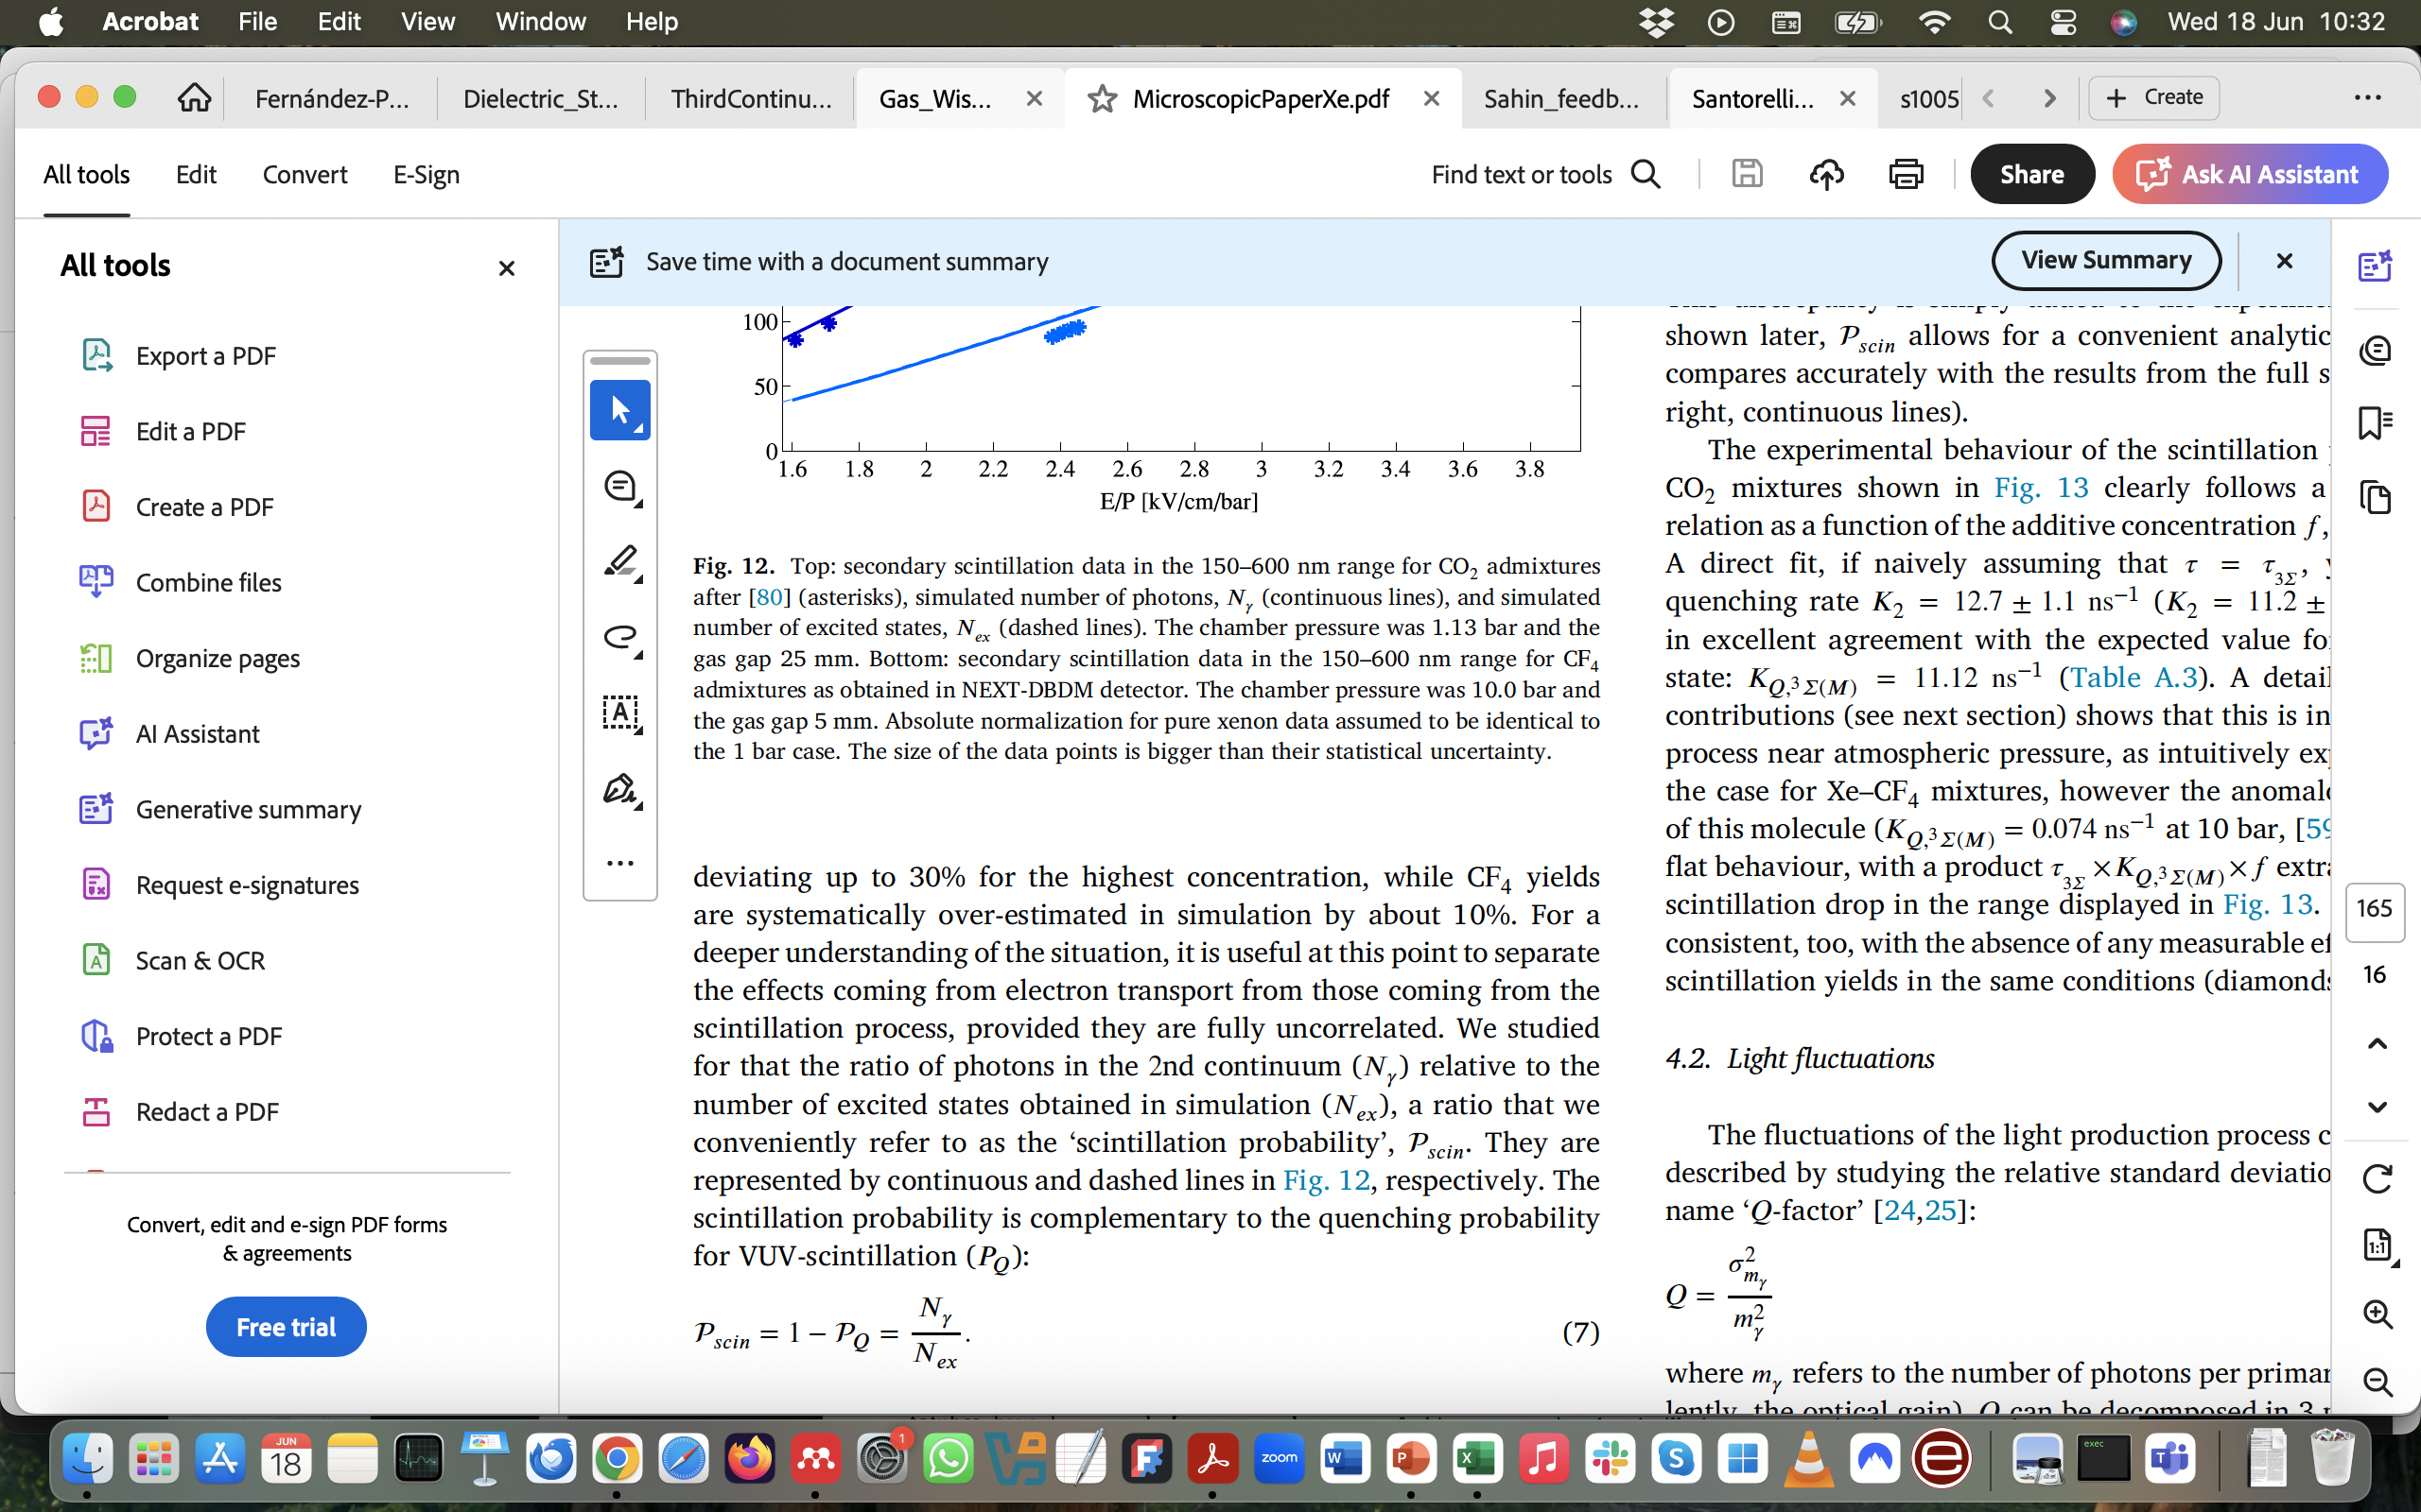
VUV quenching in gaseous detectors (xenon)
(electroluminescence conditions)
C. A. O. Henriques, Studies of xenon mixtures with molecular additives for the NEXT electroluminescent TPC, PhD thesis, Dec 2018
Compatible with dominance of quenching:
P_{scin} ~ 1/𝛕 · (1/𝛕 + K_{Q}) ~1/f

Slide 18
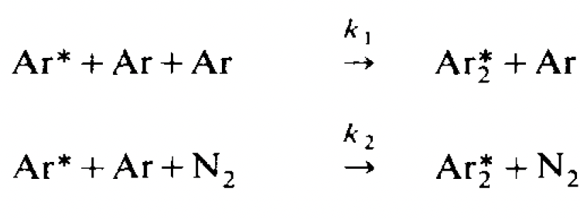
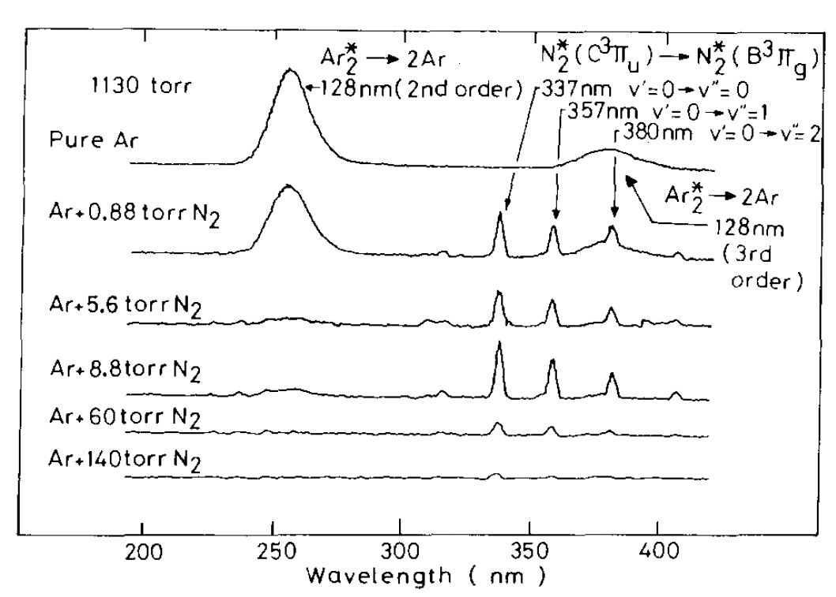
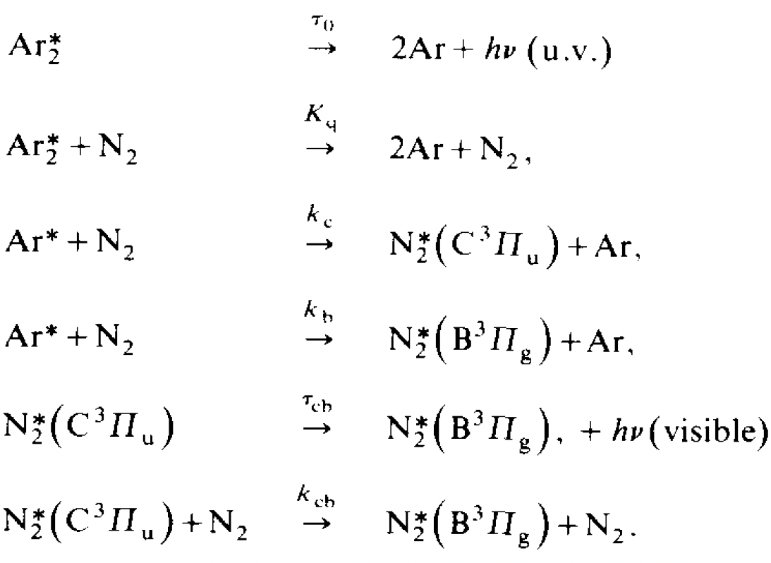
The golden VUV quenching channel (gaseous wavelength-shifting)
Argon-Nitrogen
no quantitative results on the wavelength-shifting efficiency (needs electron transport)

Slide 19
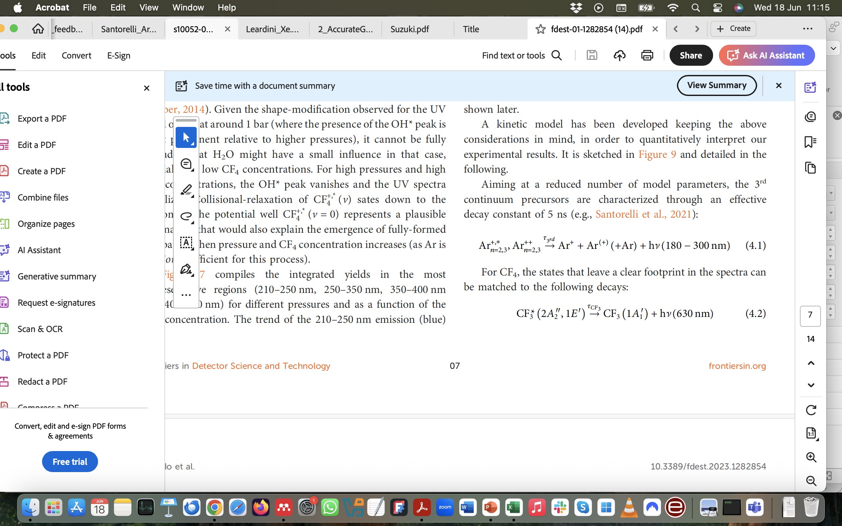
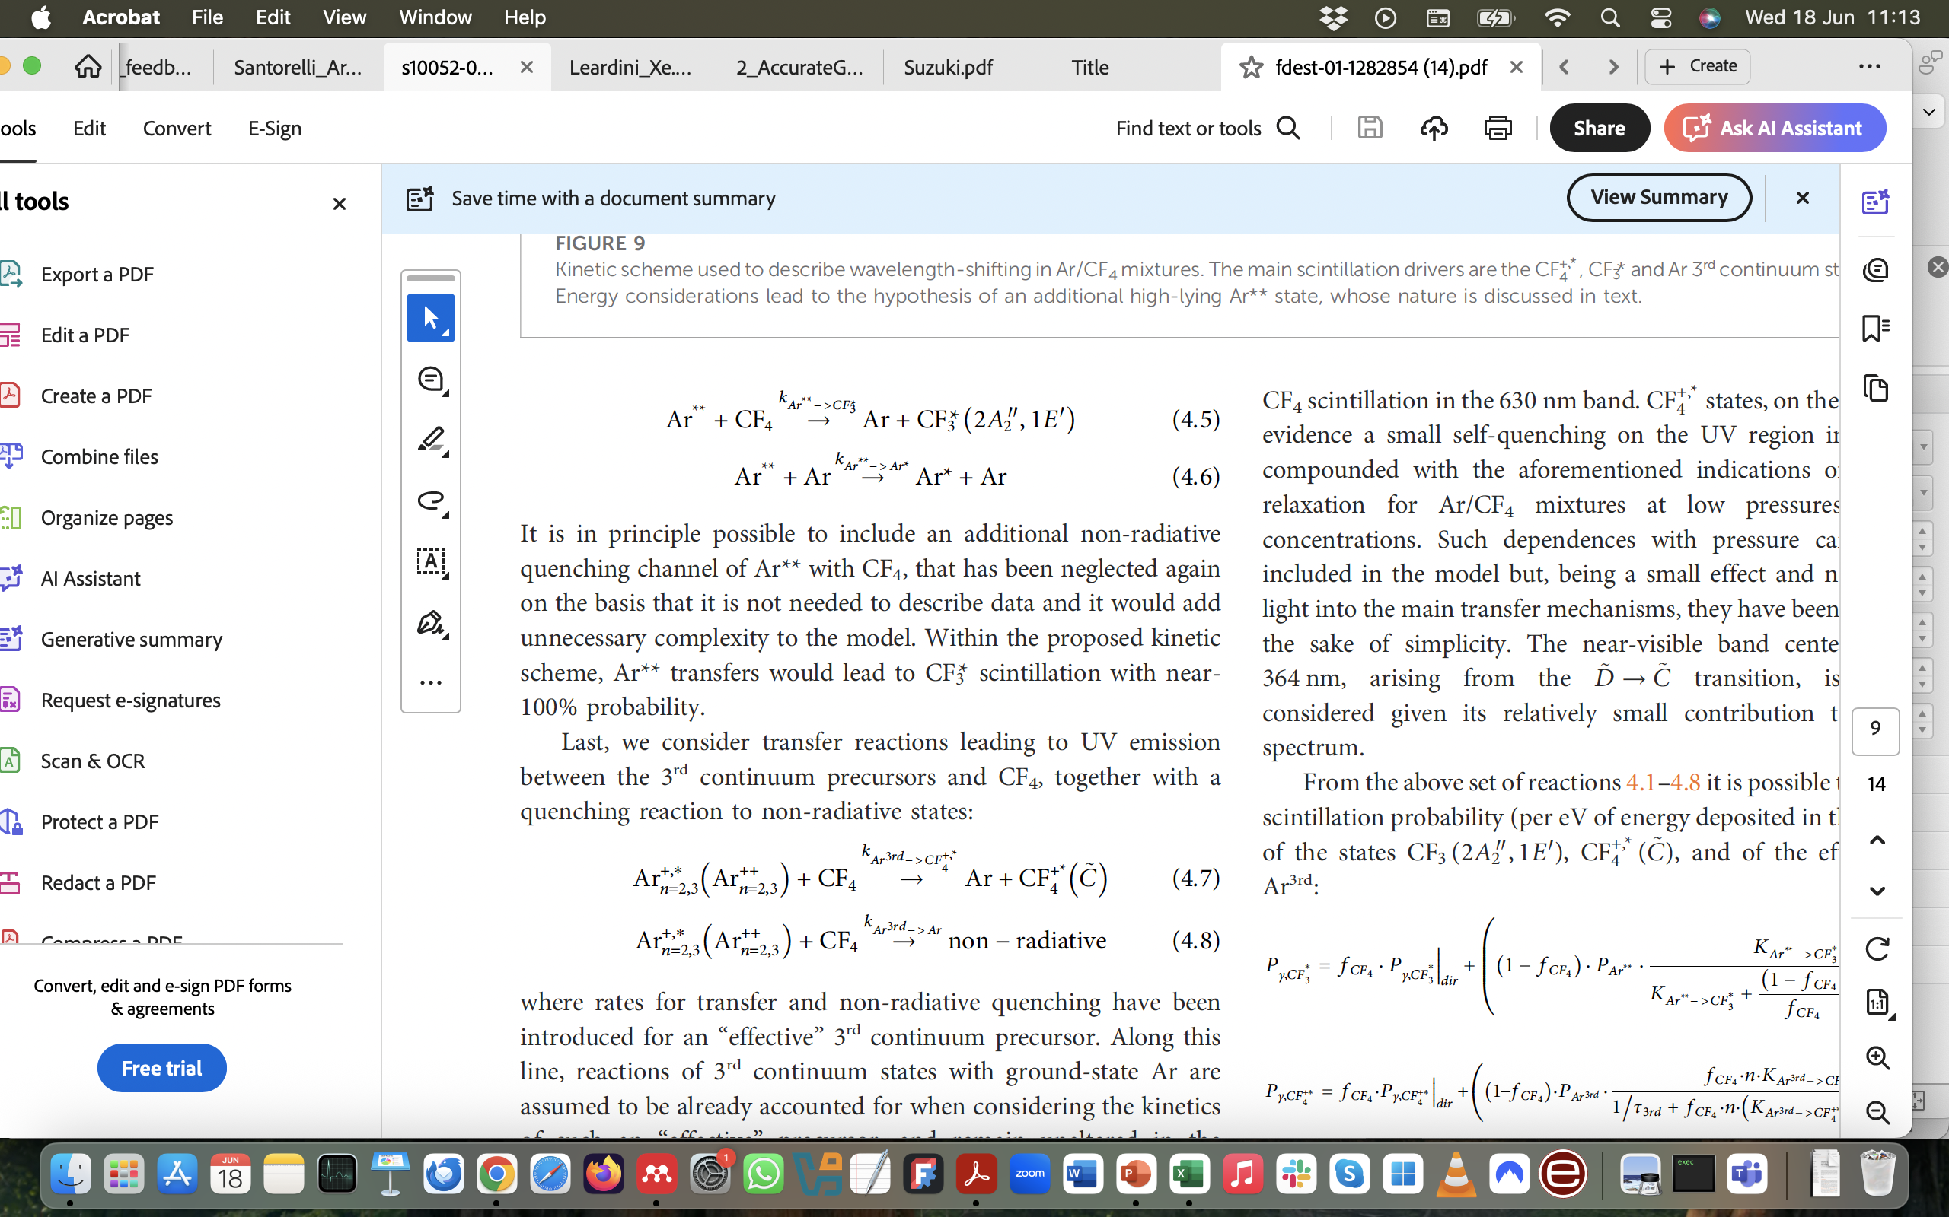
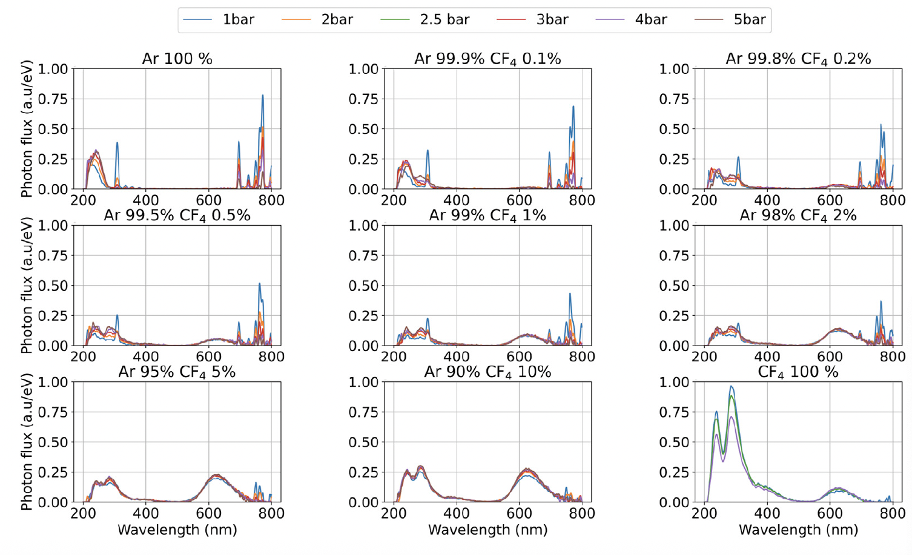
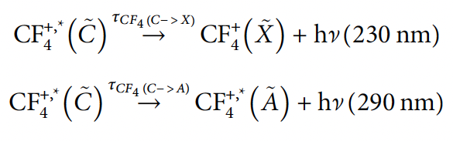
The golden VUV quenching channel (gaseous wavelength-shifting)
Argon-CF₄
UV band
visible band
P. Amedo et al., Observation of strong wavelength-shifting in the argon-tetrafluoromethane system, Front. Detect. Sci. Technol 1:1282854 (2024)

Slide 20
Conclusions
Best understanding of the scintillation in gaseous detectors has been obtained from studies in electroluminescence mode as well as from primary scintillation. Breaking with the past: first-principle microscopic simulations are nowadays possible!
Systematic studies of VUV emission in avalanche conditions are very scarce (I am not aware of any systematic work after:
but scattered results exist).
The fundamental microphysics wisdom exists, but it is not included in gaseous detector simulators such as Garfield++ yet, and must be included through external programs (e.g.: excimer formation, quenching, wavelength-shifting, photoionization/absorption in gas, streamer dynamics).
Systematic experimental data on breakdown with control on gas purity, and different geometries, quencher concentrations and pressures, ideally in the same setup, would help at completing the existing body of information (Gasik, Procureur, others….) and addressing the role of VUV photons in streamer inception.
Gaseous wavelength-shifting efficiency. Of great practical importance!… requires detailed microscopic modelling.
P. Fonte, et al, Feedback and breakdown in parallel plate chambers, NIMA305(1991), also at Fonte’s PhD

Slide 21

Bonus
Ar* + CF₄ -> Ar* + F + CF₃*
Courtesy of Jesús González-Vázquez (Universidad Autónoma de Madrid)

