Slide 1
Open discussion on strategies for choosing alternative gasses - Part 1
Marcello Abbrescia

Slide 2
Strategy used to replace TFE
Just choose the molecule most similar to TFE –commercially avaialble- characterized by a low GWP → HFO
Add to it CO2 to move the operating voltage in the range of the HV systems of the present LHC experiments
How modelling and simulation can help us to understand the properties of HFO?
How modelling and simulation can help us to look for additional eco-friendly alternatives to TFE?
Of course the problem is not limited to TFE → see talk by Djunes

Slide 3
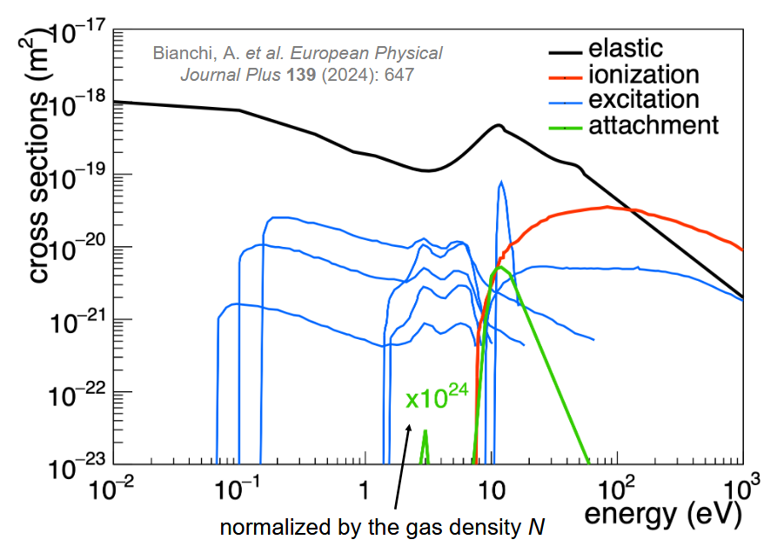
MATOQ by A. Bianchi
A custom made software to unfold from the electron swarm parameters available in literature a set of electron cross sections
Iterative approach to optimize the results obtained
Comparison with experimental results
Latest presentation at RPC2024: https://indico.global/event/6191/contributions/51227/attachments/25770/44473/RPC2024_AntonioBianchi.pdf

Slide 4
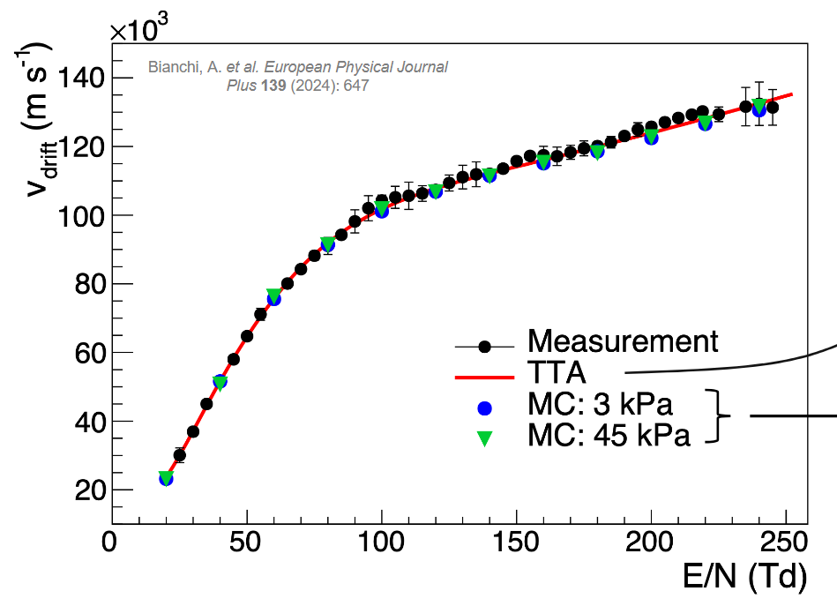
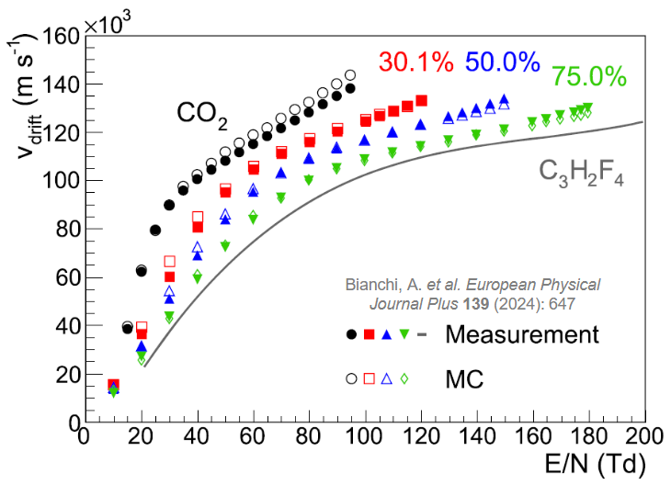
Drift velocity in MATOQ by A. Bianchi
Pure HFO
Mixtures of HFO and CO2

Slide 5
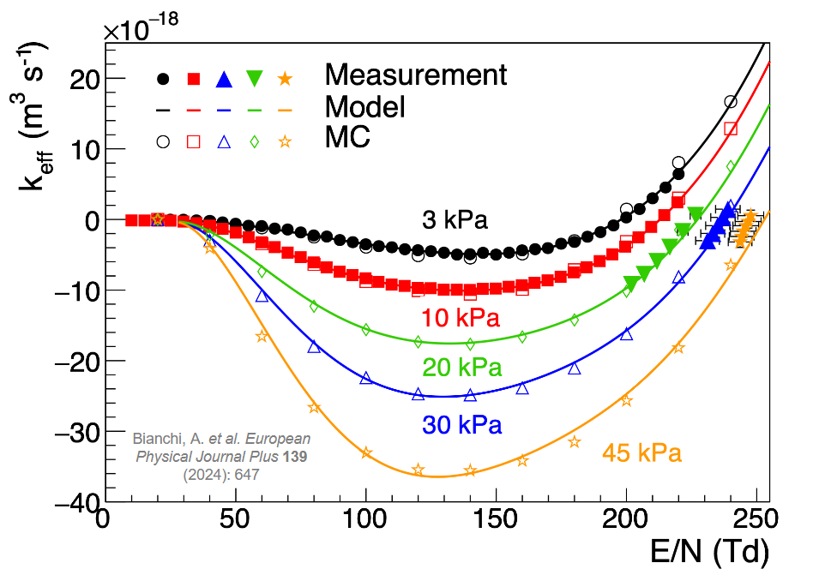
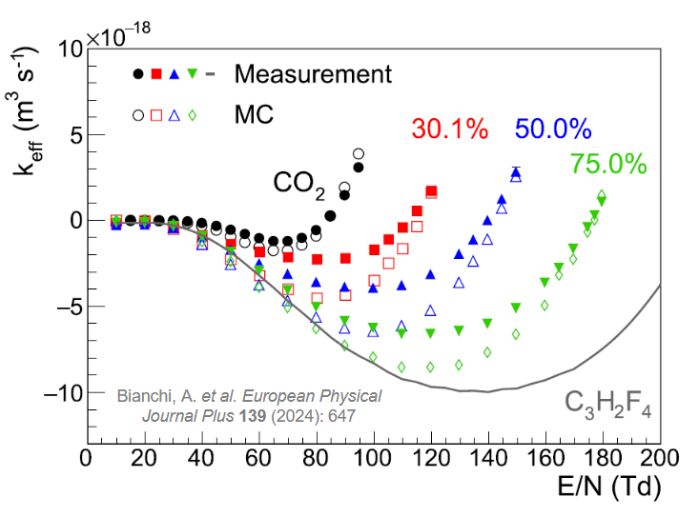
Effective Ionization in MATOQ by A. Bianchi
Pure HFO
Mixtures of HFO and CO2

Slide 6
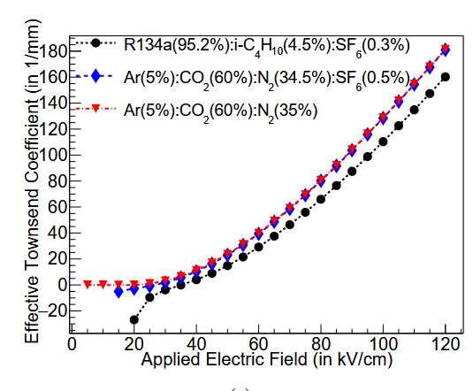
Modelling at Saha Institute in Kolkata
Basically a hydrodinamic model using COMSOL
Primary ionization coefficient and electron transport parameters from HEED and MAGBOLTZ
Study of TFE based mixtures and eco-friendly mixtures for the INO experiment based on Ar/CO2/N2
J. Datta et al., Numerical qualification of eco-friendly gas mixtures for avalanche-mode operation of resistive plate chambers in INO-ICAL, 2021 JINST 16 P07012

Slide 7
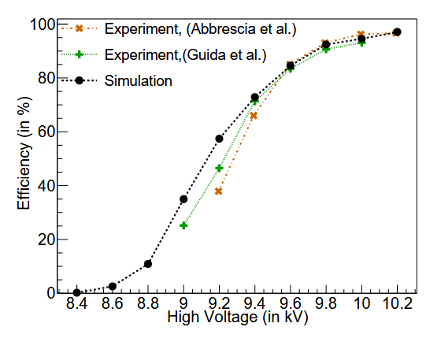
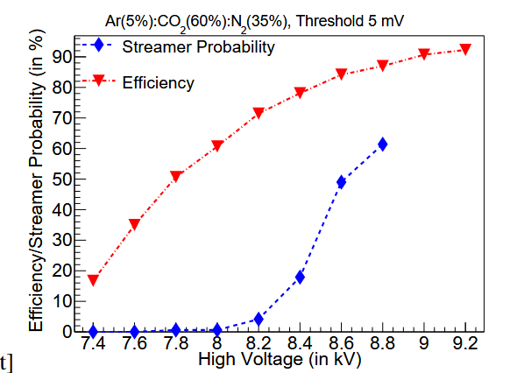
Modelling at Saha Institute in Kolkata
Validation of the model with STD gas mixture
Prediction of efficiency and streamer probability with ecofriendly gas mixtures containing Ar/CO2/N2

Slide 8
Simulation of ecofriendly gases at Belgrade
Development, extension and generalization of multi-term theory for solving the Boltzmann equation (Dujko et al. 2010 Phys. Rev. E 81 046403) → MC code to study the transport of electrons in eco-friendly RPC gas mixtures.
Development of sets of cross sections for electron scattering in C2H2F4, C3HF5, C3H2F4, CF3I, C5F10O, and C4F7N
Saša Dujko et al., Studies on electron swarms and streamer discharges in environmentally friendly RPC gas mixtures under LHC-like conditions, RPC2024, https://indico.global/event/6191/contributions/51194/attachments/25784/44501/Dujko_RPC_Final%20No%20CS.pdf

Slide 9
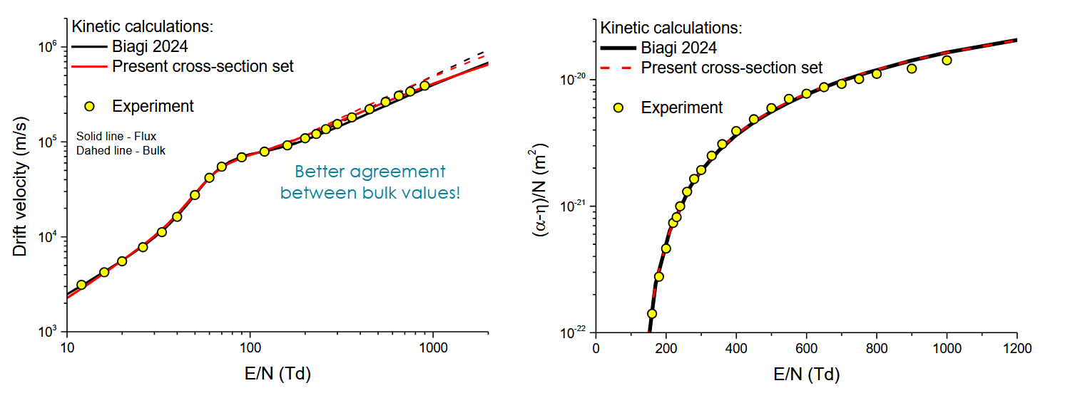
Swarm electron coefficients for TFE
Similar calculations for HFO presentated at Santiago2024

Slide 10
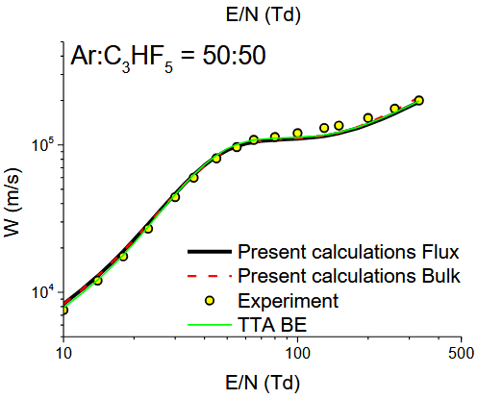
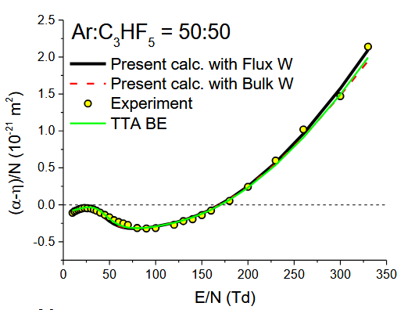
Investigation of mixtures of pentafluoropropene

Slide 11
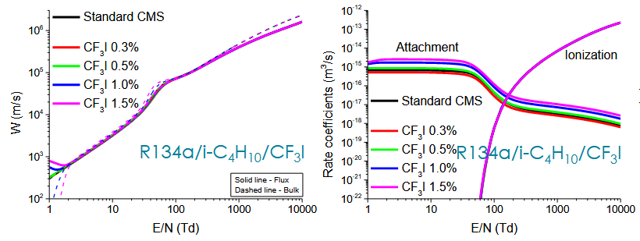
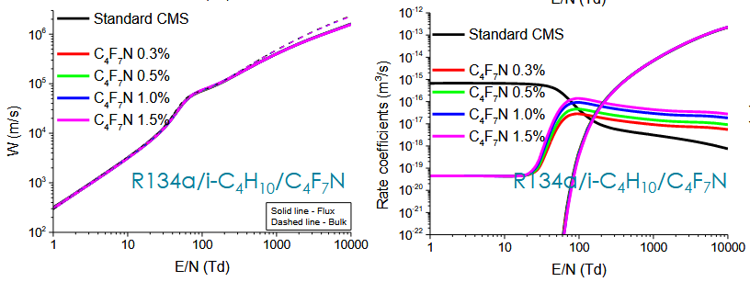
Possible alternatives to SF6

Slide 12
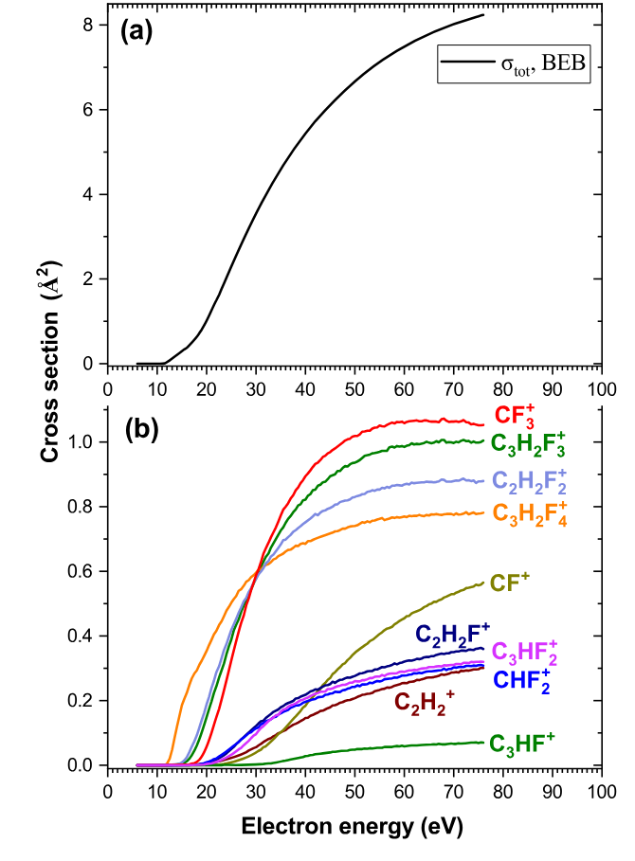
The «Zurich» project
Started some years ago from Christian M. Franck from ETHZ in collaboration with CERN EP-DT → see talk by D. Stocco
Development of HFO1234ze cross sections
Study of free electron collision-induced fragmentation of HFO
Total ionization cross section of C3H2F4 calculated using the BEB formalism.
Partial cross sections for the selected mass peak
Hlib Lyshchuk et al 2025, Electron-induced dissociation of HFO1234ze: dissociative electron attachment and dissociative ionization* Phys. Scr. 100 055409DOI 10.1088/1402-4896/adcb77

Slide 13
Simulation of streamer probablity
Based on Garfield++ and including axis-symmetric space-charge model originally developed by Christian Lippmann.
Modelling CO₂/R134/i–C₄H₁₀/SF₆ mixtures in single gap RPCs
An avalanche incepts a streamer if if its space-charge field anywhere at any time is comparable to a fraction of the background field → Meek criterion
Dario Stocco, Christian M. Franck, Numerical studies on streamer probability in resistive plate chambers for eco-friendly gases, NIMA, Volume 1075, 2025, 170409, ISSN 0168-9002, https://doi.org/10.1016/j.nima.2025.170409.

Slide 14
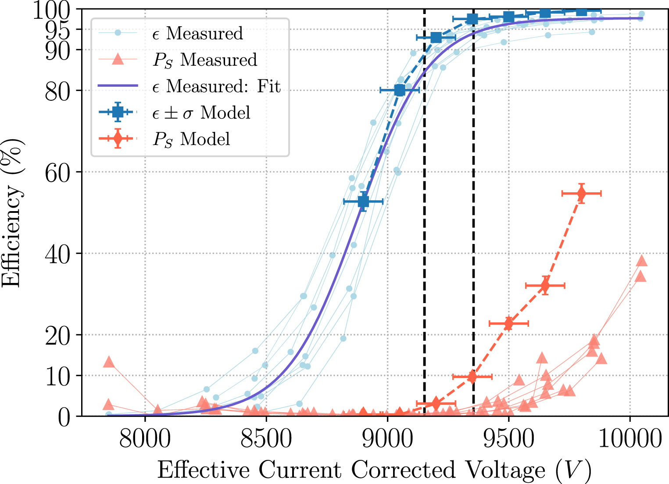
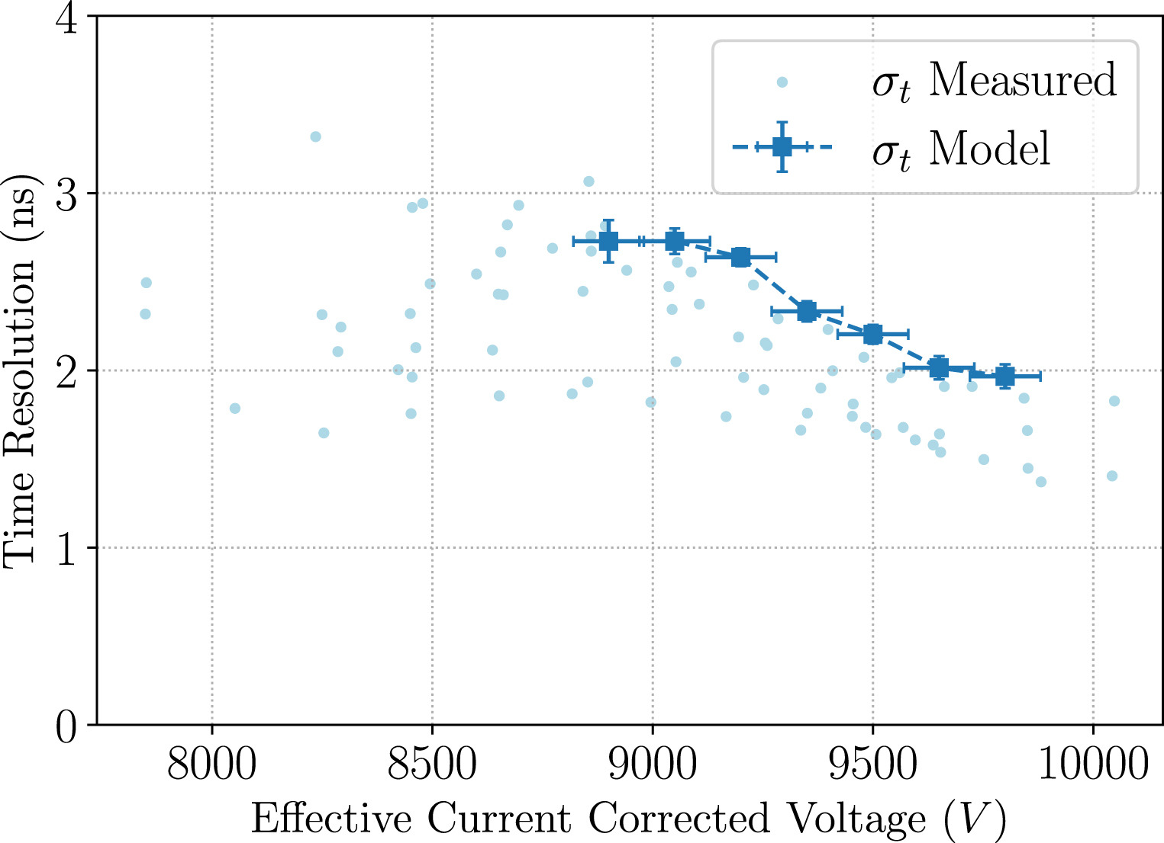
Simulation of streamer probablity
Dario Stocco, Christian M. Franck, Numerical studies on streamer probability in resistive plate chambers for eco-friendly gases, NIMA, Volume 1075, 2025, 170409, ISSN 0168-9002, https://doi.org/10.1016/j.nima.2025.170409.

Slide 15
Final considerations
Simulation and modeling can help a lot in understanding the properties of eco-friendly gas and gas mixtures once that they have been identified.
However, two critical points (at least) still hold:
  Computation of the streamer probability → need the simulation of large avalanche, recombination, photoionization, all well known to be hard to simulate at the present state of the art → reason why WG4 is concentrating on that
  Aging effects → being in between plasma physics and chemistry, really hard to have a clear picture of them

Slide 16
Final considerations
NEW eco-friendly gas or gas mixtures are quite difficult to identify with the present simulation tools
Because the bondary conditions change rapidly and are not clear
Possible use of artificial intellingence like they use for the discovery of new anti-biotics → extremely resource consuming
At the moment, three directions could be promising:
HFOze
«Exotic» gases, like C3HF5, and others (Belgrade)
Toward the old: improved electronics might improve avalanche/streamer separation, so use heavy noble gases (Xe) + CO2 opaque to UV (MA)

