Slide 1


Initial Steps Towards a Computationally
Efficient neBEM Solver
Shubhabrata Dutta, Purba Bhattacharya, Tanay Dey, Nayana Majumdar, Supratik Mukhopadhyay
Saha Institute of Nuclear Physics, Kolkata, India, A CI of Homi Bhabha National Institute
Adamas University , Kolkata
&
5th DRD1 collaboration meeting
16th - 20th June 2025
17th June, 2025

Slide 2
Outline
Electric field solvers: neBEM, among several others
GPU Acceleration: Integrating CUDA with neBEM
Electric Field Modeling in THGEM Structures
Preliminary Work: Dynamic Updating of Space-Charge-Induced Fields.
Summary

Slide 3
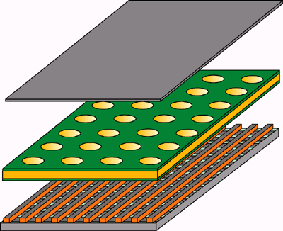
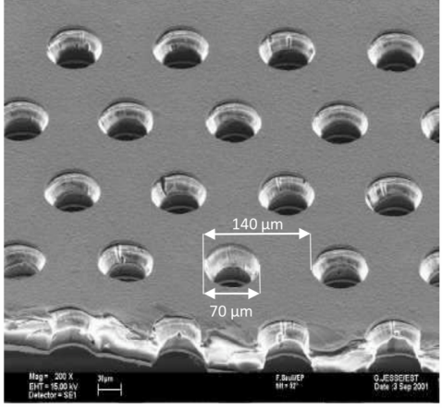
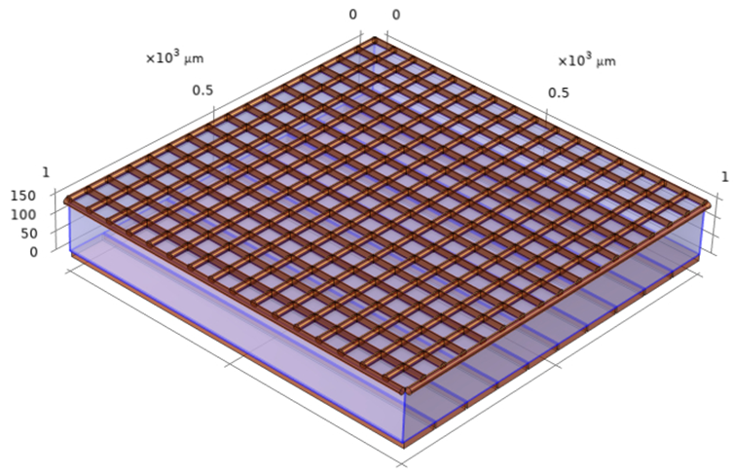
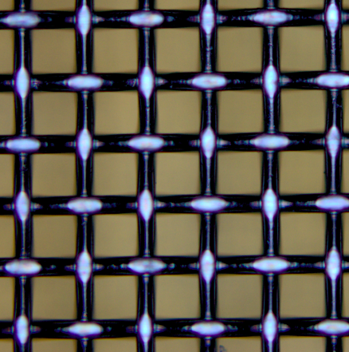
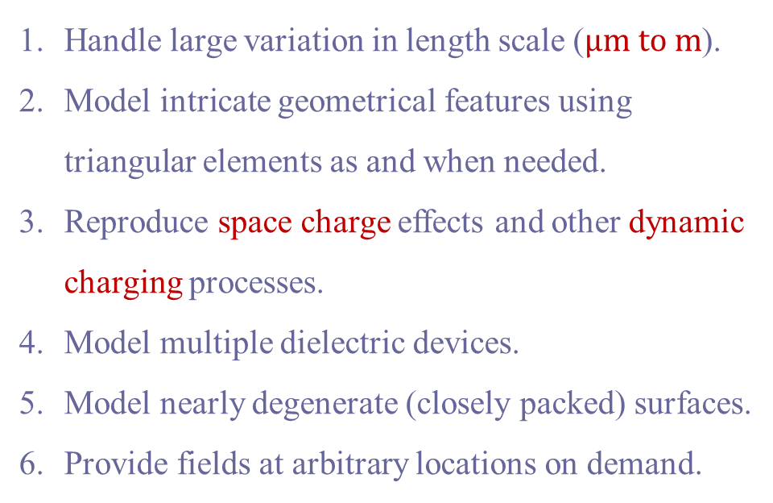
Expected Features of Field Solver for MPGDs
Handle large variation in length scale ($μm to m$).
Model intricate geometrical features using triangular elements as and when needed.
Reproduce space charge effects and other dynamic charging processes.
Model multiple dielectric devices.
Model nearly degenerate (closely packed) surfaces.
Provide fields at arbitrary locations on demand.
GEM
63 μm
18 μm
Micromegas

Slide 4
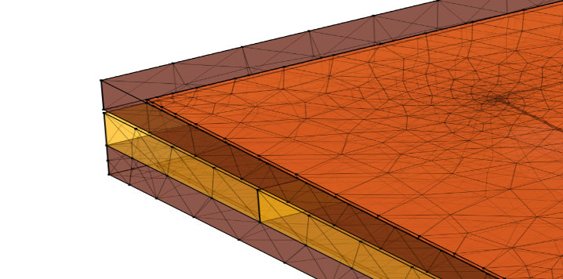
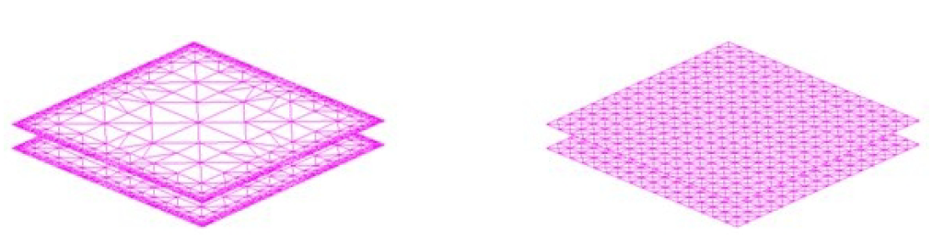
Various approaches to compute electric field
Direct measurement of the electric field inside MPGDs is a difficult task to perform.
Indirect measurement relies upon the gas discharge process using spectral analysis.
It becomes necessary to rely on analytical or numerical methods.
Analytical
Accurate for simple geometries (e.g., wire chambers).
Effective in 2D / axisymmetric geometries.
Not suitable for complex 3D geometries.
Inadequate for real detectors with imperfections.
FEM
Solves Laplace’s equation at nodal points within the discretized volume.
Interpolates / extrapolates potential / field values at non-nodal points.
BEM
Solves boundary integral equations from Poisson’s equation.
Evaluates potential/field based on charge distribution on boundaries.
Structured volume mesh in FEM
Adapted surface mesh in BEM
Uniform surface mesh in BEM
Generated in COMSOL [6]

Slide 5
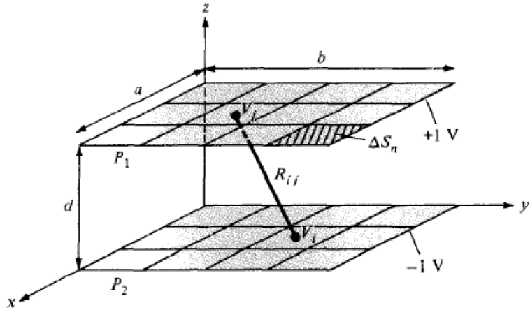
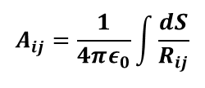
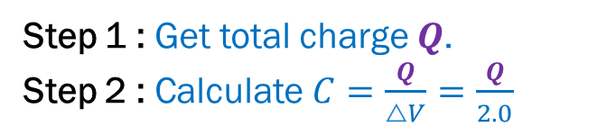
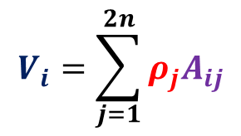


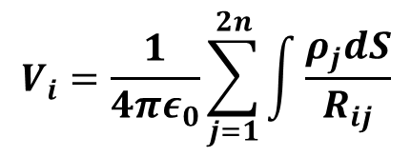

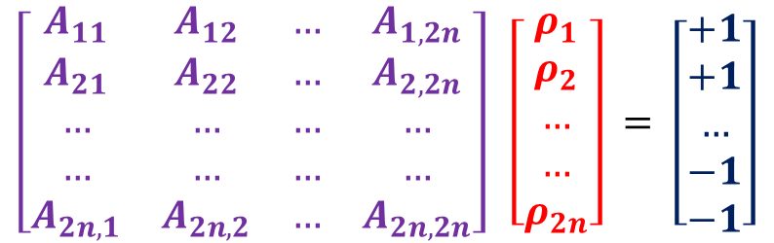

Conventional BEM
Capacitance of a parallel plate capacitor :
Step 1 : Get total charge $Q$.
Step 2 : Calculate $C=\frac{Q}{△V}=\frac{Q}{2.0}$
$$A_{ij}=\frac{1}{4πε_{0}}\int{\frac{dS}{R_{ij}}}$$
Analytical expression for i = j exists for few useful shapes!
$$for i≠j$$
$$ΔS_{j}$$
$$V_{i}=\frac{1}{4πε_{0}}\sum_{j=1}^{2n}{\int{\frac{ρ_{j}dS}{R_{ij}}}}$$
$$V_{i}=\sum_{j=1}^{2n}{ρ_{j}A_{ij}}$$
$A ρ= V$
$$ΔS_{j}$$
All we need to know is the influence coefficient matrix.
Depends entirely on geometry and material budget.
Weighting field calculation for signal generation is easy.
Potential and field at any point can be calculated.
$ρ=A^{−1} V$
$$\left[\begin{matrix}A_{11} & A_{12} & … & A_{1,2n} \\ A_{21} & A_{22} & … & A_{2,2n} \\ … & … & … & … \\ … & … & … & … \\ A_{2n,1} & A_{2n,2} & … & A_{2n,2n}\end{matrix}\right] \left[\begin{matrix}ρ_{1} \\ ρ_{2} \\ … \\ … \\ ρ_{2n}\end{matrix}\right] = \left[\begin{matrix}+1 \\ +1 \\ … \\ −1 \\ −1\end{matrix}\right]$$

Slide 6
Challenges With Conventional BEM
Field point
The conventional BEM approach has a few serious drawbacks
Major assumptions:
    Surface charges assumed to be concentrated at nodal points rather than distributed across elements.
    Boundary conditions satisfied at predetermined points, not across the entire element.
Near-field inaccuracies:
    Estimation of potential and field near boundaries and interfaces become erroneous.
    Complications with closely spaced surfaces, edges, corners, and geometric singularities.
Influencing element
Effect of the influencing element on the field point ( ) is usually sought for.
Charge distributed over the influencing element is assumed to be concentrated at the star ( ).
The boundary condition is also satisfied at the same point.
This is the so-called collocation point.
For self-influence, analytical expressions exist for few element shapes (rectangular, triangular) so that zero distance is well taken care of.
To address the mentioned issues with BEM, neBEM (nearly exact Boundary Element Method) was introduced.
Accounts for true charge density distribution on elements, shown in the next slide .

Slide 7
Advantages and disadvantages of neBEM
Improved Accuracy:
  Accurate across the entire physical domain, including near-field regions.
  No need for specific formulations for different sections of the domain.
Enhanced Solutions:
  Effectively addresses problems involving complex geometries and closely spaced surfaces.
BEM
Ref. : https://gitlab.cern.ch/garfield/garfieldpp/-/tree/master/NeBem
Major drawback of neBEM stems from the large number of complex closed-form analytic expressions employed to evaluate potential and field, and the usual BEM menace of fully populated influence matrix.
Excellent accuracy is achieved at the cost of painfully slow computation.
This was alleviated to a certain extent by implementing OpenMP [7].
In this work, we present implementation of GPU capabilities (CUDA[2]).
neBEM

Slide 8
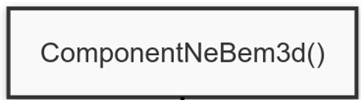
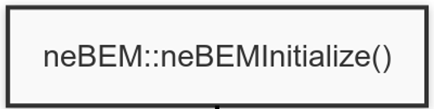

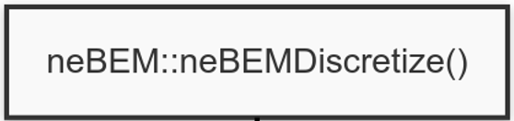
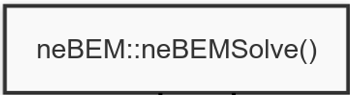

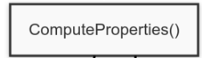





Workflow
ValueKnCh()
$if (OptKnCh)$
RHVector()
InvertMatrix()
( LU or SVD )
LHMatrix()
$if (OptPP)$
CreateFastVolPF()
$if (OptFastVol)$
Solve()
$if (OptWtFldFastVol)$
CreateWtFldFastVolPF()
PFAtPoint()
$if (OptKnCh)$
ElePFAtPoint()
KnChPFAtPoint()

Slide 9
Workflow
30 mins
ValueKnCh()
$if (OptKnCh)$
RHVector()
InvertMatrix()
( LU or SVD )
LHMatrix()
$if (OptPP)$
CreateFastVolPF()
$if (OptFastVol)$
Solve()
$if (OptWtFldFastVol)$
CreateWtFldFastVolPF()
PFAtPoint()
OpenMP
$if (OptKnCh)$
ElePFAtPoint()
KnChPFAtPoint()

Slide 10
Workflow
30 mins ➔ 1 min
ValueKnCh()
$if (OptKnCh)$
RHVector()
InvertMatrix()
( LU or SVD )
LHMatrix()
$if (OptPP)$
CreateFastVolPF()
$if (OptFastVol)$
Solve()
OpenMP
$if (OptWtFldFastVol)$
CUDA
CreateWtFldFastVolPF()
PFAtPoint()
OpenMP + CUDA
$if (OptKnCh)$
ElePFAtPoint()
KnChPFAtPoint()

Slide 11
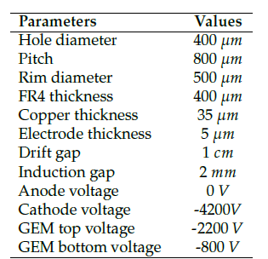
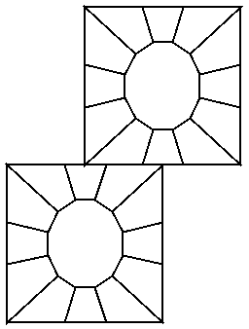
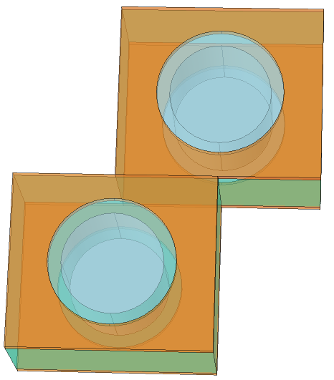
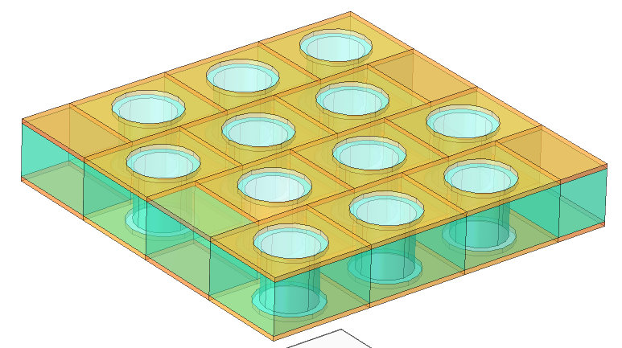
Application for THGEM simulation
Staggered THGEM geometry has been modelled in neBEM by repeating a unit cell, consisting of two holes. Same approach has been adopted for COMSOL Multiphysics also.
In neBEM, 35 repetitions has been used in ± X and ± Y direction.
After creation of surface mesh, the THGEM model contains 10622 elements in neBEM.
Y
Unit cell repeated in COMSOL
X
Z
Unit cell in neBEM

Slide 12
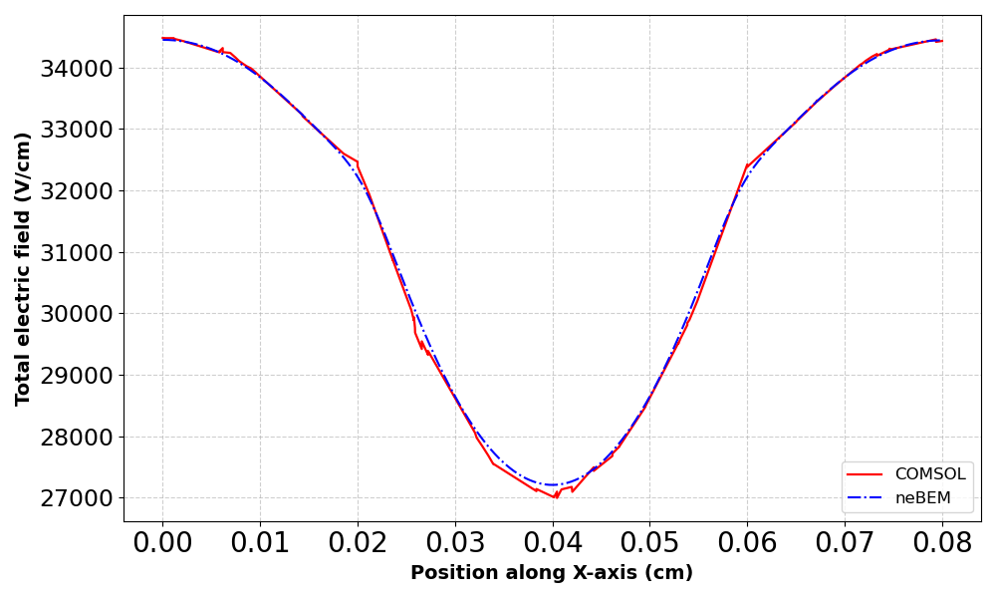
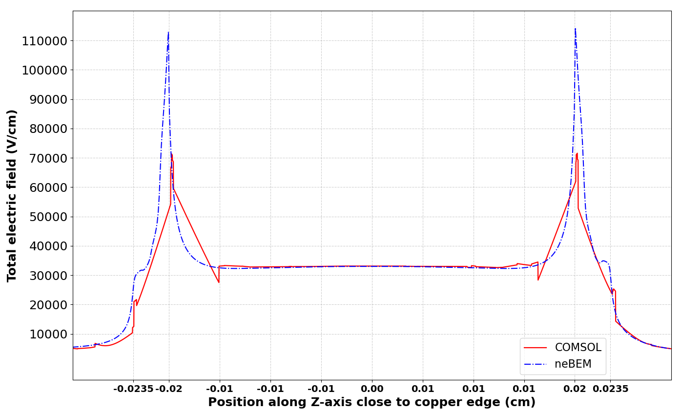
Evaluation of Electric Field
Both methods capture the general field trend, neBEM exhibits sharper field variations near the copper edge, whereas COMSOL tends to smooth out these variations. ( Meshing calibrated for: Fluid Dynamics + extremely fine )
Given neBEM’s ability to represent intricate boundary conditions more precisely, we expect it to provide a more promising solution in such regions of high field gradients.
Further refinements and benchmarking are necessary for a more detailed quantitative assessment.
Z
X

Slide 13
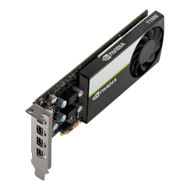
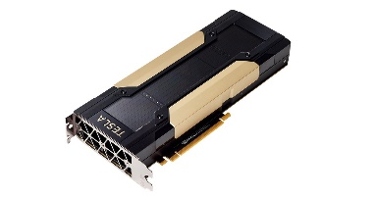
Used Hardware and Software for Benchmarking
Workstation
HPC Cluster
Intel Xeon(R) Gold 6142
2.6 GHz, 32 cores
64 GB memory
Intel Xeon(R) Gold 6140
2.3 GHz, 36 cores per node
384 GB memory per node
NVIDIA T1000
Compute Capability : 7.5
896 CUDA cores
8 GB memory
Clock Rate : 1395 MHz
Tesla V100-PCIE-16GB
Compute Capability : 7.0
5120 CUDA cores
16 GB memory
Clock Rate : 877 MHz
CUDA 12.5 with NVIDIA driver 535 running Ubuntu 22.04
CUDA 12.2 with NVIDIA driver 535 running CentOS 7
Compiler: nvcc V12.5.40
Compiler: nvcc V12.2.128

Slide 14
Benchmarking Results
SVD inversion has been used (selected by nebem.UseSVDInversion())
neBEM by default use LU (usually much faster than SVD) however needed some extra preparation for overlapping surfaces to get accurate solution.
Below table depicts the time taken to calculate field and potential at a particular point for the mentioned THGEM model having 35 repetitions, consisting of ~10500 elements.
# of Threads | Without GPU | With GPU
1 | 1503.94 min | 280.28 min
2 | 657.68 min | 146.23 min
4 | 272.31 min | 75.17 min
8 | 152.53 min | 40.39 min
16 | 107.73 min | 21.26 min
# of Threads | Without GPU | With GPU
1 | 1588.02 min | 361.43 min
2 | 691.82 min | 195.43 min
4 | 294.61 min | 105.02 min
8 | 147.26 min | 56.69 min
16 | 138.79 min | 33.27 min
Workstation
HPC Cluster
On the HPC cluster, the speedup using only OpenMP is ~ 14 times (1504 / 108).
OpenMP + GPU gives ~72 times speedup!
On Workstation, the speedup using only OpenMP is ~ 11 times (1588 / 139).
OpenMP + GPU gives ~50 times speedup!

Slide 15
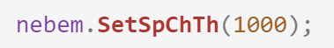
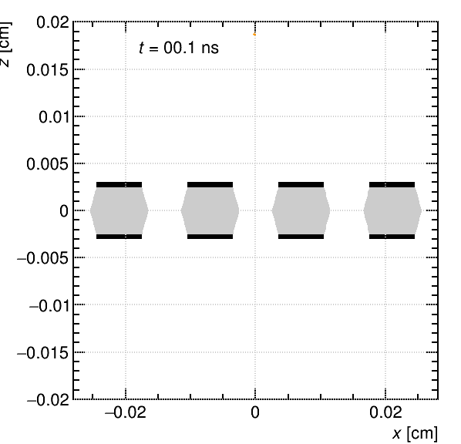
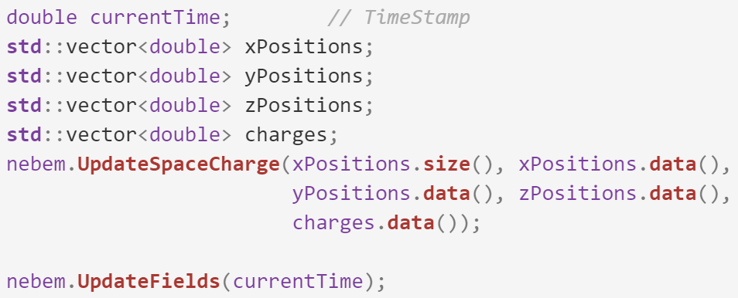
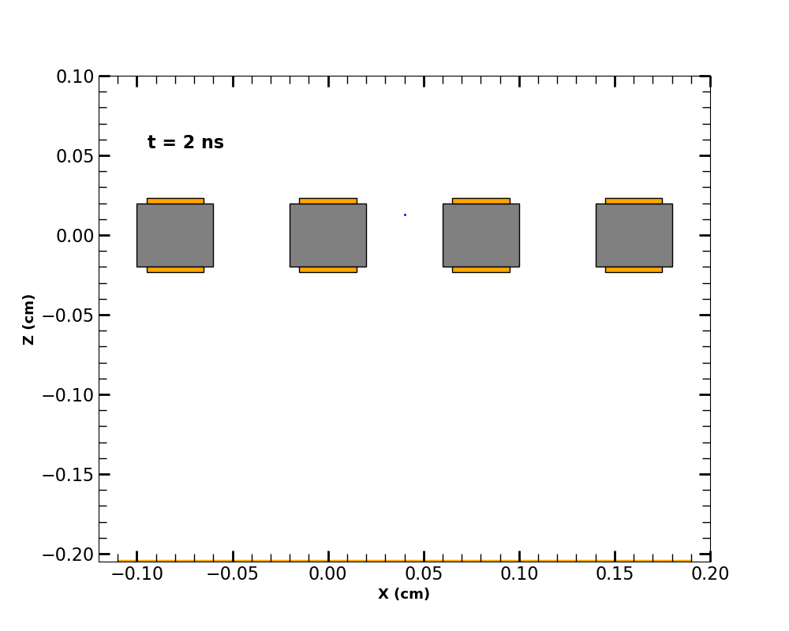

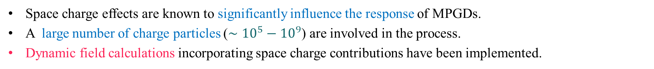

Dynamic Field Update in neBEM
Space charge effects are known to significantly influence the response of MPGDs.
A large number of charge particles ($∼{10}^{5}−{10}^{9}$) are involved in the process.
Dynamic field calculations incorporating space charge contributions have been implemented.
Dynamically updated field map at each avalanche step
neBEM
UpdateFields
$if (>SpChTh)$
UpdateRHVector
Ansys
Constant field map imported once
Solve
$if (OptFastVol)$
UpdateFastVolPF

Slide 16
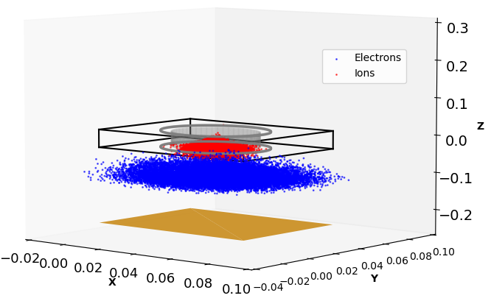
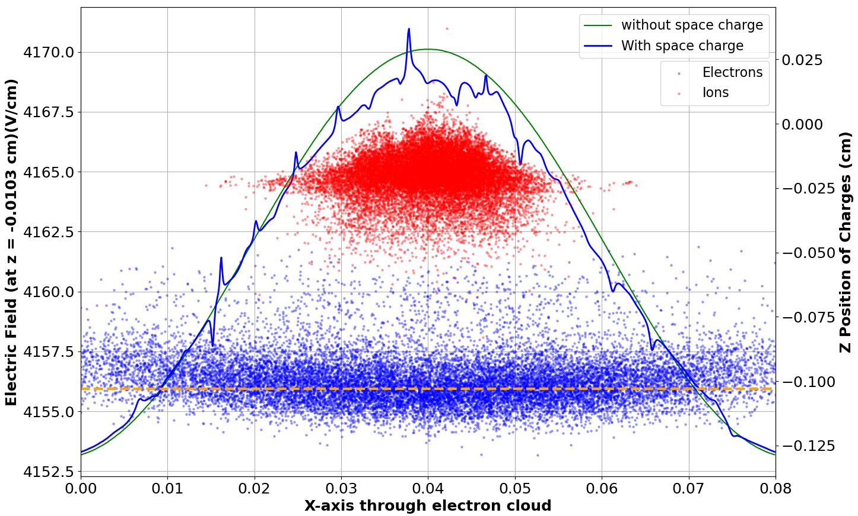
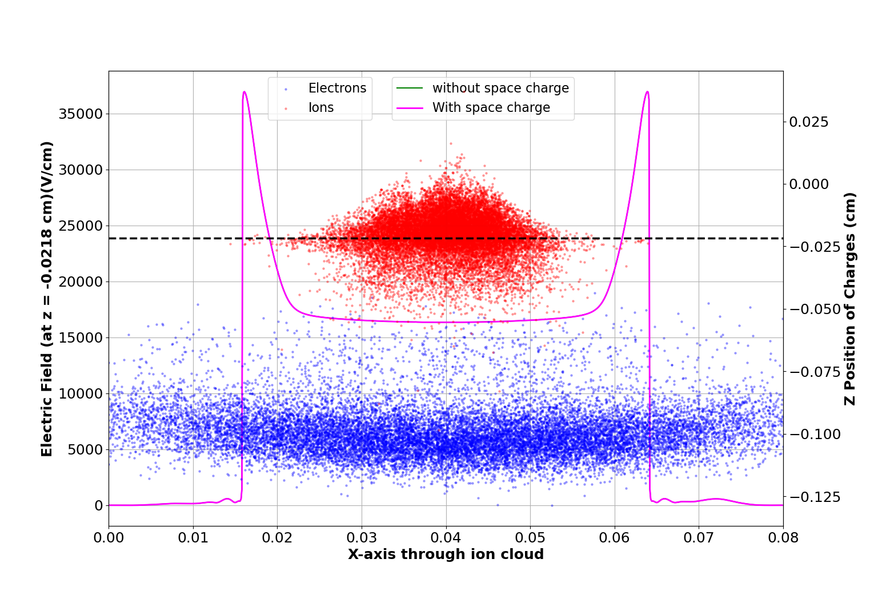
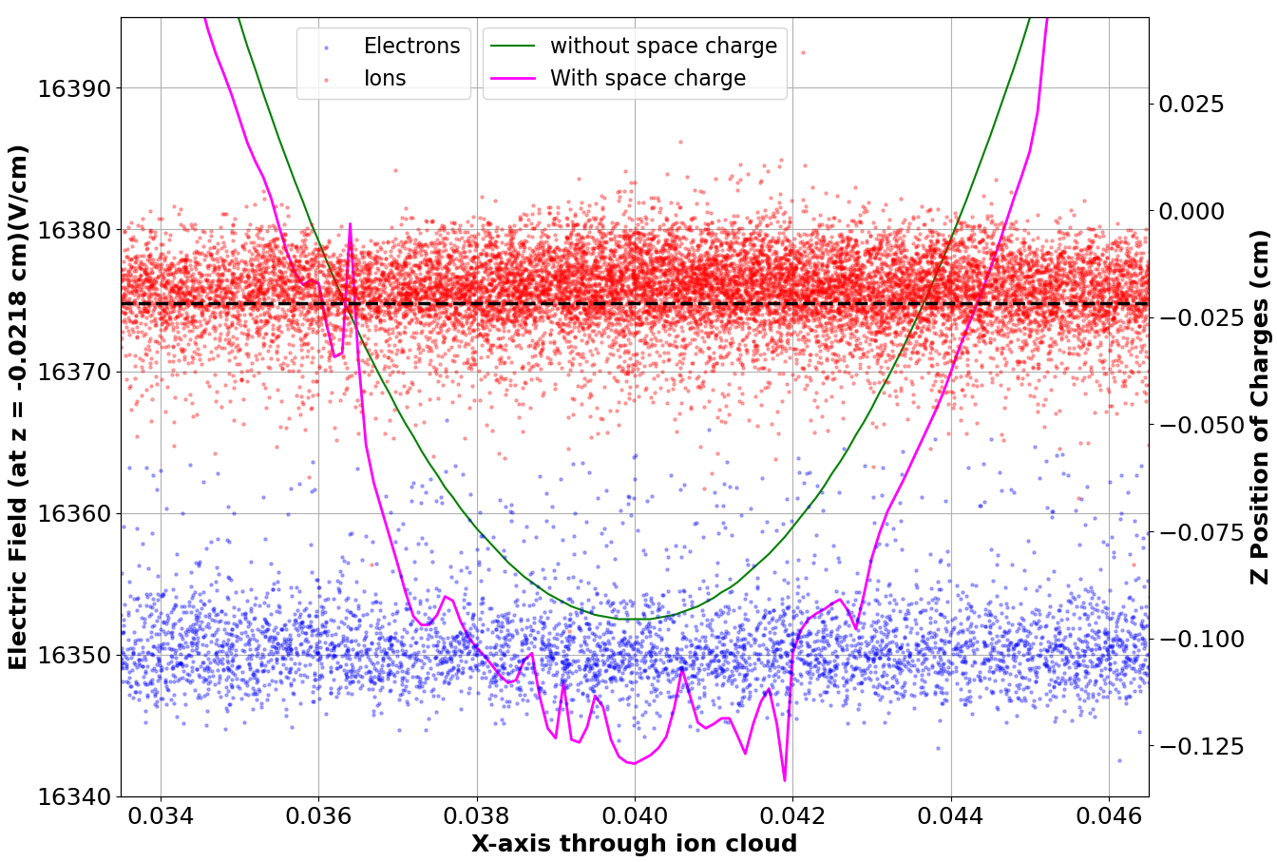
Effect of Space Charges on Field
Effect of space charge on the electric field distribution through the electron and ion clouds at 30 ns
t = 30 ns
Through Ion Cloud
X
Through Electron Cloud
Figures taken from the accepted manuscript titled “Numerical simulation of space charge effects in MPGDs” of MPGD2024 conference by S.Dutta et al.(JINST_043P_0125)
X

Slide 17
SUMMARY
We have successfully implemented CUDA in neBEM. It will be useful for solving large complex realistic model in much less time.
The GPU version is much faster than the already existing CPU versions of neBEM, without any compromise in accuracy. We could achieve ~ 3 - 7x speed for GPU-accelerated versions in HPC cluster and ~ 2 - 4x speed in average workstation, on top of ~10x speedup due to multi-threading.
Space charge contribution have been incorporated into dynamic field computations.
Optimization and profiling to identify remaining bottlenecks is necessary. There appears to be scope for increasing this performance gain even further.
Work on implementation and benchmarking of GPU-based space charge and charging up simulation are in progress.
We hope to have this entire work integrated into the Garfield++ code-base soon enough.

Slide 18
References
[1] Garfield++ [ https://gitlab.cern.ch/garfield/garfieldpp ]
[2] NVIDIA CUDA [ https://developer.nvidia.com/cuda-toolkit]
[3] H. Schindler, Garfield++ User′ s Guide [ https://garfieldpp.web.cern.ch/garfieldpp ]
[4] "Experimental and Numerical Investigation on Micro-Pattern Gas Detectors".Thesis by Purba Bhattacharya (December 2014), Department of Physics University of Calcutta, Kolkata, India
[5] Computation of 3D electrostatic weighting field in Resistive Plate Chambers, Nuclear Instruments and Methods in Physics Research Section A: Accelerators, Spectrometers, Detectors and Associated Equipment 595 (2) (2008) 346–352. doi: https://doi.org/10.1016/j.nima.2008.07.033.
[6] COMSOL Multiphysics [https://www.comsol.co.in/.]
[7] OpenMP [https://www.openmp.org/. ]
[8] T. Dey, S. Mukhopadhyay, S. Chattopadhyay, Numerical study of effects of electrode parameters and image charge on the electric field configuration of RPCs, Journal of Instrumentation 17 (04) (2022) P04015. doi:10.1088/1748-0221/17/04/p04015.
[9] Tanay Dey, Purba Bhattacharya, Supratik Mukhopadhyay, Nayana Majumdar, Abhishek Seal, Subhasis Chattopadhyay,
Parallelization of Garfield++ and neBEM to simulate space-charge effects in RPCs, Computer Physics Communications, Volume 294, 2024, 108944, ISSN 0010-4655, https://doi.org/10.1016/j.cpc.2023.108944.
[10] “Boundary Element Method” Lecture given by Prof. Supratik Mukhopadhyay, RD51 Collaboration Meeting, 22-26 June 2020.
[11] I. B. Smirnov, “Modeling of ionization produced by fast charged particles in gas”; Nucl. Instrum. Meth. A vol. 554 (2005) 474. (online at http://cern.ch/heed )
[12] David B. Kirk, Wen-mei , “W. Hwu Programming Massively Parallel Processors: A Hands-on Approach”
[13] Jason Sanders , Edward Kandrot “CUDA by Example: An Introduction to General-Purpose GPU Programming”
[14] S. Biagi; “Magboltz - Transport of electrons in gas mixture”; online at http://cern.ch/magboltz

Slide 19




Acknowledgement
The Organisers
– for their support under all circumstances.
Collaborators from RD51 / DRD1 collaborations
– for constructive suggestions / help, especially from Rob and Heinrich.
Lab Mates : Subhendu Das, Pralay Kumar Das and Saikat Ghosh
– for their continuous help and encouragement.
SINP, HBNI, DAE, Adamas University, SERB Project No. SRG/2022/000531
– for providing the necessary funding and equipment support throughout this work.

Slide 20
Thank You

Slide 21
Backup slides

Slide 22

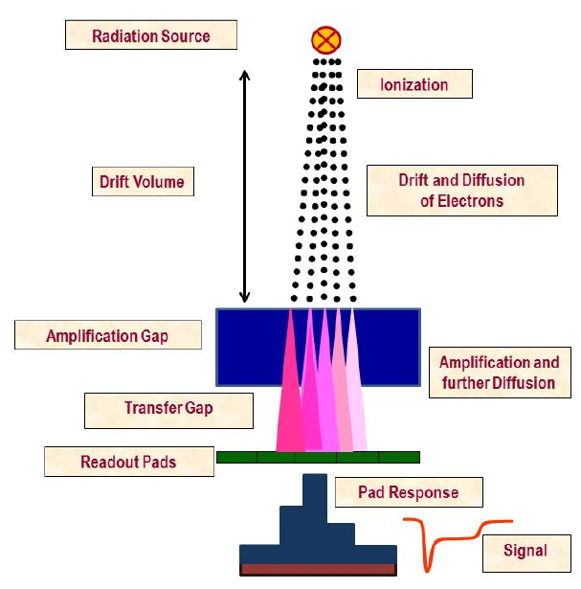
Garfield++
Garfield++: A toolkit for the detailed simulation of particle detectors based on ionisation measurement in gases and semiconductors.
Heed: Provides computed information on interaction of fast charged particles with matter and its ionization.
Magboltz: Calculates the transport parameters of electrons drifting in the gases under the influence of electric and magnetic fields.
Field Solver: Computes electromagnetic field; interfaces to Garfield++ are available for commercially available FEM packages such as Ansys, Comsol, and open source BEM and FEM packages such as neBEM and Elmer.
Device dynamics depends crucially on electric field.
Field solving is very important for MPGDs due to their intricate, essentially 3D geometry.
Ref. [4]

Slide 23
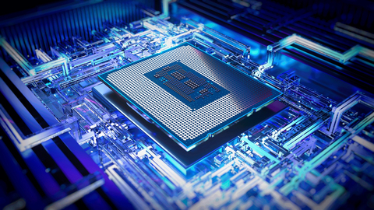
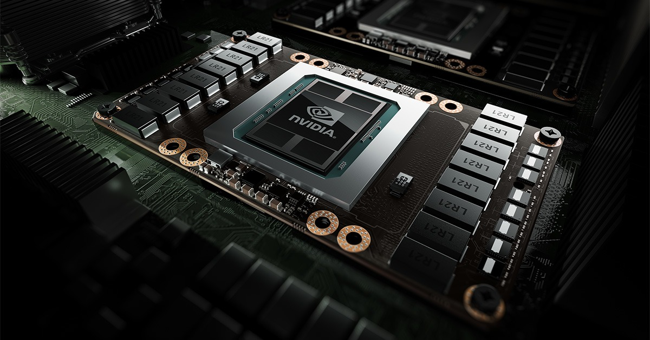
CPU vs GPU
 | CPU | GPU
Function | Generalized component that handles main processing functions of a server | Specialized component that excels at parallel computing
Processing | Designed for serial instruction processing | Designed for parallel instruction processing
Design | Fewer, more powerful cores | More cores than CPUs, but less powerful than CPU cores
Suitable for | General purpose computing applications | High-performance computing applications
intel.com
13th generation intel CPU
nvidia.com
NVIDIA Tesla P100 GPU
aws.amazon.com/compare/the-difference-between-gpus-and-cpus

Slide 24
THGEM Model – A Realistic scenario
For this study a staggered model of THGEM has been used (similar to the experimental setup currently being pursued at the SINP laboratory).
Field profiling has been carried out with GPU accelerated version of neBEM in Garfield++ and commercially available FEM package COMSOL Multiphysics to check the consistency of the model.
Chrono library functions has been used to time the computation for solving the model and calculating electric field and potential value at a predefined point of the model.
A study comparing the execution times of CUDA with OpenMP implementations has been performed for both Singular Value Decomposition (SVD) and Lower Upper Decomposition (LU) solution approach.

Slide 25
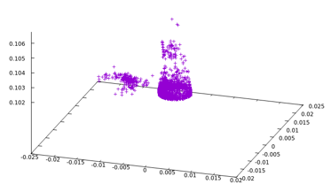
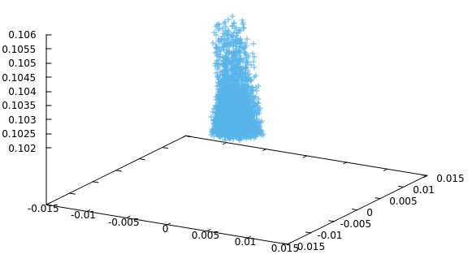
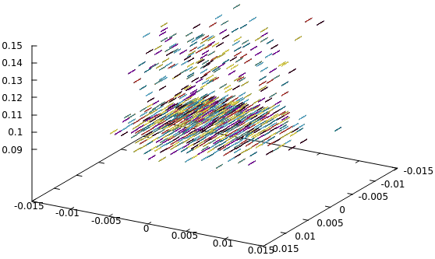
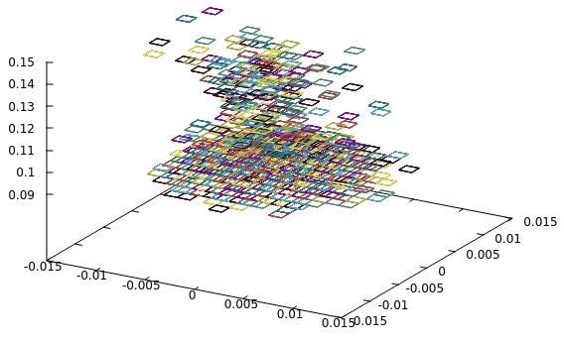
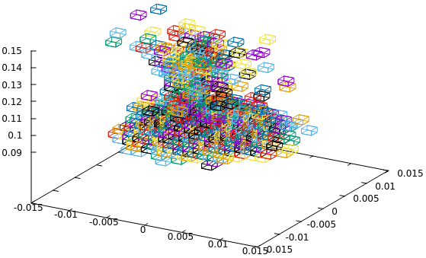
Space charge in GEM –particle model
Material borrowed from the Ageing and Stability Conference 2023 presentation of P. Bhattacharya
Existing models to represent space charge
  point
  line
  ring
  area
  Volume (PIC)
Future plans
  disc
  volume (integrations being tried)
Electrons
Ions
Line representation
Area representation
Volume representation
Several representations of space charge are already implemented.

Slide 26
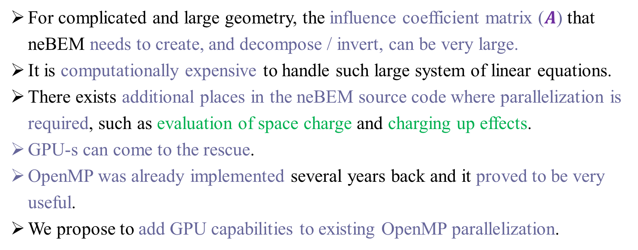
Why neBEM needs GPUs?
For complicated and large geometry, the influence coefficient matrix ($A$) that neBEM needs to create, and decompose / invert, can be very large.
It is computationally expensive to handle such large system of linear equations.
There exists additional places in the neBEM source code where parallelization is required, such as evaluation of space charge and charging up effects.
GPU-s can come to the rescue.
OpenMP was already implemented several years back and it proved to be very useful.
We propose to add GPU capabilities to existing OpenMP parallelization.

Slide 27
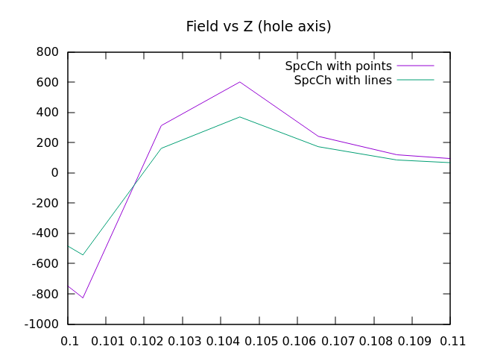
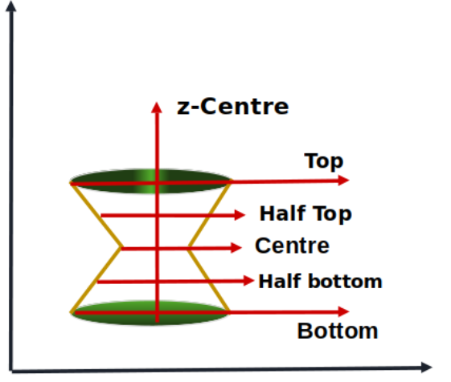
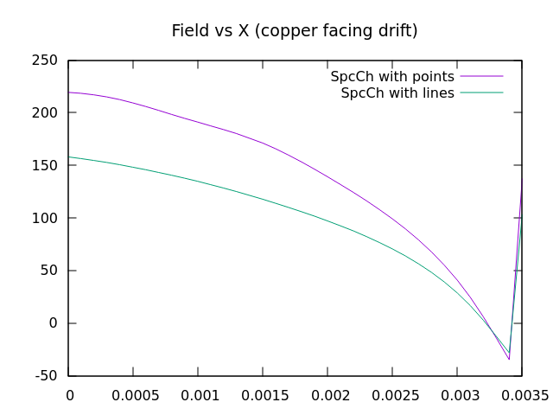
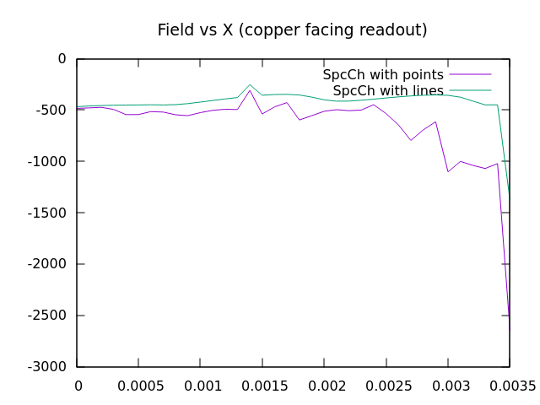
Field distortions due to Space charge effects
Along axis
(along axis)
Fluid model
Particle model
Top radius
Field values are compared for lines indicated above (not all are shown)
Good agreement is observed among results obtained using particle and fluid models
Bottom radius

Slide 28
prerequisites for LU approach : RmPrim
One can choose by nebem.UseLUInversion(). Needed some extra preparation for this type of model.
To get correct solution using LU some overlapping primitives needed to be removed (in this model 7 primitives , marked with Blue and Red lines) by using nebem.SetOptRmPrim(1) option.
The primitives to be removed should be listed on the neBEM input file “neBEMInp/neBEMRmPrim.inp".
One can define the primitive by indicating a normal to it and a point on the plane.
Primitives needed to be removed
First few lines of "neBEMRmPrim.inp" file

Slide 29
Benchmarking of execution time: LU approach
One can choose by nebem.UseLUInversion().
Much faster than SVD approach even if GPU parallelization is not switched on.
Reasonably faster in comparison to SVD with GPU parallelization.
# of Threads | Without GPU | With GPU
1 | 361.95 min | 268.85 min
2 | 190.463 min | 144.34 min
4 | 101.68 min | 70.93 min
8 | 64.66 min | 37.33 min
16 | 59.49 min | 19.36 min
# of Threads | Without GPU | With GPU
1 | 411.33 min | 335.65 min
2 | 210.61 min | 178.42 min
4 | 110.69 min | 93.12 min
8 | 61.79 min | 47.36 min
16 | 45.29 min | 25.32 min
HPC Cluster
Workstation
On the HPC cluster, the speedup using only OpenMP is ~ 6 times (362 / 59).
OpenMP + GPU gives ~19 times speedup!
On the Workstation 2, the speedup using only OpenMP is ~ 9 times (411 / 45).
OpenMP + GPU gives ~16 times speedup!

Slide 30
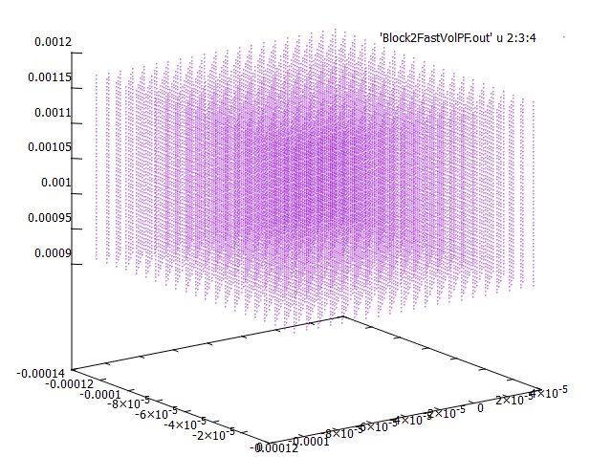
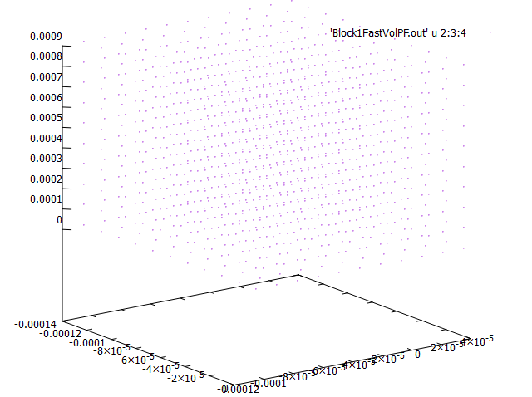

prerequisite for avalanche : FastVol
Simulation of avalanches, signals at pickup electrodes, effects of space charge, charging up, and similar other such phenomena, necessitates evaluation of physical and weighting, potential and field, at a large number of spatial locations and temporal instances.
This turns out to be computationally very expensive. Hence, the necessity of a precomputed map of potential and field – the so-called, FastVol.
Both physical and weighting (several of the latter, if we have a number of electrodes on which need to see the signal) potential and field are stored on a cartesian 3D map.
Trilinear interpolation is used to find out these properties at any arbitrary point.
Closely packed points in FastVol
Sparsely located points in FastVol
Example input file of a FastVol related to a single GEM

