Slide 1
Preliminary results of Picosec-μRGroove
Qixuan Huang
5th DRD1 collaboration meeting, 19-June-2025

Slide 2
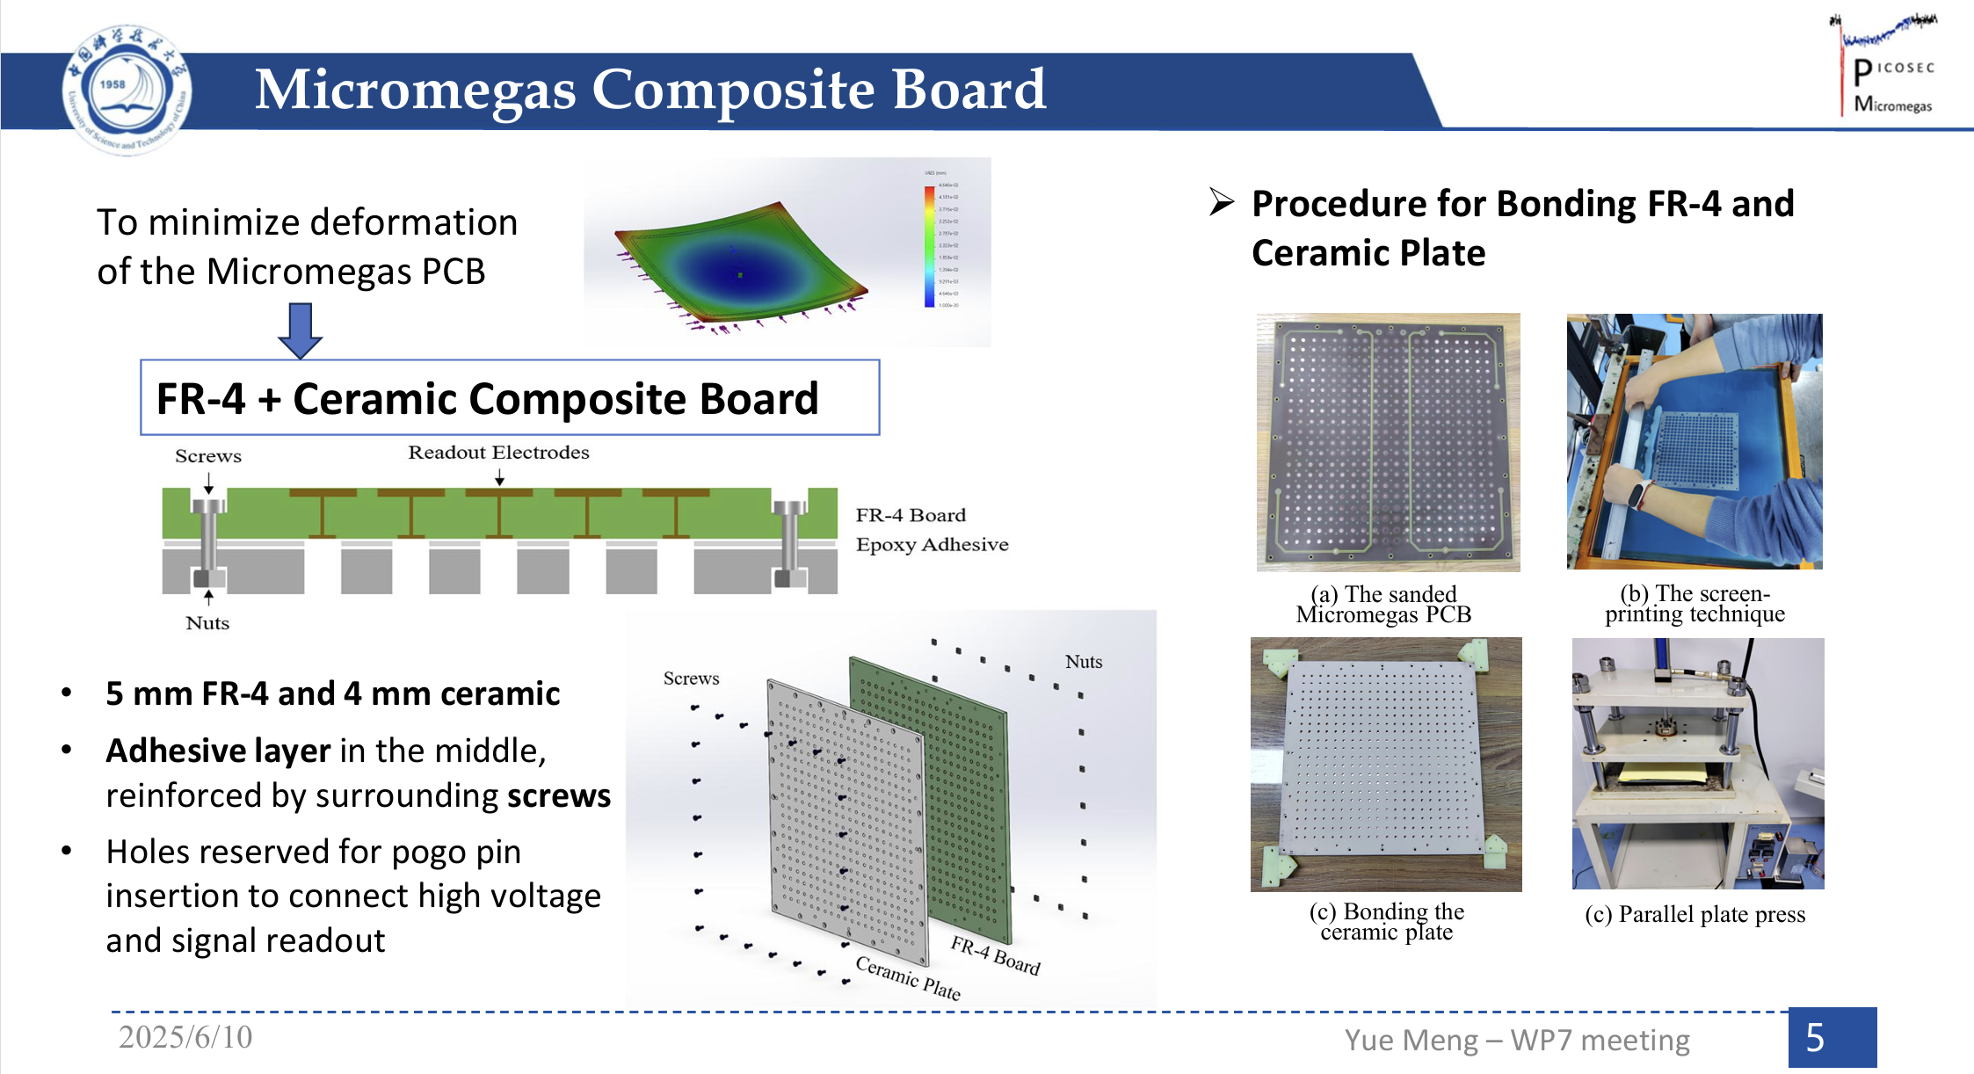
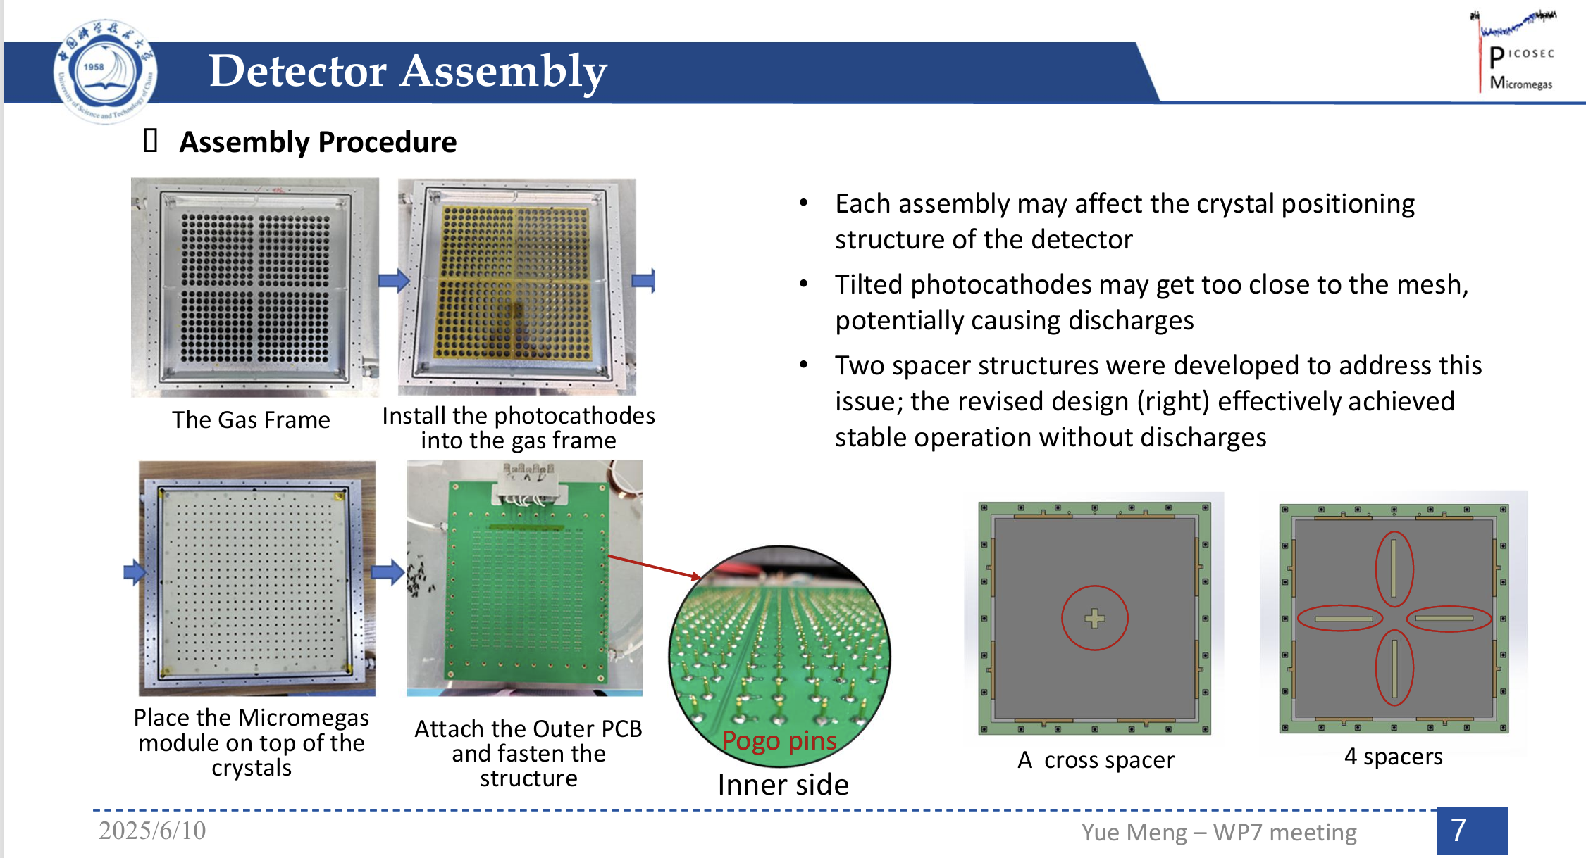
Deformation in picosec-MM
Non-uniformity on both gain and time resolution of picosec-MM mainly comes from the deformation of detector parts;
Make every detector part flatten can greatly improve the uniformity，Picosec-MM collaboration already did excellent work on 10cm×10cm and 20cm×20cm detectors !!!
However, to make everything flatten, ceramic materials and complex manufacturing techniques are required, which limited the applications；
Yue Meng, DRD1 - WP7 Timing Detectors, 10/June/2025

Slide 3


Another possible solution
Use another single-stage MPGD without any inner tension to minimize the PCB deformation；
Avoid ceramic materials and complex manufacture；
Use small size MgF₂ crystals to follow the deformation of the PCB;
Hard Frame
MgF₂
MPGD+PCB
Not in scale
Hard frame
Soft cushion sheet
MgF₂
MPGD+PCB

Slide 4
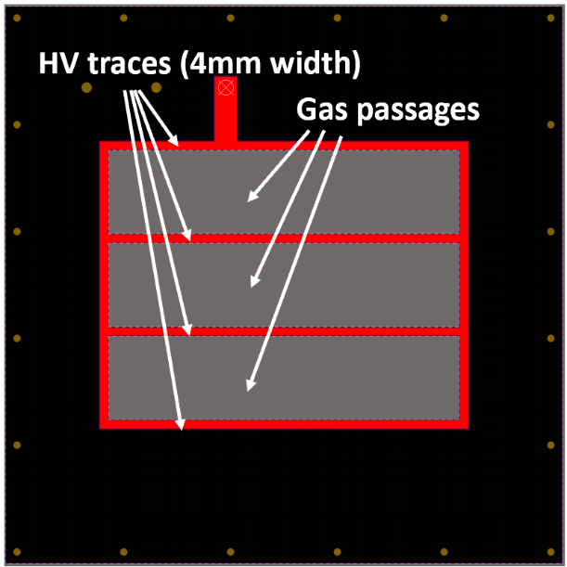
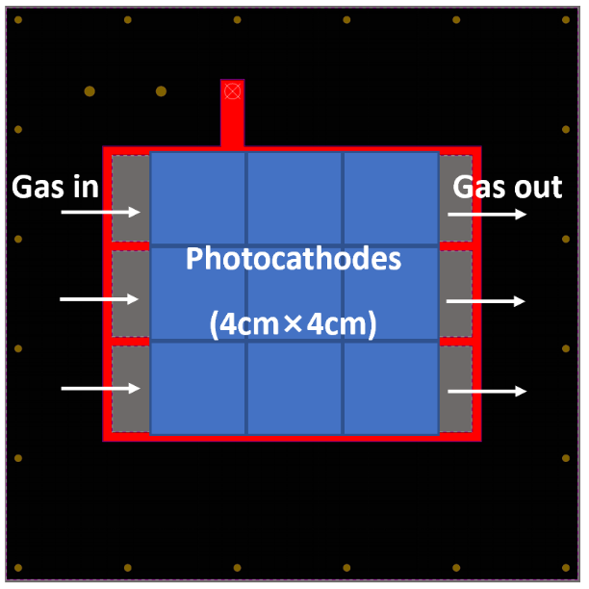
Key points of the “small MgF₂” solution
Use only horizontal metal trace for the HV supplying to all the photocathodes；
Gas passages are longer than the total width of crystals to allow the gas smoothly gas flow;
If we use 4mm width HV trace and 4cm×4cm crystal, the dead area is 10%, this number will not change when the detector size increase;
We can decrease the “trace width/crystal size” to “2mm/2cm×2cm” if the non-uniformity is still too large for a 4cm×4cm crystal;

Slide 5
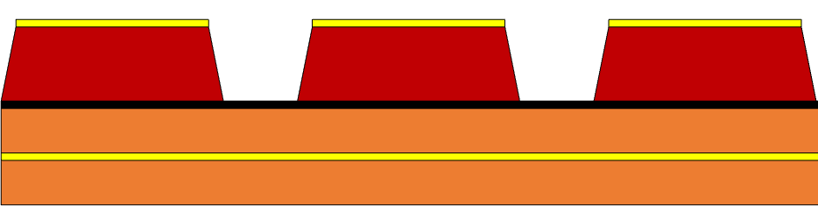
Why μRGroove?
Single stage amplification, no inner tension, good to decrease the deformation of the PCB;
High collection efficiency of primary electrons, good for high drift field application;
USTC is able to make small size μRGroove with 1d readout;
Charged particle
MgF₂
Photocathode
e⁻
Drift gap

Slide 6
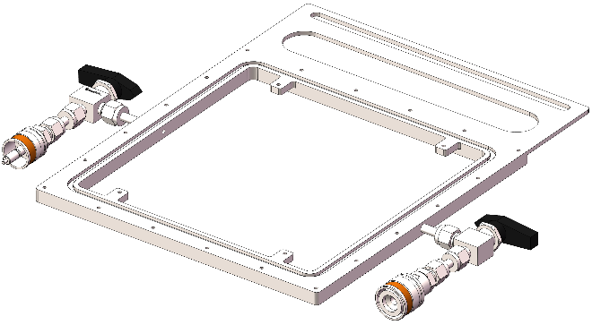
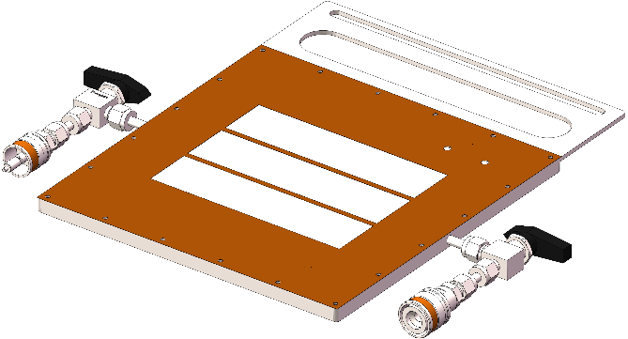
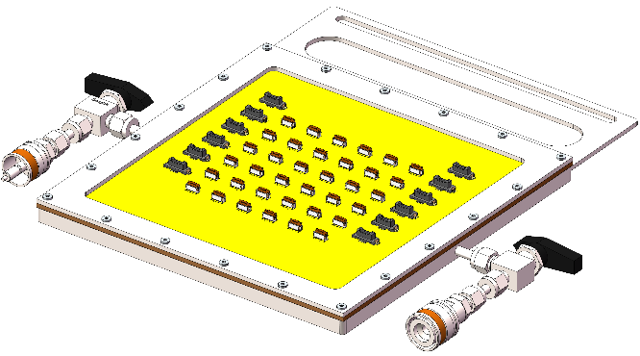
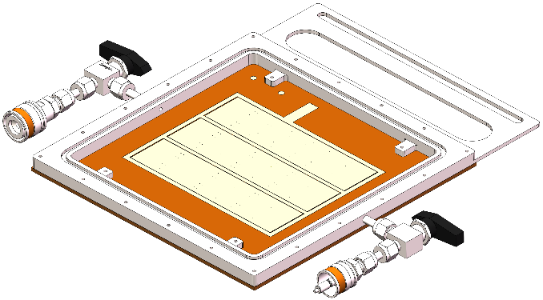
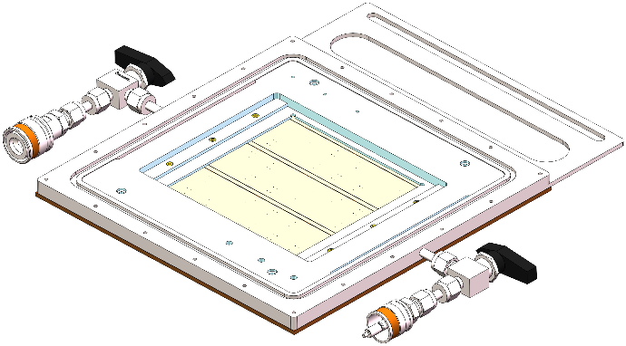
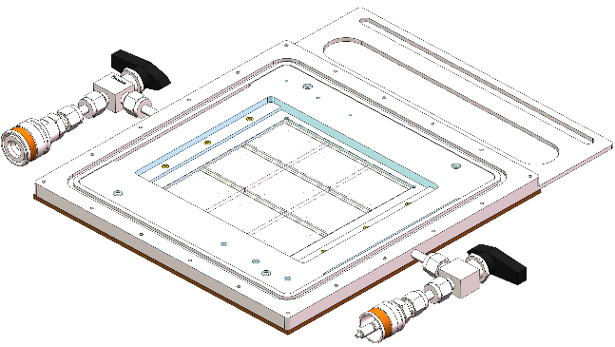
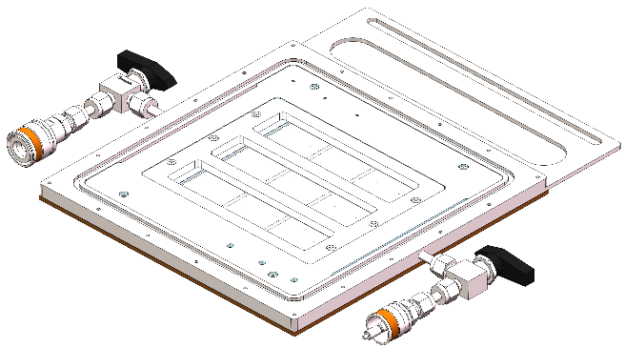
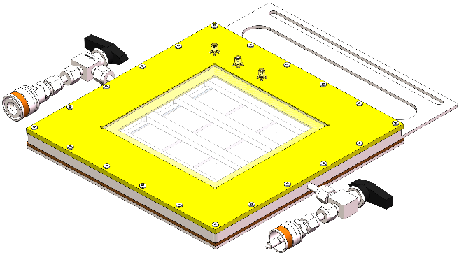
Design of 12cm×12cm Picosec-μRGroove
1. Stainless steel frame
2. Spacer
3. μRGroove PCB
4. Inner FR4 frame
5. MgF₂ Crystals
6. Hard fixer + soft cushion sheet
7. Window

Slide 7
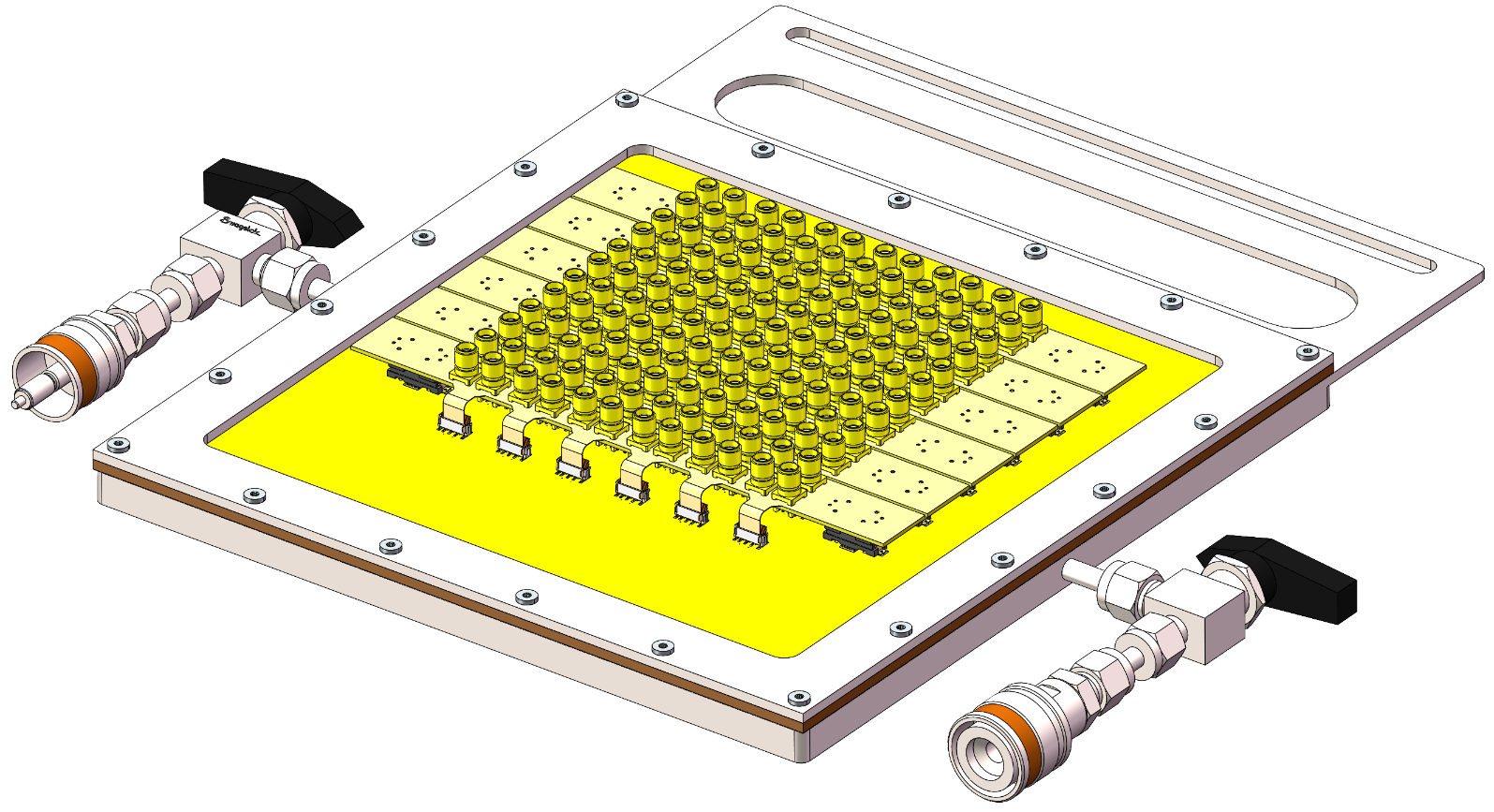
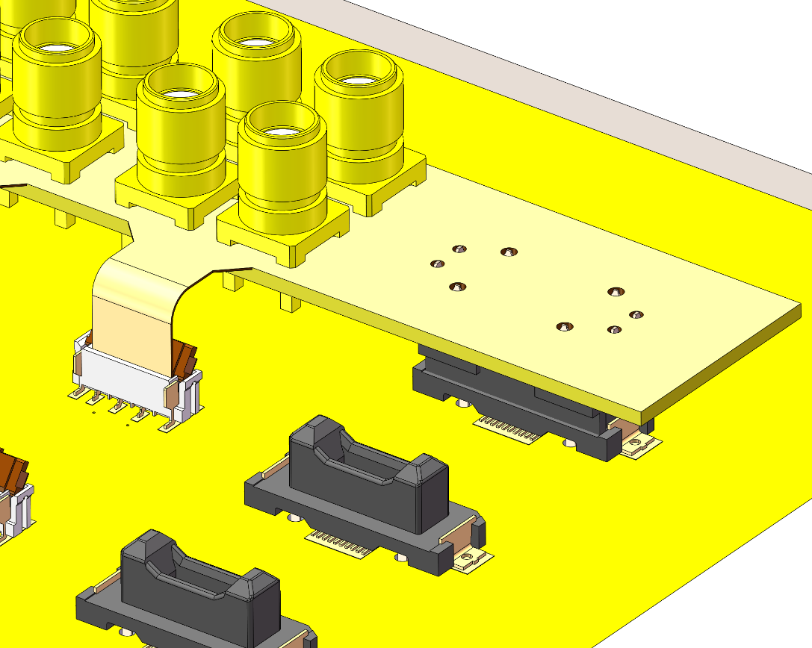
Readout of 12cm×12cm Picosec-μRGroove
No spring contact pin used to avoid PCB deformation caused by the force of pins;
FPC connectors and flexible PCB are used for readout;
Board-To-Board connectors are used to fix the readout PCB;
FPC connectors
Board-to-board connectors

Slide 8
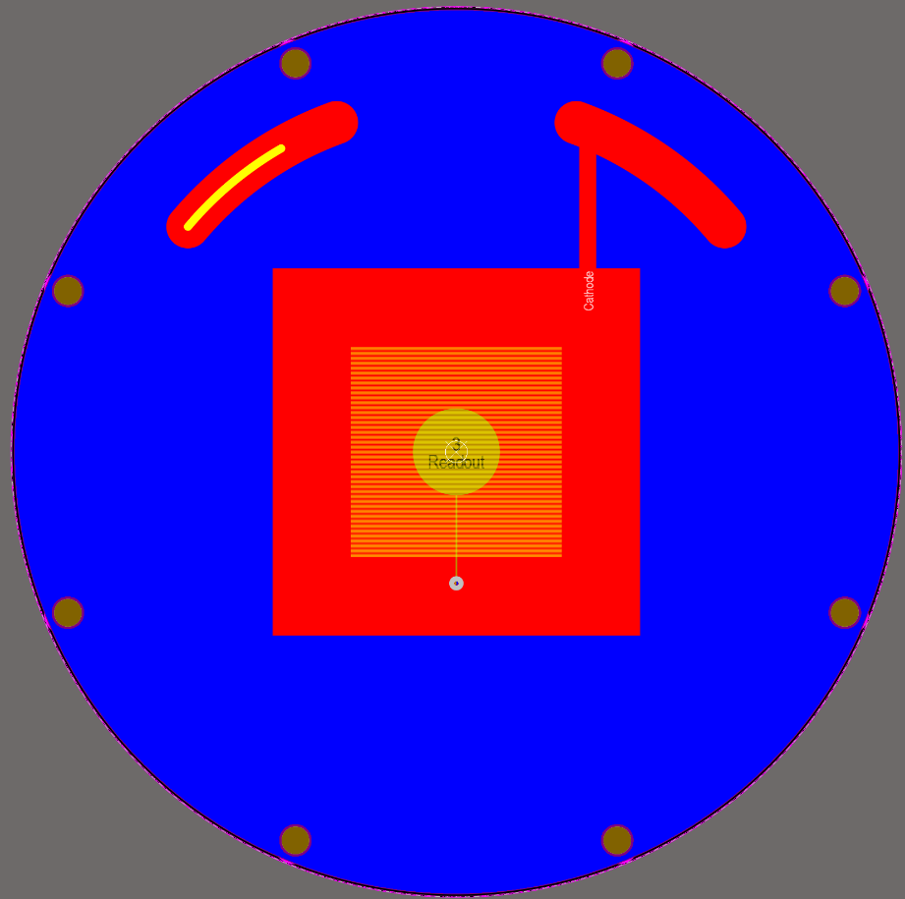
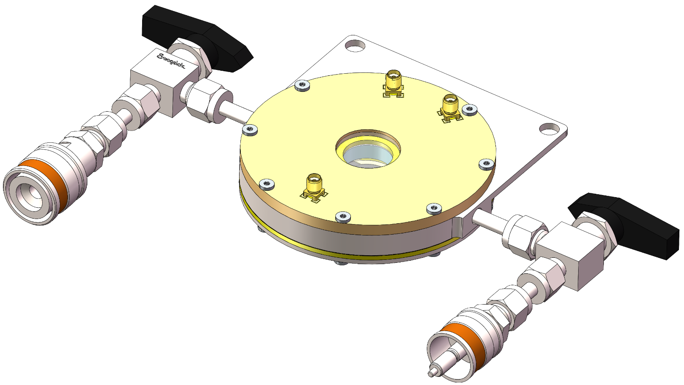
Principle verification of Picosec-μRGroove
Before the manufacturing of large detector, we should use small ones to do the principle verification;
Active area is 24mm×24mm, readout by a round pad with 10mm diameter;
75μm APICAL used, the corresponding width of groove is 90μm, pitch is 140μm;

Slide 9
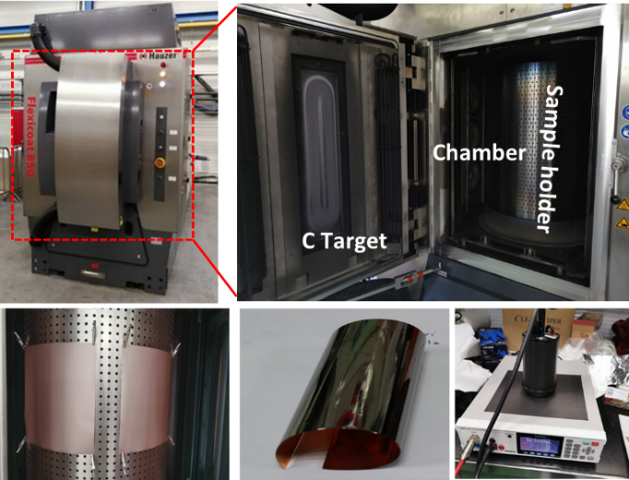
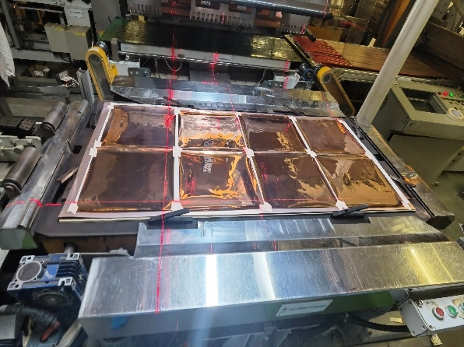
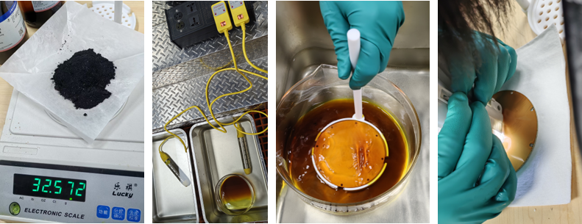
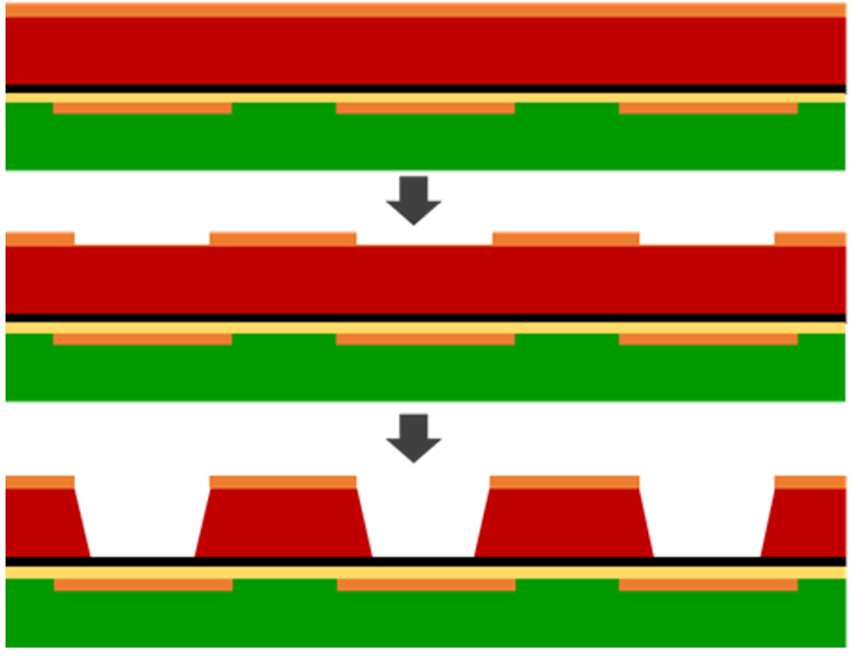
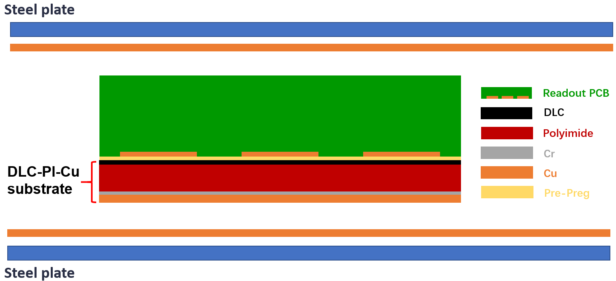
Production of Picosec-μRGroove prototype
@LICP, Lanzhou
@Yixing Fastprint
@USTC
Readout PCB
DLC-PI-Cu
1. Etching substrate
2. Lamination
3. Etching

Slide 10
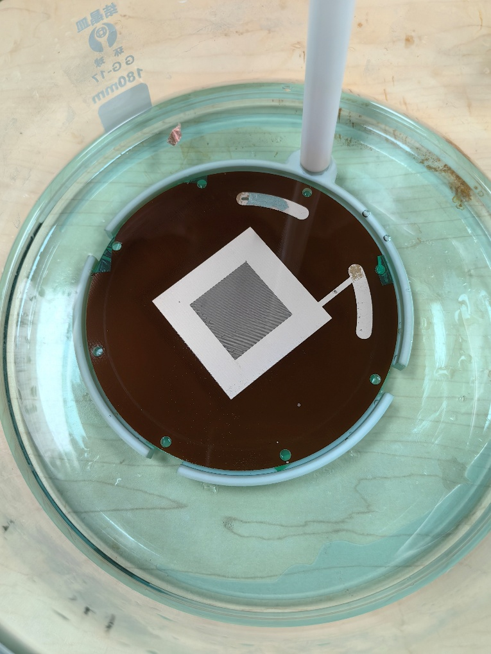
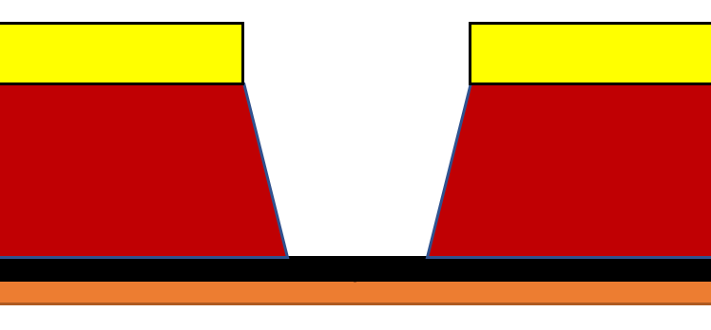
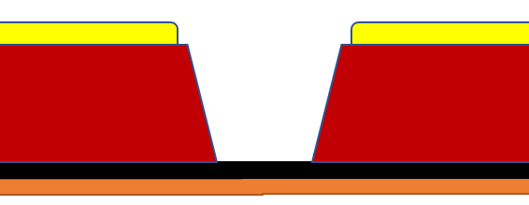
Micro-etching of Copper
Micro-etching
Expect effect of Micro-etching：
smooth edges
Thinner thickness
Basically no effect on width
Discharge reduces after etching
Low etching rate: 0.3∼0.5 μm/min

Slide 11
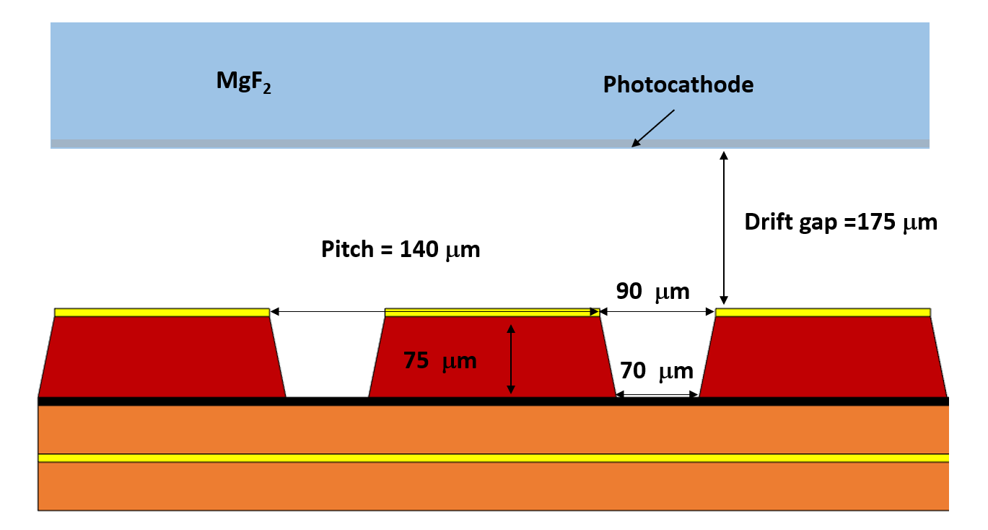
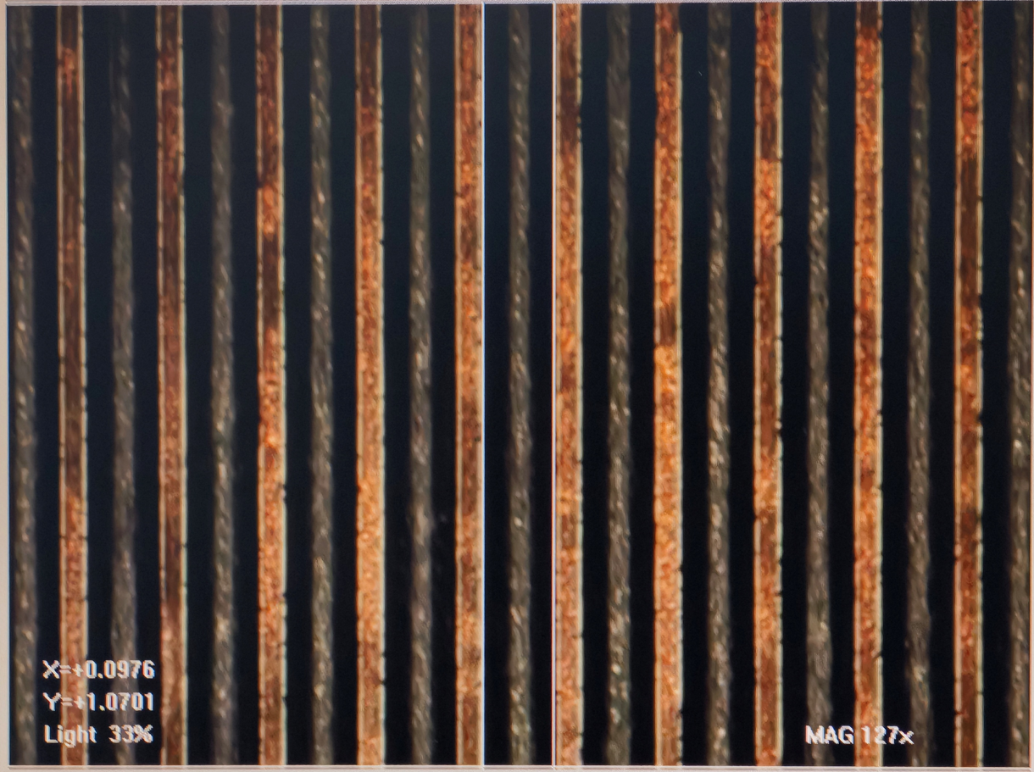
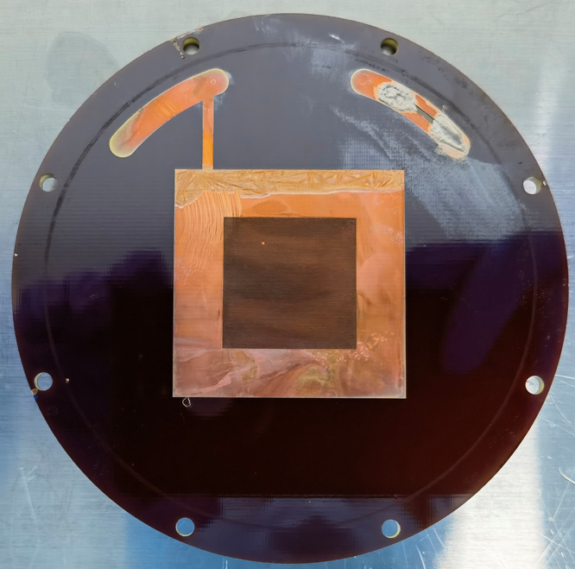
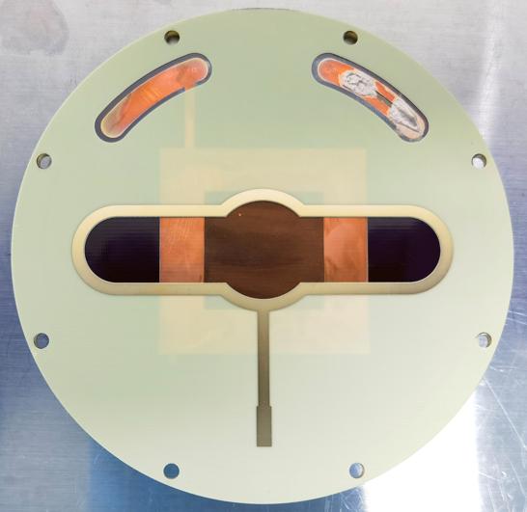
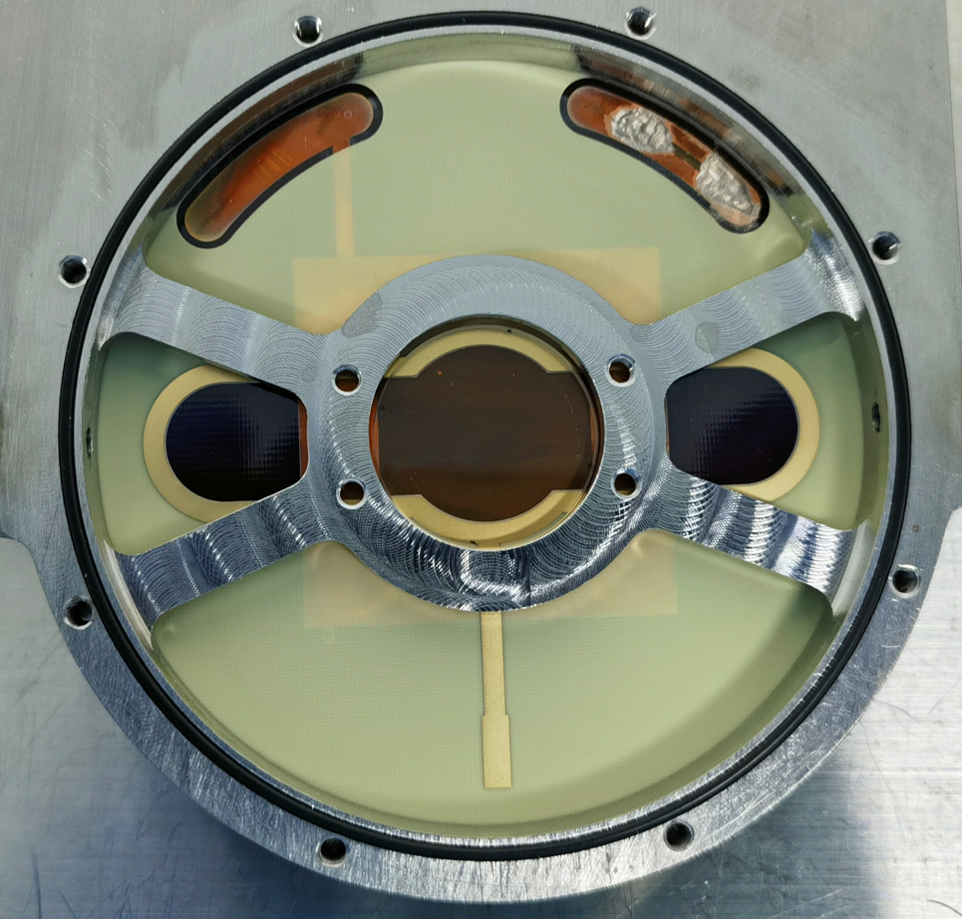
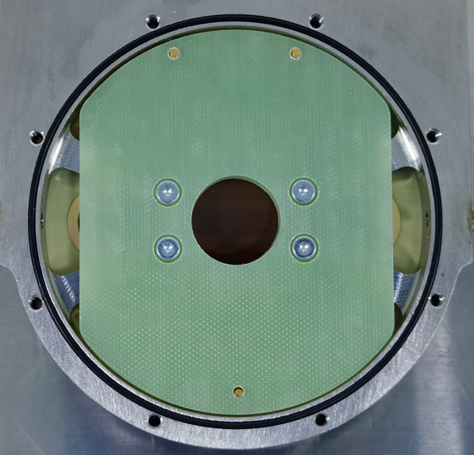
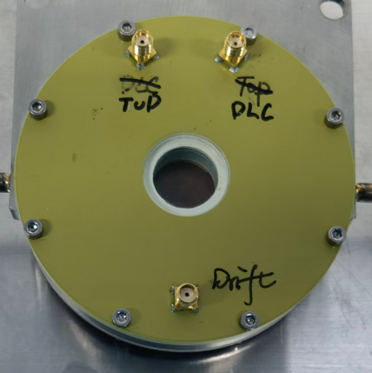
Picosec-μRGroove
Thickness: ~ 75 μm
Groove width: ~ 98/34 μm
Groove etching is not perfect
μRGroove PCB
175 μm spacer
MgF₂ crystal with
2nm DLC photocathode
Hard fixer
Window

Slide 12
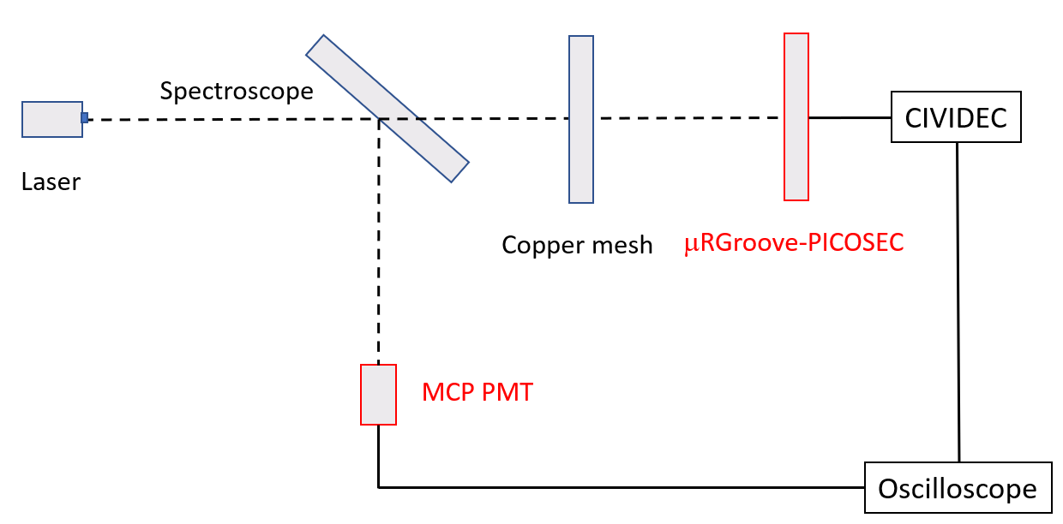
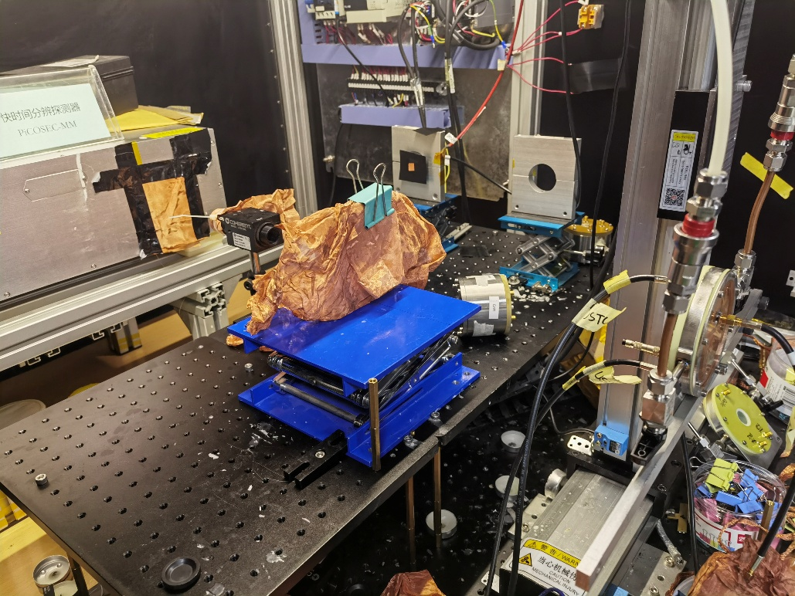
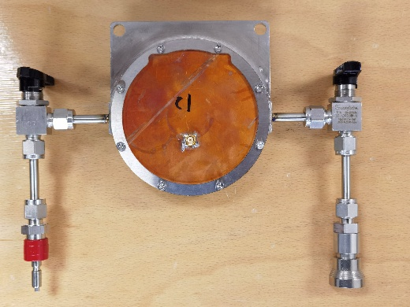
Laser test setup with small prototype
MCP PMT
Laser
PICOSEC-μRGroove
The setup of Laser test small prototypes :
Prototypes: single-pad PICOSEC-µRGroove
Reference timing detector: MCP-PMT (< 10 ps resolution)
Preamplifier: CIVIDEC
Readout: high resolution oscilloscope (20 GHz sample rate)
Single pad

Slide 13
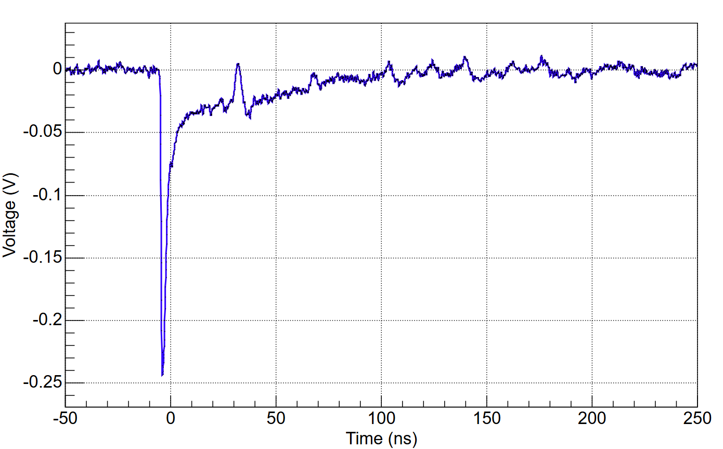
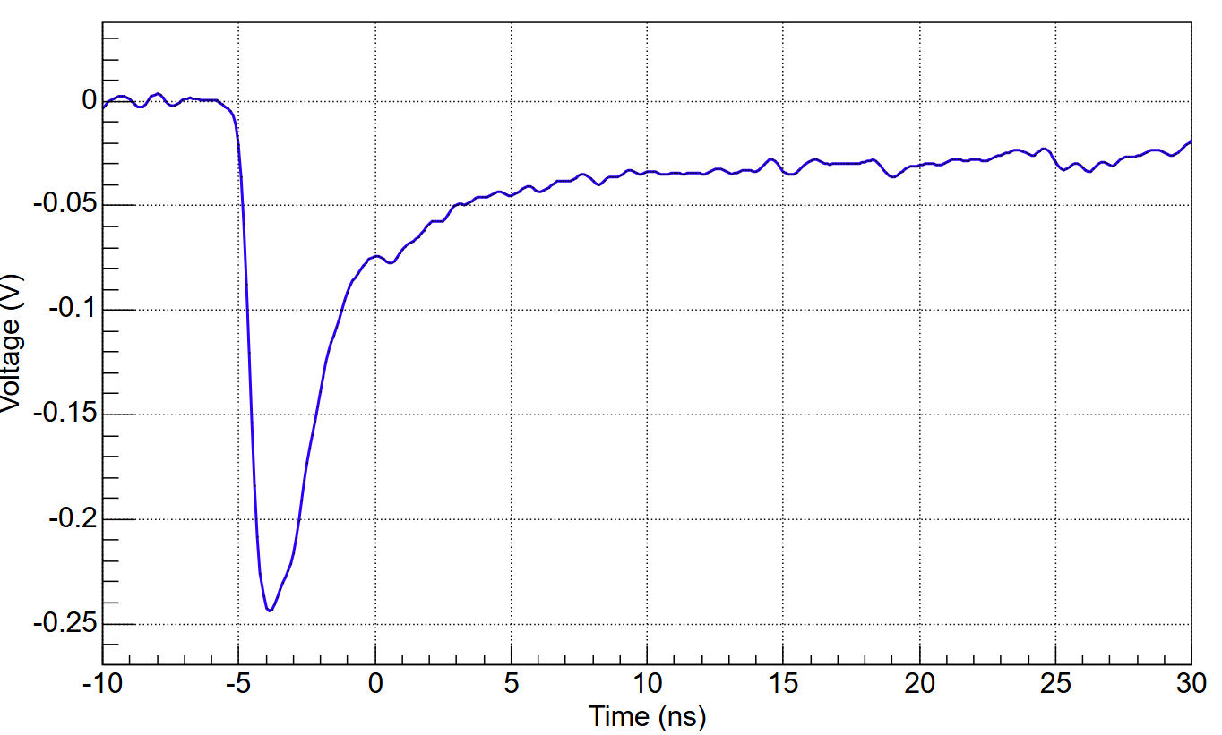
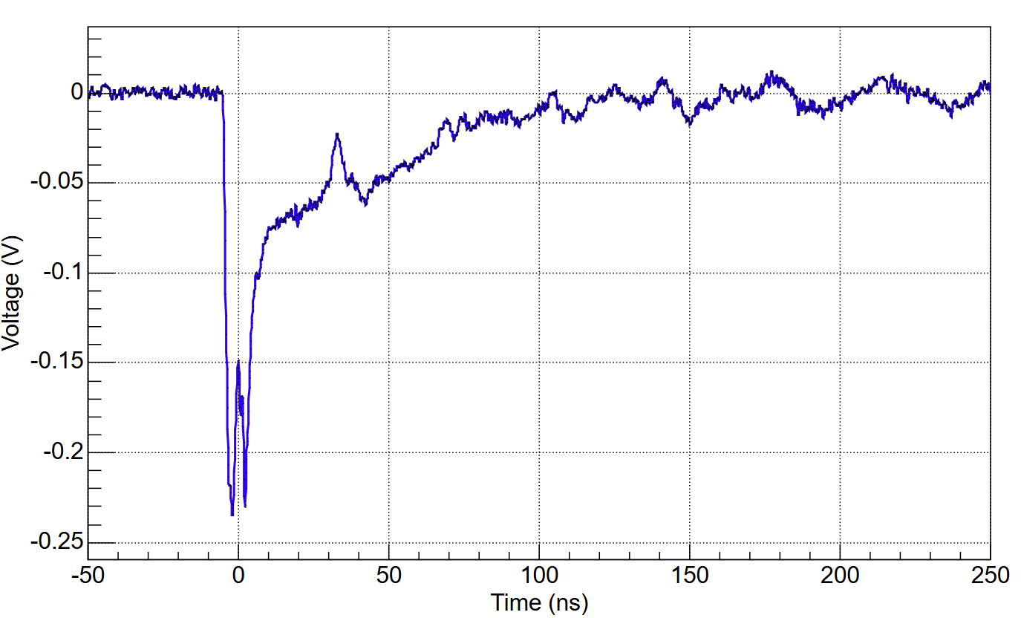
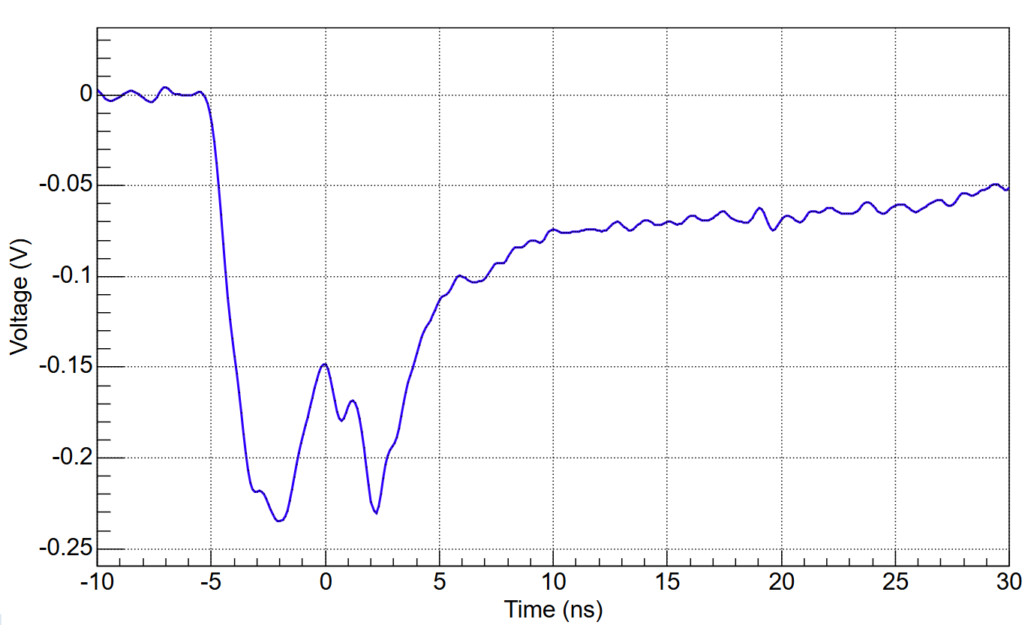
Waveform of Picosec-μRGroove prototype
Abnormal
Photon feedback?

Slide 14
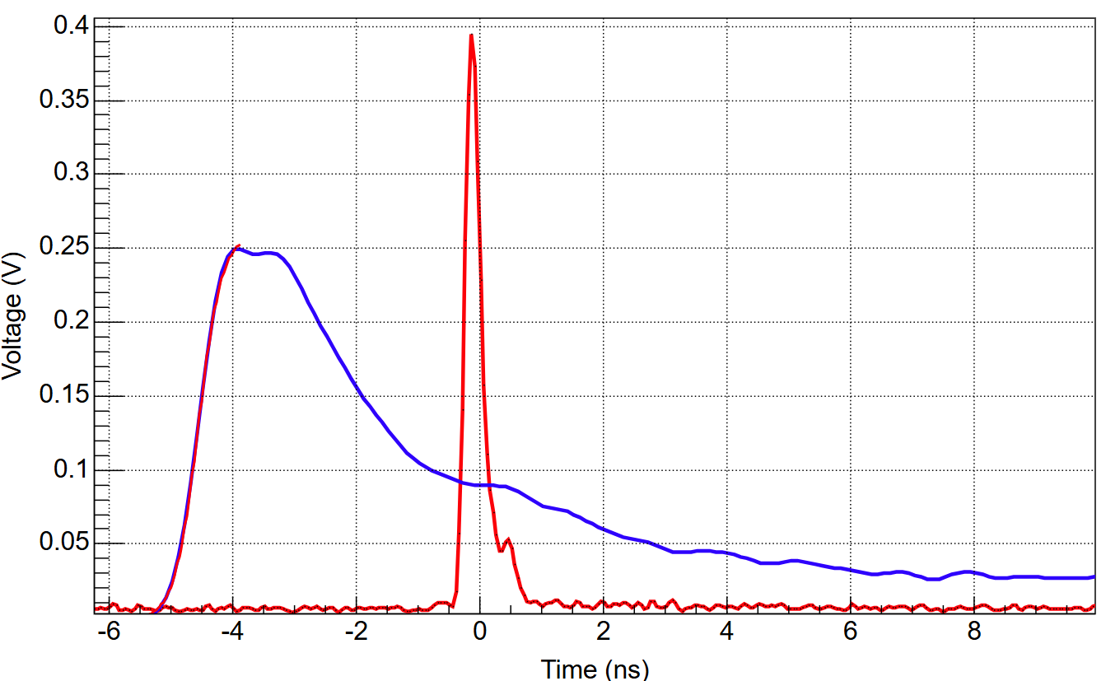
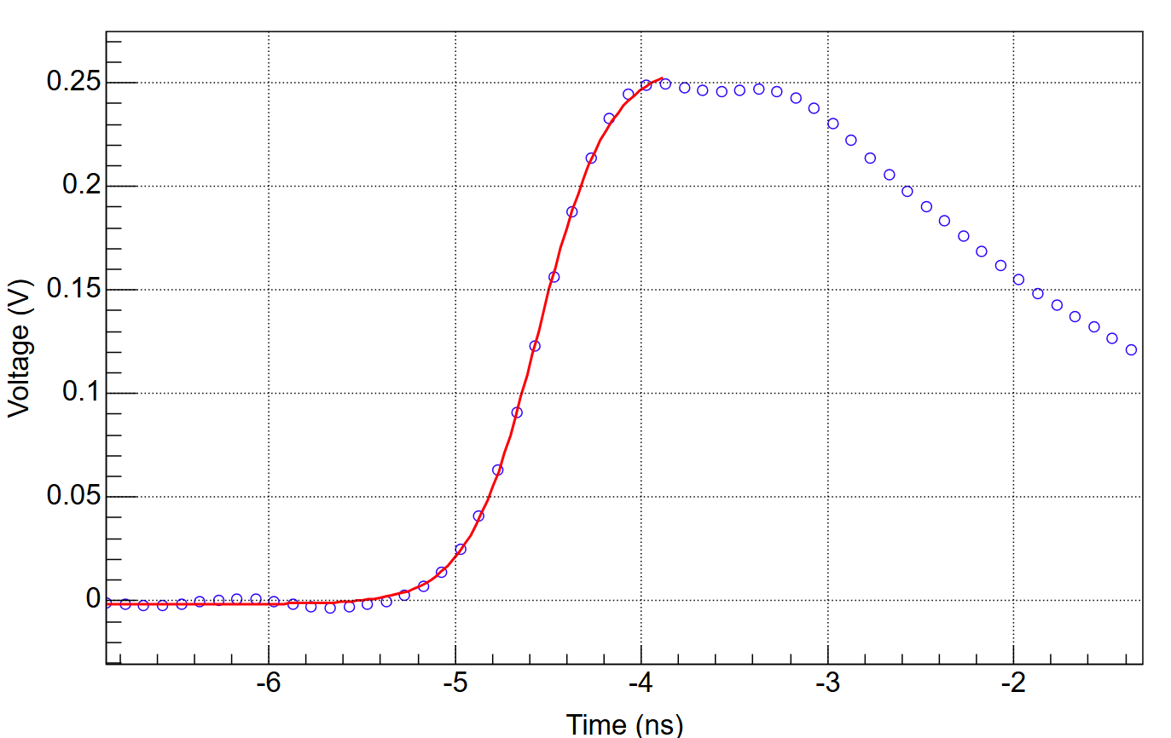
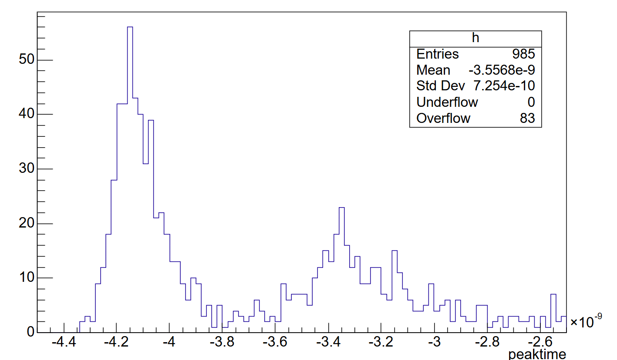
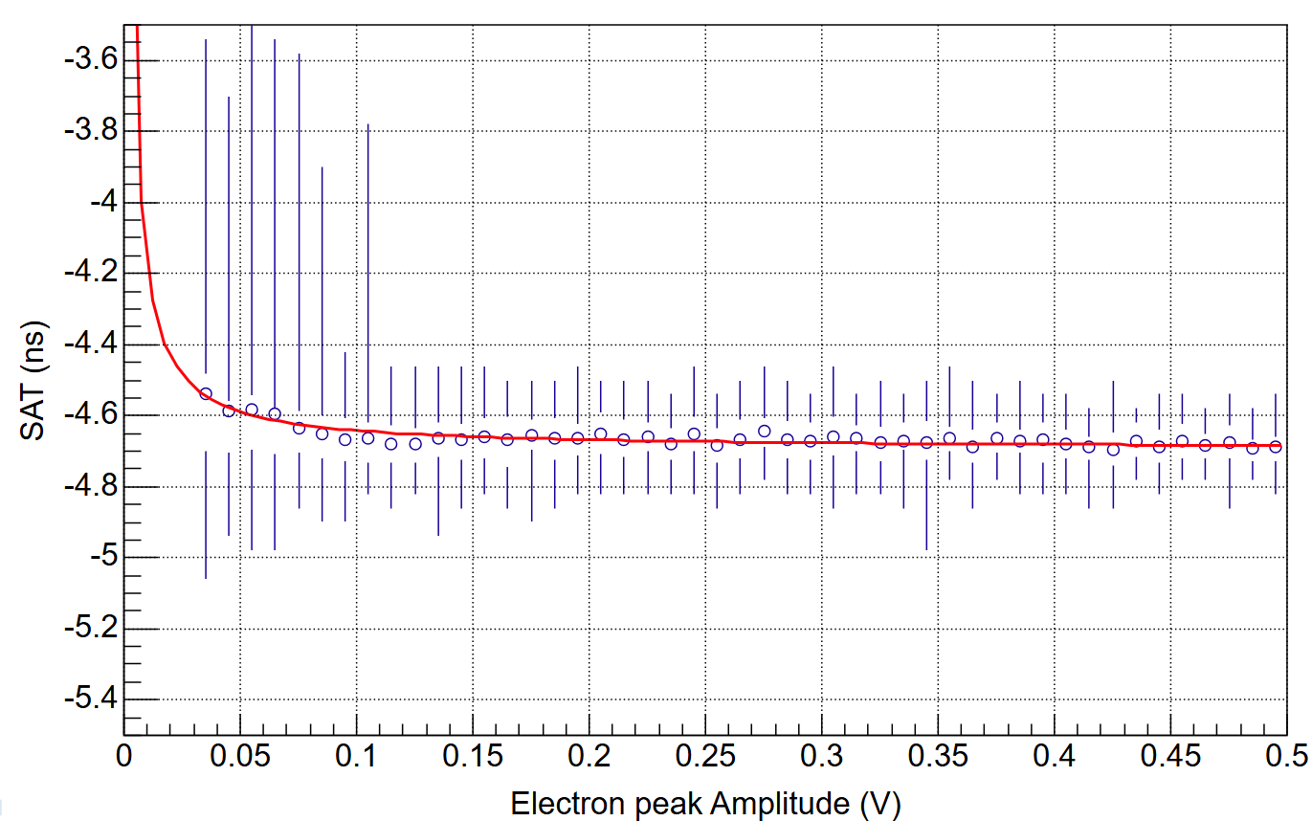

Analysis of PICOSEC data
MCP-PMT
PICOSEC-μRGroove
Time difference $=t_{\text{μ}\text{RGroove}}−t_{\text{MCP}\text{−}\text{PMT}}$
Sigmoid fit of signal
Cuts according to peak time
A sigmoid function is fitted to the leading edge of the electron-peak
The time corresponding to a 20% CF method applied to the sigmoid fit
Time walk correction is applied before subtracting from the reference time
Cuts according to peak time is used
Time walk correction

Slide 15
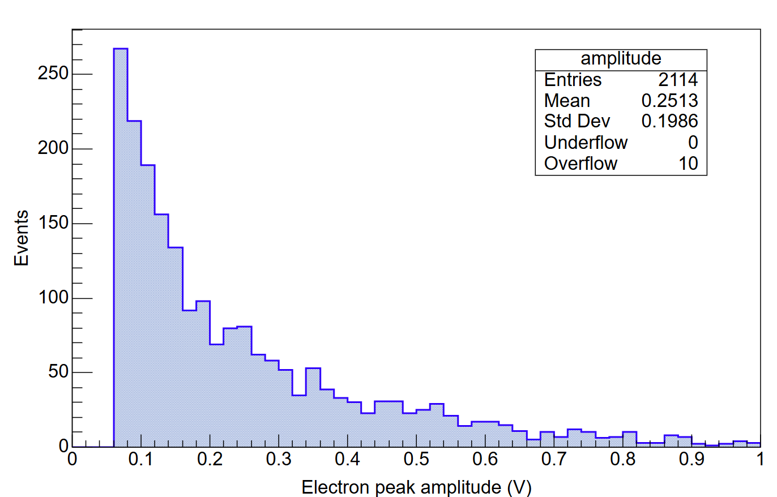
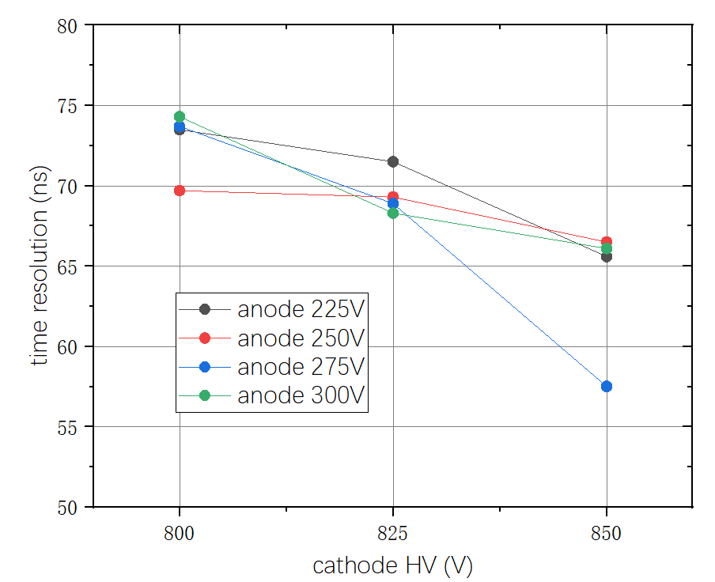
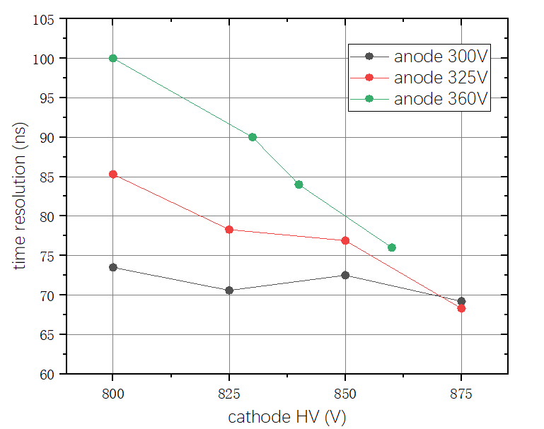
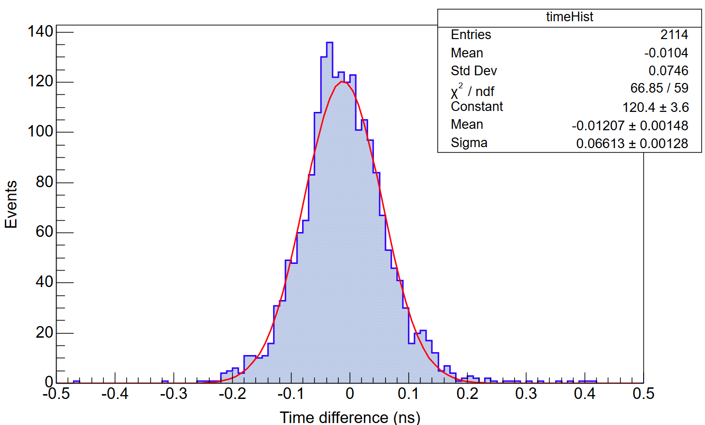
Preliminary results
prototype1
prototype2
66 ps
The Polya distribution was not observed
Single photon time resolution achieves ~ 60 ps @ 850V cathode voltage

Slide 16
Summary & Outlook
Several picosec-μRGroove prototypes are produced;
~60ps time resolution for single-photon achieved;
The distorted waveforms limited the time resolution;
Detector optimization to reduce the distorted waveforms;
The picosec-μRGroove prototypes will be tested in July beam.

