Slide 1
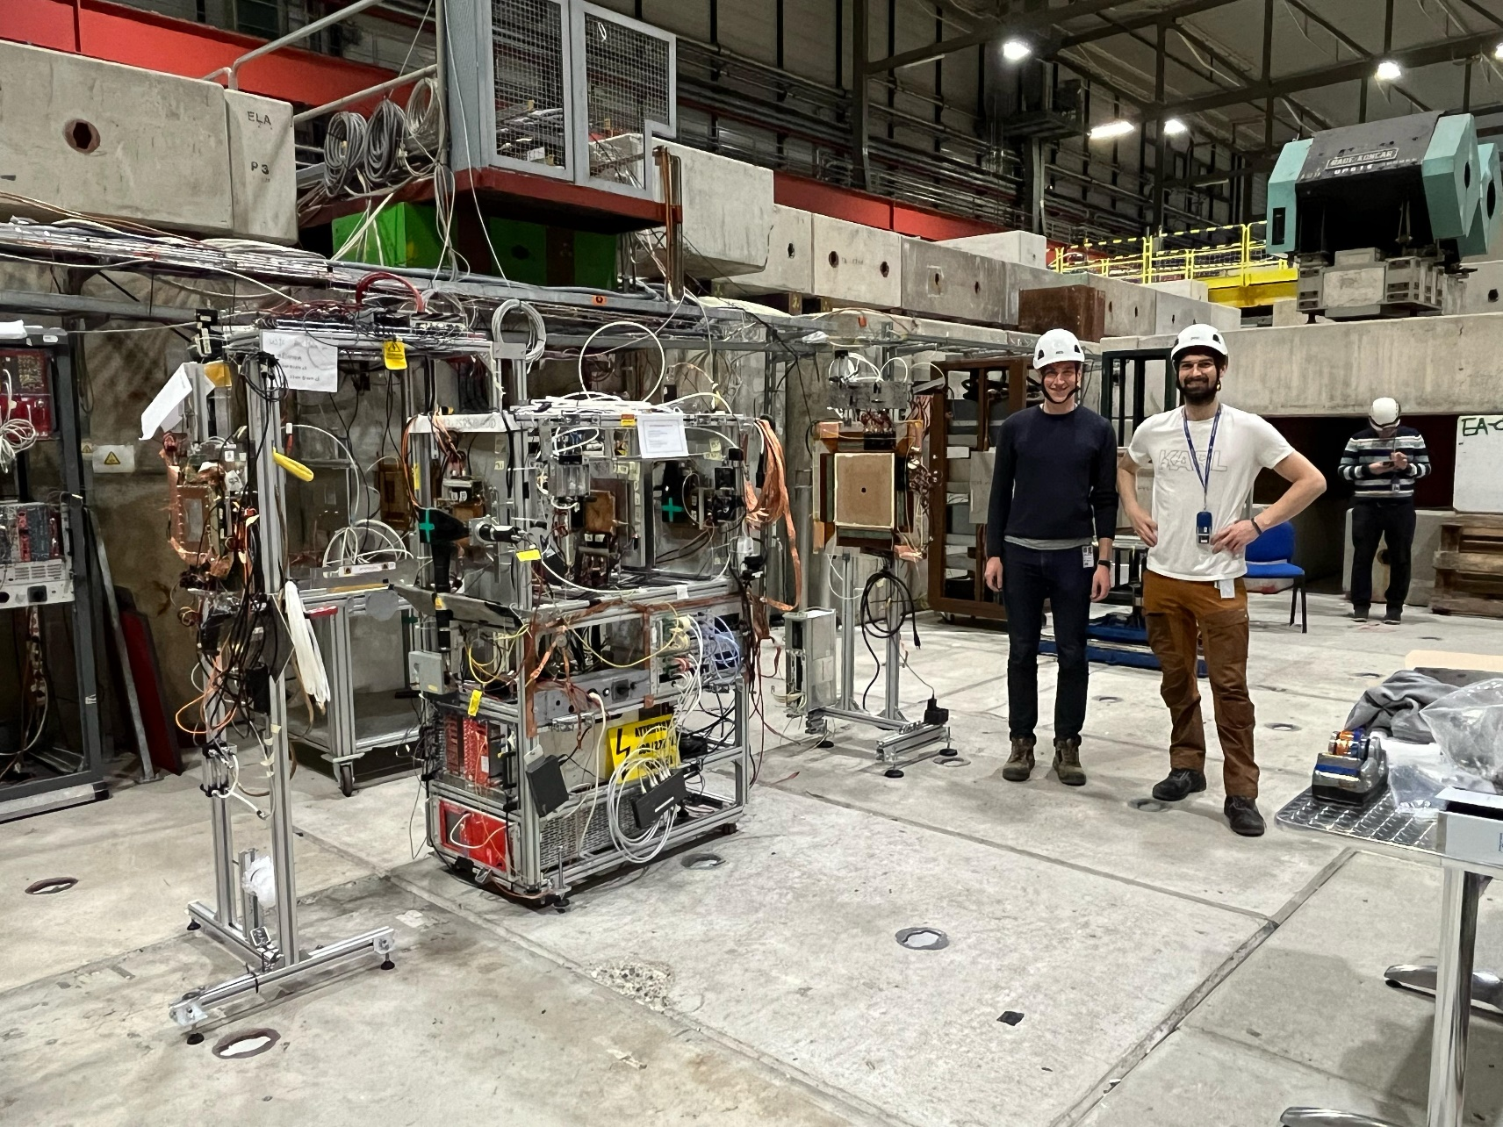
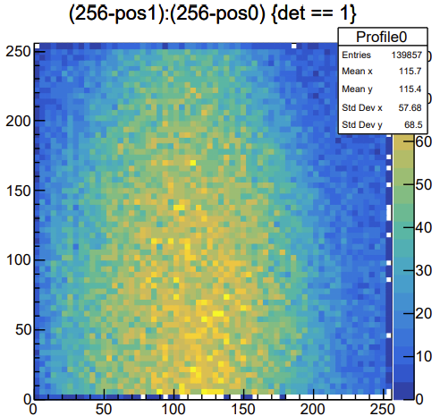
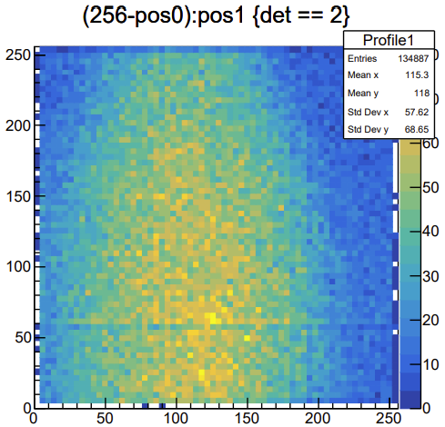
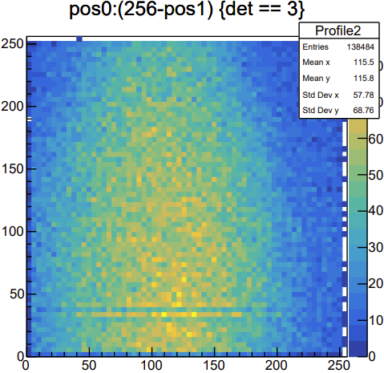
GDD/DRD1 Telescope
Planned measurements:
Studies on the effect of CF4 in µRWELL
Summer Student project: Commissioning of new telescope (setup B)
→ utilise Corryvreckan for tracking
Provide reference tracking for WellPix (µRWell + Timepix4) prototype
Support: GEM TPCs and R/O of non MPDGs with VMM3a/SRS
→ MWPC-Tracker-VMM; INFN Bari RPC group
Firmware tests (event counter to sync with e.g. PICOSEC setup)
Setup A:
3 scintillators in coincidence trigger (~ns reference)
3 compass-like triple GEM trackers (50um to 100um reference)
DUTs
Setup B:
3 Thermal bonded MM (borrowed from Zhiong et al.)
https://doi.org/10.1016/j.nima.2020.164958
WellPix as DUT
Requirements and needs:
No magnet, no alignment, no movable table
Gases: Ar/CO2 93/7 & 70/30, Ar/CO2/CF4 - 45/15/40
Beam: mainly Muons, potentially Pions
T1
T2
T3
Tracker 1
DUT1
DUT2
SCINT.
Tracker 3
Tracker 2
SCINT.

Slide 2
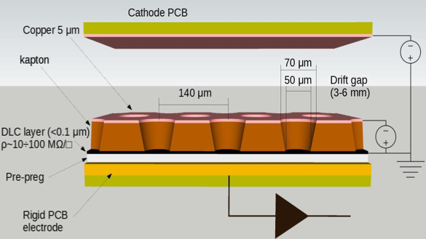
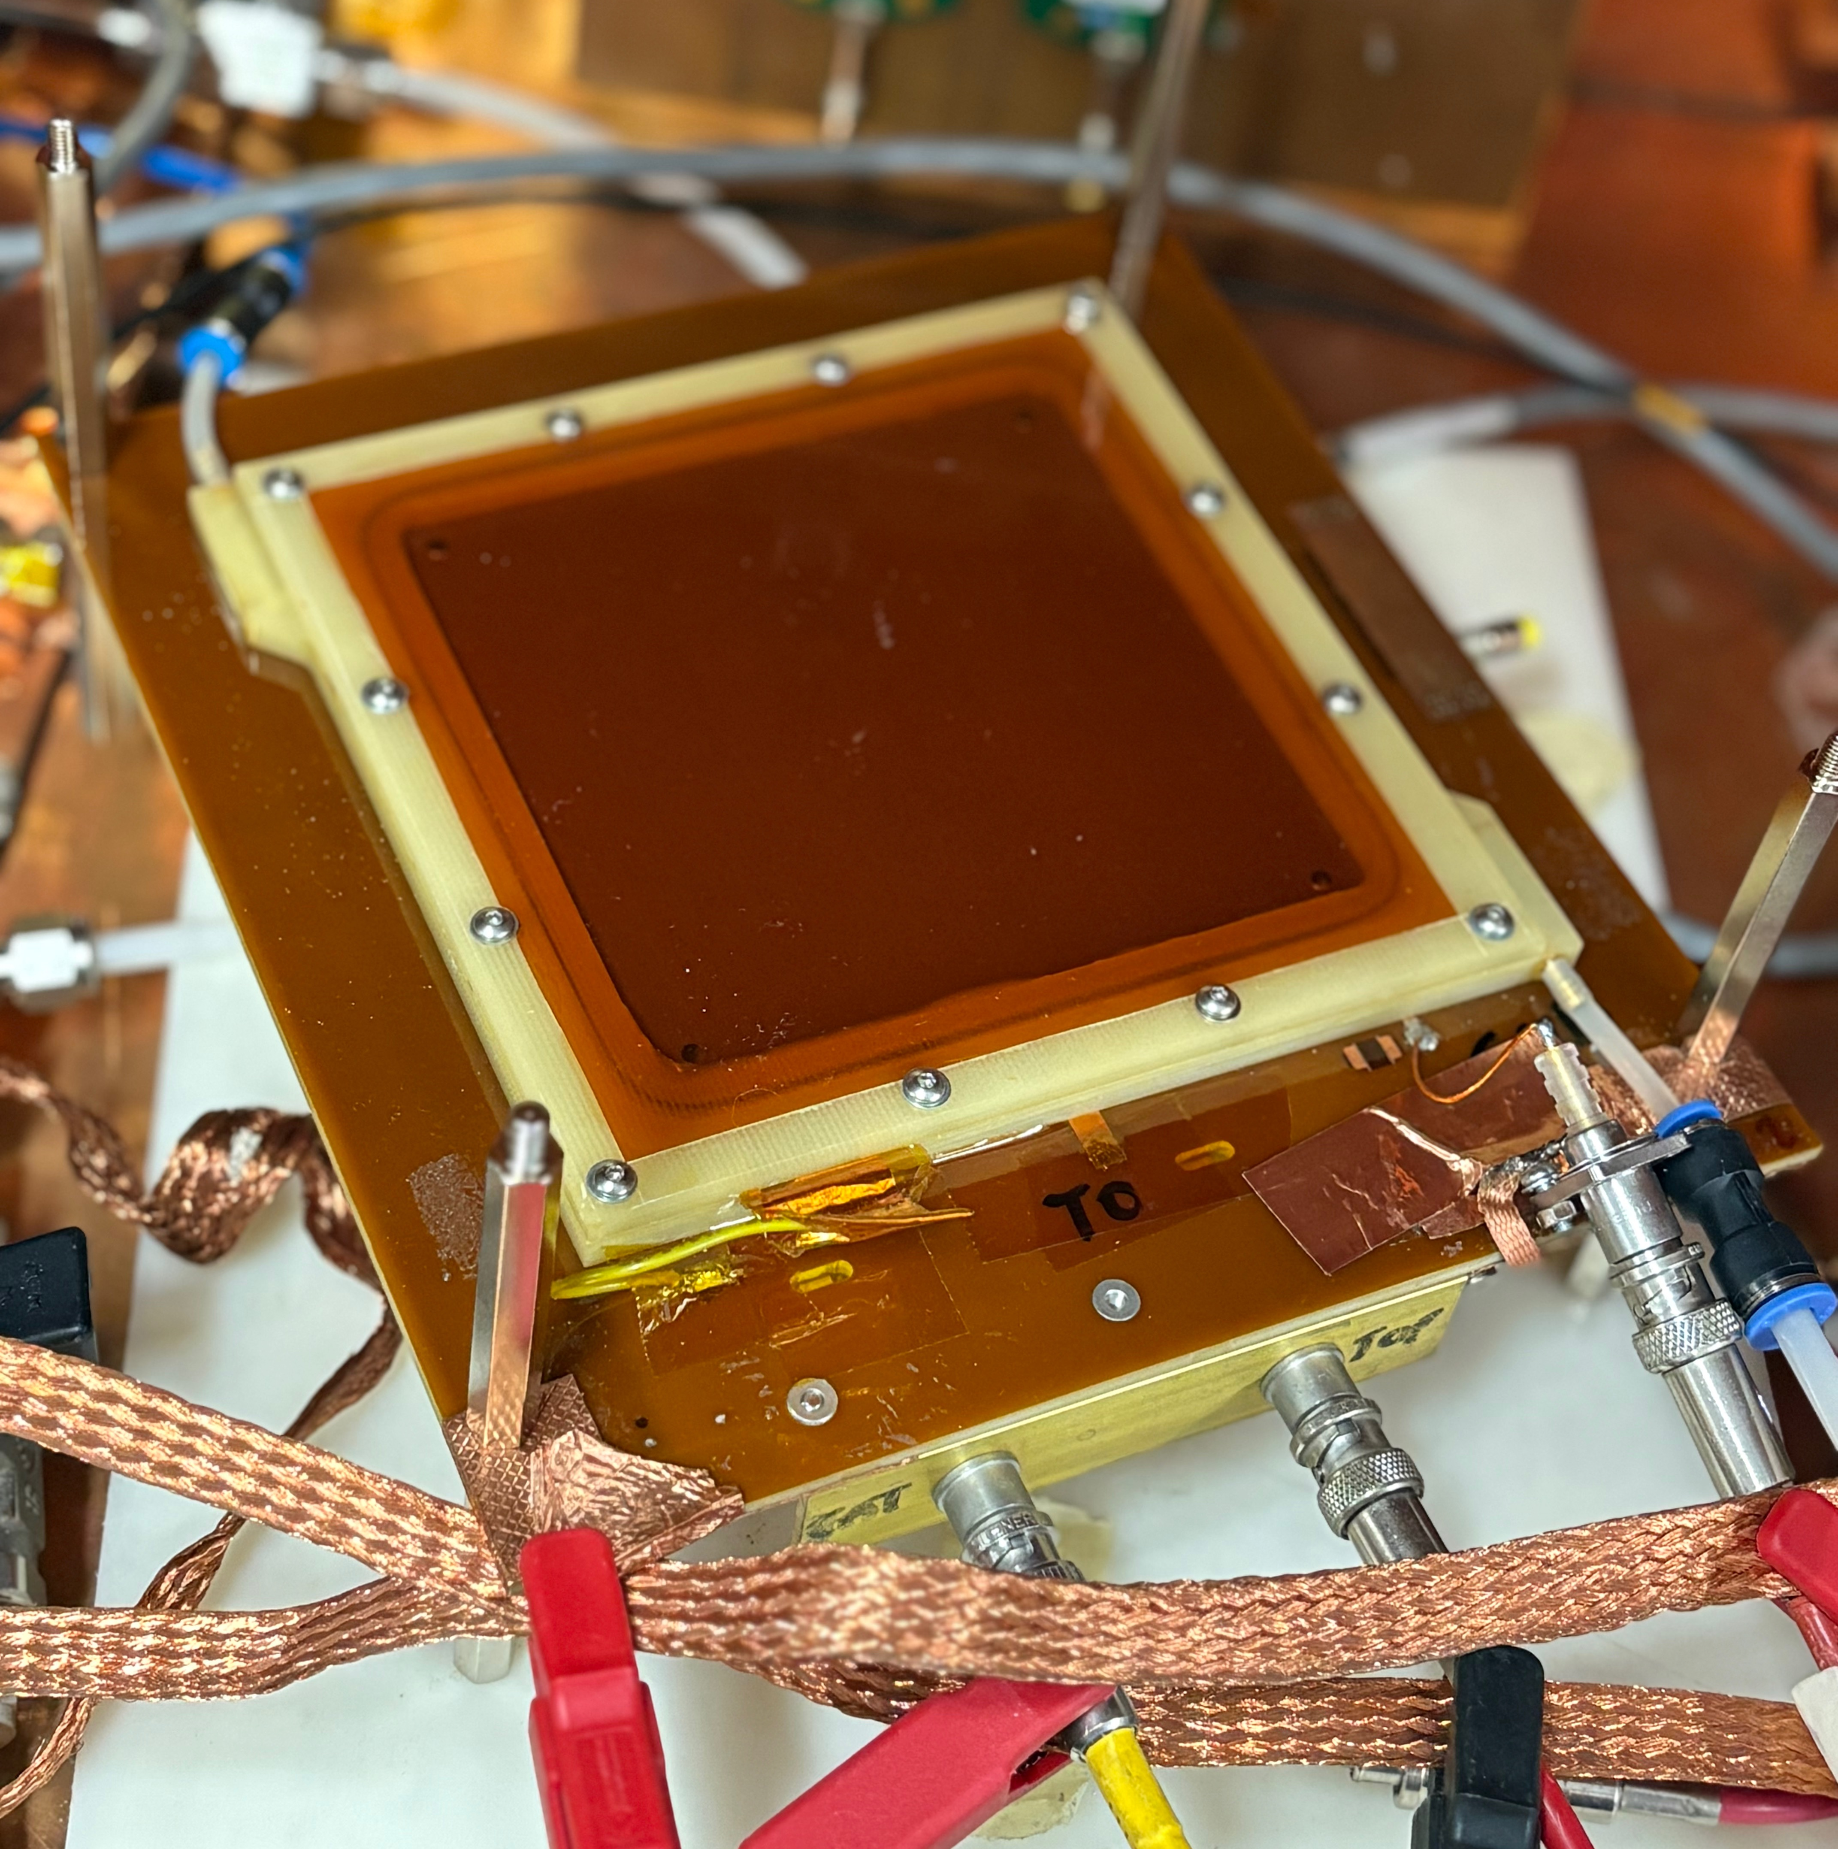

Studies on the effect of CF4 in µRWELL
Goal: reducing the CF4 concentration
Gas mixtures to test:
Ar/CO2 - 70/30
Ar/CO2/CF4 - 45/15/40
Test beam in preparation of the November test beam, where different gas mixtures will be tested
To evaluate how the addition of CF₄ affects performance in μRWELL detectors, focusing on:
Efficiency
Time and spatial resolution
Hit profile, using the VMM read-out chip
Additional:
Test a second μRWELL with an alternative powering scheme to compare performance under different configurations.
10 x 10 cm µRWELL prototype
Drift gap: 6mm
Read-out pads: 1 × 1 cm²
Read-out channels: 121
DAQ: VMM
Special thanks to the GDD team!
Ștefania Juks | EP-DT-FS Gas Group
19 June 2025

Slide 3
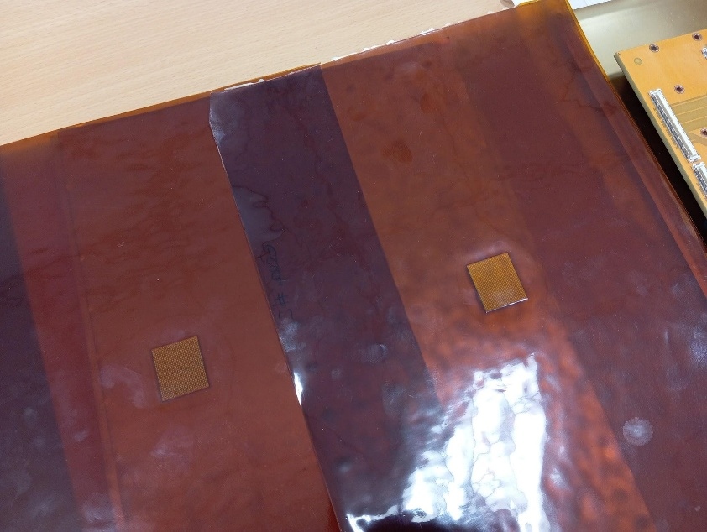
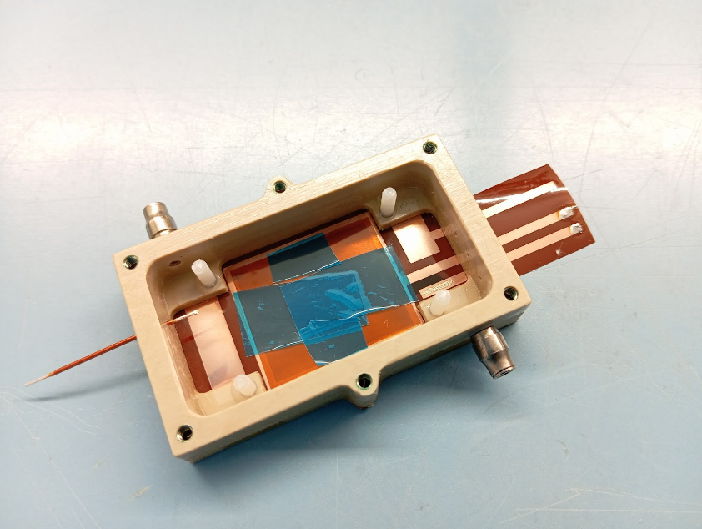
WellPix µRWell with Timepix4
Project: embedding of Timepix4 (high-granularity readout) in MPGD amplification stage by means of PCB manufacturing technologies
Timepix4: square pixels with 55 µm pitch
µRWell: hexagonal hole pattern with 140 µm pitch
Explore if/how spatial resolution and efficiency are affected by this mismatch
Needs:
Reference tracking with Setup B
Ar/CO₂ (70/30) and MAYBE Ar/iC₄H₁₀ (98/2)
Synchronisation between SRS and SPIDR4
Timing reference
L. Scharenberg, D. Marques, K.J. Flöthner
19 June 2025

