Slide 1


National Technical University of Athens
School of Applied Mathematics and Physical Sciences
Environmental and Magnetic Field Monitoring System
Evgenia Leonida
Prof. Yorgos Tsipolitis
NTUA

Slide 2

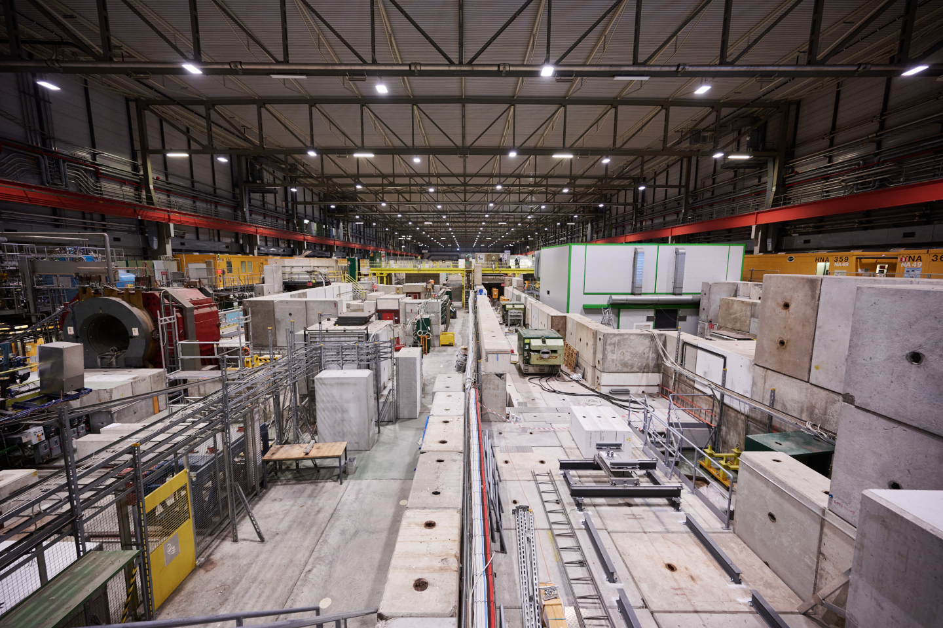
Motivation and Objective
Particle detector test environments, such as those at CERN's North Area, require precise monitoring of environmental conditions to ensure accurate experimental results.
Develop a complete system for monitoring critical environmental and magnetic parameters using Arduino, Raspberry Pi, and sensor boards.
Ensure integration with Grafana and modern SCADA platforms (e.g., WinCC OA) for real-time control and visualization.
Provide a reliable, scalable, and field-tested solution that contributes to improving the usability and robustness of existing detector infrastructure.
Parameters like temperature, pressure, humidity, and magnetic field can significantly affect the performance and interpretation of gaseous detectors.
objective
There is a growing demand for low-cost, accurate, and easy-to-maintain monitoring systems that support detector operations.

Slide 3
System Overview

Slide 4




System Overview
Environmental Sensor
Magnetic Field Sensors
The system is designed to measure environmental and magnetic field parameters.
It integrates hardware (sensors + microcontrollers) and software (data collection, storage, and visualization).
Sensor Board
Arduino
Arduino Uno/Mega: Reads sensor data and sends it over serial
Raspberry Pi: Acts as a bridge and local processing node
InfluxDB: Stores sensor data in time-series format
Grafana: Provides real-time visualization and historical analysis
Raspberry Pi
Influxdb
Grafana

Slide 5
System Overview
Environmental Sensor
Magnetic Field Sensors
Magnet
Arduino Uno/Mega: Reads sensor data and sends it over serial
Raspberry Pi: Acts as a bridge and local processing node
InfluxDB: Stores sensor data in time-series format
Grafana: Provides real-time visualization and historical analysis
Magnetic Field Sensors
Sensor Board
Arduino
Environmental Sensors
Arduino
Serial
Communication
Raspberry Pi
Raspberry Pi
Environmental Sensors
Influxdb
Grafana
Grafana
Test Beam Area
Raspberry Pi fails under strong magnetic fields due to high-speed components and poor EMI shielding;

Slide 6
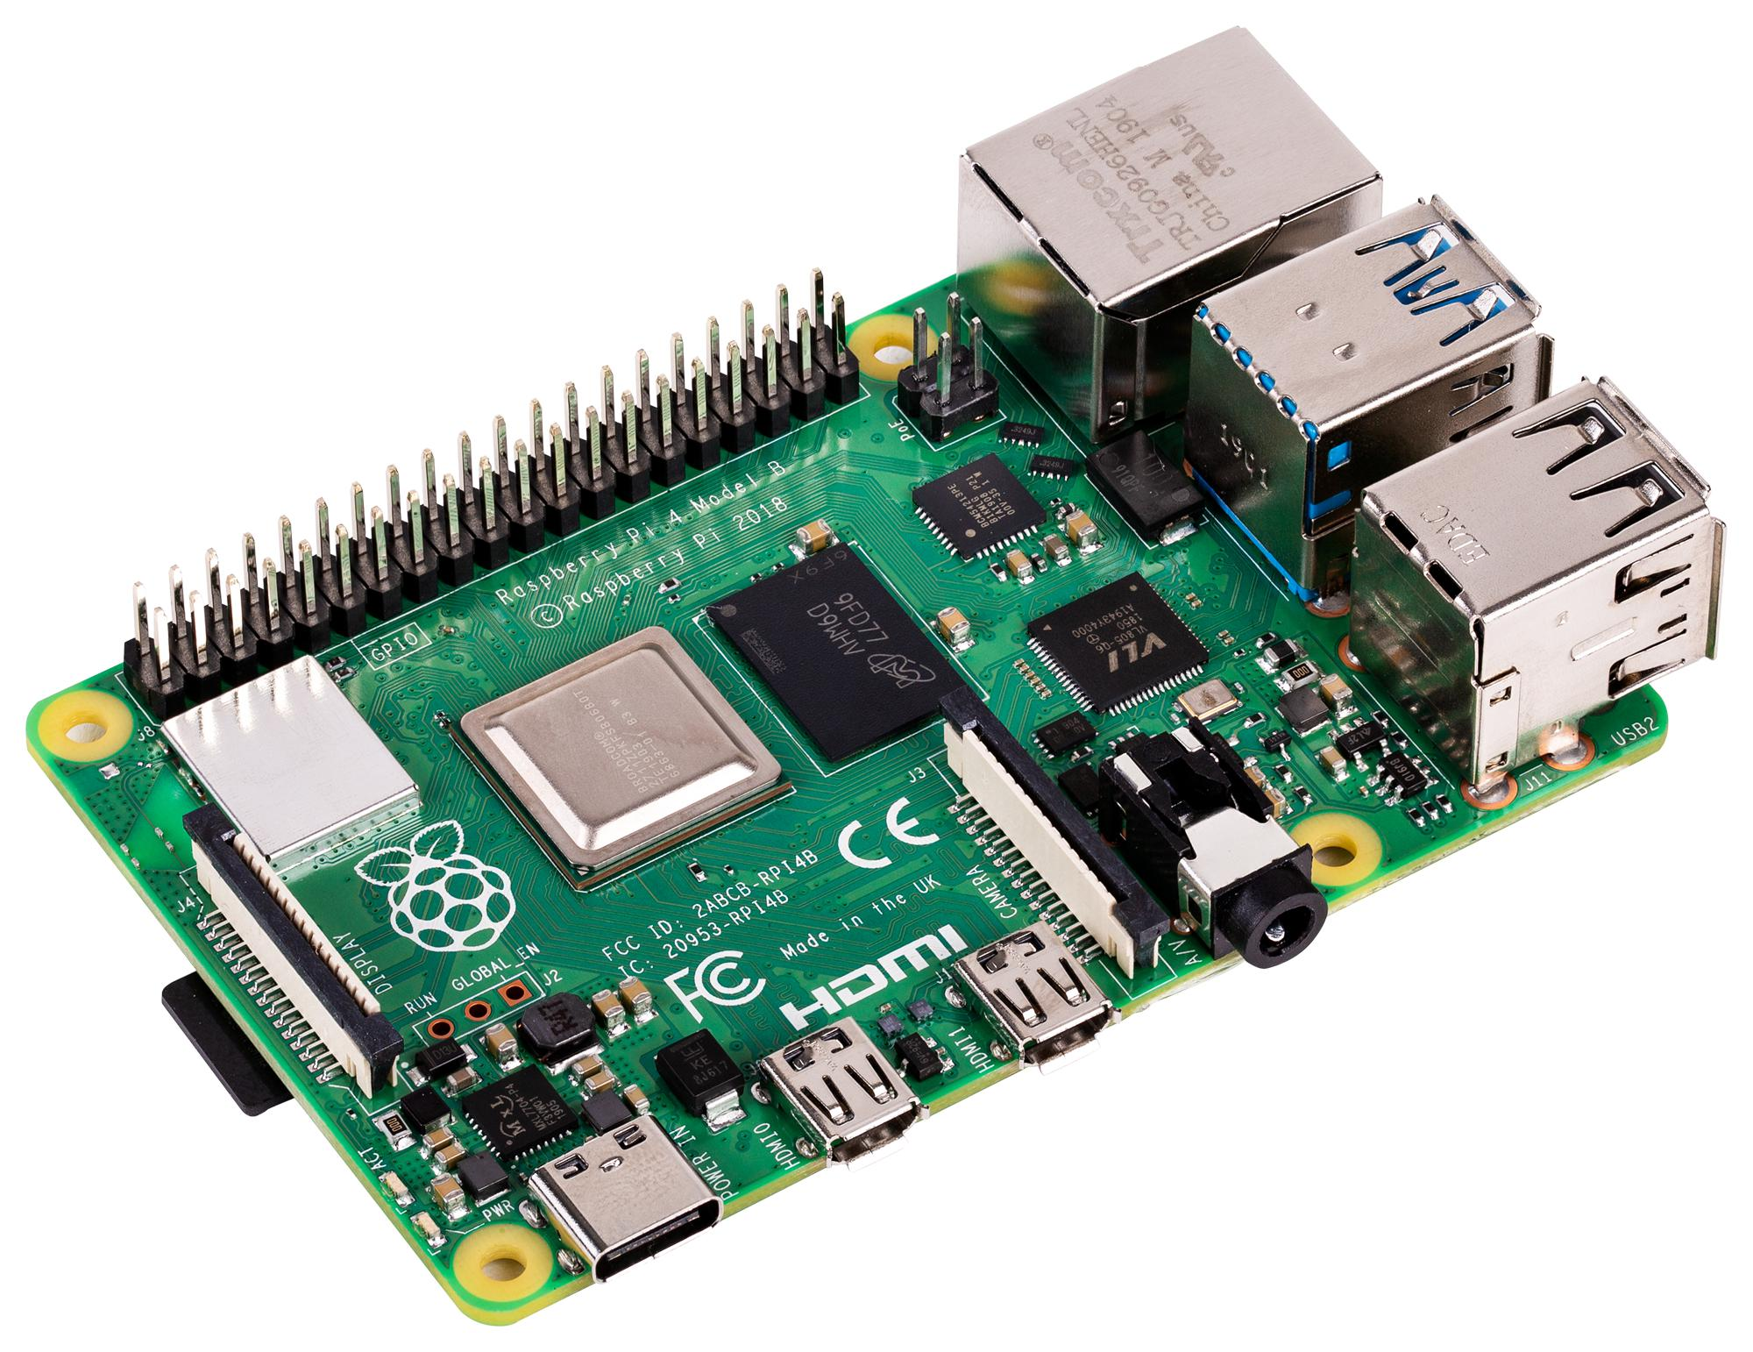
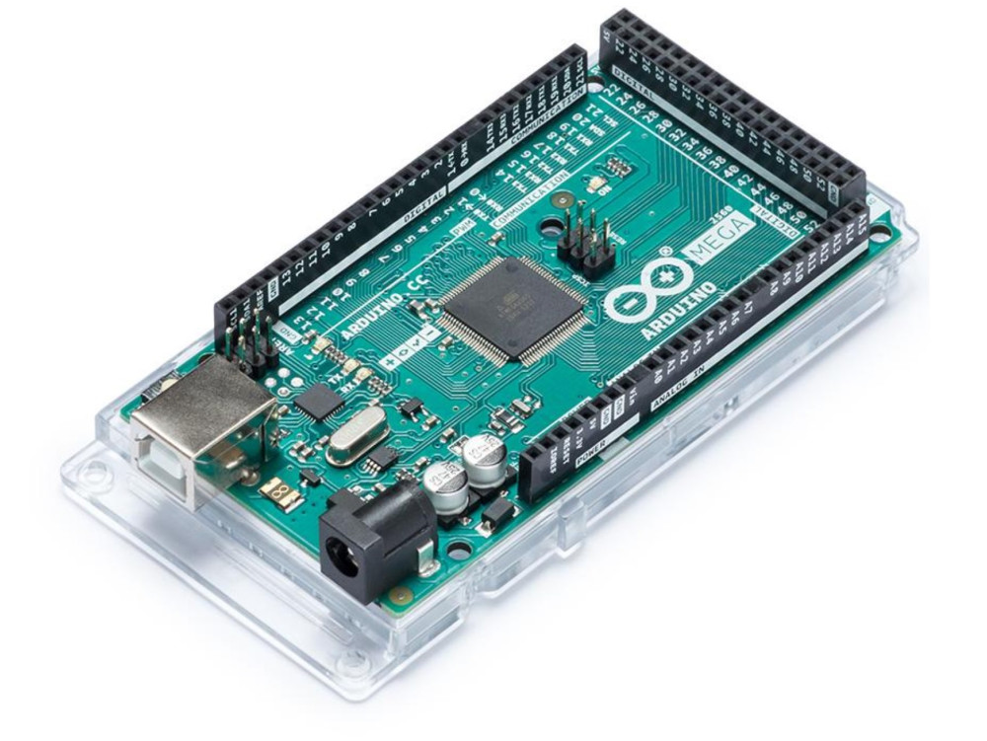
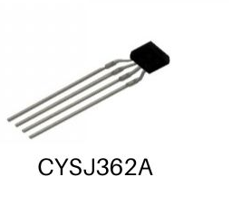
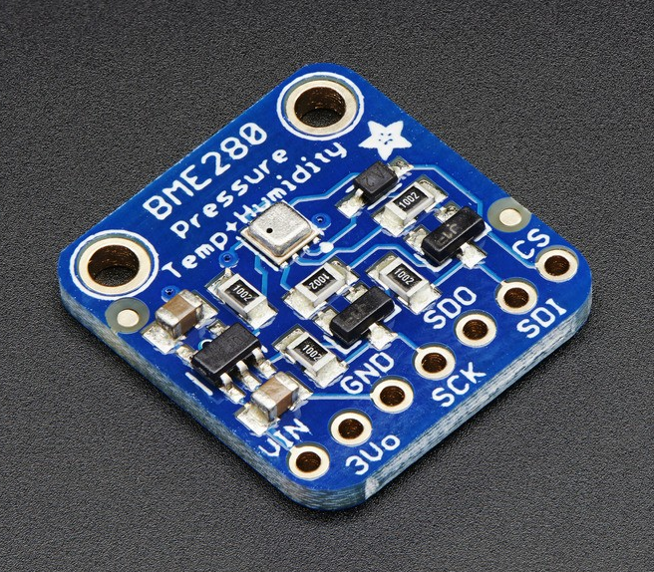
Hardware Components
2x BME280 Sensor (temperature, pressure, humidity)
3x Hall Effect Sensors (magnetic field monitoring) (CYSJ362A)
Arduino Mega(data acquisition)
Raspberry Pi 3B+(data collection + database interface)
one for each axis (x,y,z)

Slide 7
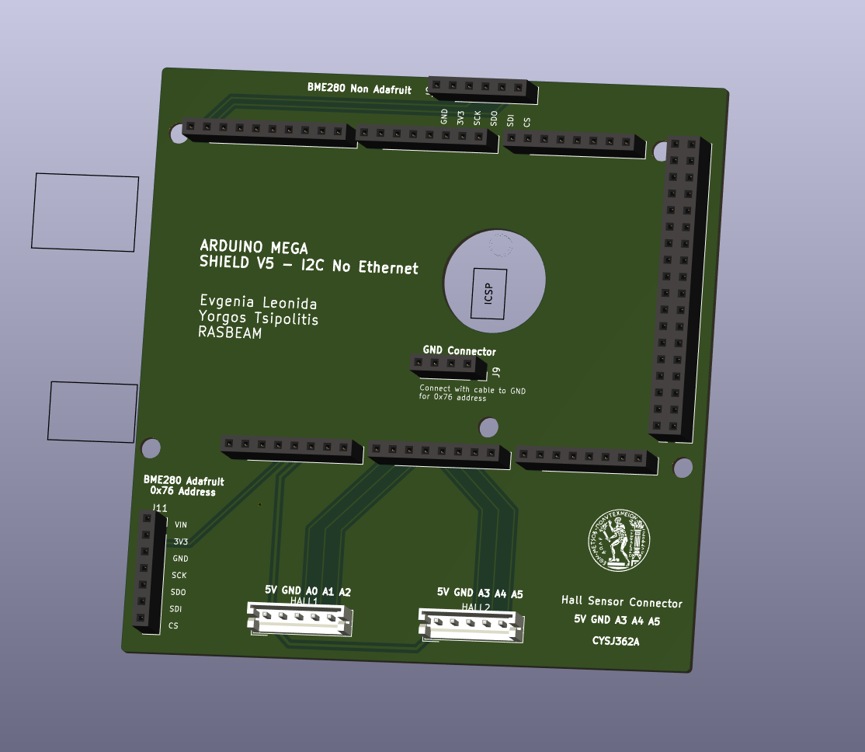
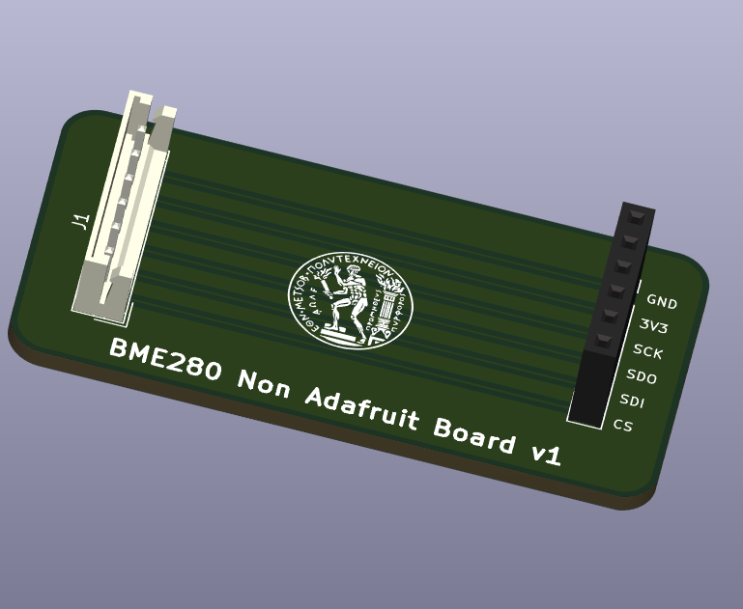
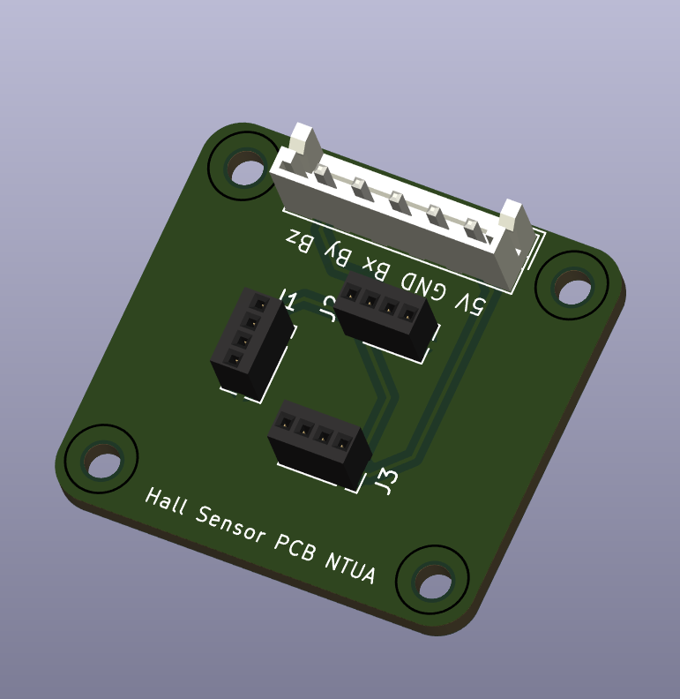
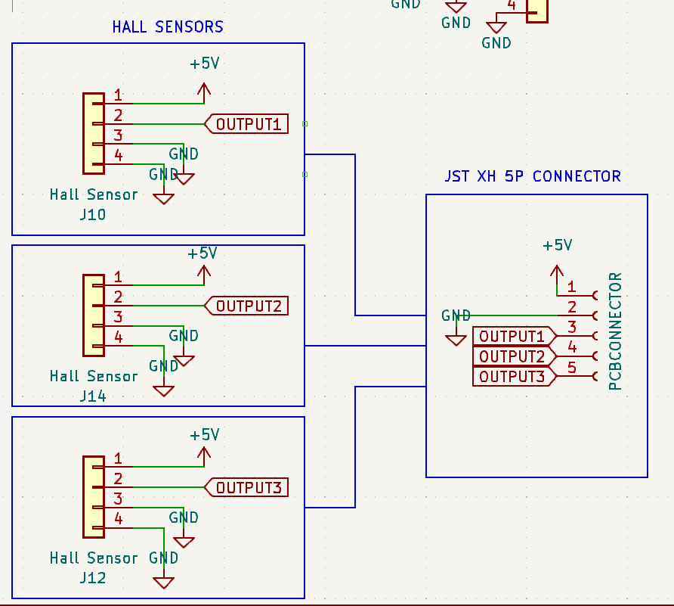
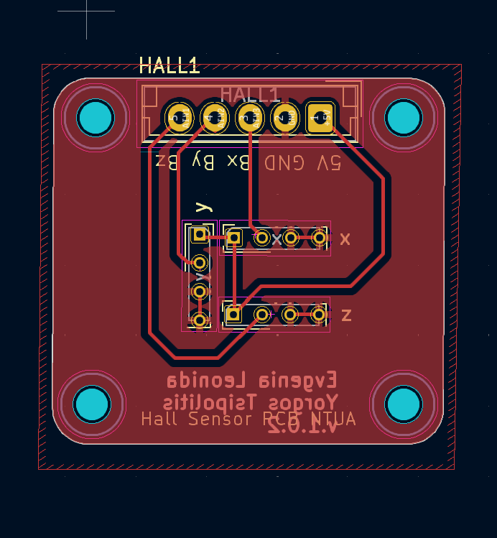

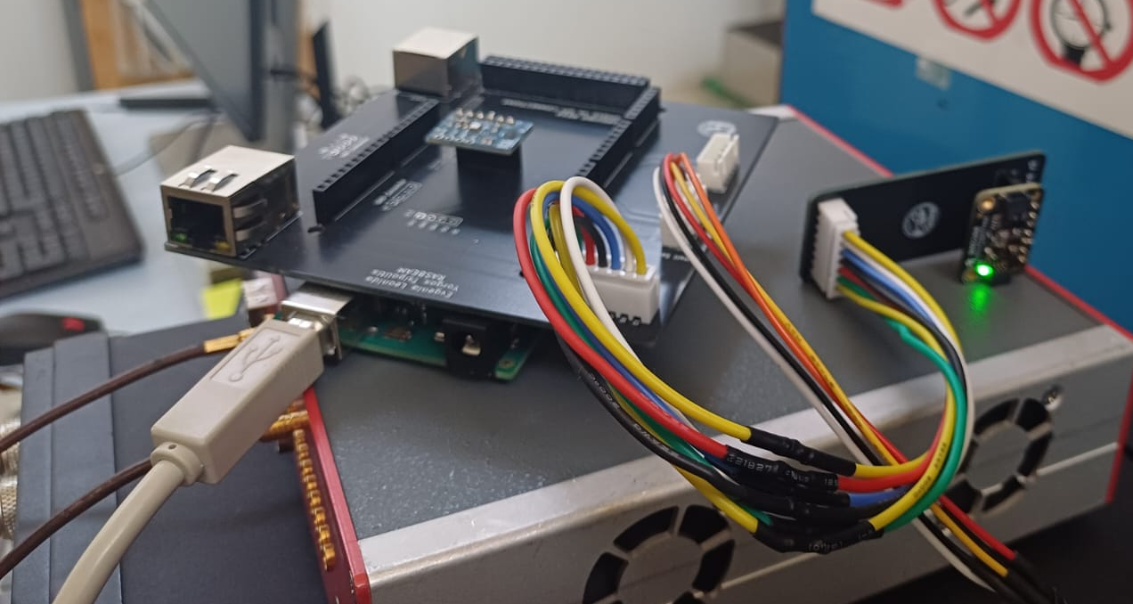
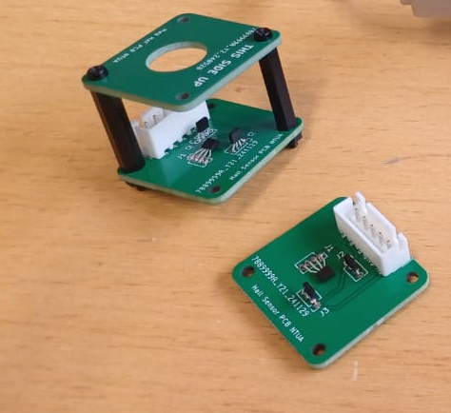
Sensor Boards
Used KiCAD for PCB Design to create the boards
Arduino Sensor Board
BME280 Board
Hall Sensors Board
Printed Boards

Slide 8
Data Flow and Communication
Environmental Sensor
Magnetic Field Sensors
Arduino
Influxdb
I2C Protocol
Analog Inputs
Arduino Mega
Acts as the main data acquisition unit.
Interfaces with sensors:
  BME280 for temperature, pressure, and humidity.
  Hall effect sensors for magnetic field measurement.
Periodically reads sensor values and transmits them via serial communication (UART) to the Raspberry Pi.
A specialized database optimized for time-stamped data.
Stores data in a way that supports queries, aggregations
Enables tracking of changes over time (e.g., temperature drift, magnetic field fluctuations).
Data is organized into measurements, tags, and fields
Sensor Board
Data Acquisition
Arduino
Data Parsing
Raspberry Pi
Grafana
Python Script: Serial Communication, logging of data
Raspberry Pi
Continuously reads serial data from Arduino via a Python script.
Formats and filters the data before forwarding it to InfluxDB.
Acts as a network-connected device, capable of running services like InfluxDB clients or monitoring scripts.
Provides flexibility for remote access
Grafana
Connects to InfluxDB to create custom dashboards with interactive plots.
Real-time monitoring of environmental parameters
Zooming into specific time ranges, Setting up alerts or thresholds (e.g., for magnetic field limits).
Highly customizable and accessible from any device with a browser.
Raspberry Pi
Time-series database
Influxdb
Data Visualization
Grafana

Slide 9
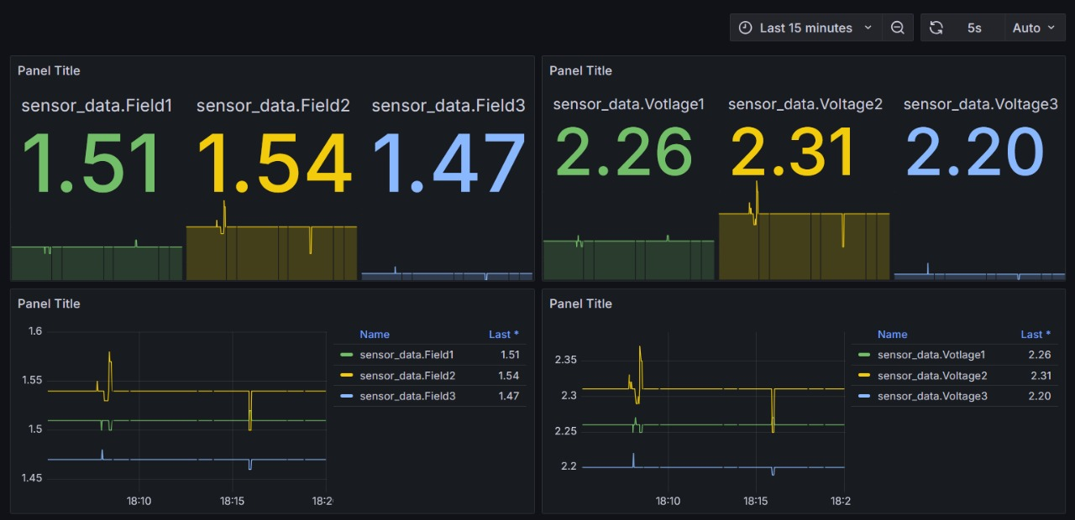
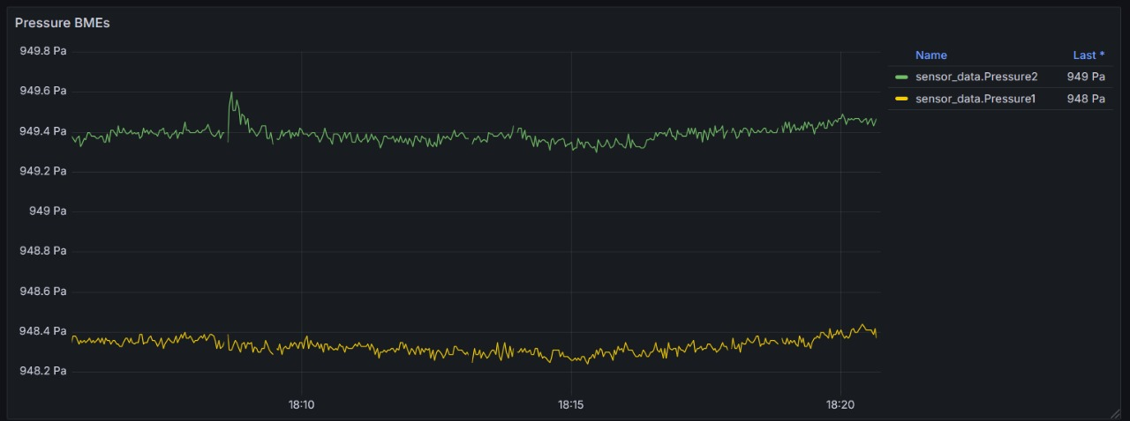
Data Flow and Communication
Environmental Sensor
Magnetic Field Sensors
Sensor Board
I2C Protocol
Analog Inputs
Data Acquisition
Arduino
Raspberry Pi
Python Script: Serial Communication, logging of data
Data Parsing
Time-series database
Influxdb
Data Visualization
Grafana

Slide 10
Testing at Magnet Park

Slide 11
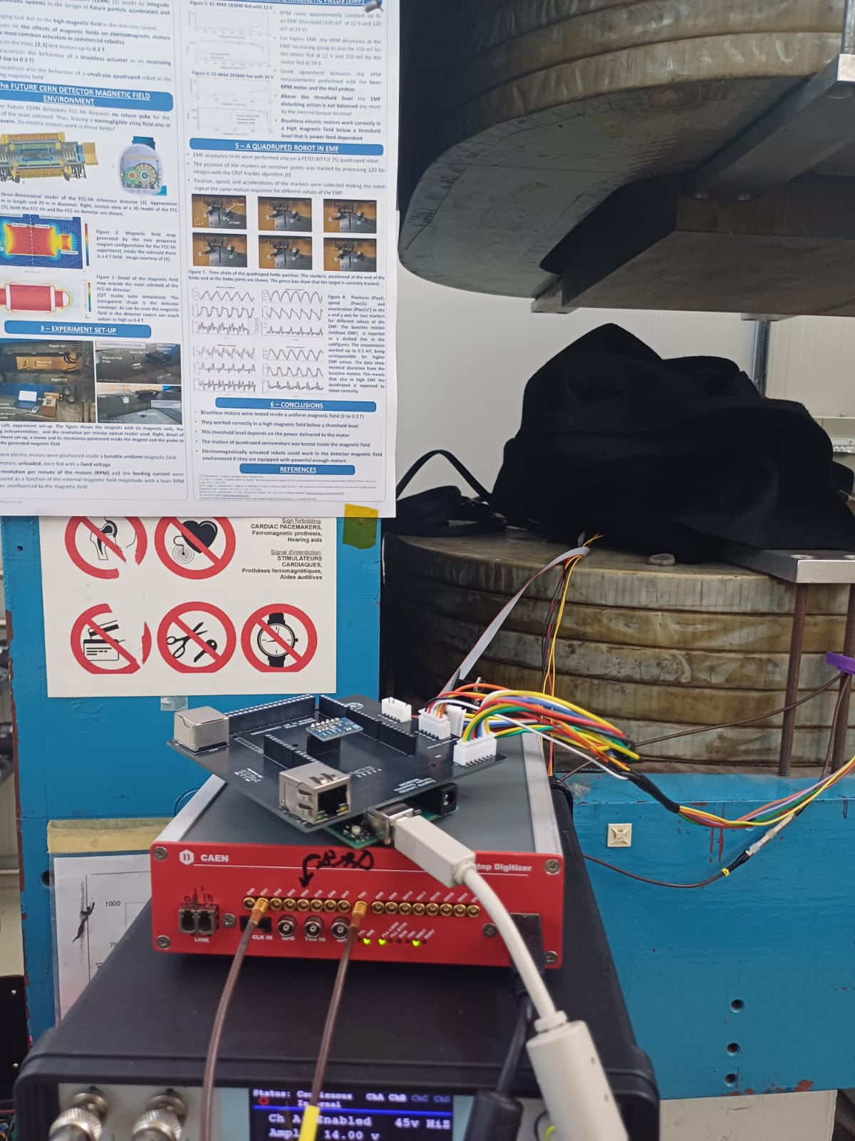
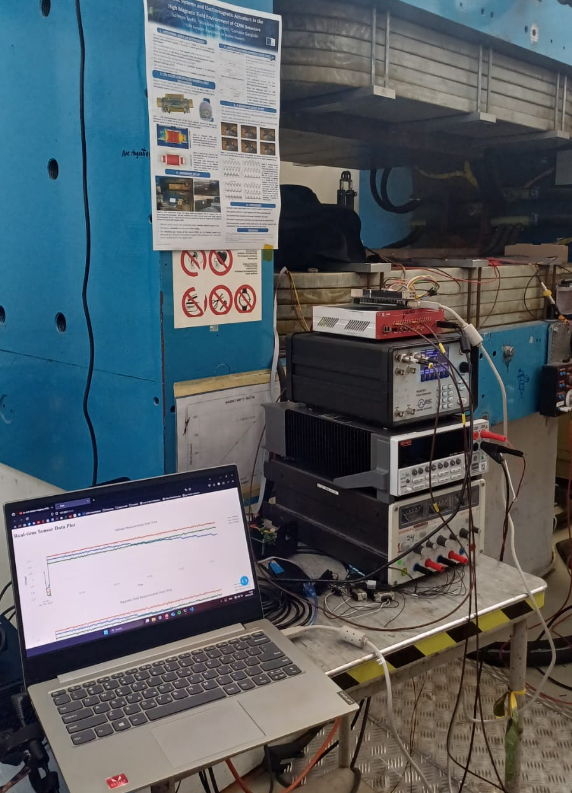
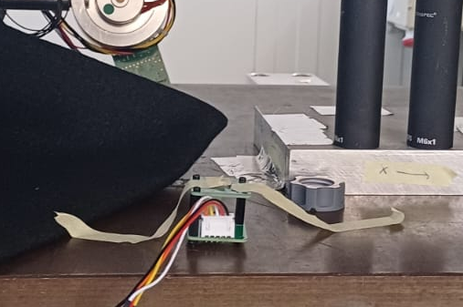

Testing and Calibrating the Hall Sensors in Magnet Park
MNP17 Magnet Park Facility, CERN
Since Hall sensors provide an analog voltage output proportional to the magnetic field, calibration is necessary to convert these readings into accurate values in millitesla (mT).
This was accomplished by exposing the probe to a well-characterized magnetic field at the Magnet Park Facility with the MNP17 Magnet that reached 500mT at CERN.
At this facility, the magnetic field is generated by a magnet whose field strength is linearly related to the input current (in amperes) according to the equation:
By applying known currents and measuring the corresponding Hall sensor voltages, we established a conversion curve from voltage to magnetic field for each sensor.

Slide 12


Calibrating the Hall Sensors in Magnet Park
MNP17 Magnet Park Facility, CERN
Next, to calibrate the sensor, we matched each timestamped combined voltage value with the corresponding known magnetic field derived from the current schedule.
Using linear regression, we established a calibration equation of the form:
This combines the three voltage signals into a single scalar value representing the total magnetic field sensor response, assuming the magnetic field vector aligns somewhere in the sensor’s three-dimensional space.

Slide 13
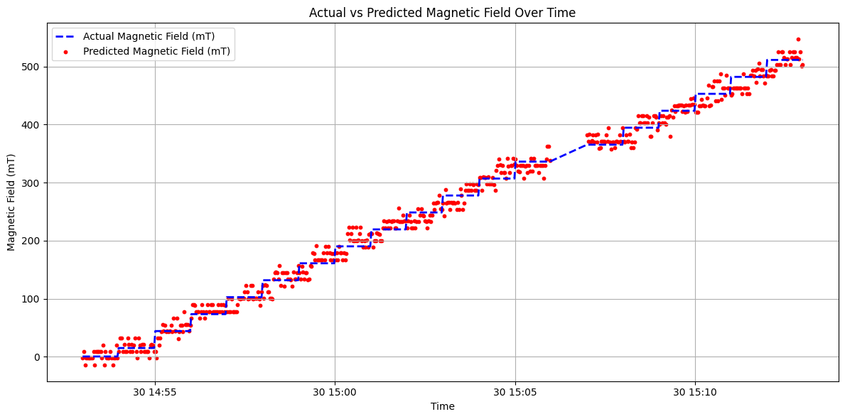
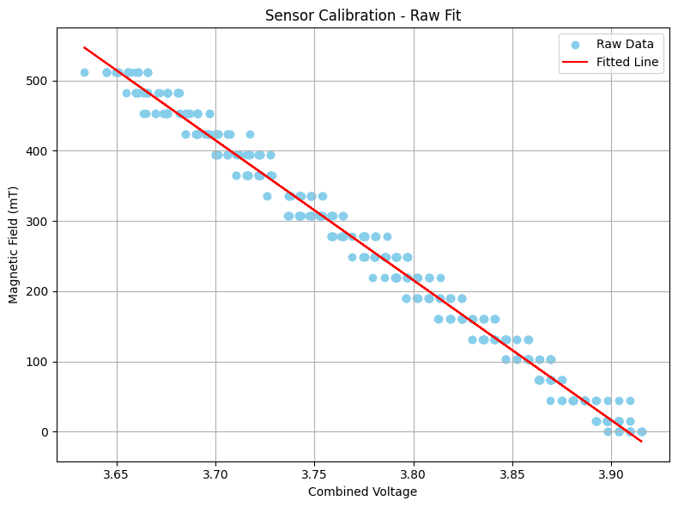
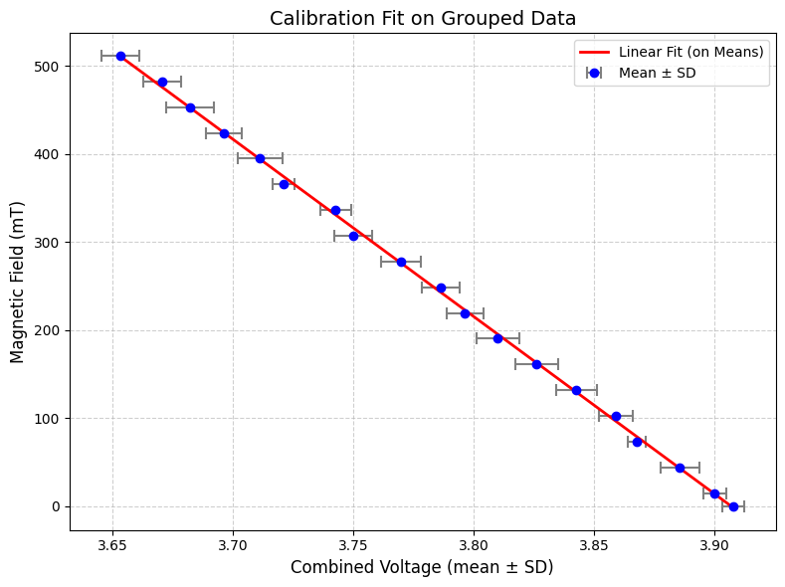
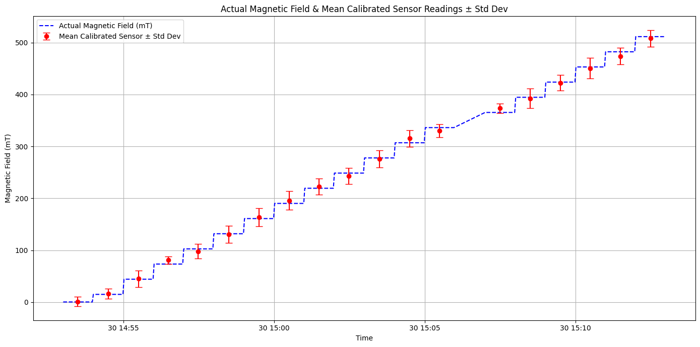

Results of Calibration
MNP17 Magnet Park Facility, CERN
[Group Fit Coeff Errors]
Slope a = -2011.587 ± 14.042
Intercept b = 7859.317 ± 53.135
Maximum σ ~ 7%
Grouped the sensor readings by each stable magnetic field level, calculating the mean predicted magnetic field for each step and its standard deviation. The mean represents the average calibrated sensor response, while the standard deviation quantifies the variability or uncertainty in sensor readings during that interval.

Slide 14
Conclusion
Successfully developed and deployed a compact, low-cost system for real-time monitoring of environmental and magnetic field parameters in test beam environments.
Combined the strengths of Arduino (real-time sensing), Raspberry Pi (data handling), InfluxDB, and Grafana (storage and visualization) into a single, automated workflow.
Future Work:
    Add automated threshold-based alerts (e.g., email or UI notifications) when environmental or magnetic values exceed safe or expected limits.
    Deploy the system directly within the magnetic field of the GOLIATH setup to evaluate performance under high-field conditions.
    Replace external probe references with individual calibration routines for each sensor. Improve measurement accuracy, repeatability, and long-term reliability.

Slide 15
Thank you for your attention!

Slide 16
Back Up

Slide 17
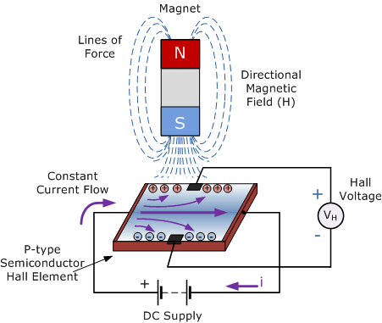
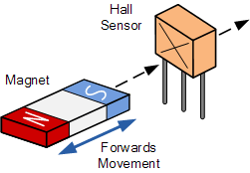
How Hall Effect Sensors Work
Common Uses:
Magnetic field measurement
Position and speed sensing
Contactless current sensing
A Hall effect sensor measures magnetic fields using the Hall effect.
When an electric current flows through a conductor and a magnetic field is applied perpendicular to the current, it pushes charge carriers to one side.
This causes a small voltage, called the Hall voltage, to appear across the conductor.
The Hall voltage is proportional to the magnetic field strength.
By measuring this voltage, the sensor can detect and quantify magnetic fields.

