Slide 1
AccGPT
LLMs for CERN!
Florian Rehm, Luke Van Leijenhorst, Verena Kain, Sofia Vallecorsa, Juan Manuel Guijarro
03.06.2025, Bites of FM4S

Slide 2

Content
What is AccGPT.
How does the AccGPT model work.
Some examples.
Current and future researches.

Slide 3
Introduction
AccGPT (Accelerating Science GPT).
  Our vision: Accelerating CERN research with AI.
AccGPT Pilot Service: The entire service.
  Providing LLMs to CERN researchers.
  LLM access via UI (similar to ChatGPT) and API.
  Assisting with LLM use case implementations.
AccGPT-Search Model: Advanced expert-model.
  A chatbot for CERN internal knowledge search.

Slide 4
AccGPT Pilot LLM Service

Slide 5
AccGPT Pilot LLM Service
Goal:
One central AI/LLM unit to provide access to LLMs (internal and external ones) and assist developers with expertise and usage examples.
  Depending on resource dedication also consultancy.
Current Status:
Still in pilot phase.
CERN has not yet decided on further AI/LLM investment.
  Though, support across all CERN hierarchy levels (next slide).
Very limited resources (manpower and hardware).
  PoC models are possible. Production models difficult.

Slide 6
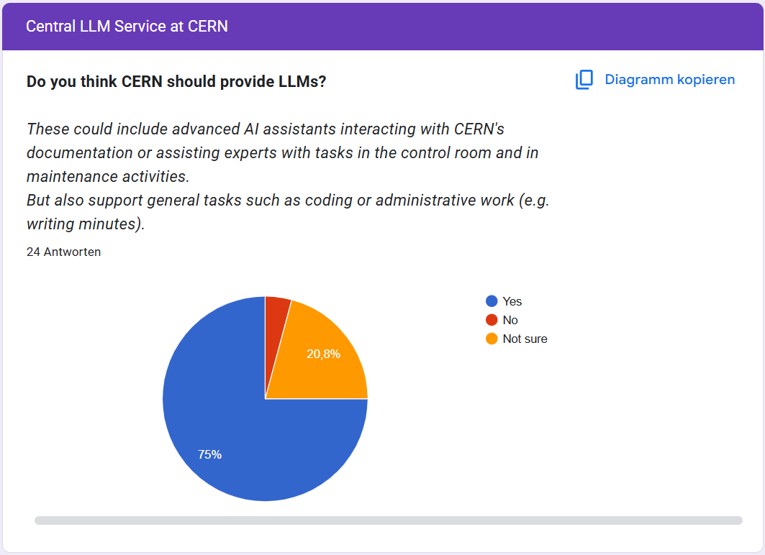
CERN Wants LLMs!
ATS-Sector-wide Survey:
Participants well distributed across the entire ATS sector.
24 groups participated.
ATS users expressed a clear interest in having a central LLM service for expert and non-expert use cases!

Slide 7
Why AccGPT?

Slide 8

Why AccGPT?
First step: Enhancing CERN knowledge retrieval.
Challenge: CERN has many and HUGE data bases:
  Challenging to find information without knowing its location.
  >> 50 knowledge (web) domains for documentation.
    Confluence (Wiki), CDS, CERN home, CERNbox, EDMS
    and more domains …
    Individual documentations.
    Support tickets.
→ Objective: Leverage AccGPT to improve knowledge finding, user support, streamline development processes, and enhance onboarding experiences.
By GPT4

Slide 9
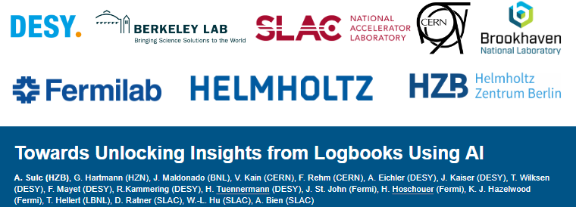
What Else?
Numerous software frameworks (such as FESA, UCAP, GeOFF, NXCALS, … ).
  With steep learning curves to use them.
  → AI assistance for learning and utilizing them.
Coding assistance:
  Many documentations contain code.
    „Generate me a code template of …“
Future AccGPT applications:
Enhancements to machine and shift logbooks.
Code Agents.
Future ++:
AI assistant in the control room: conversational UI / controls.
IPAC’24 - 15th International Particle Accelerator Conference

Slide 10
Inside of AccGPT-Search

Slide 11
Inside of AccGPT-Search – Conventional Setup
The (core) AccGPT pipeline*:
Based on two core models:
  Embedding model:
    Retrieves „relevant content“ from database.
  Large Language Model (LLM):
    Formulates responses using the „relevant content“.
    Focus on open-source models.
    Possibility to use commercial models.
Accompanied by a
self-created knowledge
data base.
Request
LLM
Relevant Content
Embedding
Database
Response
Retrieval Augmented
Generation (RAG)
* In reality the AccGPT pipeline has progressed and is more complex.
Notes:
It is not only about the LLM. The llm is only a part of the model

Slide 12
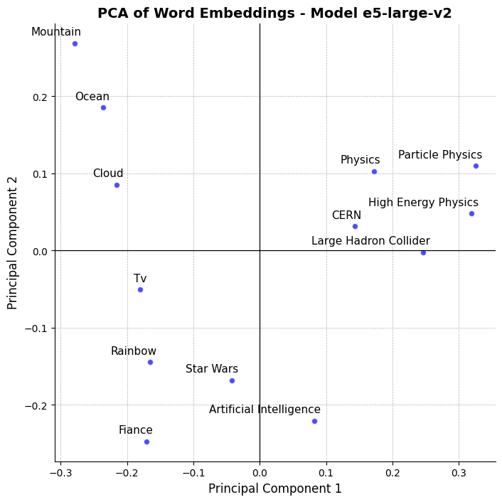
1. The Embedding Model
Function:
  Maps textual data into a latent space (1 024 dimensional).
  Embed single words, sentences, or entire paragraphs.
Representation:
  Related phrases are close in the latent space.
In AccGPT-Search:
  Retrieve the most relevant content from our database based on user questions.
  This is done by taking the closest data point(s) to the question in the latent space.
  Utilizing open-source embedding models:
    Model in use: BERT e5-large-v2*
* Bidirectional Encoder Representations from Transformers.
EmbEddings from bidirEctional Encoder rEpresentations (https://arxiv.org/pdf/2212.03533.pdf)

Slide 13
2. The Large Language Model (LLM)
Definition:
  Huge deep learning models trained on vast amounts of text to understand and generate human-like language.
Capabilities:
  Deep text understanding and context-awareness.
Our implementation:
Using pre-trained open-source LLMs: LLaMA.
Combined with external models, currently by Groq*.
LLM Input
System Prompt
+
User Prompt
(Question)
+
Relevant Context
LLM Response
*Groq designs ultra-fast AI inference hardware and hosts open-source LLMs via API, while Grok is a chatbot by xAI.

Slide 14
Some AccGPT Examples

Slide 15
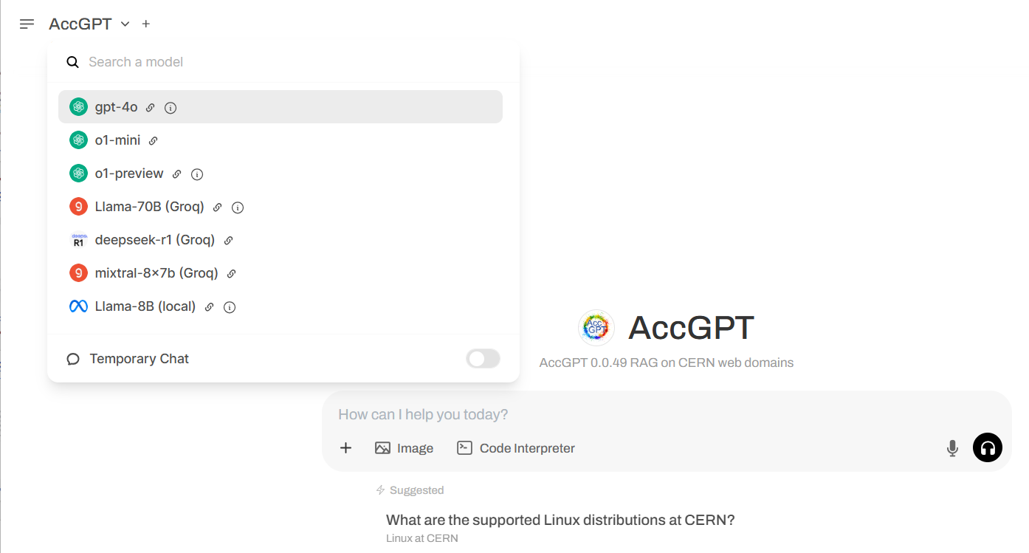
The AccGPT User Interface

Slide 16
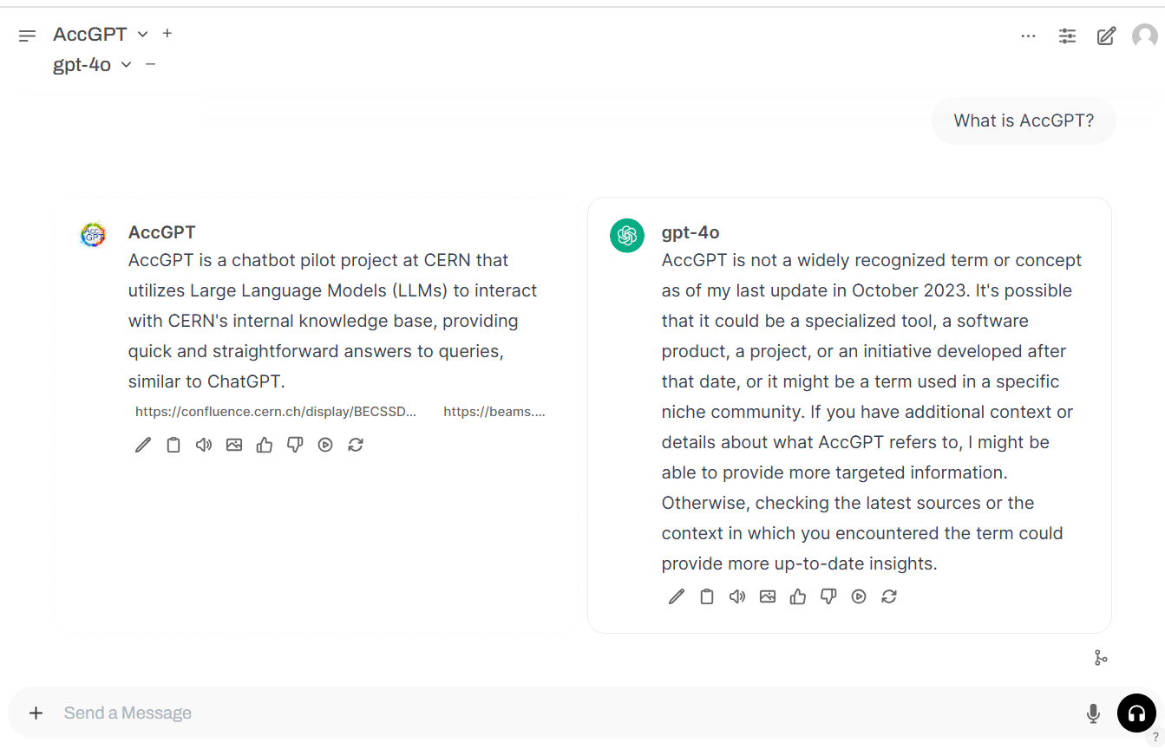
AccGPT: Example 1

Slide 17
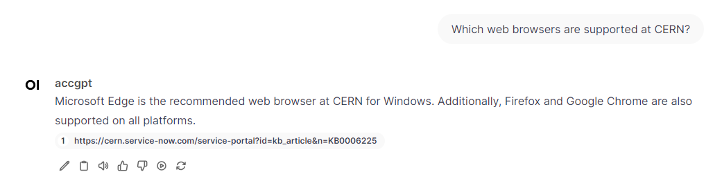
AccGPT: Example 2
References
Disclaimer:
We do not guarantee the accuracy or completeness of the provided responses. We strongly encourage users to verify the information.
Feedback

Slide 18
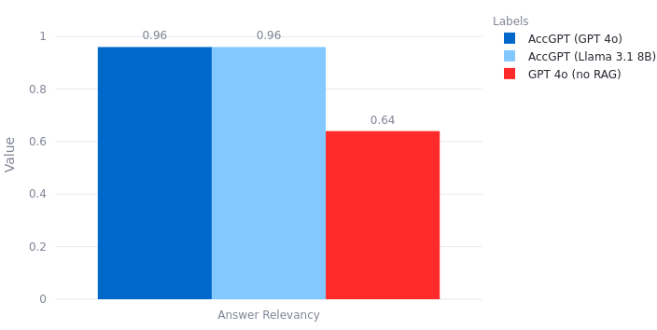
Accuracy: RAG vs non-RAG
(RAG: Retrieval Augmented Generation)
With RAG (AccGPT):
  AccGPT performs extremely well, independently of the LLM.
  For Q&A set, RAG retrieves the correct knowledge in >90% of cases (not shown).
Without RAG:
  Accuracy drops, as default LLM is not aware of CERN knowledge.
  Not zero, since many questions are not exclusive to CERN.
Answer Relevancy:
Evaluates how accurately the LLM response matches experts' questions on CERN related topics.
(Curated dataset from experts)

Slide 19

Data Quality Importance
Not only AccGPT determines the accuracy:
Data quality is KEY !!!
(garbage in … garbage out)
Important aspects:
  Keep documentations updated.
  Keep documentations detailed.
  Duplicates make the model struggling.
  Text based information is best.
  Ideally: FAQs and examples.
For coding:
  Templates or examples make it easier for the model.
By GPT 4
→ Keep this in mind if you plan to make your
documentation accessible to chatbots.

Slide 20
New Feature

Slide 21
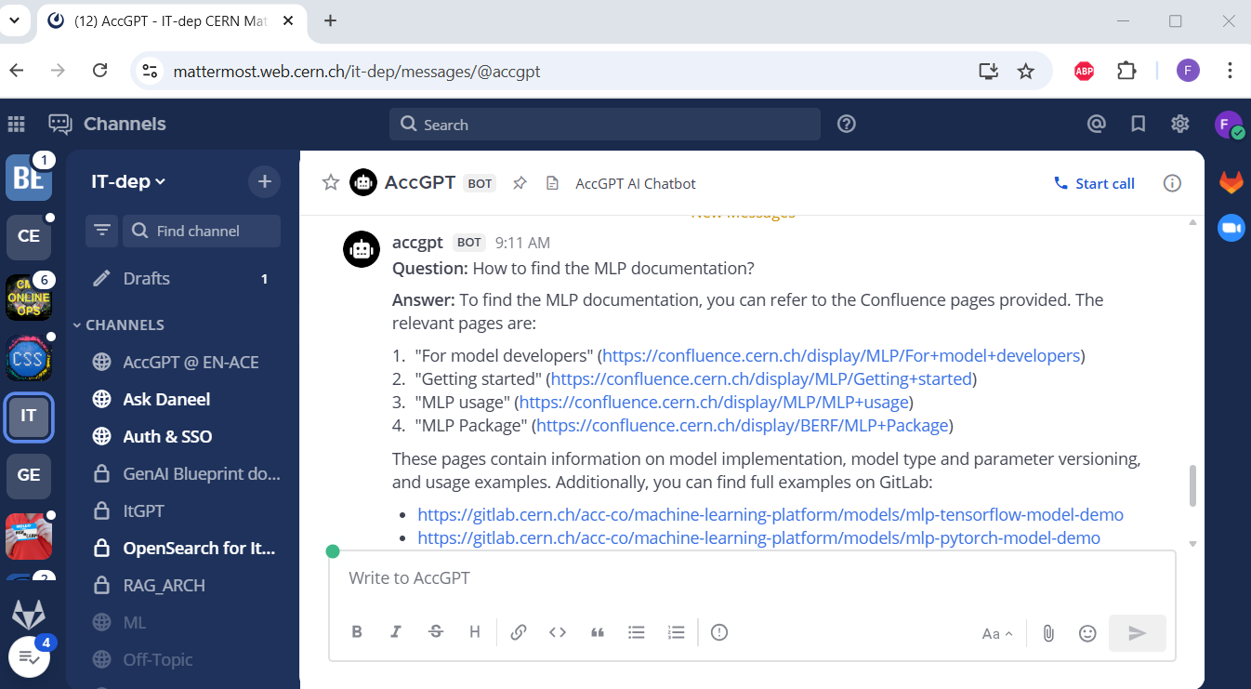
AccGPT in Mattermost !!!
Usage:
/accgpt [message]
Where?
Dedicated chat.
Within every chat.
Sometimes buggy…
Still older AccGPT
version.

Slide 22
Next Steps

Slide 23
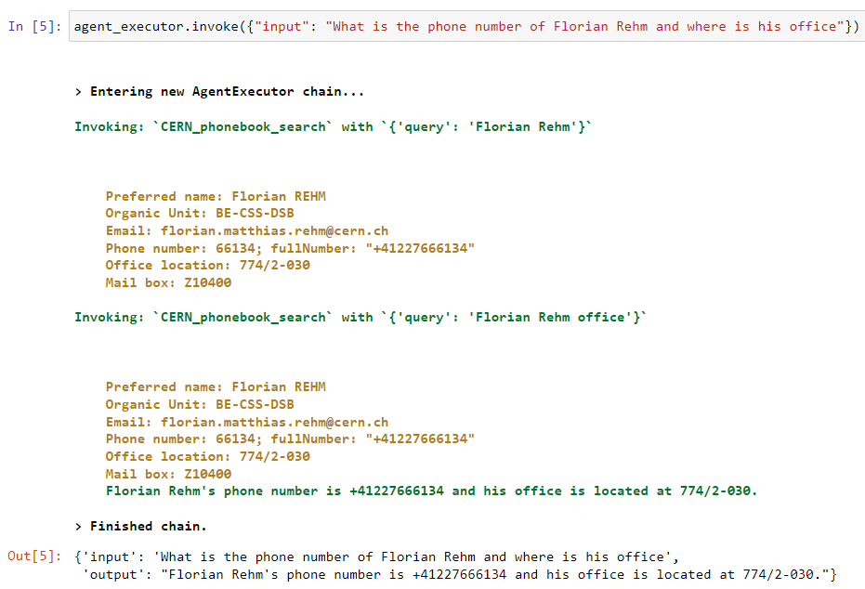
AccGPT: Next Steps - Agents
Agents can do sub-tasks by calling functions.
For example:
  Querying the CERN phonebook.
  However:
  The phonebook feature will not come (soon),
  due to data privacy reasons.

Slide 24
AccGPT-Agentic
Making AccGPT agentic:
  Normal RAG: simple single-step retrieval workflow.
  Agentic RAG: multi-step adaptive workflow.
Strength:
  Answers are more detailed and complete.
Weakness:
  Sequential process, slower than AccGPT.
Currently only RAG search. More tools to come.
Example Question:
What were the major activities and upgrades carried out during each of CERN’s Long Shutdowns?
Step | Agentic retrieval steps
1 | CERN Long Shutdowns
2 | Timeline Long Shutdown
3 | LS1 activities and upgrades
4 | LS2 activities and upgrades
5 | LS3 activities and upgrades

Slide 25
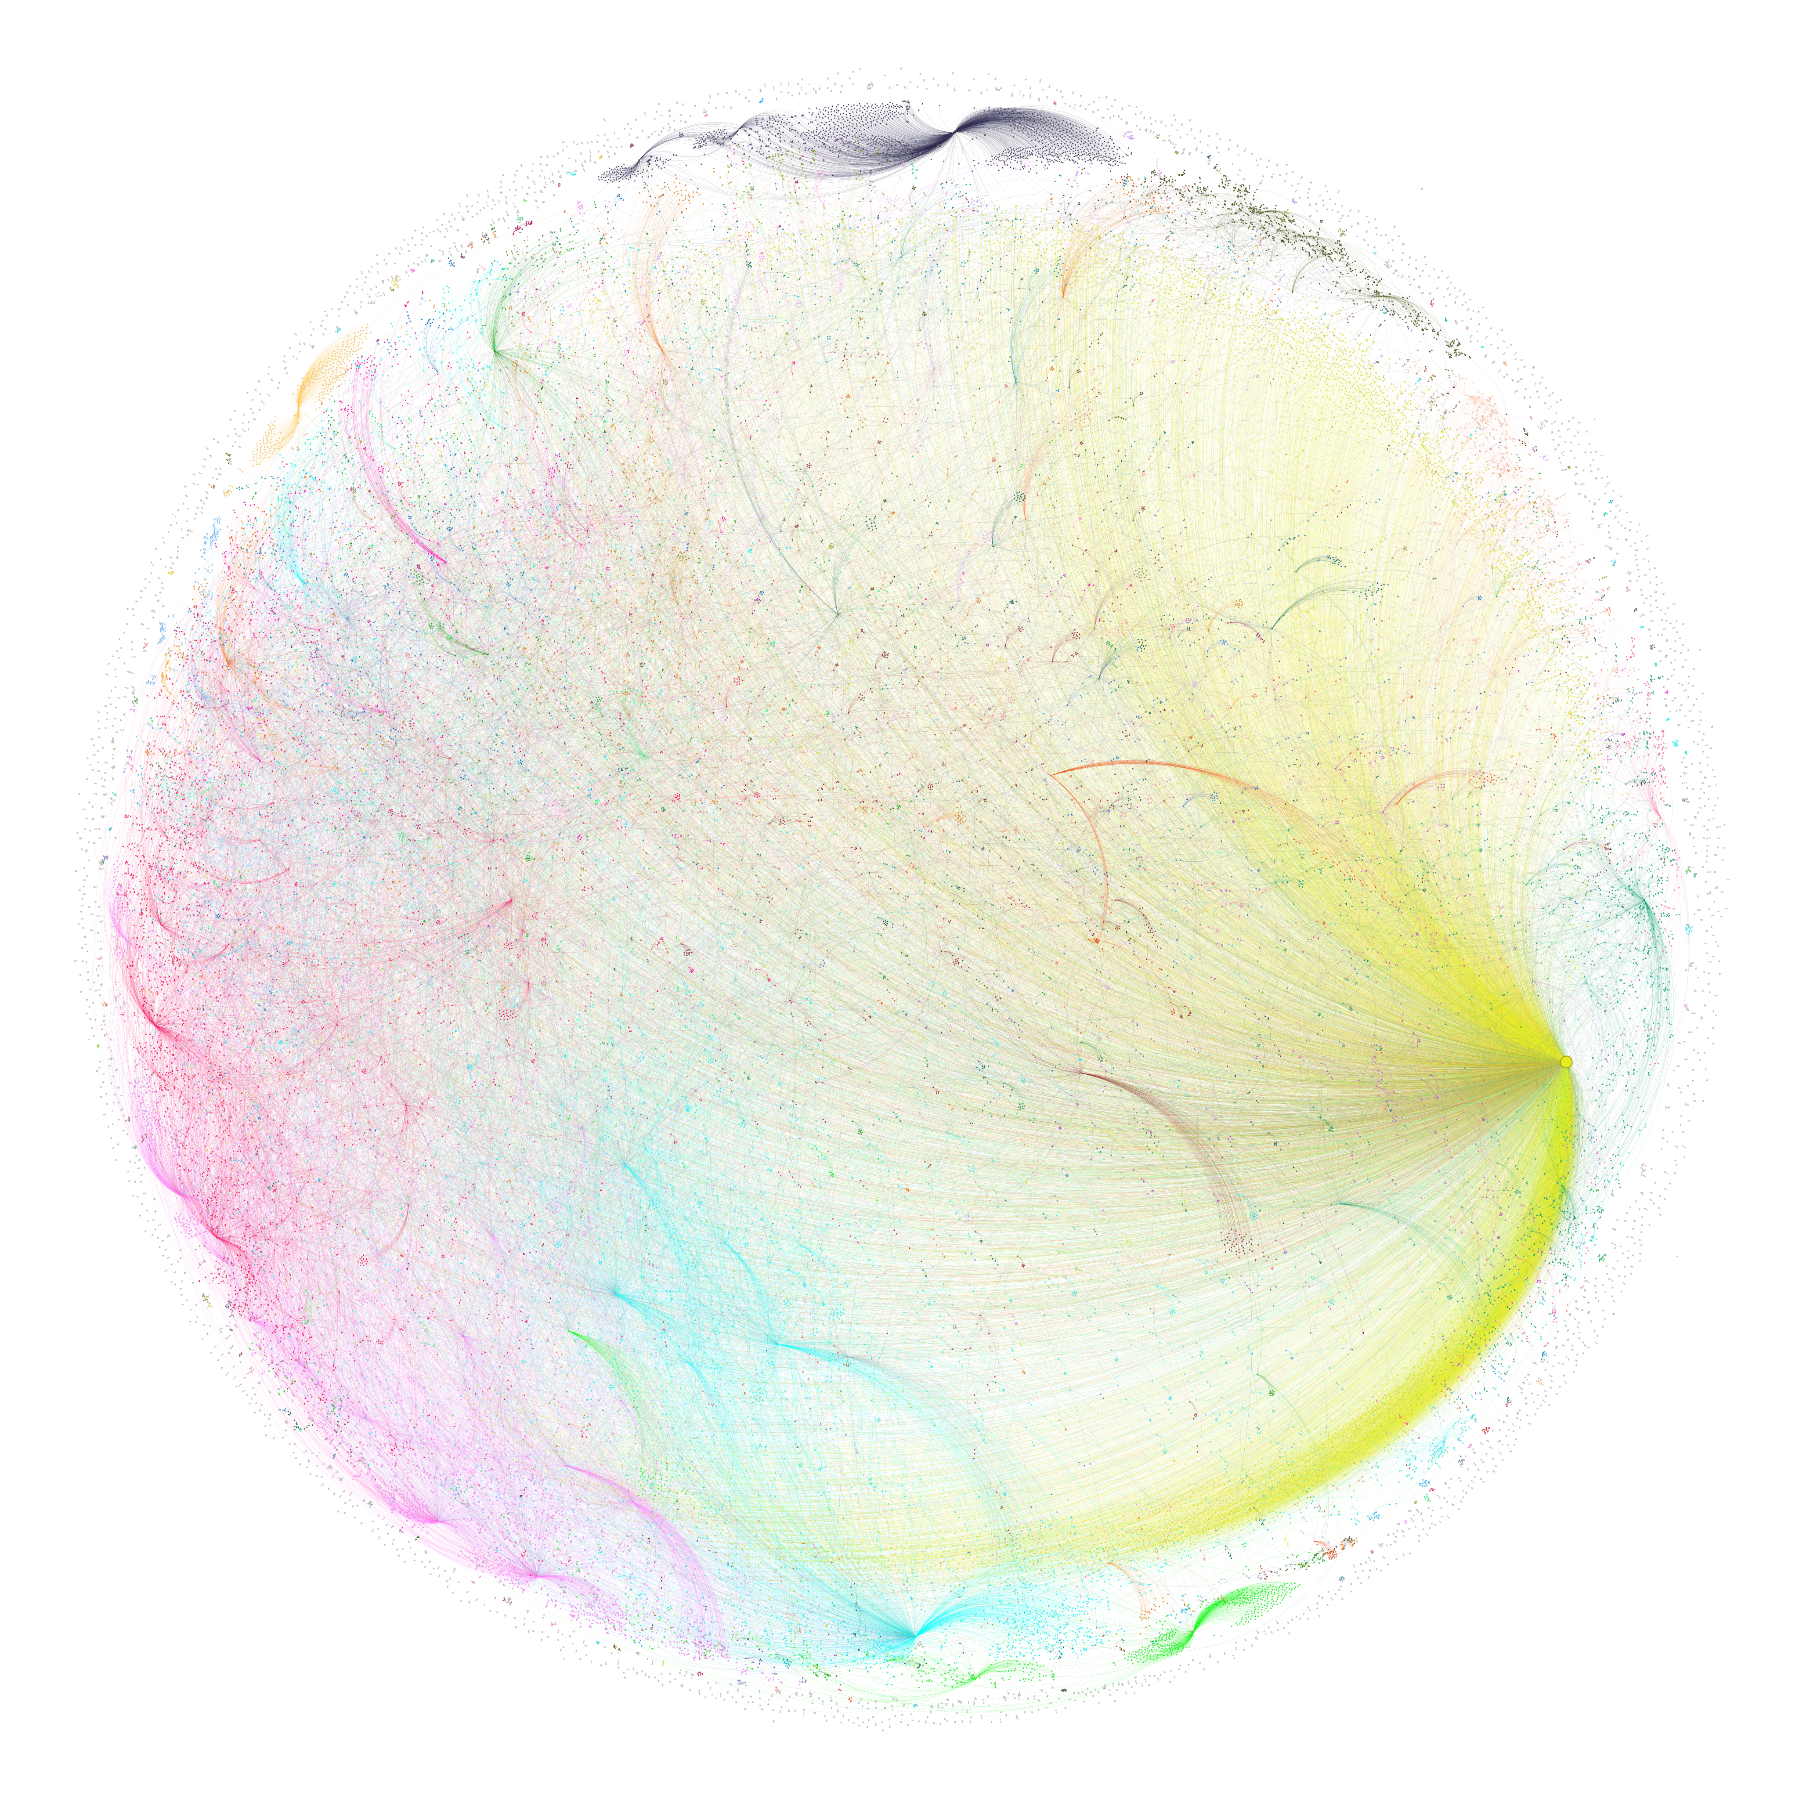
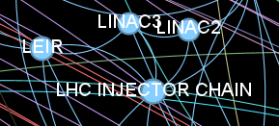
AccGPT-GraphRAG
Utilization of a Knowledge Graph instead of simple RAG.
  Knowledge Graph: A network of connected entities and relationships that captures structured information.
    Graph generated by LLMs.
Strengths:
    Enables precise retrieval across complex, interlinked data structures.
    Generates high-level, coherent overviews across large
    knowledge domains.
Weaknesses:
    Graph creation is expensive
    and time-consuming
    (~1 million LLM calls).

Slide 26
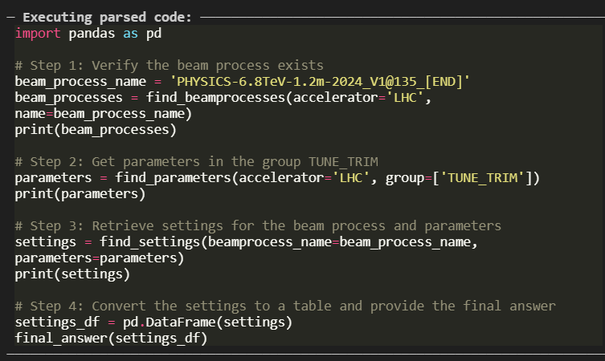
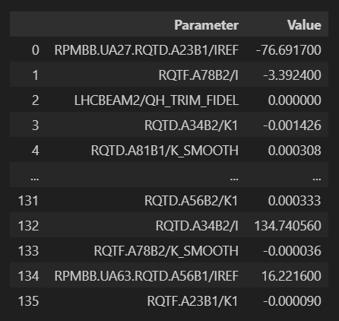
Coding Agents
Coding Agents differ from standard LLM Agents by using programmatic reasoning and executing complete code workflows, rather than relying on step-by-step API calls.
Generate a table of the settings of the parameter group TUNE_TRIM in LHC BP for the beam process name 'PHYSICS-6.8TeV-1.2m-2024_V1@135_[END]'

Slide 27
Summary

Slide 28
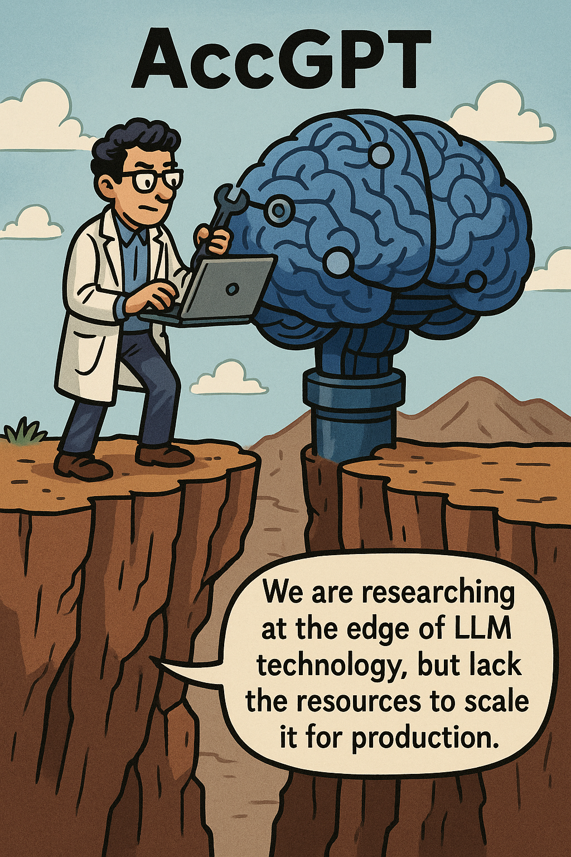
Summary
AccGPT: A CERN LLM service pilot.
AccGPT-Search: A PoC for CERN specific knowledge retrieval.
  Good accuracy, growing capabilities.
  Achieved a lot with limited resources.
  Much potential, but lacking production-scale support.
Many developments and researches in the pipeline.
AccGPT Resources:
  Knowledge sources.
  Landing page & registration.
  User interface.

