Slide 1





Workers of Idea square as animals
(don’t hate me, Pablo asked me)
Nora Amasha

Slide 2
  Since I'm new here and not very familiar with these nice people, and being a bit shy about approaching more than 15 individuals, I'll be taking a different approach—trusting my instinct."
)

Slide 3
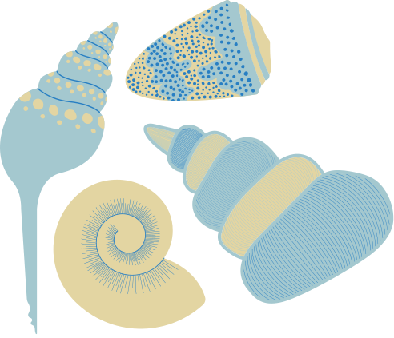
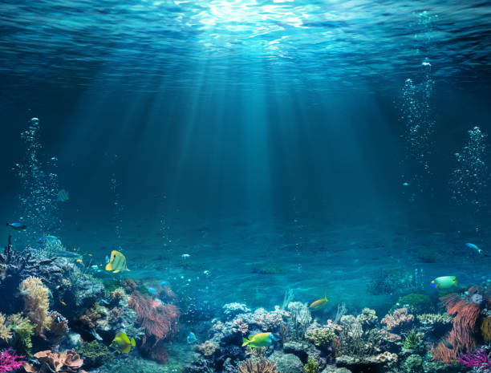
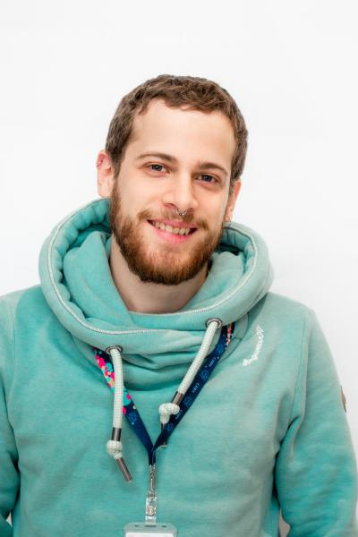
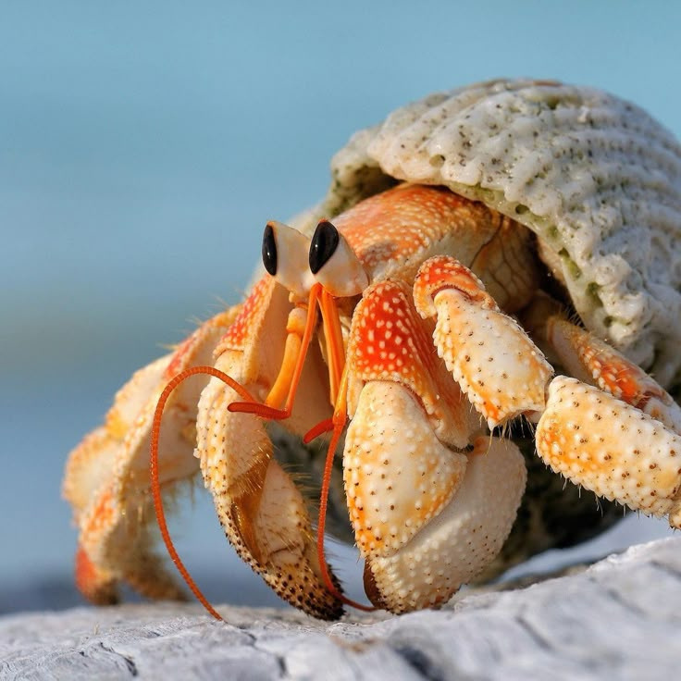
Jimmy as a.......
Bernard l’hermite

Slide 4
Why?
I feel like that's his natural habitat. And he's got a hoodie on, with a touch of red hair....

Slide 5
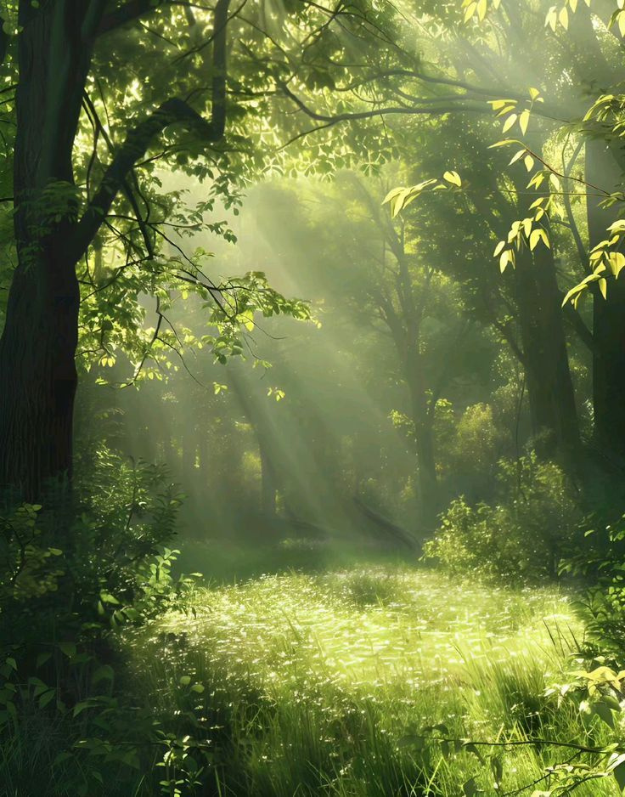
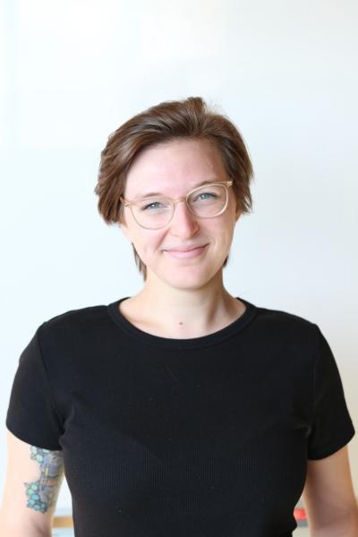
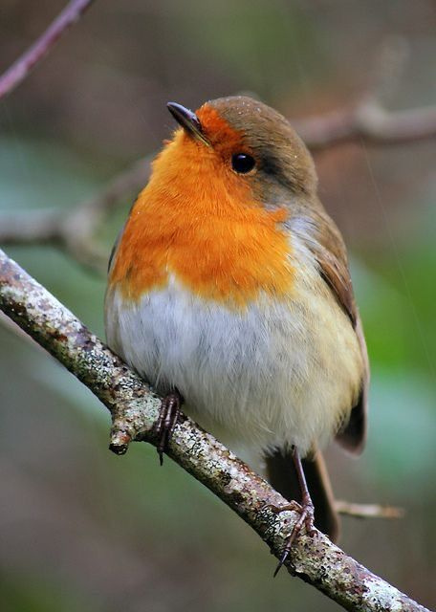

Catarina as a ....
Rosignol

Slide 6
Why?
Catarina is one of the people I know best at Idea Square, and I really feel she embodies a nightingale. I can't quite explain why, but it's as if, in a reverse transformation, a nightingale would turn into Catarina."

Slide 7
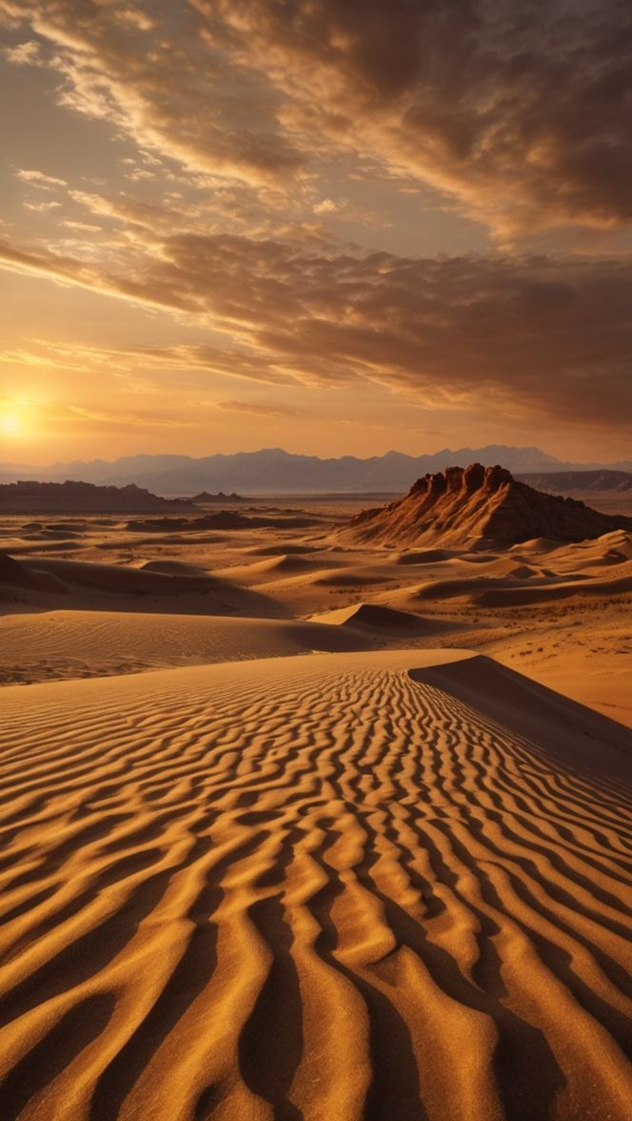
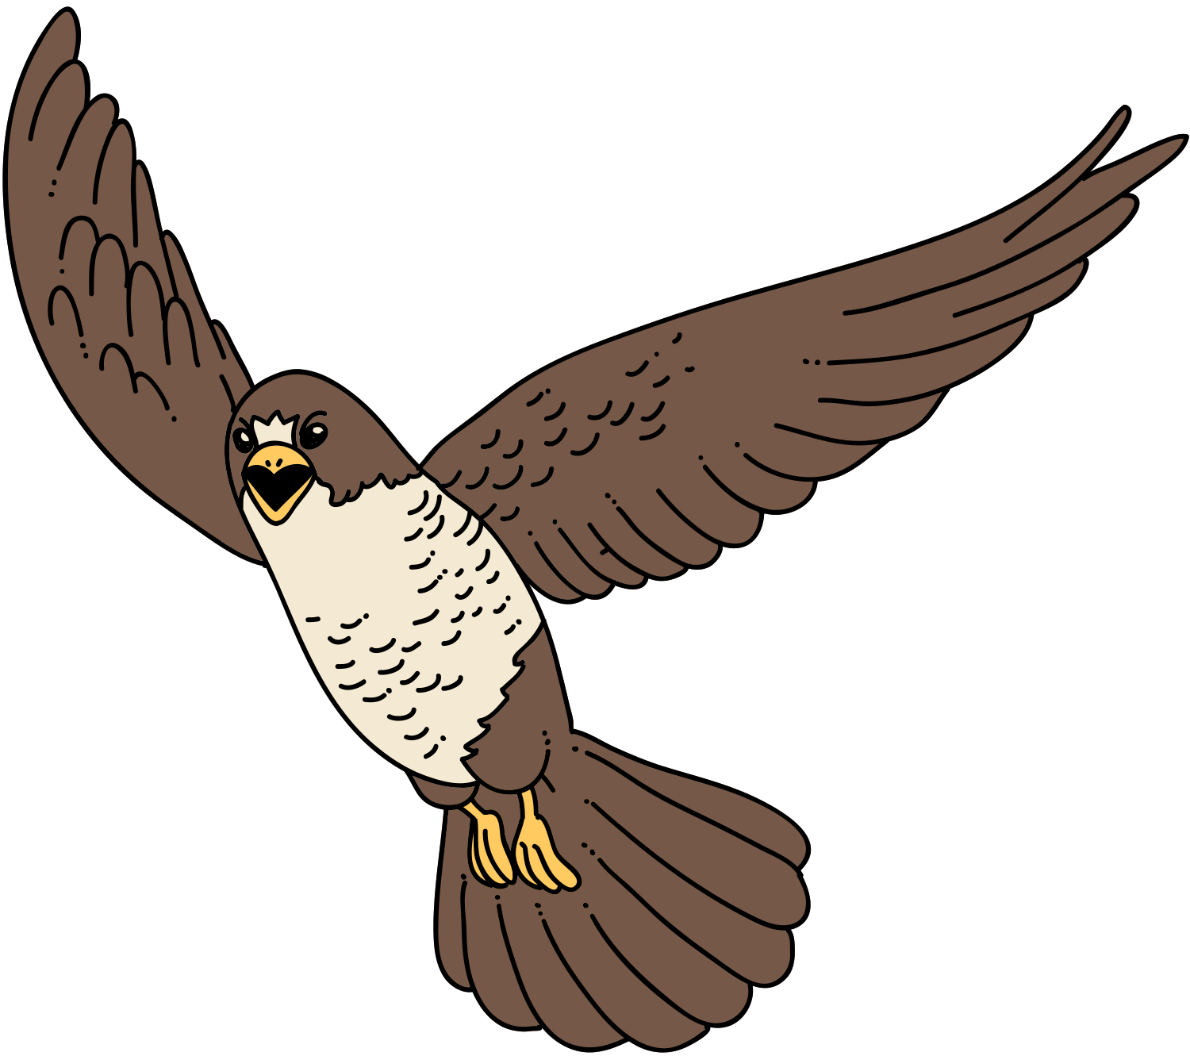

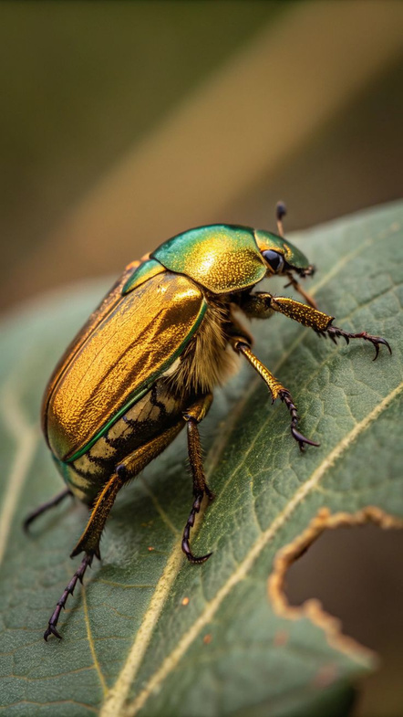
Markus as a.....
Scarabe

Slide 8
Why?
He looks like a historian on a treasure hunt, guided by an ancient prophecy, much like Indiana Jones. But sadly, a single misstep transforms him into a scarab beetle, doomed to live in the desert—unless the treasure is destroyed, not claimed.

Slide 9
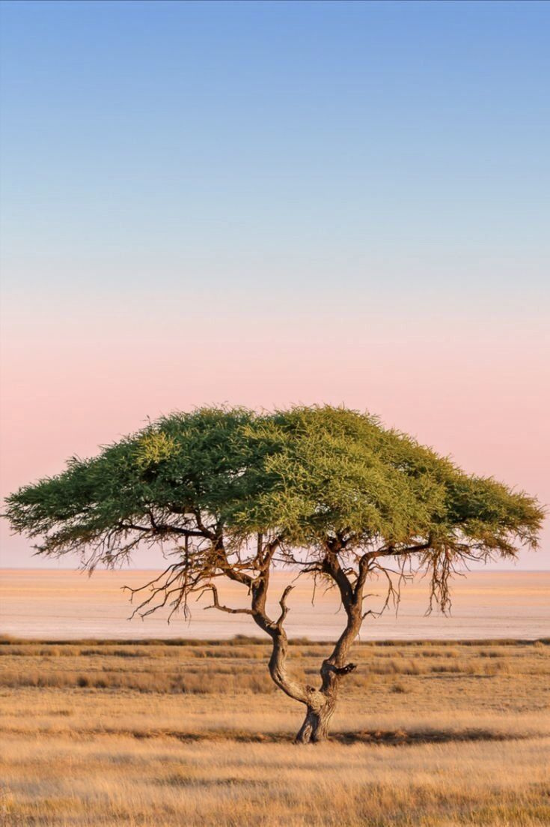
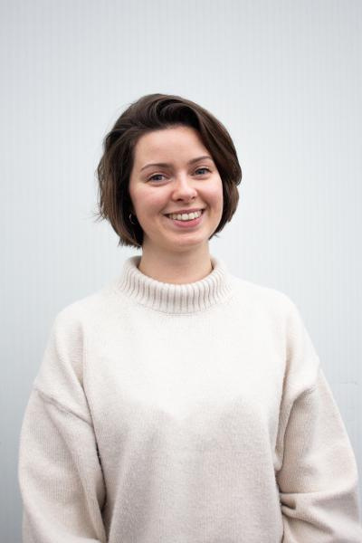
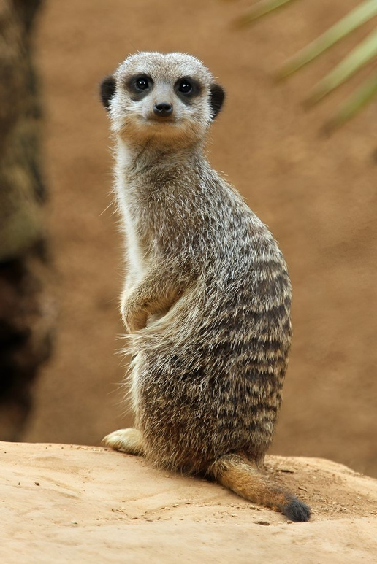
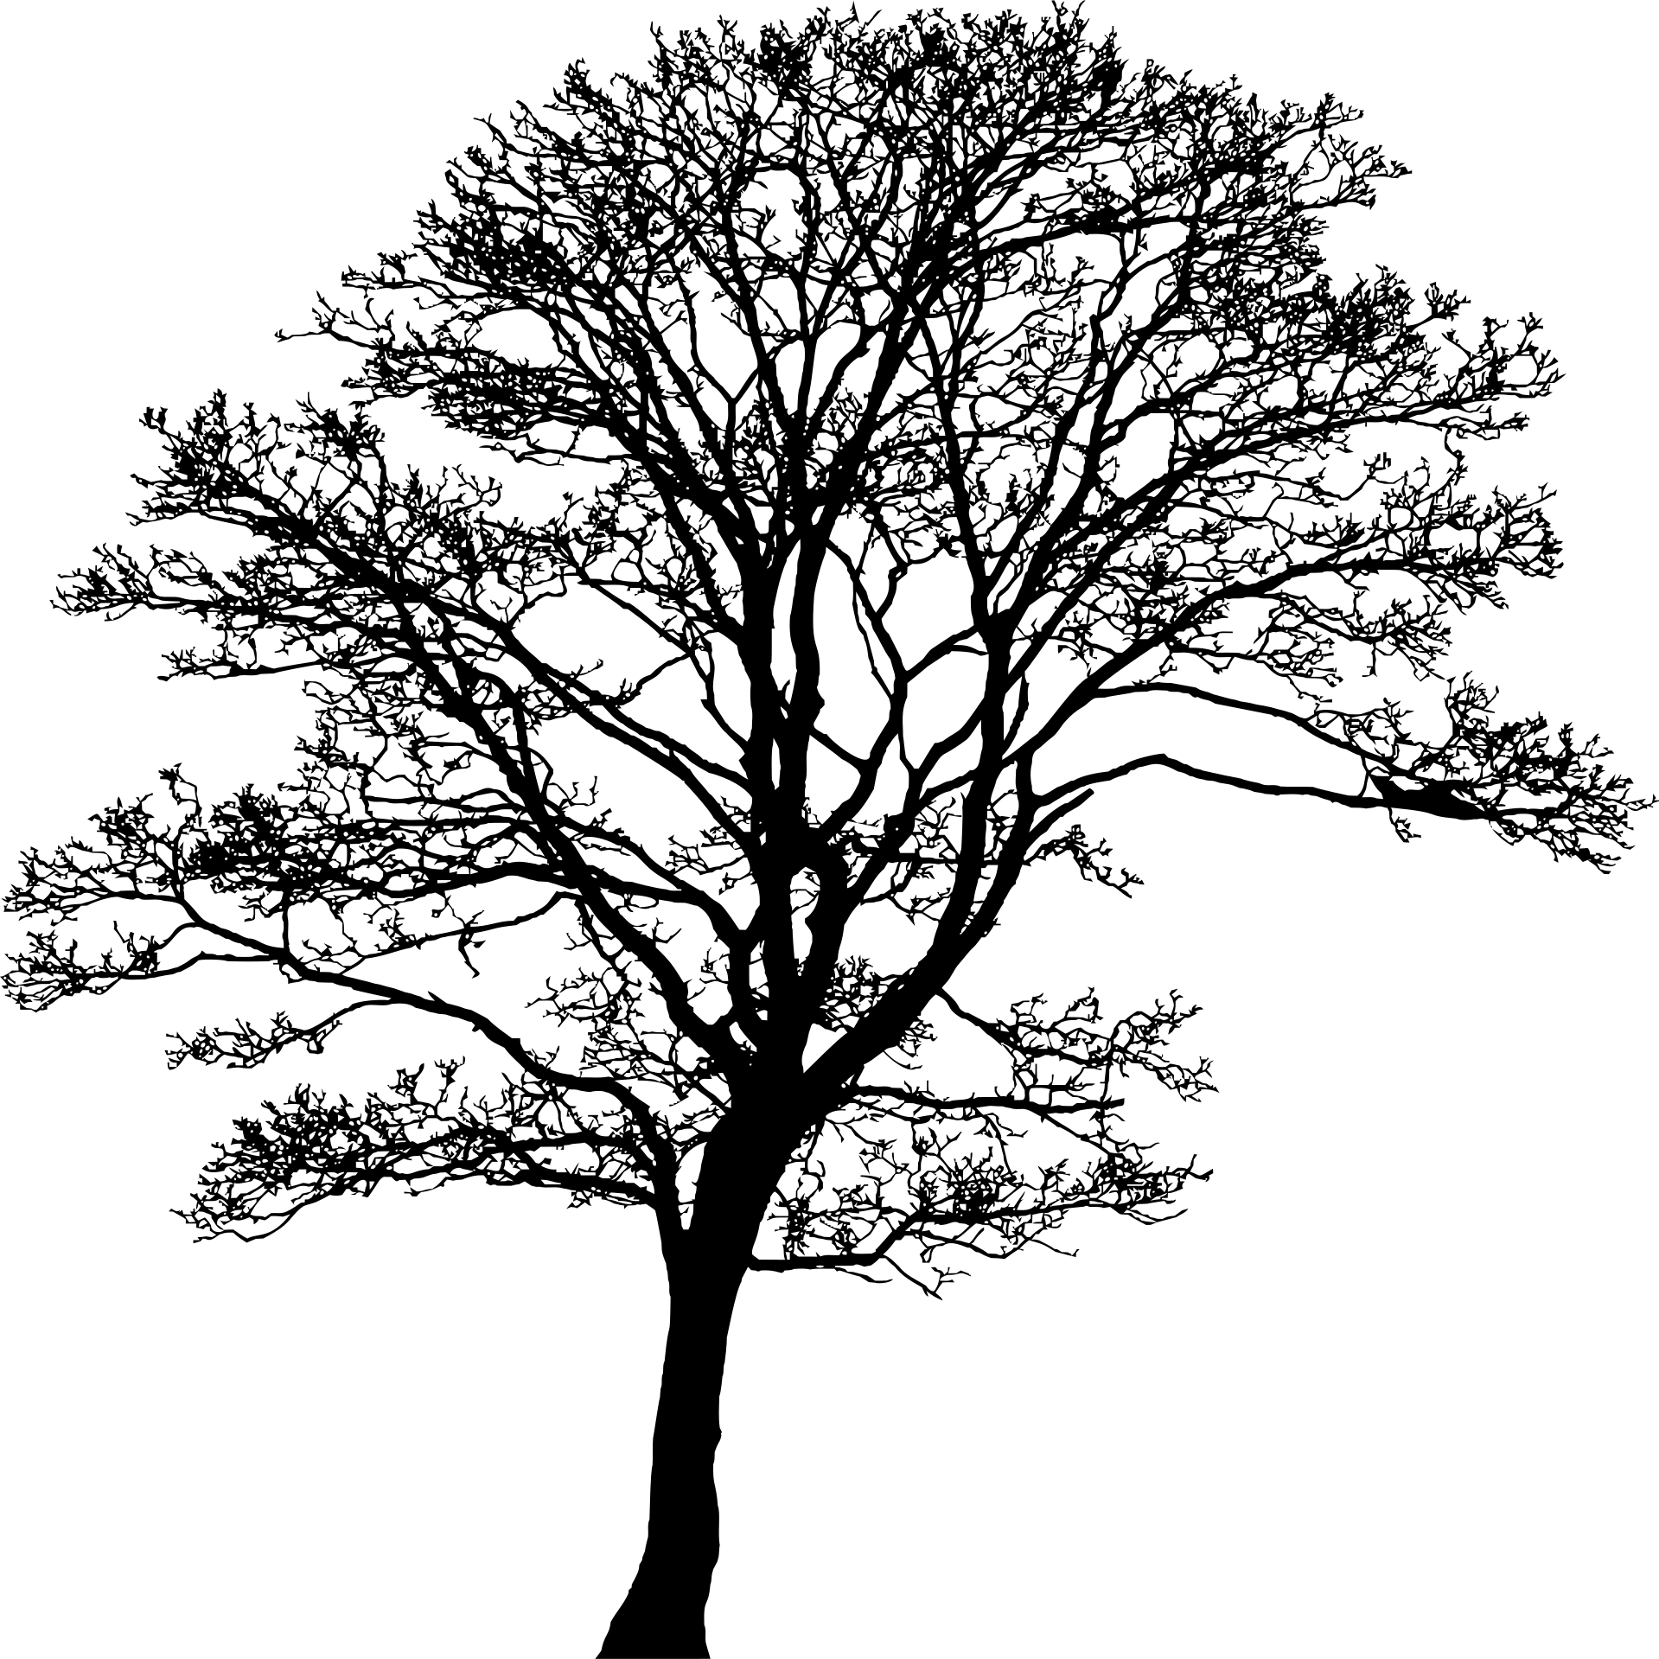
Mirabelle as a....
suricate

Slide 10
Why?
Mirabelle reminds me of a suri cat living on the East African coast. She's part of a large suri cat family, acting as her tribe's messenger, and she loves to organize beach parties.

Slide 11
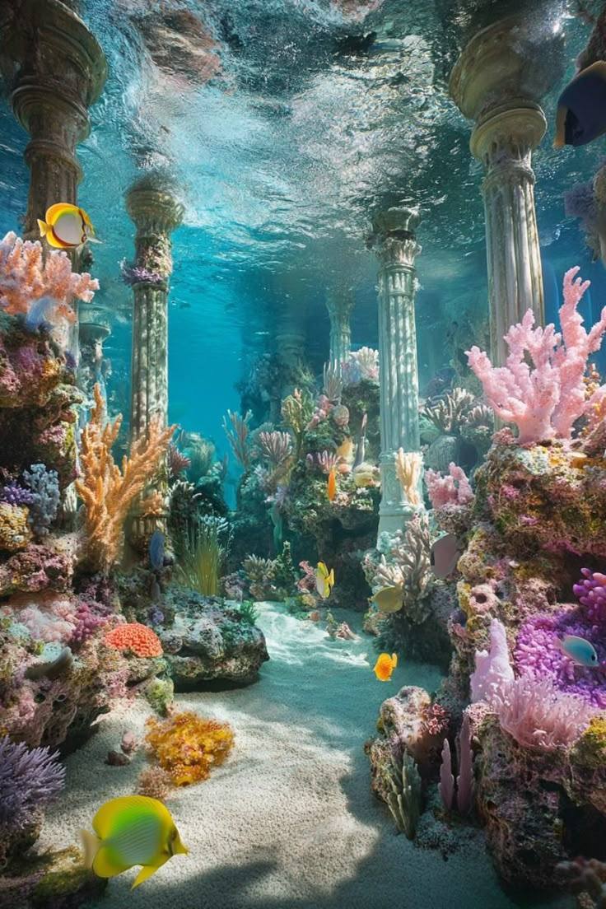

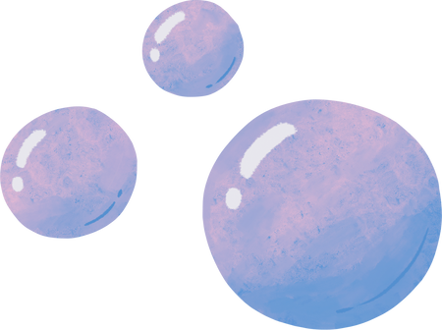
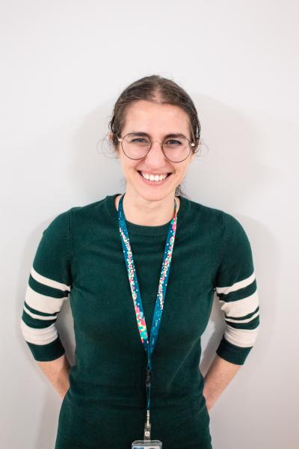
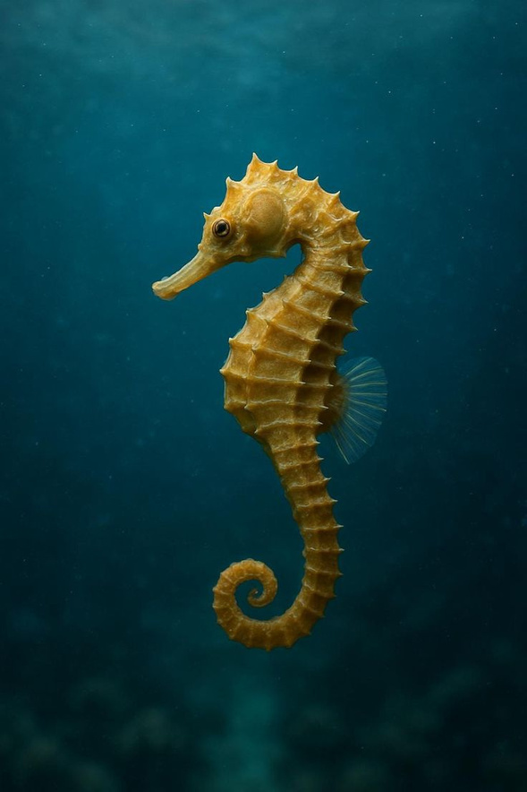

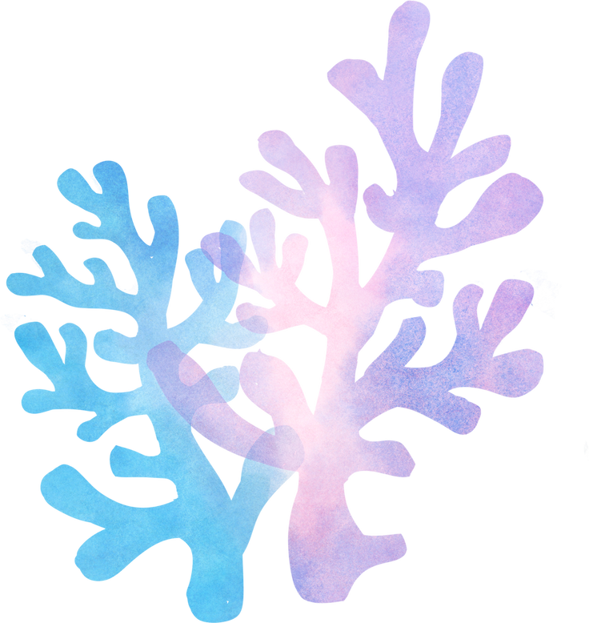

Giulia as a .......
hippocampe

Slide 12
Why?
I can totally see Giulia as a seahorse. Since she's a anthropologist, she really fits the seahorse's personality traits: patience and contemplation. She would be great at analyzing all the mammals passing by and hiding behind a coral to spy on them.

Slide 13
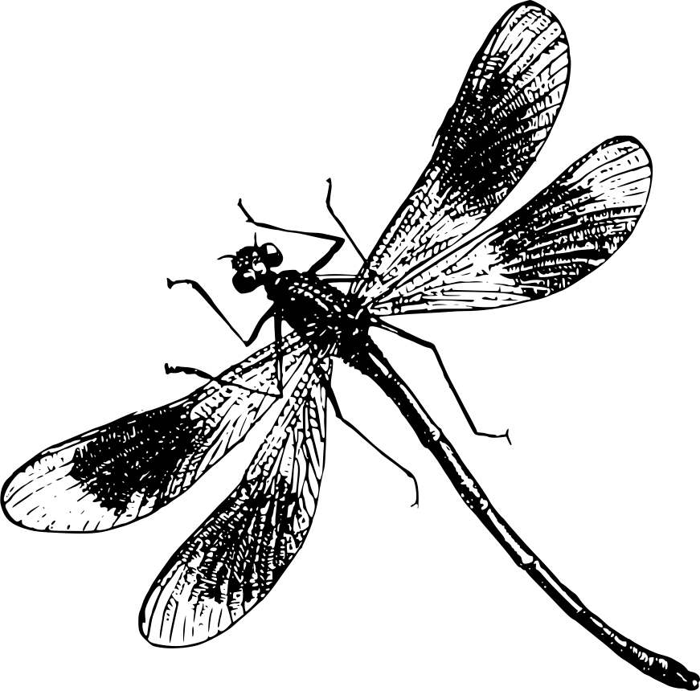
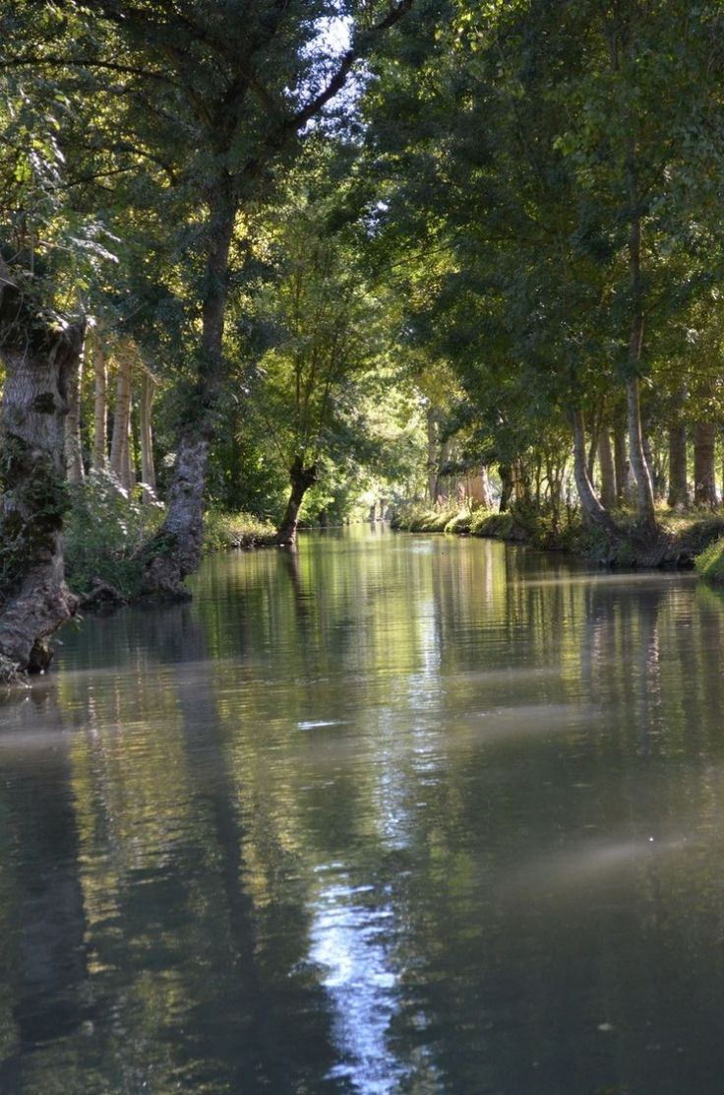
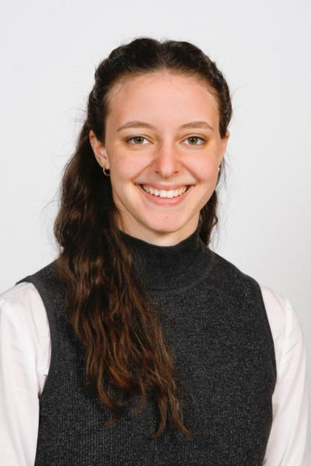
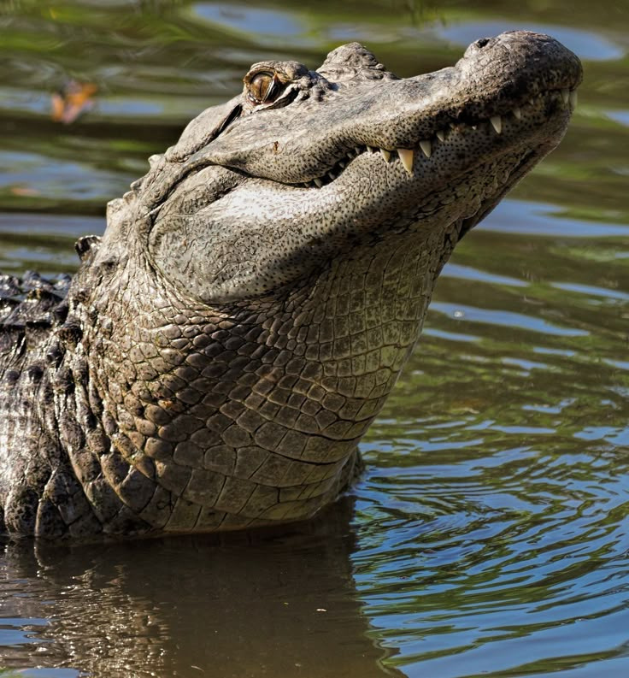

Dina as a .......
Alligator

Slide 14
Why?
Please don't take this the wrong way, I adore Dina, but I simply see her as an alligator."

Slide 15

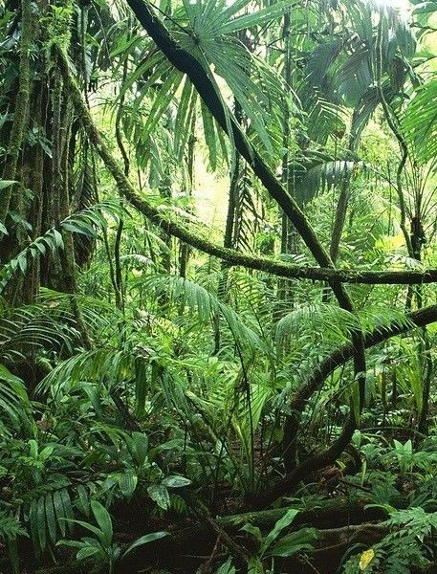
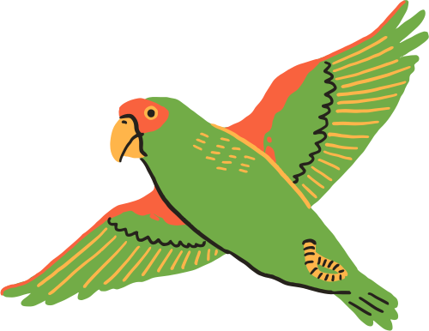
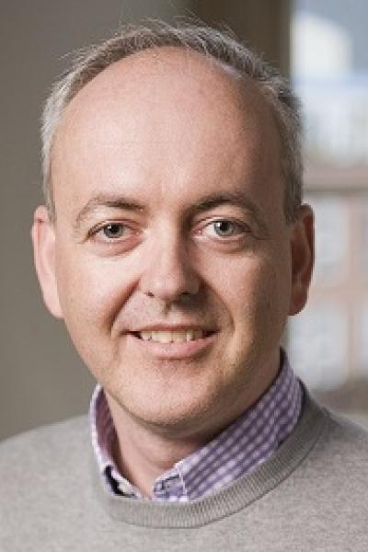
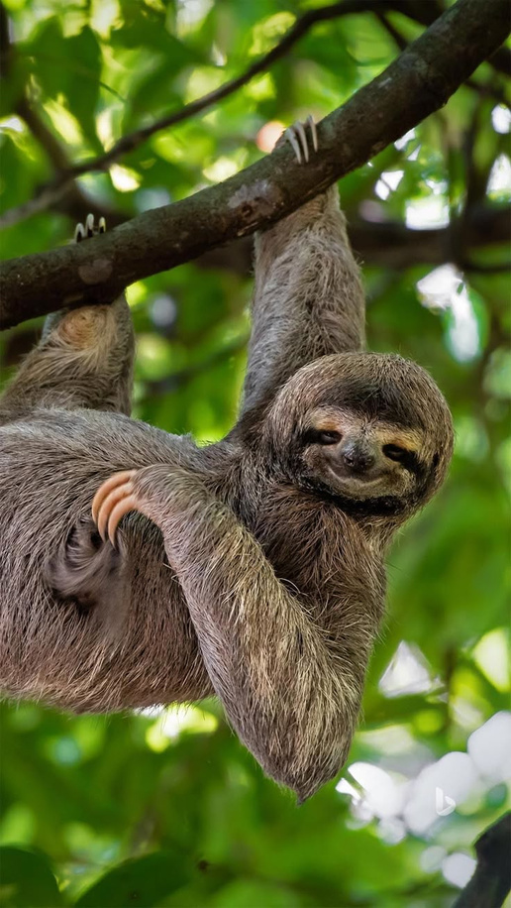
Roy as a .......
Paresseux

Slide 16
Why?
obviously
Mirabelle warned me you might be offended, but with all due respect, please don't be

Slide 17
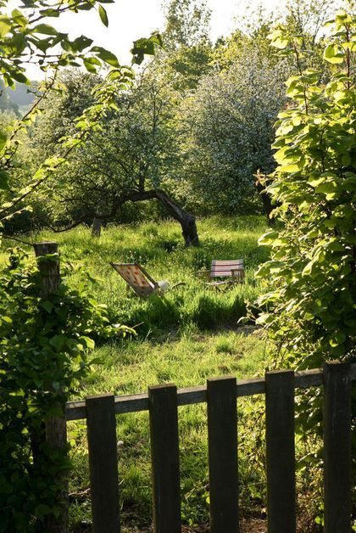
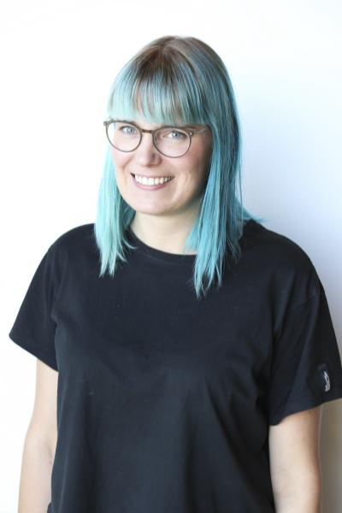
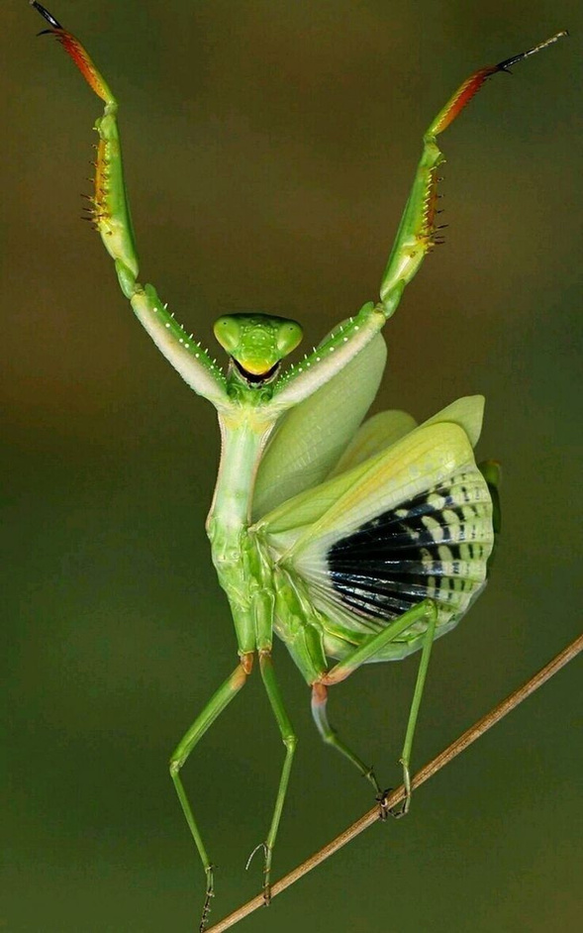
Menthe religieuse
Laura as a .......

Slide 18
Why?
Laura reminds me of my best friend in terms of personality. I get the impression that she has this craziness in her that turns out to be very funny, which is why I think a praying mantis would suit her well."

Slide 19
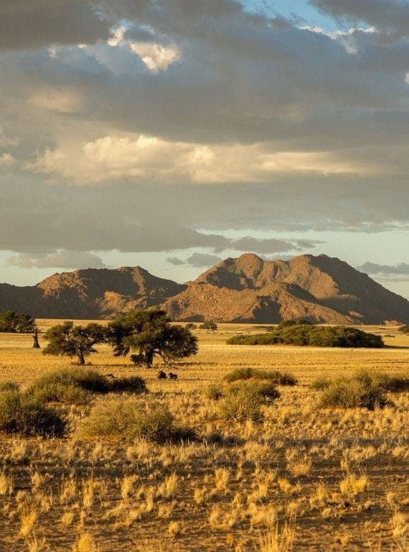
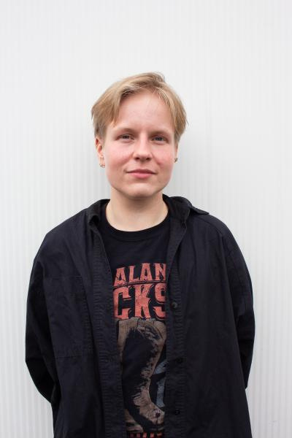
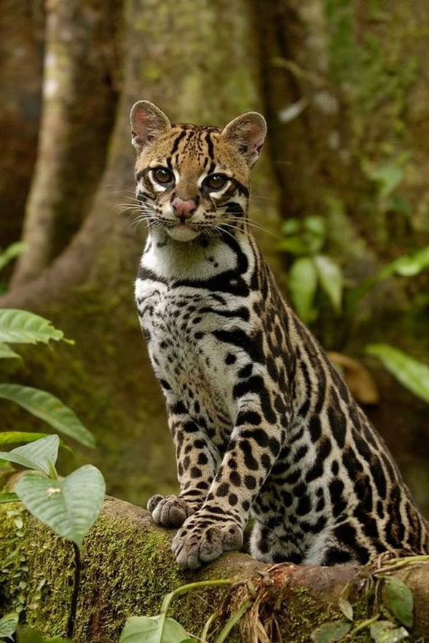
Lauri as a .......
ocelot

Slide 20
Why?
I really like Lauri; I think he resembles an ocelot. He gives off the same energy, that's all

Slide 21

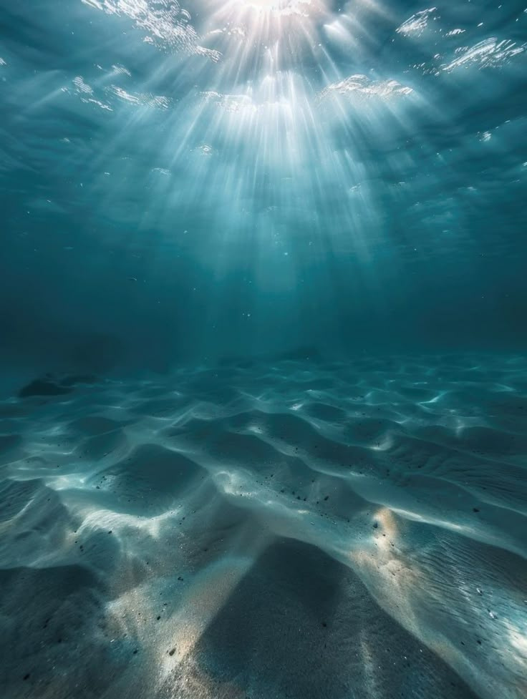

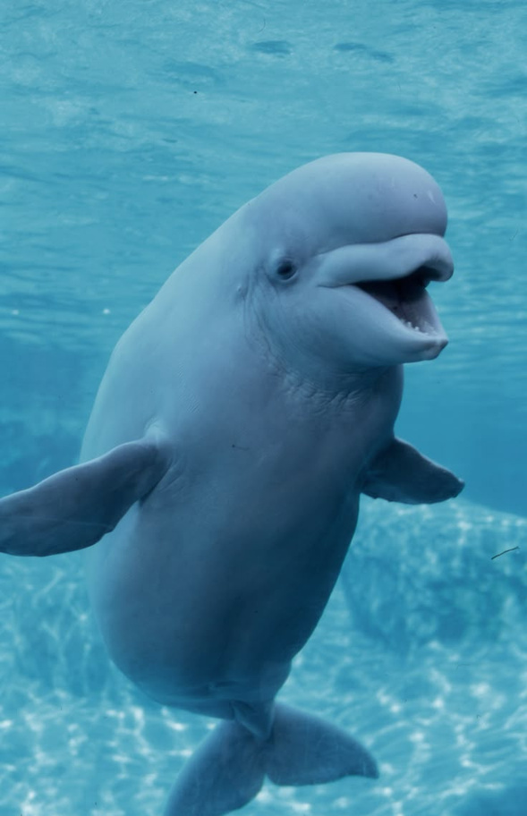

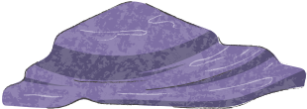
Pablo as a .......
Beluga

Slide 22
Why?
I was asked to assign several animals to Pablo, but I can't remember which ones now. Either way, I'd already found the perfect one for Pablo: a beluga. They're both curious, friendly, and sociable, and they resemble each other.

Slide 23
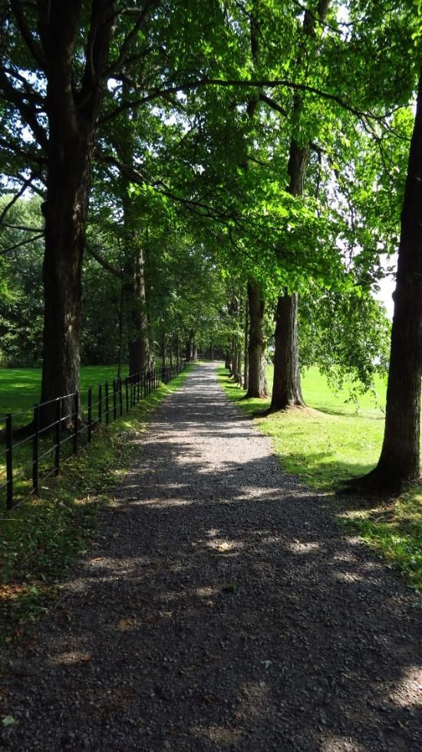
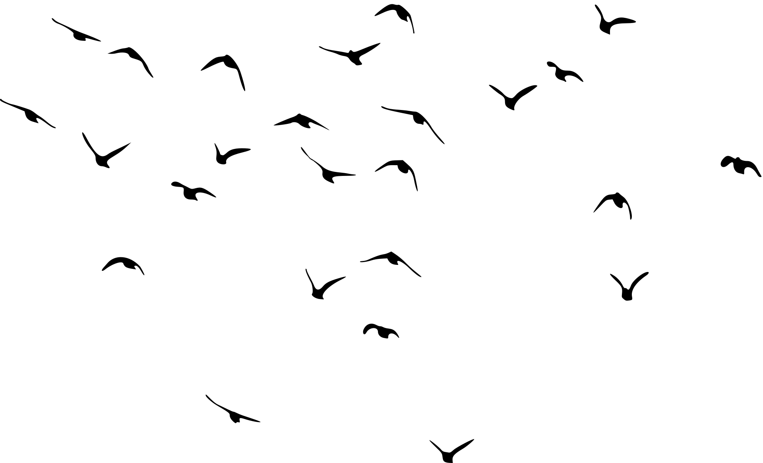
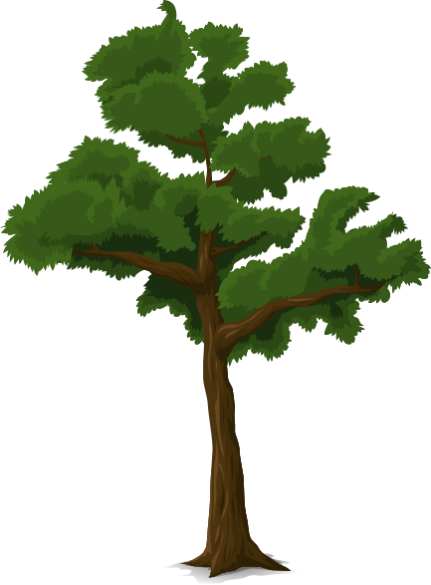
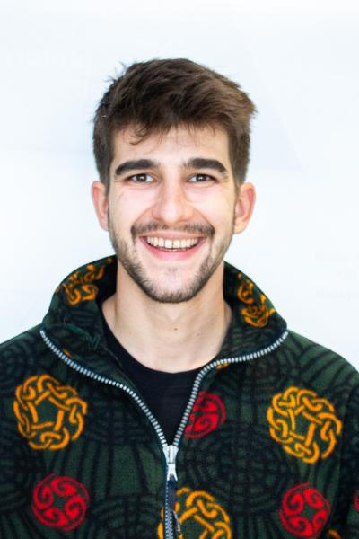
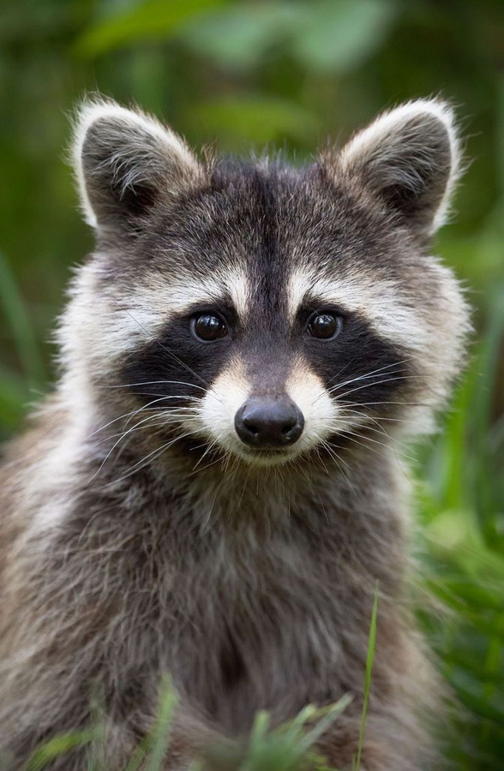
Ole as a .......
raton laveur

Slide 24
Why?
Initially, I'd assigned a dark brown dog to Ole, but actually, he's a raccoon. He looks mischievous, just like raccoons. I doubt he'd rummage through trash cans, but if he does, then I've done my job well!

Slide 25
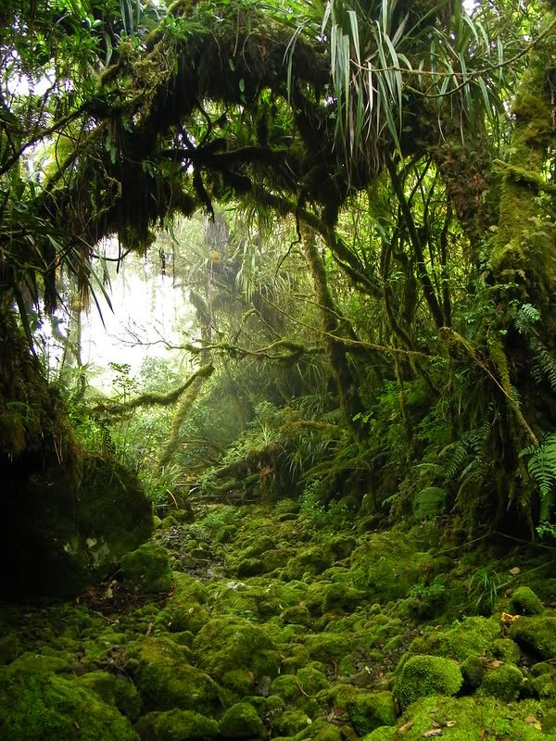


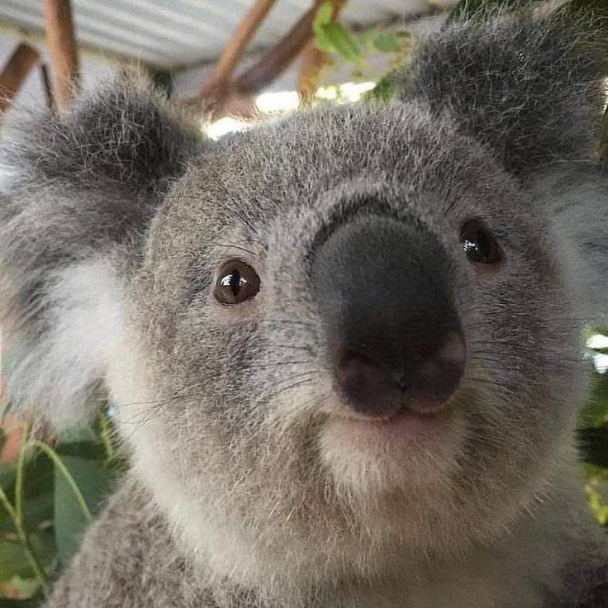


Robert as a .....
Koala

Slide 26
Why?
I see him as a koala, first of all, because of their striking resemblance. And, of course, for sleeping while hugging trees. Plus, they share the same personality: patient, idealistic, and efficient.

Slide 27
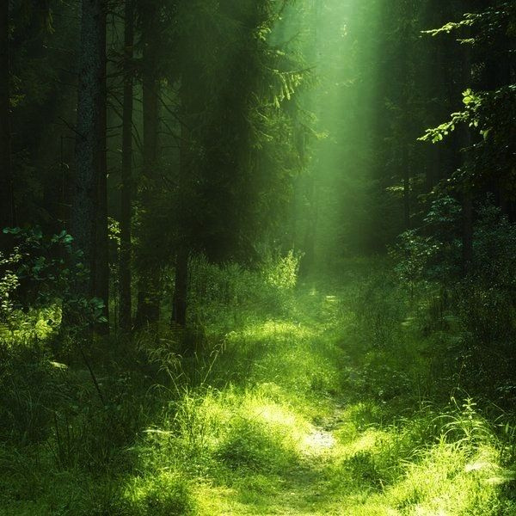
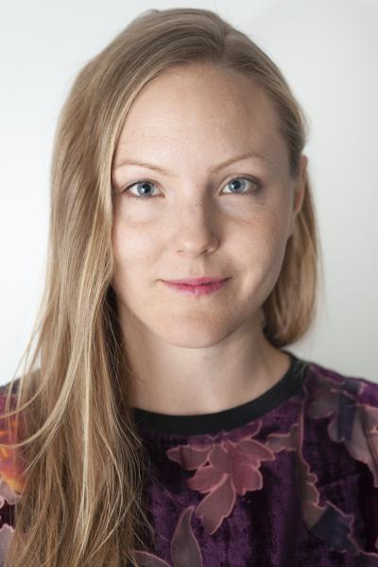
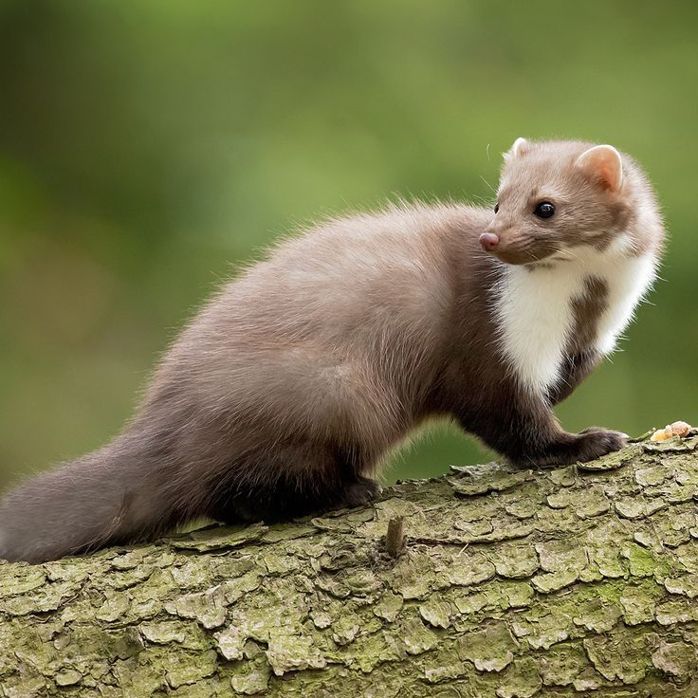
Tuuli as a .....
Fouine

Slide 28
Why?
I found her animal very quickly. I've never met Tuuli yet, but in terms of personality, she seems perfectionistic and determined, exactly like a weasel.

Slide 29
Thanks you for watching
Long live self-deprecating humor !
Nora Amasha

Slide 30
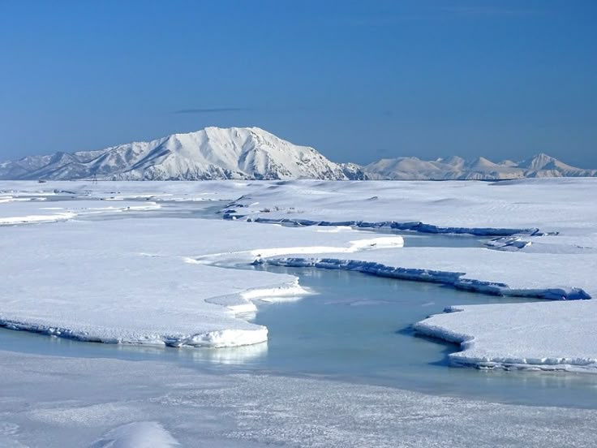
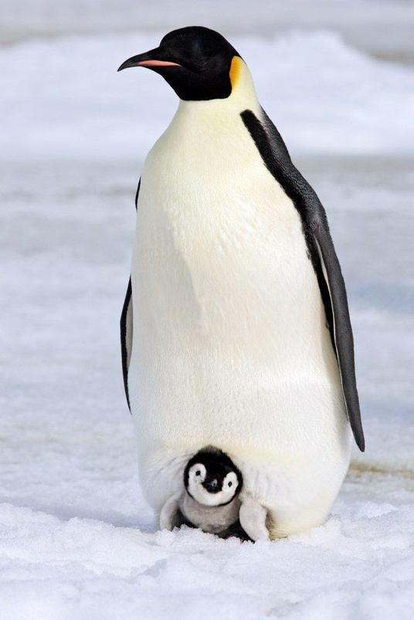
Me as a penguin
(not the cute one)

