Slide 1
My IdeaSquare
Name: Laura Wirtavuori
Team Meeting June 19th and 20th 2025

Slide 2
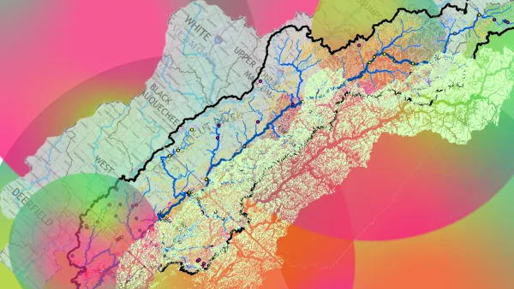
IdeaSquare, the serendipity space at CERN building radical futures.
What do I mean? Not only focused on education but also on providing space for and actively participating in different projects bringing together multidisciplinary participants from science, industry, and policy-making
Why? To have a broader impact and better harness the potential brought by being at CERN.

Slide 3
Elements of My Vision
Value for CERN
Being the place through which people at CERN can contribute back to society and the broadcaster of CERN and the scientific way of working and thinking.
Continuity
When a course or project ends, the outputs are not dropped – either they work as input for next projects or there is a stakeholder that continues the work
New partners
Closer collaboration with CERN
Industry
Policymakers
Radical
Collaboration
Non-acceptance of shit that’s going on
Belief that there can be a more equitable world
Value of working and communicating based on fact
Different formats
From one year courses to week long design sprints,a clear offering to attract a carefully curated set of participants

Slide 4
How to Achieve My Vision
Radical
Identify a challenge / issue that we think requires urgent solving
New partners
Find a partner working on the identified challenge believing in the value of working together with students using i2P
Continuity
Make sure the partner has a clear vision on how to utilise the outputs
Different formats
Together with partner design a format that utilises i2P and involves the partner and students to work together
Value for CERN
Find people from CERN to work together with the students and the partner on the challenge

Slide 5
Where do I start today?
Seeing if any of this resonates and how cause none of it is gonna happen alone, and nothing is gonna happen if we all pull to different directions.

Slide 6
Possible roadblocks
Too big vision for it to be realistic
Can’t find partners interested
Too complex for unis / students to participate
No time to do anything about it

Slide 7
Ways around
Too big vision for it to be realistic
Break it into intermediate victories
Can’t find partners interested
Allow time and be smart in looking
Too complex for unis / students to participate
Start small with one pilot
No time to do anything about it
Something else needs to go

Slide 8
Thanks and Questions

