Slide 1




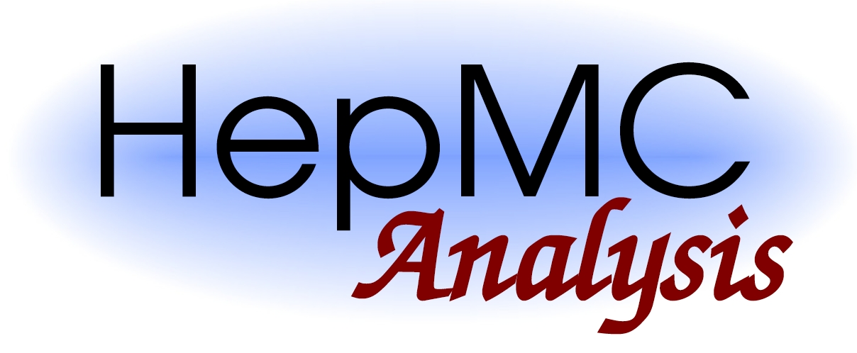

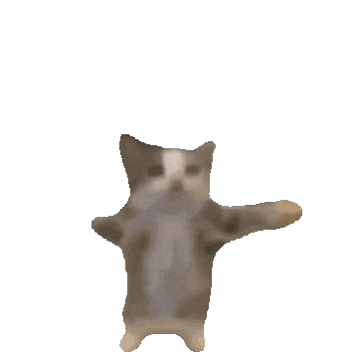
EXO-24-030: WH SUEP
Reinterpretation
today is a good day.
05/06/2025
Zeynep Demiragli, Carlos Erice Cid, Gianfranco de Castro, Ryleigh Resendiz

Slide 2
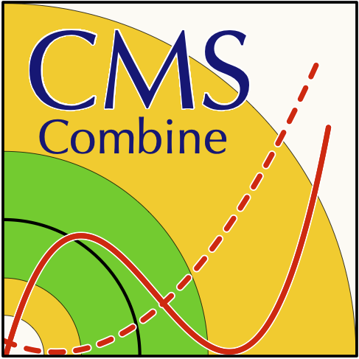


Starting with the fun stuff
Meeting with Common Analysis Tools (CAT) conveners tomorrow
  CAT talk, nothing physics-y, just about the reinterpretation materials we’re putting out
  everyone seems to be excited
New grad student in the office !!
  Potential talk at CMS week in June
  EXO conveners have been pinged
in a race against another unknown analysis to release model agnostic results
  got a suspicious message inquiring about when we plan on going public…
she’s so back

Slide 3
Don’t worry guys the fun has only just begun
can you tell I am excited and there are very cool things underway

Slide 4
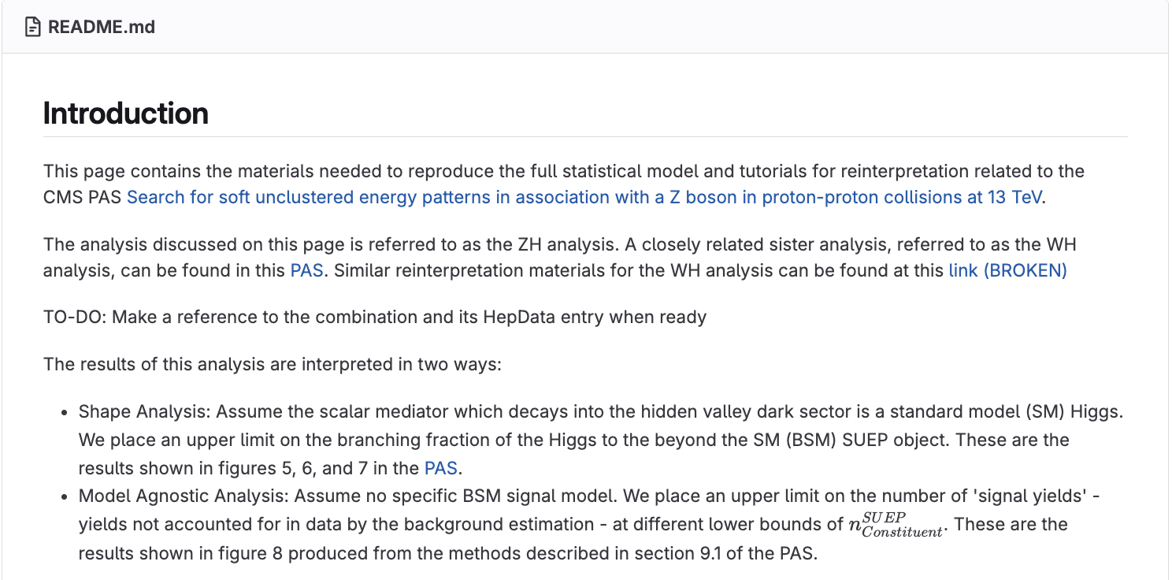
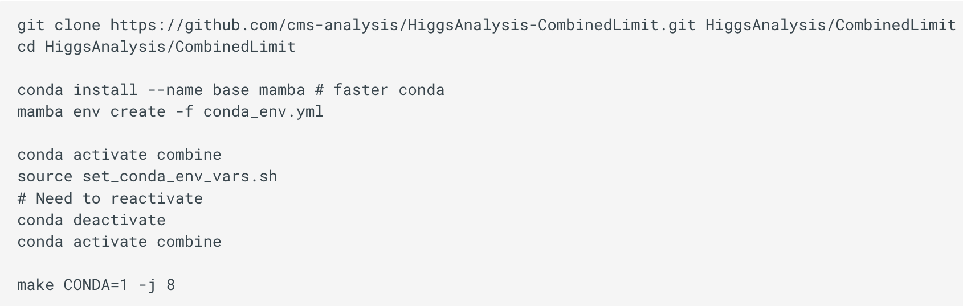
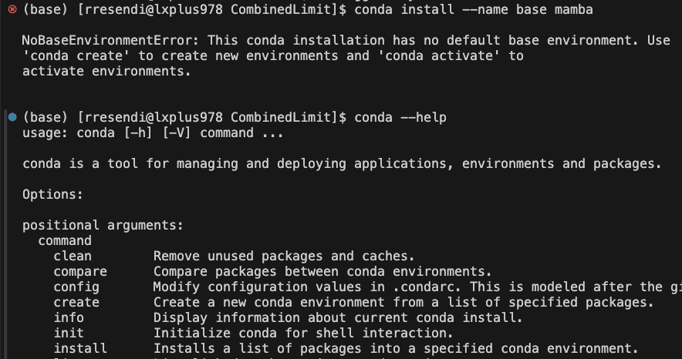
Preparing for CAT Meeting
Reinterpretation material packet presentation will be given by Gianfranco
I will be touching on issues with software installation/Combine installation instructions, etc.
  combine installations (in particular) don’t work out of the box
Ran through ZH data card workflow to ensure results were reproduceable
  they weren’t
Working through streamlining software installation instructions and will be presenting solutions to all issues:
  Combine installation for non CMS-users
  gcc vs. clang. a nightmare for any macOS user.
  Dockerfile for SUEP HEPMC generator also does not work
    obviously not a CAT issue but we’re working on it

Slide 5
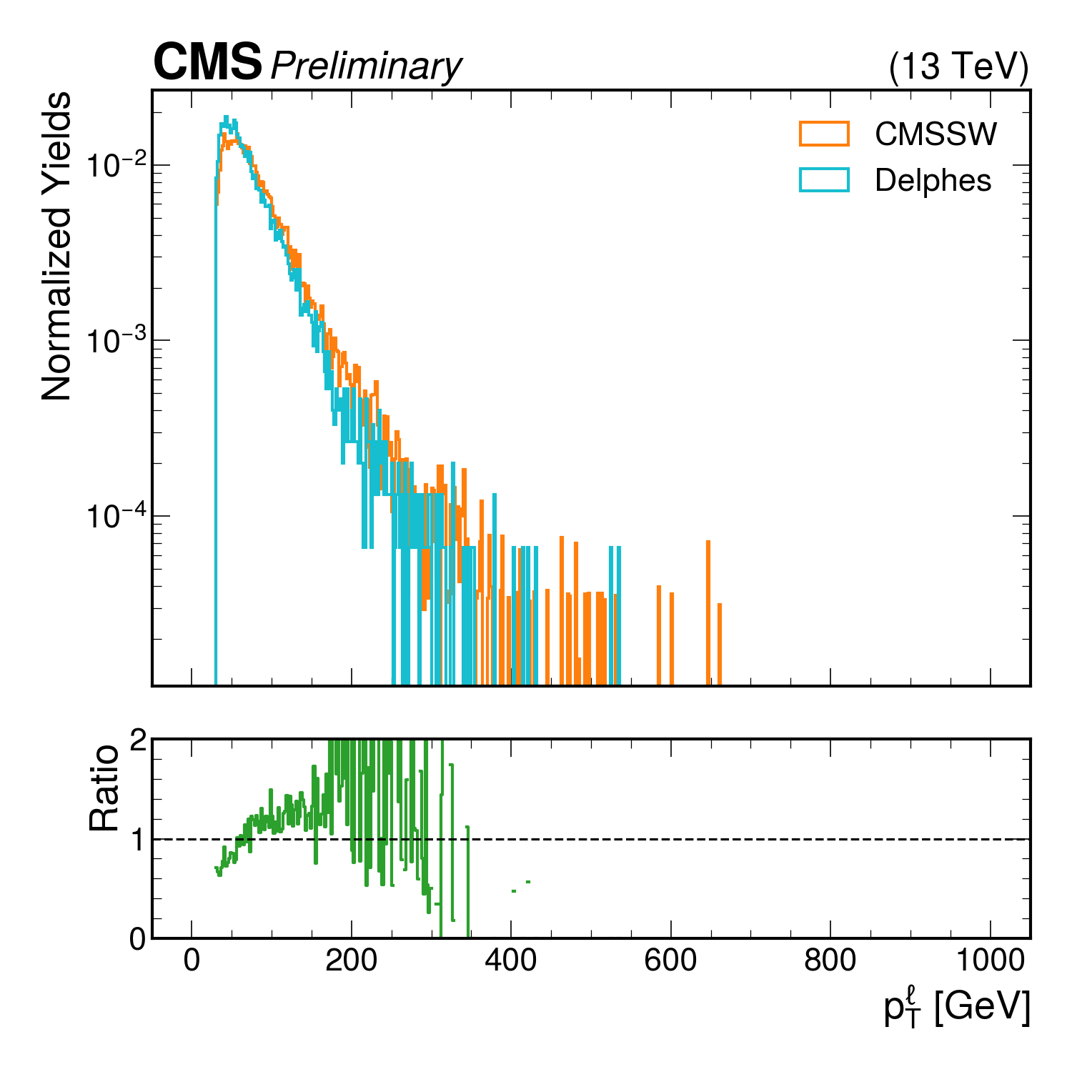
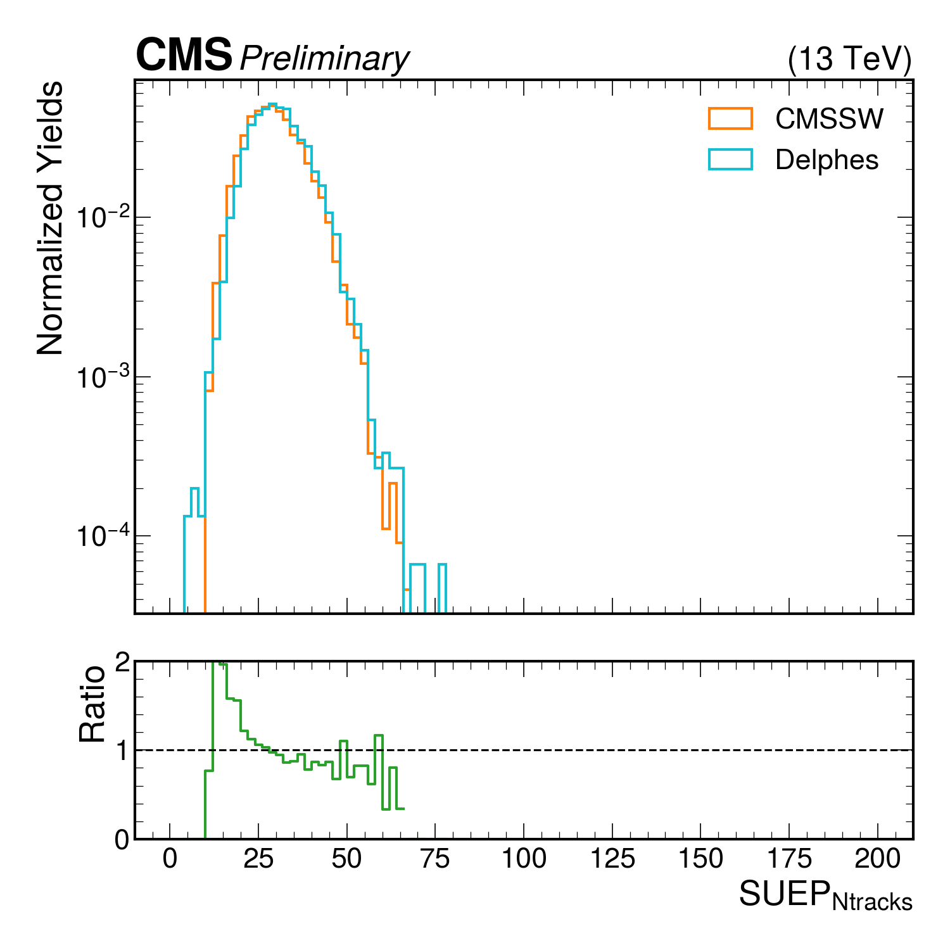
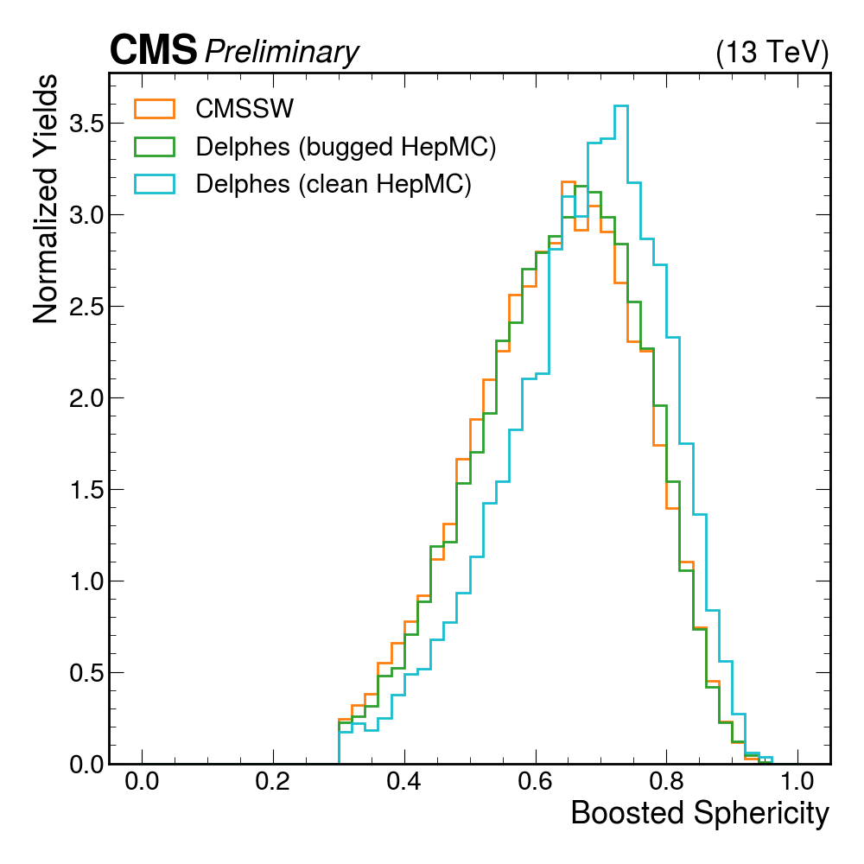
Updated Delphes/CMSSW Comparisons

Slide 6
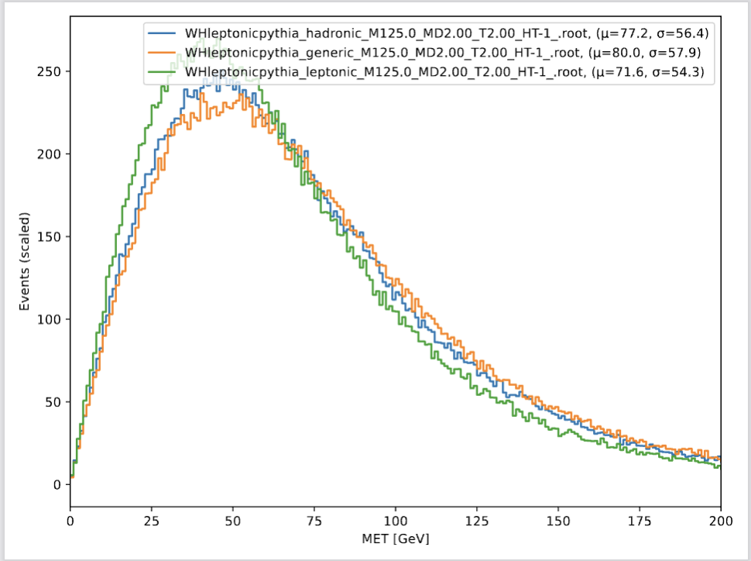
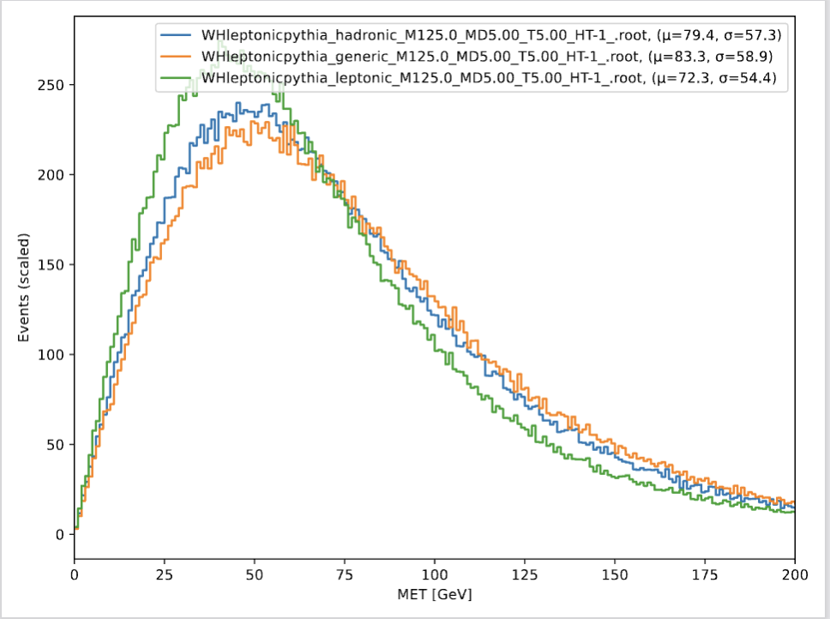
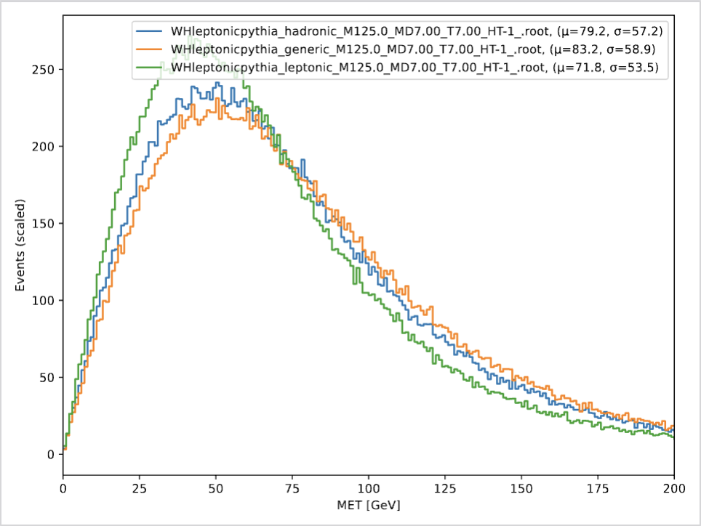
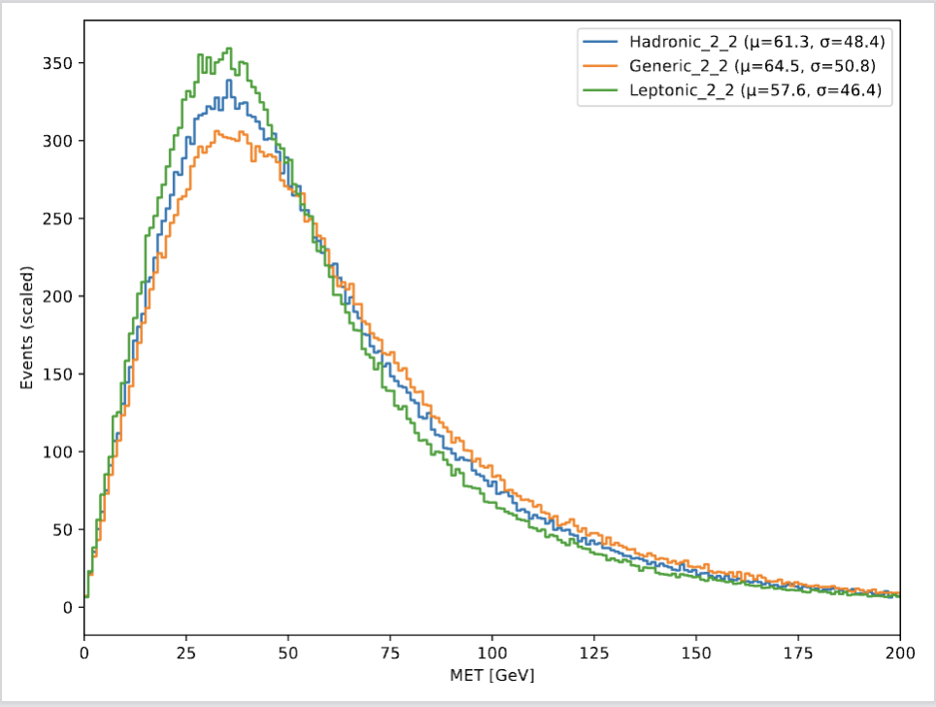
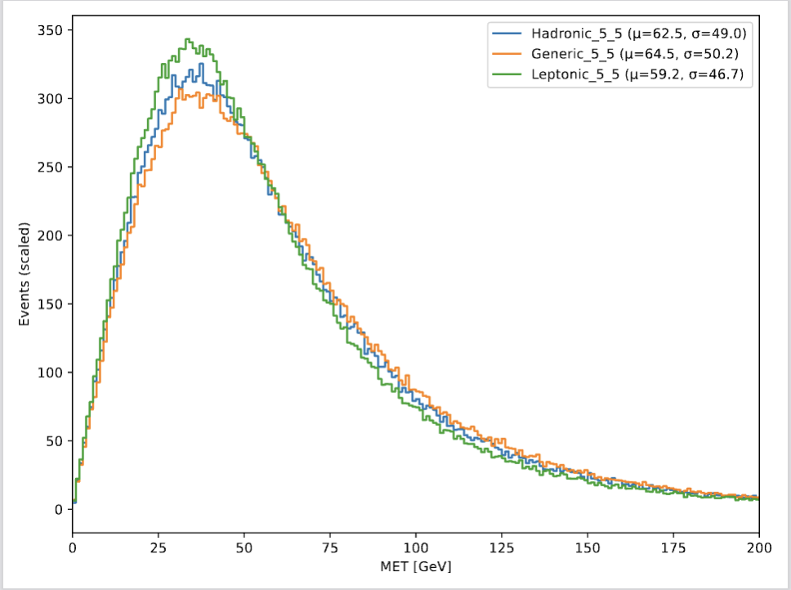
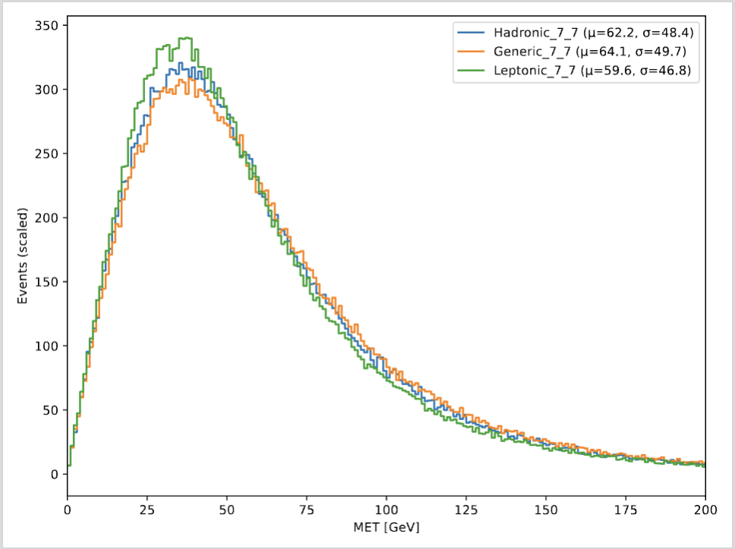
MET mismodeling
Top plots: MET distribution for the same decay modes with different mass and temperature (CMSSW)
Bottom plots: MET distribution for the same decay modes with different mass and temperature (Delphes)
Generic_7_7 and Leptonic_7_7 are severely problematic
No pileup simulated in Delphes, which means MET modeling will be way ‘cleaner’ than CMSSW
Expect this to vary across years because of the COM energy and integrated luminosity of the detector increasing → more pileup

Slide 7
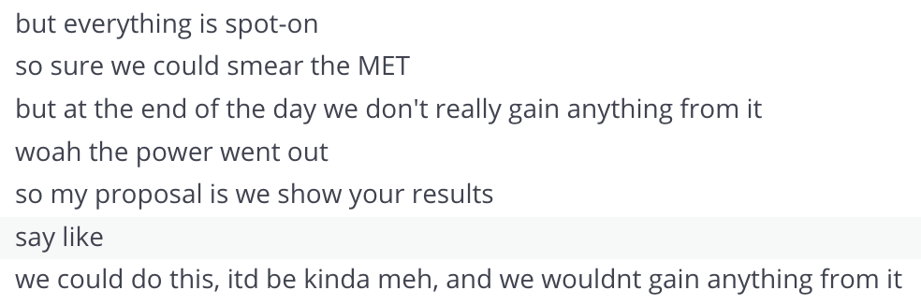
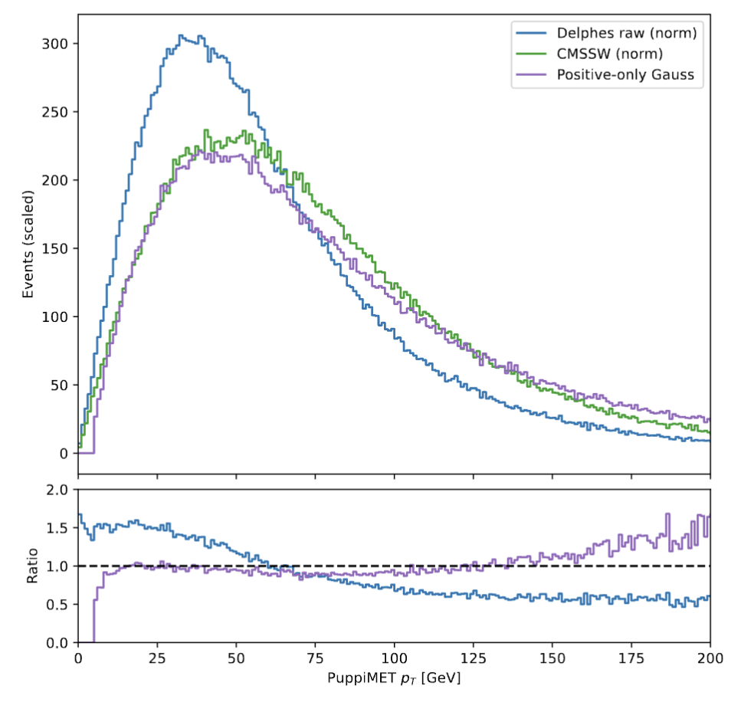
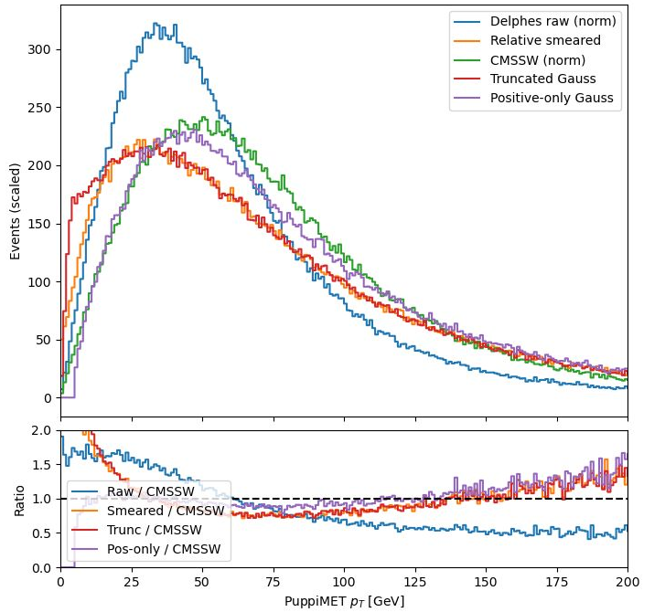

Plans to smear MET model
In awe of Gianfranco’s genius, honestly.
Determine the relative resolution of the MET distributions in Delphes and CMSSW
$Χ_{D}=\frac{p_{T}^{MET, Reco}−p_{T}^{MET, Gen}}{p_{T}^{MET, Gen}}$ & $Χ_{C}=\frac{p_{T}^{MET, Reco}−p_{T}^{MET, Gen}}{p_{T}^{MET, Gen}}$
(Assume the distributions are Gaussian) Find the ($μ$, $σ$) of the distributions
$(μ\left(Χ_{D}\right), σ(Χ_{D}))$ & $(μ\left(Χ_{C}\right), σ(Χ_{C}))$
Determine the appropriate scale factor required to smear the Delphes distribution
$$μ\left(Χ_{smear}\right)= μ\left(Χ_{C}\right)−μ\left(Χ_{D}\right)$$
$$σ\left(Χ_{smear}\right)=\sqrt{\left\lfloor σ^{2}\left(Χ_{C}\right)−σ^{2}(Χ_{D})\right\rfloor }$$
Throw a gaussian with ($μ\left(Χ_{smear}\right)$, $σ\left(Χ_{smear}\right)$) and scale
$p_{T}^{MET, Reco}$ only if the gaussian is positive
  gauss. > 0 worked the best
decided to ditch and not do this because…

Slide 8
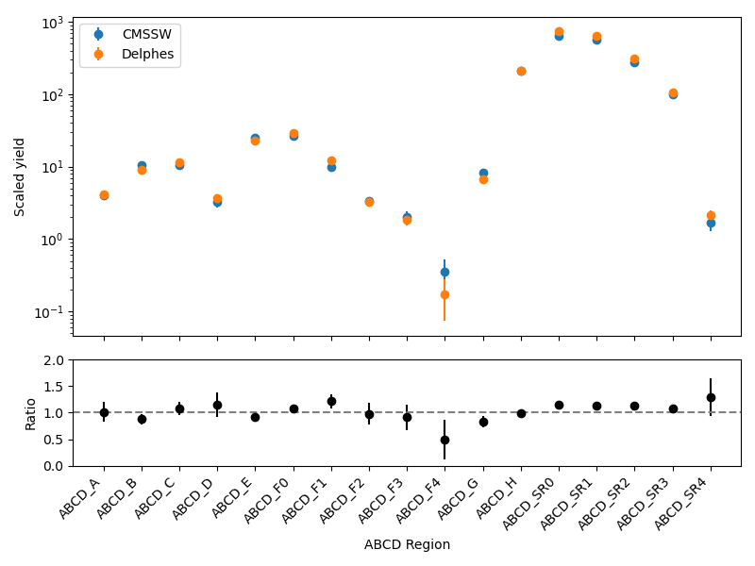
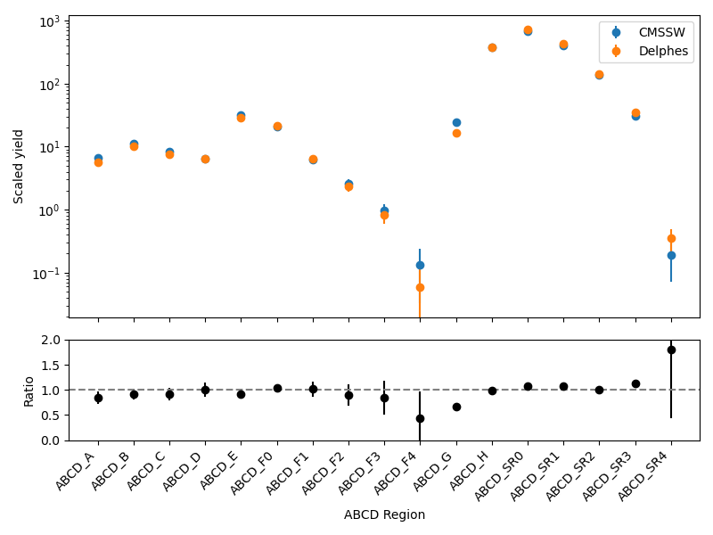
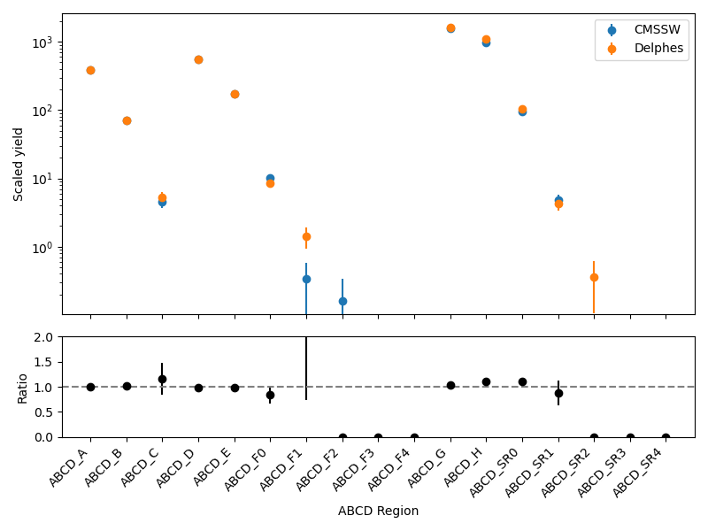
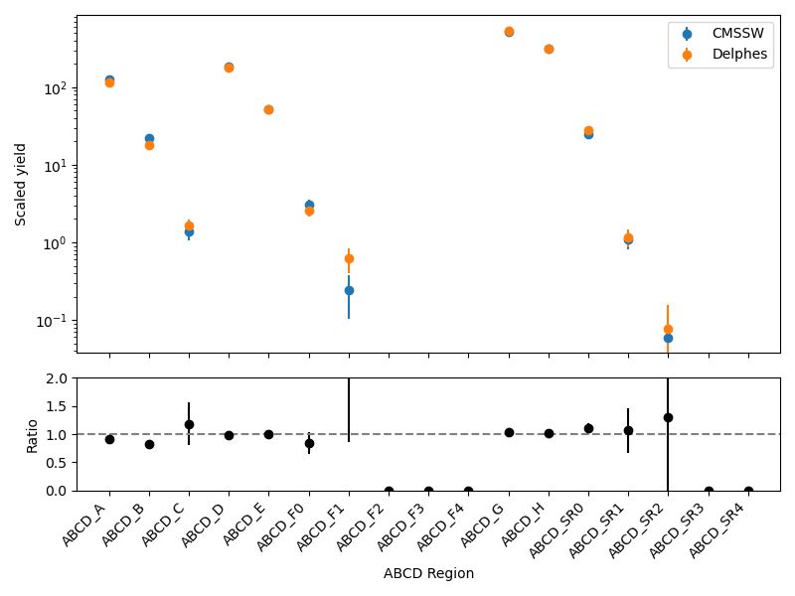
WH Full ABCD Region Fit
it’s so fcking beautiful i could cry

Slide 9
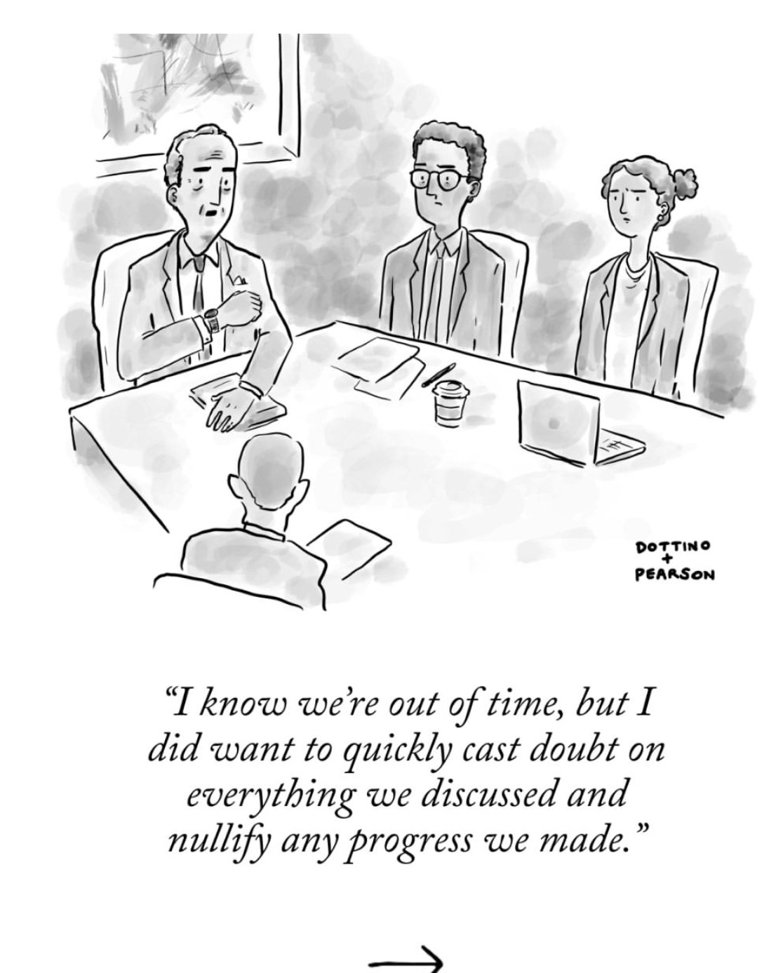

Completed basically everything
DONE WITH THE ANALYZER !!!!!!!!!!!!!!!!!!!!!!!!!!!!!!!!!!!!!!!
  totally not jinxing it at all
  end of an era
Checked signal yields and predictions with the tuned nominal Delphes VH card
  and they look absolutely stunning
Looked at upper limits from Combine fits
  within 30% agreement
  random track dropping → 20% agreement
    either going to keep this because it works or strategically approach this
Literally jumping for joy. But still a tad too close to call.
WH and ZH Reinterpretation materials: complete.
Will begin doing this process all over again for VH
  except all of the heavy lifting is done.
  just have to analyze combine limits

Slide 10
Backup

Slide 11
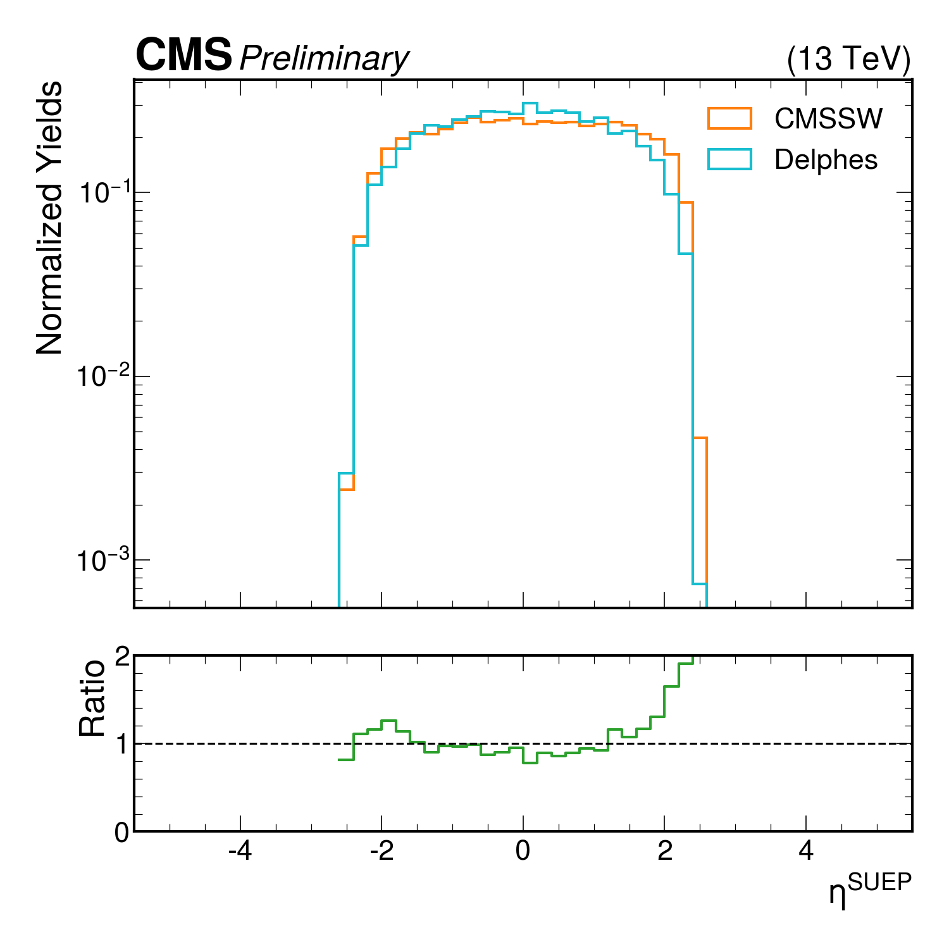
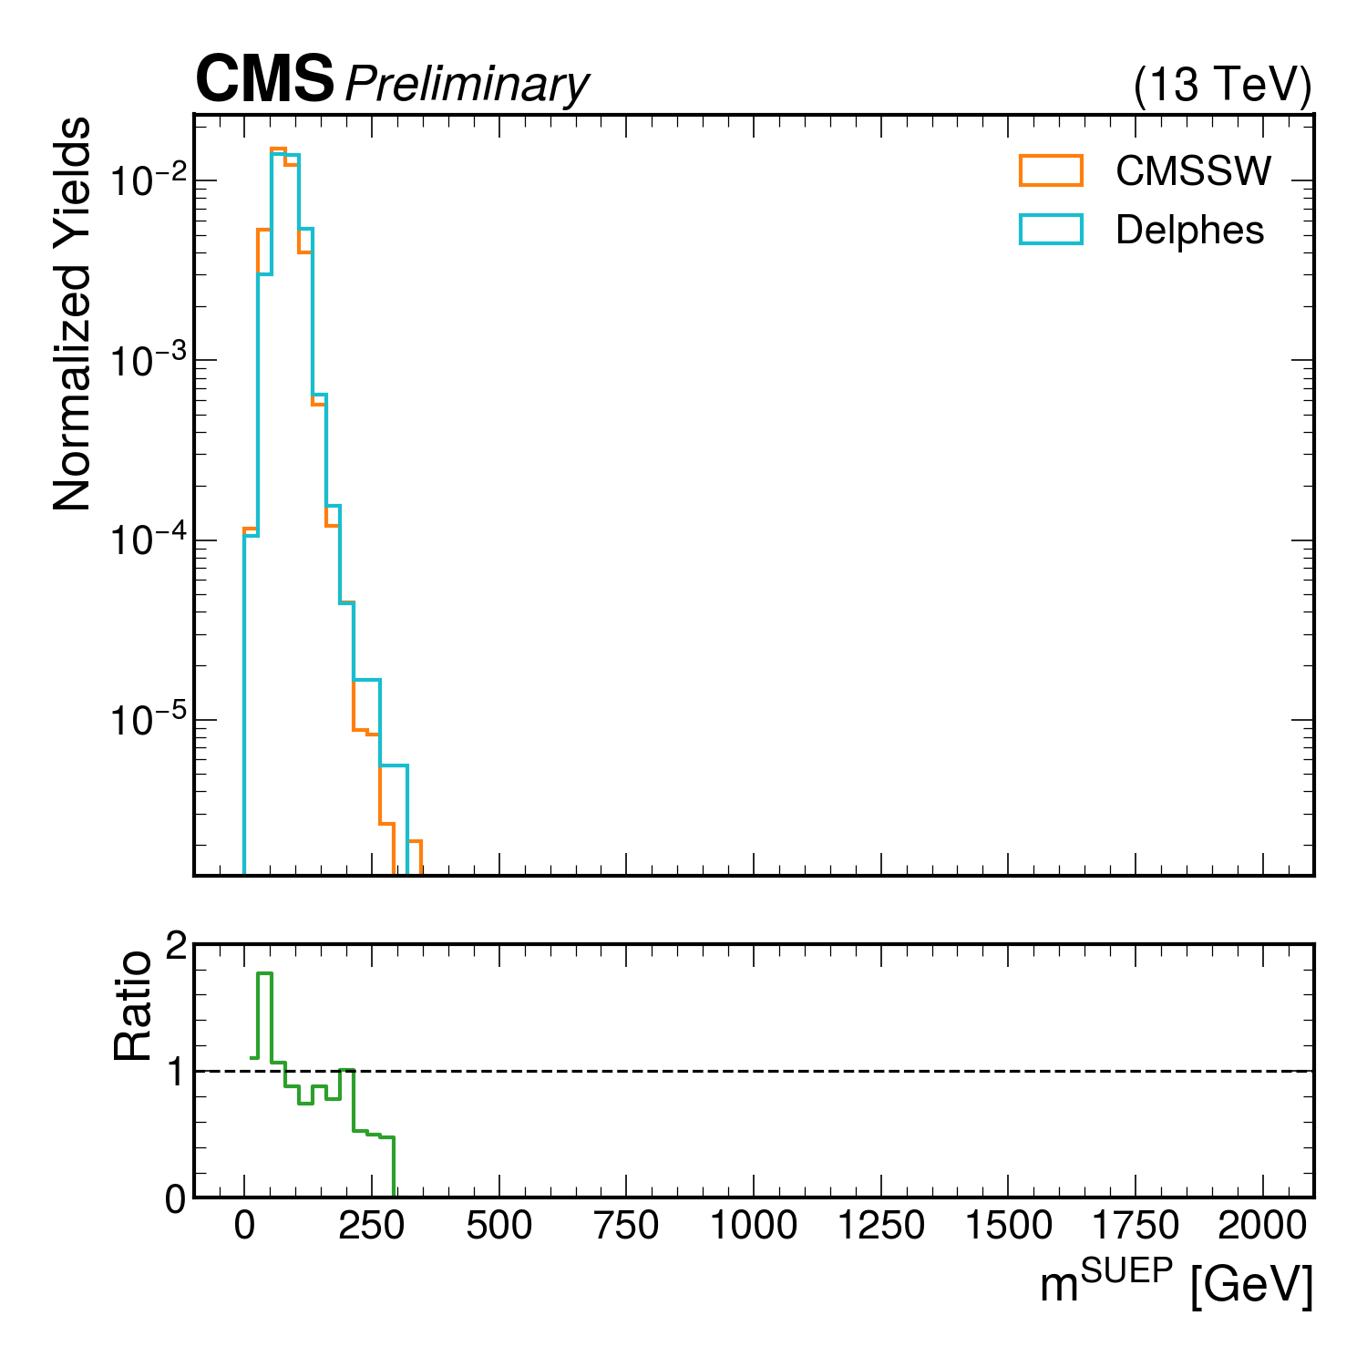
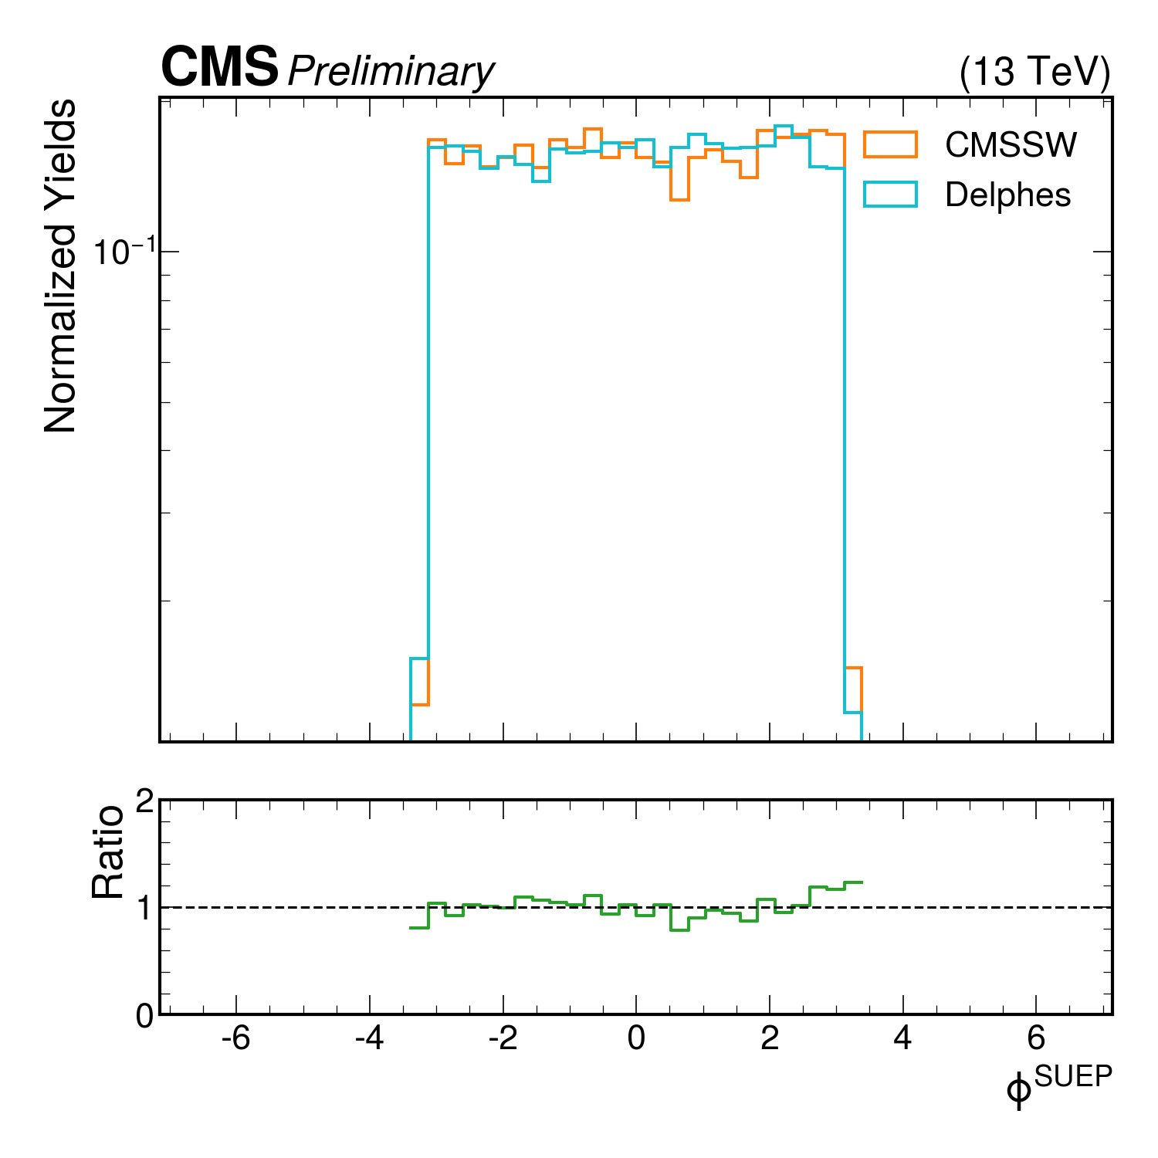
SUEP Kinematic Comparison Shapes

Slide 12
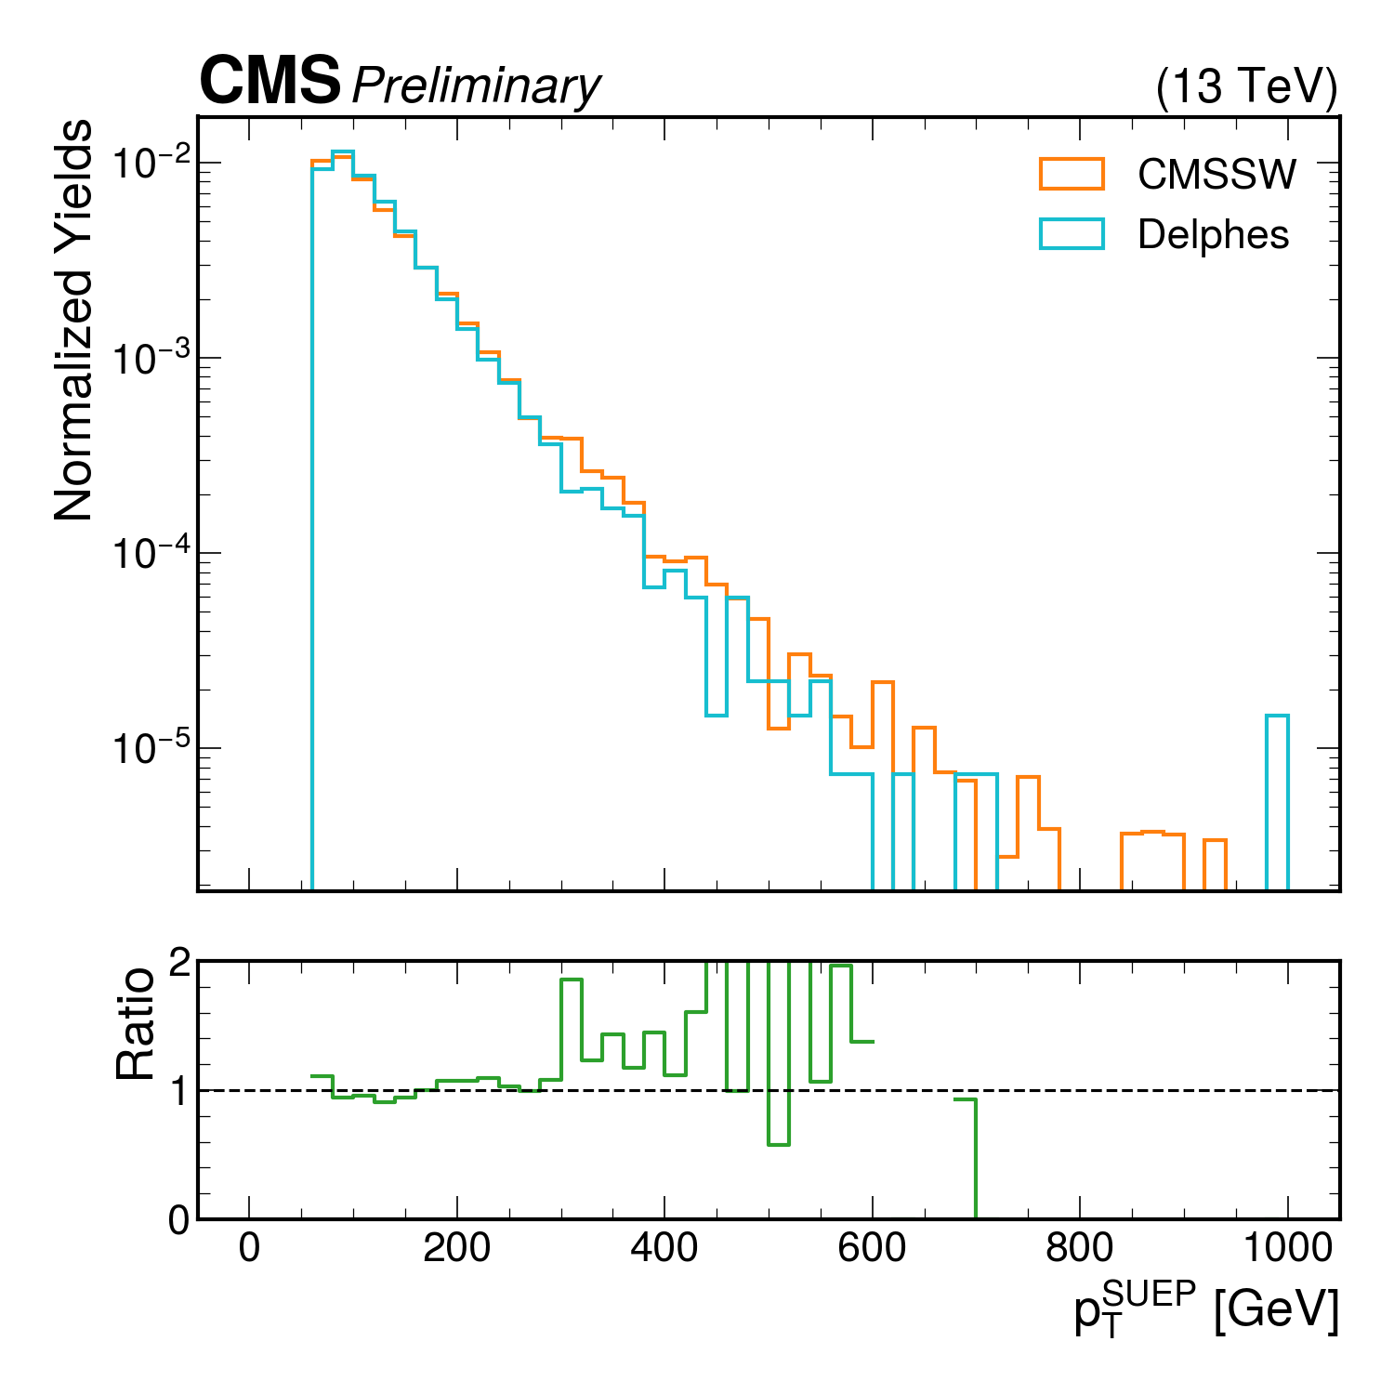
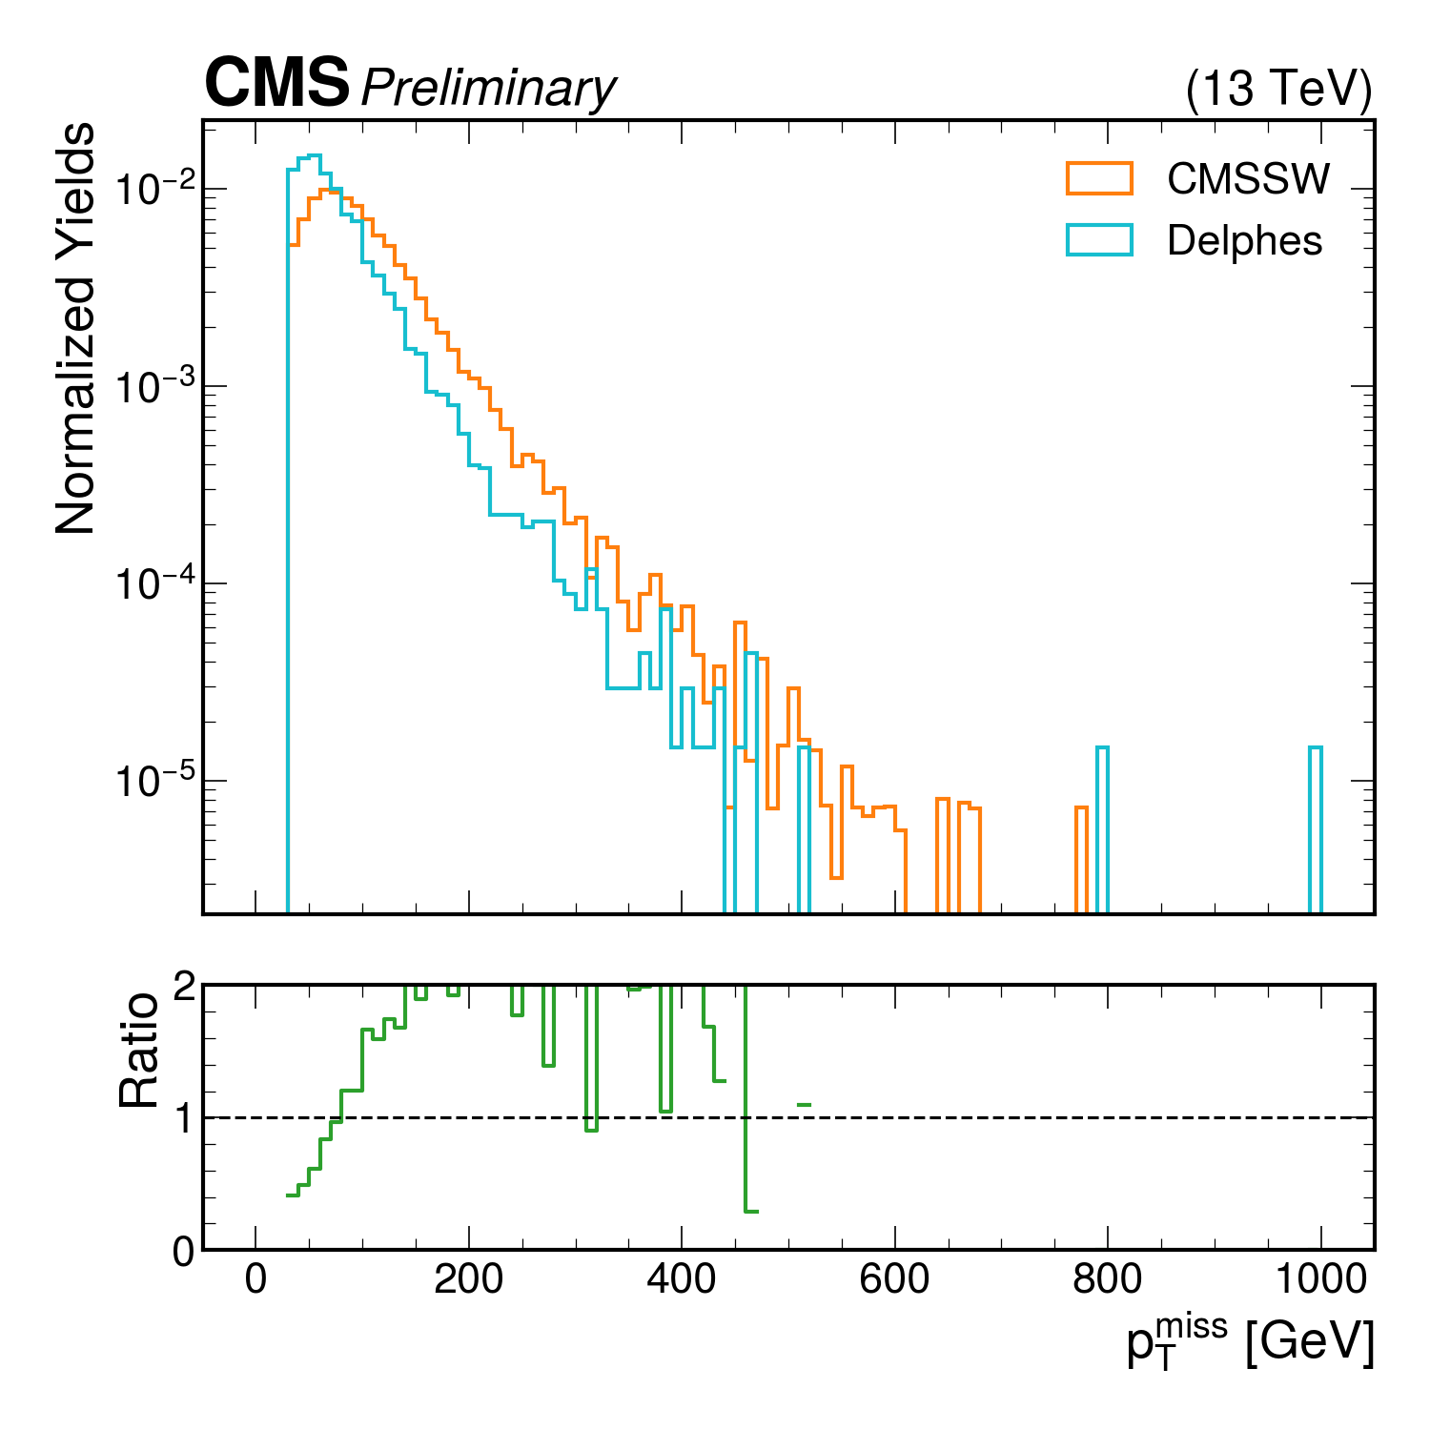
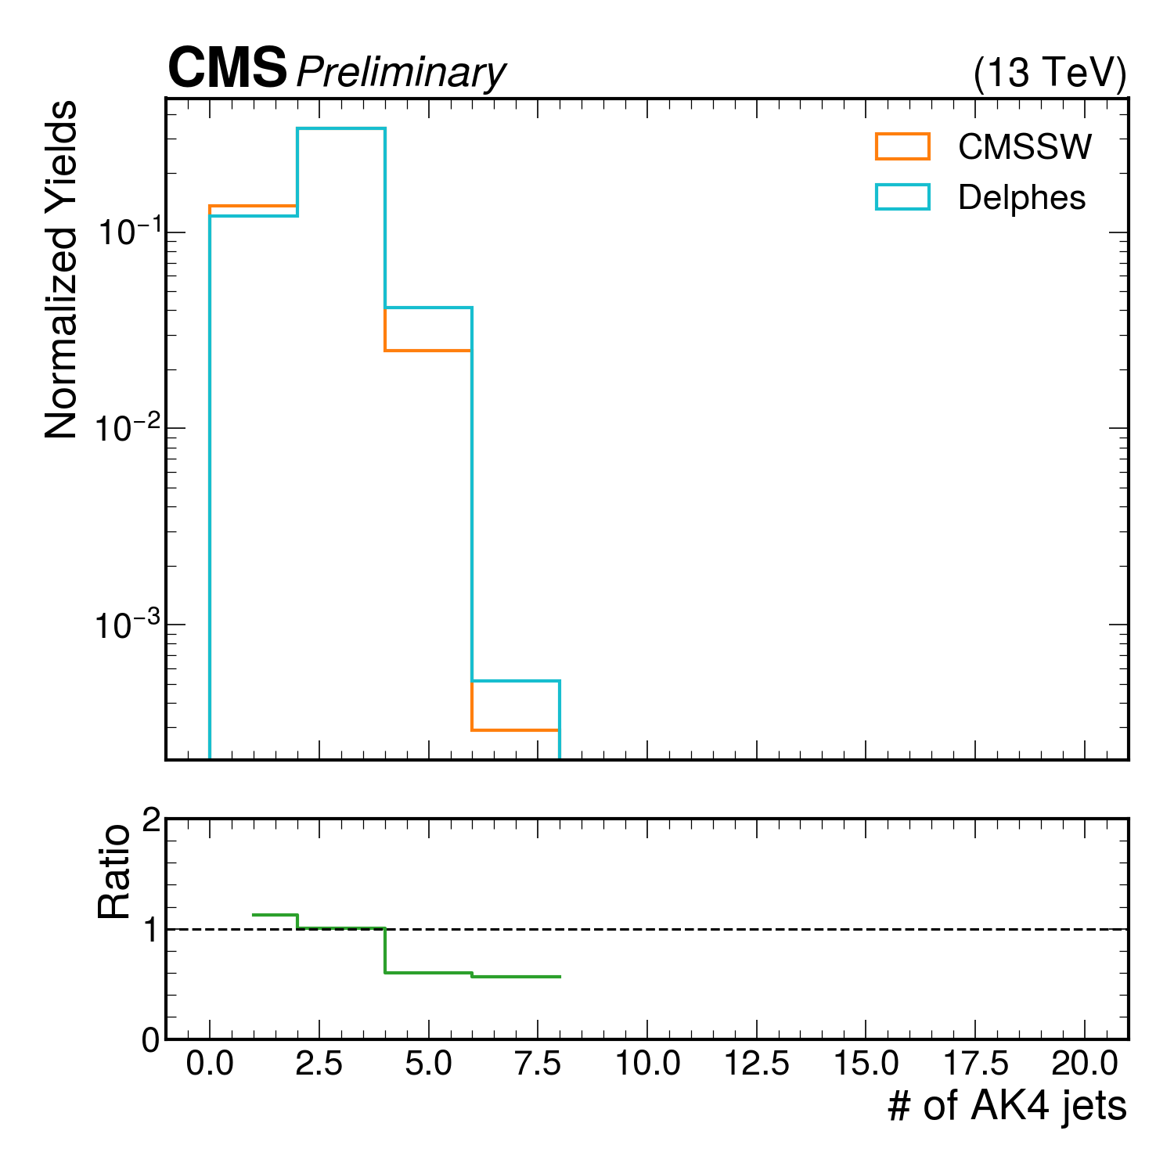
Cont.

Slide 13
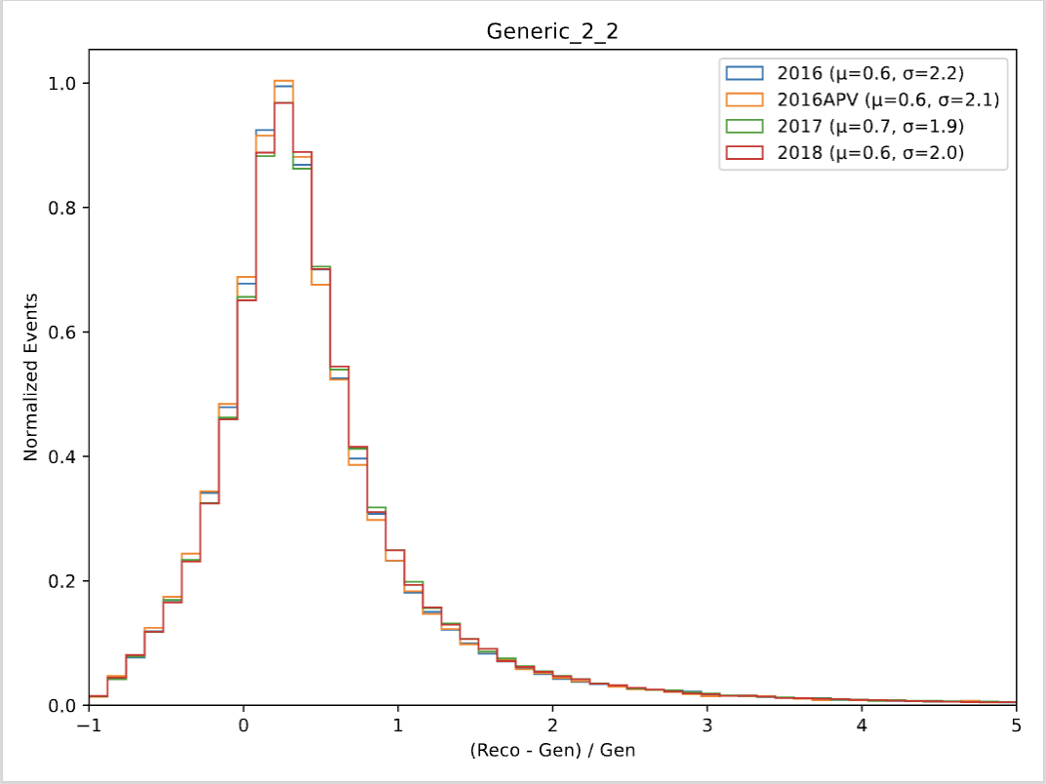
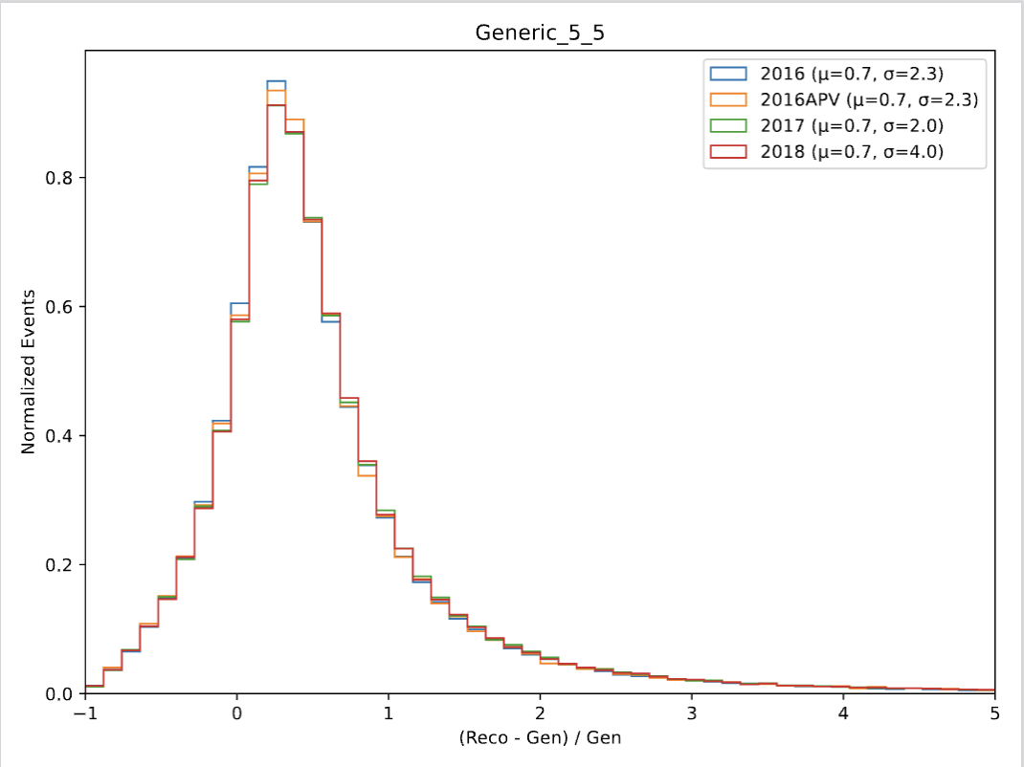
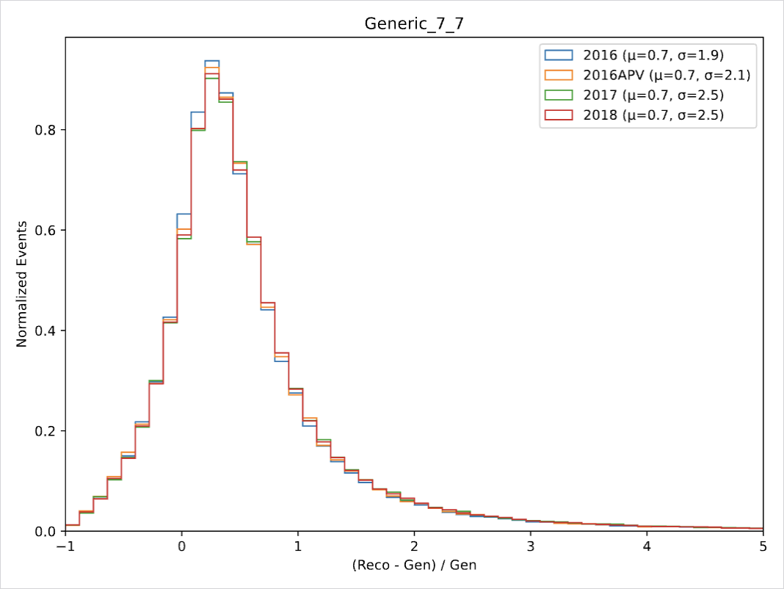
CMSSW Generic Decay MET Distributions

Slide 14

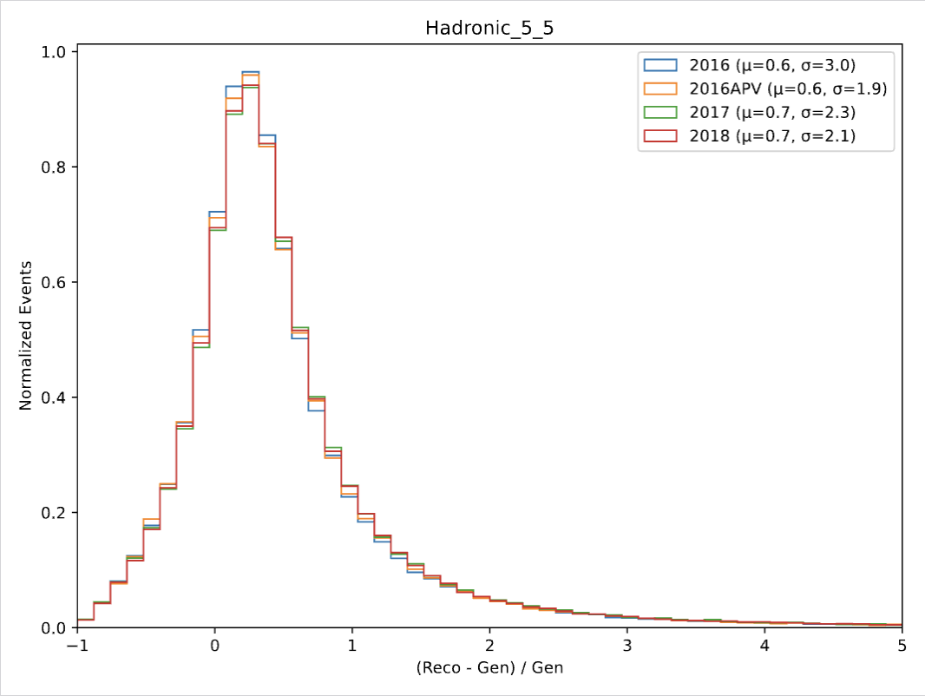

CMSSW Hadronic Decay MET Distributions

Slide 15
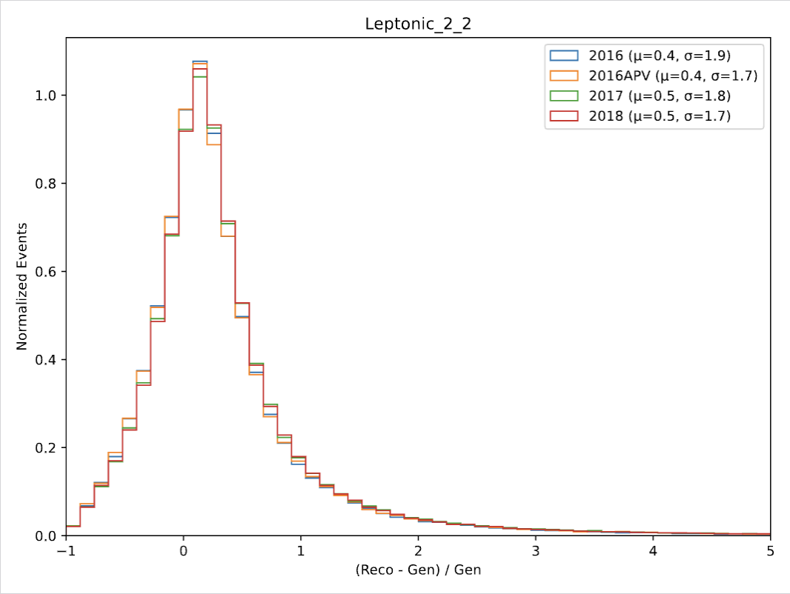
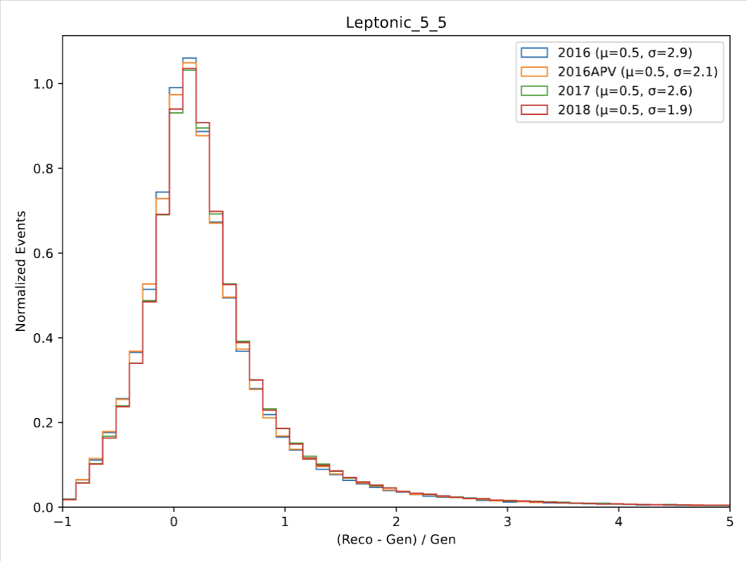
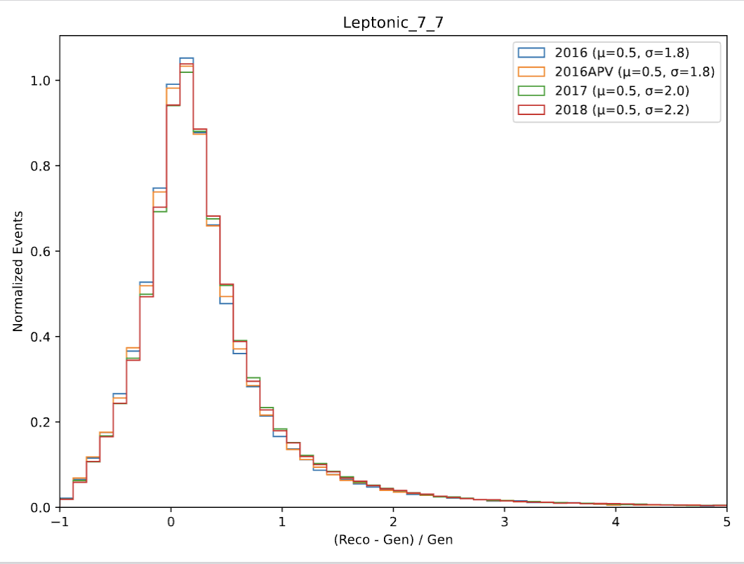
CMSSW Leptonic Decay MET Distributions

Slide 16
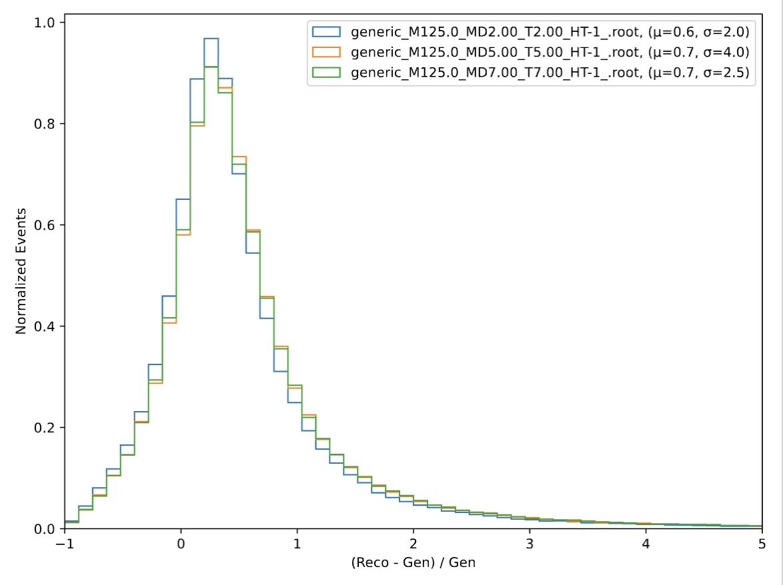
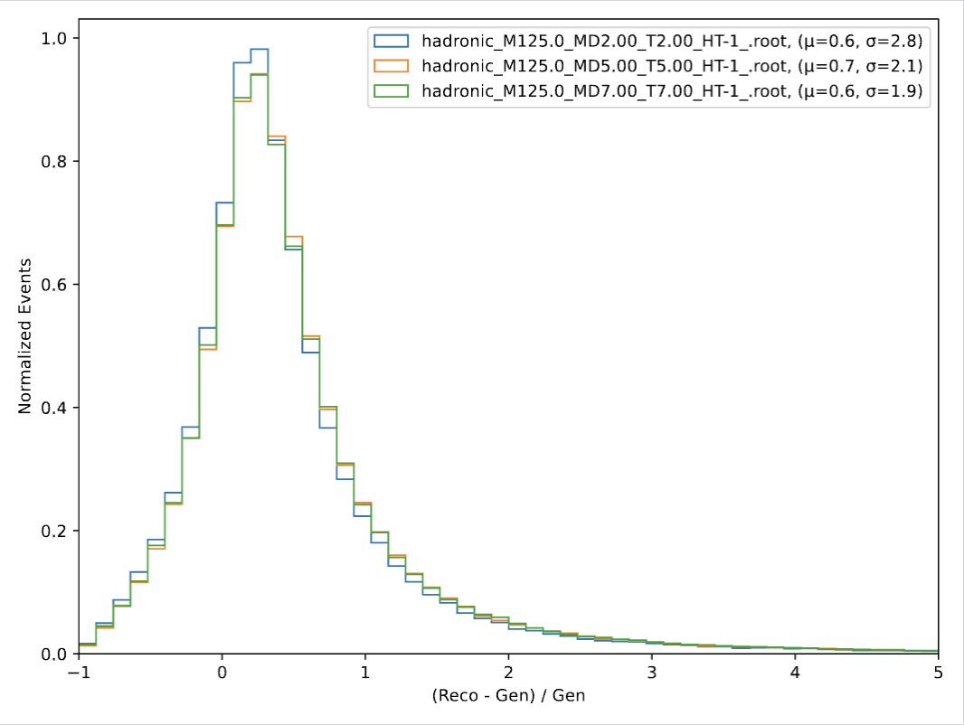
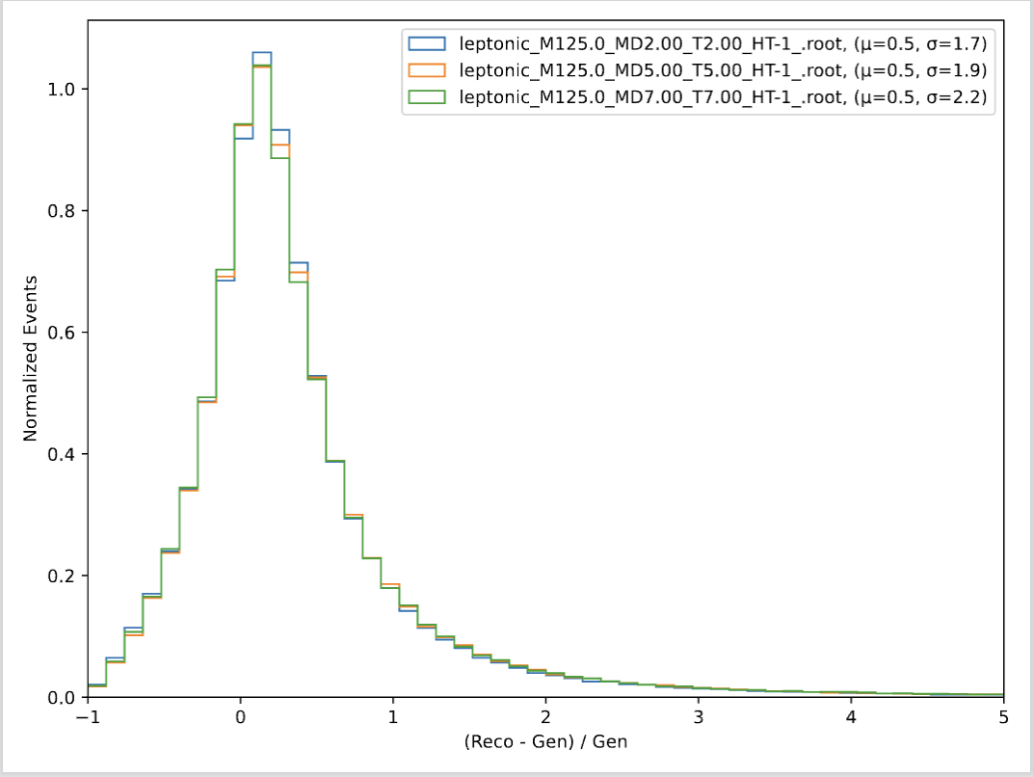
CMSSW MET Distributions by Decay

Slide 17
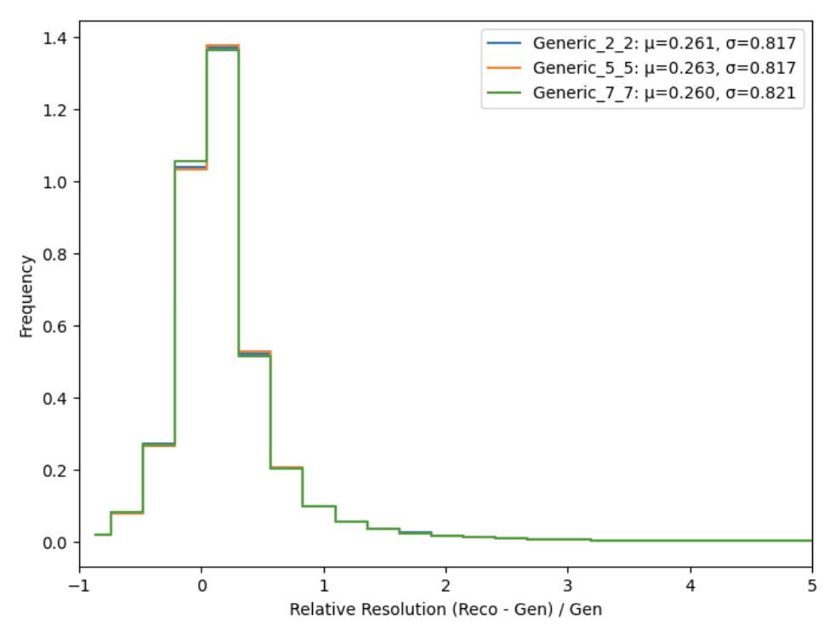
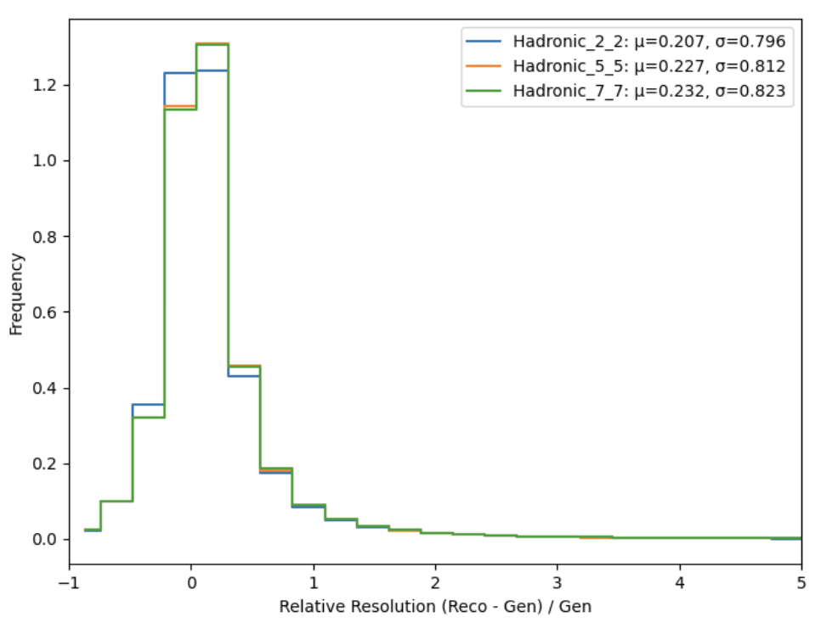
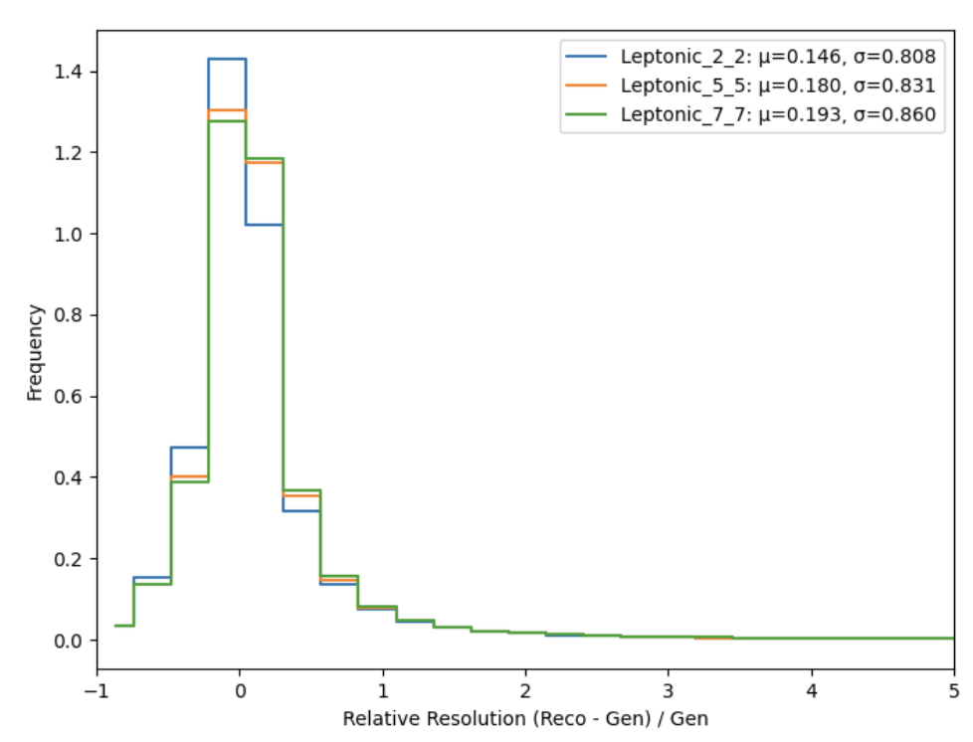
Delphes MET Distributions by Decay

Slide 18
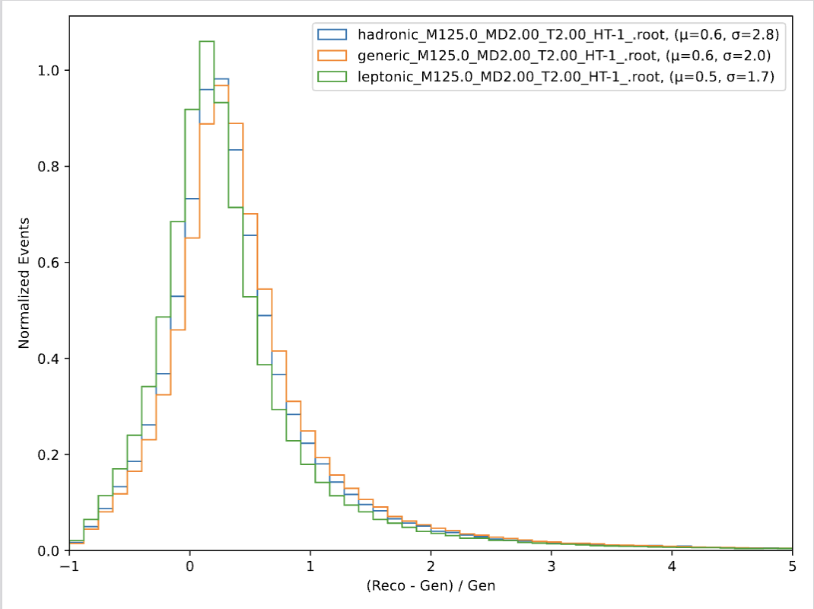
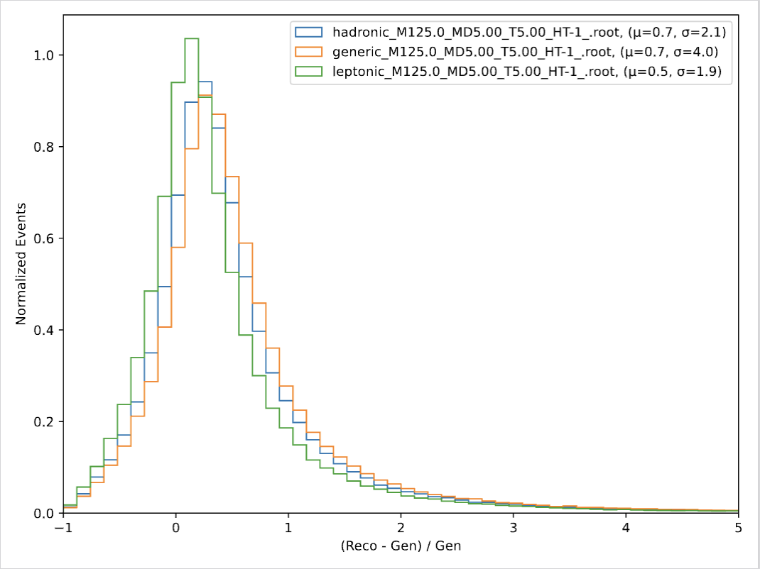
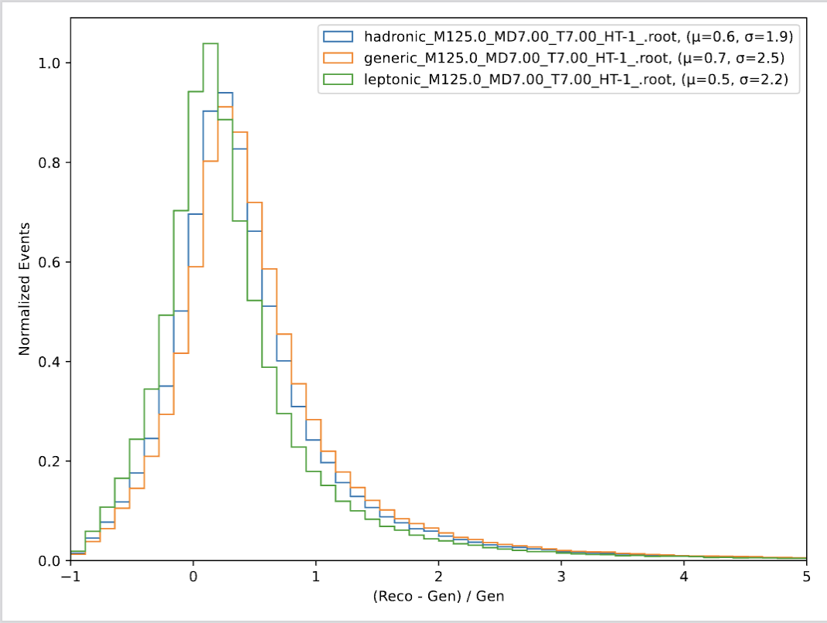
CMSSW MET Distributions by (mD, T)

Slide 19
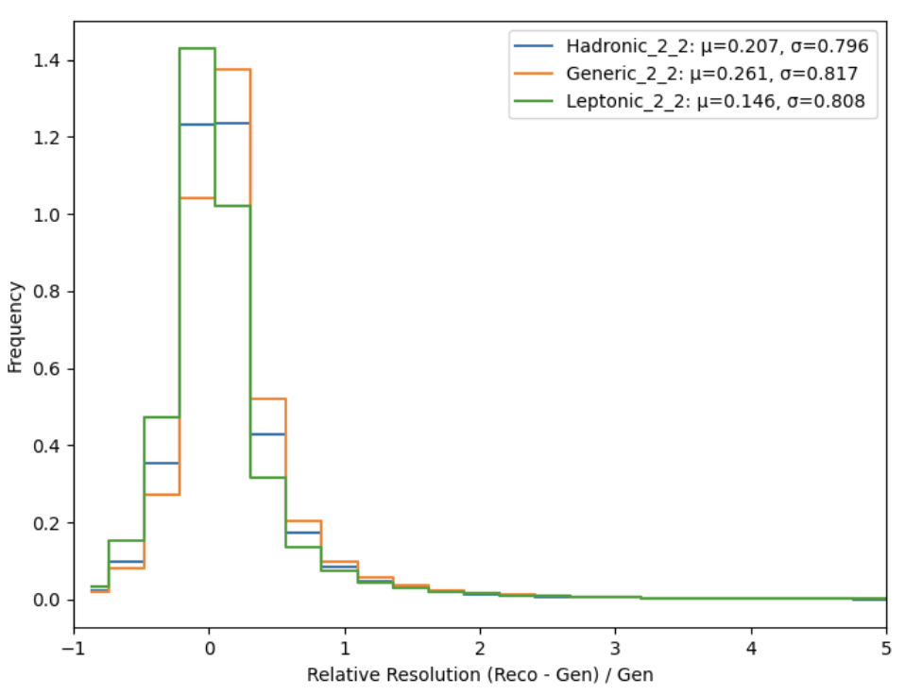
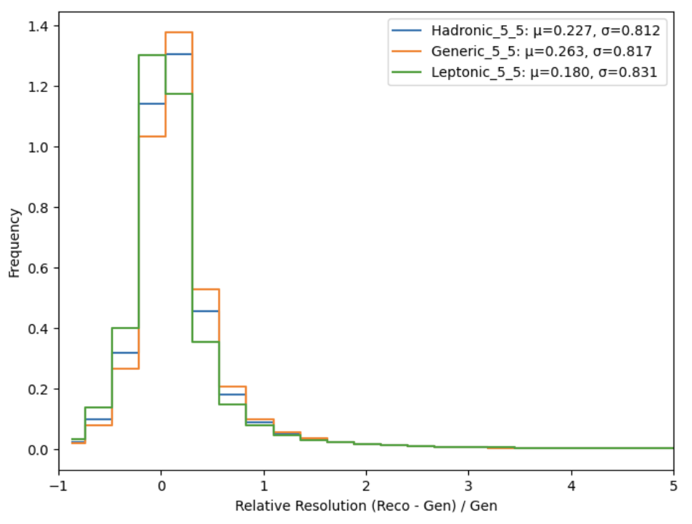
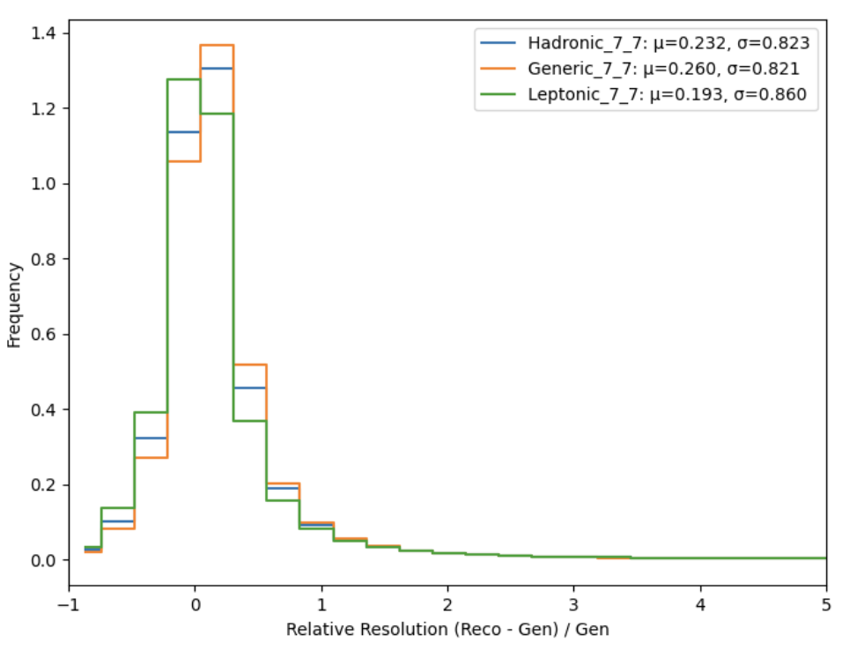
Delphes MET Distributions by (mD, T)

Slide 20
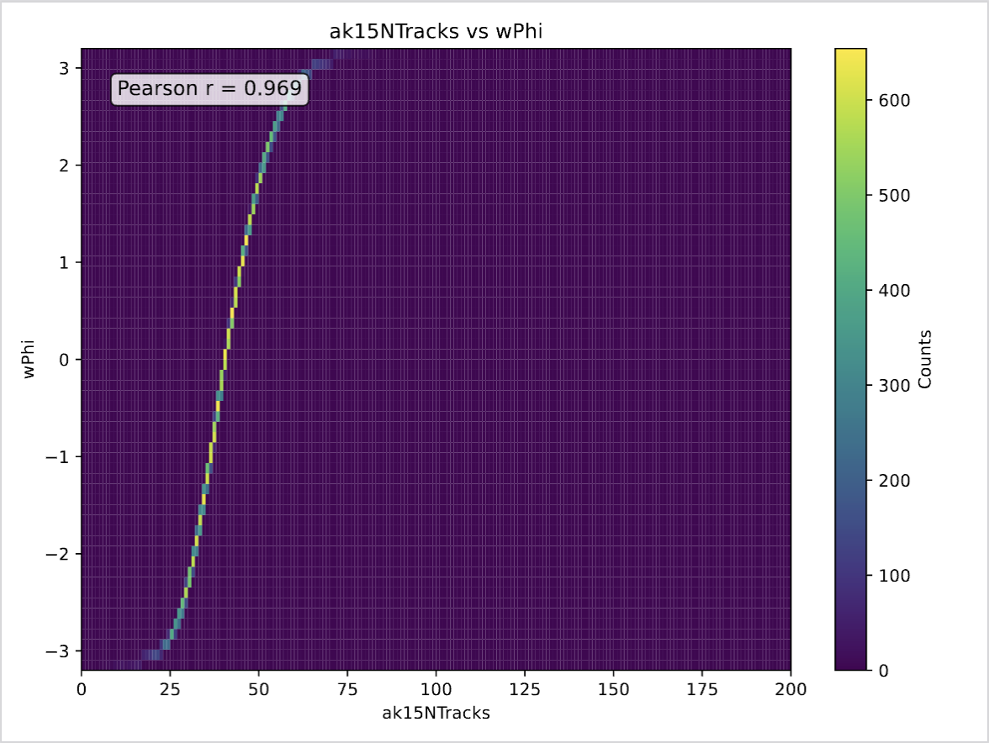



2D Var Scans

