Slide 1
May 6 Status Report
Dongha Simon Lim

Slide 2

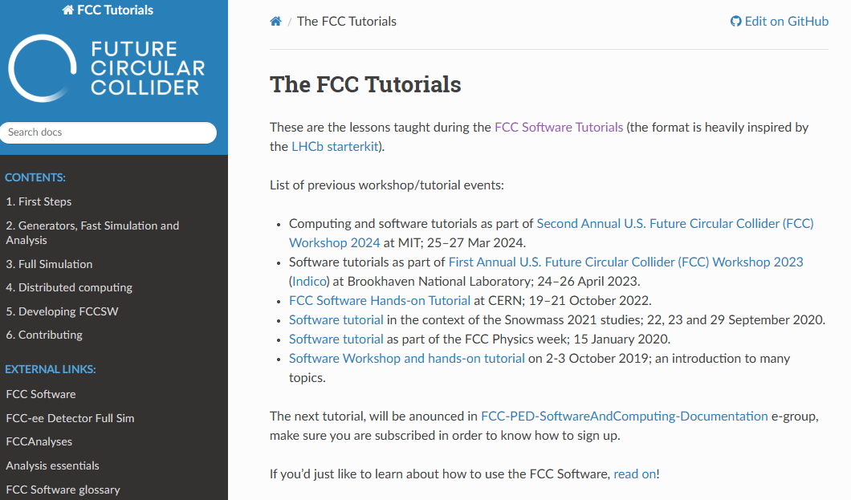
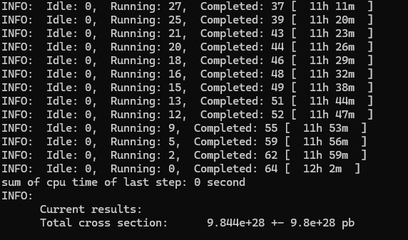
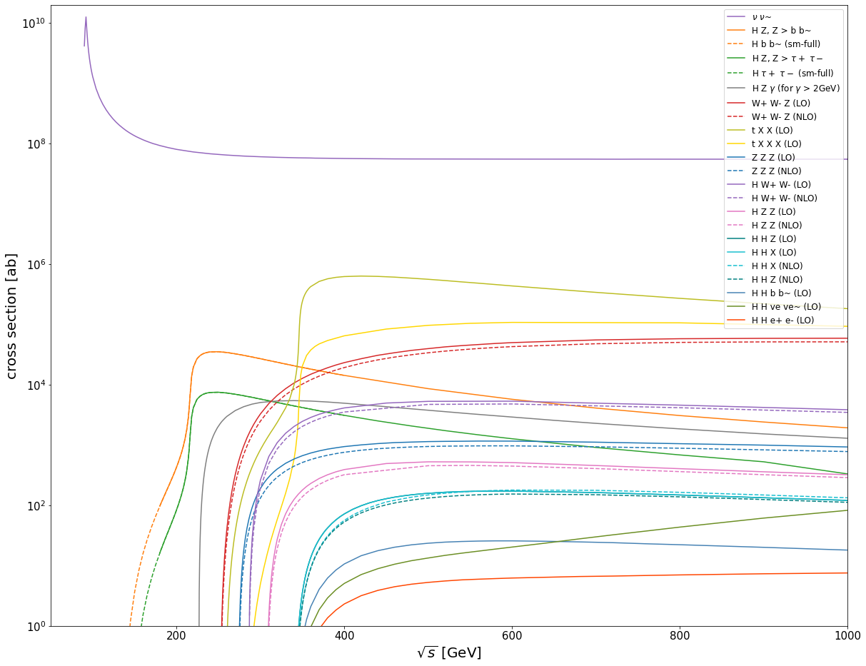
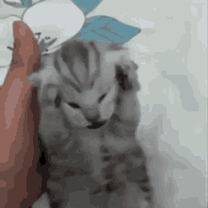
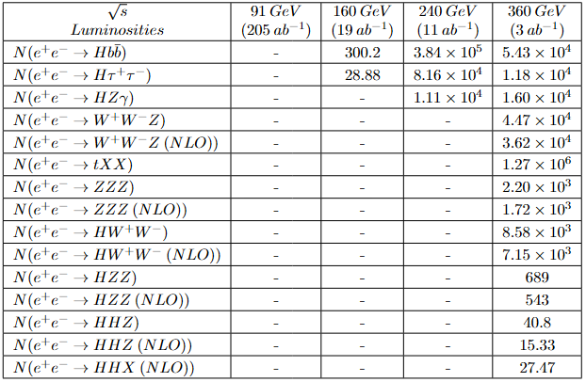
Last time…

Slide 3
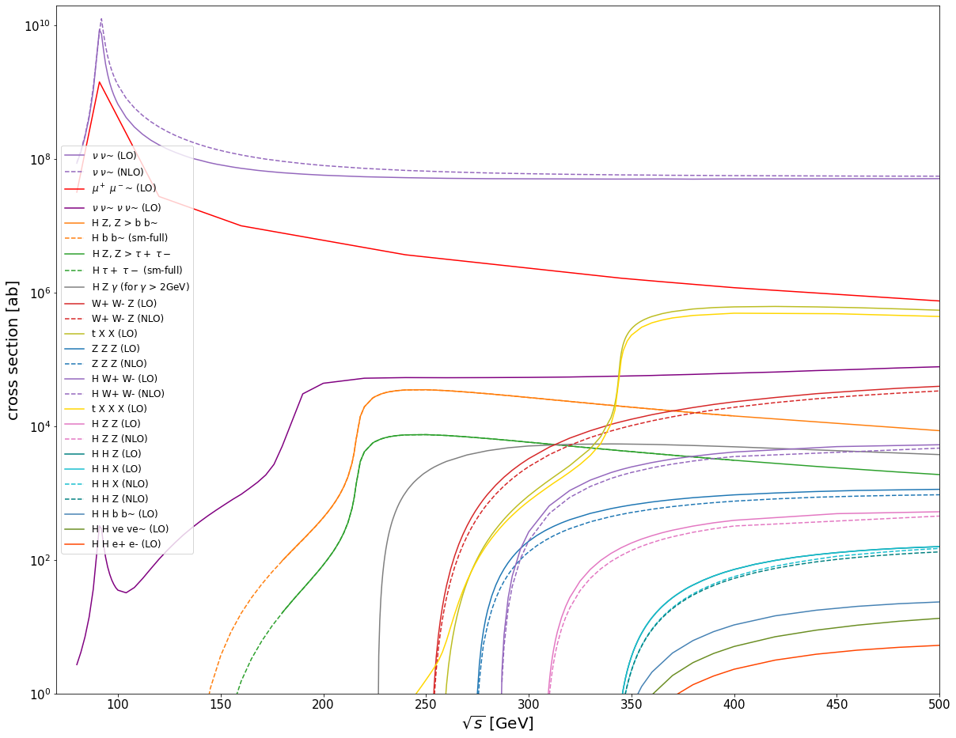

Slide 4
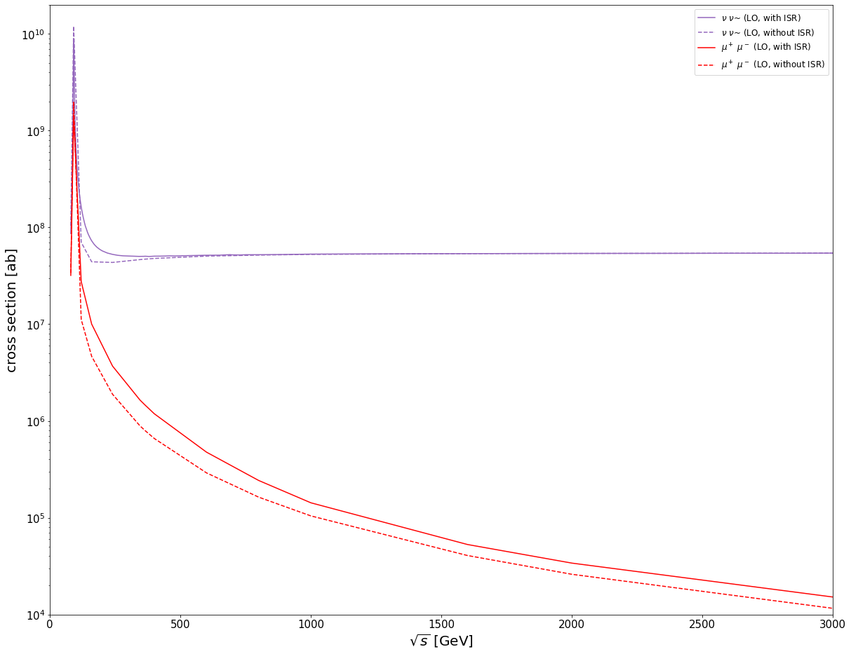
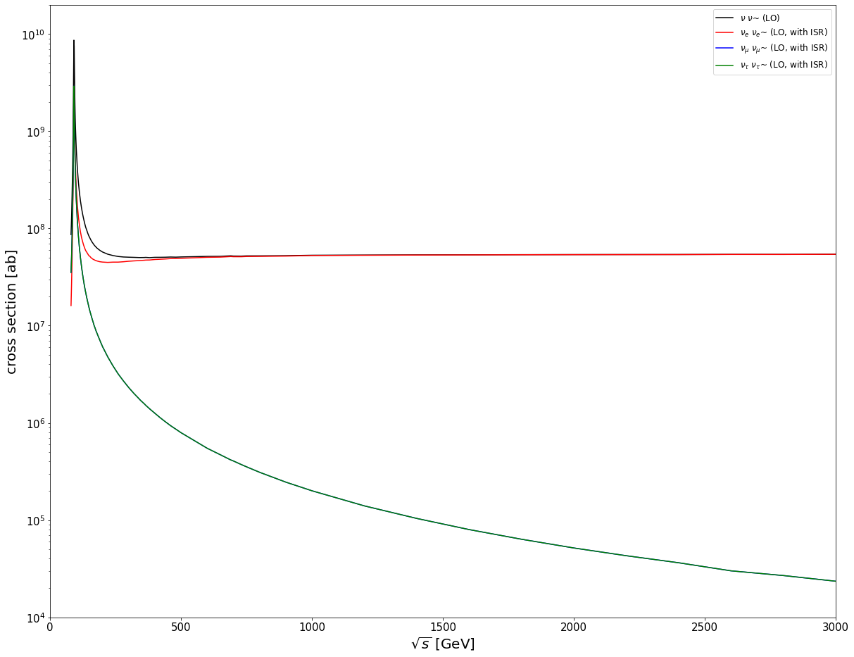

Slide 5
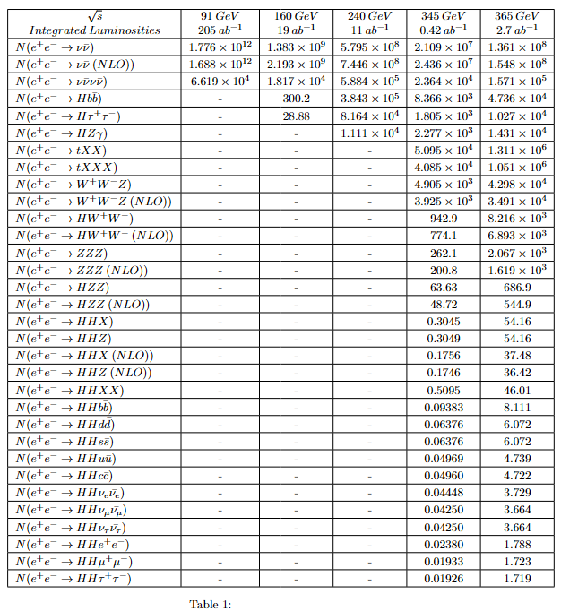
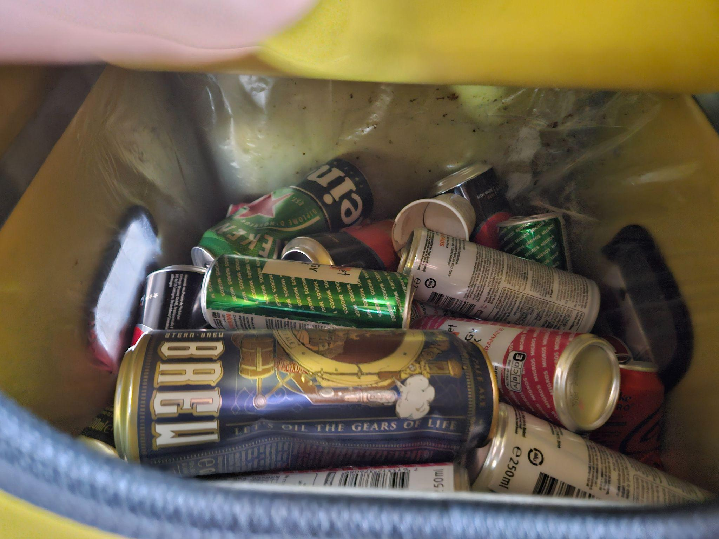
Table for # of Events Updated

Slide 6

Had to rerun most of it…
Had to specify coupling orders
  aS<=99 aEW<=99
Reran everything, mostly at a few important sqrt(s) values
Most did not change, but too a while

Slide 7
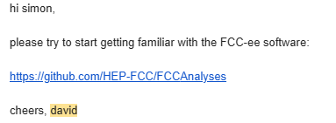
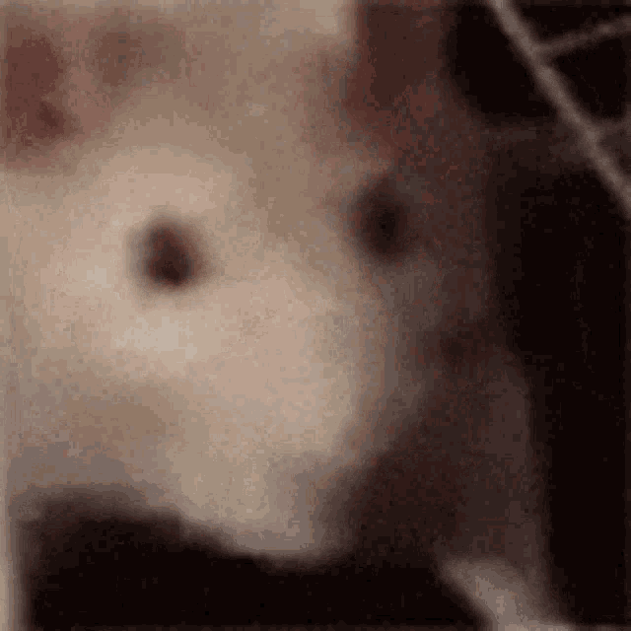
It started!
Finally free from MadGraph

Slide 8
It didn’t matter…

Slide 9
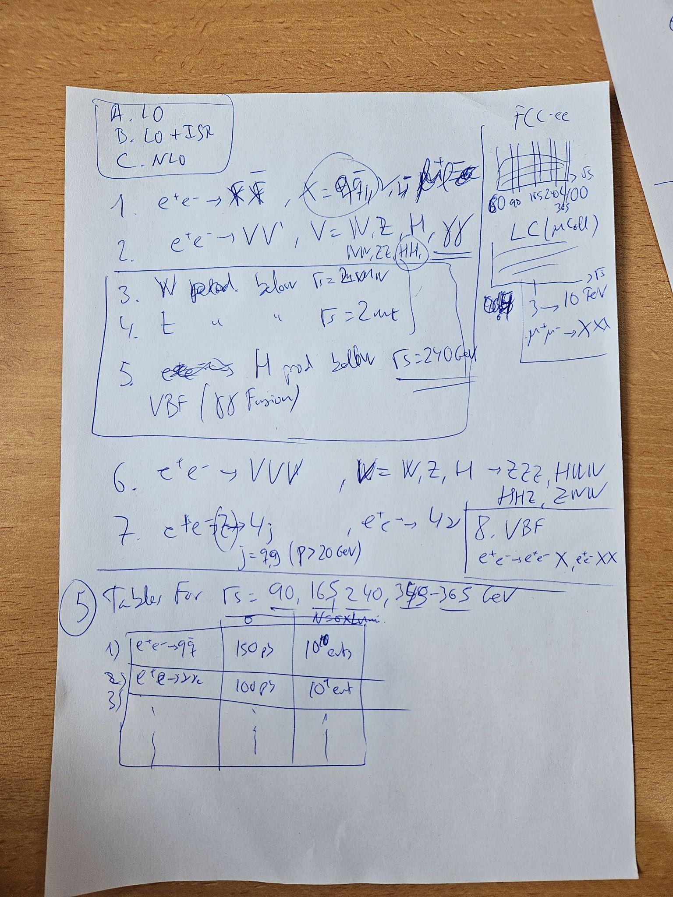
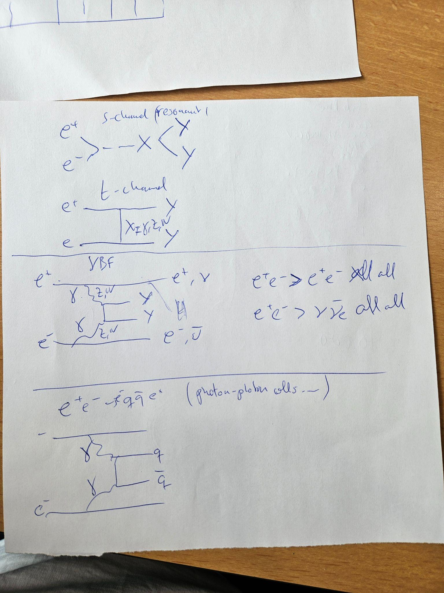


Slide 10

Working on a Compendium now,
Which means I’m back on MadGraph.
Collection of e+e- cross sections from sqrt(s) up to 10 TeV. (technically mu+mu- for 3TeV to 10TeV, but this isn’t possible for ISR or NLO currently with MG5)

Slide 11
Organized as such
f fbar
V V (including H)
W production below sqrt(s) = 2 m_W
t production below sqrt(s) = 2 m_t
H production below 240 GeV with VBF
VVV
4 jets and 4 nu
VBF e+e- X and e+e- XX
Plus an updated table, graph of up to 3TeV with e+e-, 3-10 TeV for mu+mu-

Slide 12
So far
All waiting on NLO, LO and LO+ISR done for the following
1. f fbar
qq, nunu, ll done for LO, LO+ISR
2. V V (including H)
WW,ZH,ZZ,HH done; gammagamma,gammaZ,gammaH on hold
6. VVV
WWZ, WWH, ZZZ, ZZH, ZHH, HHH
7. Jjjj,nunununu
Needs up to 10TeV
8. e+e-X/XX VBF
(I think) done with e+e-X, figuring out e+e-XX currently

Slide 13

Things to work on:
W,top, and H prod below sqrt(s) = 2*mass
VBF e+e-XX
Didn’t feel like making graphs for today

