Slide 1
Some thoughts on Margins and Stability in Nb₃Sn magnets
HFM forum – 4 June 2025
Gerard Willering (CERN)
https://indico.cern.ch/event/1544424/

Slide 2
Some thoughts on Margins and Stability in Nb₃Sn magnets
Non-uniform current distribution in Rutherford cables
  Effect on margin
  Effect on training performance
  Effect on stability
  4.5 K vs 1.9 K

Slide 3
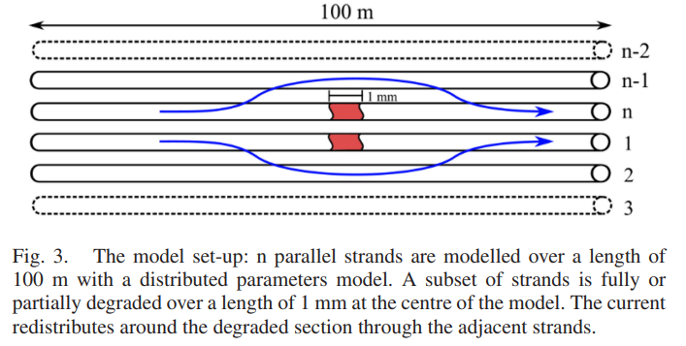
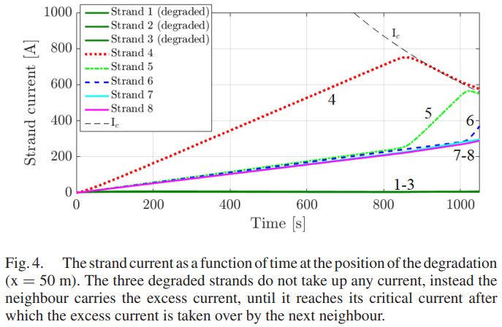
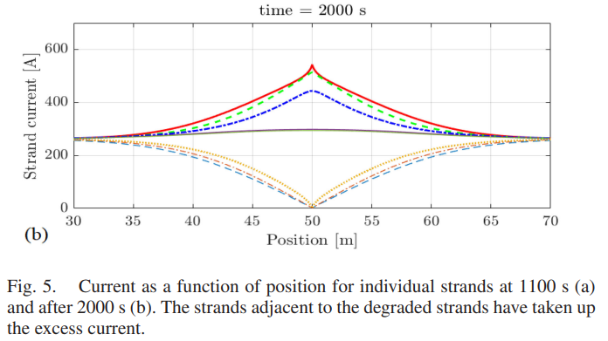
Non-uniform current distribution in Rutherford cables
For several models and prototype Nb₃Sn magnets (11T and MQXF) measurements showed that local defects caused current redistribution.
At the defect zone, depending on several factors, the neighboring strands can locally reach high current density, up to current sharing conditions.
The current redistribution diffuses until far away from the defect zone, depending on interstrand contact resistance.
R. Keijzer et al., Modelling V-I measurements of Nb₃Sn Accelerator Magnets with conductor degradation, Trans. Appl. Supercond., Vol. 32, No 6, Sept 2023

Slide 4
Non-uniform current distribution in Rutherford cables –
effect on margin and training performance
Depending on possible conductor degradation, the current in local strands can be anywhere between 0 and critical current.
Non-uniform current distribution can therefore strongly reduce the effective margin to the current sharing regime.
This means that locally the margin to any perturbation (stick-slip, epoxy cracking, beam loss) can be reduced, giving a lower effective margin.
This can also impact training if locally the enthalpy margin is recuded.

Slide 5
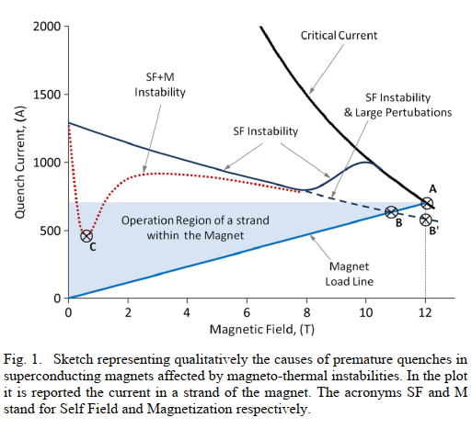
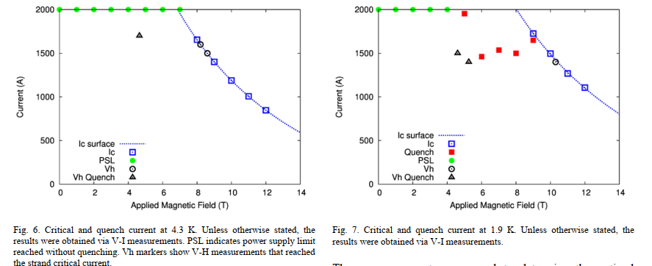
Non-uniform current distribution in Rutherford cables –
Effect on stability
Depending on other conductor properties, like RRR, non-uniform current distribution can push part of the conductor in the SF instability regime, which could lead to instabilities and quench.
At 4.3 K the short sample limit of each strand is lower, but at 1.9 K the instability limit could be lower, see plot below.
B. Bordini et al., Impact of the Residual Resistivity Ratio on the stability of Nb₃Sn magnets, Trans. Appl. Supercond., Vol. 22, No 3, Sept 2012
B. Bordini et al., Extensive Characterization of the 1 mm PIT Nb₃Sn strand for the 13-T FRESCA2 magnet, Trans. Appl. Supercond., Vol. 22, No 3, Sept 2012

Slide 6
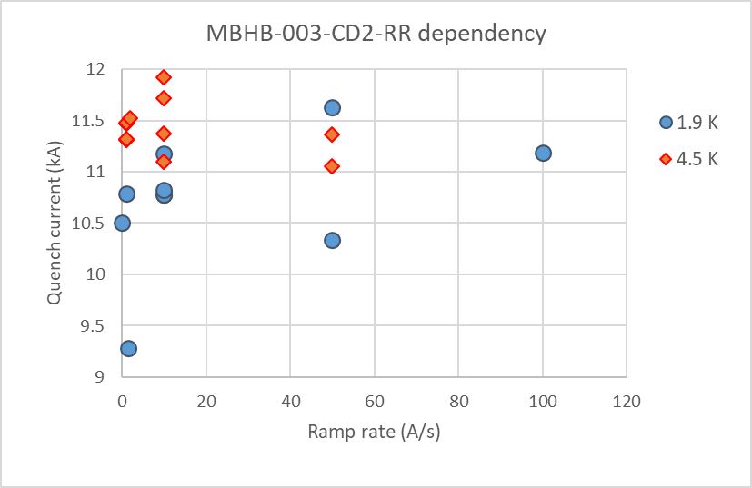
1.9 K vs 4.5 K margin
1.9K
4.5 K
Some observations:
Instability is typically larger at 1.9 K compared to 4.5 K.
The maximum current density (in case of non-uniform distribution) is higher at 1.9 K compared to 4.5 K.
In case of non-uniformity in real magnets, often an inversed temperature dependency in quench current is observed, especially at lower ramp rates.
4.5 K operation for Nb₃Sn should be considered when discussing stability and margin.
Note: In training in Nb₃Sn magnets is often much slower at 4.5 K than at 1.9 K.

Slide 7
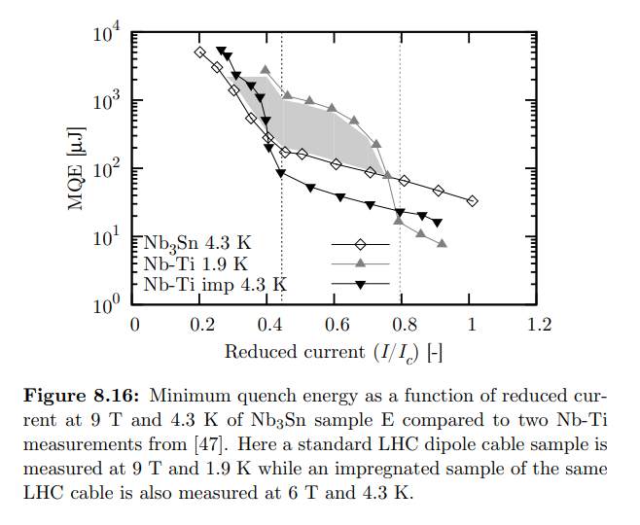
Thesis Gerard Willering (CERN/University of Twente) Stability of Superconducting Rutherford cables for accelerator magnets, 2009
Thesis Michiel De Rapper (CERN/University of Twente) Thermal Stability of Nb3Sn Rutherford Cables for Accelerator Magnets, 2014

Slide 8
Summary:
Uniformity of performance between the strands is important to have uniform current distribution.
Non-uniform current distribution will impact negatively the performance, margin and stability of the magnet.
These slides are only intended to give some thoughts on existing knowledge of stability in Nb₃Sn magnets to have a discussion on the topic.

