Slide 1
The I.FAST
Challenge Based Innovation
Online welcome meeting
27th June 2025
Nicolas DELERUE / CNRS
with Darina Baizhanova/ESI, Phil Burrows/Oxford, Elias Metral/CERN, Florence Mouthon/ESI, Louis Rinolfi/ESI, Valeriia Starovoitova/IAEA, Maurizio Vretenar/CERN

Slide 2
The I.FAST project
I.FAST = Innovation Fostering in Accelerator Science and Technology
https://ifast-project.eu/home
49 partners (research organizations, industry,…) including: CERN, CNRS (France), University of Oxford and other UK Universities, INFN (Italy), DESY, GSI (Germany), ESI,…
Gathering top researchers in the field of particle accelerators
Looking at innovative applications of accelerator technology

Slide 3

I.FAST Challenge Based Innovation
The I. FAST CBI is one of the many tasks within the I. FAST Project.
The aim of the challenge:
Use accelerator technology to address a given problem:
“Accelerators for health: imaging and new treatment modalities”
Can you suggest innovative use of accelerator technology to address the challenge?

Slide 4
The process
To help you better understand accelerators and the challenge, there will be seminars on both topics.
There is also some material at http://www.ifast-cbi.particle-accelerators.eu/material-about-particle-accelerators/
Feel free to contact the seminar speakers for additional details about their presentation.

Slide 5
The program
The online seminar program is on indico: https://indico.cern.ch/category/19887/
The in-person seminars program will be posted soon on indico.
In addition to the seminars there is:
  Plenty of time for collaborative work
  A visit of CERN
  A visit of Annecy
  Two “conferences”

Slide 6
Seminars
There will be 4 online seminars organised before the challenge (all at 17:00 Geneva time):
  Tuesday July 8th, 17h, Willy Mondelaers, "Small particle accelerators and their applications in medicine and industry"
  Thursday 10th July, 17h, Ugo Amaldi, "History of hadrontherapy"
  Tuesday July 15th, 17h, Joao Seco, "Introduction to Radiation Biology"
  Thursday July 17th, 17h, Valeriia Starovoitova, “IAEA activities related to accelerators applications to healthcare”
Please mute your microphone during the seminars.
Feel free to ask questions at the end. Even if the question seems trivial, it is not a problem to ask it!

Slide 7
Collaborative spirit
Although this is a challenge, it is important to keep a collaborative spirit between teams.
In the accelerator world, everyone tries the best for his/her facility but we also go to other facilities to help at critical times.
If you have information that may be relevant to another team. We encourage you to pass it to them.

Slide 8
Who are you? / Teams
You should have received an email with your team number.
You will have a dedicated meeting this week to meet your team (you have received an email with the time/date).
Each team is balanced (based on the answers you gave in the application forms) in gender, in academic training (physicists, engineers, life scientists, medicine students,…) and in country of study.

Slide 9
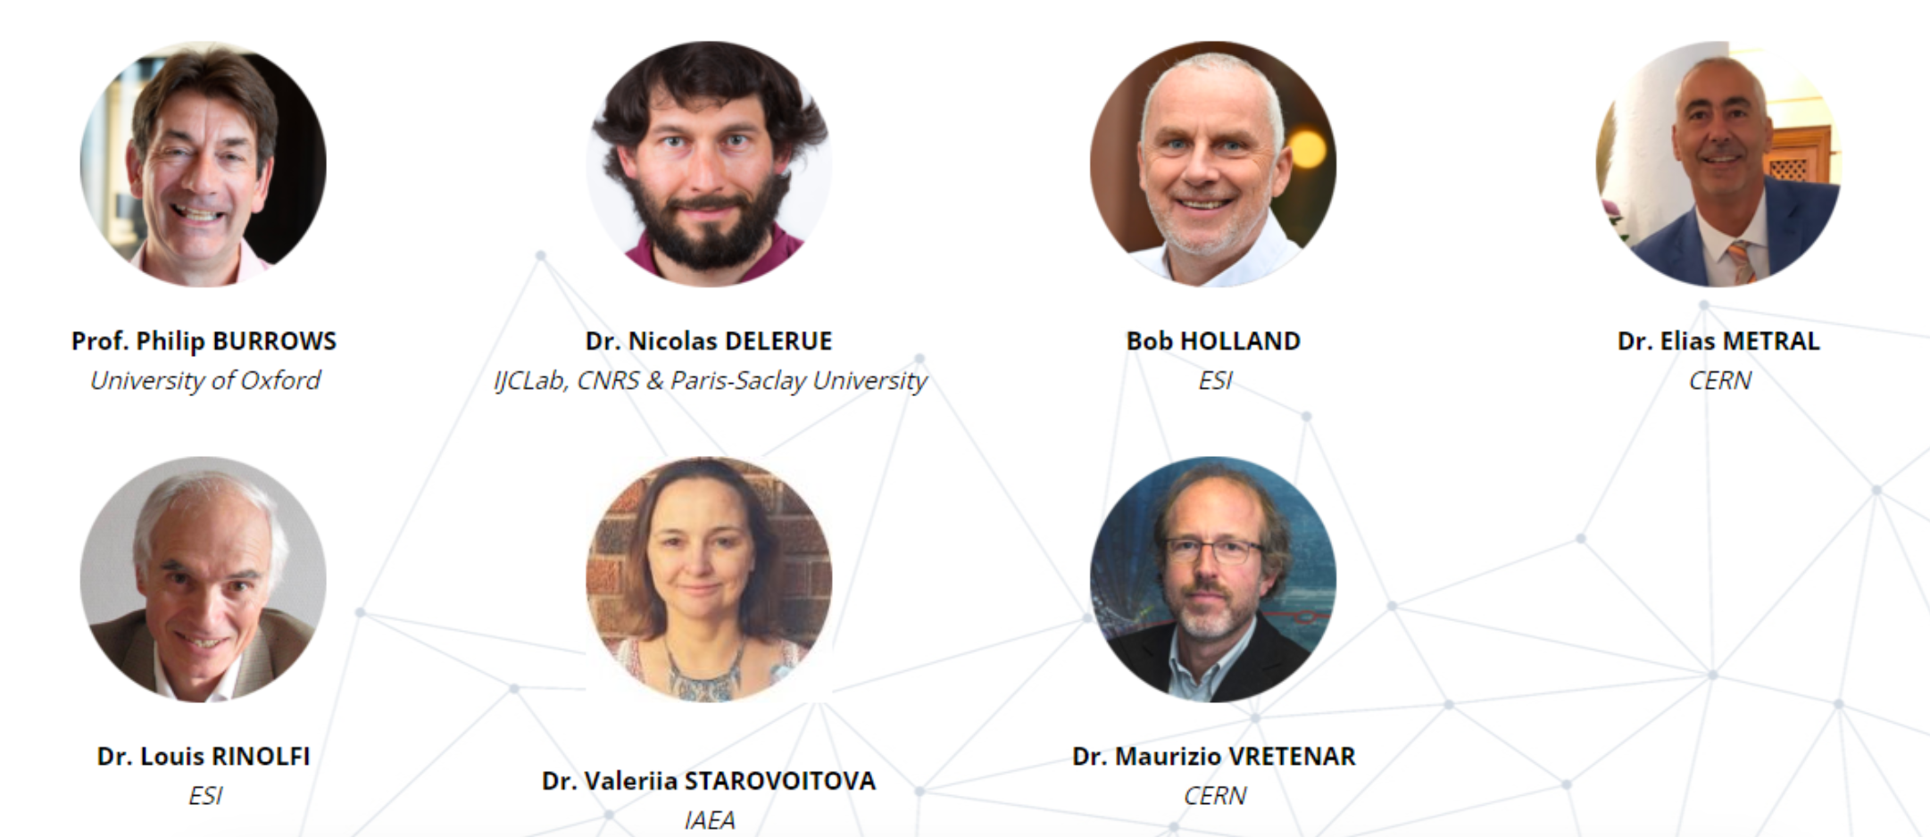
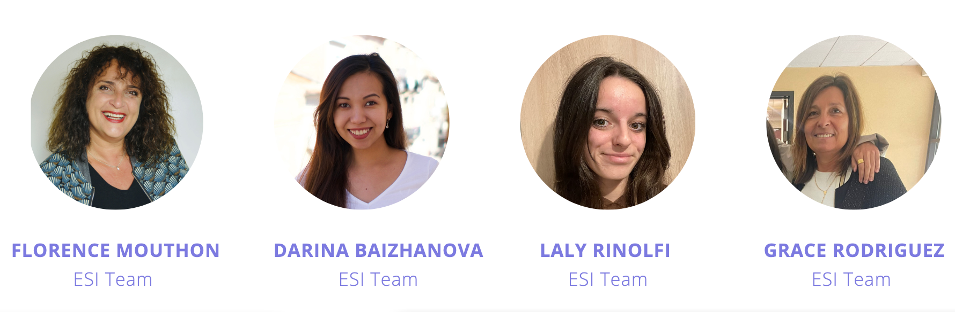
Who organises the I. FAST CBI?
The steering committee

Slide 10









We are grateful to the CBI sponsors
The I. FAST CBI 2025 takes place thanks to the generous contributions of the following sponsors:
I.FAST
TIARA
EPS-AG
CERN-ATS
Eddy Offerman
ESS
CNRS
ESI
Archparc
This project has received funding from the European Union’s Horizon 2020 Research and Innovation programme under GA No 101004730.

Slide 11
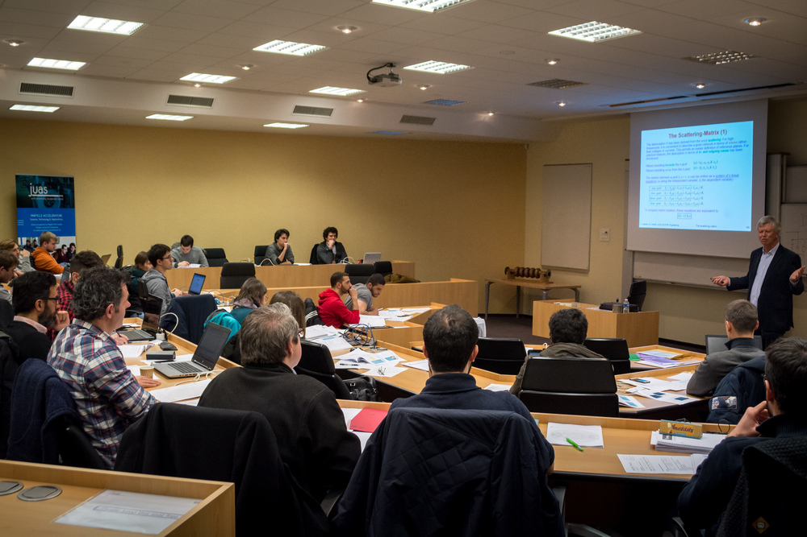
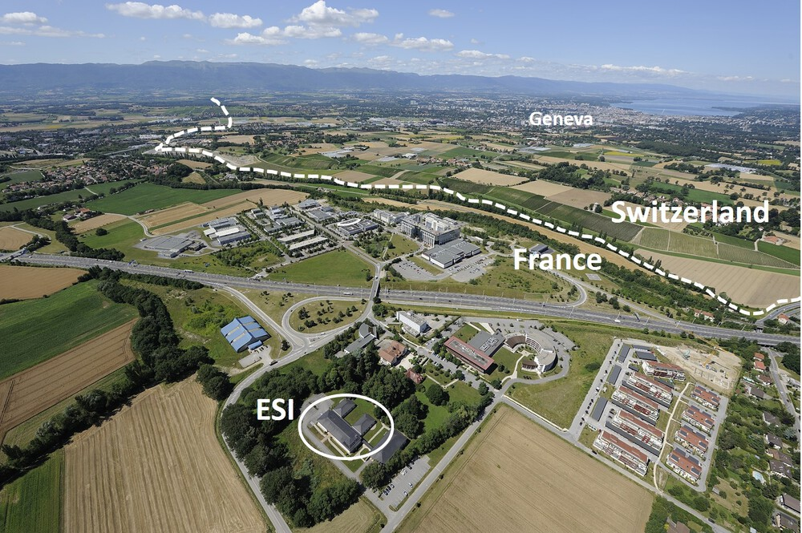
Hosting
The challenge will take place at the European Scientific Institute (ESI) in Archamps near Geneva: https://www.esi-archamps.eu/
ESI has strong experience in hosting scientific schools
The ESI team is taking care of the logistics, accommodation and travel arrangements for the participants.
Presentation after this one.

Slide 12
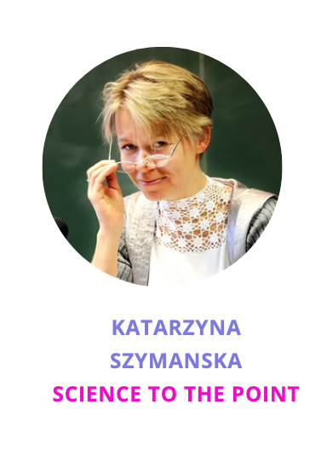

The ESI team and Kasia

Slide 13

WhatsApp group
To communicate during the challenge we use a WhatsApp group.
If you have not yet done so, please join the group (see email yesterday at 15:44 from ESI Logistics logistics@esi-archamps.eu.

Slide 14
Outlook
Looking forward to the I.FAST CBI 2025!
See you in Archamps on July 22nd!

