Slide 1


ET-PP (WP6)
2nd review meeting (RP2)
Project: 101079696 — ET-PP — HORIZON-INFRA-2021-DEV-02
Horizon Europe: Coordination
and Support Actions
15/05/2025
Grant agreement: Nº 101079696

Slide 2

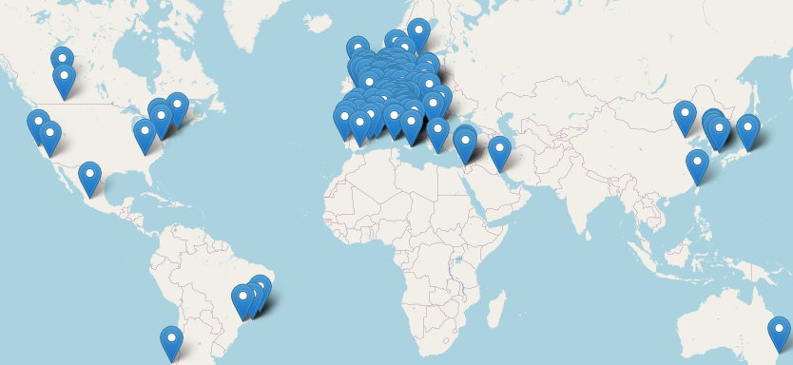
WP 6: Introduction and objectives
WP6 has been designed as the entry-point in ET-PP to the activities and results of the ET Scientific Collaboration
  Original Objectives:
From the ET-PP GA
The evolution of the ET framework impacted on the distribution of the tasks and of the deliverables aiming to achieve these objectives
The ET Collaboration is (currently) responsible for
  ET observational science,
  ET instrumental science (detector) and
  ET site scientific characterization methodologies
WP6 is acting within this updated framework
Map of the Institutions of the ET Collaboration
1803 members, in 261 institutions, in 31 countries
15/05/2025
Project: 101079696 — ET-PP, 2nd review meeting

Slide 3
WP 6: Tasks
ET (refined) science case
  The scientific and strategic scenario has matured with respect to the snapshot we had in 2020:
    Global interest in a 3G network of GW observatories
    A good number of governments in Europe is actively interested to host ET
    A monumental but incomplete success of the current GW detectors
Optimization of the ET science return within this new framework
    First step: A broad understanding of ET's science targets and potential with different geometries: «Science with the Einstein Telescope: a comparison of different designs»
    Marica Branchesi et al JCAP07(2023)068, DOI 10.1088/1475-7516/2023/07/068, arXiv:2303.15923 [gr-qc]
      Identified two geometries as possible implementations of ET:
      Δ-10km, 2L-15km with a clear strength and weakness evaluation
    Second step: produced a deep and “conclusive” study of ET's science targets in the two identified geometries:
      The Science of the Einstein Telescope (aka "The BlueBook")
      ET-0036B-25, arXiv:2503.12263 [gr-qc] (delivered)
15/05/2025
Project: 101079696 — ET-PP, 2nd review meeting

Slide 4
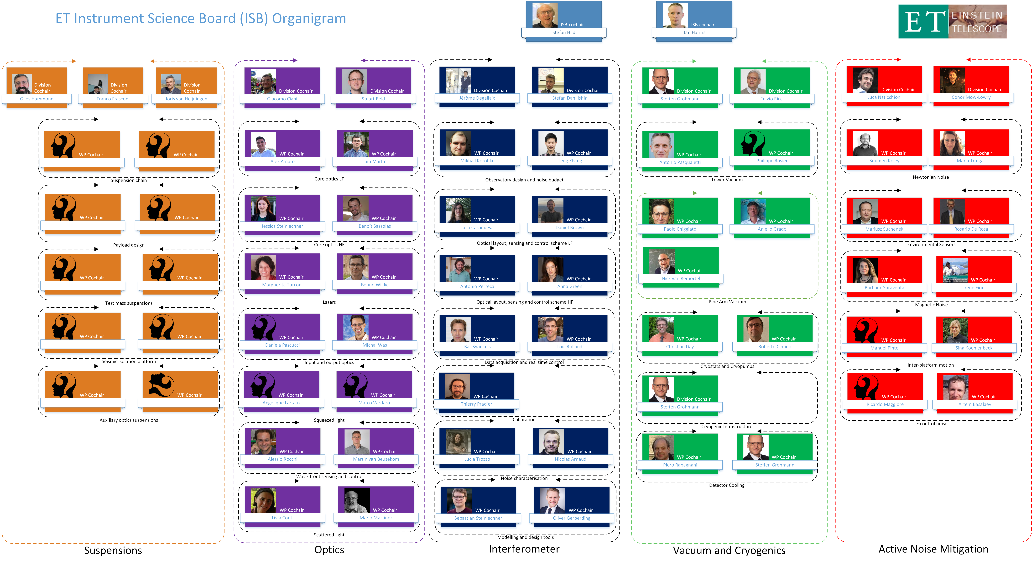
WP 6: Tasks
ET Detector Design
  The Instrument Science Board of the Collaboration is devoted to the scientific and technical activities to develop technologies, define the design and prototype the apparatuses for the ET detectors
  The activity is based on national R&D efforts, regular coordination meetings at the level of division chairs and technical meetings at the level of WPs
  The detector design is coordinated by the ETO PO, that gives the framework, and ETC ISB that fills the content
15/05/2025
Project: 101079696 — ET-PP, 1st review meeting
Notes:
ISB 566
OSB 753 members

Slide 5
WP 6: Tasks
ET Data Management Plan (DMP) and Data Access Policy (DAP)
  This complex task aims to define the ET policy for data access and the consequent DMP (D6.6, M46)
  Several actors have to play in synergy to achieve the expected result
    The scientists have to optimize the data access policy to maximize the science return of ET
    Agencies have to optimize the usage of public resources
    The global network of GW observatories and scientific communities to define the scientific framework
    Technical bodies (EIB and WP8) have to design an efficient DMP for ET
  At the 2024 ET symposium we introduced the discussion with a wide overview of the policies adopted by large R.I. in Astronomy, Astrophysics and Physics
  At the next ET Symposium (May 26-30,2025), we will explore the options for ET.
  A committee will be formed to produce an ET vision on the DMP/DAP
15/05/2025
Project: 101079696 — ET-PP, 1st review meeting
Notes:
Some remarks on DAP ( e.g. proprietary period), which needs to be discussed with the international partners too.

Slide 6
WP 6: Critical risks, deviations from Annex I, contingency plans
WP6 tasks have been strongly affected both by the evolution of the ET framework and by the debate on the ET configurations
Tasks (still) under the responsibility of ETC:
  Science Case: completed and delivered
  DMP/DAP: still on track
    Brainstorming activity started by ETC
    Risk: large number of actors needed to define a full strategy
      Level of awareness and readiness still quite low with some of the actors
      Starting positions quite heterogeneous
      Need to find a balancing between conflicting interests
    Plan: create a committee to prepare a proposal
  Detector design: see next slide on deliverables
15/05/2025
Project: 101079696 — ET-PP, 1st review meeting

Slide 7
WP 6: Deliverables and Milestones
The Deliverables expected since the last review are:
  Refined Science Case:
    Status: delivered
    Content: a scientific paper (submitted to JCAP), 800+ pages, «full» collaboration authorship, a corner-stone for the ET science
  Detector Preliminary TDR
15/05/2025
Project: 101079696 — ET-PP, 1st review meeting

Slide 8
WP 6: Deliverables and milestones
Detector Preliminary TDR:
Structure defined and TOC created:
  Part 1: a refined CDR based on
    New optical designs:
      ET Optical Layout Update 2024 (ET-0443A-24)
      ET-15km-L Optical Layout Update 2024: main document (ET-0695A-24)
    Preliminary Detector Layout - 10km Triangle (ET-0676A-24)
    Task Force output (expected end of May)
    Writing team in preparation
  Part 2: a “living” TDR based on:
    Product breakdown Structure (PBS), defined by ETO and filled by ISB,
      This iterative process completed its second iteration in April 2025
    Parameters files, containing descriptions and parameter values, uploaded by ISB members, to be filled
    on 5th of May 2025
    Online PBS database, storing all the ET detector parameters and descriptions
    Python code, reading the online database and producing an automatic LaTeX output.
15/05/2025
Project: 101079696 — ET-PP, 1st review meeting

Slide 9
WP 6: Deliverables and milestones
Detector Preliminary TDR:
  Already delayed from Month 24 (Sept 2024) to “not earlier than July 2025”
  Considering the complexity of the activity and the delay accumulated in the intermediated steps, it is more realistic to schedule it for the end 2025? (TBD)
15/05/2025
Project: 101079696 — ET-PP, 1st review meeting

Slide 10
WP 6: Contribution from each partner
WP6 is the link to the collaboration. A very large fraction of the scientists and engineers in ETC are affiliated to institutions that aren’t beneficiaries or third parties of ET-PP. For this reason, the table hereafter has an administrative value but is not representing the effective HR investment in the activities
INSTITUTION |  | PM as per Annex I | PM in the period
IFAE | CONTRIBUTIVES | 10 | 3,6
INFN | CONTRIBUTIVES | 20 | 4
UW | CONTRIBUTIVES | 1 | 0,58
CNRS | CONTRIBUTIVES | 28 | 15,27
NIKHEF | CONTRIBUTIVES | 2,5 | 4,32
UAntwerpen | CONTRIBUTIVES | 48 | 18
Total Person Months | CONTRIBUTIVES | 111,5 | 45,77
Total Person Months | REQUESTED EC | 0 | 0
Project: 101079696 — ET-PP, 1st review meeting
15/05/2025

Slide 11
WP 6: Outlook and perspectives
WP6-ETC activities focus on the missing deliverables:
  Detector preliminary TDR
    Process well defined
    Human resources still to be fully involved
    Timeline: further delay expected, but conclusion within 2025 for the first version
  Data Management Plan & Data Access Policy
    Activity still at the embryo stage within the ETC
    Other actors (ETO, global community) to be involved
    A special committee to be set-up
15/05/2025
Project: 101079696 — ET-PP, 1st review meeting

Slide 12
ET-PP (WP6)
2nd review meeting (RP2)
Project: 101079696 — ET-PP — HORIZON-INFRA-2021-DEV-02
Horizon Europe: Coordination
and Support Actions
15/05/2025
Grant agreement: Nº 101079696

