Slide 1
Status of BSR recommissioning
S. Burger, D. Butti

Slide 2
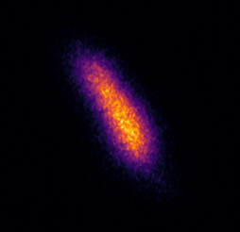
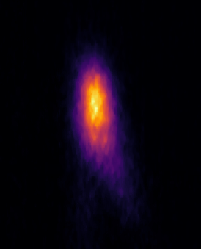
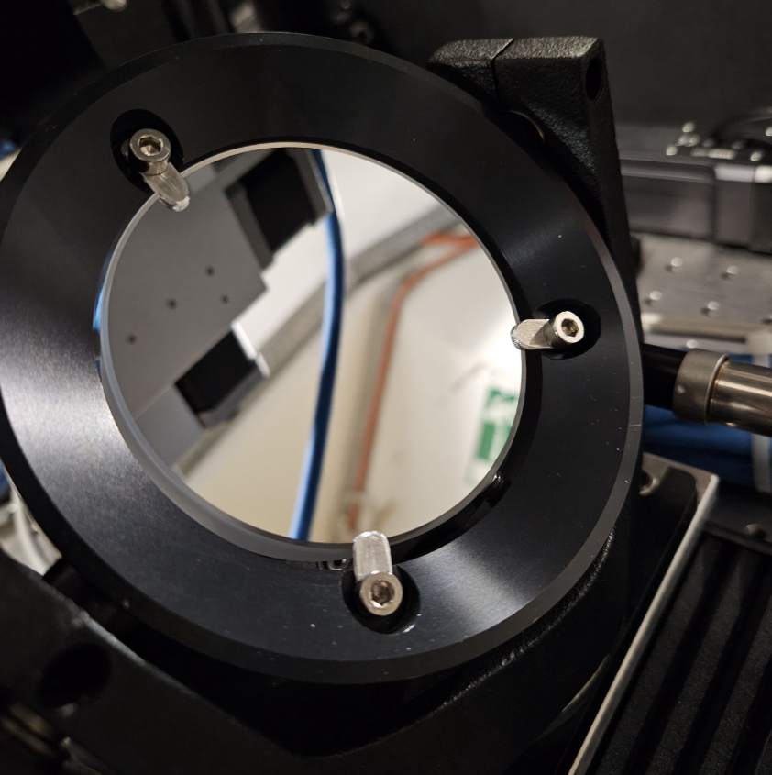
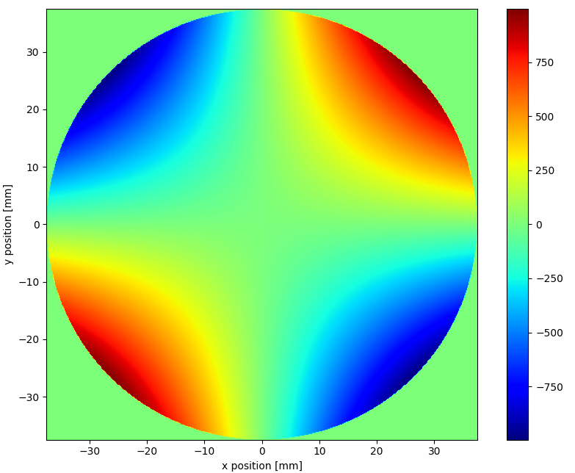
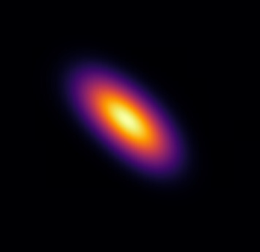
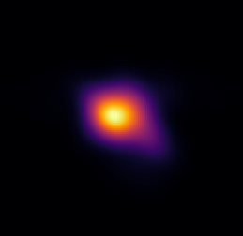
BSRT B2 light spot issue understood
Issue with BSRT B2 light spot tracked down to deformation of the first mirror on the table thanks to (lucky!) observation with alignment laser
In parallel, simulations performed. Observed distortion is consistent with astigmatic aberration of mirror with +-250 nm peak-to-valley within the synch light aperture
Distortion is created by tension of mounting screws. Temporarily fixed by installing thicker mirror, long term fix is to review mirror mount
MEAS INJ
MEAS FT
SIM INJ
SIM FT
simulated deformation [nm]

Slide 3
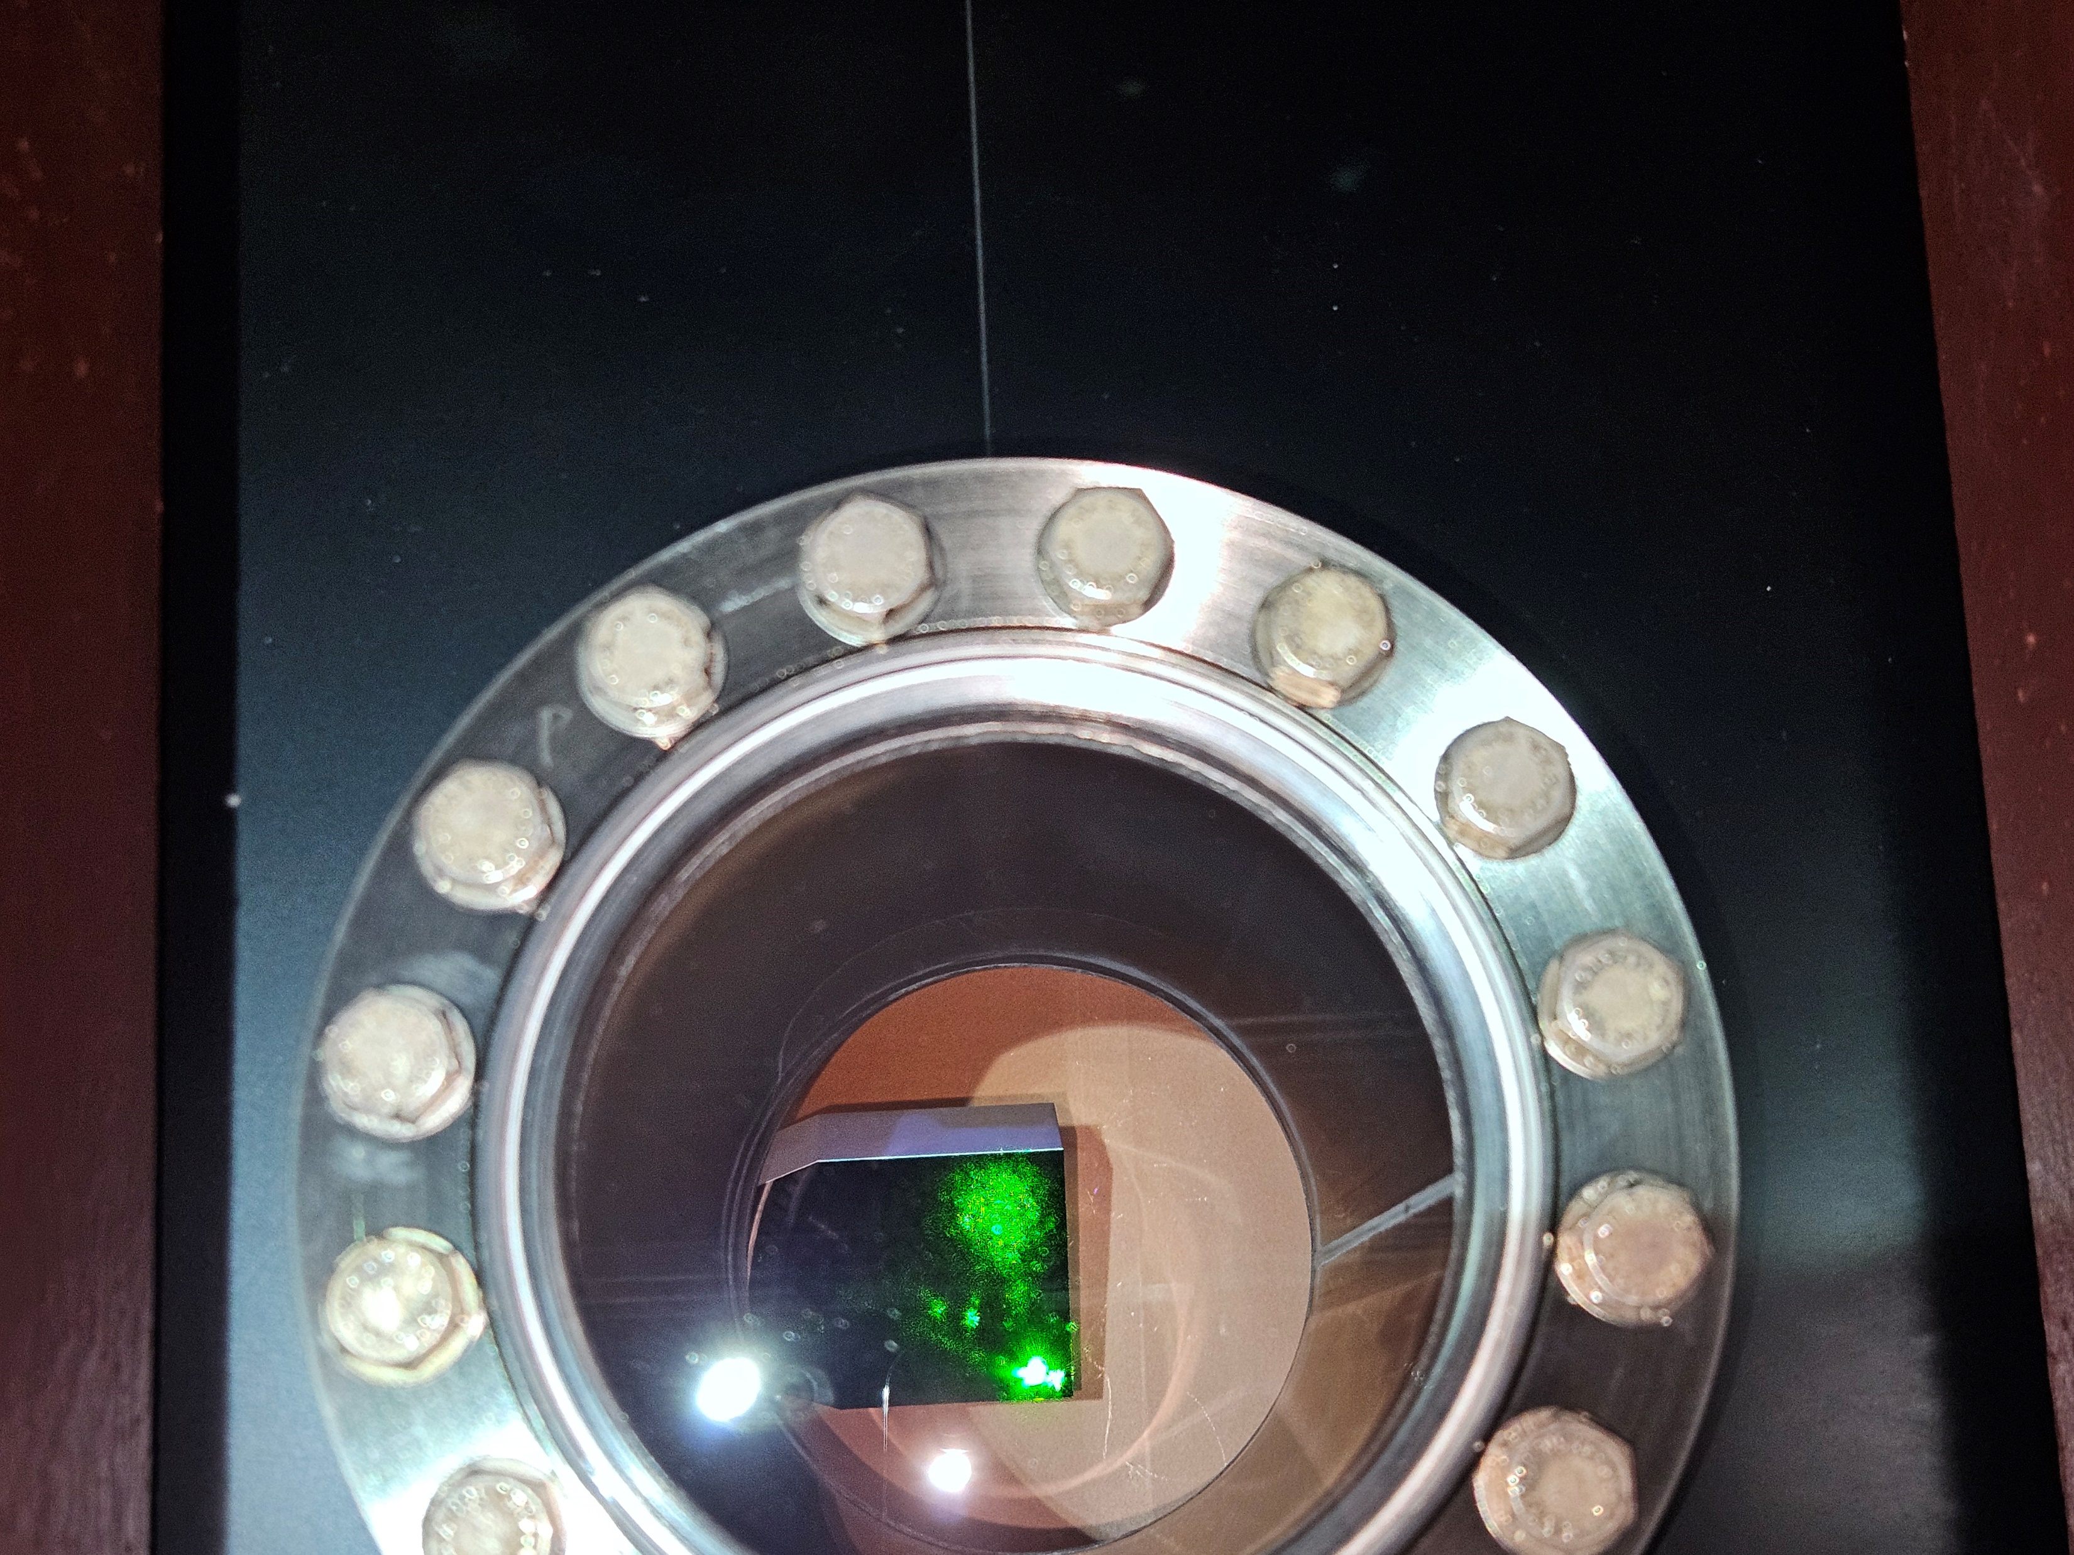
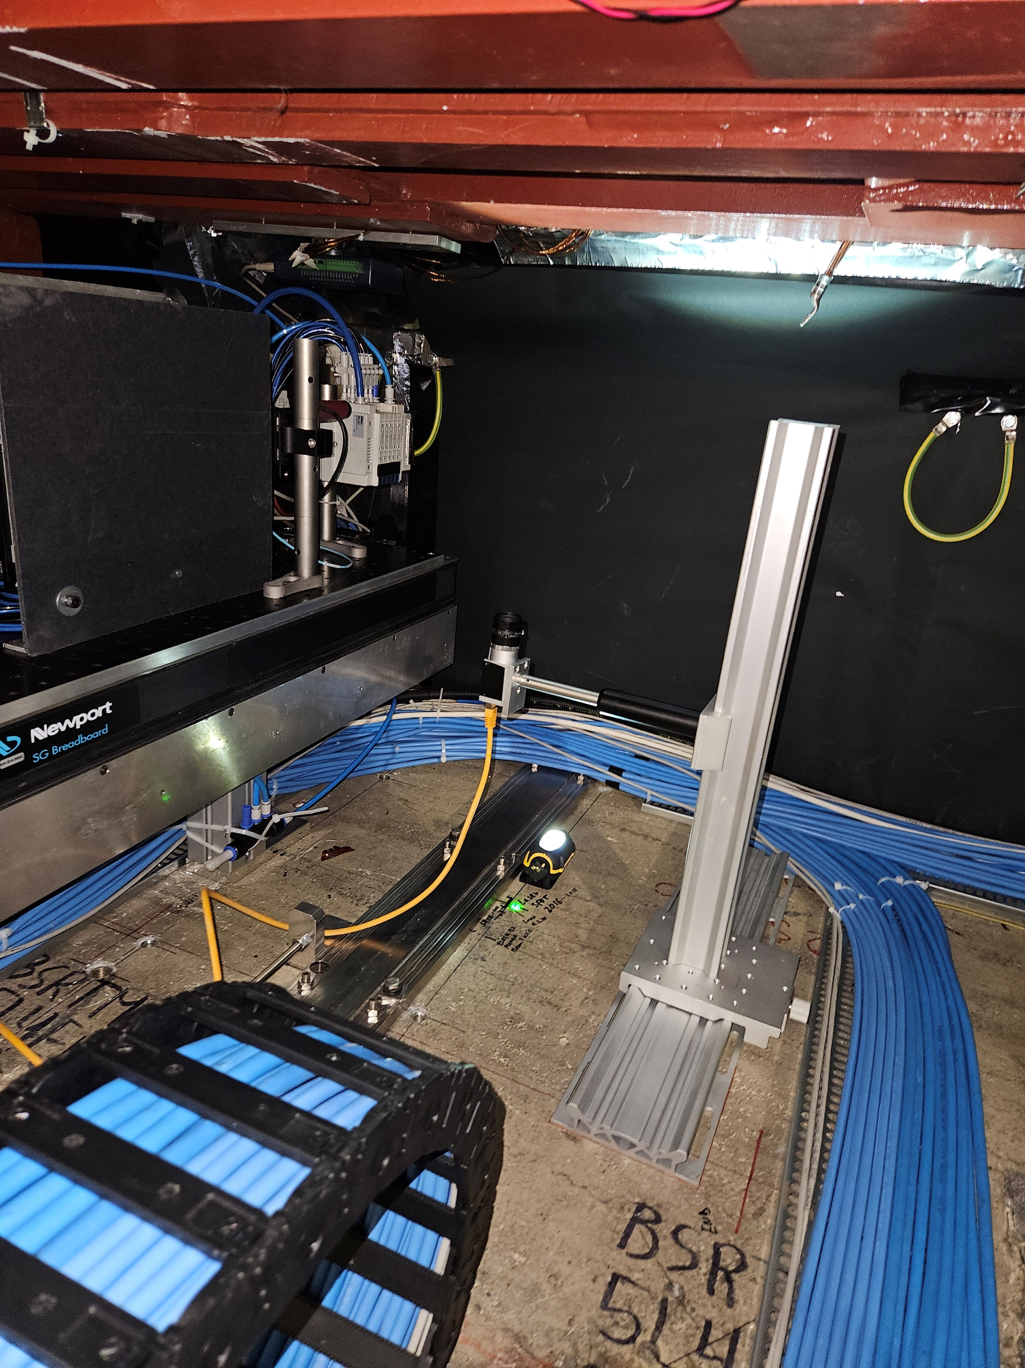
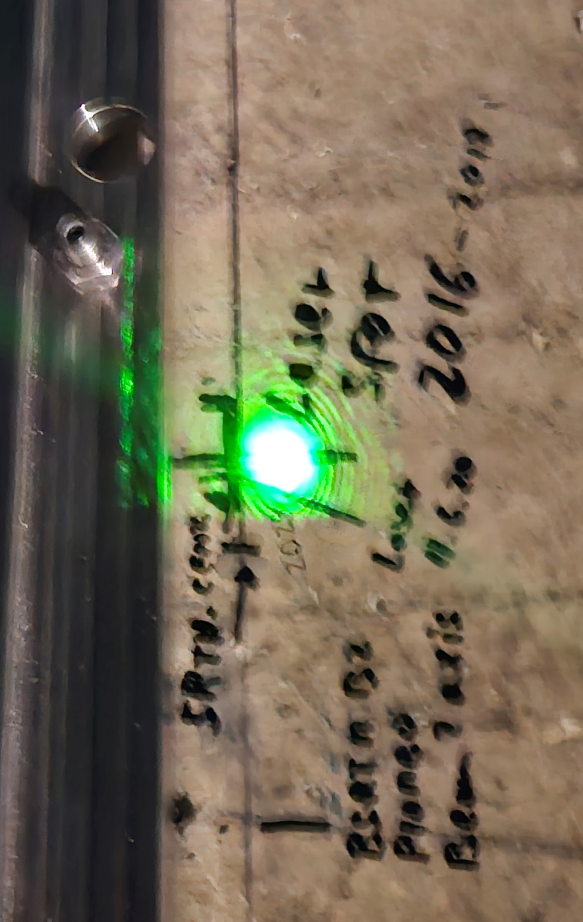
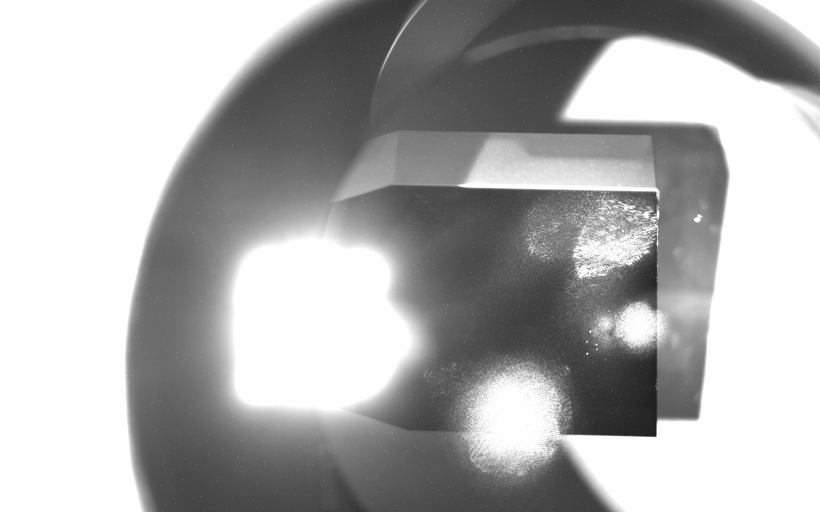
Green laser alignment on B2
2025_05_07
Check laser on mirror with a camera
Picture with phone camera
From now, it is confirmed that green laser alignment should respect:
1/ Through iris before BSRTR mirror
2/ Ref point below the extraction mirror on the floor
Camera
Viewport
Image taken with basler camera
Support
Laser spot (?) in the middle of reflections.
~theoritical 8mm OK
No need to check at extraction mirror

Slide 4
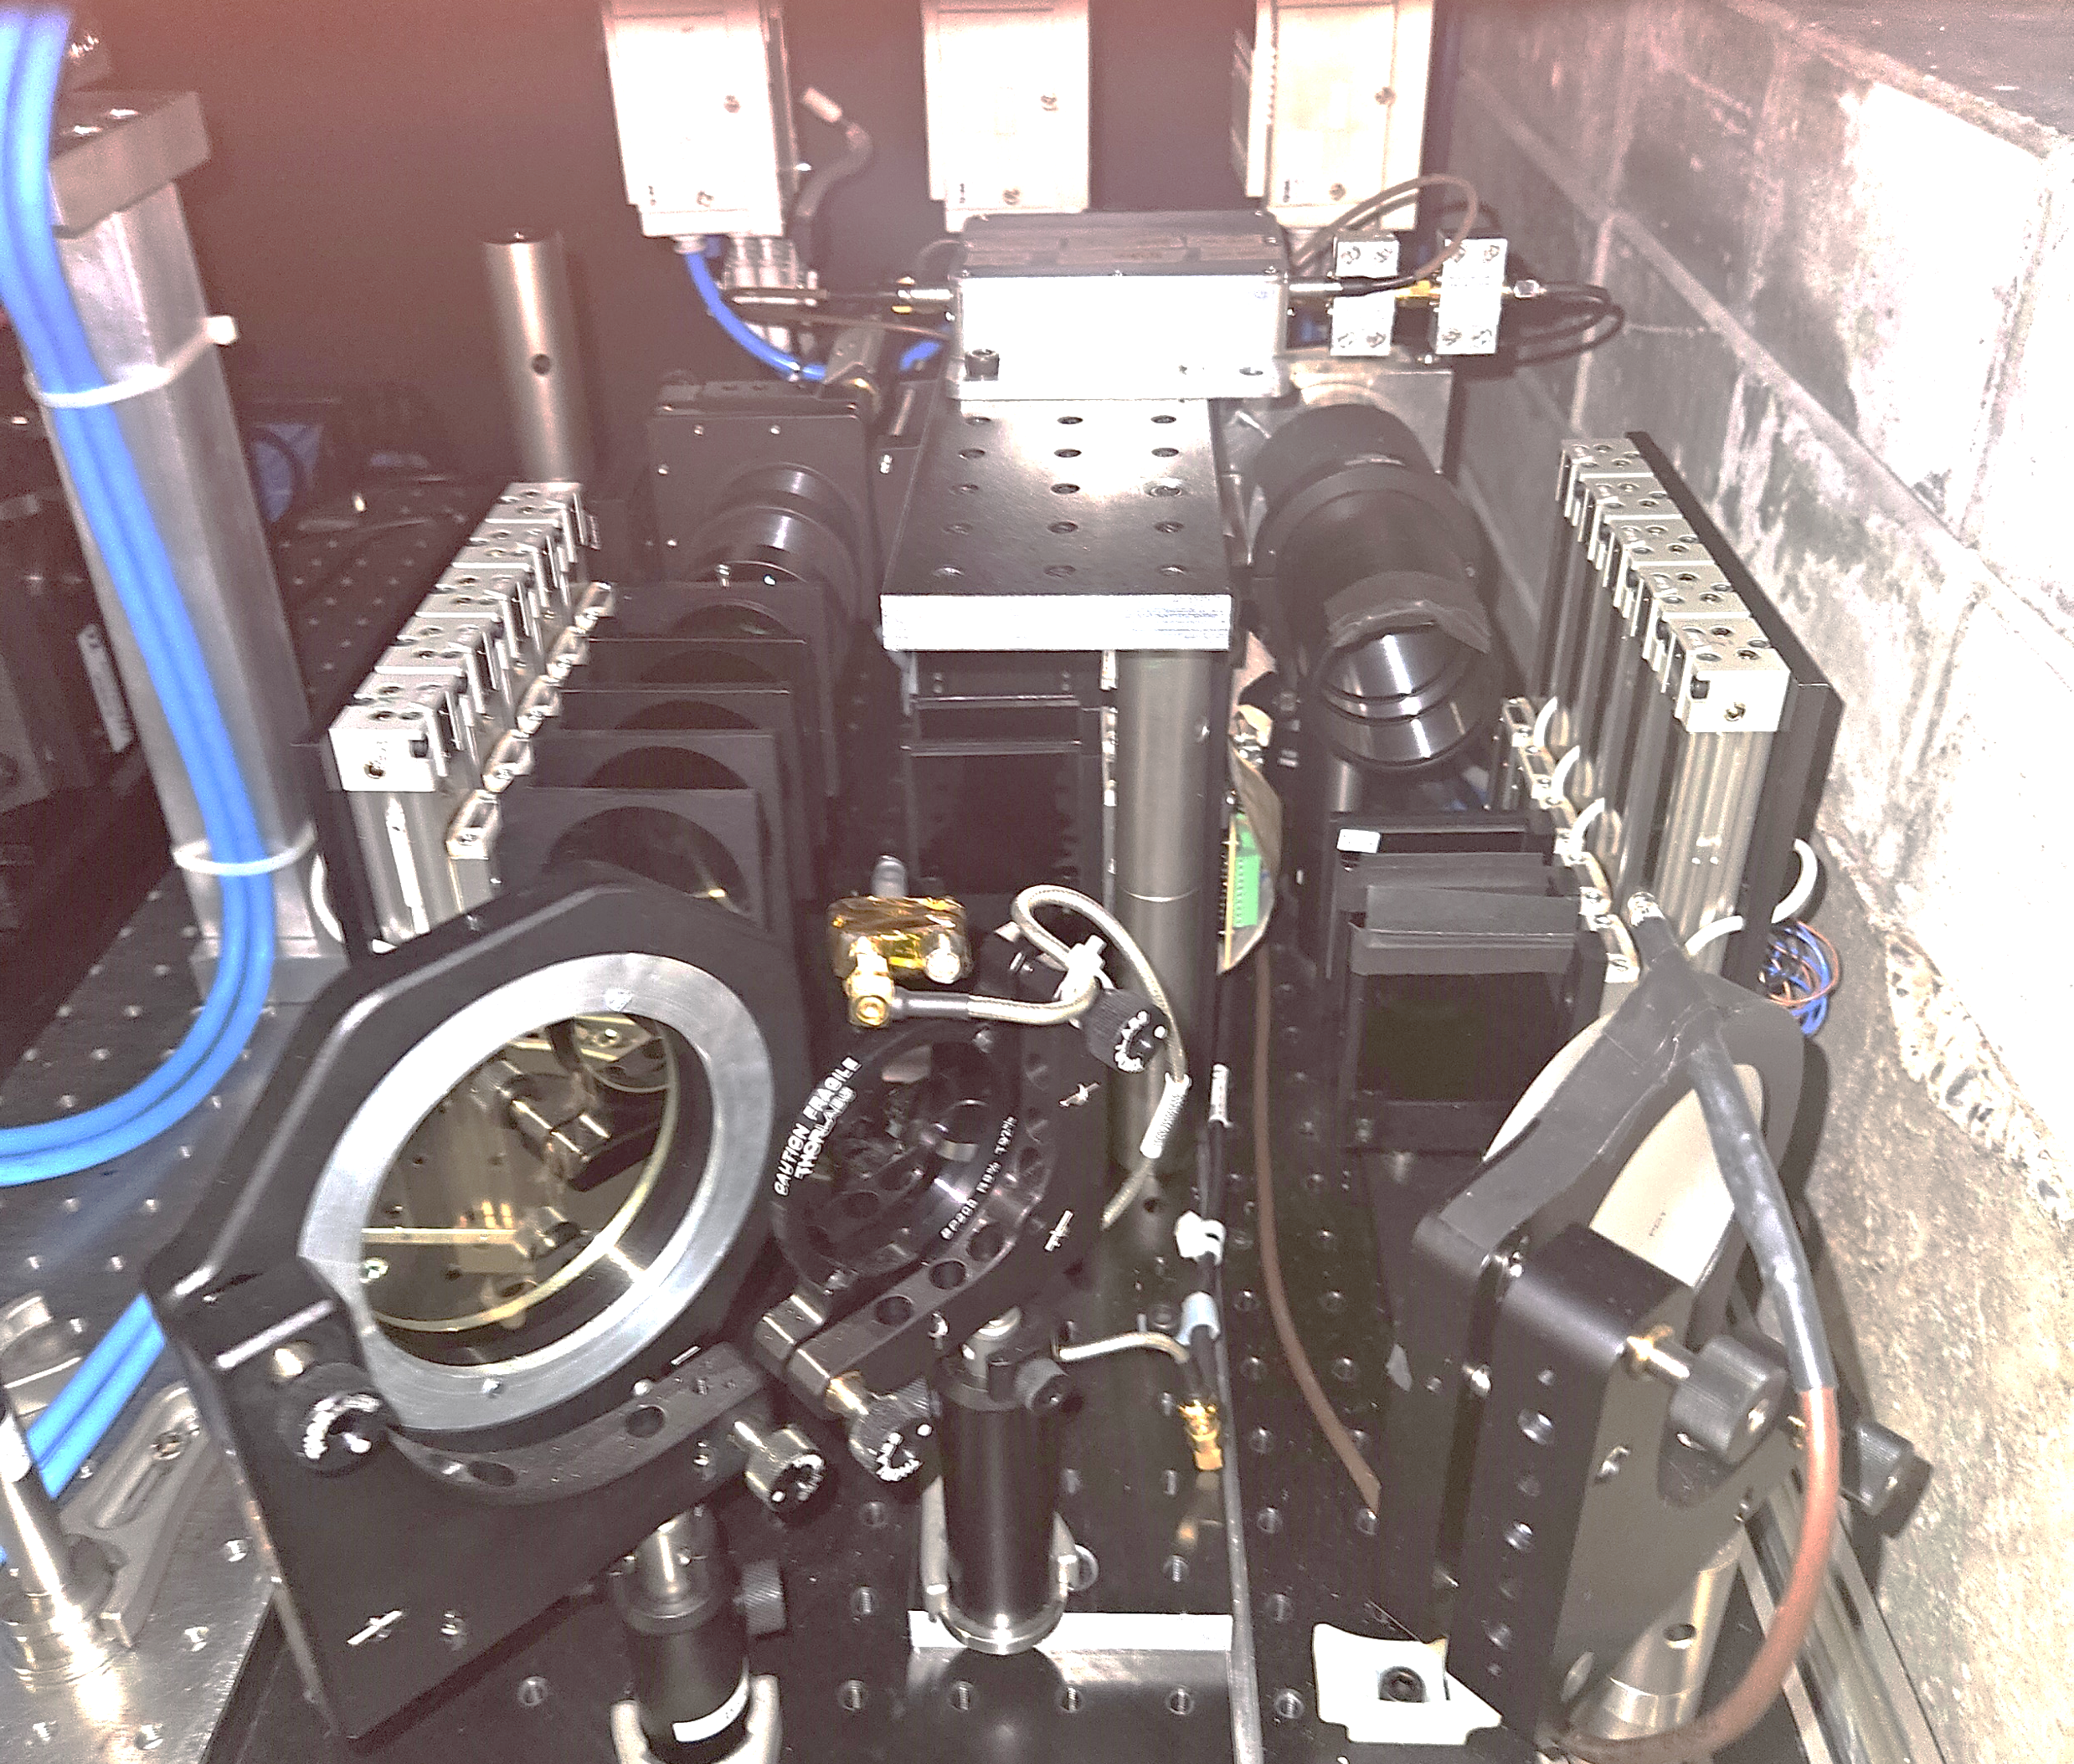
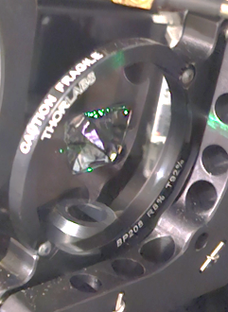
BSRA B1 changes
2025_05_07
‘Someone’ broke the pellicle beam splitter of the new BSRA…
LDM
BSRA
BSRAN
BSRAN found misaligned: light was not in the middle of the splitter and on the left edge of the filters
Realignment difficult with this 2” configuration. Already at the mechanical limit of the setup/surrounding
Move to 3” (anyway no spare of 2” found !)

Slide 5

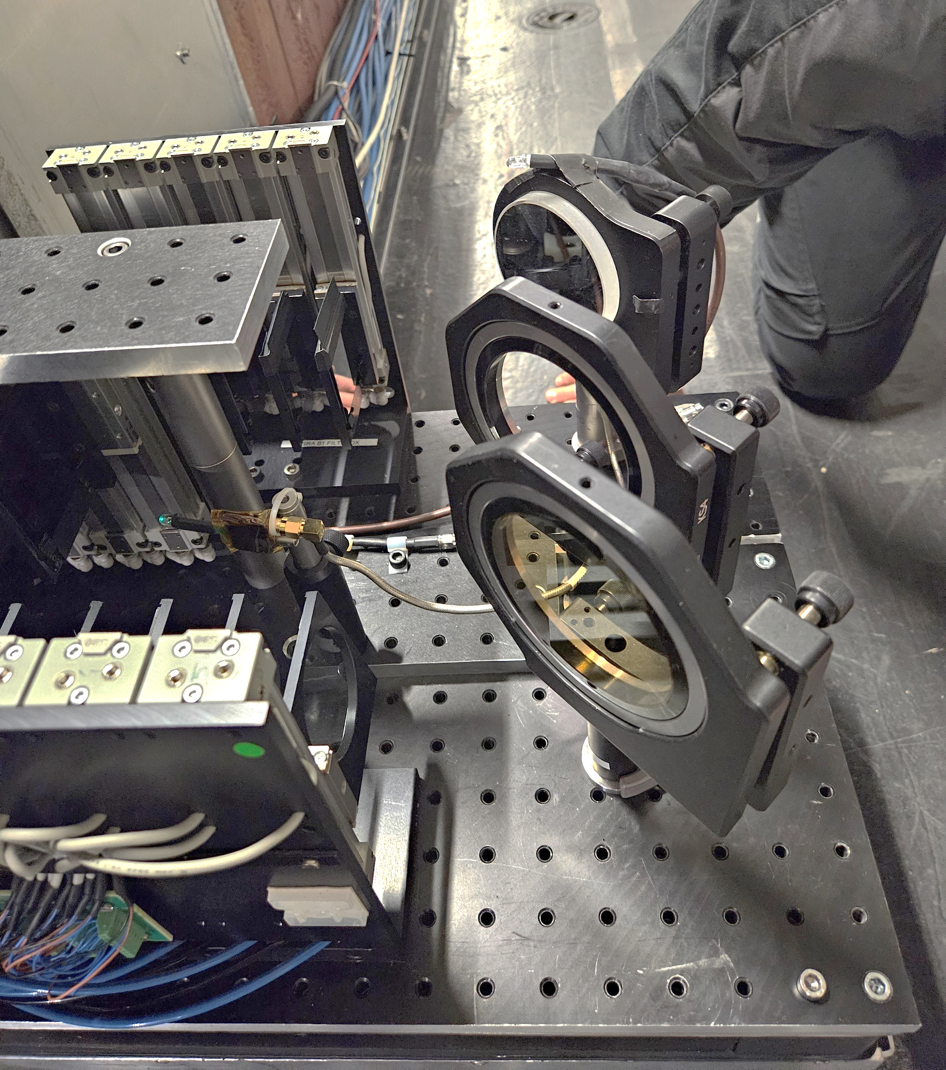
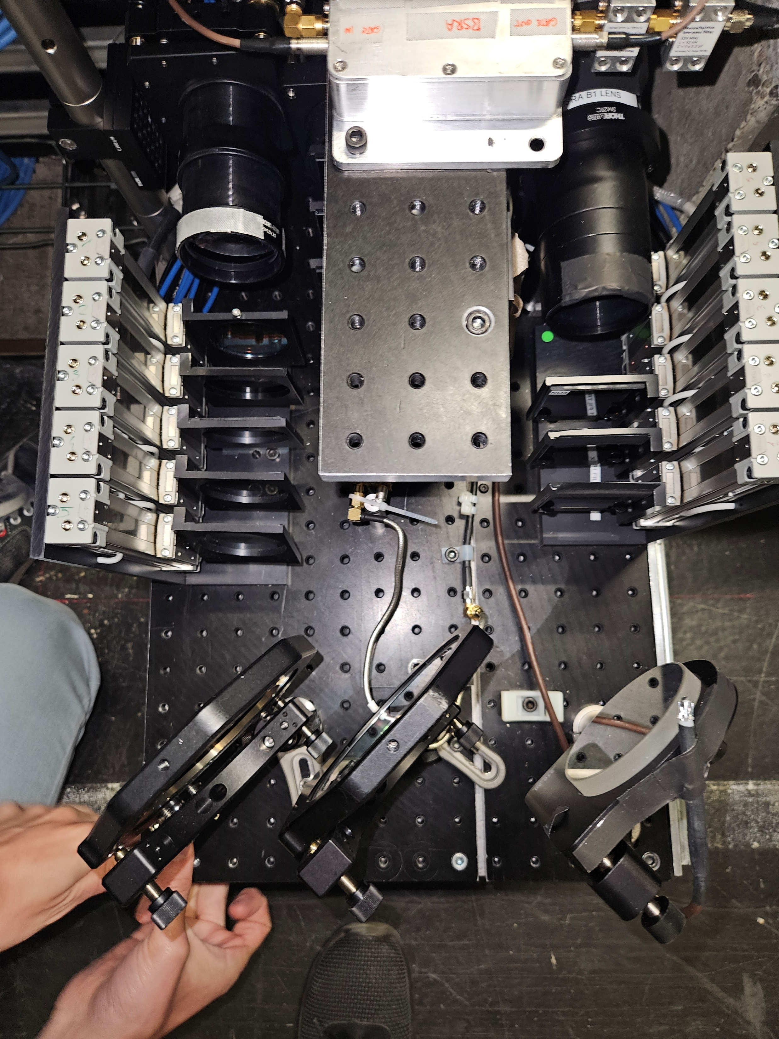
BSRA B1 changes
2025_05_07
New 3” pellicle beam splitter on the BSRAN

Slide 6
Pellicle splitter spare situation
2025_05_07
In stock we have :
2” THORLABS
8/92 (R/T): https://www.thorlabs.de/thorproduct.cfm?partnumber=BP208
0x spares
No other use now in BSRs instruments? Should we have spares?
3” Edmund Optics
50/50 (R/T) Edmund Optics https://www.edmundoptics.com/p/762mm-clear-aperture-50r50t-pellicle-beamsplitter/4514/
  2x spares
  ~400$
8/92 (R/T) Edmund Optics https://www.edmundoptics.com/p/762mm-clear-aperture-8r92t-pellicle-beamsplitter/4511/
  1x spares
  ~265$
Do we need 2” now that we replaced the BSRA (new) splitter ?
I would buy at least 4x 3” 8/92 and 1x3” 50/50 → ~1500$
Any other ratio needed?
On which budget(s)?
2025_05_07

Slide 7
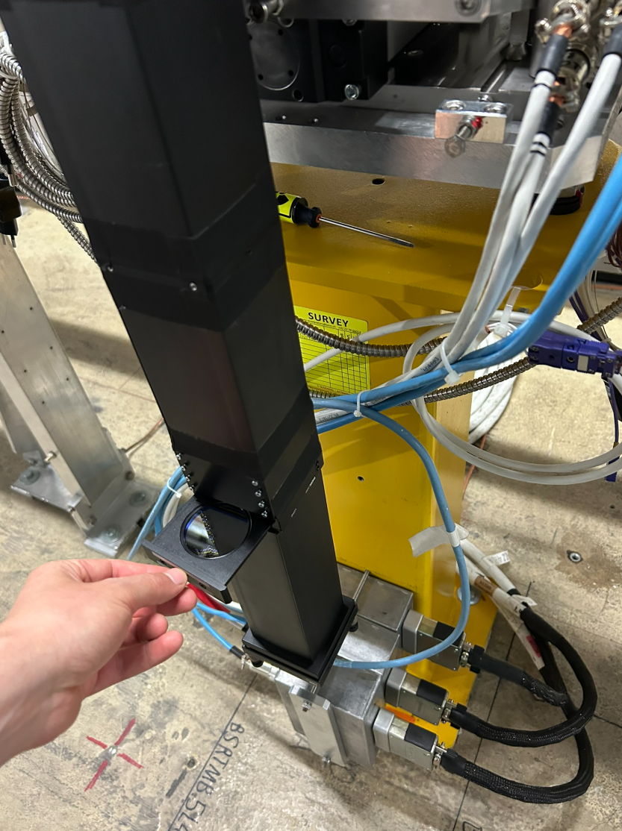
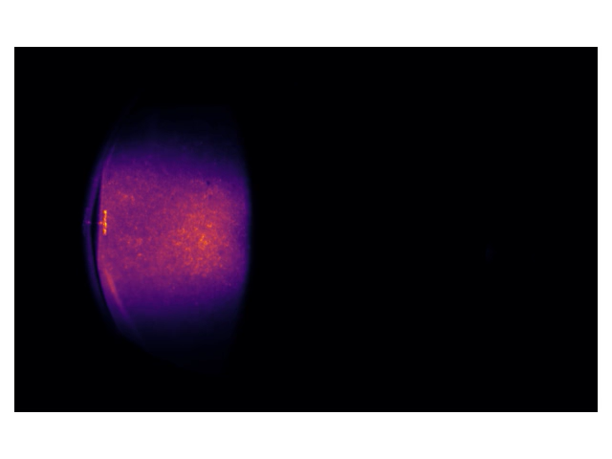
BSRTMB status
Animation of extracted synchrotron radiation observed during mirror insertion at end of ramp
So far, no changes of mirror temperature (expected as we had max 300 bunches at injection for scrubbing)
405x10 nm filter inserted for monochromatic observations with higher intensity

Slide 8
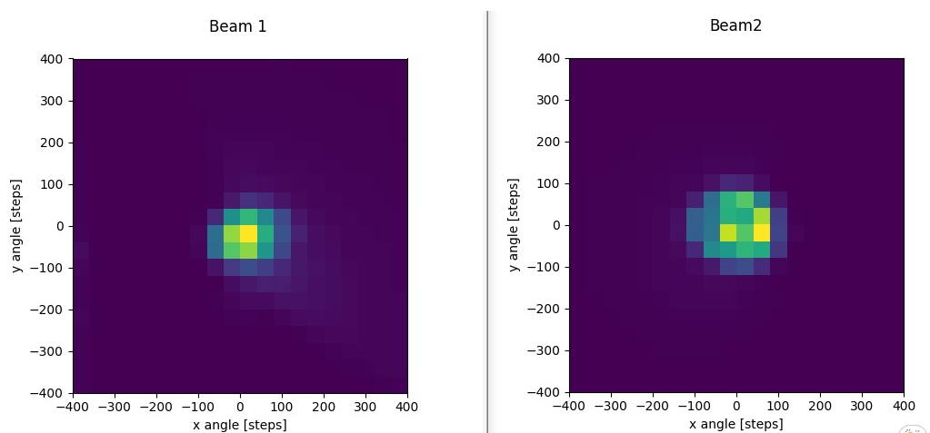
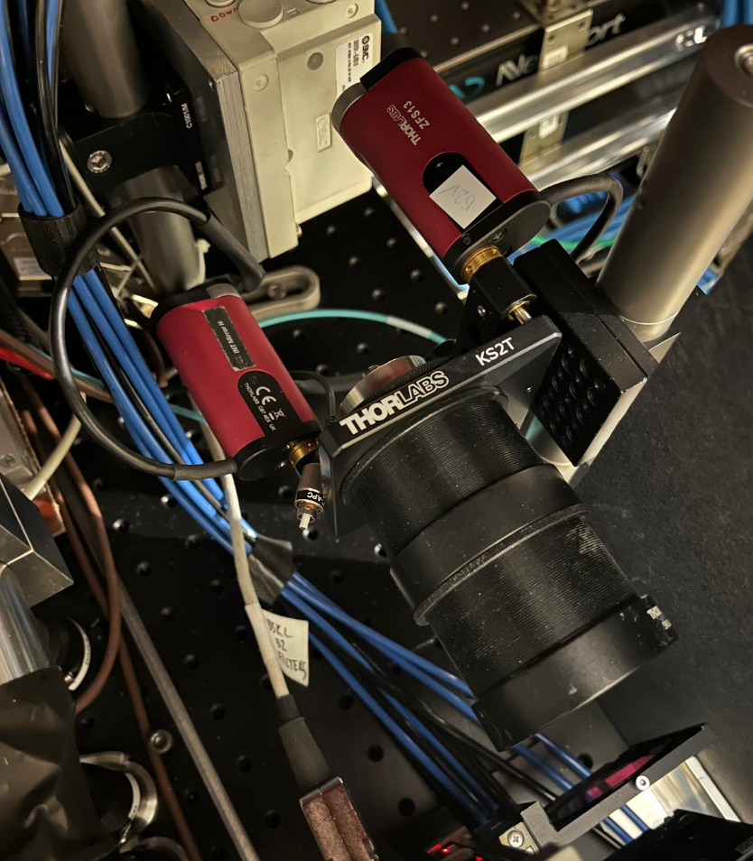
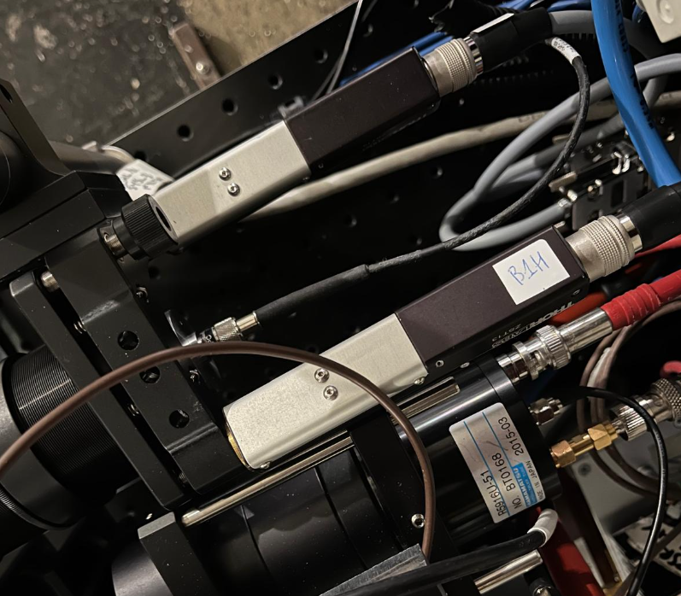
BSRL status
BSRL optics upgraded during YETS to have better SR to fiber coupling:
Beam 2 seems conform to VdM requirements (>1e-8 Hz/p)
Beam 1 is barely distinguishable from noise when bandpass filter
Extensive characterization of BSRL coupling in the last days.
Beam 2 measured 30%. Beam 1 initially measured <10% and optimized to >80% focusing the lens.
Still missing >2 orders of magnitude… other tests still possible but coupling unlikely to be the root cause!
Backend equipment (fiber to UA, detector, signal to TDC) present main suspect
Complete 2D angular scan

