Slide 1
BSRH status
J. Pucek

Slide 2
Changes
BSRT/BSRH splitter installed and Daniele is not complaining :D
New FEC installed (cfv-us45-bsrhb2)
  All basler (tgt) cameras moved to the new FEC
  Main camera can run > 10Hz at FF (BTVDC deployed)
Installation of a CM illumination under way (important for final focusing)
Expert GUI now uses both RDA and JAPC for communication

Slide 3
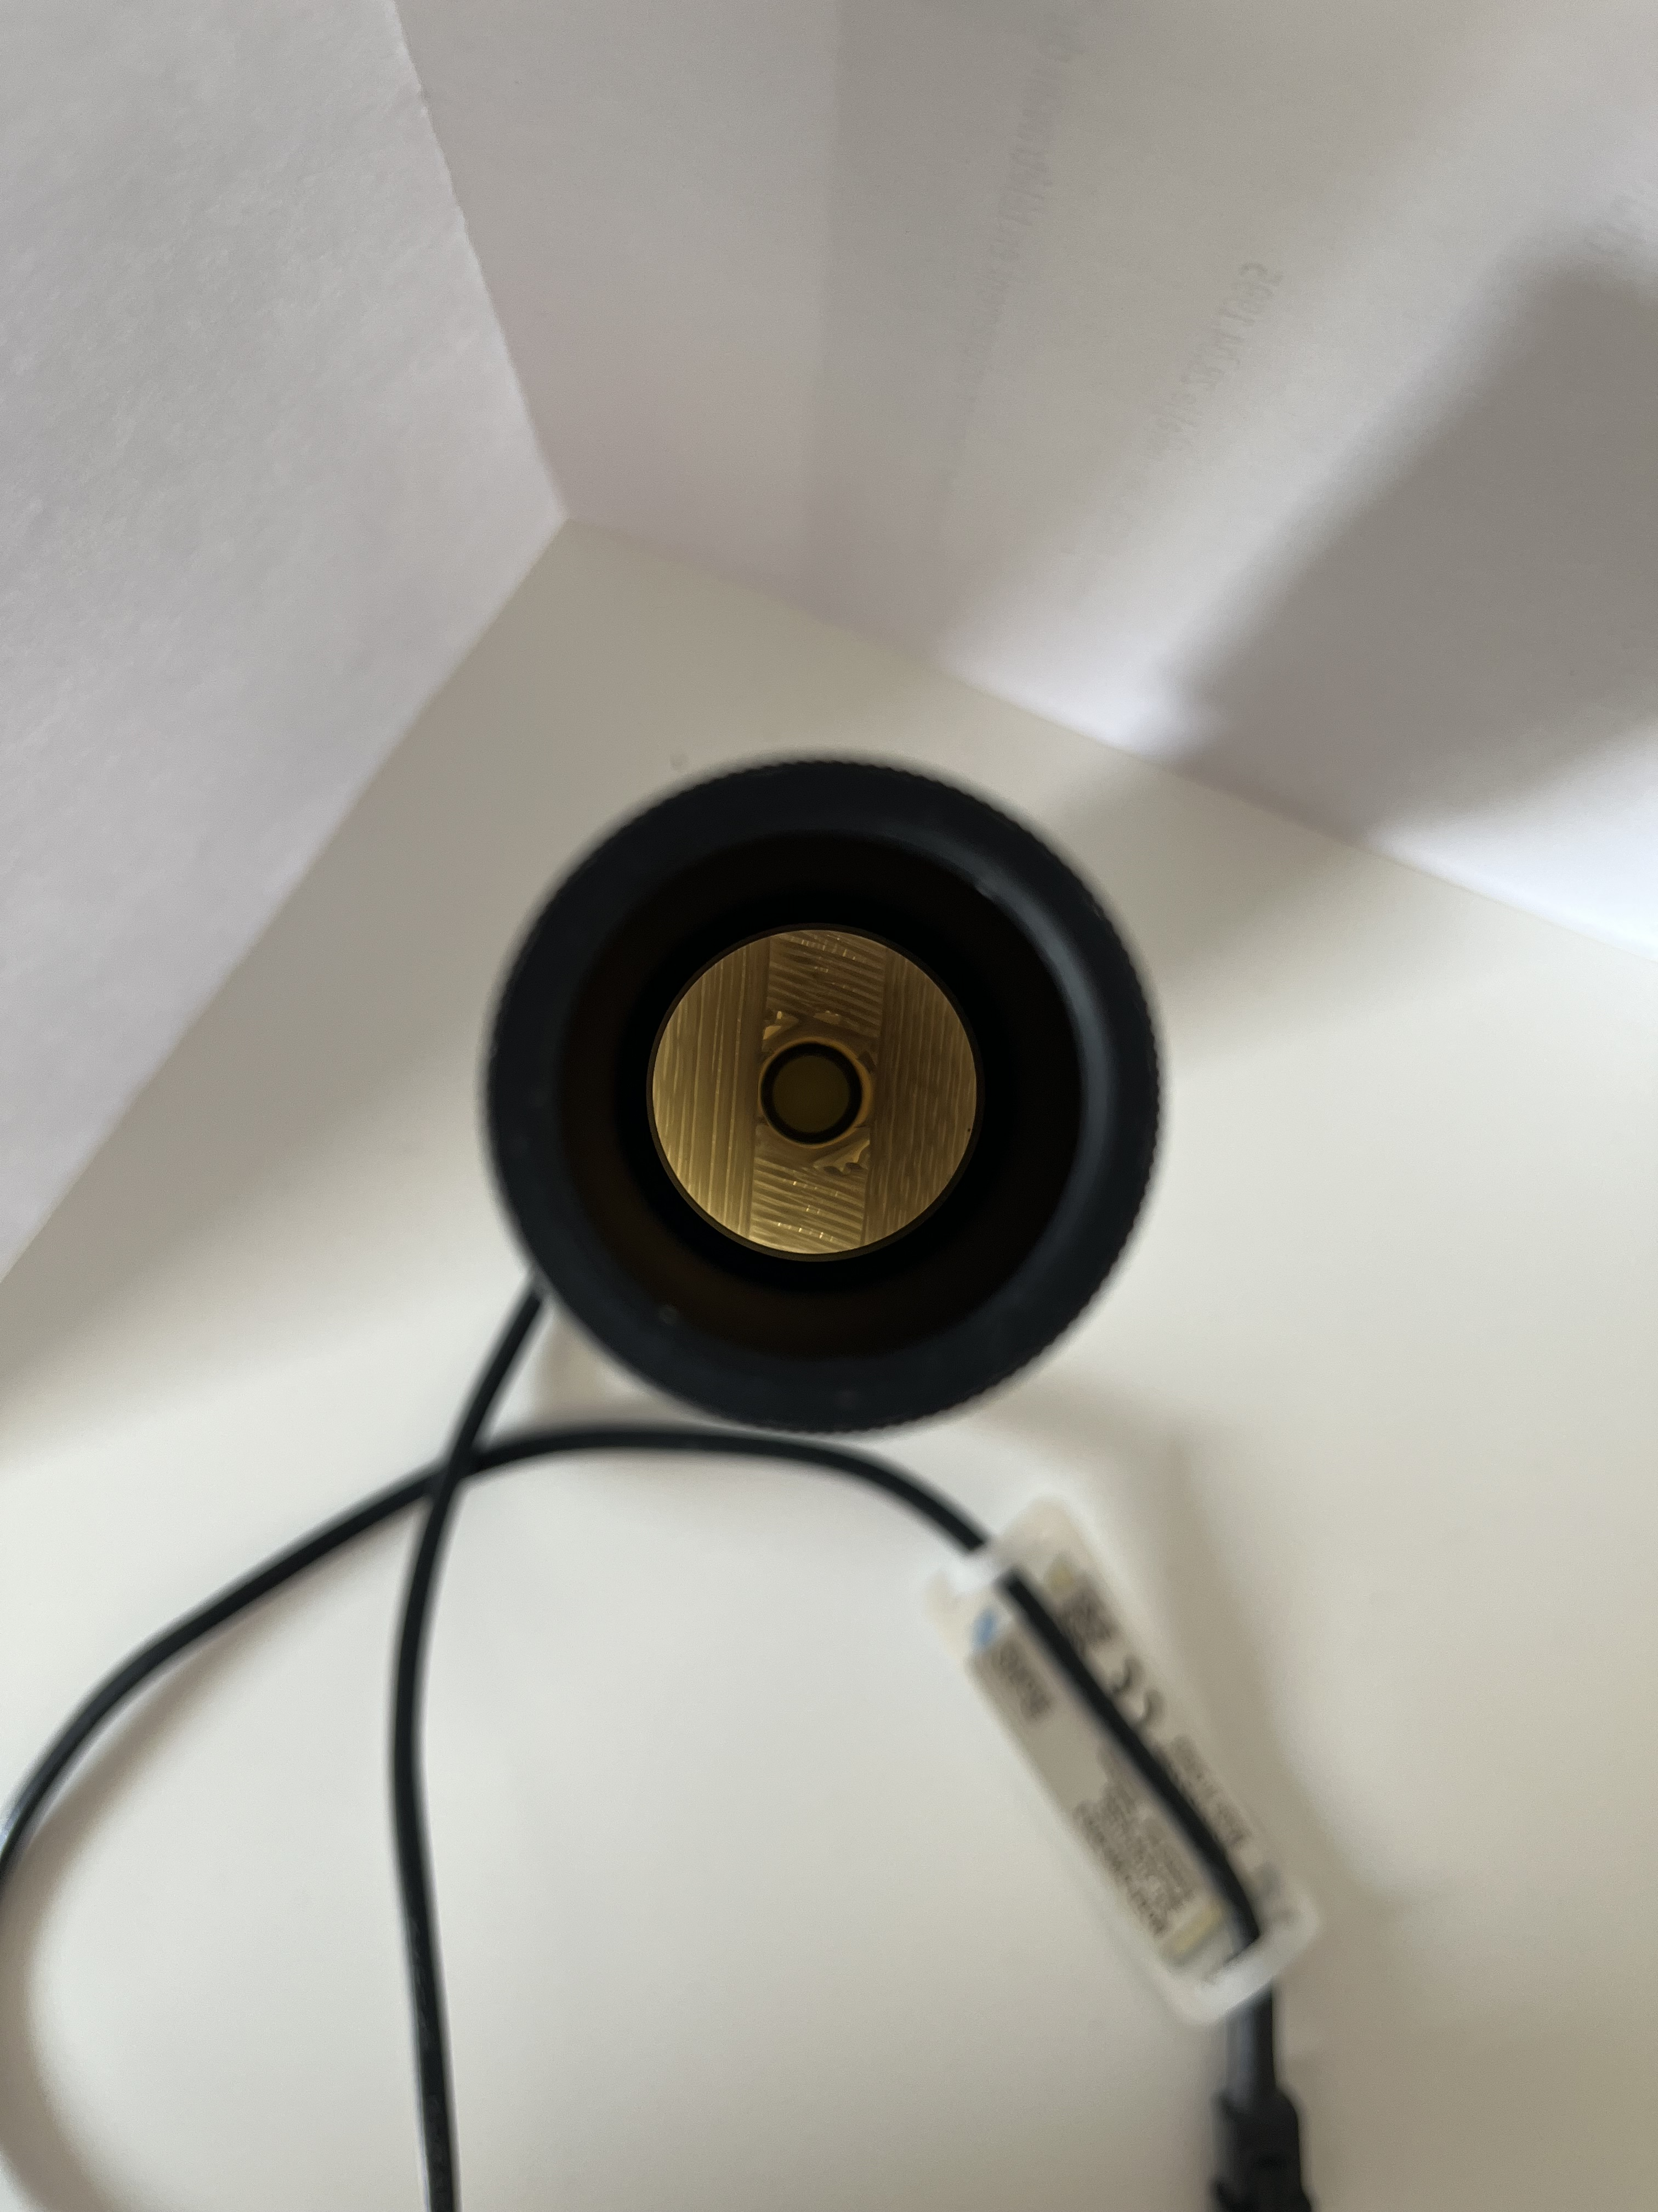
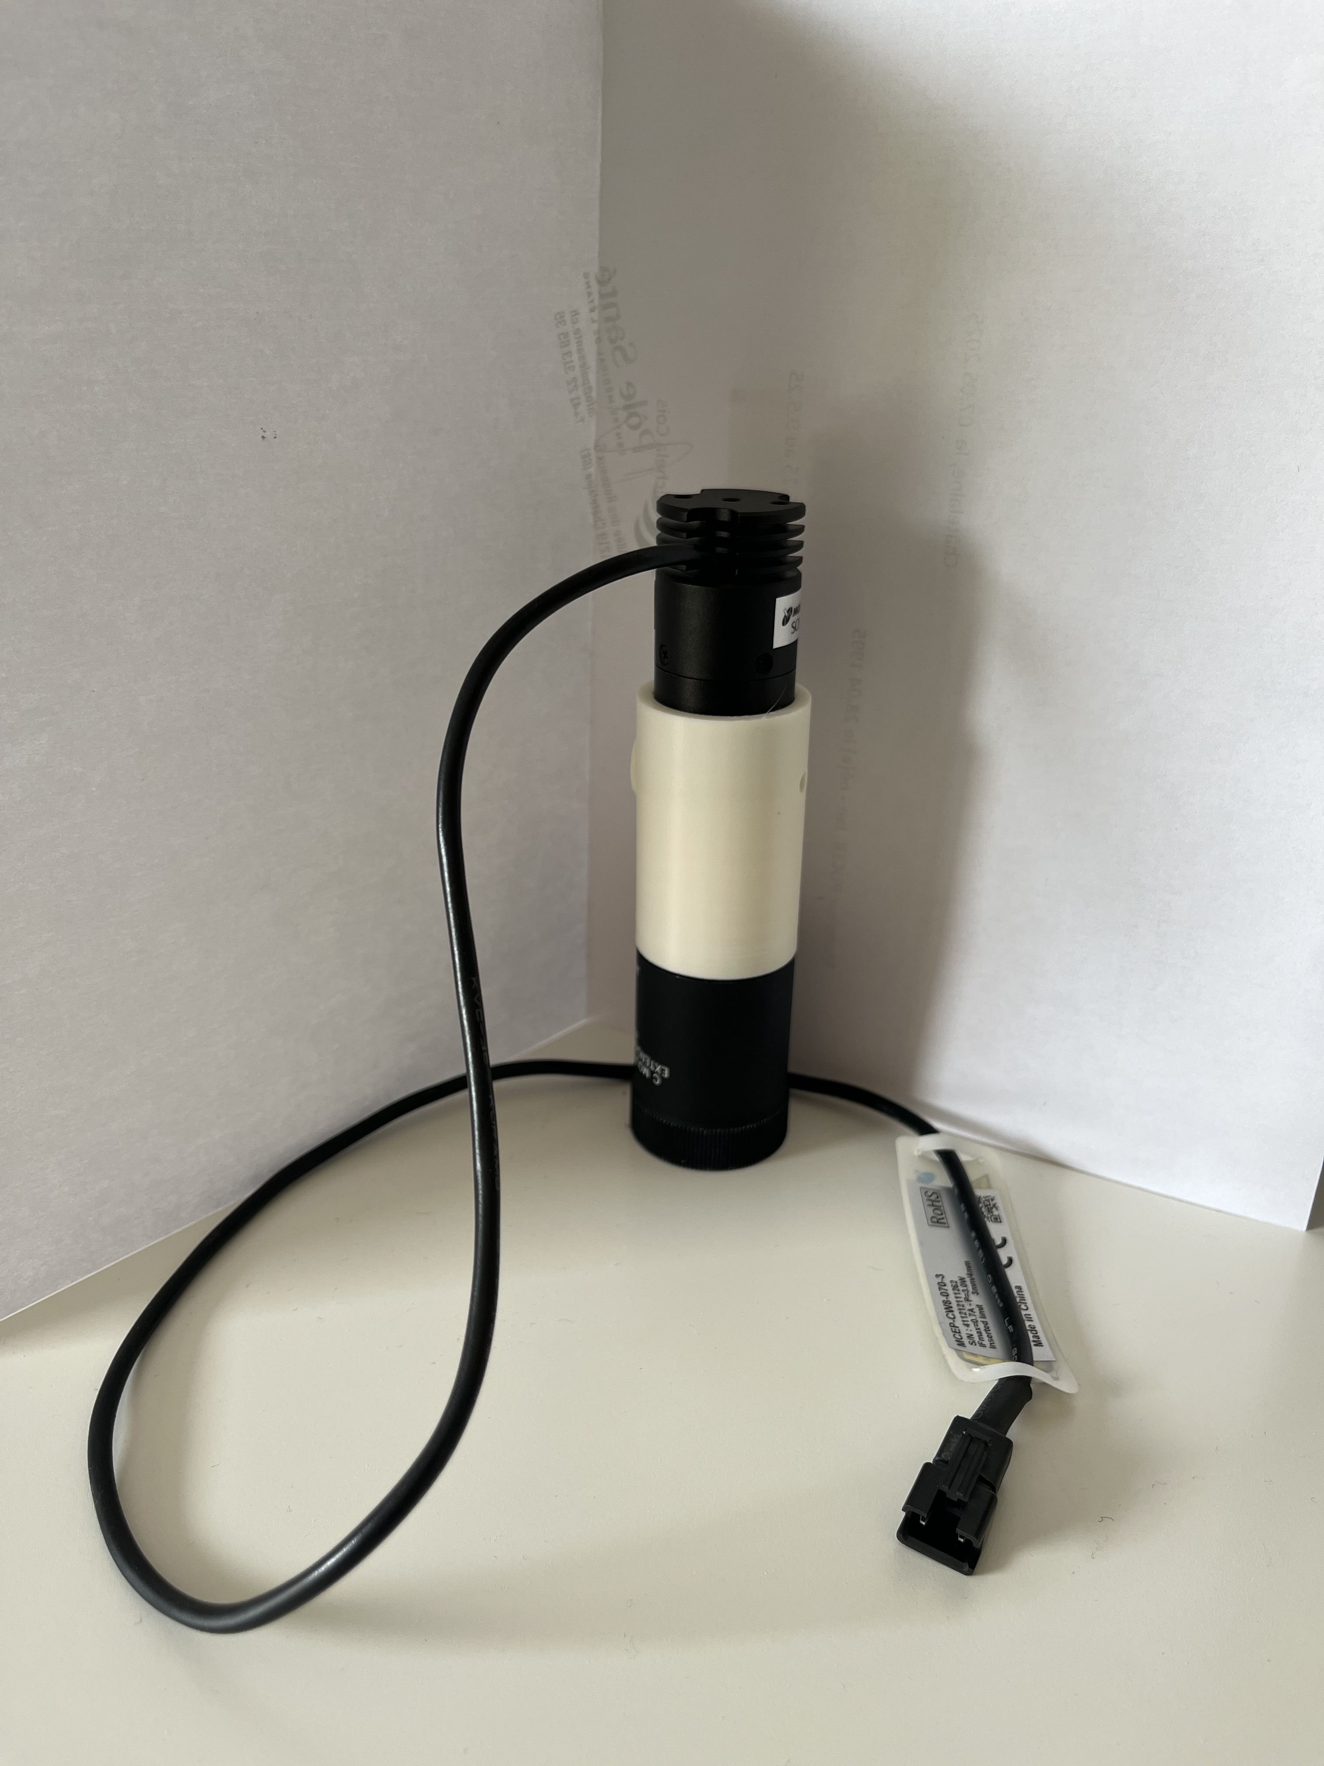
Setup
Alignment done, preparing an automated steering system (due to motion of BSRT M1 affecting the optical line of BSRH)
Focusing of the telescope done (in H the parabola is very broad)
Temporary focus done on the final camera, for best performance the CM illumination needed

Slide 4
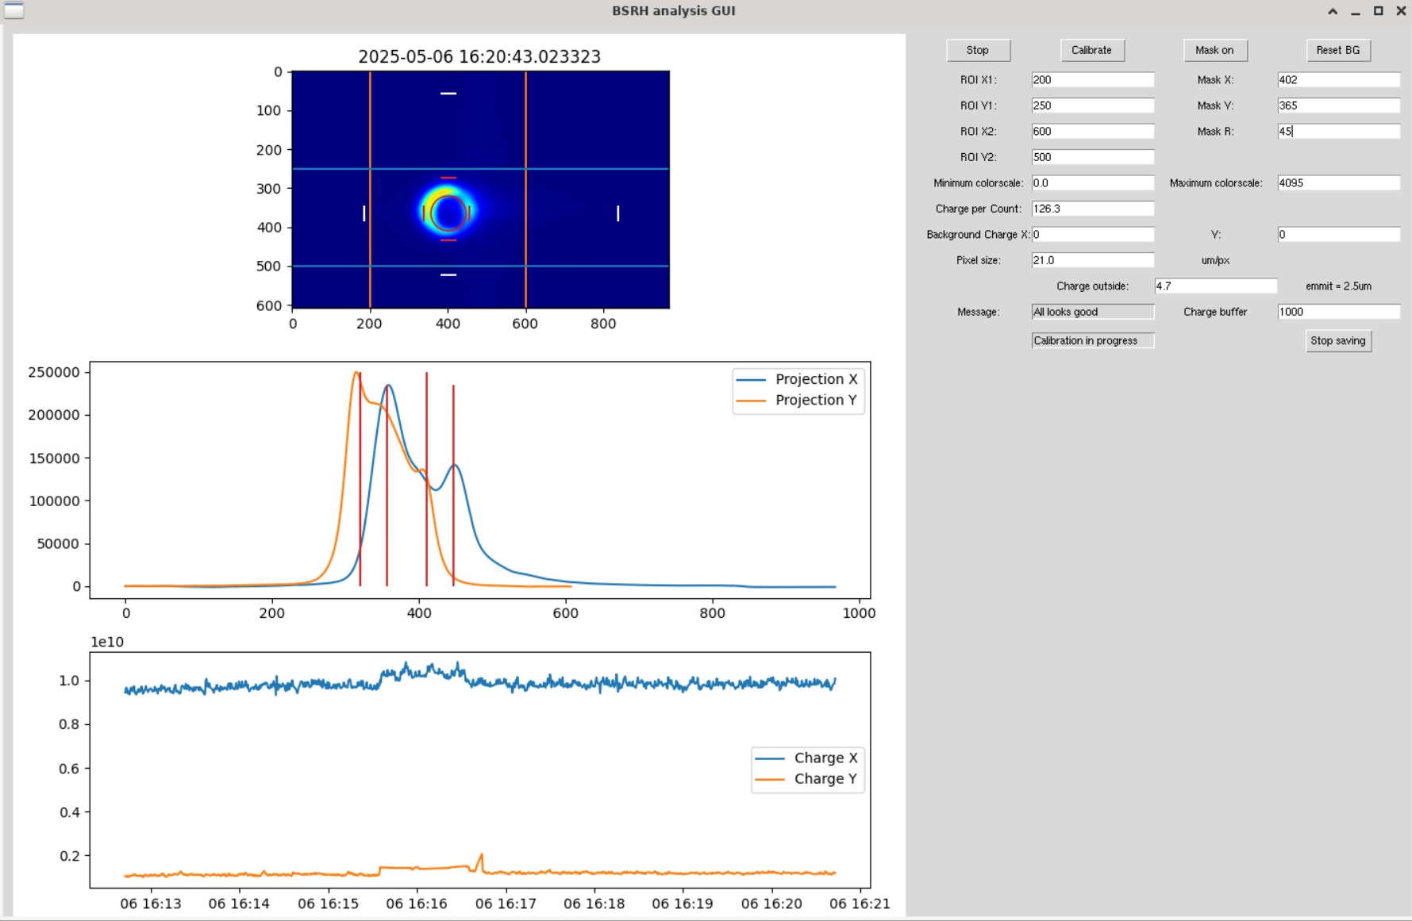
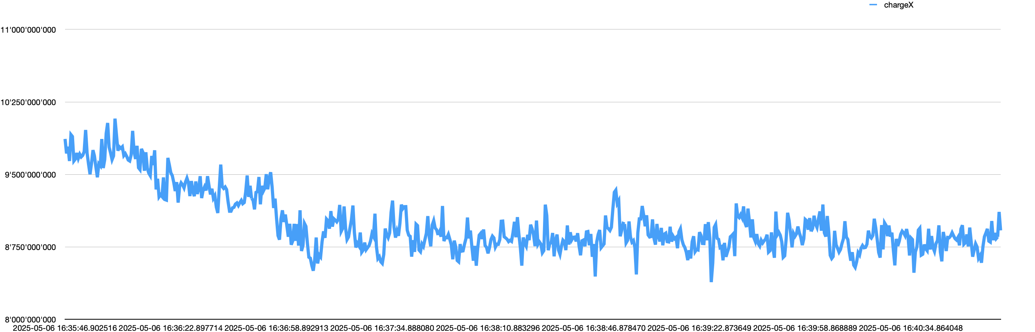
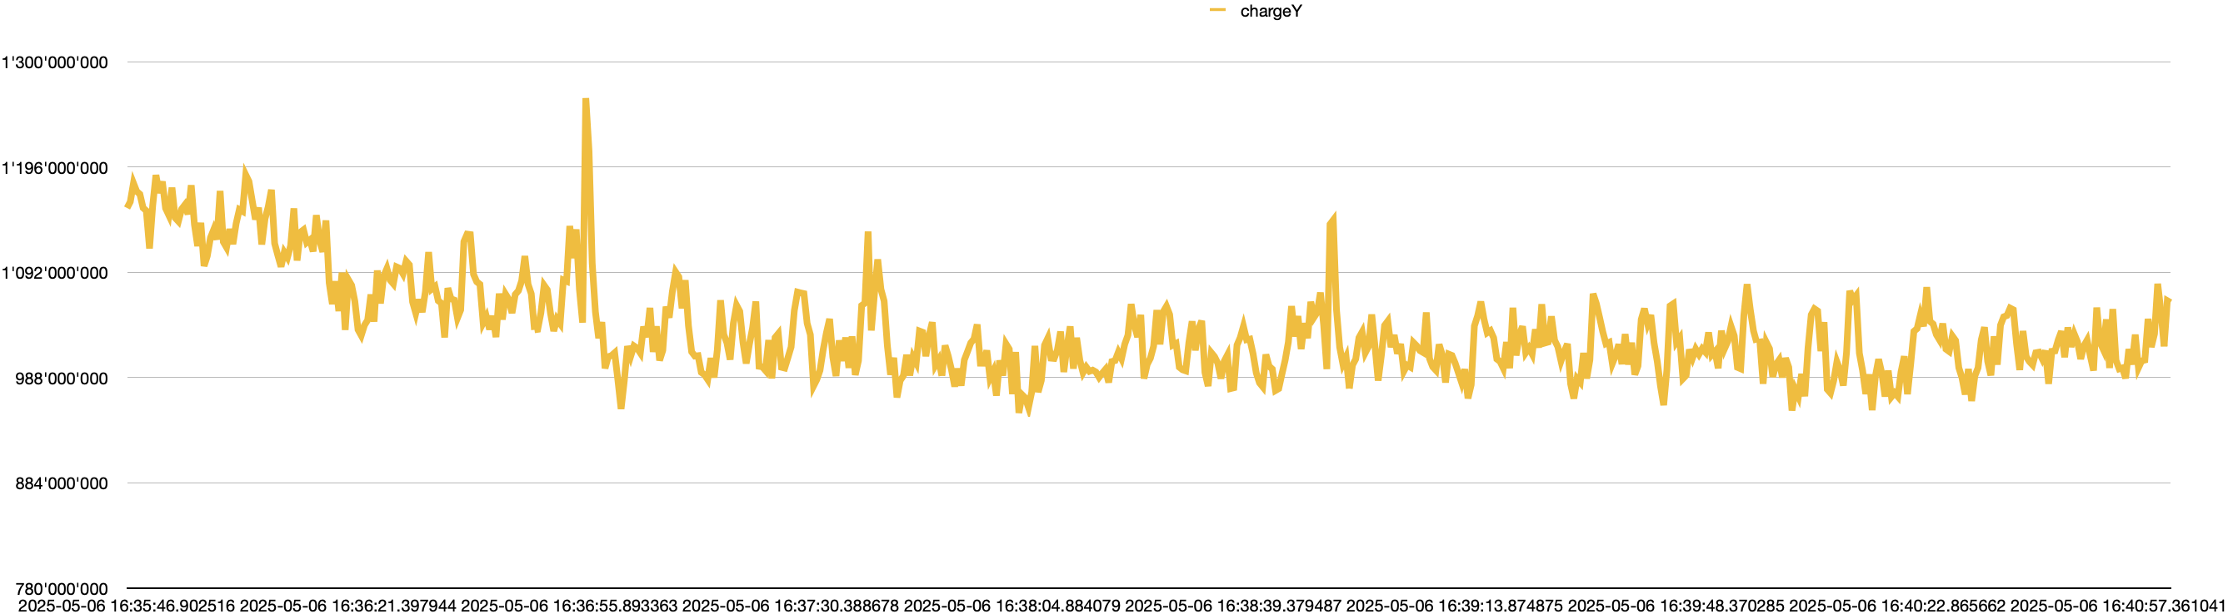
Sample data taking
2% of the measured value
3% of the measured value

Slide 5
Next steps
Install the illuminator and finilize the focusing
Prepare automated scripts for the calibration run
Try to measure a physics fill
MD in LHC’s slot 1 in June
*viewport facing up for BSRTMB?

