Slide 1

G. Iadarola
With input from:
B. Abreu Figueiredo
R. De Maria
P. Raimondi
K. Skoufaris

Slide 2
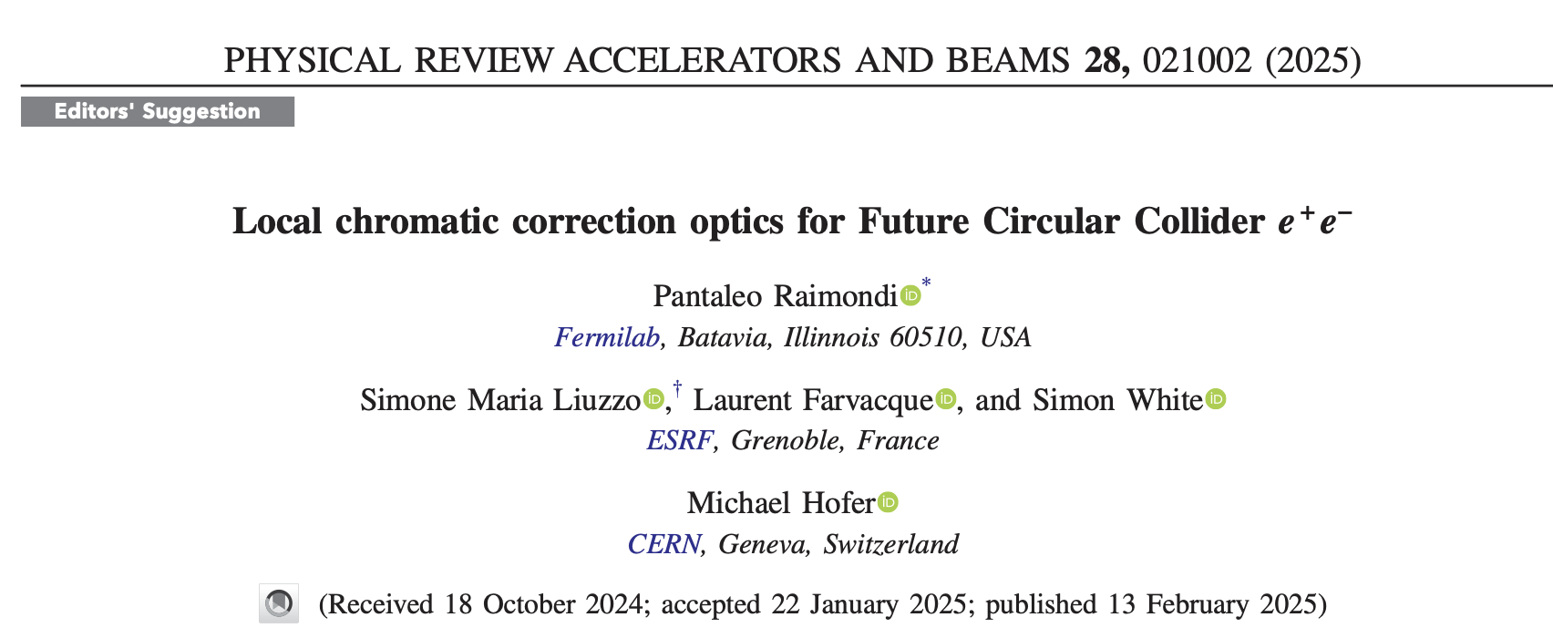
Introduction
Over the last years we invested significant effort to improve Xsuite performance and interface in describing accelerator lattices and design optics
  First full LHC cycle made with Xsuite tested in MD in 2024
To probe and improve the tools capability also in the context of “green-field” accelerator design we tried to reproduce reasonably from “scratch” the lattice building and matching of the FCC-ee LCC lattice
We heavily relied on:
  Paper by P. Raimondi et al. describing the optics
  MAD-8 matching scripts available in the acc-models repository
  Discussions with Pantaleo (thanks a lot!)

Slide 3
Design choices
Aimed at keeping the strengths of MAD (-X, -8, -NG) while using Python (ease of use and economy of resources):
  Compact and expressive lattice description
  Easy way of describing circuits (deferred expressions)
  Fast way of defining and performing numerical optimization
Tried to address what we encountered as important limitation of using MAD-X
  Optics matching is often an iterative exercise where the designer enables/disables knobs, adding/removing constraints, changes weights etc.
  Typically, → often at in MAD-X this is obtained by commenting/uncommented lines in a script the end you would keep the resulting strengths but you would have no detailed log of how the steps that got you to that result
  With Xsuite we aim at provide an interface that helps the designer to naturally keep track of the design steps
    Important when sharing this information and training younger colleagues

Slide 4
The tutorial
The outcome of the exercise is a tutorial in the form of Jupyter notebooks illustrating
How the lattice is ”assembled”
How the linear optics is matched (matching quad strengths)
How chromatic and detuning properties are controlled (matching of sextupoles strengths)
Available at https://github.com/giadarol/fcc_92/tree/main/004_tutorial_cap_meeting
Built with the aim of providing a resource to colleagues learning the tool and to collect input on how to further improve

Slide 5
Ring description

Slide 6
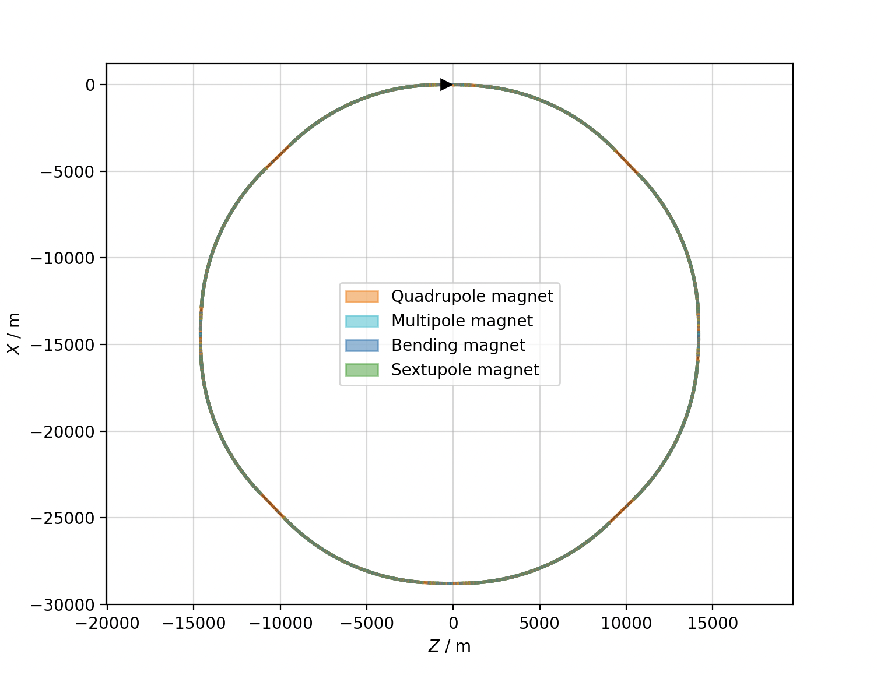
Describing the ring – general structure of the ring
The ring is made my four identical quarters
Each quarter contains one experimental insertion, one technical insertion and two arcs
Exp
Arc
Arc
Tech.
Tech.
Arc
Arc
Exp
Exp
Arc
Arc
Tech.
Tech.
Arc
Exp
Arc

Slide 7
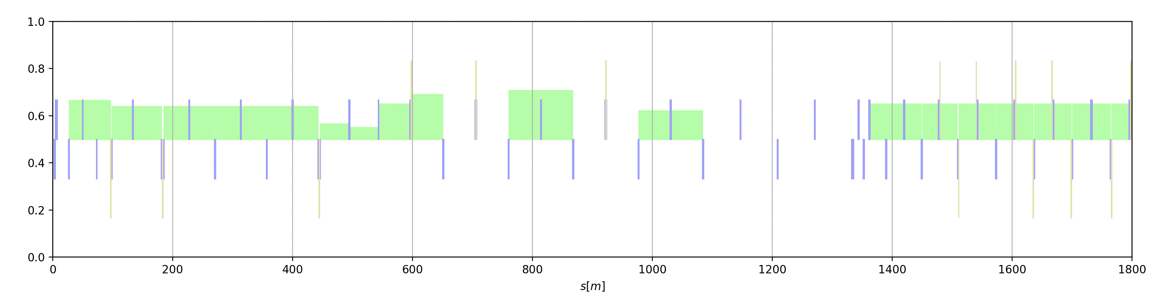
Describing the ring – insertion region
Each ring portion in devided in other sections:
Final focus quads
Dispersion suppressor (DS)
Chrom. corr. Section Y (CCS-Y)
Chrom. corr. Section X (CCS-X)
Arc
IP
Crab sextupole

Slide 8
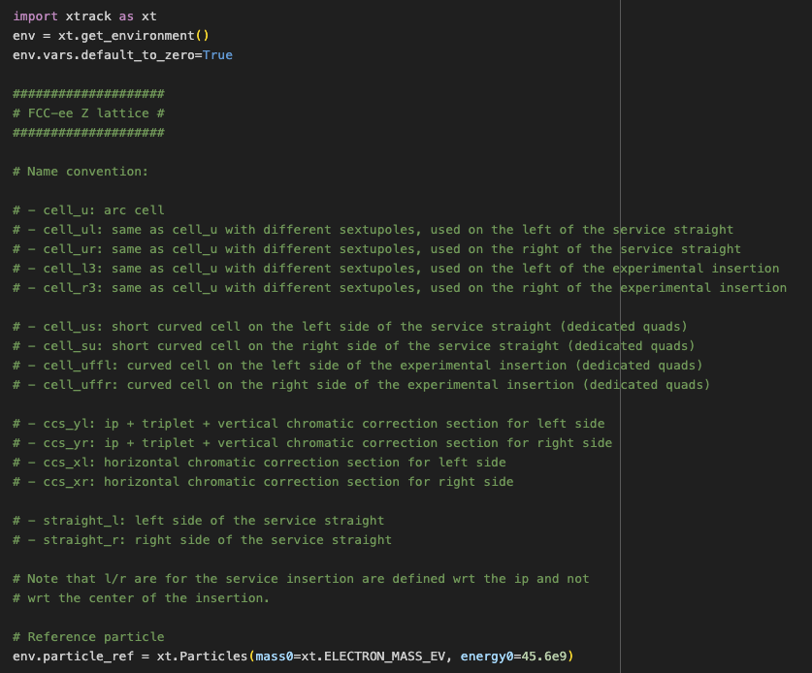
Lattice description
MAD (8, X, NG) is particularly handy in describing this kind of lattices
We invested in riproucing the same capabilities without using an ad-hoc language: the lattice can be described as a Python script
Variable, elements, beamlines, are all managed by an “Environment”
Xsuite version of te FCC-ee lattice file

Slide 9
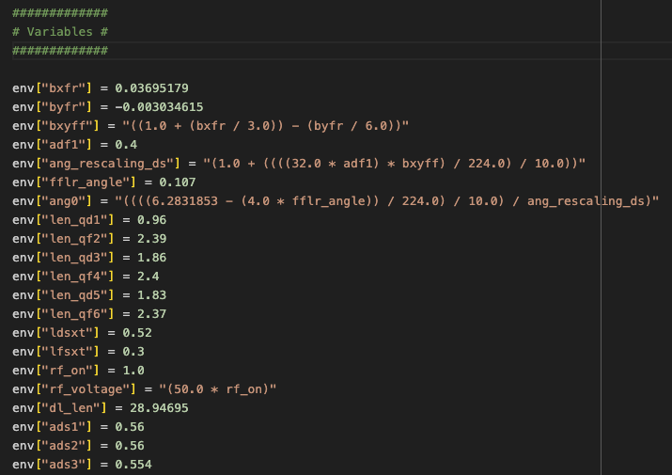
Lattice description
MAD (8, X, NG) is particularly handy in describing this kind of lattices
We invested in riproucing the same capabilities without using an ad-hoc language: the lattice can be described as a Python script
Variables can contain numbers or deferred expressions
Strings are
deferrred expressions

Slide 10
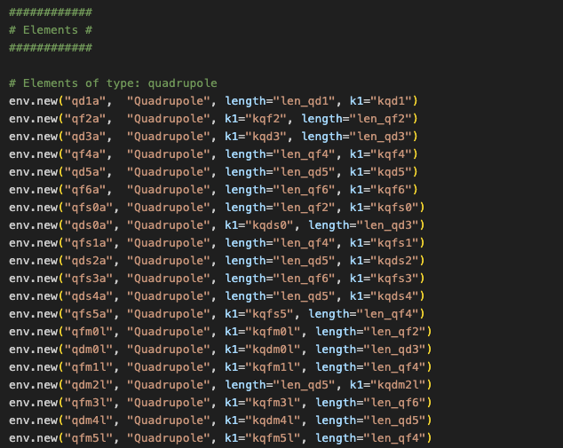
Lattice description
MAD (8, X, NG) is particularly handy in describing this kind of lattices
We invested in riproucing the same capabilities without using an ad-hoc language: the lattice can be described as a Python script
Element properties can contain numbers or deferred expressions
Strings are
deferrred expressions
Strings are
deferrred expressions

Slide 11
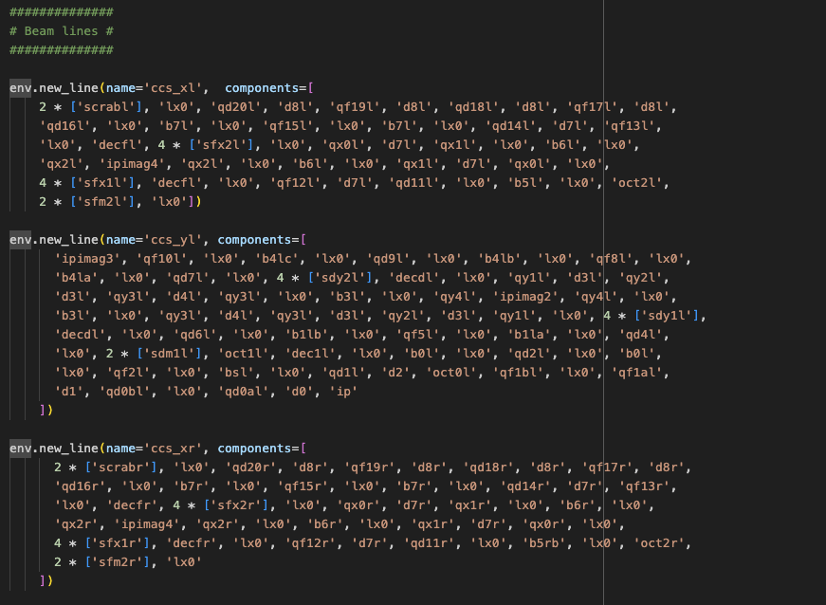
Lattice description
MAD (8, X, NG) is particularly handy in describing this kind of lattices
We invested in riproucing the same capabilities without using an ad-hoc language: the lattice can be described as a Python script
Beam lines can be defined as list of elements (explicit drifts) or by specifying the s positions of the elements
Strings are
deferrred expressions
Strings are
deferrred expressions

Slide 12
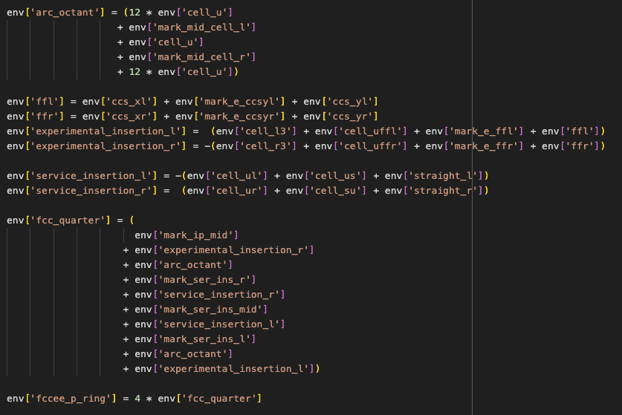
Lattice description
MAD (8, X, NG) is particularly handy in describing this kind of lattices
We invested in riproucing the same capabilities without using an ad-hoc language: the lattice can be described as a Python script
Lines can be combined on multiple levels using arithmentic operators (“+”, “-” “*”)
Strings are
deferrred expressions
Strings are
deferrred expressions

