Slide 1
LS3 activities and resources for current lead maintenance
C. Barth, M. Rowland and A. Ballarino for MSC-HSD
May 2025
Acknowledgement : M.-P. Careil and T. Kramer

Slide 2
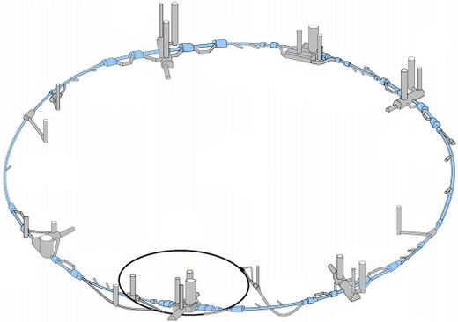
Current lead maintenance - Overview
Conduction cooled current leads
2240x 60 A and 120 A leads distributed in LHC tunnel
  Each assembly of 4 is equipped with a 230 V AC fan to prevent condensation
Vapor cooled current leads:
64x 13 kA leads and 310x 6k A in the DFBs
  Distributed air ventilation system to prevent
  condensation of RT components
  Each with individual insulation vacuum
  and electric heating system
750x 600 A leads in the DFBs
  Each assembly of four with individual
  insulation vacuum
  Each with electric heating system
DFBs located left & right of each point

Slide 3
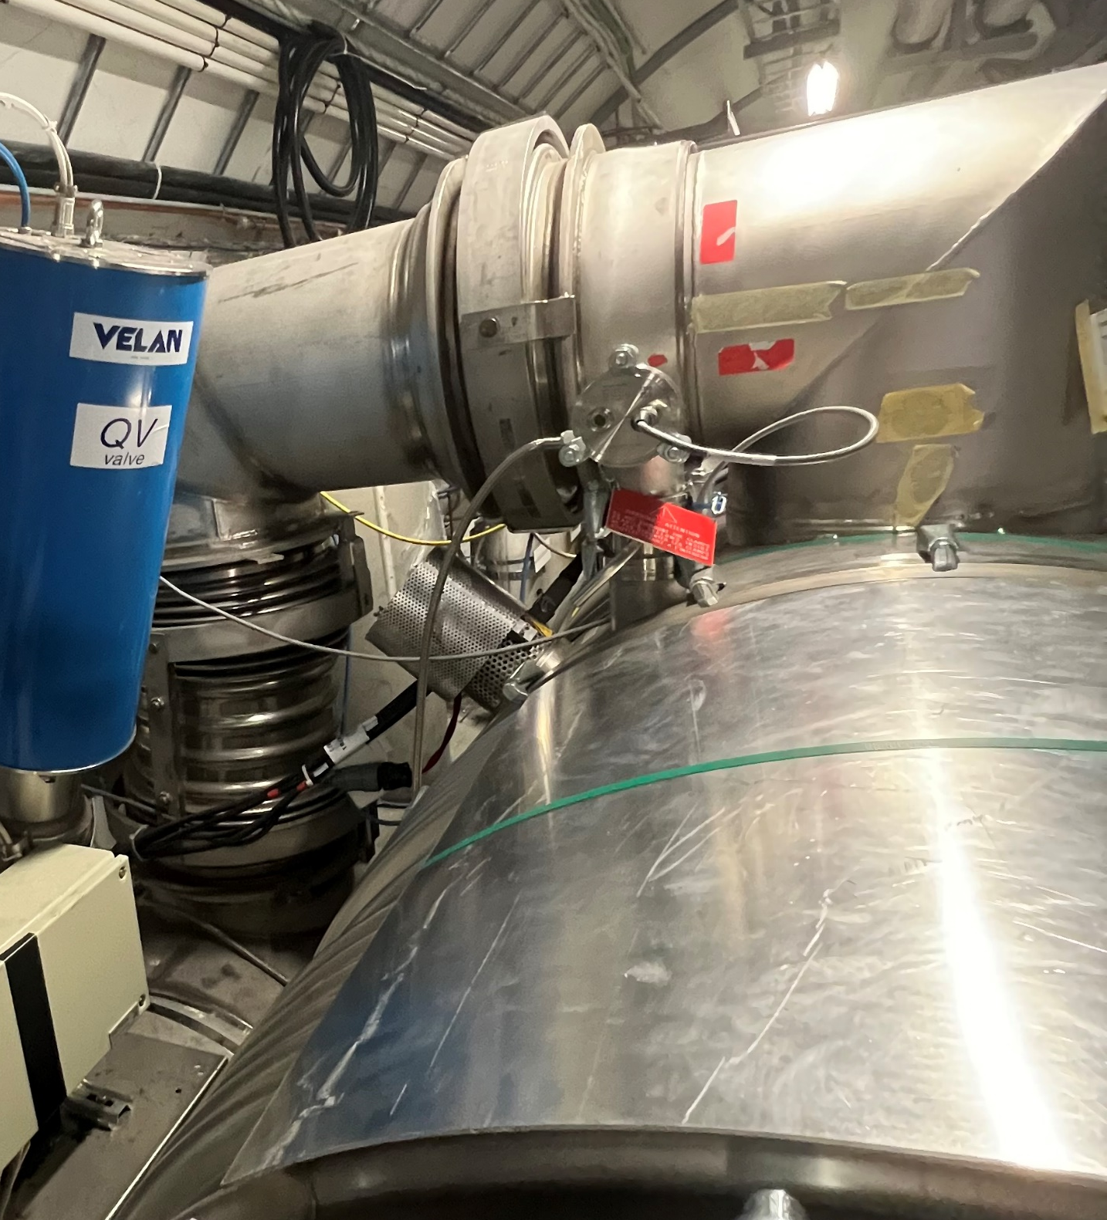
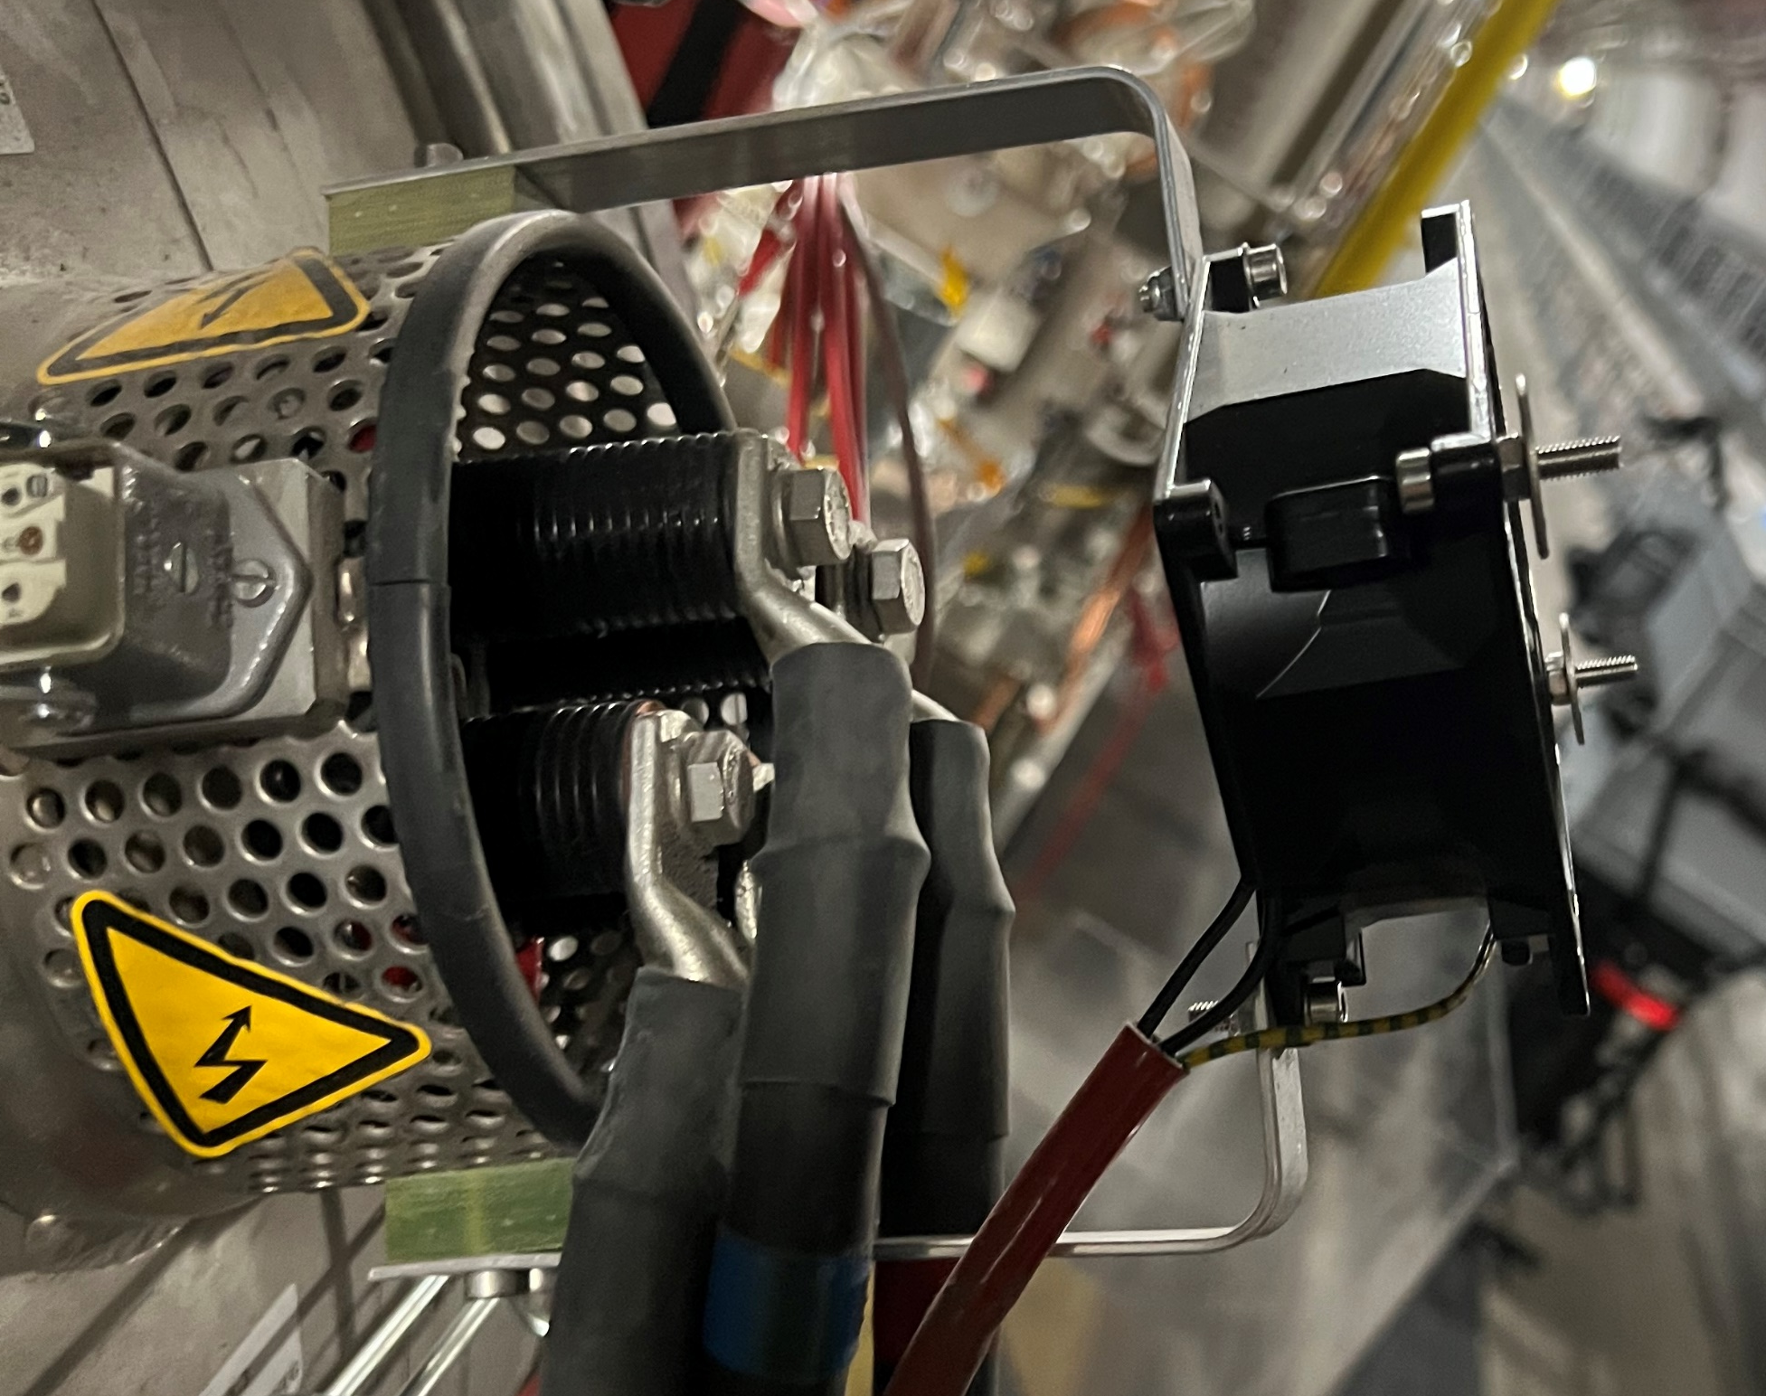
Conduction cooled current leads
2240x 60 A and 120 A leads distributed in LHC tunnel
  Fans operate 24/7
  20 – 50 fans (~ 4 – 8 %) need
  to be replaced every year
Foreseen maintenance activities
  Inspection of all fans & replacement
  of broken and end-of-life fans
  MSC : 1 month :
    Sc. Staff : 0.1 / Tech Staff : 1.0 / FSU-TEMP : 1.0

Slide 4
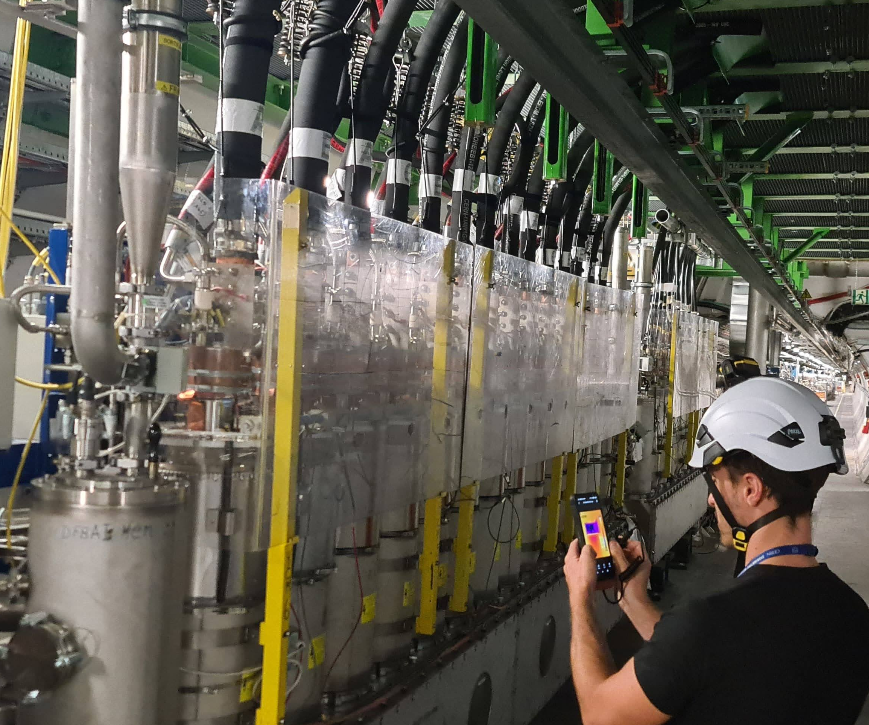
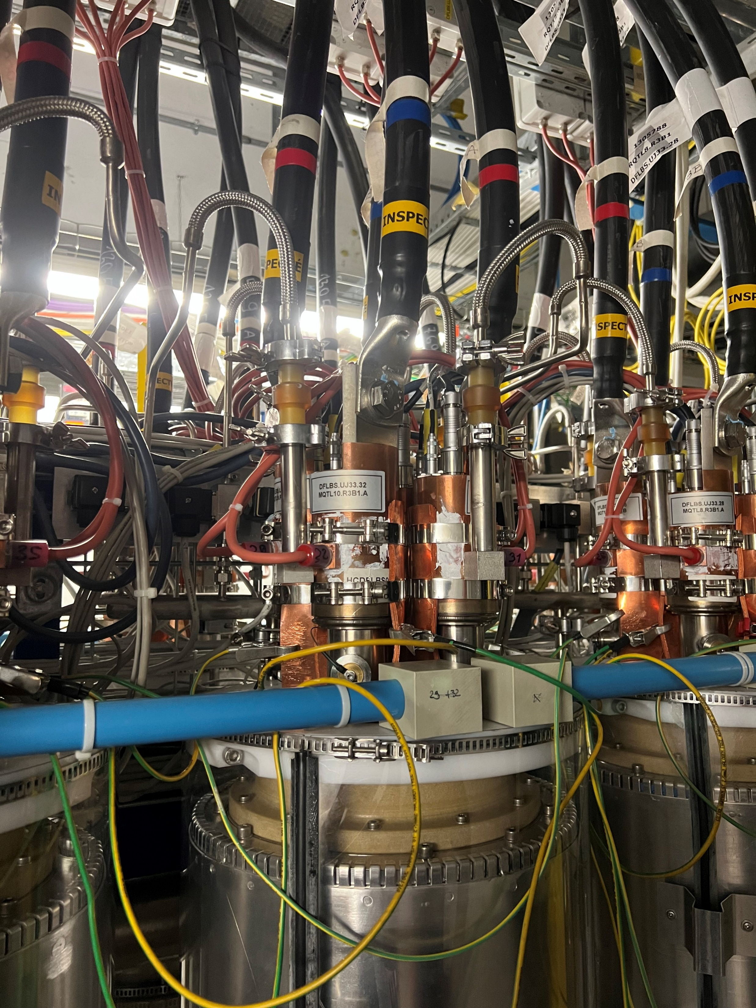
Vapor cooled current leads
64x 13 kA, 310x 6 kA & 750x 600 A leads in the DFBs
  Insulation vacuums need to be guaranteed
  Heating systems functioning need to be guaranteed
  Ventilation system functioning need to be guaranteed
    Condensation has been repeatably observed during
    YETS on room temperature components in some DFBs
Foreseen maintenance activities
  Control of all insulation vacuums,
  re-pumping of the vacuums wherever needed
  Control of heating systems
  Control of ventilations systems
  Comparing performance of different DFBs
  Upgrade / repair of less performing systems
  MSC : 5 months :
    Sc. Staff : 0.1 / Tech Staff : 1.0 / FSU-TEMP : 1.0

Slide 5
Summary
Resources
  Sc. Staff : 0.1 / Tech Staff : 1.0 / FSU-TEMP : 1.0
  Needed for 6 months
Budget
  Material : within budget
  Personnel : foreseen during PSM WP6a
Planning
  From beginning of 2028
LS3 specific
  Works & Services Supervisors
    Christian Barth & Maxwell Rowland
  Access to zones
    Access to entire LHC tunnel needed, activities can be coordinated around other activities (same strategy as during YETS)

