Slide 1
LS3 activities and resources for WP6a installation
Y. Leclercq, C. Barth, A. Ballarino for WP6a
May 2025
Acknowledgement : Rita Perez Martinez, Stefanos Spathopoulos, Florian Pasdeloup and all WP6a

Slide 2
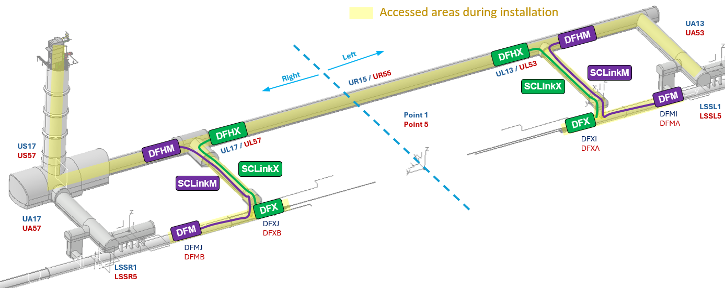
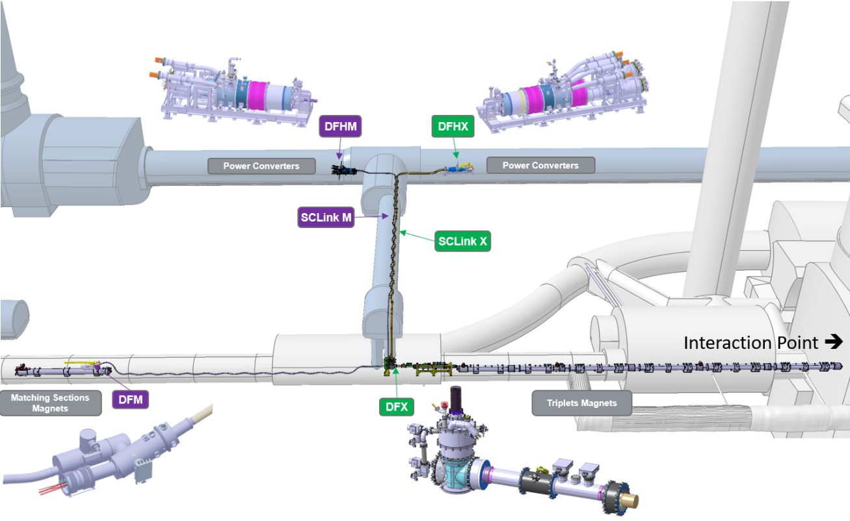
WP6a LS3 activities
Cold Powering Systems Installation
8 systems (4 @ P1 + 4 @ P5)
2 types IT (X) & MS (M)
New galleries, Cores & LHC
Activities during LS3 :
Infrastructure Installation
Transport
Electro-mechanical assemblies
Quality Control

Slide 3
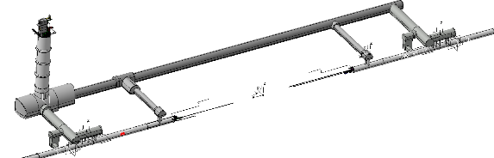
WP6a overview & organization
LS3 Phases
Surface preparation
Installation of infrastructure
Lowering & unspooling in series
SCLink ends assembly & interface
Tasks distribution
WP6a (TE-MSC) experts focused on key operations involving the superconducting cables
  SCLink unspooling
  DF assemblies
  Current Leads interfaces
  Proximity equipment
Strong support from other CERN groups/ departments
  EN-HE : for transport, handling, unspooling
  EN-ACE : for structure installation to vault
  EN-MME : for welding activities, QC & QA
  TE-VSC : for QC (leak tightness) & pumping
  ElQA team : for QC (electrical)
2025 |  | 2026 |  | 2027 |  | 2028 |  | 2029
Cold Powering Systems assembly & qualification
A. Surface preparation
B. Tooling installation
C. Lowering & Unspooling
D. SCLink Ends assembly & interfaces

Slide 4
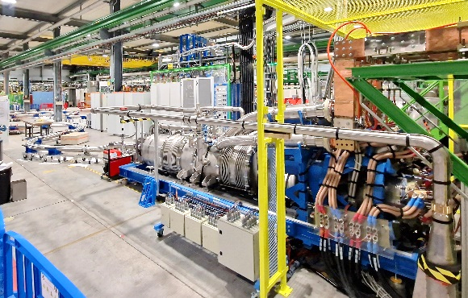
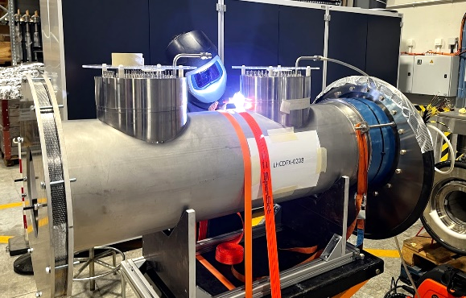
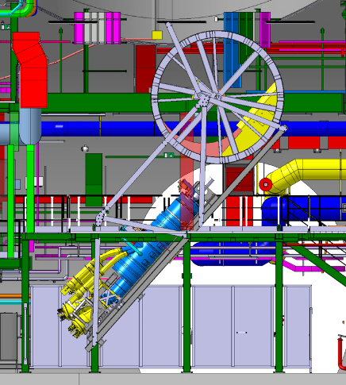
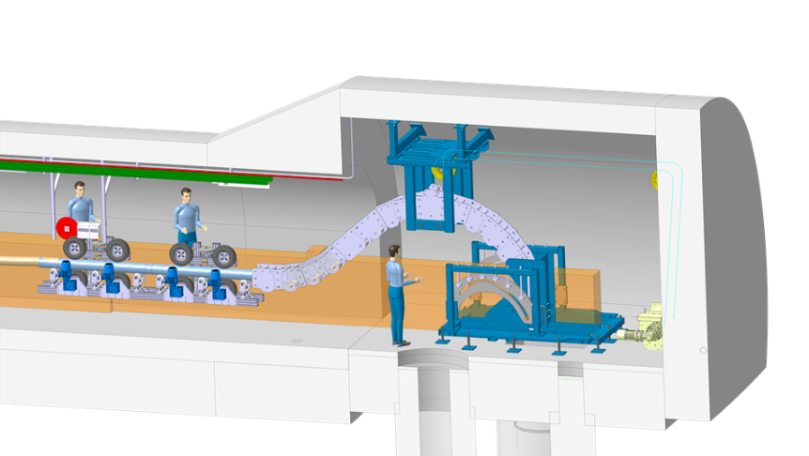
A. Surface preparation : period Q1-2027 to Q2-2028
Active components preparation
  DFX & DFM preparation (IFS, conditioning)
    MSC : 15 weeks : Sc. Staff : 0.5 / Tech Staff : 1 / FSU-TEMP : 2 / Quest : 1
  Proximity equipment
    UR : installation by WP6b sub-contractor / UL : installation by EN-ACE (TBC)
    MSC : 25 weeks : Sc. Staff : 0.5 / Tech Staff : 0.5 / FSU-TEMP : 2 / Quest : 0
Tunnel supports & tooling preparation
  Supports production
    MSC : 10 weeks : Sc. Staff : 0.25 / Tech Staff : 0.3 / FSU-TEMP : 1 / Quest : 1
  Cable chains, guiding rails, shelves, QXL trays
    EN-ACE-COS + MSC : 25 weeks : Sc. Staff : 0.25 / Tech Staff : 0.5 / FSU-TEMP : 2.5 / Quest : 1
Procedure qualification & practice
  Dummy lowering in Point 1 & 5
    EN-HE + MSC : 4 weeks : Sc. Staff : 2 / Tech Staff : 2 / FSU-TEMP : 2 / Quest : 1
  Cores insertion qualification
    EN-HE + MSC : 20 weeks : Sc. Staff : 1 / Tech Staff : 1 / FSU-TEMP : 1 / Quest : 1
  Procedure & practice
    MSC : 20 weeks : Sc. Staff : 1 / Tech Staff : 0.5 / FSU-TEMP : 1 / Quest : 1
TE-MSC : 1.5 years of continuous activity with evolutive needs, in average :
Scientific Staff : 1.5
Technical Staff : 2.25
Quest : 3
FSU/TEMP : 3.6

Slide 5
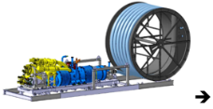
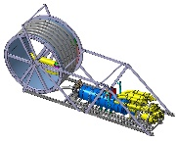
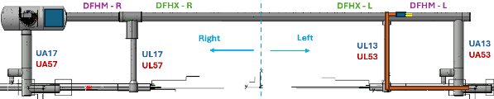
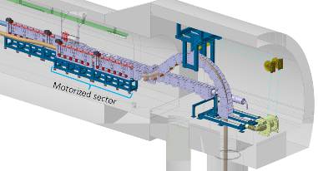
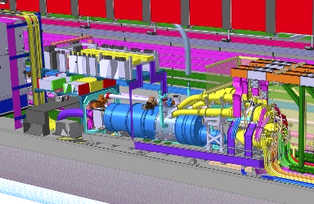
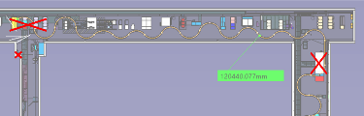
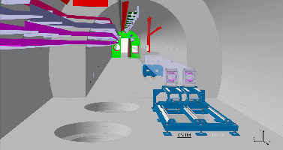
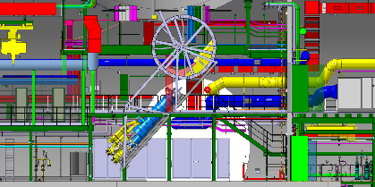
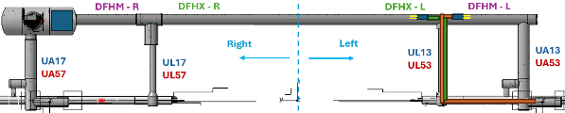
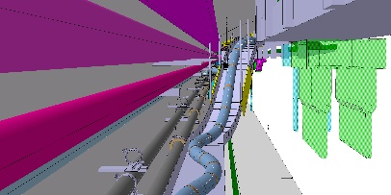
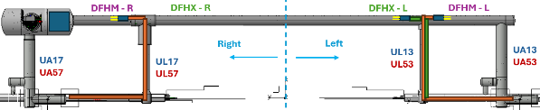
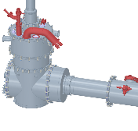
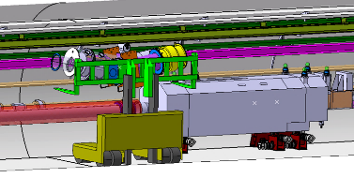
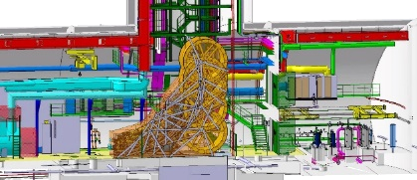
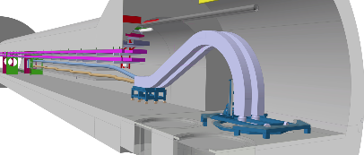
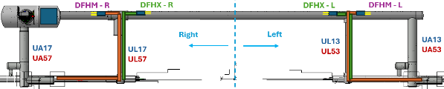

B. C. & D. Cold Powering system installation
LS3 Phases
Surface preparation
Installation of infrastructure
Lowering & unspooling in series
SCLink ends assembly & interface
B.
C.
D.
Supports & Tooling installation
Lowering SCLink+DFH
Unspooling
Core insertion
UR activity
Preparation
Left -M
M
Cryogenic & electrical interfaces
UR
UL
Lowering
Left -X
Right -M
LHC activity
DFX assembly
LHC
Landing
X
Right -X
DFM assembly

Slide 6
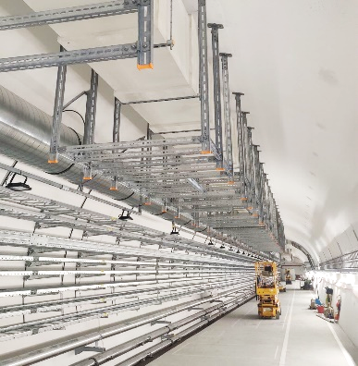
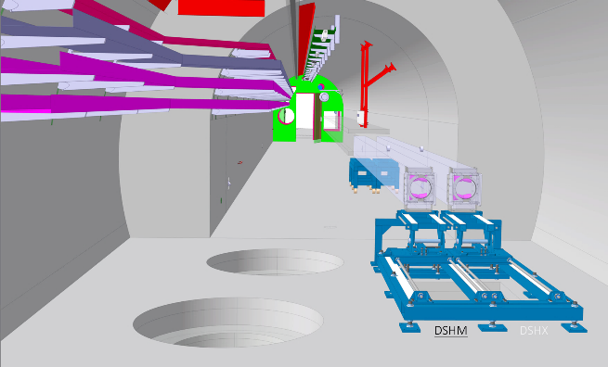
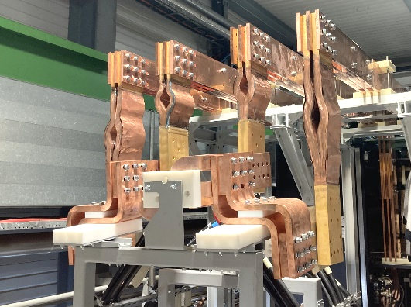
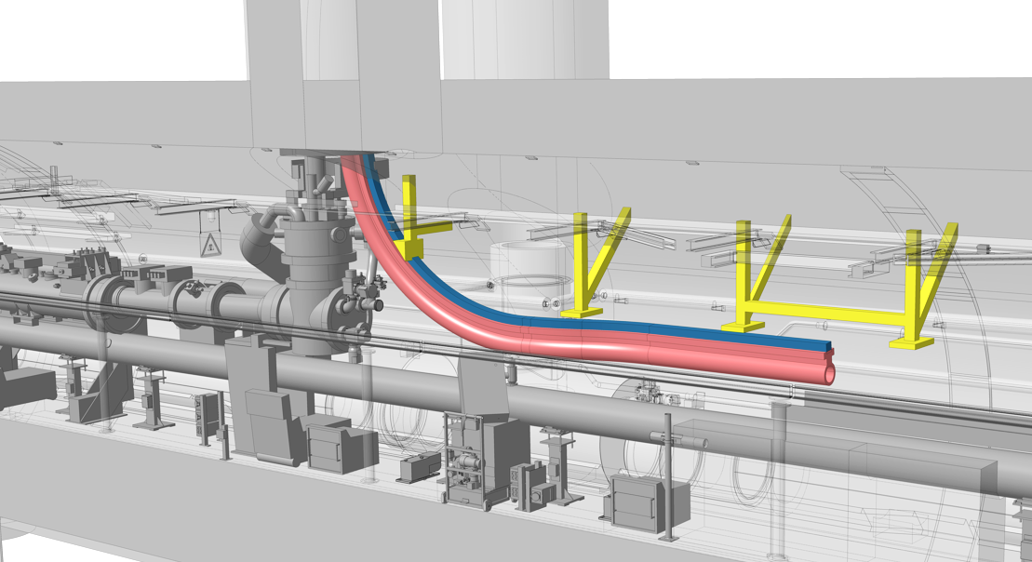
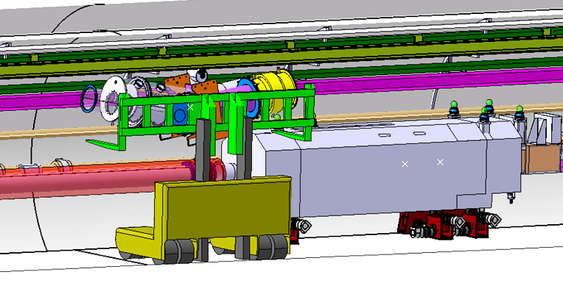
B. Supports & tooling installation : until Q2-2028
1
2
3
2
1. & 2. UR & UL – service galleries
    Supporting trays :
      UR : installation by WP6b sub-contractor
      UL : installation by EN-ACE (TBC)
    DFH flexible busbars installation
      EN-HE + MSC 4 x 1 week
        Sc. Staff : 1 / Tech Staff : 1 / FSU-TEMP : 2 / Quest : 1
    Insertion core tooling
      EN-HE + MSC 4 x 1 week
        Sc. Staff : 1 / Tech Staff : 1 / FSU-TEMP : 2 / Quest : 1
3. LHC tunnel
    Supports installation
      EN-ACE-COS
    Fine tooling installation (DSHM rail, QXL tray, DFM rail)
      MSC – 4 x 1 week
        Sc. Staff : 1 / Tech Staff : 2 / FSU-TEMP : 4 / Quest : 1
    DFM installation
      EN-HE + MSC 4 x week
        Sc. Staff : 1 / Tech Staff : 1 / FSU-TEMP : 2 / Quest : 1
3
TE-MSC : 16 weeks distributed from Q3-2027 to Q1-2028:
Scientific Staff : 1
Technical Staff : 1.2
Quest : 0.5
FSU/TEMP : 2.5

Slide 7
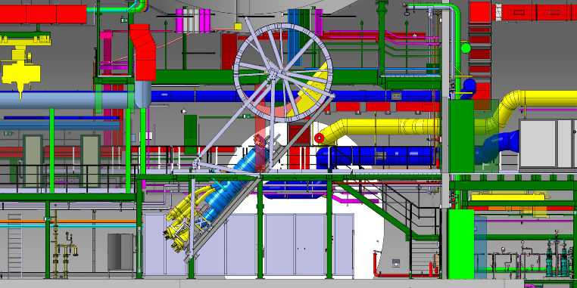
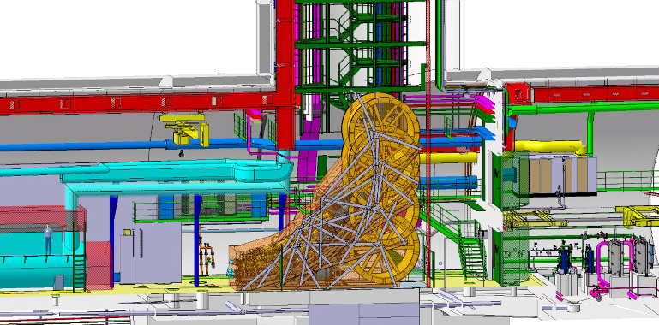
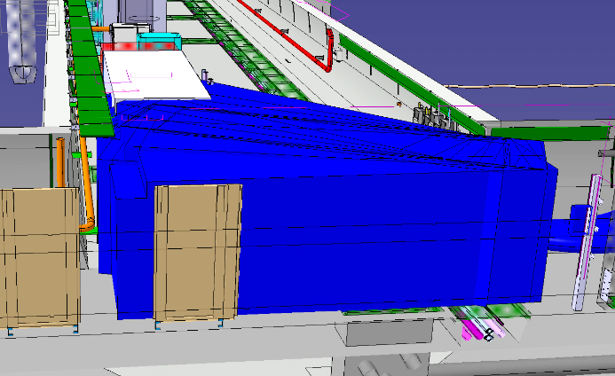
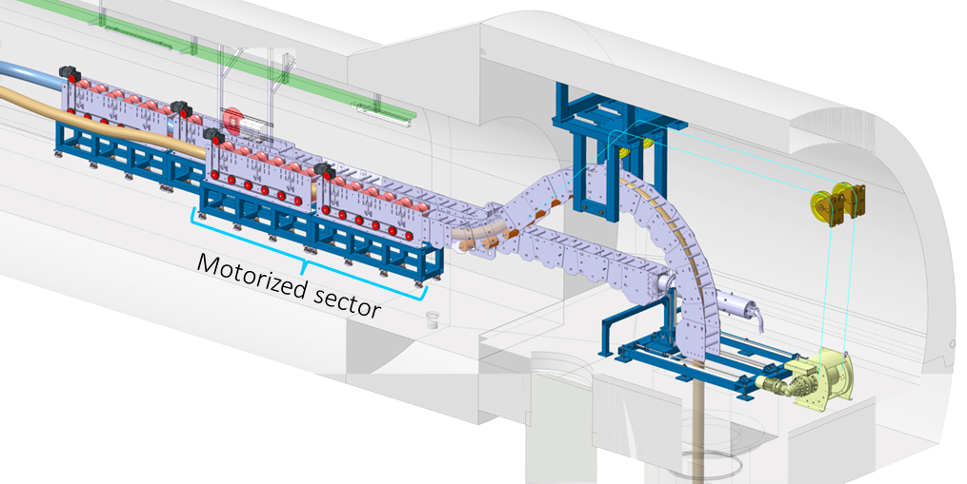
C. Lowering & Unspooling in series
1
2
1
2
2
1
2
2
1. Lowering
    Transport to point, lowering preparation – execution - release
      EN-HE + MSC – 8 x 1 weeks
        Sc. Staff : 2 / Tech Staff : 2.5 / FSU-TEMP : 2 / Quest : 1
2. Unspooling & routing
    Routing in UR
      EN-HE x5 + MSC – 8 x 1 week
        Sc. Staff : 2.5 / Tech Staff : 2 / FSU-TEMP : 3 / Quest : 1
    Insertion in cores X
      MSC – 4 x 2 weeks
        Sc. Staff : 2.5 / Tech Staff : 2 / FSU-TEMP : 3 / Quest : 1
    Routing M to D2
      EN-HE + MSC – 4 x 2 weeks
        Sc. Staff : 2.5 / Tech Staff : 2 / FSU-TEMP : 3 / Quest : 1
    Surface logistics
      MSC – 4 x 4 weeks :
        Sc. Staff : 0 / Tech Staff : 1 / FSU-TEMP : 1 / Quest : 0
    Quality control
      ElQA, TE-VSC
TE-MSC : 32 continuous weeks from Q2-2028 to Q4-2028:
Scientific Staff : 2.3
Technical Staff : 2.8
Quest : 1
FSU/TEMP : 5.5

Slide 8
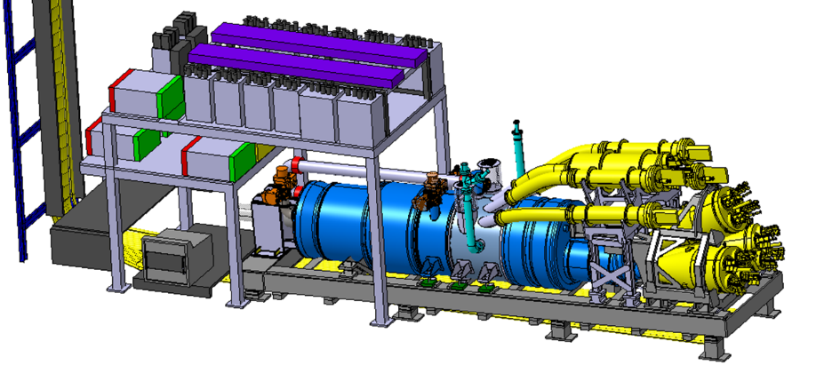
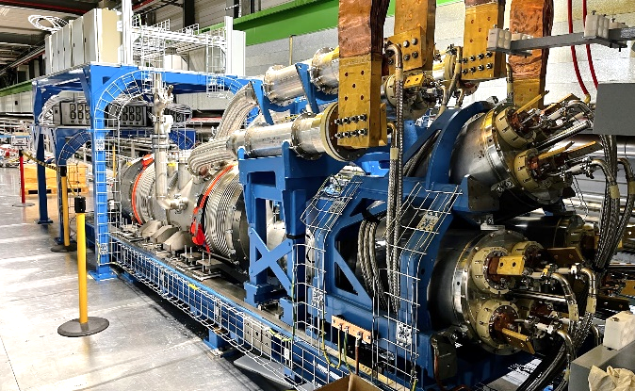
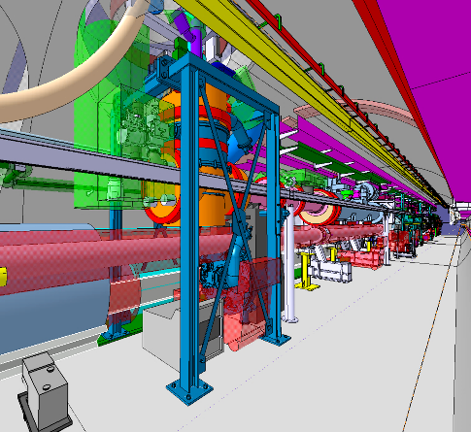
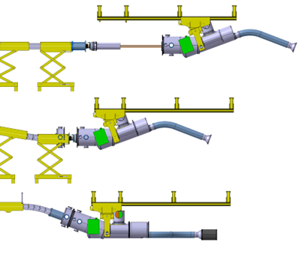
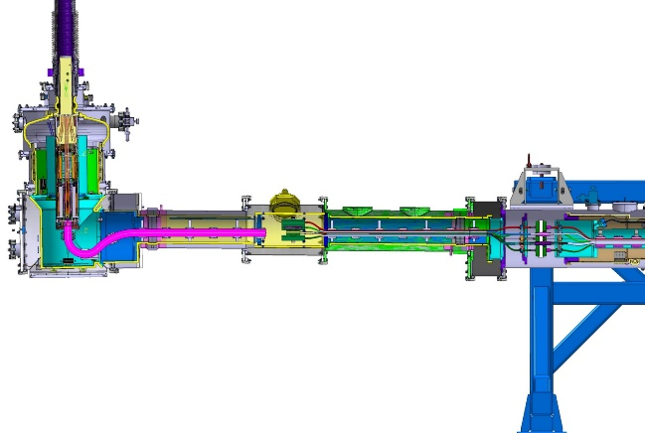
D. SCLink ends assembly & Interfaces
1
1
2
3
2
3
2
3
2
3
UR galleries
    Proximity equipment
      MSC – 4 x 5 weeks
        Sc. Staff : 0.5 / Tech Staff : 0.5 / FSU-TEMP : 1 / quest : 1
    Cryogenic, electrical interfaces
      MSC – 4 x 5 weeks
        Sc. Staff : 0.6 / Tech Staff : 0.5 / FSU-TEMP : 1 /Quest : 1
LHC Tunnel
    DFX & DFM assembly
      EN-MME + EN-HE
      MSC – 4 x 4 weeks
        Sc. Staff : 0.6 / Tech Staff : 1 / FSU-TEMP : 2 / Quest : 1
    Cryogenic transfer lines
      EN-MME + EN-HE
      MSC – 4 x 1 weeks
        Sc. Staff : 0.6 / Tech Staff : 1 / FSU-TEMP : 1 / Quest : 1
WP3-WP6a interconnect closure
      ElQA + EN-MME + TE-VSC
      MSC – 4 x 1 week
        Sc. Staff : 1 / Tech Staff : 1 / FSU-TEMP : 1 / Quest : 1
1. & 2. : TE-MSC : 25 continuous weeks from Q4 to Q1 2029.
Scientific Staff : 2.3
Technical Staff : 2.8
FSU/TEMP : 5.5
Quest : 1
3. : TE-MSC : 8 discontinuous weeks from Q1 to Q2 2029.
Scientific Staff : 1.5
Technical Staff : 2
FSU/TEMP : 4
Quest : 1

Slide 9
Summary
Resources
  Needs identified until 2029
  Needs comply with resources request presented to HL project at WP6a-PSM of February 2025.
Budget
  Material : within budget
  Personnel : request made to project during PSM WP6a
LS3 : Works & Services Supervisors
  Parallel activities ➔ several WSS
  Christian Barth, Yann Leclercq
  Florian Pasdeloup, Marc-Philippe Careil
LS3 : space
  Underground & surface base de vie / chantier / temporary storage defined and requested
Tunnel Activity
2025 |  | 2026 |  | 2027 |  | 2028 |  | 2029
Cold Powering Systems assembly & qualification
A. Surface preparation
C. Lowering & Unspooling
D. SCLink Ends assembly & interfaces
B. Tooling installation

