Slide 1
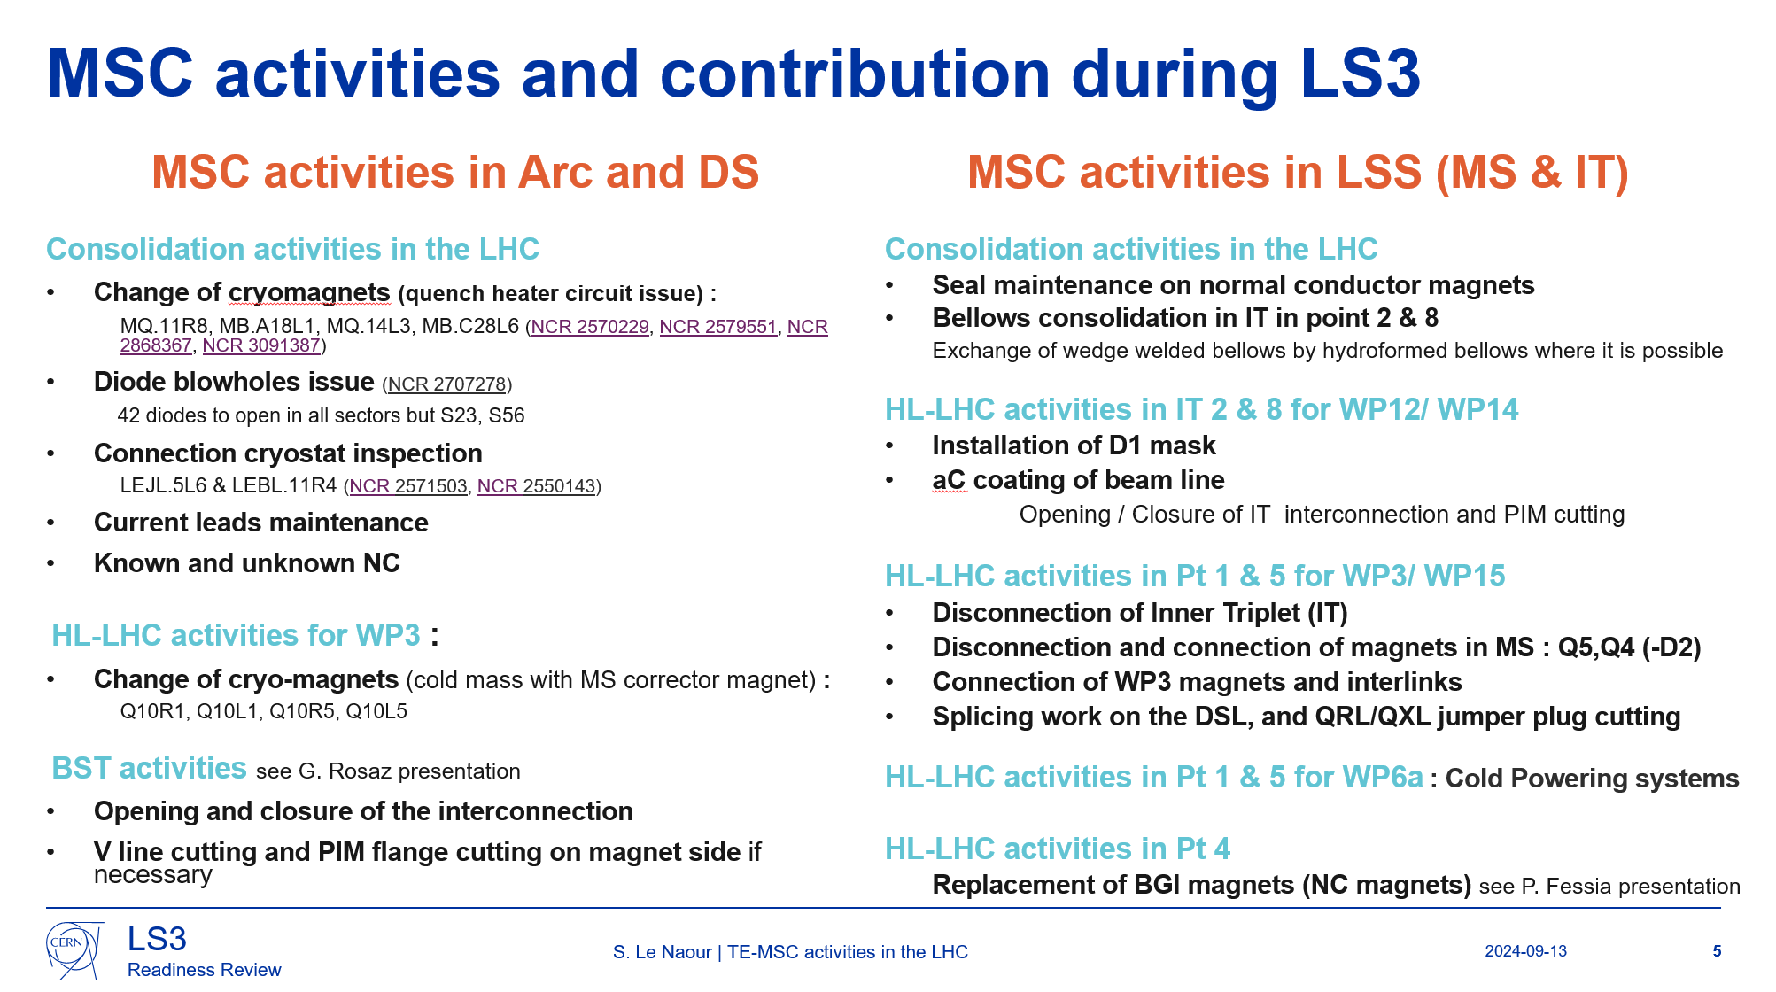
MSC activities declared in PLAN for LHC during LS3
MSC presentation at the readiness review
covered by TE LS3 Coordination
covered by MSC-HSD resources
covered by MSC-NCM resources
(Including CRG inst.)
Including D1

Slide 2
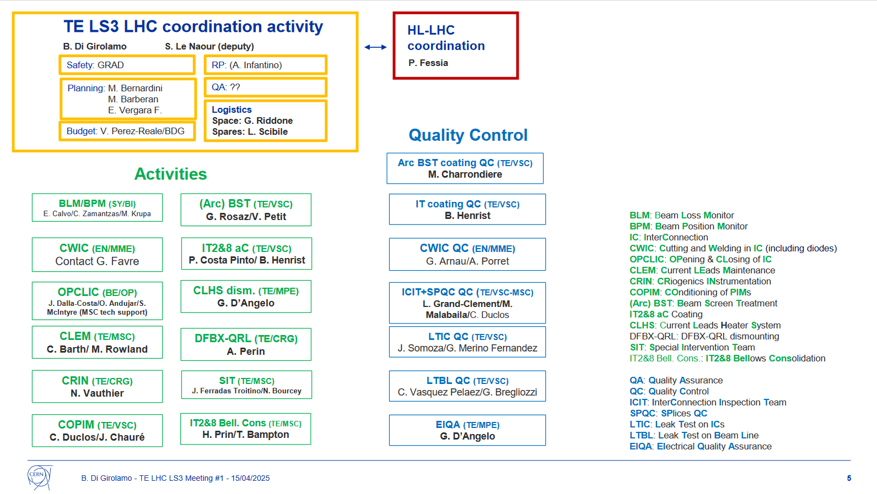
List of MSC WSS:
N. Bourcey
J. Ferradas
H. Prin
T. Bampton
L. Grand-Clement
M. Malabaila
S. McIntyre
C. Barth
To be confirmed
Triplet dism.
Magnet (TE/MSC)
H. Prin/J. Ferradas
CLHS (TE/MPE)
G. D’Angelo
DFBX-QRL (TE/CRG)
A. Perin
Suggestion

Slide 3
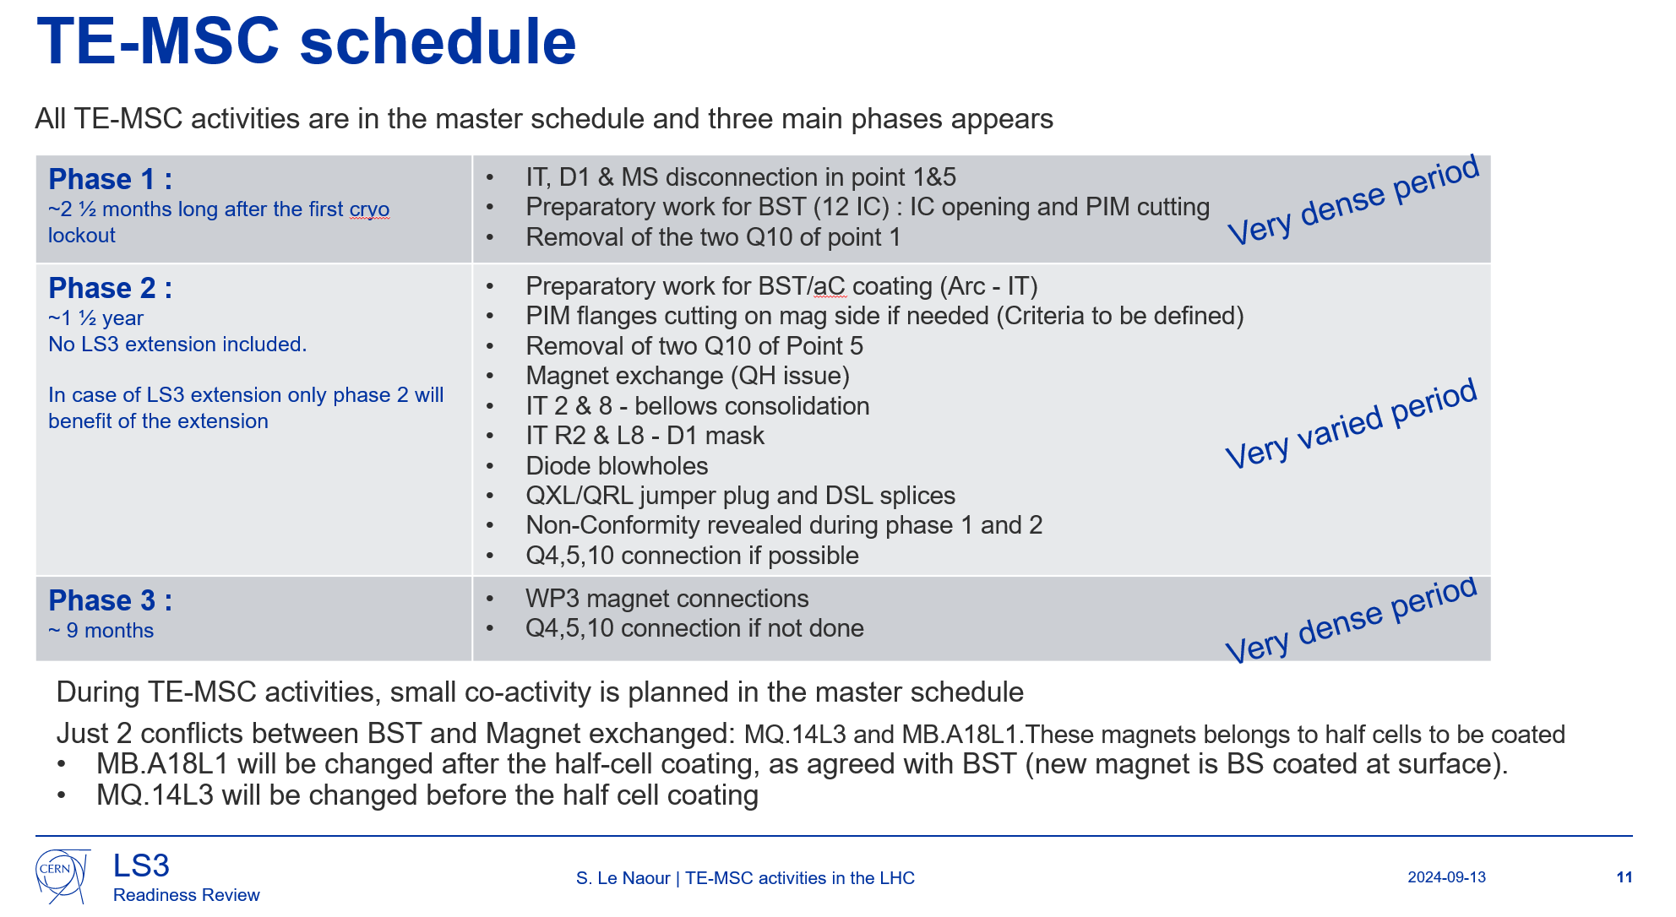
one
three

Slide 4
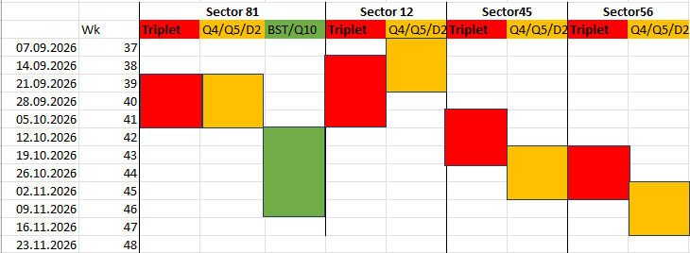

Resources : Phase 1
With CMI resources ?
OPCLIC :
  Triplet W opening (+Thermal shields) : 3x4
  Arc W opening : 38 IC
ICIT (inspection after opening, before closure)
Triplet disconnection
SIT : Q4/Q5/D2 x 4 + BST + Q10
1 Main coordinator (BE/OP)
1 Field coordinator
2 Technicians
CMI ?
With LSC+ ? resources
2 Main coordinators
2 Field coordinators
6 Mechanicians (cutting)
2 Electromechanicians
2 logistics (up to 4 if needed)
3 technicians (for triplets)
LMF*
MMM- LSC
and SMT
*LMF resources available due to the end of cold masses production (see next slide)

Slide 5
TE-MSC schedule for cold masses
2024: 3.5 Q2 (B03/B05/B06, start B07); 1.5 D2 (S2, start S1); 0.8 CP (S4) = 5.8
2025: 3.5 Q2 (finish B07, B08, B09, B10); 2.5 D2 (finish S1, S4, S3¹), 2.2 CP (finish S4, S5, S2) + 1 Q10 = 9.2
2026: 2 Q2 (B11, B12), 2 D2 (S5, S6), 1 CP (S3), 3 Q10 (S2, S3, S4) + Q1/Q3? = 8 + ?
¹Depends on D2 delivery, now scheduled for September 2025
²Depends on MCBXFA3 delivery, now scheduled for August 2025
Spares
Status 05/05/2025 for 2025 progress:
Completed: Q2-B07, D2-S1, CP-S4
Ongoing: Q2-B08/B09; D2-S4, CP-S5

Slide 6
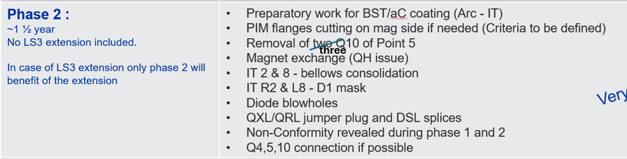
Resources : Phase 2
2027 + Q1 2028
With CMI resources ?
OPCLIC : 60% of 240 IC(arc + triplets)
  With 3 IC opening/day + 2IC closing/day ~ 4 months + 6months
ICIT (inspection after opening, before closure)
CLEM
SIT
  BST (130 IC) , if 2 IC/day (3,5 months)
  7 magnets to disconnect (2 months)
  4 magnets to reconnect (3 months)
  42 Diodes (2 months for SIT, cutting + welding by EN-MME)
IT2/8 bellows cons. (Q2-2027→ Q1-2028)
  1 quarter/side with D1 masks
SPQC
Logistics + MSC-QC
With LSC+ ? resources
With HSD resources
With LMF resources
With 4 mechanicians to coordinate
(depends on % PIM flanges to cut)
With 2 welders + 2 electromechanicians
With 2 electricians
With 2 mechanicians + 2 welders
+ 2 electromechanicians
With 2 electricians
With 2 logisticians
+ Main coordinators and Fields coordinators

Slide 7
Resources : Phase 2
Q2 & Q3 -2028
OPCLIC : remains of 240 IC(arc + triplets)
  With 3 IC opening/day + 2IC closing/day ~ 4 months + 6months
ICIT (inspection after opening, before closure)
CLEM
SIT (depends on QRL reinstallation !)
  12 magnets to reconnect (Q4, Q5, Q10)
  DSL splices + QRL plug
  QXL plug
SPQC
Logistics + MSC-QC
With CMI resources ?
With LSC+ ? resources
With HSD resources
With LMF resources
With 2 welders
+ 4 electromechanicians
With 2 electricians
With 2 logisticians
+ Main coordinators and Fields coordinators

Slide 8
Activities completion of Phases 1 and 2
Outer bellows can be closed if leak test has been performed
  Welding work on PIMs → depends on VSC strategy for beam line leak test
  Welding work on helium volume → depends on QRL maintenance in S23, 34, 67, 78 or QRL/QXL work in S81, S12, S45, S56,
Activities in S67, S78
  40 % of BST activities
  4 diodes
  Few CRG non conformities
Except in S34, 90% of diode issue (16) prevent the vacuum subsector to be closed before the helium leak test: Provoked quench in the cryomagnets?
MSC activities phase 2 highly depends on QRL re-installation and validation.
If the 4 cryomagnets are quenched without issues
No He volume reworked (except if dipole lyra issue,
or k flexibles damaged …)

Slide 9
Resources : Phase 3
Q4 2028-2029
OPCLIC : Few closure
ICIT (inspection after opening, before closure)
CLEM
SIT
IT2/8 bellows cons. (Q2-2027→ Q1-2028)
SPQC
Logistics + MSC-QC
All previous resources
+ 4 electromechanicians (From SM18, CMI?)
+ 2 Controllers (outside LMF?)

Slide 10
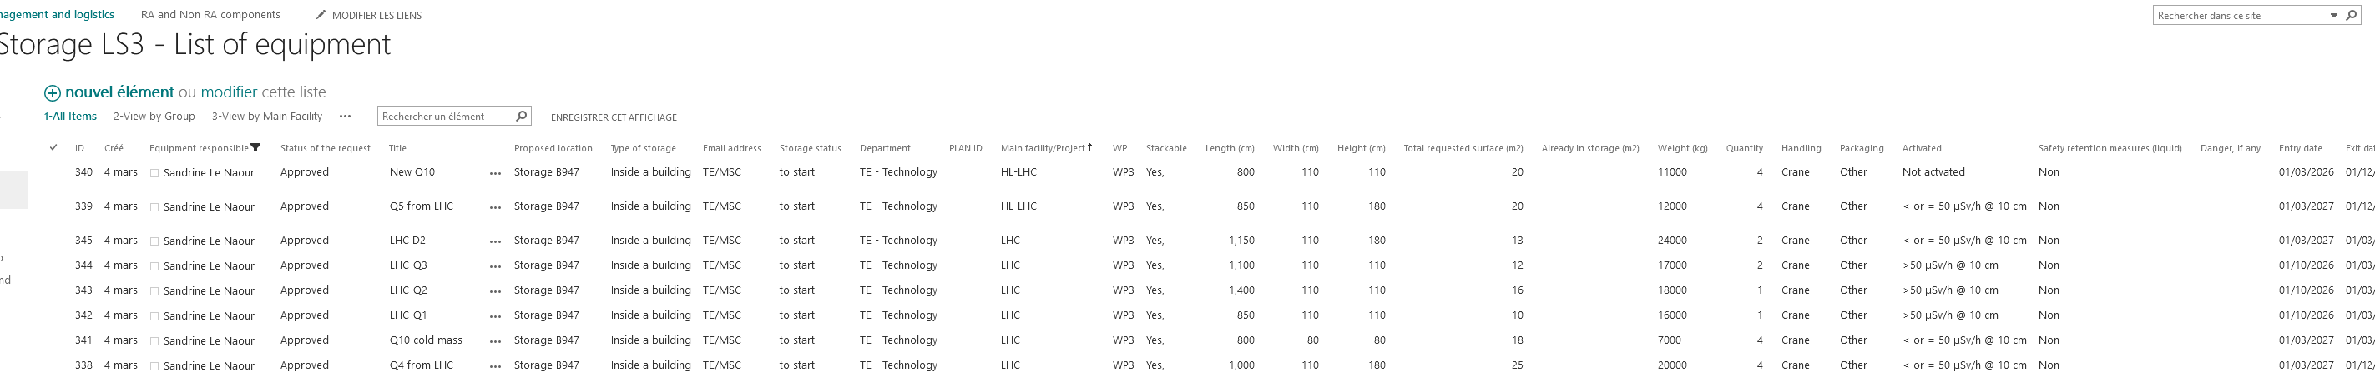
For logistics : Space declared
Radioactive waste : RWForecast2025
3xQ1, 3xQ2, 2xQ3, 2xD2
To store : Storage LS3
→ In addition of cryomagnets already stored, 1xQ1, 1xQ2, 2xQ3, 2xD2, 4xQ5, 4xQ4, 4xQ10, 4xQ10 coldmass

Slide 11
For logistics : Base de Chantier
Declared : https://cern.sharepoint.com/sites/project-space-management-LS2
  ID 113 : Bungalow in Point 5
  ID 114 : Bungalow in Point 18 (close to 3153)
  ID 167 : Bungalow in Point 2 (WP12)
  ID 167 : Bungalow in Point 8 (WP12)
MSC request
shared
VSC request

Slide 12
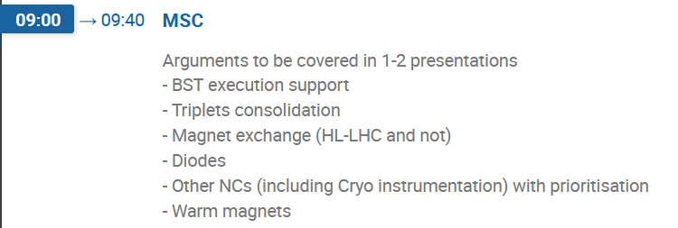
LS3 LHC TE tasks and associated resources (draft)
We got requests for clarification about what would be needed as content of the presentations for May 9th (https://indico.cern.ch/event/1533925). I want to provide you with a list of points. It may be obvious for some of you, but repeating it doesn’t hurt.
The meeting is dedicated to verifying the readiness for the LS3 operations we need to perform in terms of resources.
- there is no need of plenty of technical details, only listing what are the tasks and what support they get
- Do all tasks have the associated teams secured or in the process of being composed of staff, TEMP, FSU, PJAS? Supervisors? Contact points?
Connected to the above: Is the planning checked regularly to avoid being asked to perform too many parallel tasks? In case we are do we have enough teams?
Concerning this point, I’m preparing a central TE tool that allows for a very easy inspection of the TE-specific planning. I should be able to release it around the end of this month, when I'll be back from my leave. In this period, the planning undergoes all sorts of optimisation, and on more than one occasion, we have seen that things sometimes go too far in parallel. Actual planning has already undergone several changes wrt the Chamonix version.
- is HL budget sufficient for all tasks connected to HL? is budget in general ok?
- is the space requested appropriate?
- any waste worry?
- safety aspects?
- synergies among groups? for example for co-activities or chain of sequential activities
- other logistics-related aspects?

Slide 13
MARTINEZ HERNANDEZ Unai

