Slide 1

Modernizing Rucio Metadata for Earth Observation Intelligence
Speaker: Dimitris Xenakis
04-11-25 8th Rucio Community Workshop

Slide 2
Outline
Challenge in Earth Observation (EO) Data Discovery
DaFab AI Project & Vision
Rucio Metadata in DaFab
From Metadata to Data Discovery in DaFab
Conclusion

Slide 3

A Plethora of EO Satellites in Orbit
1. Challenge in Earth Observation (EO) Data Discovery
Today.. More than 1200 satellites
For various applications:
Land Use Mapping & Change Detection
Agriculture & Food Security
Forestry / Biomass Monitoring
Urban, Infrastructure & Facility Monitoring
Geodesy, Gravity & Earth Dynamics
Disaster Risk, Response & Recovery
Weather / Clouds / Aerosols / Radiation
Oceans (Sea Level, Waves, Biogeochemistry, ..)
Cryosphere (Ice Sheets, Glaciers, Sea Ice, ..)
…

Slide 4
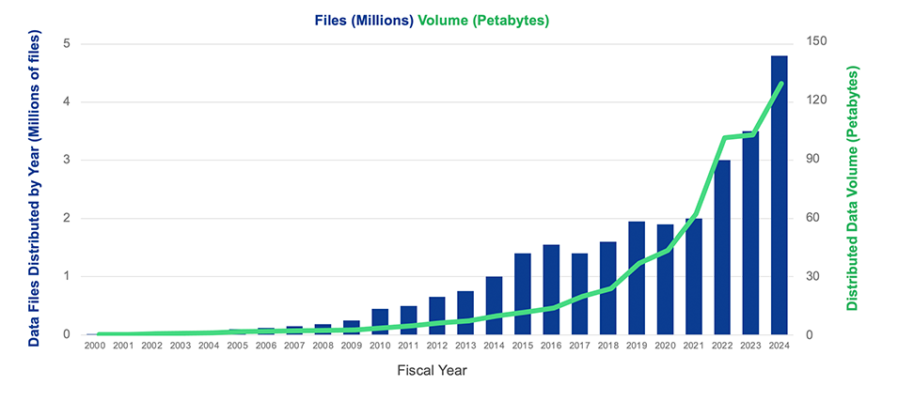
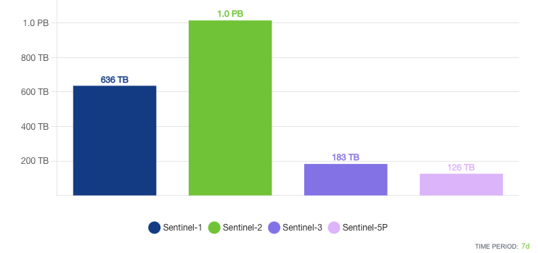
Exponential EO Data Growth
1. Challenge in Earth Observation (EO) Data Discovery
From 2 public providers alone..
NASA Earthdata (EOSDIS) :
- Archive growth: Up to 150 TB/day.
- Average distribution to users: 450 TB/day.
- Total archive: 130 PB.
Copernicus Data Space Ecosystem (CDSE): - Archive growth: Up to 30 TB/day. - Average distribution to users: 70 TB/day.
- Total archive: 95 PB.
Total Data Volume and Data Files Distributed by Year
Total Data Volume Distributed in One Month

Slide 5
Multiple EO Data Locations/Mirrors ESA/Copernicus case
1. Challenge in Earth Observation (EO) Data Discovery
[EU] CDSE (Copernicus Data Space Ecosystem):
EU‑hosted infrastructure (exposing Browser, STAC/OpenSearch/OData APIs, and S3‑compatible object storage).
[EU] EUMETSAT:
Data Store for web/API download and EUMETCast for near‑real‑time delivery
[EU] WEkEO:
Copernicus DIAS jointly operated by EUMETSAT, ECMWF, Mercator Ocean International, and the EEA.
[UK] CEDA (Centre for Environmental Data Analysis) / JASMIN:
Large archive + co‑located compute (STFC Rutherford Appleton Laboratory, Didcot).
[EU / US] AWS Open Data:
Community S2 Cloud-Optimized GeoTIFFs in us‑west‑2 with the Earth‑Search STAC API.
[EU] Microsoft Planetary Computer:
A curated STAC catalog hosted on Azure West Europe.

Slide 6
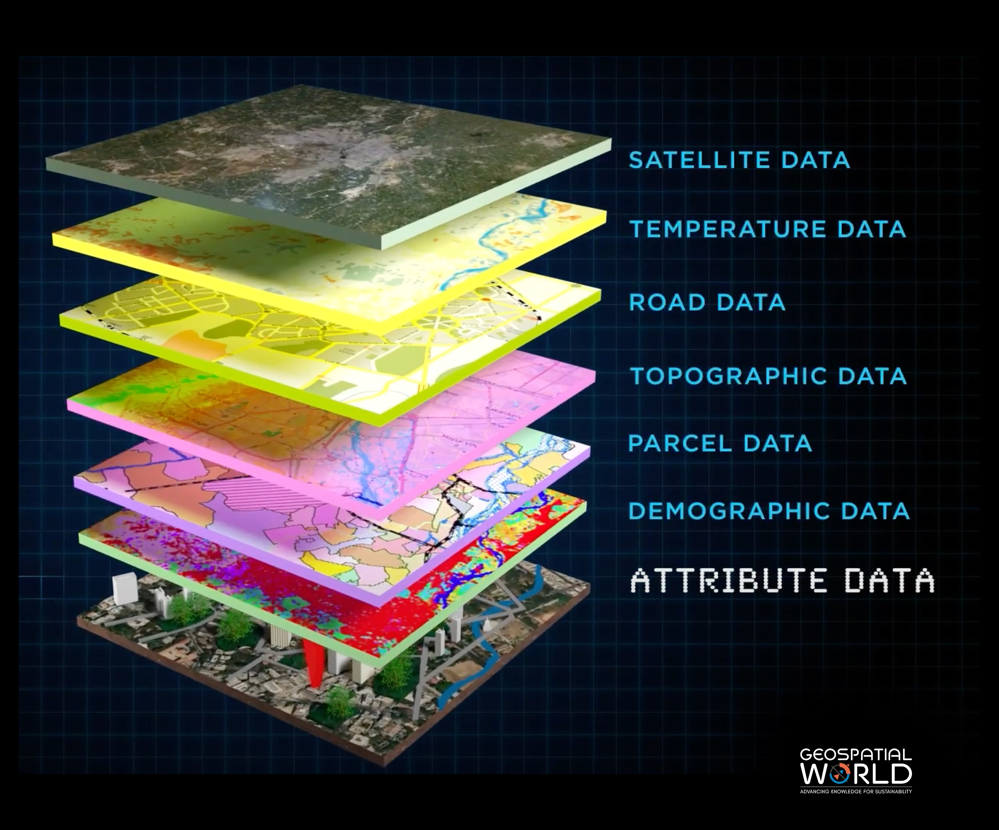
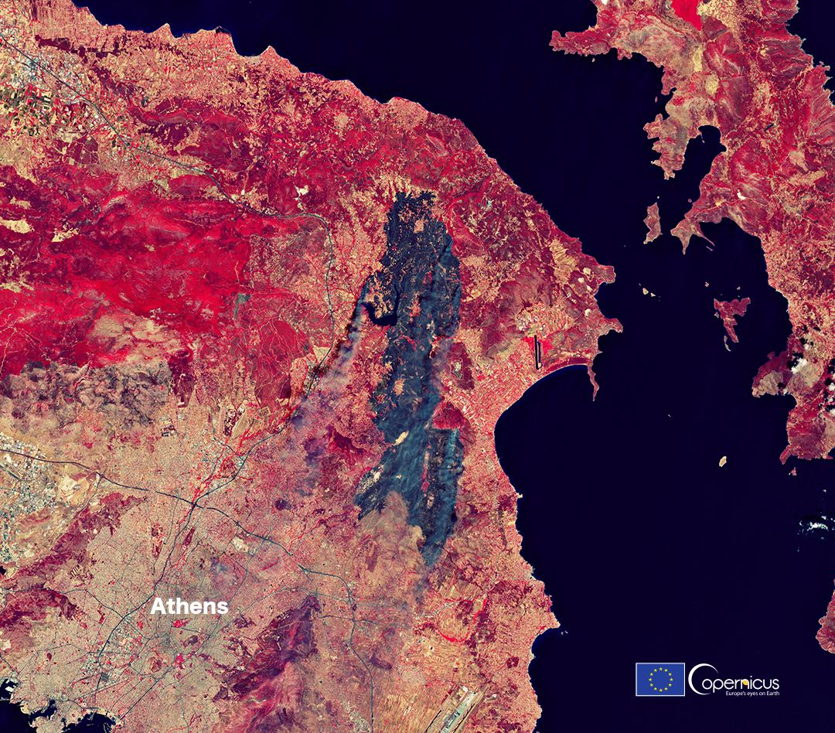
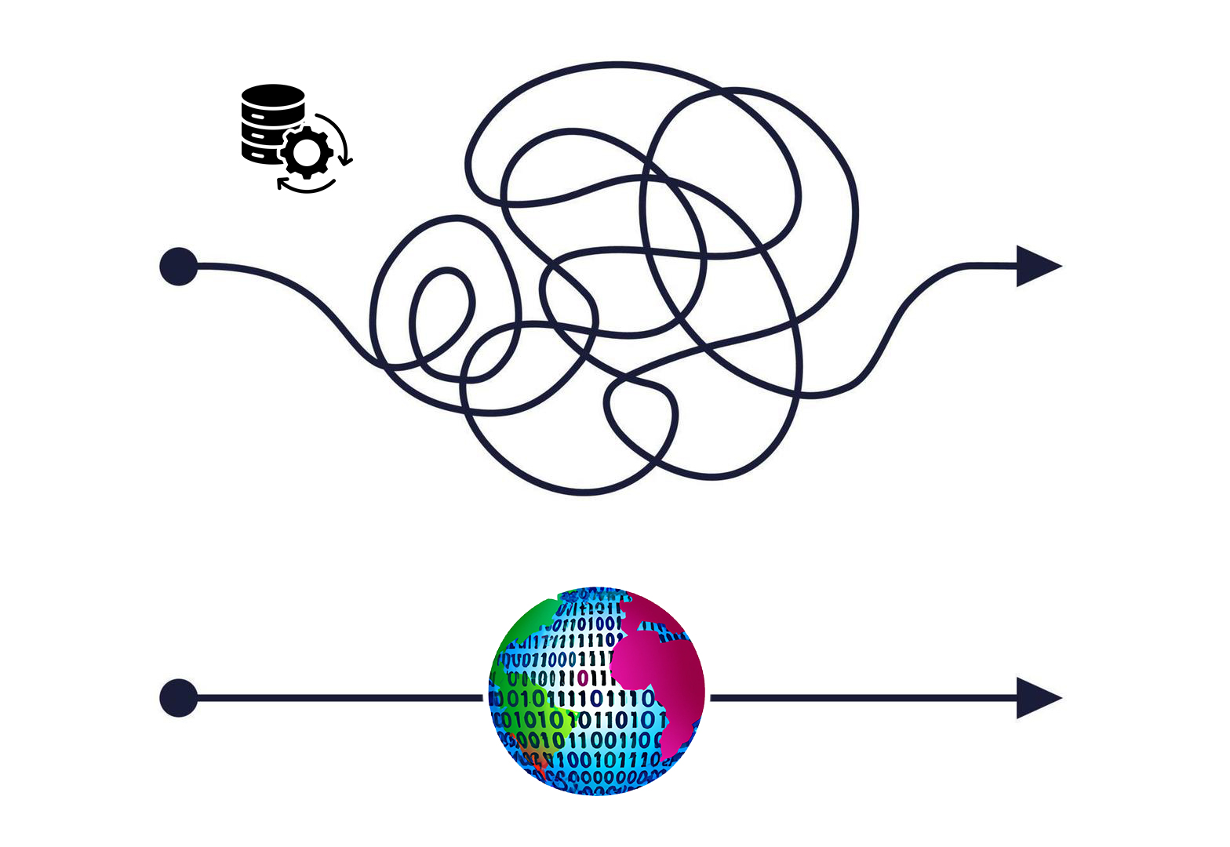
Overview of DaFab AI Facilitating the EO data exploitation
2. DaFab AI Project & Vision
Scalable and Sustainable Data / Workflow Management
Unified Access to Distributed and Heterogeneous Data Sources
Timely EO Analysis through
AI-driven Metadata Extraction

Slide 7









Overview of DaFab AI Vision
2. DaFab AI Project & Vision
Facilitate EO data exploitation
through innovative cloud services
and high-performance computing.

Slide 8

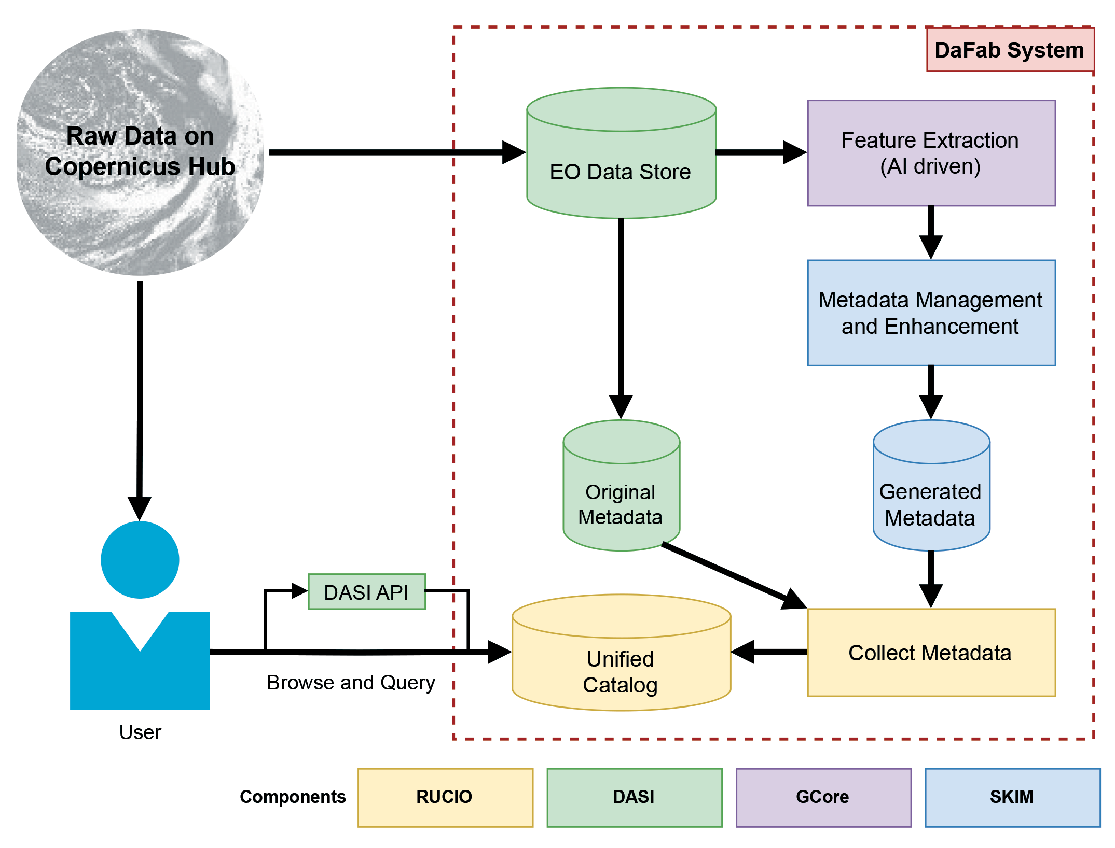

Rucio’s role in the DaFab ecosystem
3. Rucio Metadata in DaFab
A unified catalog ingesting and harmonizing the AI-derived and multi-sourced metadata, exposing interfaces so users can retrieve the consolidated, STAC-compatible data

Slide 9
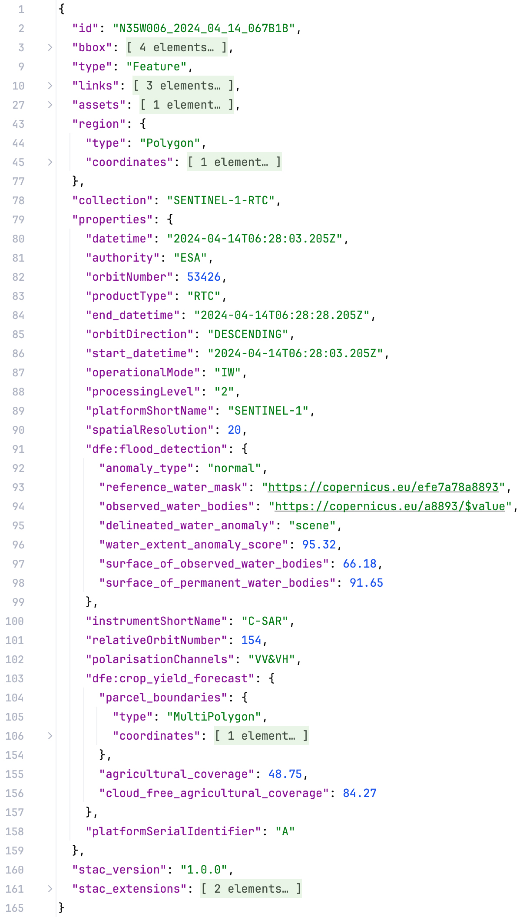
Metadata Structure in DaFab Support for complex structures needed
3. Rucio Metadata in DaFab

Slide 10
Metadata Structure in DaFab Support for complex structures needed
3. Rucio Metadata in DaFab
Management operations on the metadata of a list of DIDs (can be a single one: [DID,])
- Best-effort (partial success allowed - default) / All-or-nothing (atomic)
- Response includes which DIDs failed to satisfy the request
Get
Complete: Retrieve the entire metadata document. Partial: Provide the (path/s to the) requested key/s, retrieving only their corresponding value/s.
Insert
Assign the provided JSON value (could be a JSON object) as the value of the provided (and introduced) key-path.
Update
Assign the provided JSON value (could be a JSON object) as the value of the provided (and existing) key-path.
Delete
Complete: Delete the entire metadata document. Partial: Provide the (path/s to the) requested key/s, deleting only their corresponding value/s.
Target exists: Replace the existing value Target doesn’t exist: Fail
Target exists: Fail Target doesn’t exist: Any non-existent intermediate paths are automatically added (to satisfy the requested path)
Upsert

Slide 11
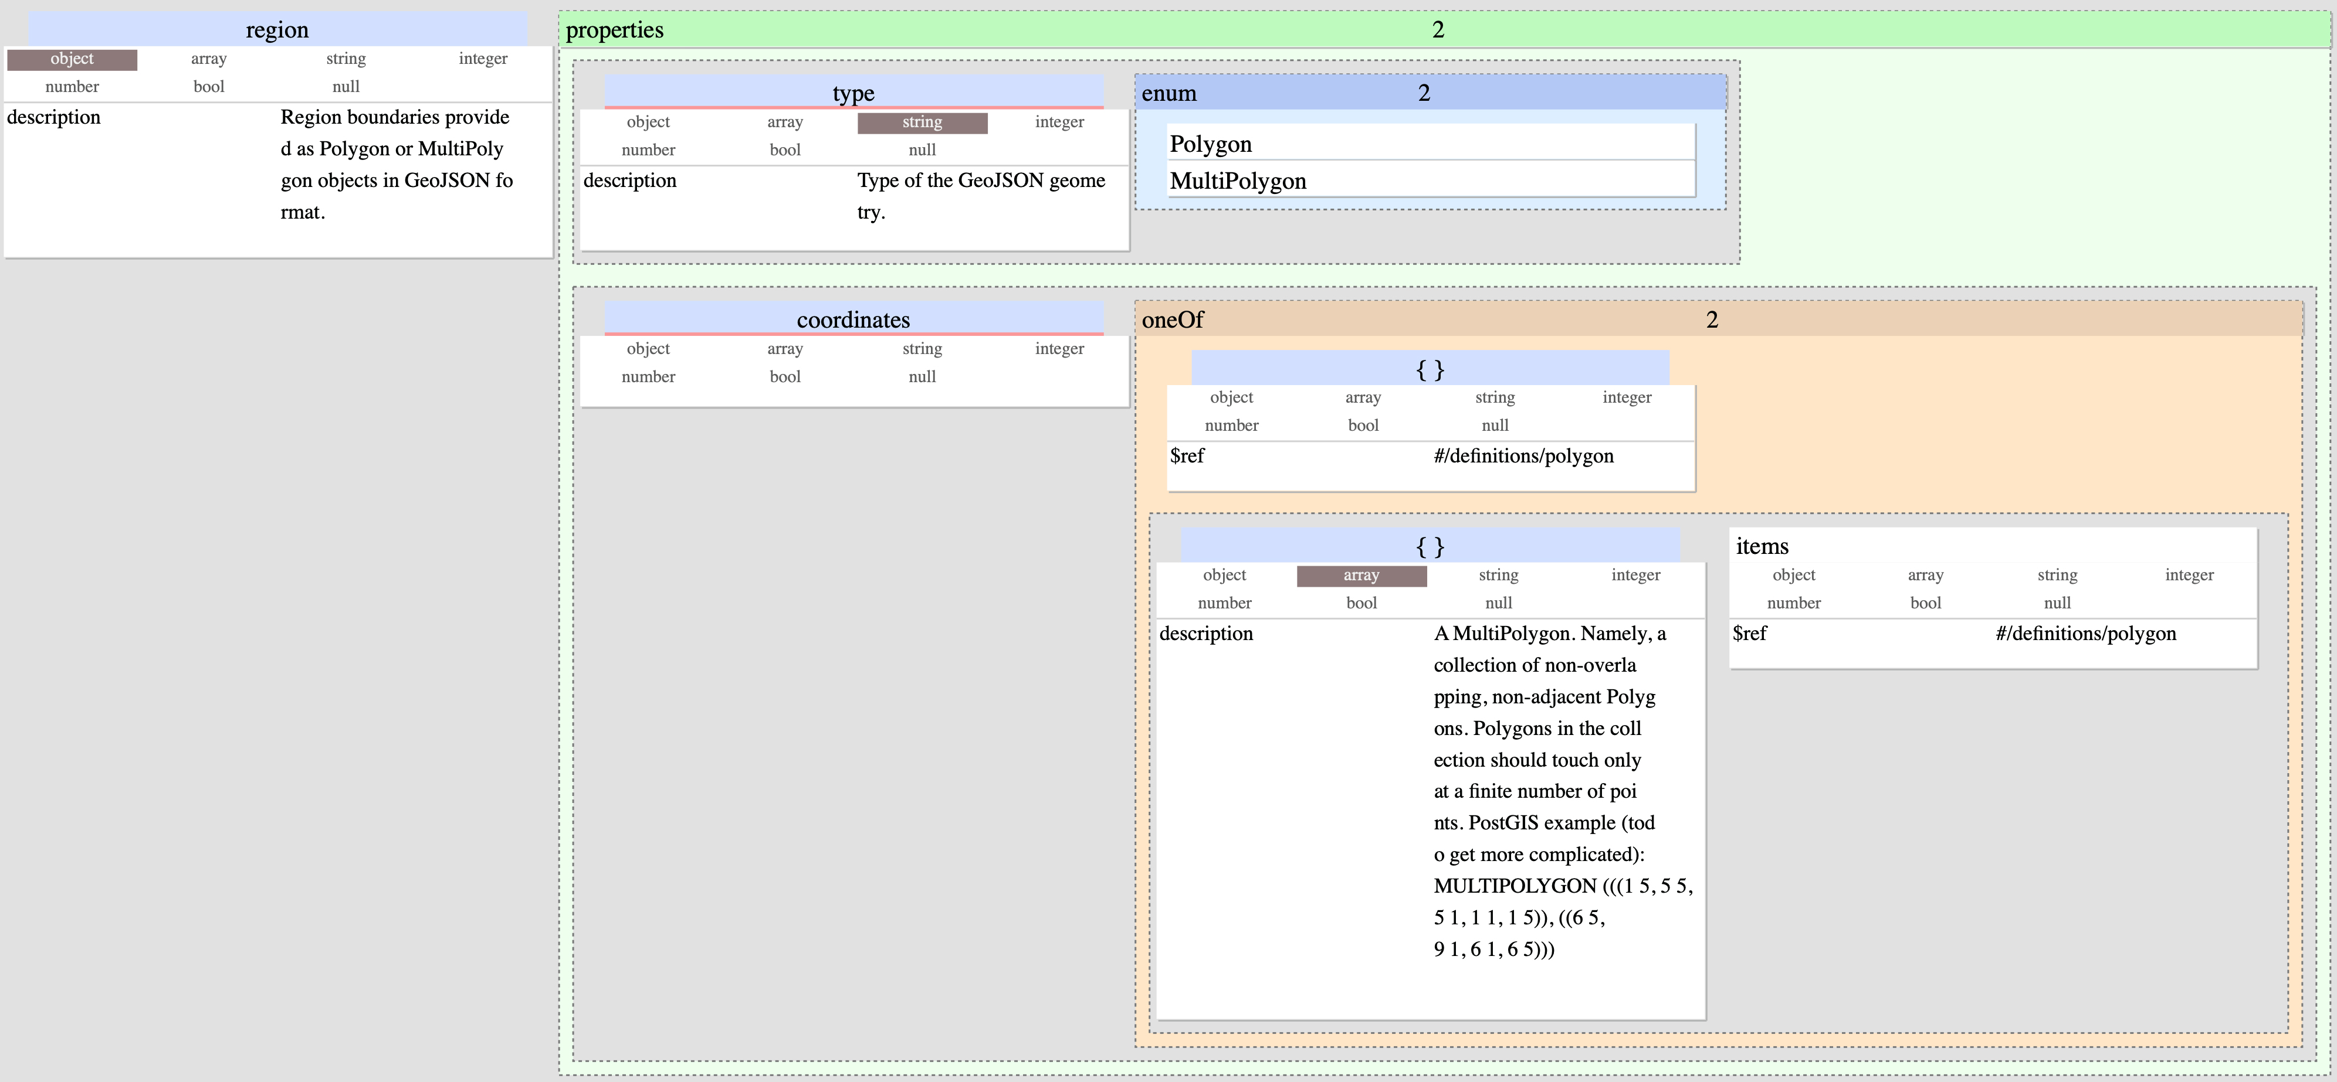
Metadata Structure in DaFab Schema needs to respect the STAC standard
3. Rucio Metadata in DaFab
Schema for the field “region”

Slide 12



4. From Metadata to Data Discovery in DaFab
Meeting DaFab’s Metadata Expectations The Good, the Bad and the Ugly
The
Good
The DaFab service is already using successfully the new metadata management.
The
Bad
No DaFab’s schema validation implemented yet at server-side. (we currently just do this at the client-side)
The
Ugly
Ok.. we can store and manage complex metadata ! So? DaFab’s goal is to offer discovery capabilities based on complex metadata!

Slide 13
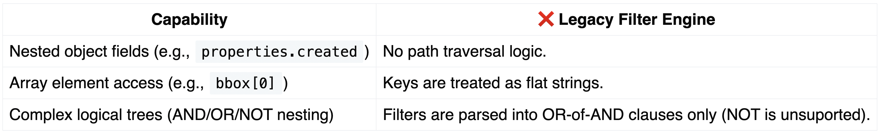
4. From Metadata to Data Discovery in DaFab
Meeting DaFab’s Metadata Expectations The filtering problem
Rucio offers some metadata-based filtering capabilities.
Fundamental problems:
A more powerful filtering engine is required.
Work in Progress: “Rucio Enhanced Filter”

Slide 14
4. From Metadata to Data Discovery in DaFab
Rucio Enhanced Filter Key Capabilities
Database-agnostic (JSON-based) syntax
Flexible Logical Operations Support for multi-layered logical conditions with the reuse of AND, OR, NOT operators.
Rich Comparison Operators Value comparisons using a wide range of operators (e.g., greaterThan, like, in, containsAny).
Array Indices & Operators Direct array filtering by specific elements or checks on array properties (e.g., contains, isEmpty).
Support for Complex Metadata Structures Enables direct, path-driven filtering of deeply structured JSON metadata.
Composable and Reusable Query Components Modular filter rules that can be reused or combined for larger, more complex queries.

Slide 15
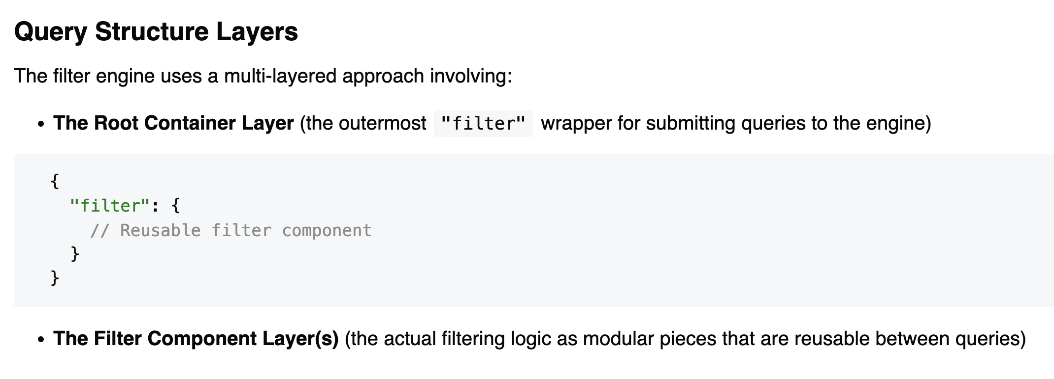
4. From Metadata to Data Discovery in DaFab
Rucio Enhanced Filter Core concepts

Slide 16
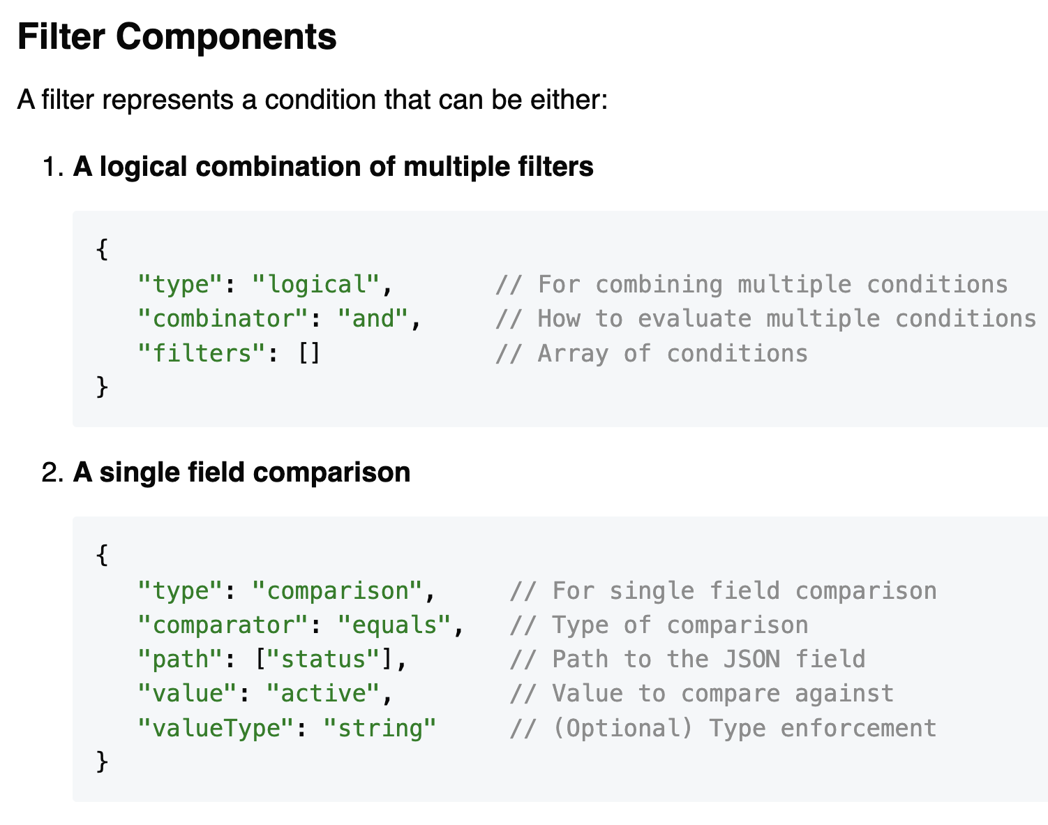
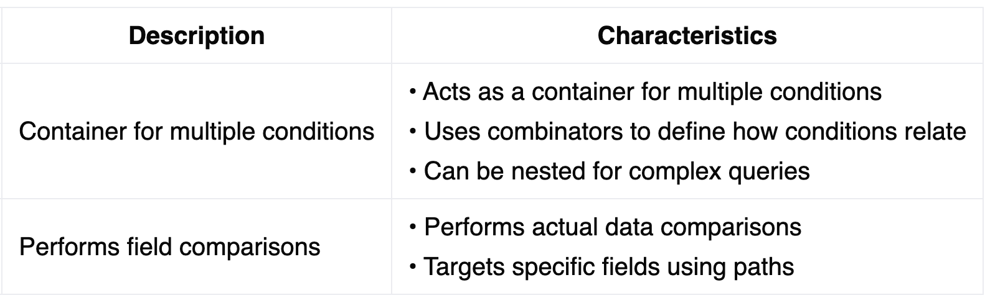
4. From Metadata to Data Discovery in DaFab
Rucio Enhanced Filter Core concepts

Slide 17
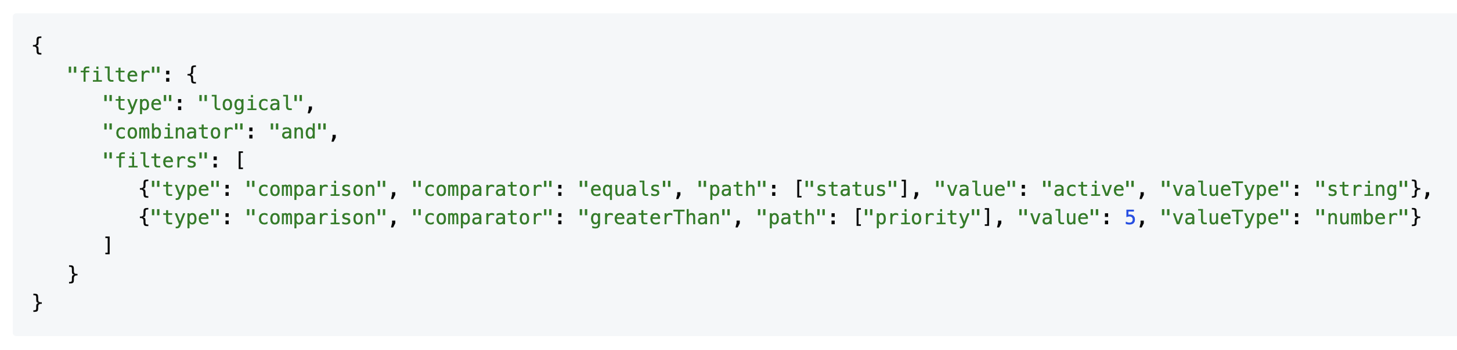
4. From Metadata to Data Discovery in DaFab
Rucio Enhanced Filter A simple example combining both components
status is active and priority is above five

Slide 18
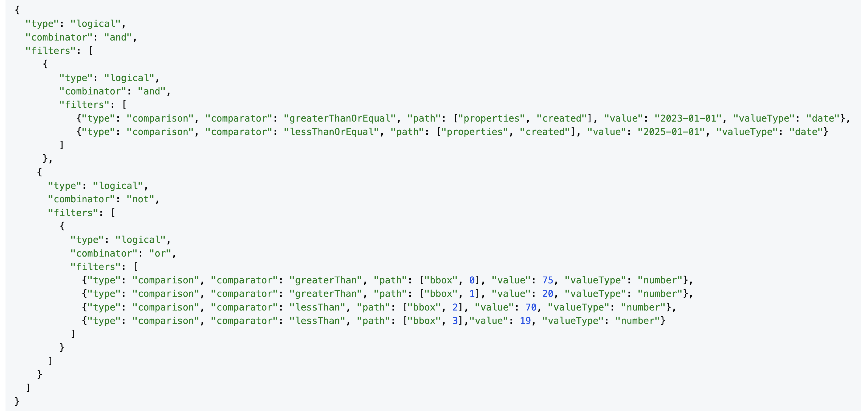
4. From Metadata to Data Discovery in DaFab
Rucio Enhanced Filter Filter in DaFab
Filter EO scenes by creation date and geographic bounds

Slide 19
5. Conclusion
Conclusion Key Takeaways
EO data is huge and scattered, making discovery hard.
DaFab‑AI unifies access and scales EO workflows with cloud + HPC.
Rucio is the unified, STAC‑compatible metadata catalog for DaFab.
We already support full JSON metadata ops on DIDs (GET/INSERT/UPDATE/UPSERT/DELETE).
Next: - Ship the enhanced filter (nested paths, arrays, AND/OR/NOT).
- Add server‑side schema validation/versioning.

Slide 20
Thank you for your attention
Dimitris Xenakis: d.xenakis@cern.ch

