Slide 1

Rucio at the EST Data Centre
Current challenges and considerations

Slide 2

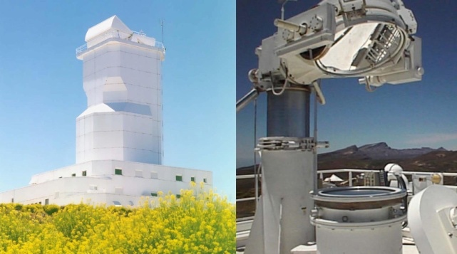
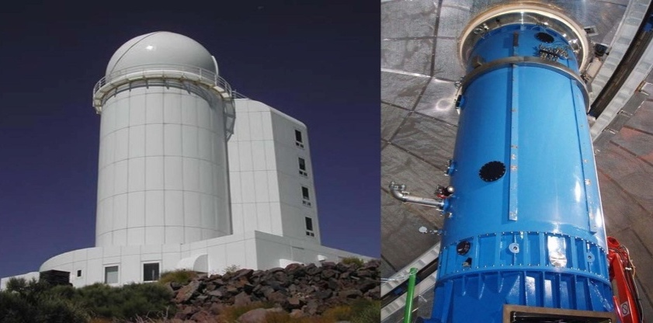
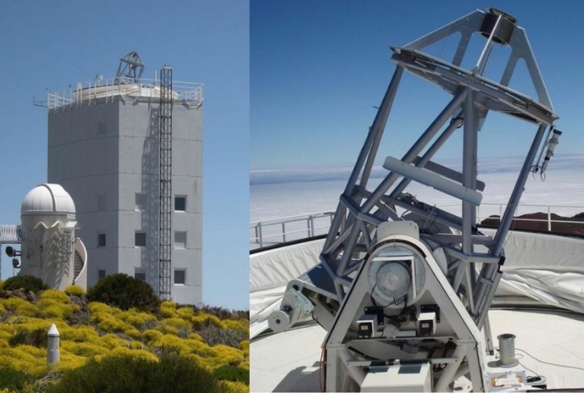
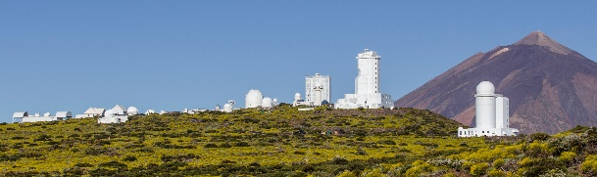
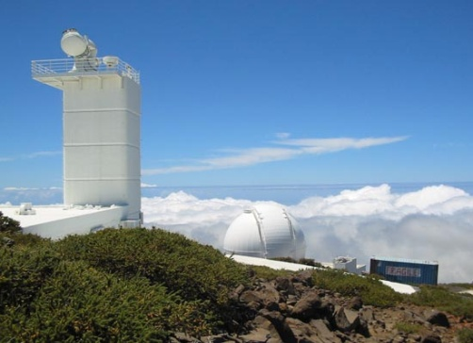
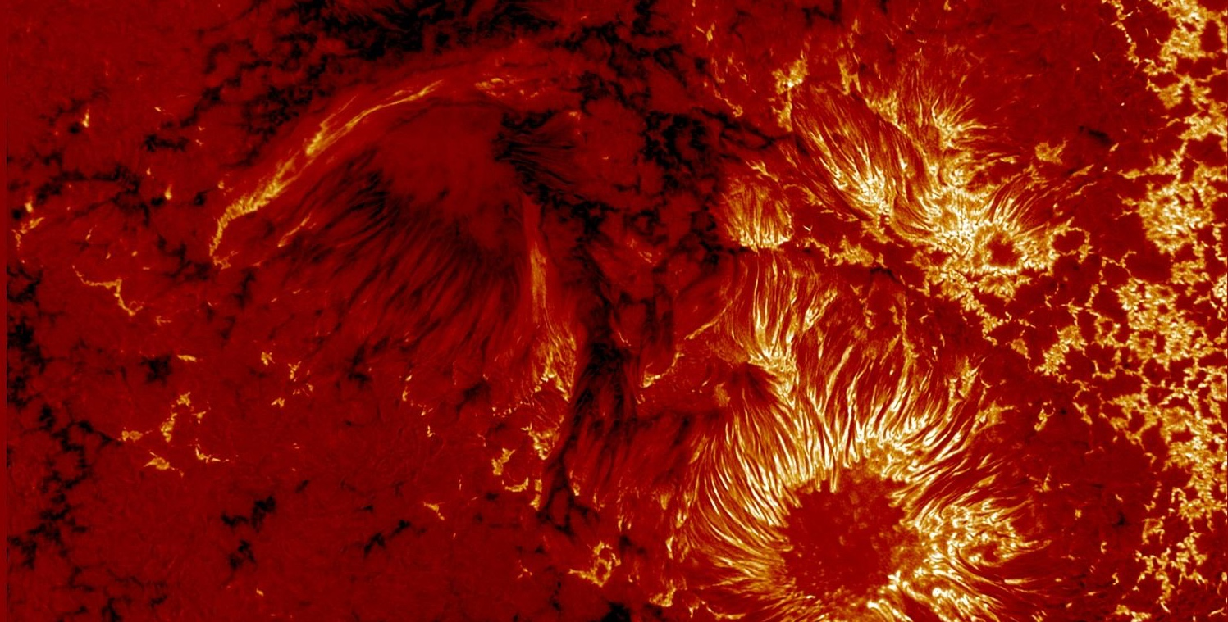
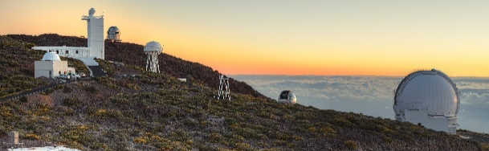
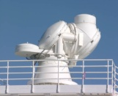
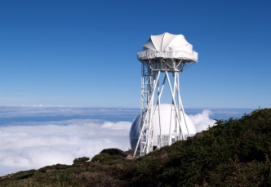
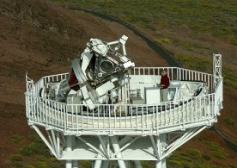
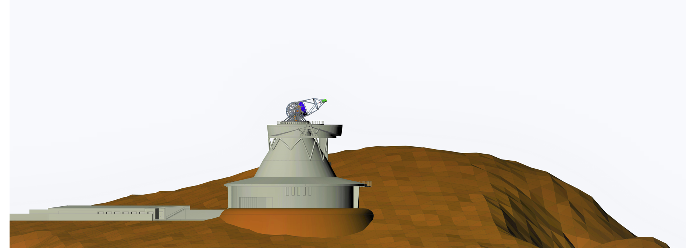
SOLAR TELESCOPE AT CANARY ISLANDS
The construction of EST will represent a key reinforcement in the development of the European Solar Research Area and the Observatories of the Canary Islands.
VTT 70 cm (Germany, 1989)
THEMIS 90 cm (France, 1996)
GREGOR 150 cm (Germany, 2012)
OT Observatorio del Teide Tenerife
ORM
Observatorio del Roque
de Los Muchachos La Palma
SST 100 cm (Sweden, 2002)
DOT 45 cm (Netherlands, 1997)
A new generation
and revolutionary
solar telescope
EST 420 cm
Astronet Roadmap 2022-2035
Notes:
The site was selected based on the excellent observation conditions, mainly during the local morning, verified along the years by the Swedish Solar Telescope.

Slide 3
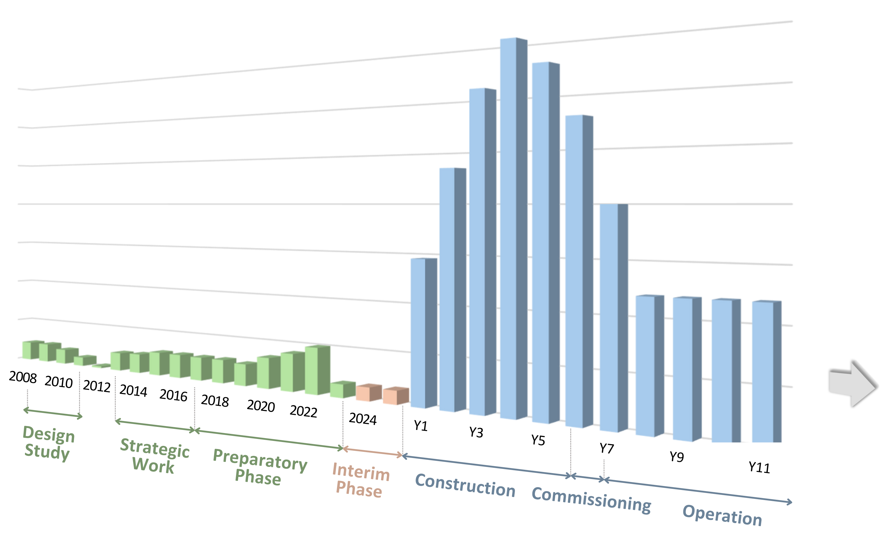
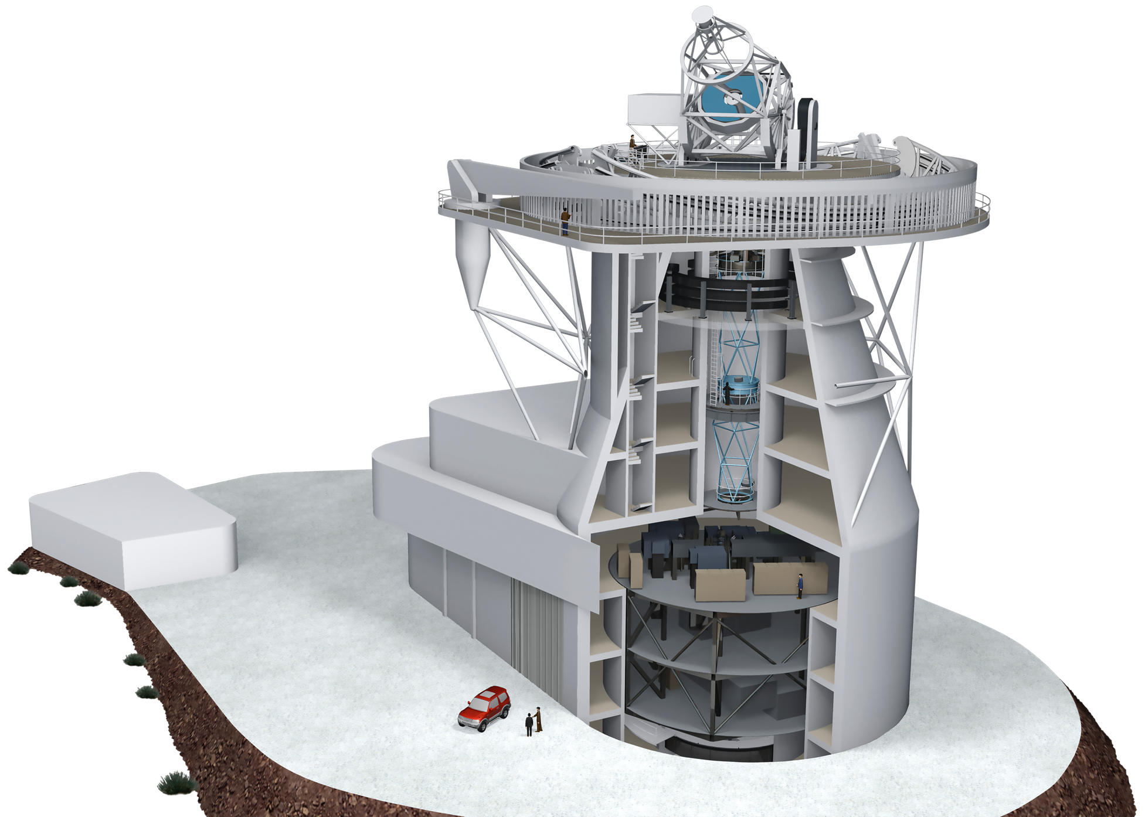
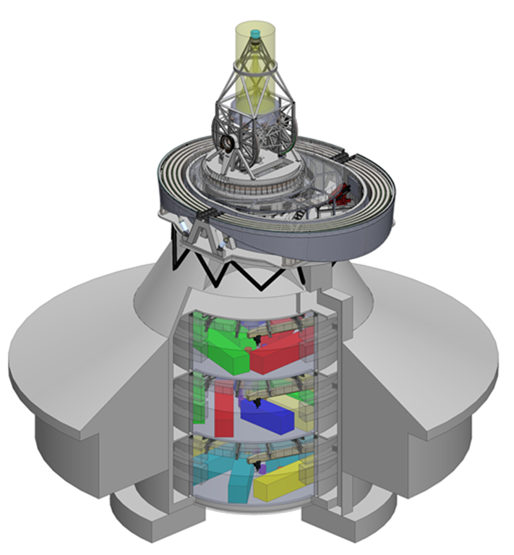
Timeline - status
Getting ready for construction
(ESFRI)
2016
Project Office
Conceptual design consolidation
Preliminary Design
Detail design specifications
PDR
Detail design and construction
APPLICATION FOR ERIC CREATION
Conceptual design

Slide 4
Challenges
Amount of data
Data Transfer
Physical
Data loss
Data management
Data access
Data embargoes
Reprocessing data

Slide 5
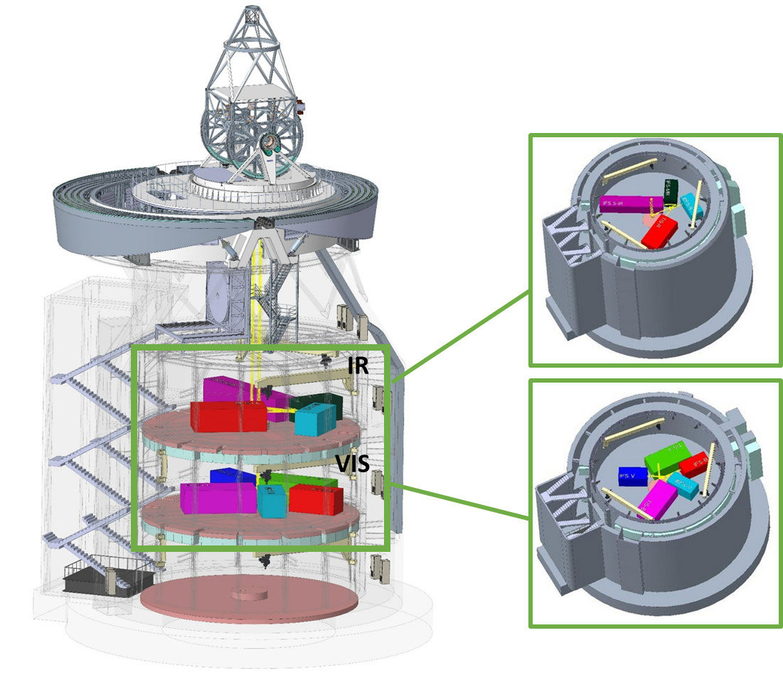
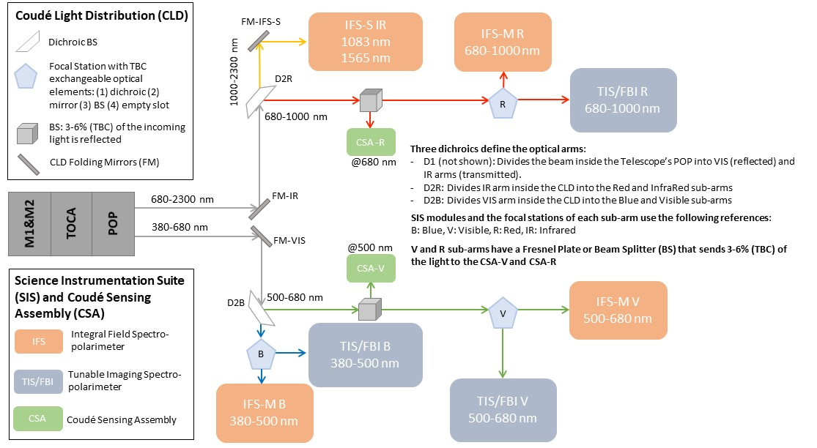
Instruments
7 Instruments which can be operated simultenously
TIS/FBIs
Blue , Visible and Red Channel
IFS-S
EMBER
IFS-M
Blue, Visible and Red Channel

Slide 6
Instrument data budget
Data Transfer
EST SIS | Data rate | LL
EMBER (1083-1565 nm) | 14 GiB/s | 6 GiB/s
IFS-M R (680-1000 nm) | 25 GiB/s | 11 GiB/s
IFS-M V (500-680 nm) | 47 GiB/s | 20 GiB/s
IFS-M B (390-500 nm) | 75 GiB/s | 33 GiB/s
TIS/FBI R (680-1000 nm) | 6 GiB/s | 3 GiB/s
TIS/FBI V (500-680 nm) | 11 GiB/s | 6 GiB/s
TIS/FBI B (390-500 nm) | 18 GiB/s | 9 GiB/s
∑ | 196 GiB/s | 88 GiB/s
Data Volume (4h)
EST SIS | Data rate | LL
EMBER (1083-1565 nm) | 0.20 PiB/d | 0.09 PiB/d
IFS-M R (680-1000 nm) | 0.35 PiB/d | 0.15 PiB/d
IFS-M V (500-680 nm) | 0.64 PiB/d | 0.28 PiB/d
IFS-M B (390-500 nm) | 1.03 PiB/d | 0.45 PiB/d
TIS/FBI R (680-1000 nm) | 0.08 PiB/d | 0.04 PiB/d
TIS/FBI V (500-680 nm) | 0.15 PiB/d | 0.08 PiB/d
TIS/FBI B (390-500 nm) | 0.25 PiB/d | 0.12 PiB/d
∑ | 2.70 PiB/d | 1.21 PiB/d
LL = Loss Less Compression

Slide 7
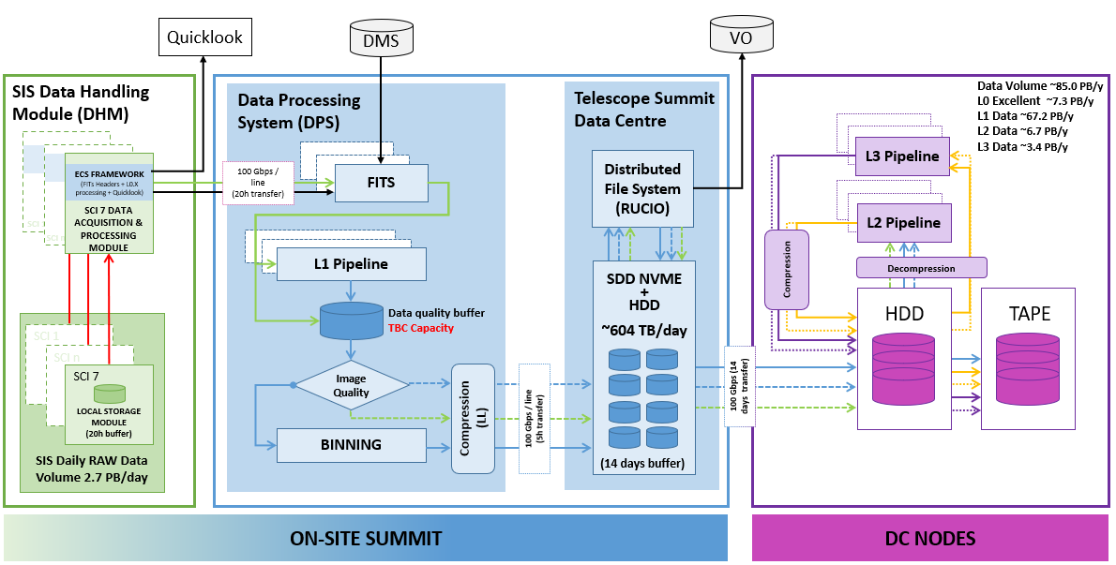
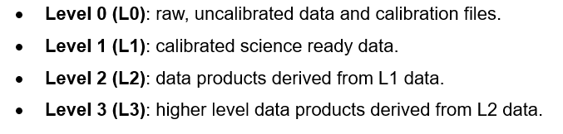
Data LeveL & FLOW
Other data streaming (Headers, Quicklook,..)
RAW
L2 Data
L0 Data
L2 Excellent Data
Excellent L0 Data
L1 Data
L3 Data
Good/Excellent L1 Data
L3 Excellent Data

Slide 8
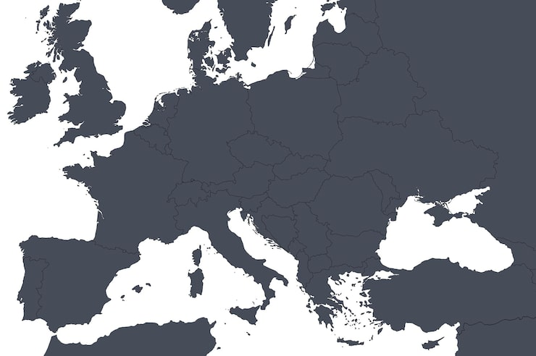
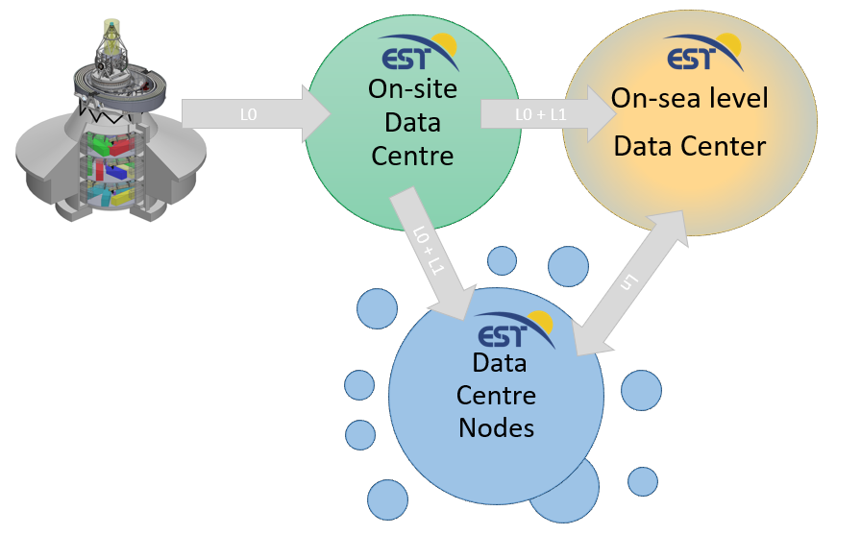
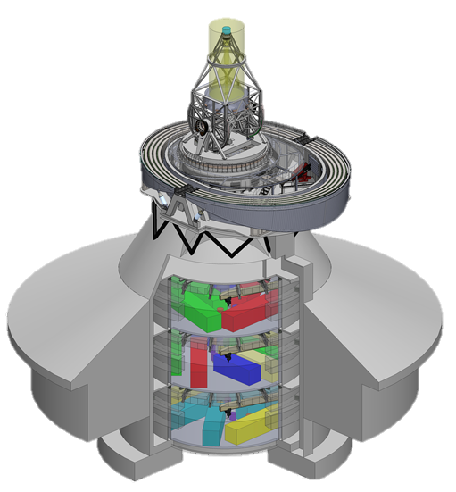
Topology
The EST Data Centre will be built on a distributed architecture, incorporating three distinct types of nodes
On-site data center is to store raw and calibrated science-ready data.
The primary node will be responsible for coordinating and transferring the scientific data to the following nodes.

Slide 9
Access – EMBARGOES - Reprocessing
Main concern is:
Embargoes:
How to control the access to the data?
Reprocessing data:
Request it.
How long is going to be available?

Slide 10
Considerations
FAIR Principles
Node draft definition
Rucio
Tokens
Embargoes
Reana
Reprocessing
Data access
Virtual Observatory
Data discovery

Slide 11
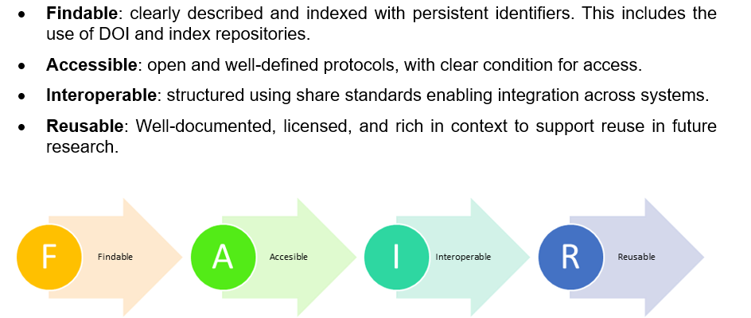
FAIR PRINCIPLES

Slide 12
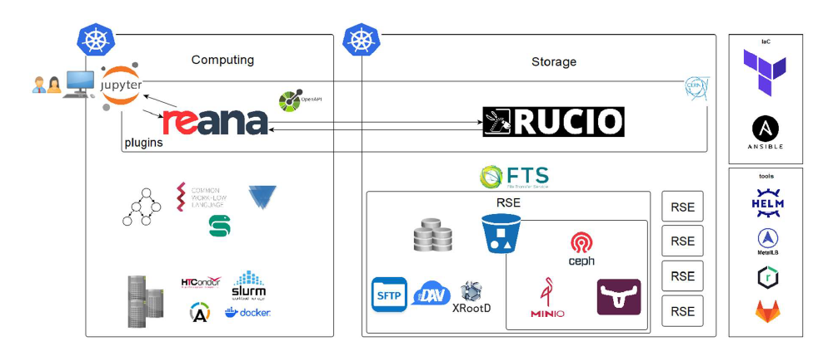
Technologies In a Node
Try to not move the data once is in its node.
Compute the data as near as possible.

Slide 13
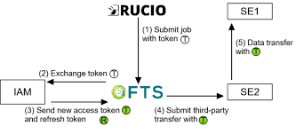

Technologies In a Node
Data Manager
Main concern is:
Embargoes.
Tokens.
Data discovery.

Slide 14
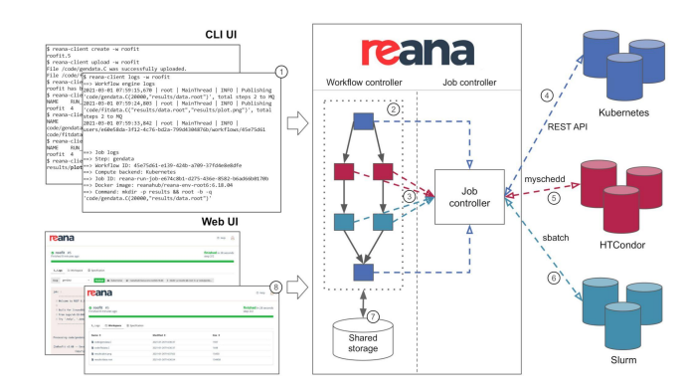
Technologies In a Node
Virtual research environment (VRE)
Main concern is:
Tokens.
Rucio access and integration.
Access :
to batch system
to distributed storage

Slide 15
Future lines
Prototype
Tokens
Find a way to implement embargoes
Integrate diverse technologies

Slide 16
Ángela Hernández Delgado
EST Software Engineer
angela.hernandez@iac.es

