Slide 1
HL-LHC Signal Cabling
Patch Panel Status
Answers received from Groups on patchable cables
G. Girardot, D. Gameiro
2025-05-09

Slide 2
Content
  Evolution of quantity
  April 2025 feedback from Groups on « patchability »
  HL Signal Cabling for patchable cables per zone
  Strategic Patch Panel Placement
  Patch panels design roadmap
  Conclusion

Slide 3
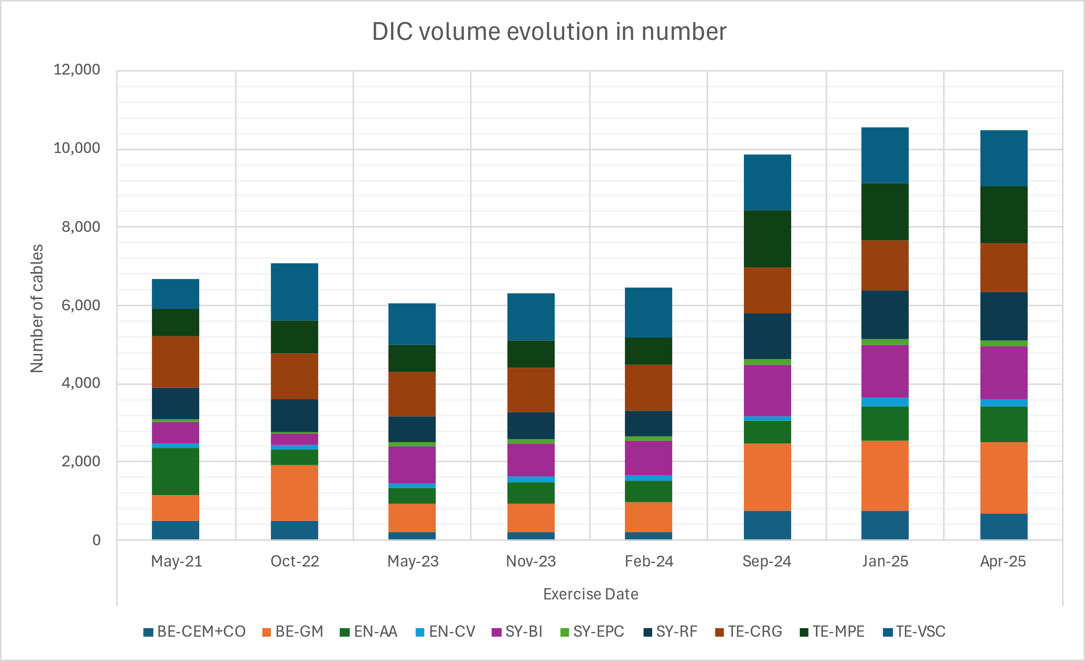
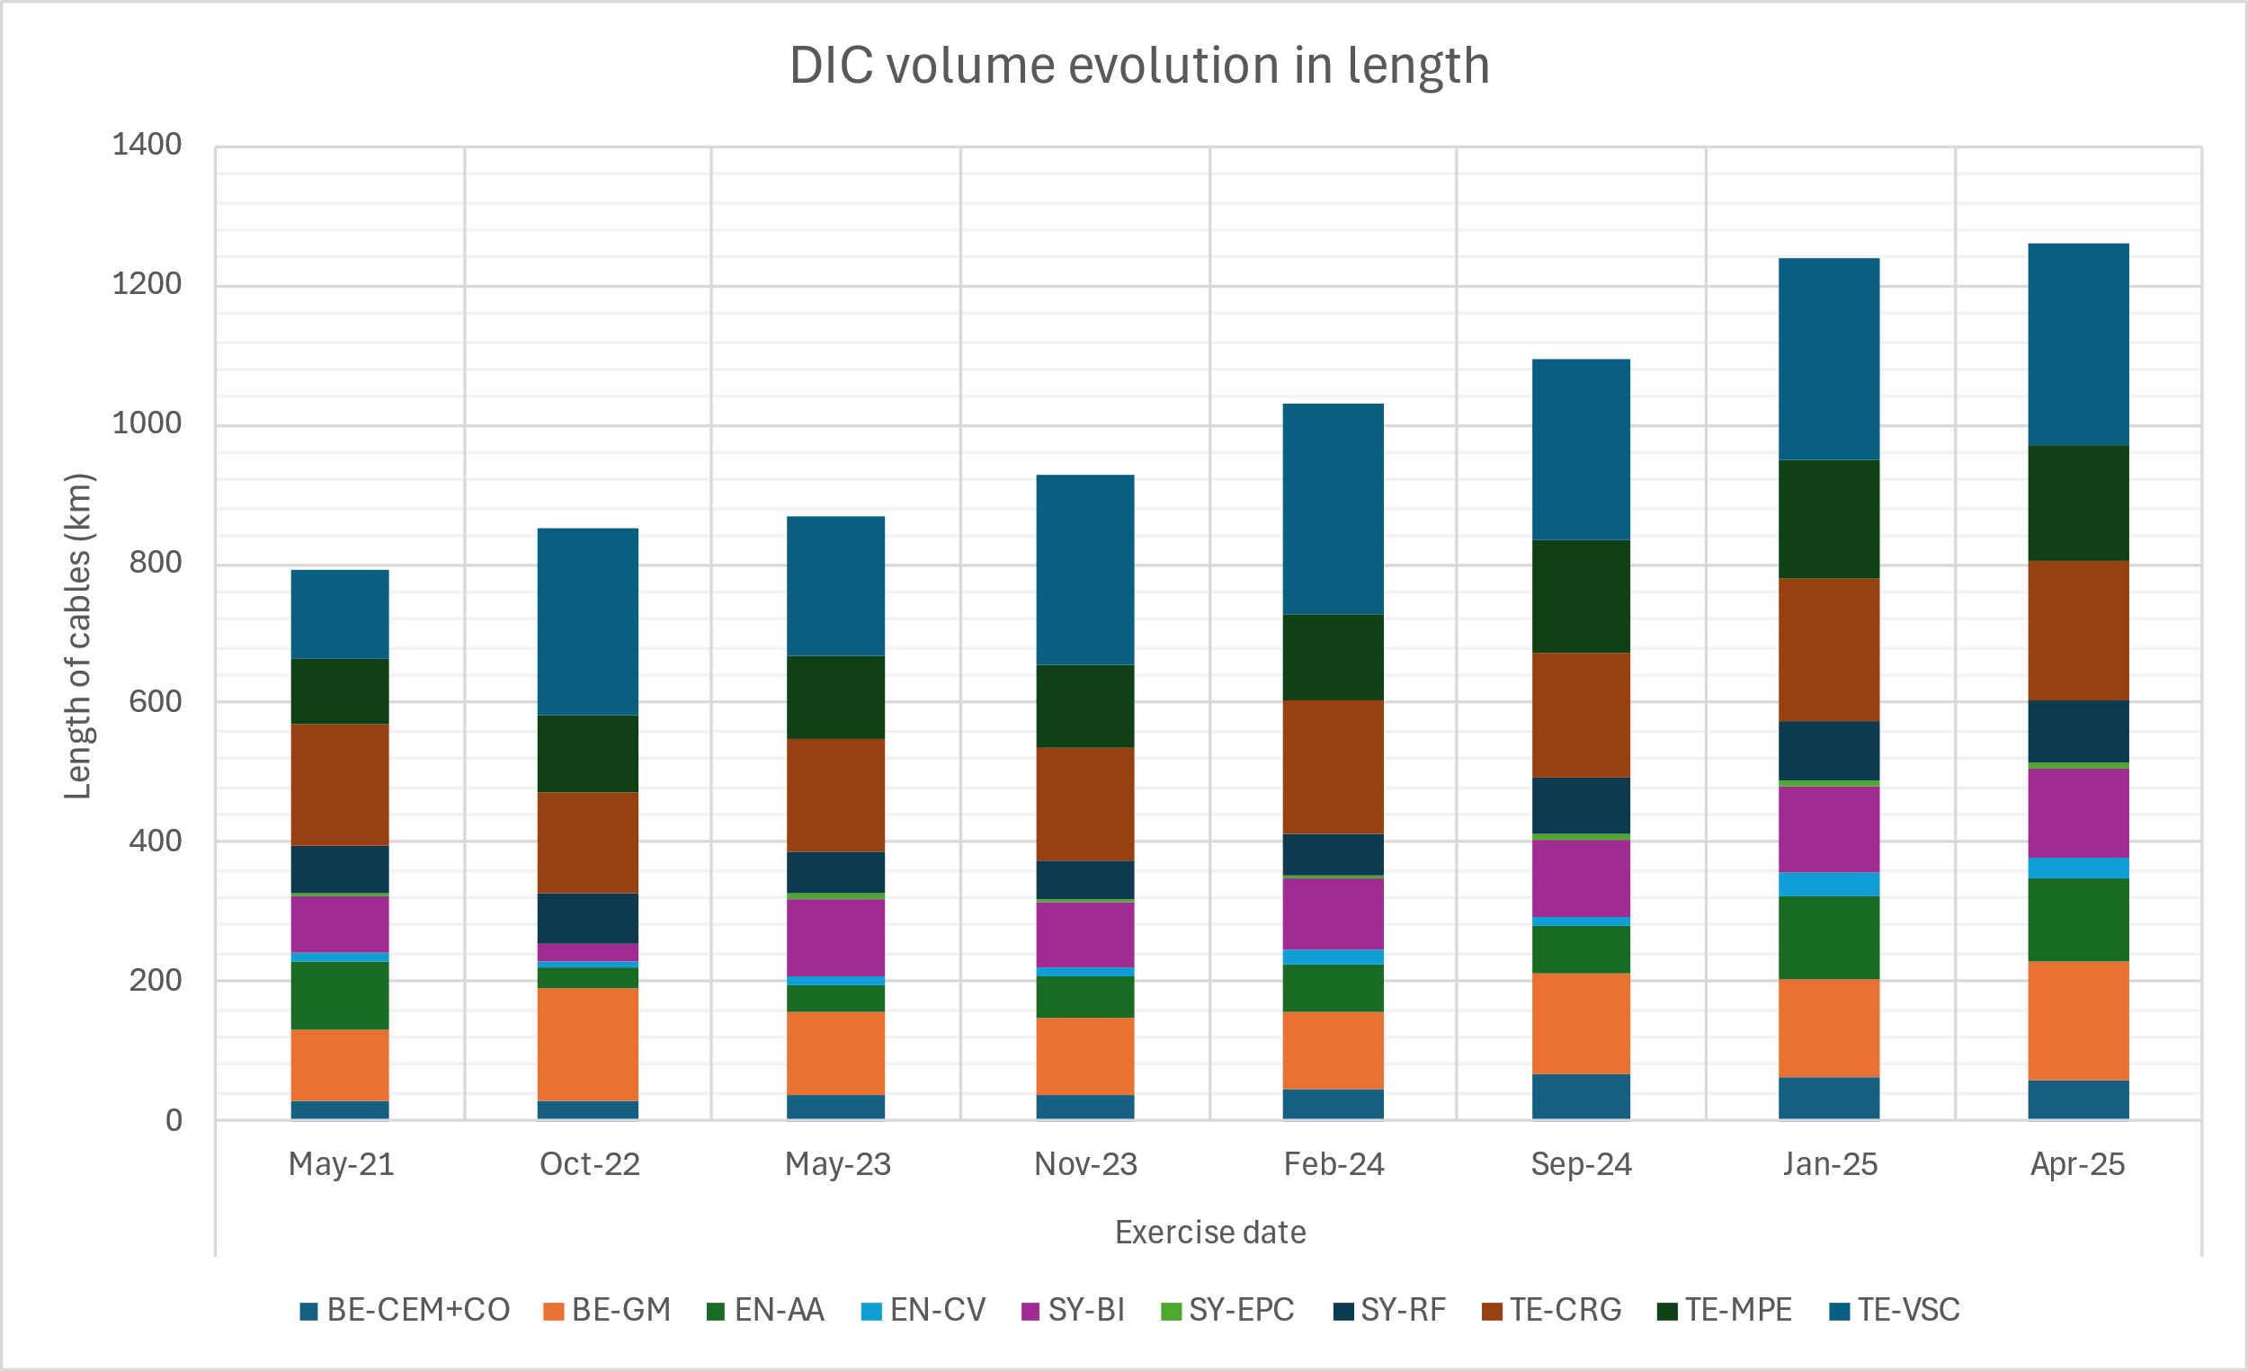
Evolution of quantity
Presented numbers are related to HL-LHC Signal Cabling and do not include PSS cabling, HL-LHC Recabling and HL-LHC DC cabling
Schedule (worst-case half-point) | RUN3 |  | LS3 |  | Total
 | Number | ≈Length (km) | Number | ≈Length (km) | Number | ≈Length (km)
Baseline nov.2022 | 2314 | 190 | 4780 | 645 | 7094 | 835
Baseline 2025 | 3492 | 295 | 7216 | 1005 | 10708 | 1300
+50%
+56%
deadline for final DIC
30/06/24
deadline for final DIC
30/06/24

Slide 4
April 2025 Feedback from Groups on “patchability”
Group | Total No. of Cables | No. of Patchable Cables
BE-CEM | 4 (0.1%) | 4
BE-GM | 576 (16.0%) | 370
EN-AA | 10 (0.3%) | 0⁽¹⁾
EP-CMT | 32 (0.9%) | 16
TE-CRG | 908 (25.3%) | 388
TE-MPE | 444 (12.3%) | 278
TE-VSC | 1066 (29.7%) | 1066
SY-BI / SY-RF | 552 (15.4%) | 0⁽¹⁾
Total | 3592 | 2122 (59%)
Groups accept to patch 59% of the proposed 3592 cables passing through the CORES
  278 cables patched for TE/MPE
    38 with resin junctions
    240 with WP07 PCB rack system
  TE/CRG requests the installation of specific 'HARTING' connectors for EMC risks for certain types of cables.
Thank you to all the participants in the patch panel studies for their remarkable efforts, which led to positive results. Your dedication and collaboration were essential in achieving these goals.
⁽¹⁾Cables disregarded for technical reasons

Slide 5
HL Signal Cabling for patchable cables per zone
 |  | Total |  | Patch Panel
 |  | No. of cables | ~Length (m) | No. of cables | ~Length (m)
 |  |  | Total |  | Total | UA/UL side | LSS side
Pass in Core | UA17 | 489 | 89280 | 236 | 55357 | 37345 | 18379
 | UL17 | 396 | 72663 | 293 | 53803 | 34318 | 19790
 | UL13 | 369 | 75613 | 259 | 54508 | 39790 | 15021
 | UA13 | 517 | 103417 | 269 | 71906 | 52570 | 19703
Pass in Core to connect in LSS | UA17 | 477 | 86162 | 236 | 55357 | 37345 | 18379
 | UL17 | 376 | 67903 | 279 | 50481 | 32730 | 18028
 | UL13 | 347 | 70140 | 245 | 50879 | 37878 | 13275
 | UA13 | 505 | 100252 | 269 | 71906 | 52570 | 19703
Pass in Core to connect outside LSS | UA17 | 12 | 3118 | 0 | 0 | 0 | 0
 | UL17 | 20 | 4760 | 14 | 3321 | 1588 | 1762
 | UL13 | 22 | 5473 | 14 | 3629 | 1911 | 1746
 | UA13 | 12 | 3165 | 0 | 0 | 0 | 0
 |  | Total |  | Patch Panel
 |  | No. of cables | ~Length (m) | No. of cables | ~Length (m)
 |  |  | Total |  | Total | UA/UL side | LSS side
Pass in Core | UA57 | 512 | 92460 | 240 | 56263 | 38090 | 18548
 | UL57 | 398 | 76673 | 292 | 56596 | 34214 | 22685
 | UL53 | 380 | 98602 | 287 | 78656 | 46950 | 31842
 | UA53 | 531 | 105601 | 246 | 67687 | 49225 | 18814
Pass in Core to connect in LSS | UA57 | 500 | 88999 | 240 | 56263 | 38090 | 18548
 | UL57 | 315 | 56078 | 218 | 37899 | 23765 | 14289
 | UL53 | 296 | 66914 | 212 | 50315 | 35681 | 14812
 | UA53 | 519 | 101879 | 246 | 67687 | 49225 | 18814
Pass in Core to connect outside LSS | UA57 | 12 | 3461 | 0 | 0 | 0 | 0
 | UL57 | 83 | 20595 | 74 | 18697 | 10449 | 8396
 | UL53 | 84 | 31688 | 75 | 28341 | 11269 | 17029
 | UA53 | 12 | 3722 | 0 | 0 | 0 | 0

Slide 6
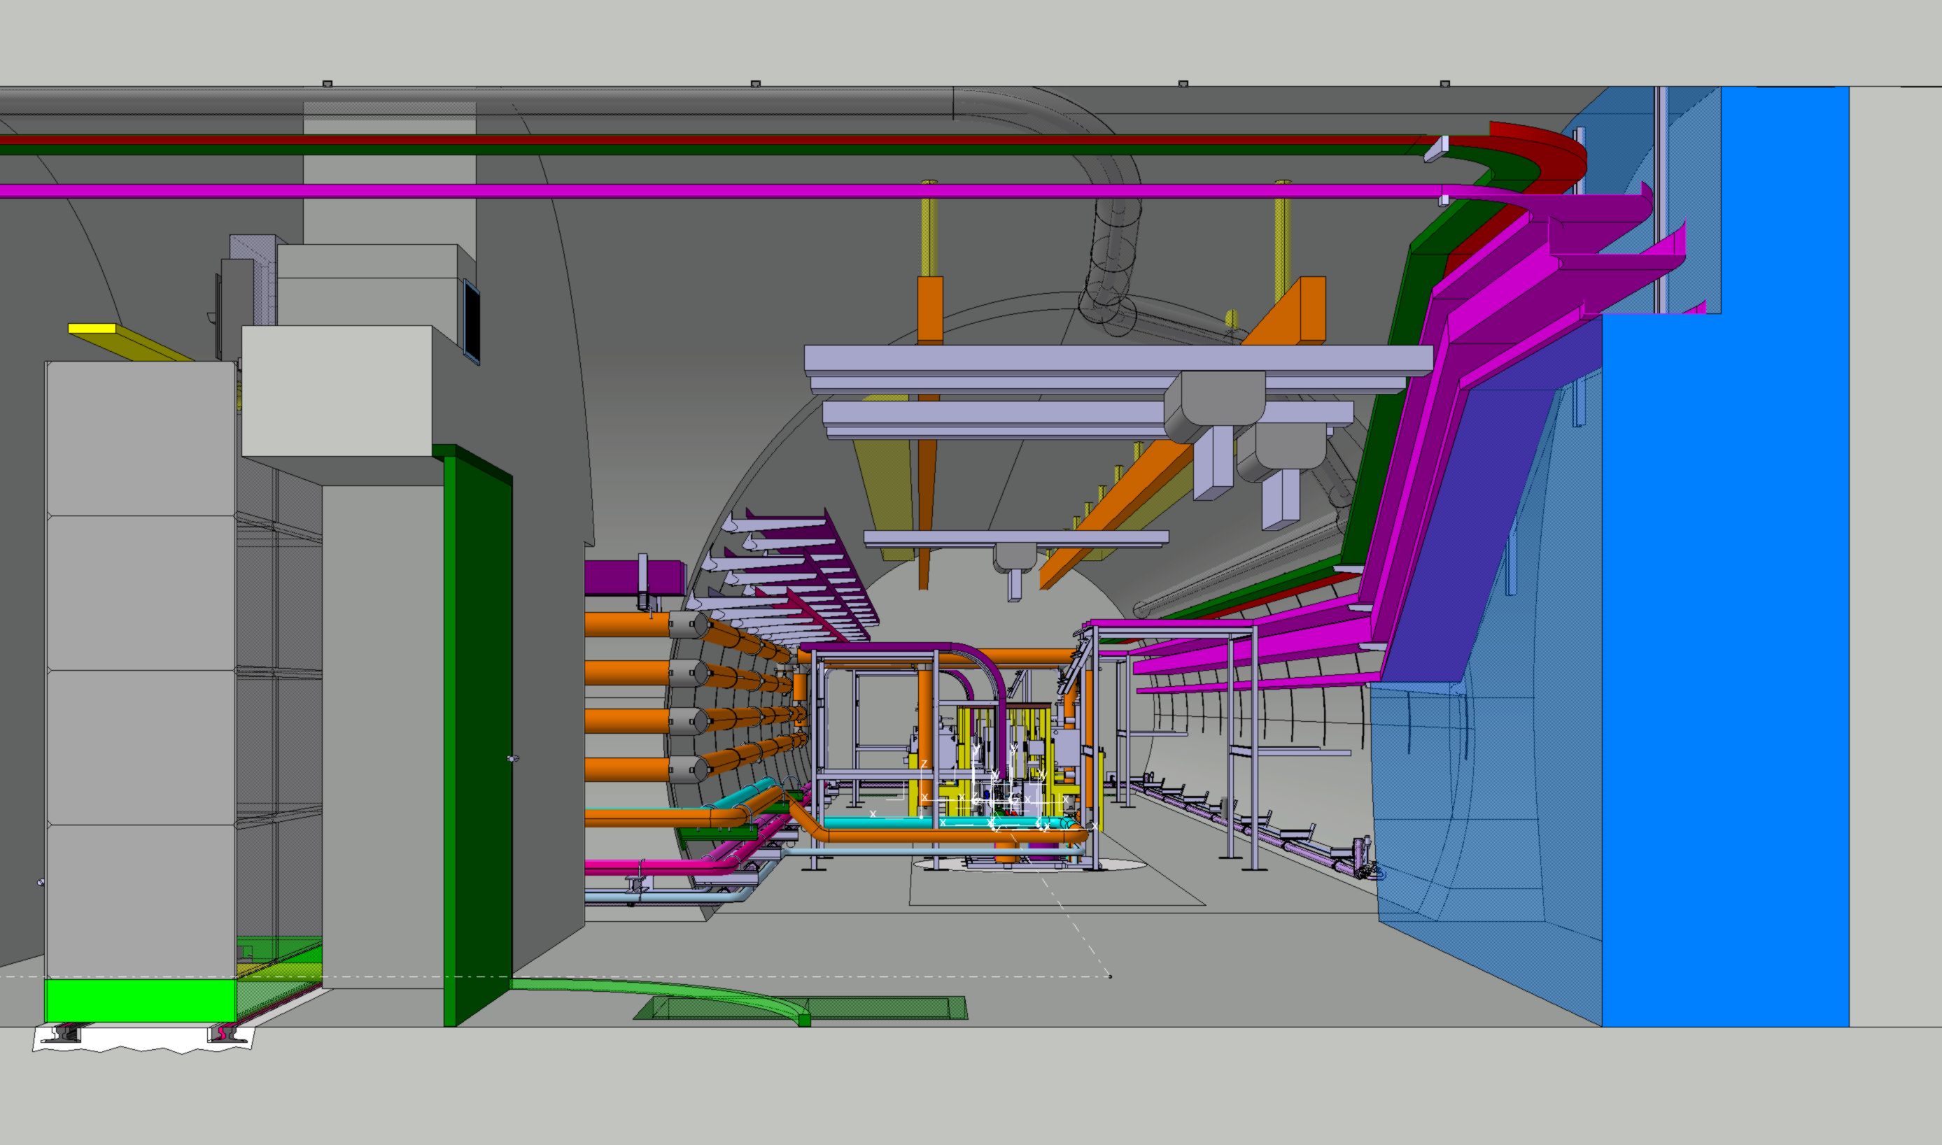
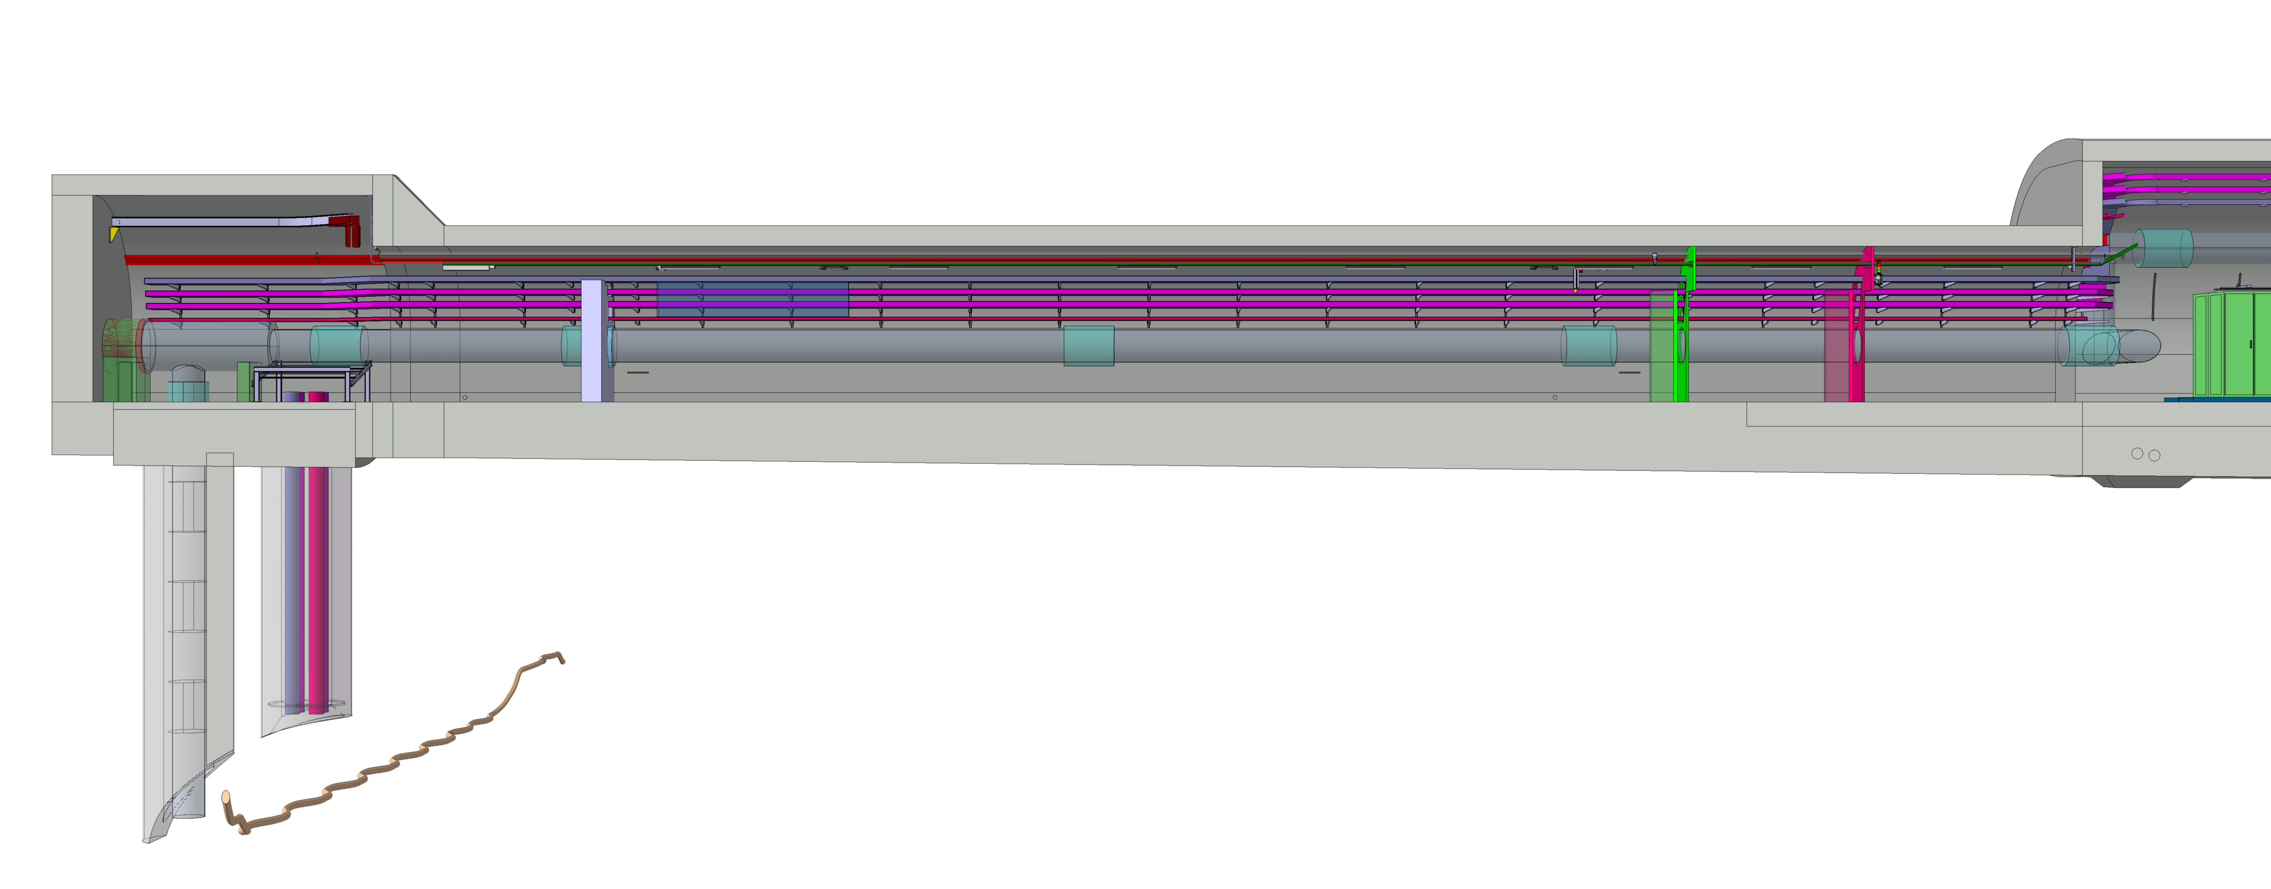
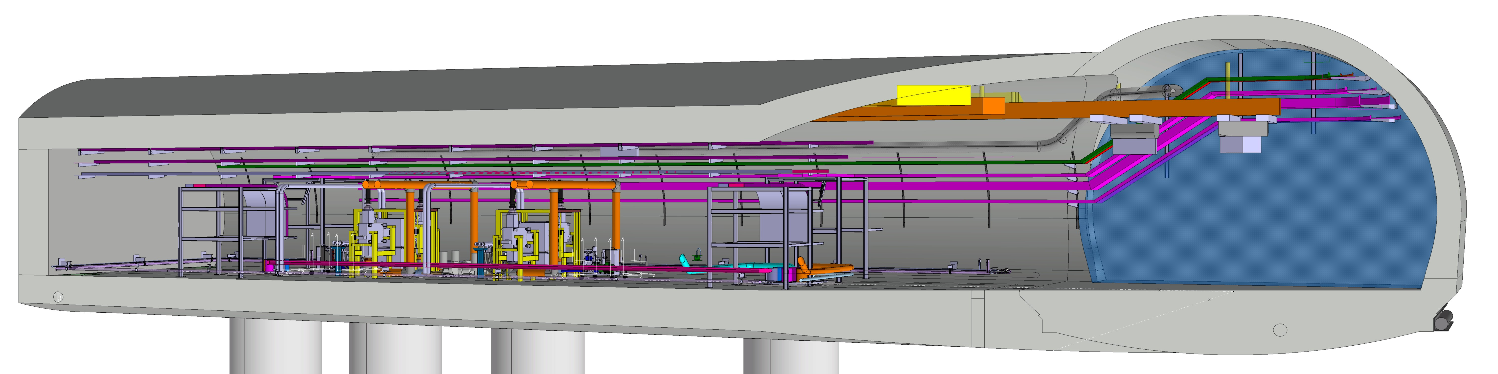
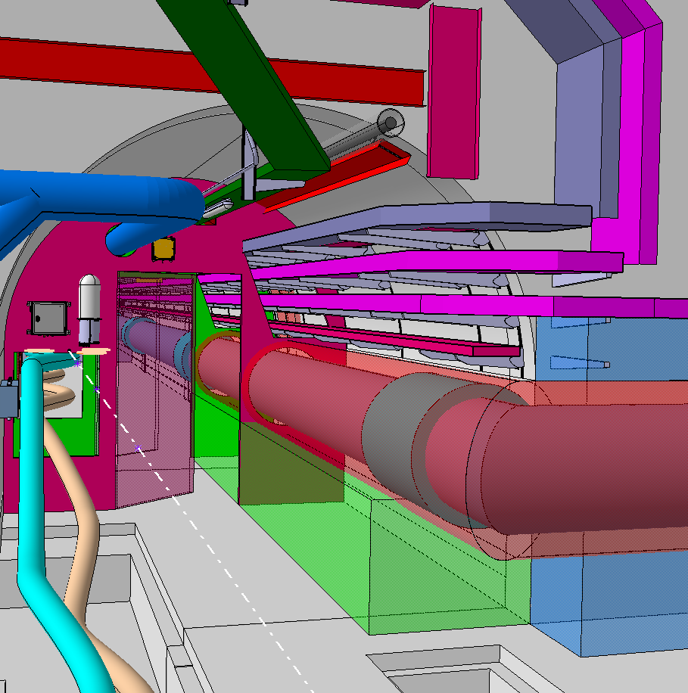
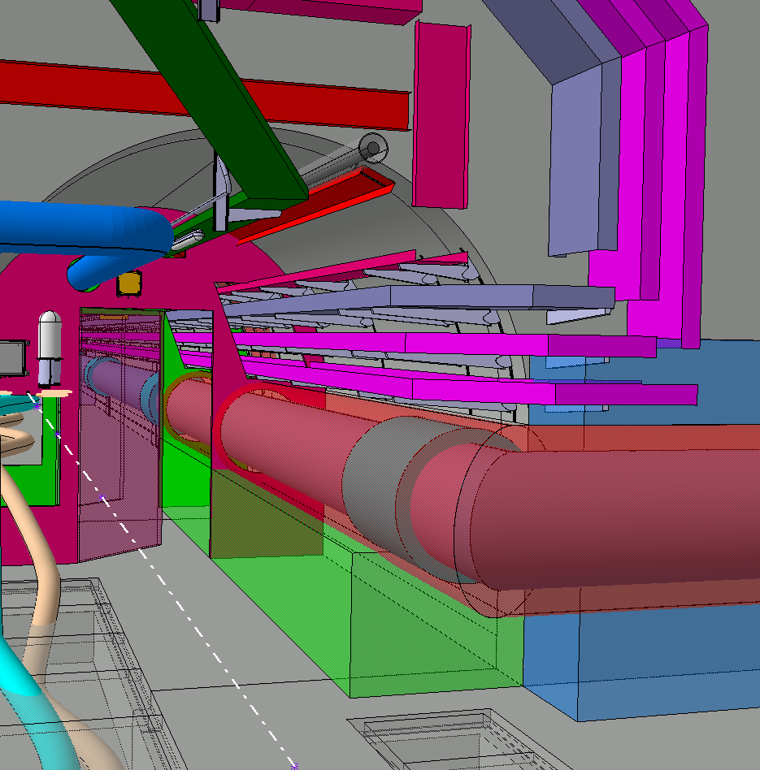
Strategic Patch Panel Placement
The patch panels will be located in two distinct areas: the UAs and the ULs.
Strategic Positioning of Patch Panels in the UAs
Strategic Positioning of Patch Panels in the ULs
Changes to the positioning of ladders in ULs

Slide 7
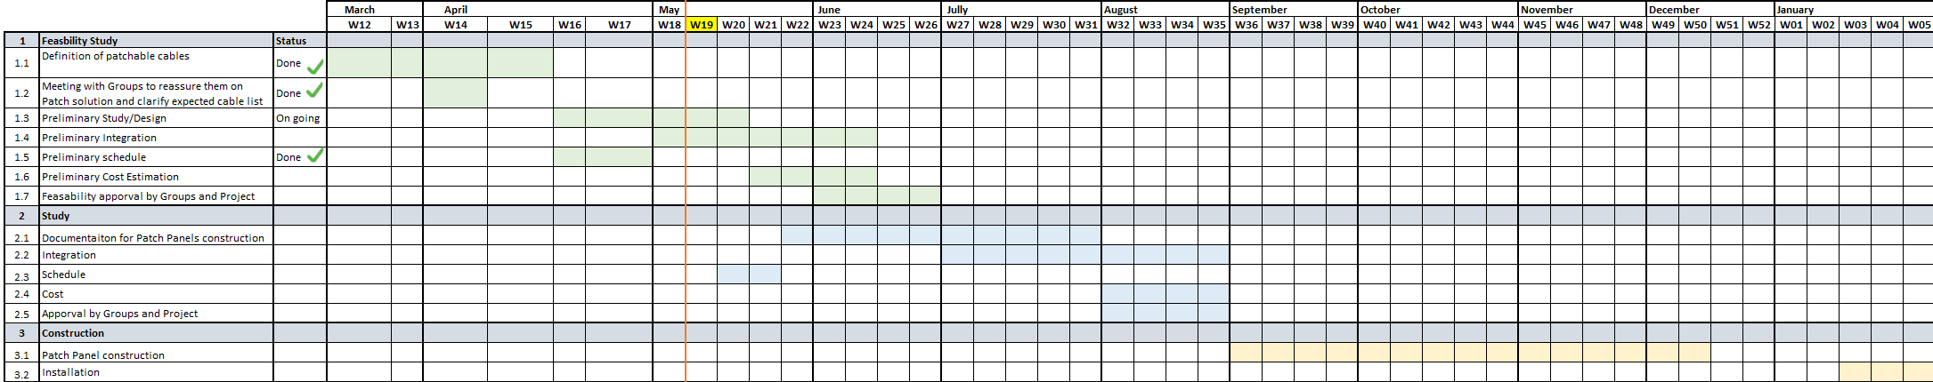
Patch Panels Design Roadmap

Slide 8
Conclusion
59% of cables passing through the CORES can be cut
  Patch panels provided by TE/MPE
  EMC patch with special ‘Harting’ connectors for TE/CRG
Preliminary study/design at the end of May
Preliminary integration is on going and will be completed by mid-June.
At the end of June/beginning of July, we will present the feasibility for approval/comments to the users concerned.

