Slide 1
Follow up of actions on control cabling after
IT String lesson learned
Julien Emonds-Alt, Gael Girardot, Mario Parodi (EN-EL)
09th May 2025
Indico 1545748

Slide 2
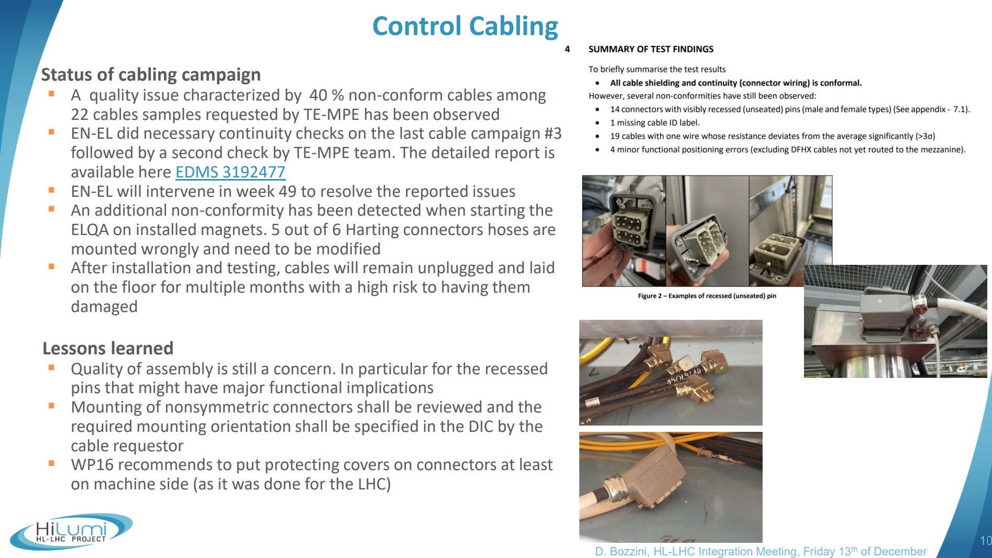
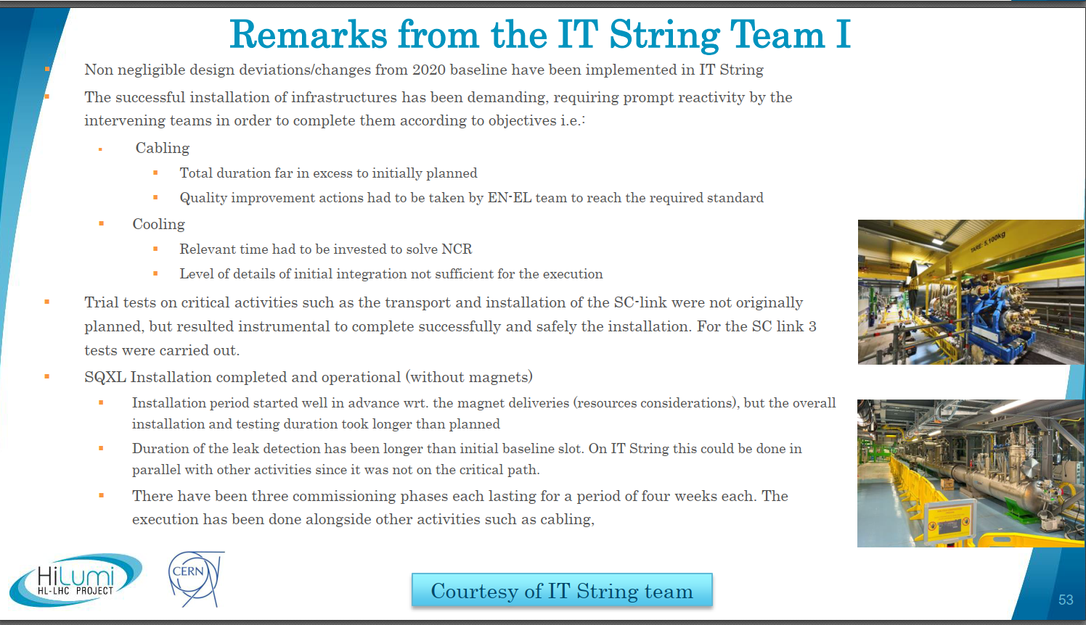
  Lessons learned on IT String relevant for HL-LHC installation #3
  Context
  Feedbacks on IT-STRING Cabling Services work (EN-EL-CS) has been shared in the framework of the “lesson learned exercise”, at different times, for the sake of continuous improvement (lessons learned)
  EN-EL/Cabling Services has provided justifications and explanations during various meetings and email exchanges and launched a set of actions.
  The purpose of this presentation is to share with HL-LHC community the status of these actions and a reminder of the lessons learned
LS3 Readiness Review Sept. 2024

Slide 3
  Lessons learned and recommendations
    Automatic continuity test is reliable.
    Manual test is not reliable, especially for modular connector such as HARTING (module positions inversion).
    Cables not having been fully tested will not be delivered, whatever the urgency and whatever the application (such as sample model), without sharing risks with the user and getting a formal agreement.
    Test shall be executed when cable is completely finished, including the sticker with cable number, even if time constrains are huge.
    EN-EL do not ensure the procurement of connector types that are not available in the CERN Store (“*” often present in type code). The user shall procure and provide them, or request their standardisation to the committee (Ticket).
    Use of new types of connectors and cables are frequently identified as contributing factors in quality issues.
    Privilege parts already used in your design (standard parts available at CERN stores).
    Process to ensure quality of new types, not becoming a standard, shall be reviewed (documentation, proto, etc.).
    Accepting requests that are not provided within the required time frame and/or modified during execution increase risk to encounter quality issues and delay.
    Coactivity may be considered for some cabling operations, but it must be defined prior to the start of the activity, as it often leads to an extension of the cabling activity duration.
    Users are encouraged to send feedback in the message send at the end of the work by using SNOW Ticket satisfaction form. Based on available SNOW stats and a brief use satisfaction survey done in Q4-2024, Cabling Services appears to be performing well.
    …

Slide 4
  Main ongoing actions
  Implementation of DIC Online application (instead of an DIC Excel)
    Include approval process and modification tracking
    Automatic data verifications implemented
Dissemination of the new tool ongoing
  Improvement of Cabling Services Quality Plan
    Review cabling convention documentation and release process
    Review checks done during connector assembly and final test
    Implement further global KPIs
    Contractor quality audits
    Etc.
Hiring of an engineer quality is ongoing (EN-EL-2025-55-GRAP). Interview stage
  Review the process to ensure quality of the installation of new connector types
  (even if not becoming standard)
    Sensibilization of the users to use what is available at CERN store, with support of the Standardization Committee
    Clarification of the responsibilities btw User and Cabling Services
    (BOM, Procurement , Assembly/Elec.drawing/Test/Convention procedures creation)
    Cabling Services may not be able to install some new/non-standard connector types
    (Complexity/Contractor competency, resource required for setup, insufficient volume, …)
    Golden sample foreseen to be built and approved
    ~ 10% of HL-LHC connectors have a new or undefined/unknown type

Slide 5
