Slide 1
Personnel Return Status for Ukraine
Oliver Braikoff
HR-TA
12/06/2025

Slide 2
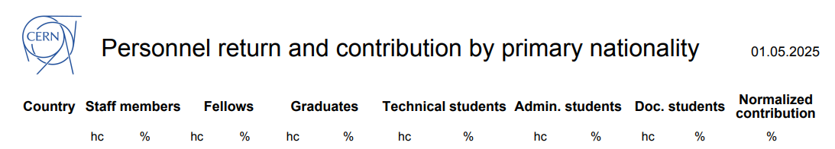
Ukraine @ CERN

Slide 3
Ukraine @ CERN – a closer look on today’s representation

Slide 4
Ukraine @ CERN – Directly recruited categories

Slide 5
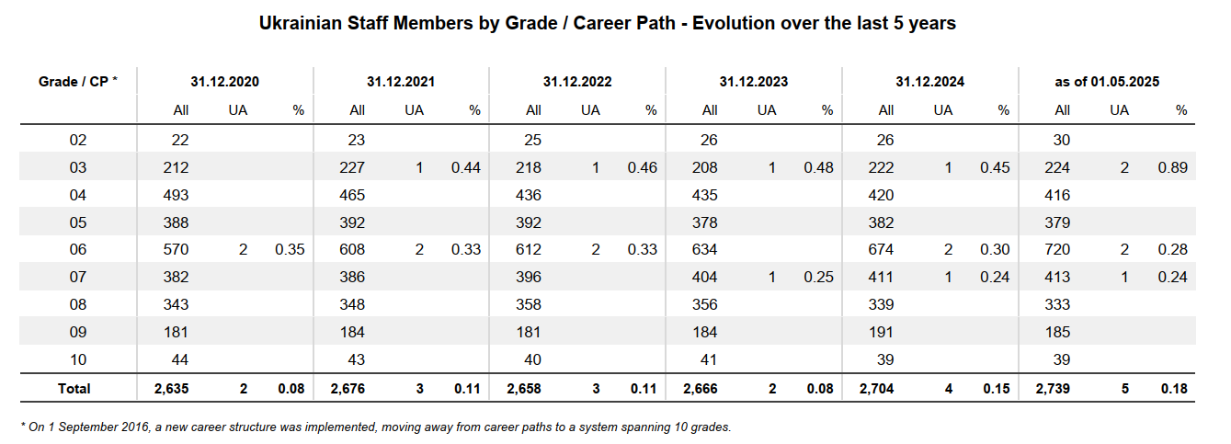
Ukraine @ CERN – Staff members

Slide 6
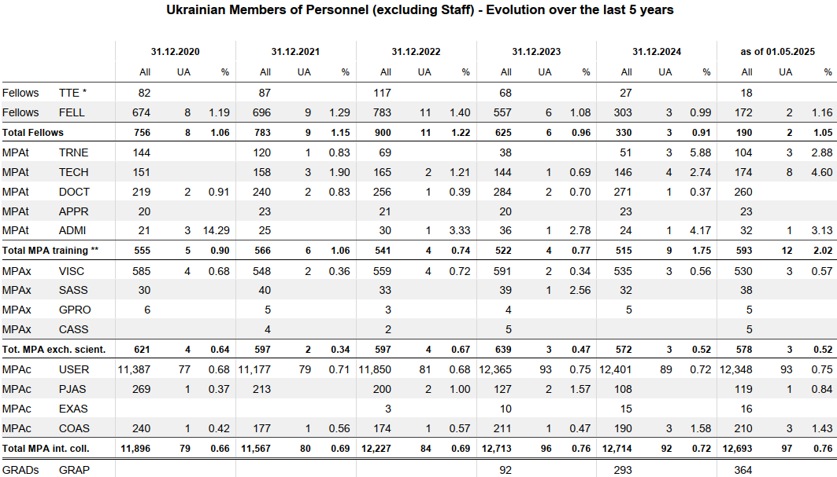
Ukraine @ CERN – Non-staff members

Slide 7
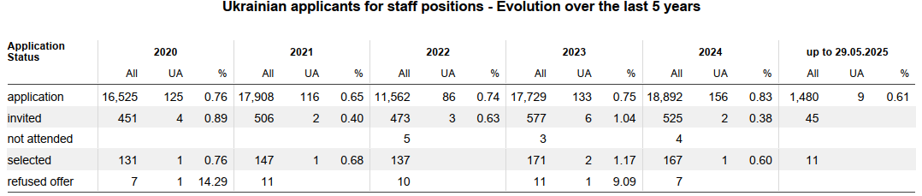
Ukraine @ CERN – Applications for staff positions

Slide 8
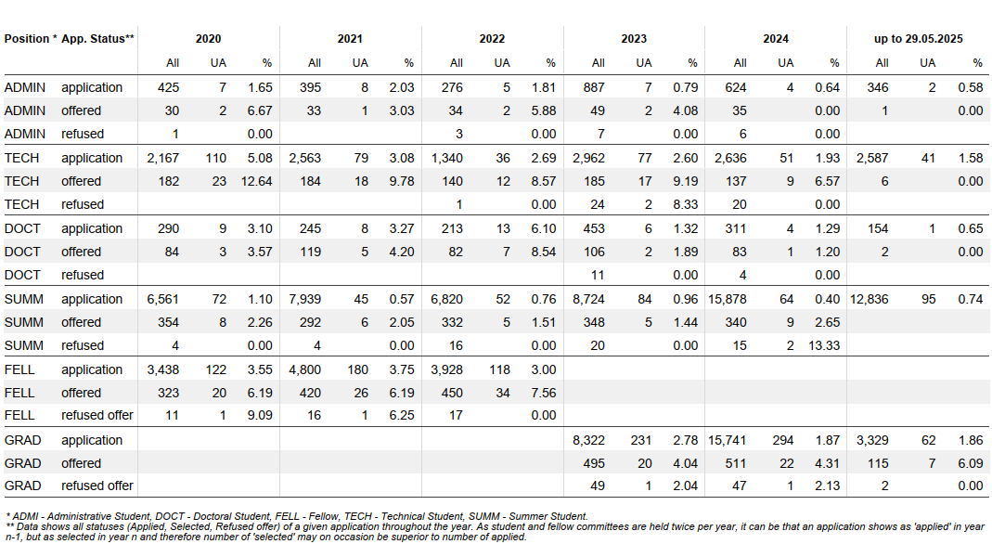
Ukraine @ CERN – Applications for non-staff programmes and positions

Slide 9
Thank you for your attention!

