Slide 1
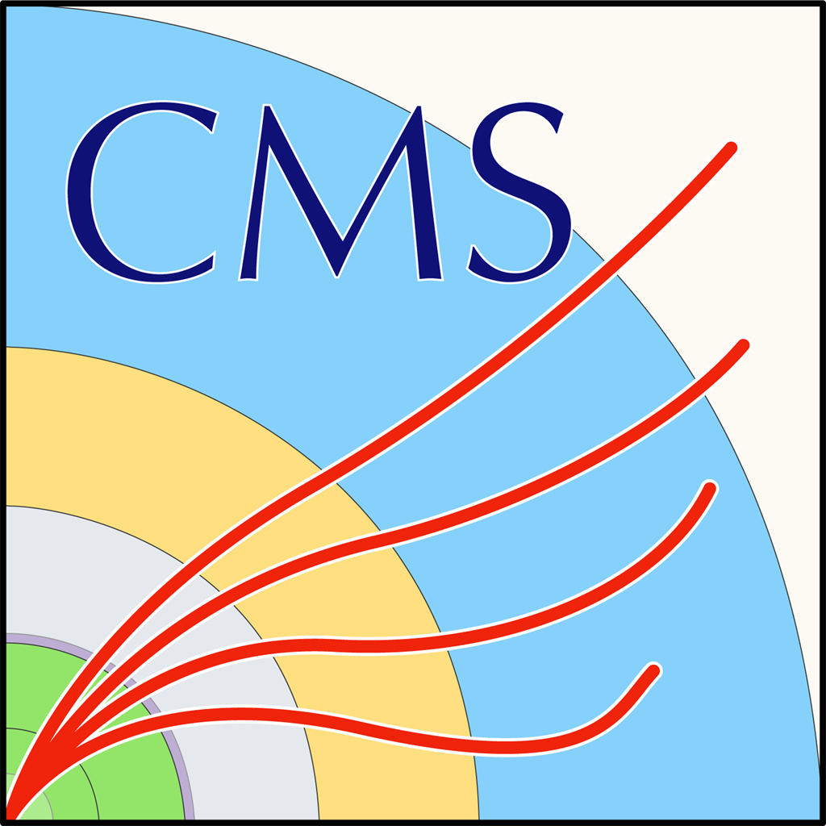
Ukraine in the CMS Collaboration
CMS Spokesperson Team
8th CERN-Ukraine Committee Meeting
12 June 2025

Slide 2
Ukraine in CMS
Currently CMS has 15 members from 03 Ukrainian institutes
Institute for Scintillation Materials of the National Academy of Science of Ukraine
National Science Centre, Kharkiv Institute of Physics and Technology
V. Karazin Kharkiv National University (KNU)
CMS Upgrades
Participation in HGCAL – R&D, prototyping for the machine cast scintillator for the hadronic part
Exploring ways for Ukraine to contribute to the future upgrade projects
Collaboration
Tier 2 (with efficient support) computing centre is in operation for CMS: 6,155,031, 8,548.65 Delivered Power (HEPscore23) 89.99% of total pledged (WLCG Report – April 2025)
Interns/students in Ukraine working on computing/physics projects
Active participation in Computing, Software, Machine Learning, BRIL (Luminosity and Backgrounds), Calorimetry - particularly HGCAL
Significant contributions to physics - in particular, in the B Physics Group

Slide 3

Student Fellows and
Equipment Transfer
Fellows Program: We aim to keep Ukrainian researchers integrated into our international collaborations
despite travel limitations. To that end, the U.S. NSF-funded IRIS-HEP software has had a program each
summer since 2022 to connect Ukrainian students (in remote) with particle physics experiments for
software-related R&D projects. This was done with funding from the Simons Foundation in 2022 and 2023,
and in 2024 and 2025 additional dedicated direct funding from the NAS/ONRG as part of IMPRESS-U (US
contacts Peter Elmer and Oksana Shadura, Ukrainian contact Olga Gogota).
43 students have been involved in between 2022 and 2025, some multiple years, and from Taras
Shevchenko National University, Kyiv Academic University and others. See the individual Fellow links from
https://iris-hep.org/fellows.html for information on their projects, involving CMS and other HEP projects.
Equipment Transfer: We are also involved, via IMPRESS-U, with a new and separate working group
“Rebuilding Engineering, Science, Education and Technology (RESET) Ukraine Action Group under the
National Academies of Sciences, Engineering, and Medicine (NASEM)” to identify and transfer used/retired,
but usable, scientific equipment of all types that is available for donation or loan to support Ukrainian to
continue scientific research. (For example, a compute cluster has been identified for transfer.) This is a new
activity and will expand. HEP contacts: Chris Tully / Peter Elmer (Princeton)

