Slide 1
Procurement Overview
for Ukraine(Associate Member State)

Slide 2
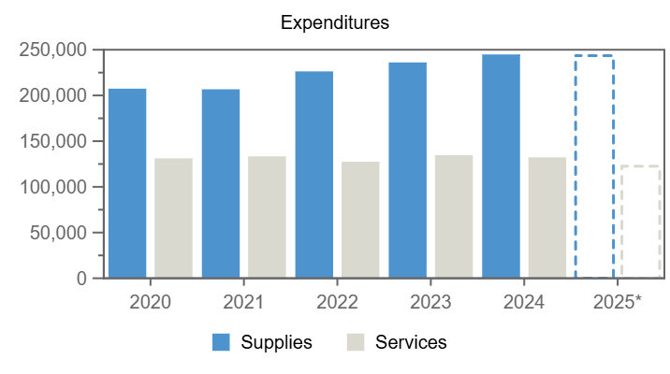
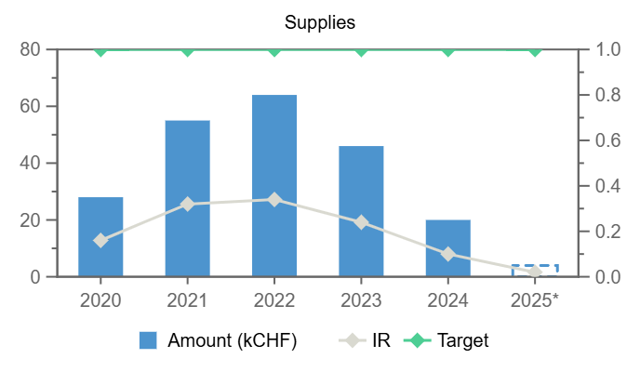
Expenditures (Ukraine, kCHF)
Year
Supplies
Services
2020
28
–
2021
55
–
2022
64
–
2023
46
–
2024
20
–
2025*
4
–
Annual contributions and industrial returns for Ukraine
Contributions (kCHF)
Expenditures (All countries totals, kCHF)
Expenditures (Ukraine, kCHF)
Year
Country Contribution
All Countries
%
Year
Supplies
Services
Year
Remaining
Procurement**
Personnel
2020
1 000
1 196 893
0.08
2020
207 407
131 216
2020
- 194
30
1 164
2021
1 000
1 199 321
0.08
2021
206 717
133 358
2021
- 676
56
1 620
2022
1 000
1 206 284
0.08
2022
226 311
127 469
2022
-1 145
64
2 081
2023
1 000
1 230 382
0.08
2023
236 125
134 661
2023
- 824
46
1 778
2024
1 046
1 266 086
0.08
2024
244 855
132 264
2024
- 353
22
1 376
2025
1 034
1 267 457
0.08
2025*
243 533
122 657
2025*
- 320
4
1 349
Industrial Return
Annual Industrial Return
Supplies
Services
Year
Ratio
Target
Ratio
Target
2020
0.57
1
–
0.4
2021
0.58
1
–
0.4
2022
0.29
1
–
0.4
2023
0.27
1
–
0.4
2024
0.24
1
–
0.4
2025*
–
1
–
0.4
*Provisional figure based on commitments

Slide 3
Top Suppliers in Ukraine
By Country of Supplier
By Country of Origin
Supplier Name
Town
No. Orders
CERN Budget (CHF)
External Funds (CHF)
Supplier Name
Supplier Country
No. Orders
% UA
CERN (CHF)
External Funds (CHF)
NC ENGINEERING UKRAINE
Lviv
1
2 568
–
NC ENGINEERING UKRAINE
UA
1
100
2 568
–
NOTZ METALL AG
CH
1
3
1 916
–

