Slide 1
BWS LHC CONS
Status and technical update
BWS LHC CONS #27
J. Emery
15.04.2025

Slide 2
March/April 2025
24.03.2025 - March BWS LHC CONS meeting #26
https://indico.cern.ch/event/1530149/
25.03.2025 - 98th Impedance Working Group meeting (Update on HL-LHC wire scanners)
https://indico.cern.ch/event/1529313/
09.04.2025 – LHC Wire Scanner - Vacuum design – VDAM
10.04.2025 – Meeting with the ball screw supplier (Amsler Linear)

Slide 3
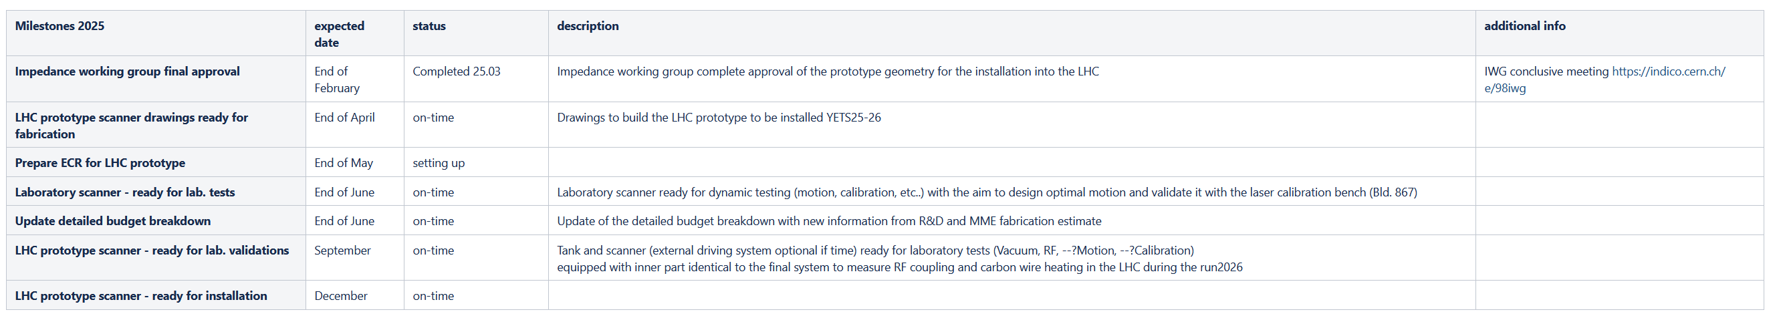
Milestones 2025

Slide 4
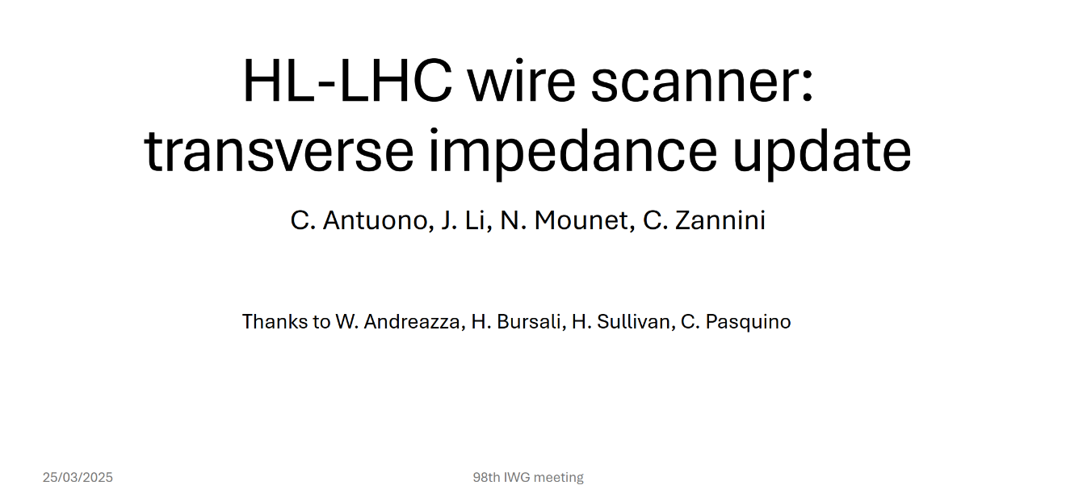
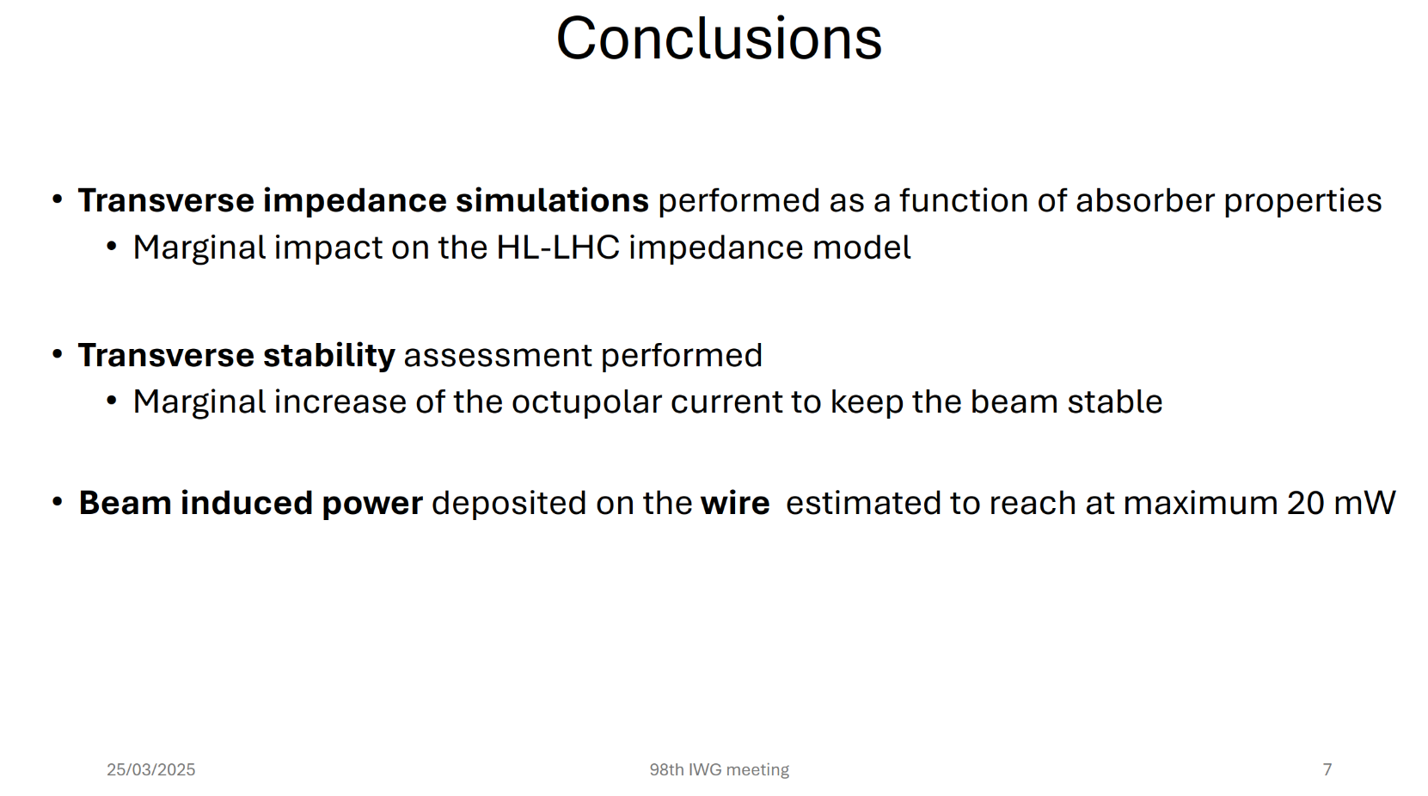
98th Impedance Working Group meeting (Update on HL-LHC wire scanners)
Design approved for LHC installation!

Slide 5
LHC Wire Scanner - Vacuum design – VDAM
Complete design review presentation by Harry
Very few changes required (William’s notes):
1) Check with the workshop if a centring feature is needed to properly align before TIG welding the parts LHCBWSLA0032 and LHCBWSLA0033
2) Add a note, on the dwg. LHCBWSLA0030 and LHCBWSLA0031, to specify that on the rectangular CF knife any machining mark crossing the knife has to be avoided
3) Add a tolerance similar at the one of the circular CF flanges, on the dwg. LHCBWSLA0030 and LHCBWSLA0031, to the dimension of the copper gasket groove(117mm x 387,2)
4) Add a section, on the dwg. LHCBWSLA0032, to detail the dimension of the CF DN40
5) Find a solution to avoid to have play between the part LHCBWSLA0068(shouldered screw) and the parts LHCBWSLA0035(rail base) and LHCBWSLA0038(rail top). The play may occur between the shouldered screw and slot on the rail top and rail base
6) Silver coating for the bolts
Design approved for LHC installation!

Slide 6
On-going request for the installation YETS 25-26
Cablings:
copper for pick-up antenna
RQF3080062 - Cable installation, number of cables: 2, length: ~90m, LHC, YETS 25-26
Fiber optics for the optical encoder
RQF3080177 - Fiber Optics installation: LHC - YETS 25-26
=> Missing exact position (~2m upstream of Beam 1 tank?)
=> Fibres to be added to PLAN 12763
ECR:
- Do you have already all the information to start the document?

Slide 7
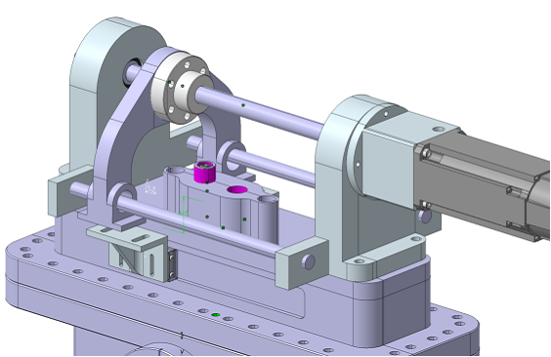
Meeting with Amsler Linear – supplier of the ball screw
Jonathan’s email:
One subject maybe to discuss regarding the rexroth product, if you plan to use it.
With Morad and Lucas (Hybrid+), we had multiples cases of the ball screw which did not have the correct preload.
It may be some issue in the quality control...
If you have time to speak with them.
Maybe there is an alternative supplier providing better quality control?

Slide 8
Investigations on the electrical connection
I discussed with Jean & C. Vuitton regarding flex.
A solution could be envisaged & electrical connection could maybe use C. Vuitton’s method of contacts. Unknown is the lifetime of copper deposition, but with large tracks it could work.
C. Vuitton and Jean are looking into another solution that could have less connections and simple to implement.
He plan to study this and make some tests.
Do you have an estimation of
the lifetime of sliding contacts?

Slide 9
Laser calibration bench for performance assessments of the test rig and laboratory scanner
Last meeting we agreed that given the high workload on the project,
SY-PM (Nabil) help could be useful to integrate the test rig into the calibration bench.
SY/ML would develop a fixation for the carbon wire on the prototype card.
This would allow to start as soon as possible the tests with the laser calibration bench and evaluation of the vibrations.
Same for the integration of the Laboratory scanner prototype, additional help of SY-PM to study the integration, vibration damping, etc.. Would be welcome.

Slide 10
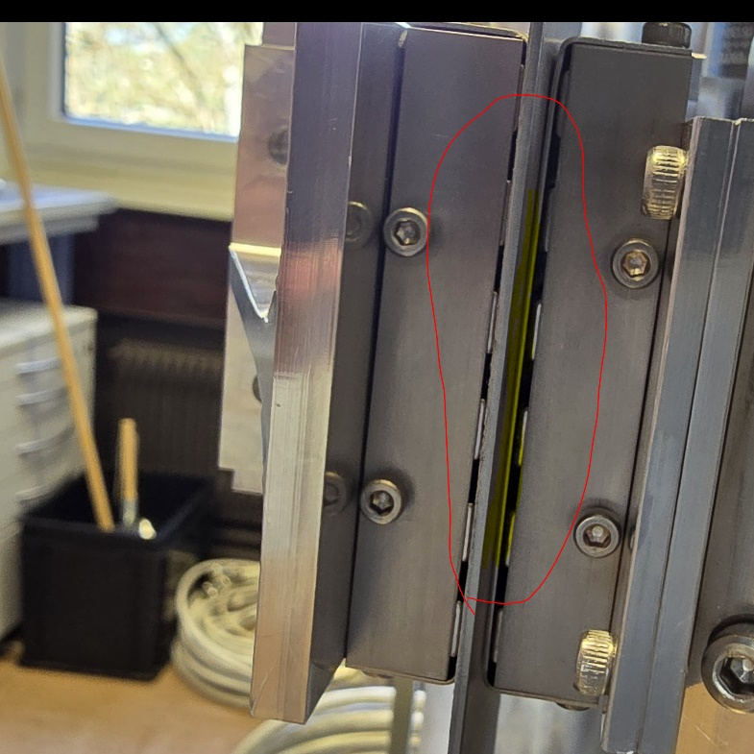
Test rig status
Test rig V3 with new bearing not operational.
One bearing broken during the magnetic parts alignments.
Is there any change in the alignment procedure.
I understood you plan to change the bearing type,
any pro/cons to discuss?
Any expected delay due to this change?
Should we brainstorm about mitigation?

Slide 11
Optical encoder optimization
Aurelie spent time on the optics simulation of the lens's arrangement.
The changes in the distances with respect to the rotary scanner will not be possible without change of the lenses.
The lenses we have currently are the shortest in focal from the series. Other series exists but have not been tested.
The sensitivity to perturbations with small focal/smaller beam size may be a problem (field of view, scratch on the surface, etc..)
Proposed strategy:
- take the existing optical design as baseline, conserve the same mechanical distances.
- select only 2 rule patterns: 15/15um and 20/20um to have 2x10 rules to full fill the series with these patters. Accuracy will come from the precision of the pattern, not the resolution
- Study in parallel an optimised optical head for smaller laser beam size/low profile head

Slide 12
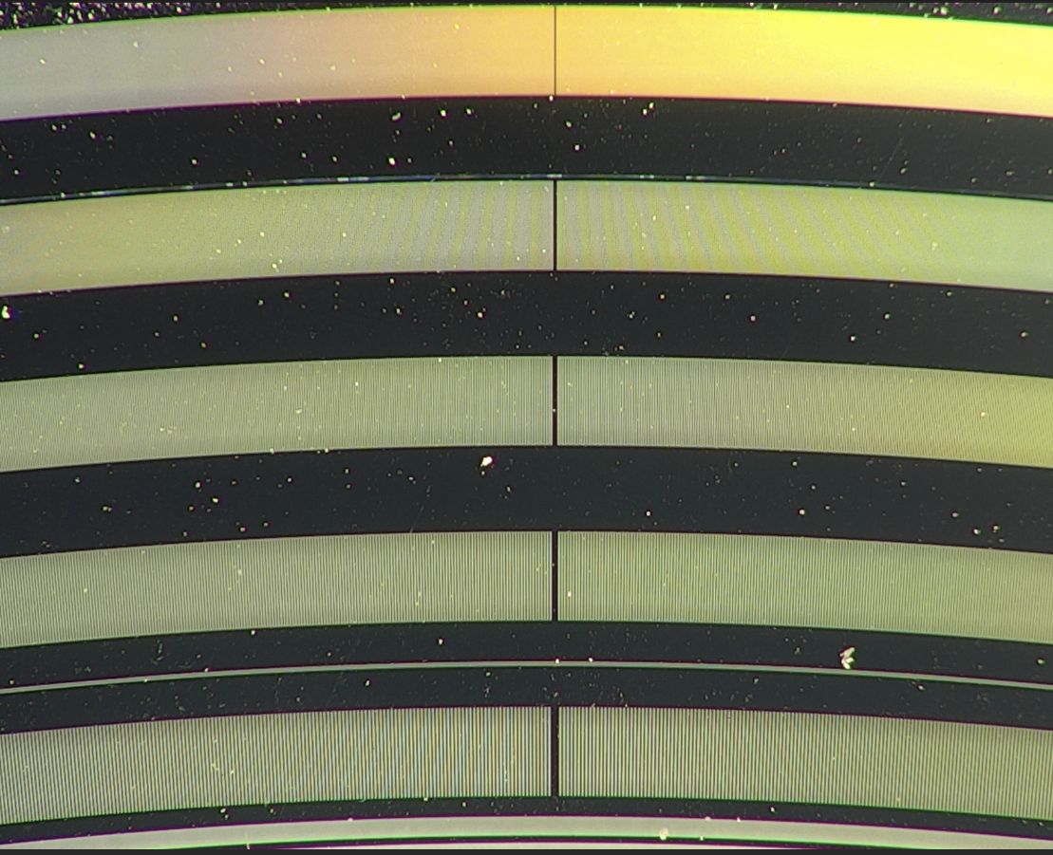
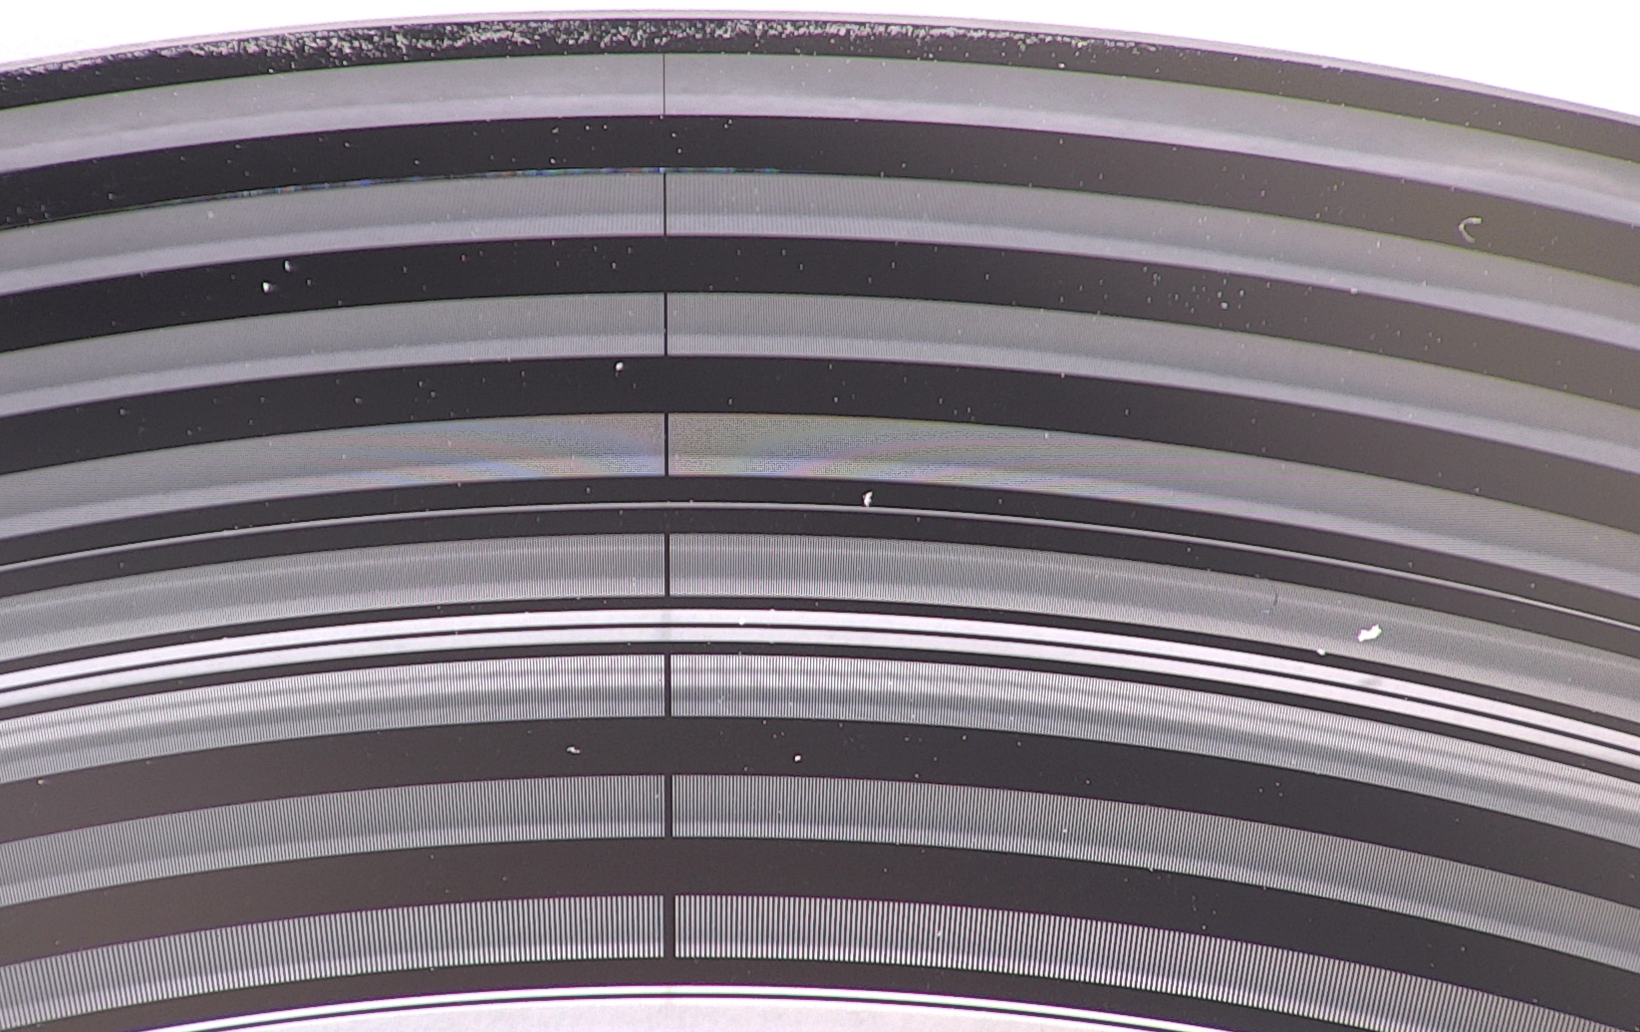
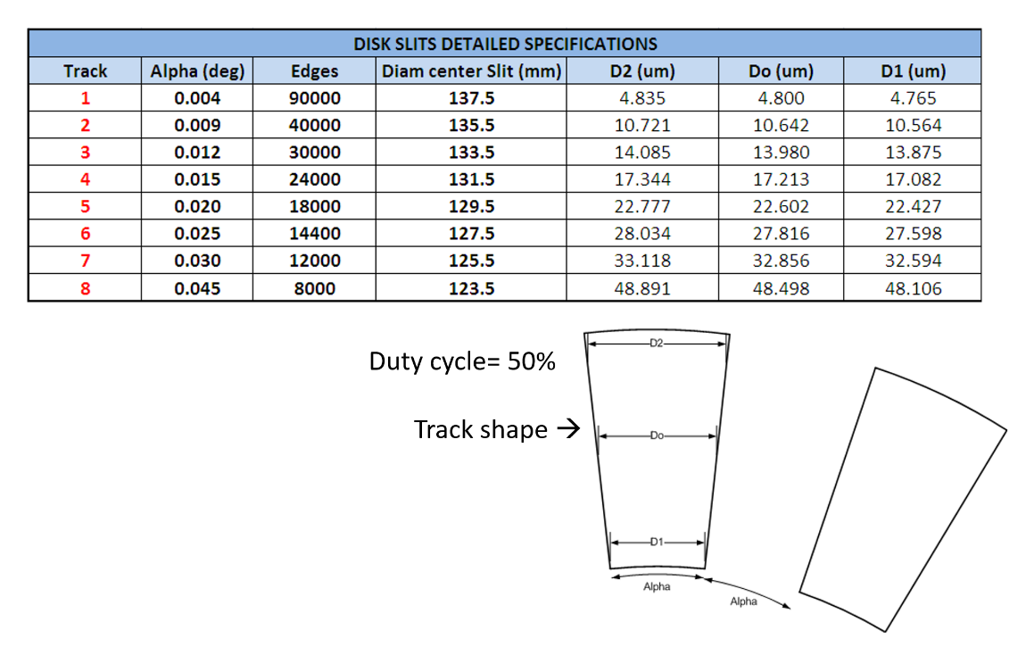
Optical rule investigation
Disk V3 observation
1
2
3
4
5
6
7
8

Slide 13
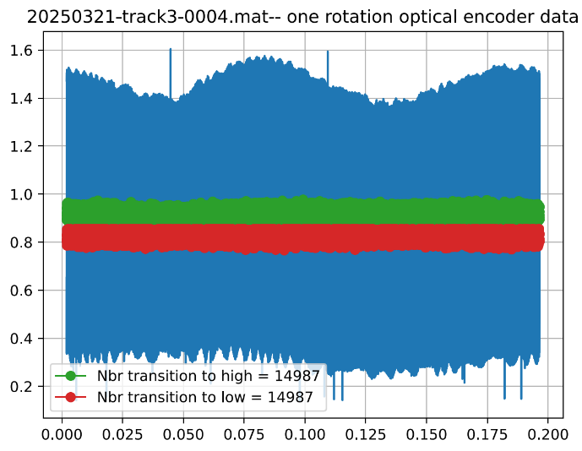
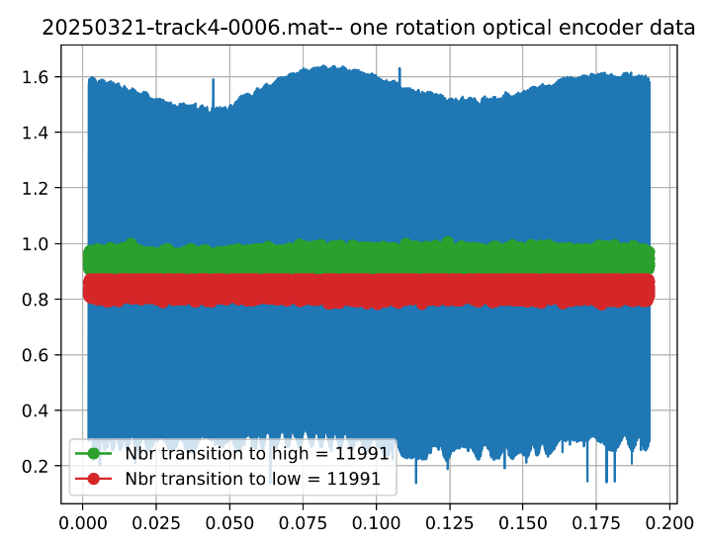
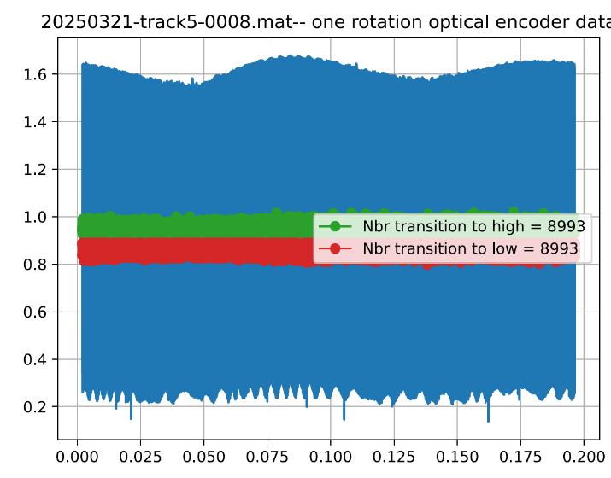
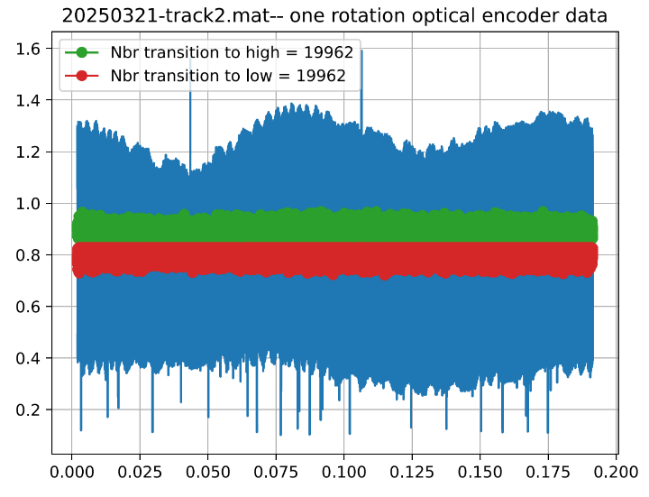
Optical encoder signal and edge detections
Data cut at exactly one revolution (using the reference encoder)
Track 2
10.6um reflective Cr
10.6um glass
Track 3
14um reflective Cr
14um glass
Track 4
17.2um reflective Cr
17.2um glass
Track 5
22.6um reflective Cr
22.6um glass

Slide 14
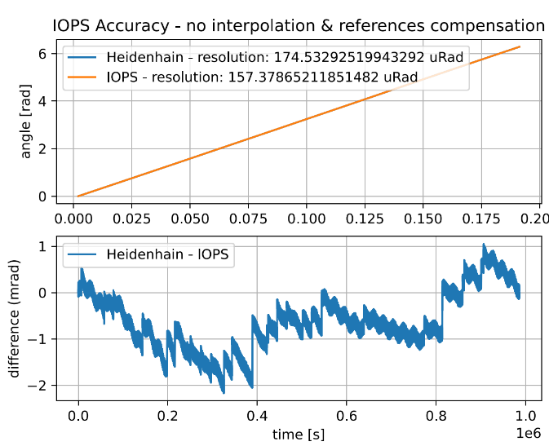
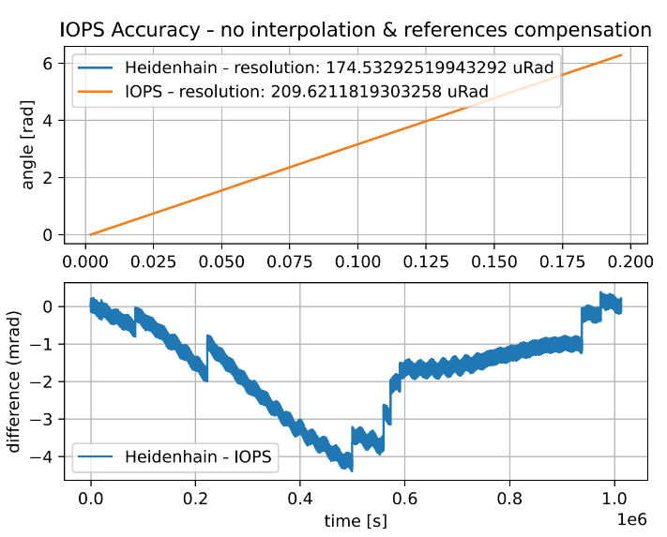
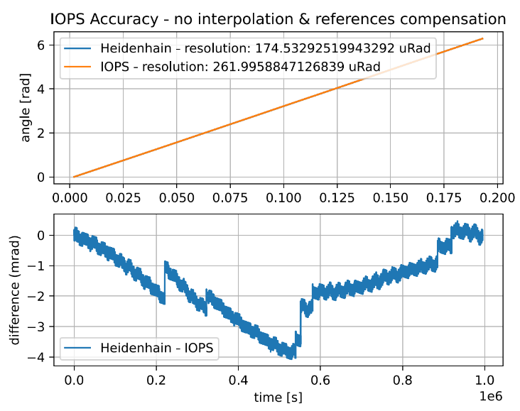
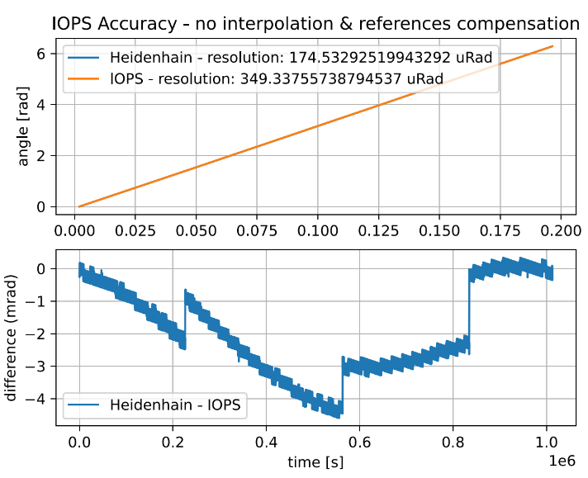
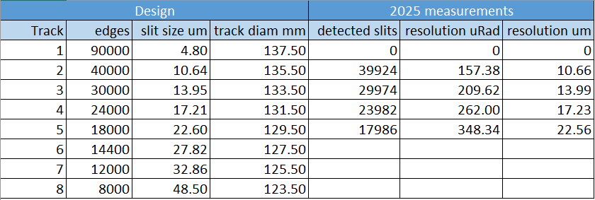
Compare reference encoder and optical disk
Disk with R=135/2mm
100uRad ~ 6.75um
1mRad ~ 67.5um
Error patterns have similar structure for all tracks.
Error sources known.
The track with 10um structure gives the lowest signal to background
Track 14um and 17um gives good results.
The track 22.6um is the optimum in terms of detected slits in the present test condition

Slide 16
February 2025
10.02.2025 - February BWS LHC CONS meeting #25
https://indico.cern.ch/event/1514016/
18.02.2025 - 96th Impedance Working Group meeting
Studies on BWSs for HL-LHC (Hikmet Bursali)
https://indico.cern.ch/event/1486663/

Slide 17
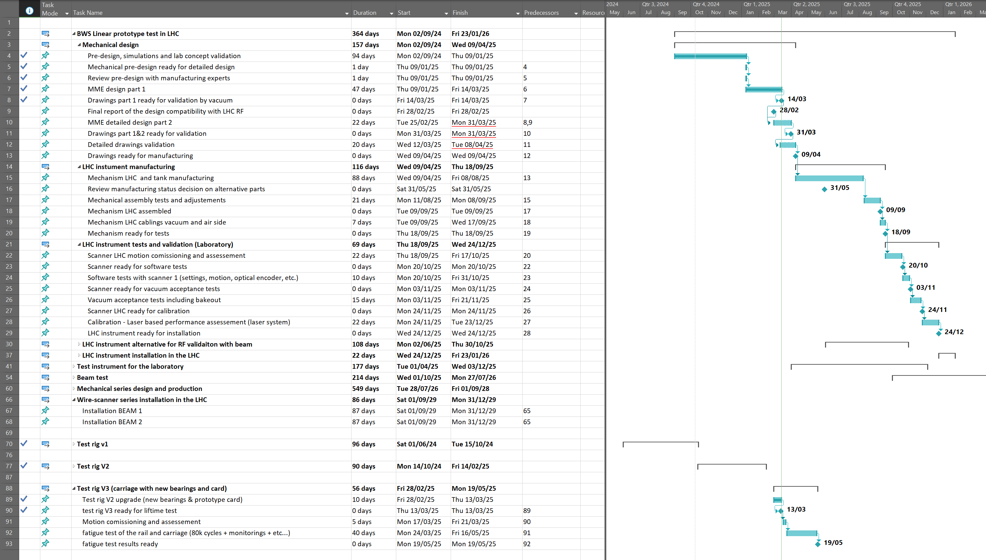
Waiting
final OK
04.03.2025 (Chiara) : Transverse simulations are done and impact on the transverse impedance is low ( 0.2%). Still, I asked for an official confirmation [from the IWG]

Slide 18
2025 Milestones
End of April 2025: Mechanical design of the tank and scanner ready without driving system
?--May 2025-- Documentations for the installation, ECR?
Mid 2025:
- Laboratory scanner ready for dynamic testing (motion, calibration, etc..)
with the aim to design optimal motion and validate it with the laser calibration bench (Bld. 867)
- Update detailed budget based on R&D advances
September 2025: Tank and scanner (external driving system optional if time) ready for laboratory tests (Vacuum, RF, --?Motion, --?Calibration)
-equipped with inner part identical to the final system to measure RF coupling and carbon wire heating in the LHC during the run2026.
End of 2025: Ready to install wire-scanner prototype in the LHC.

Slide 19
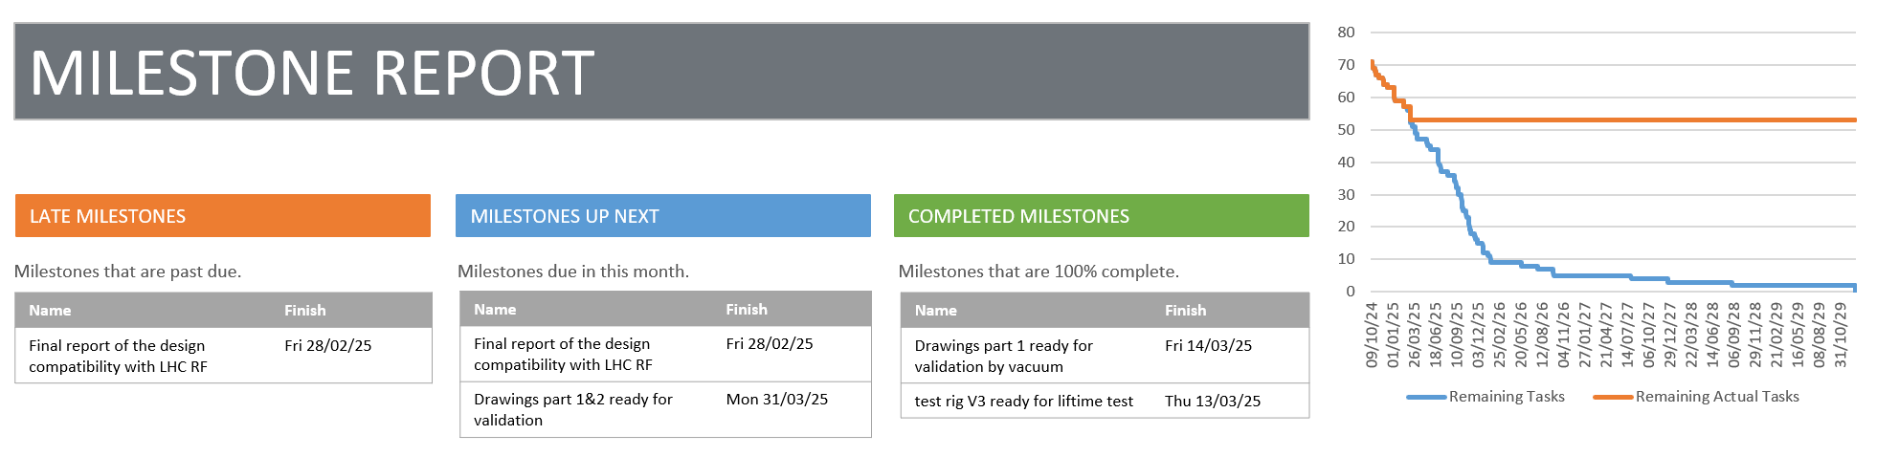
BWS LHC CONS – MS Project reporting
(as good as what we file in it…)

Slide 20
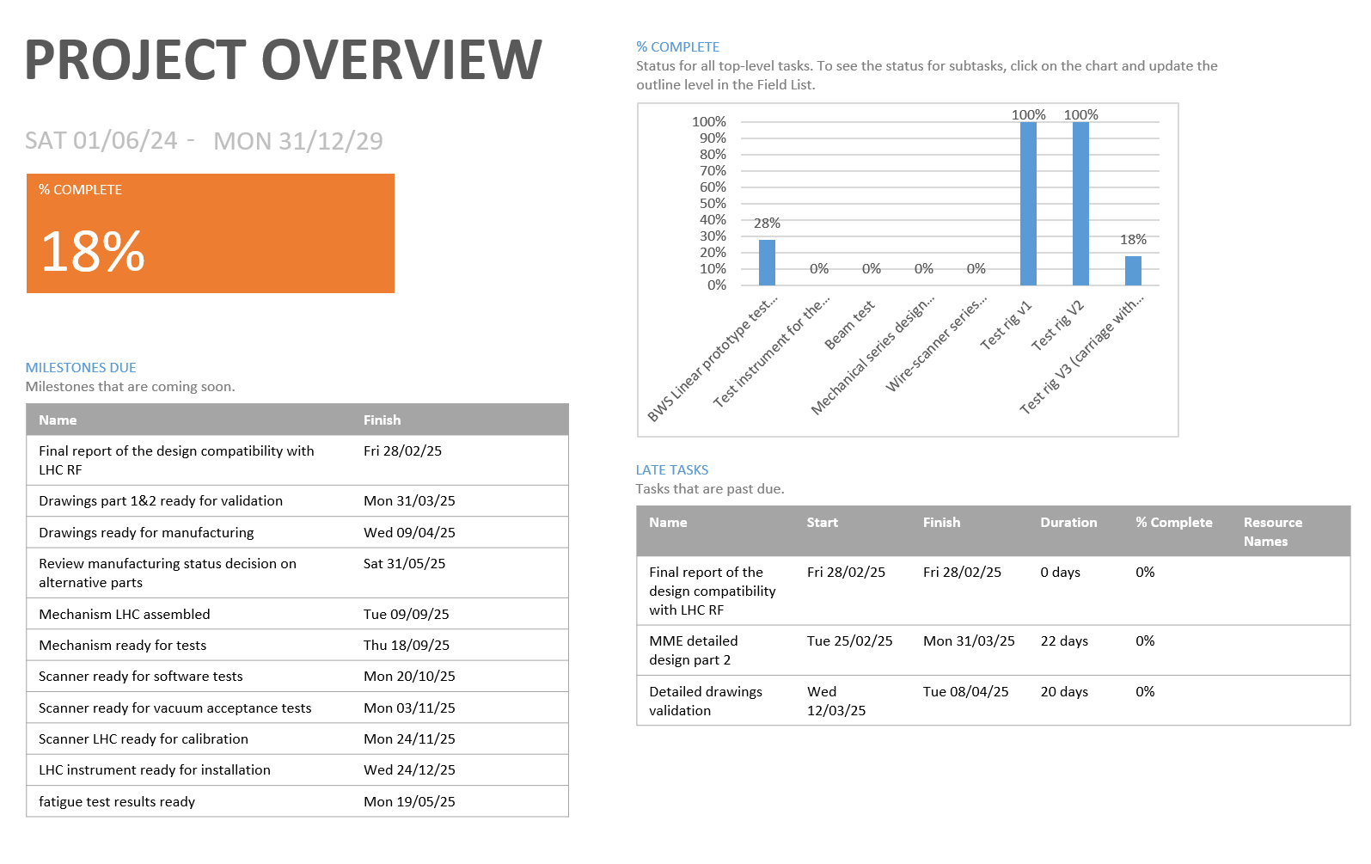

Slide 21
January 2025 recorded activities
09.01.2025 - Kick off detailed linear design SY-BI / EN-MME
=> status update today (Harry)
14.01.2025 - January BWS LHC CONS meeting
https://indico.cern.ch/event/1503356/
21.01.2025 - Magnet system for LHC BWS - final design
https://indico.cern.ch/event/1504619/
=> Magnet team waiting for simulation inputs (Jonathan/Harry)
23.01.2025 - BI consolidation activities review
https://indico.cern.ch/event/1478672/
28.01.2025 - Optical ruler design discussion
=> missing info on the markings (Jonathan)

Slide 22
Proposed project structure (presented BI cons day 23.01.2025)
Milestones and Deliverables
WU 1 | Next activities/ milestones/deliverables | Date Expected
WU 1 | Design/production/test of a prototype in the LHC | By 09.2026
WU 1.1 | Detailed design with MME | By 05.2025
WU 1.2 | Production of the protype LHC (mechanical, electrical) | By 10.2025
WU 1.3 | Laboratory test of the prototype (vacuum, RF, motion?) | By 12.2025
WU 1.4 | LHC Beam test and analysis | By 07.2026
WU 2 | Next activities/ milestones/deliverables | Date Expected
WU 2 | Design/production/test of dynamic proto in the Laboratory | By 05.2026
WU 2.1 | Detailed design with MME | By 05.2025
WU 2.2 | Production (mechanical, electrical, c-wire technology) | By 10.2025
WU 2.3 | Laboratory test of the prototype (motion, calibration with laser) | By 05.2026
WU 3 | Next activities/ milestones/deliverables | Date Expected
WU 3 | Design/production/validation of the series for the LHC | By 2029
WU 3.1 | Final detailed design with MME (after results machine & lab tests) | By 04.2027
WU 3.2 | Production of the series (mechanical, electrical, PMT, etc…) | By 06.2028
WU 3.3 | Calibration of the instruments in the Laboratory | By 12.2028
WU 4 | Next activities/ milestones/deliverables | Date Expected
WU 4 | Installation 4 new linear scanners + validation with beam | By end 2031
WU 4.1 | Installation of the 4 scanners in the LHC | By 12.2029
WU 4.2 | Validation with beam, comparison against OP systems | By end 2031
WU 5 | Next activities/ milestones/deliverables | Date Expected
WU 5 | Installation and validation 4 spares linear scanners in LHC | By end 2032
WU 5.1 | Decommissioning Hybrid+ and installation 4 last scanners | By end 2031
WU 5.2 | Validation with beam, comparison against OP scanners | By end 2032

Slide 23
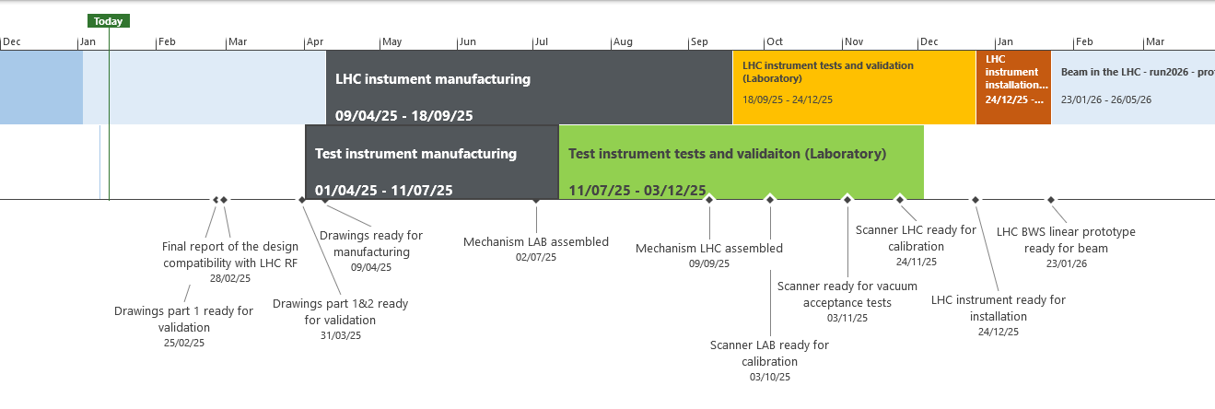
Planning
Today
Jul '24
Oct '24
Jan '25
Apr '25
Jul '25
Oct '25
Jan '26
Apr '26
Jul '26
Oct '26
Jan '27
Apr '27
Jul '27
Start
01/06/24
Mechanical design
02/09/24 - 09/04/25
LHC instument manufacturing
09/04/25 - 18/09/25
LHC instrument tests and validation (Laboratory)
18/09/25 - 24/12/25
LHC instrument installation in the LHC
24/12/25 - 23/01/26
Beam in the LHC - run2026 - prototype test with beam
23/01/26 - 26/05/26
Mechanical series design and production
28/07/26 - 28/07/27
Wire-scanner series installation in the LHC
29/07/27 - 27/08/27
Finish
27/08/27
✔Mechanical pre-design ready for detailed design
09/01/25
Test instrument manufacturing
01/04/25 - 11/07/25
Test instrument tests and validaiton (Laboratory)
11/07/25 - 03/12/25

Slide 24
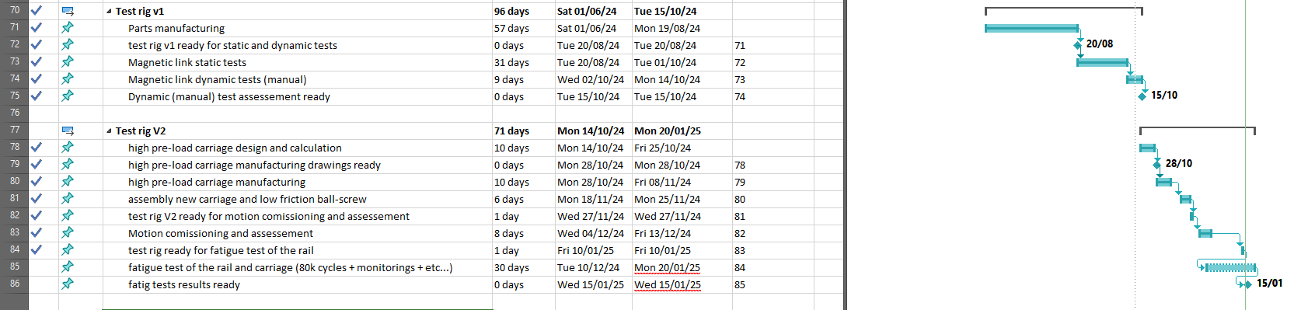
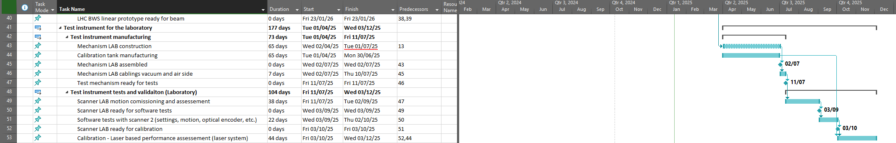
Laboratory test instruments

Slide 25
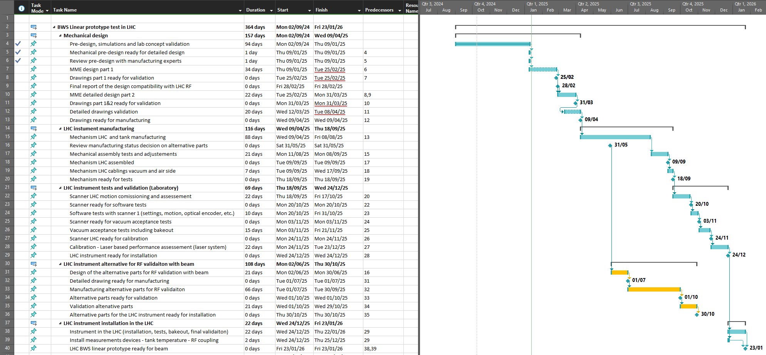
LHC test instrument

Slide 26
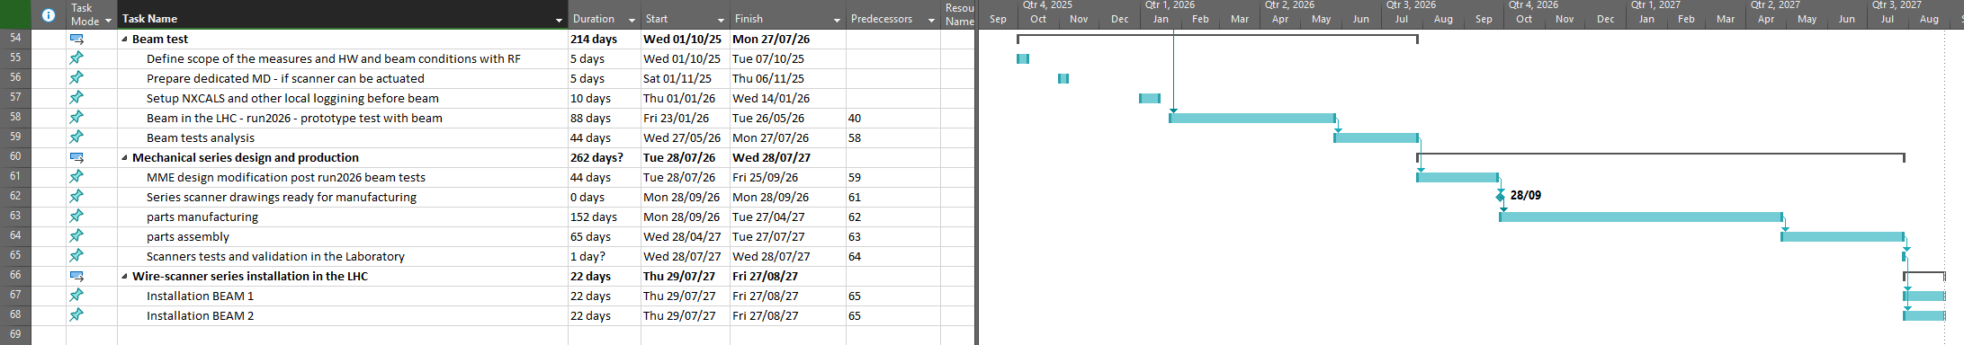
New entries:
LHC test instrument validation and series production

