Slide 1


Transformative Innovation:
How Does It Happen for Real?
Pablo Garcia Tello
IdeaSquare, CERN

Slide 2
Disclosure
I always speak from experience, not from books or theory.
What I’ll share comes from lessons I learned sometimes the hard way.

Slide 3
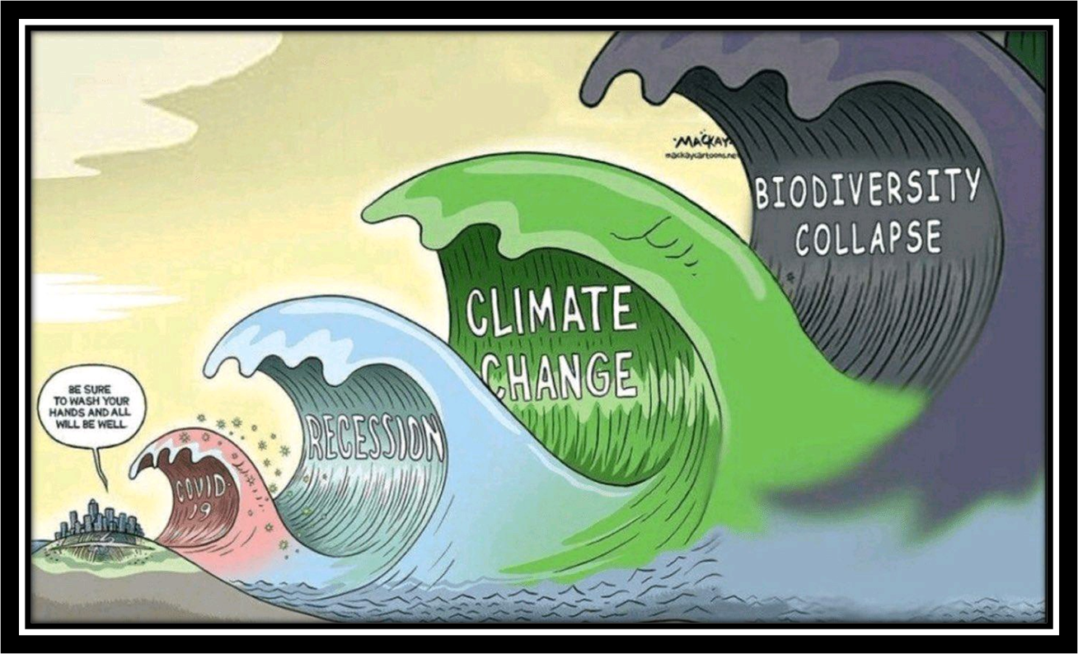
Context: Why do we (humankind) need transformative Innovation?

Slide 4
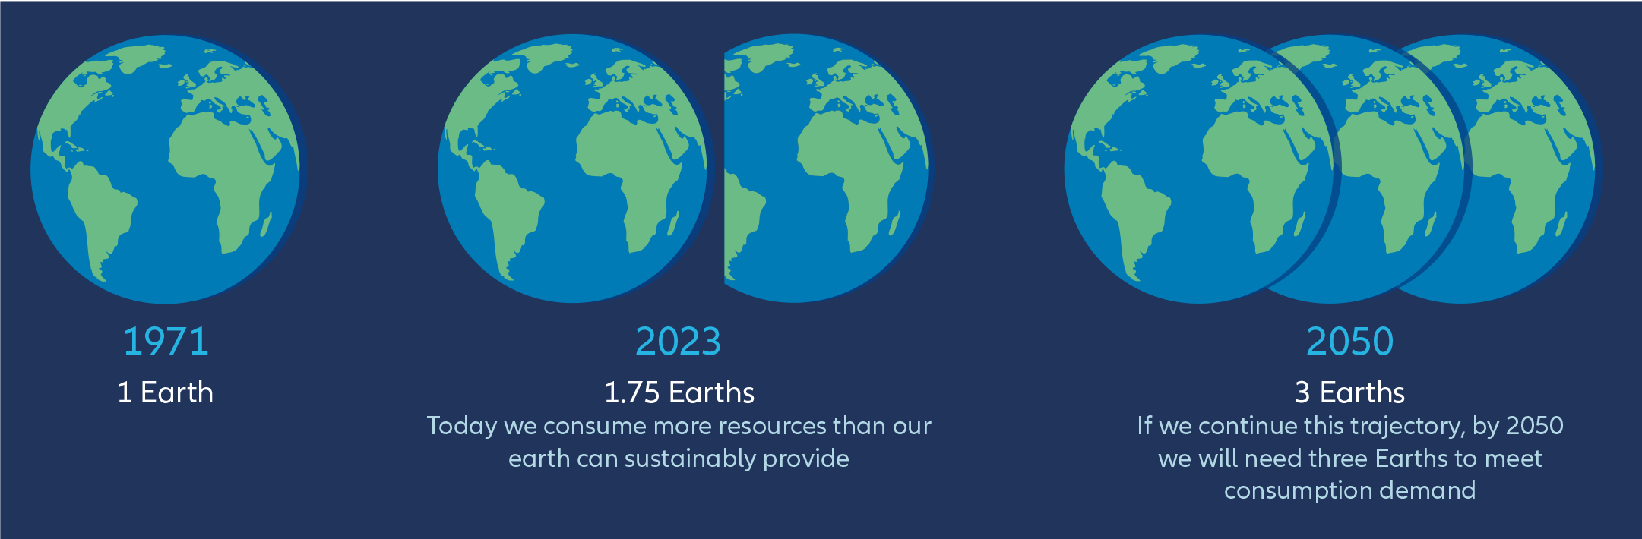
Context: Why do we (humankind) need transformative Innovation?

Slide 5
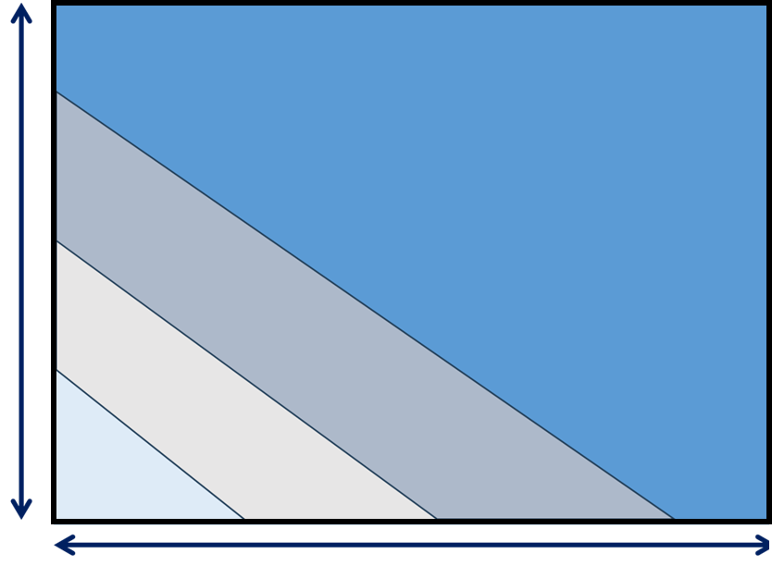
Context: What do I mean by “Transformative Innovation”?
Innovation Taxonomy
High
Transformative
Innovation
Social Impact
Breakthrough or Radical
Innovation
Incremental
Innovation
No
Impact
Low
Low
Paradigm Change
High

Slide 6
Context: What do I mean by “Transformative Innovation”?
Examples (My opinion)
Fire
Agriculture
The Wheel
Printing Machine
Steam Engine
Water Sanitation
Vaccines
The Transistor (and integrated circuit)
The Computer
The Internet
The WWW
The Mobile Phone
AI (when/if it arrives at all and to be seen)

Slide 7
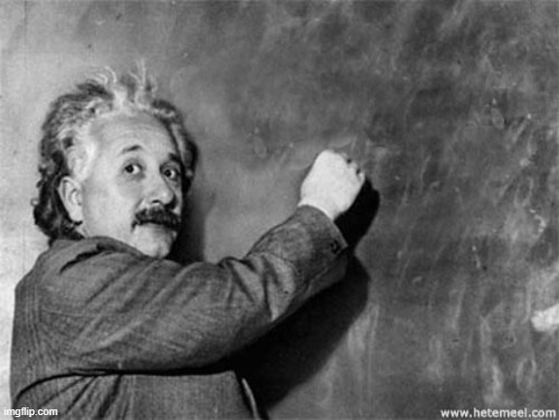
How does it start?
Wouldn’t it be fun to imagine…

Slide 8
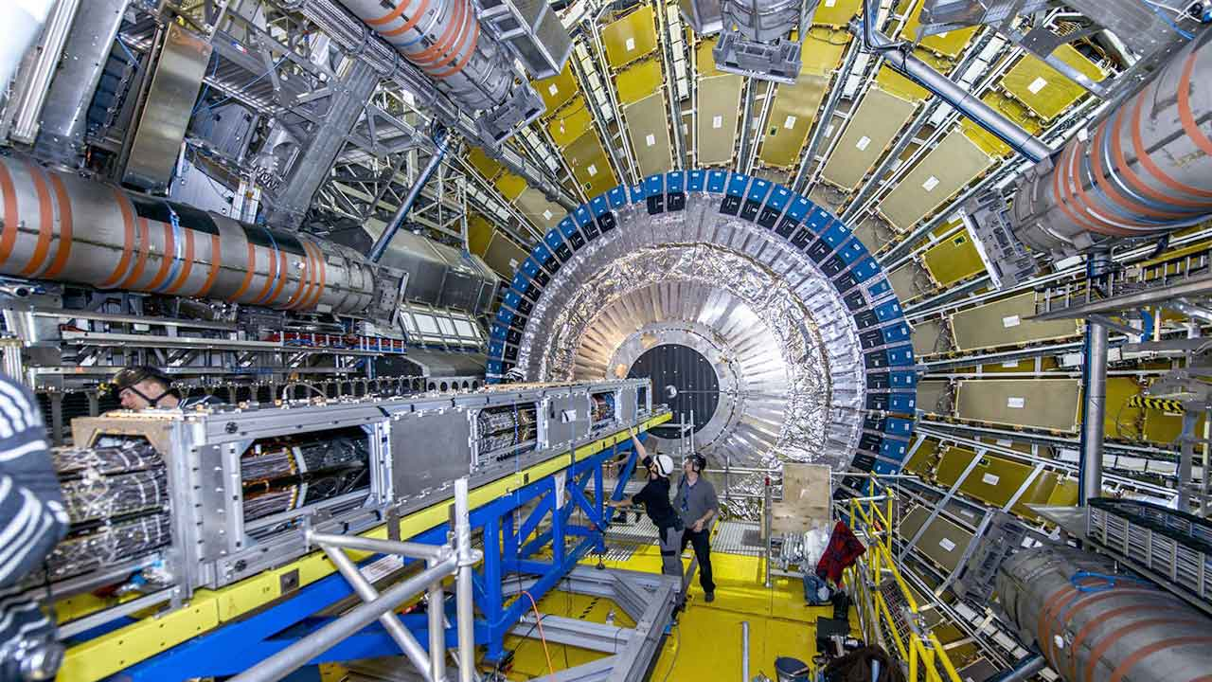

Slide 9
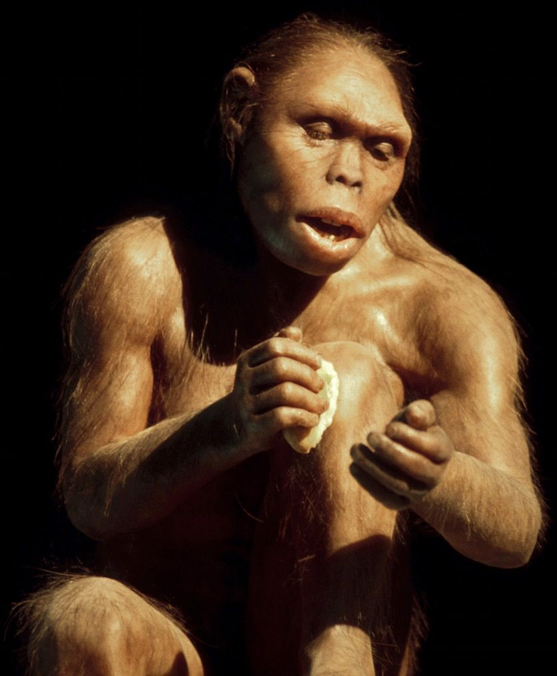
“What if…” ALWAYS comes first than “If…then”

Slide 10
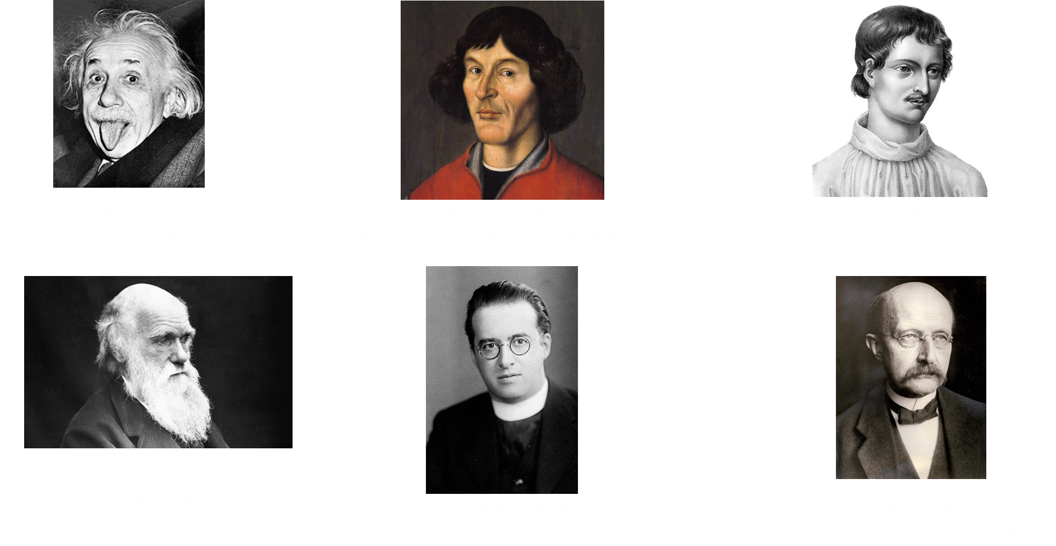
“What if…” ALWAYS comes first than “If…then”

Slide 11
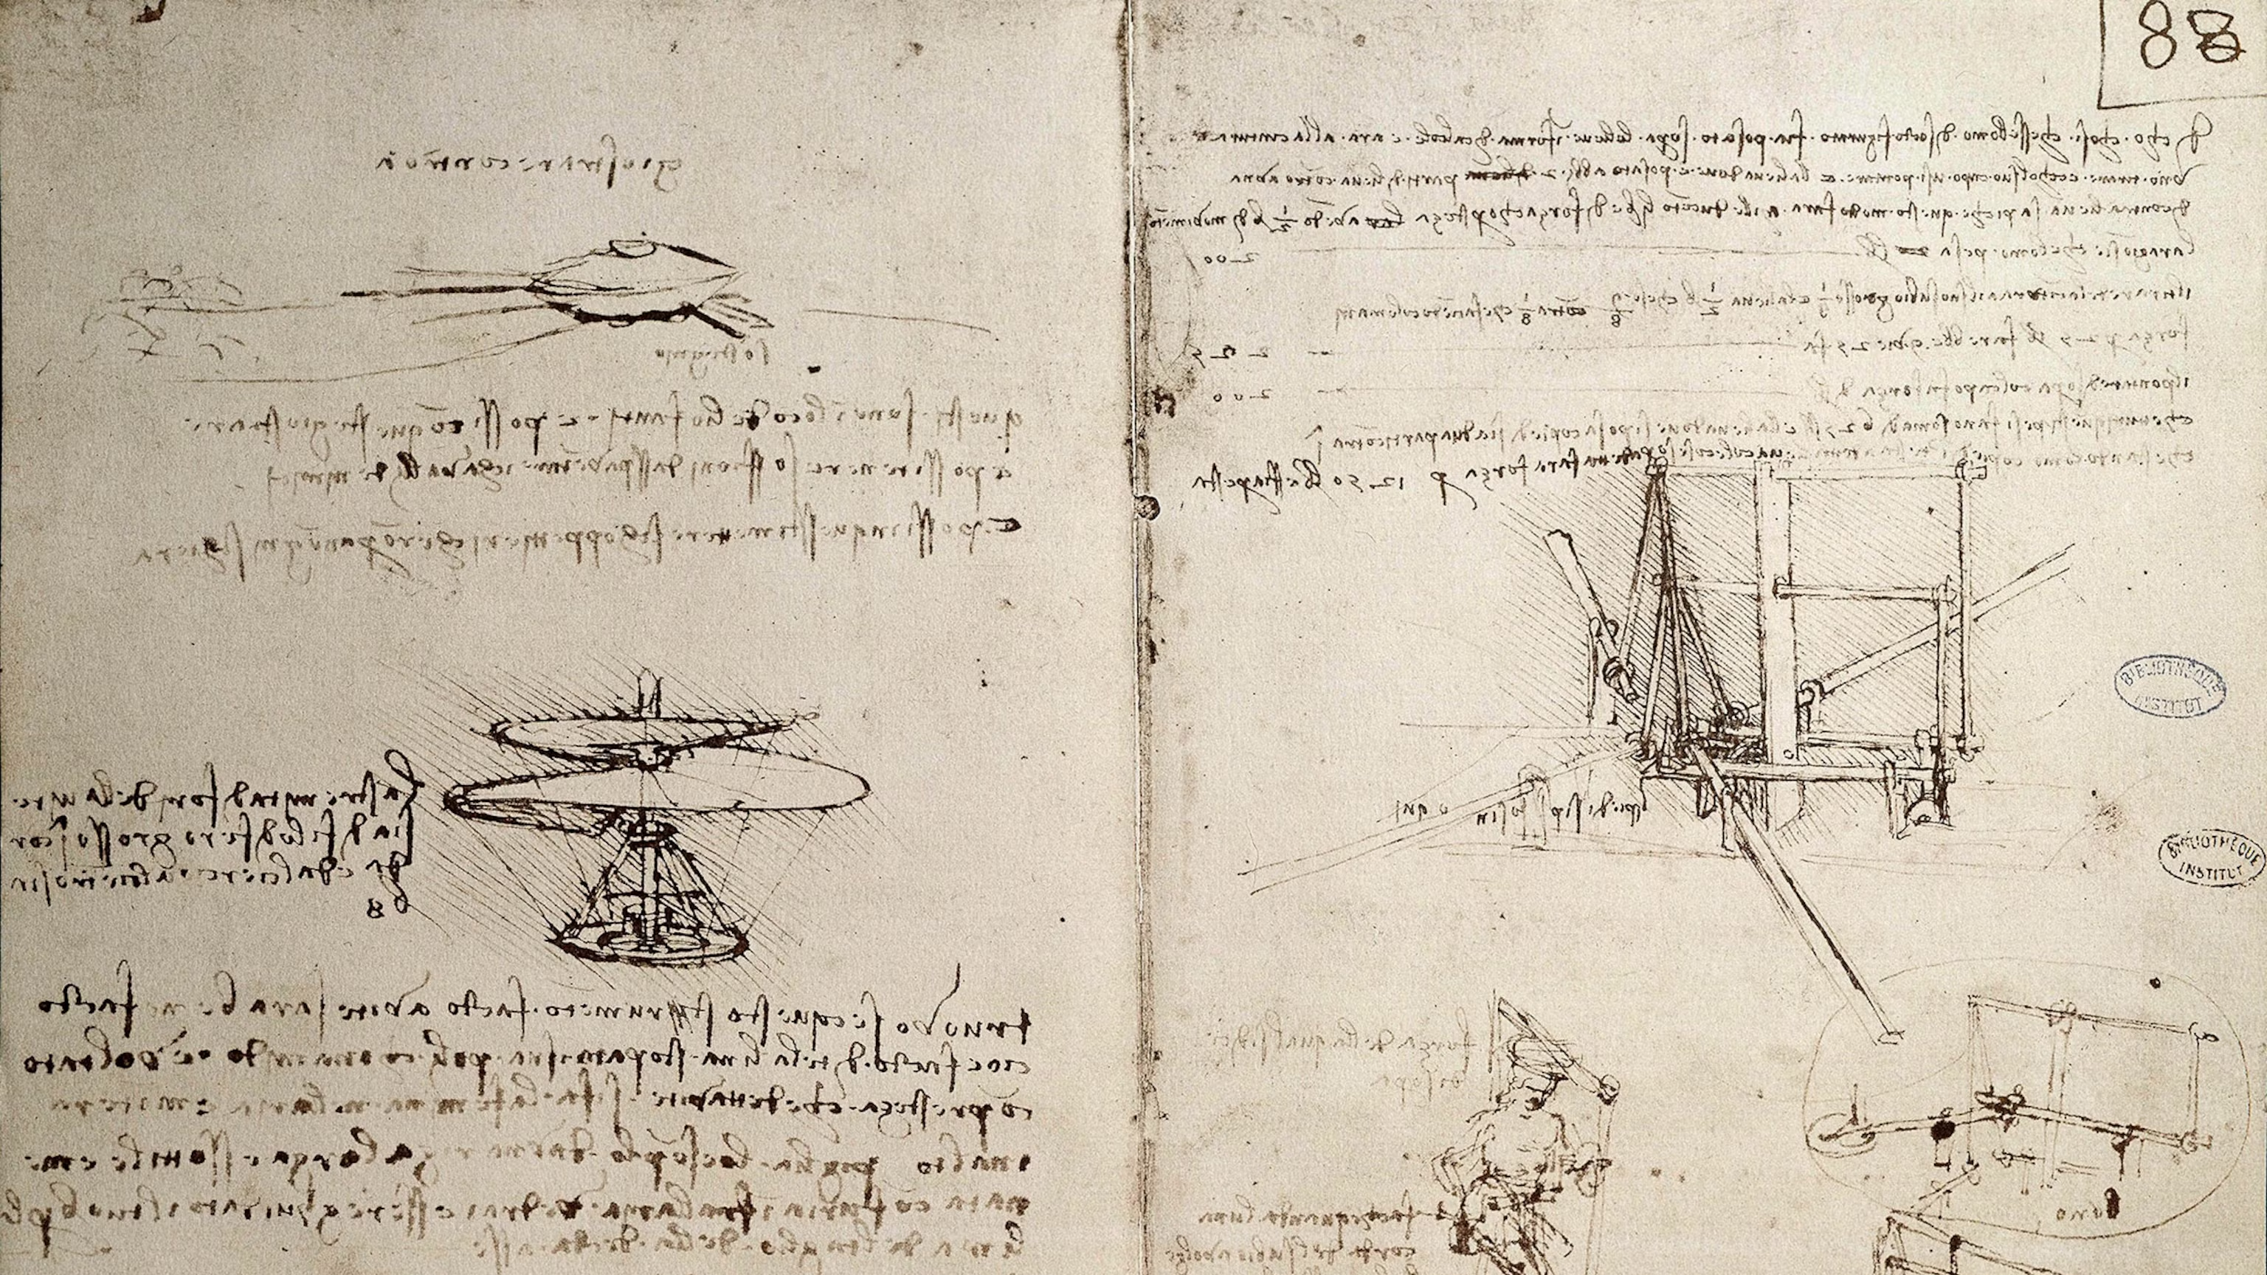

Slide 12
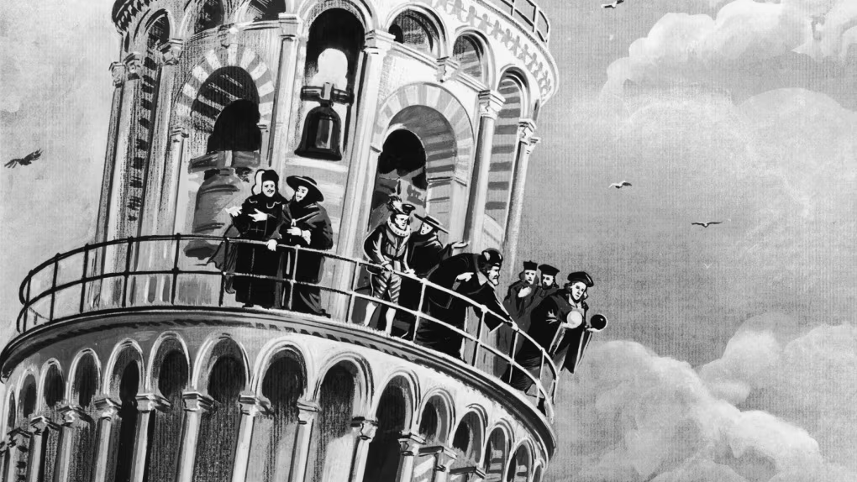

Slide 13
Why industrial innovation is rarely transformative?
Uncertainty
A
A’
B
Time

Slide 14
Business School Innovation vs. Innovation for Real
Progress
B
Pathway
Parallel reality 1
Parallel reality 2
Theory and Books
A
Design
Prototyping
Construct
Install
Operate
Time

Slide 15
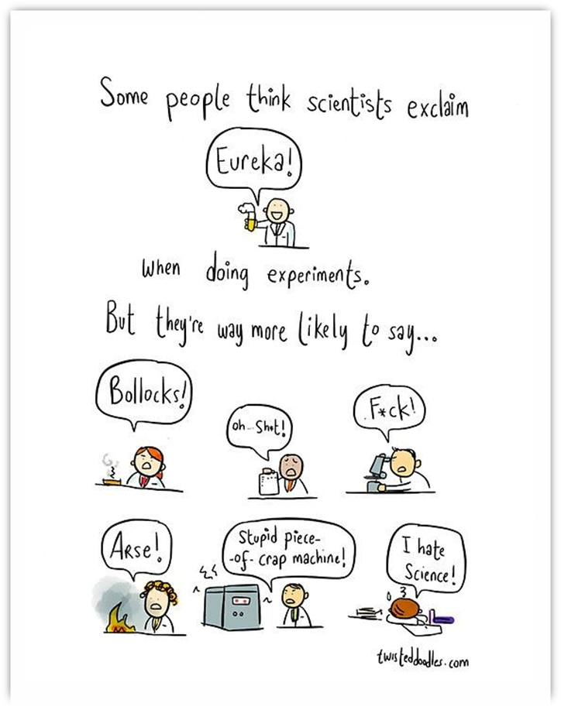
Business School Innovation vs. Innovation for Real

Slide 16


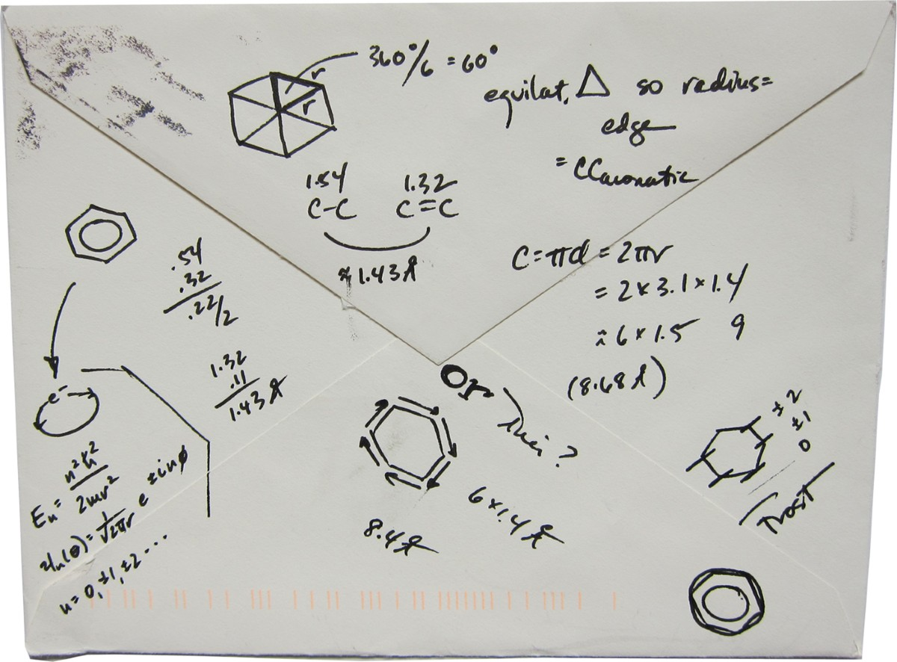
Three Ingredients
Anticipation
Challenging Assumptions
Order of Magnitude Thinking

Slide 17
Thanks to all and questions

