Slide 1


FoCal-H absorber assembly procedure
Maciej Czarnynoga
10/06/2025

Slide 2
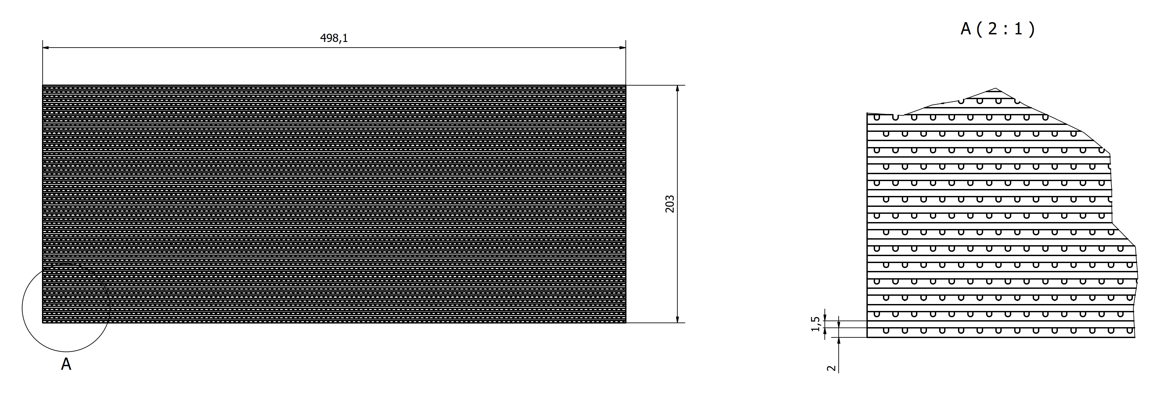
What we want to assemble
The absorber is constructed from alternating layers of grooved plates and separation plates, with the grooved plates measuring 2 mm thick and the separation plates 1.5 mm thick. For the prototype, the absorber will consist of 58 grooved plates and 58 separation plates. Each grooved plate contains 124 scintillating fibers, resulting in a total of 7,192 fibers. These fibers are inserted into the grooves during the absorber assembly proces.

Slide 3
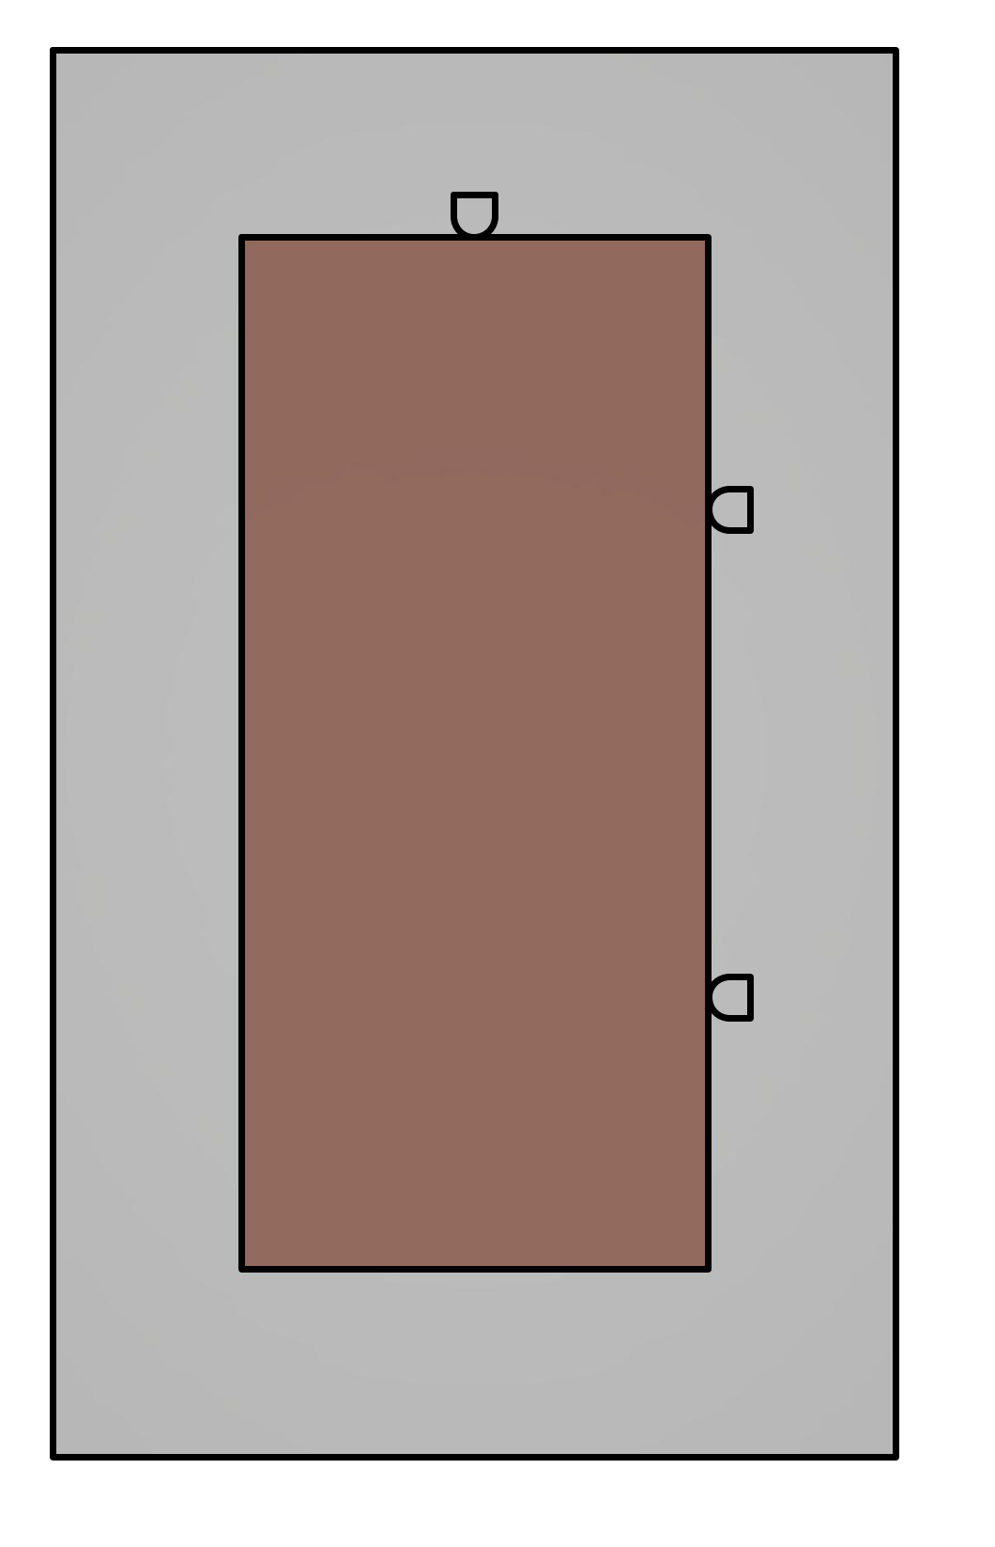
Reference points
The primary objective is to align all plates on the "beam pipe side" so that they are perfectly coplanar. This ensures the detector can be closed around the beam pipe without any gaps between its two halves.
Once this is achieved, the next step is to align the plates to create a single plane at the front of the detector, closest to the interaction point.

Slide 4
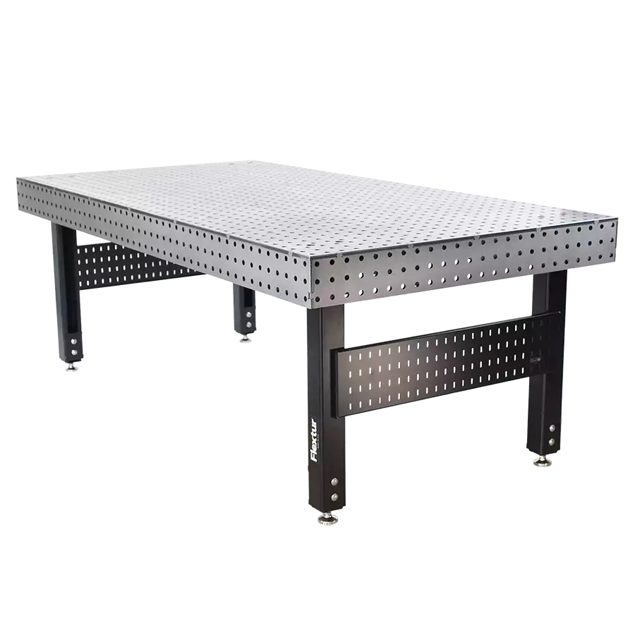
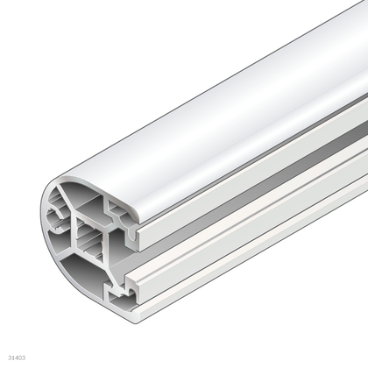
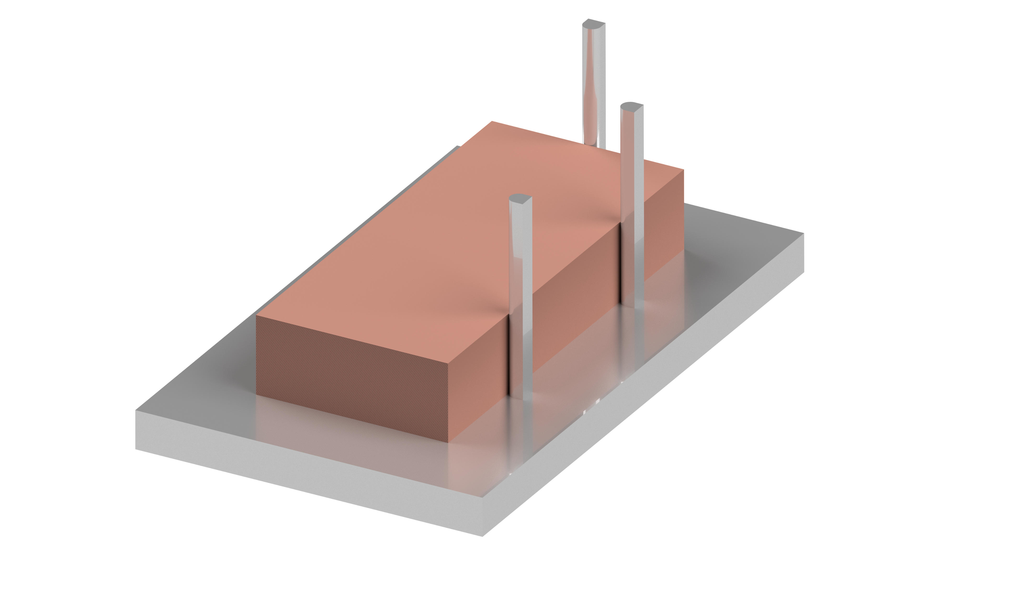
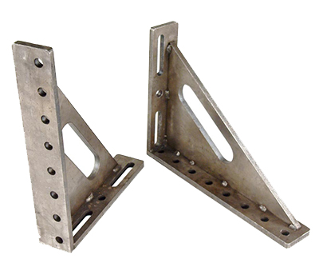
Reference points
Standard aluminum profile 40x40, or we can use standard welding table accessories as reference points
We can use a welding table, a lot of ready-to-use clamping and mounting solutions for assembly. Easy to find a table that stands up to a few tons.

Slide 5
Assembly process - sliding variant
We maintain two types of plate stocks: grooved plates and separating plates. By placing these stocks on carts with adjustable height, we can easily slide the plates onto the assembly table. The cart’s height is set to match the top of the absorber assembly, allowing each subsequent plate to be smoothly positioned on top.
The primary disadvantage of this method is the risk of damaging fibers during the sliding process. Furthermore, making additional adjustments to the position of the top plate can potentially shift the plates beneath it.
The greatest advantage of this method is its simplicity, as well as it does not require the development of any custom tools.

Slide 6
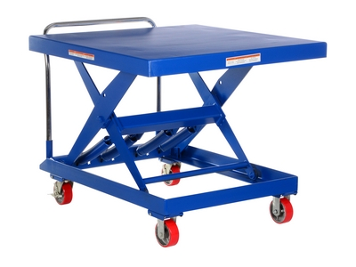
Assembly process - sliding variant-needed equipment
Essential equipment:
Assembly table, with reference elements.
Two carts with adjustable height.
For the final detector assembly, height can present a significant challenge, as standard adjustable-height carts typically do not offer sufficient range to accommodate the required positioning.

Slide 7
Assembly process - lifting variant
Plates are lifted and positioned using a crane equipped with a vacuum lifting tool, then carefully placed onto the absorber assembly. This approach minimizes the risk of damaging fibers that have already been installed in the absorber.
The main drawback of this approach is the necessity for a crane equipped with a dedicated vacuum lifting tool, which requires additional setup, specialized equipment.

Slide 8
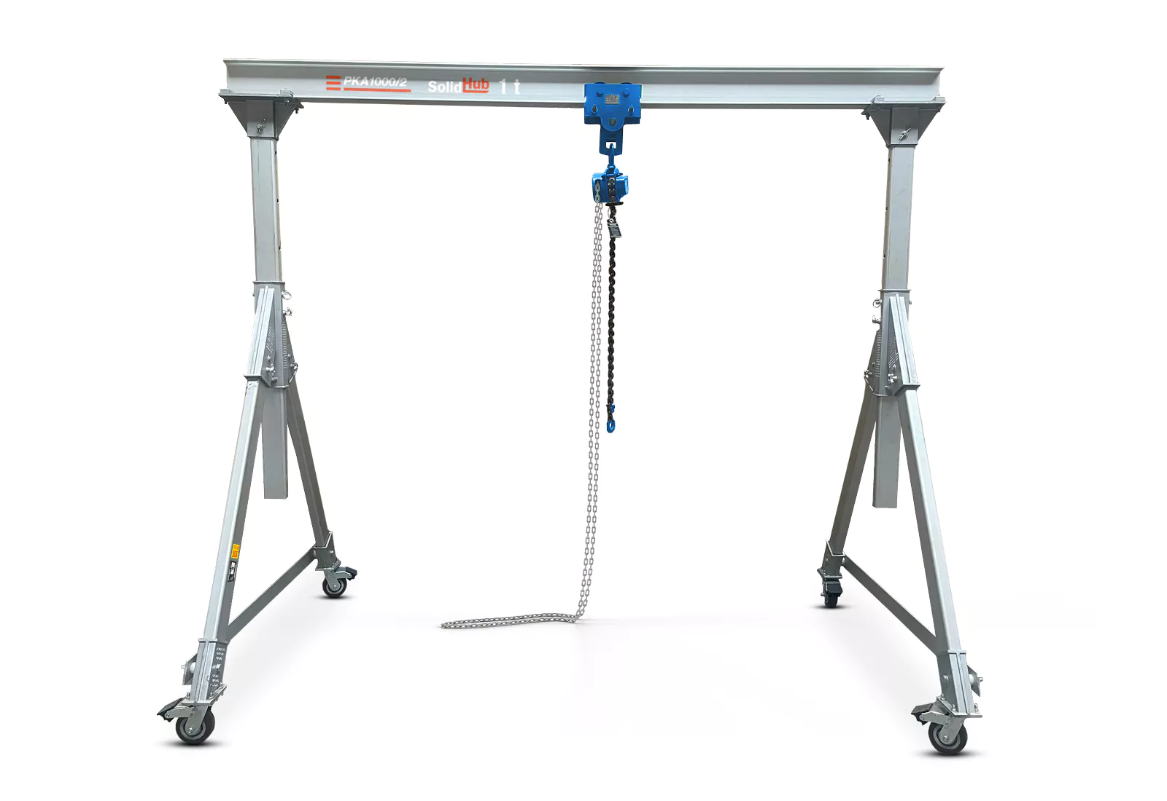
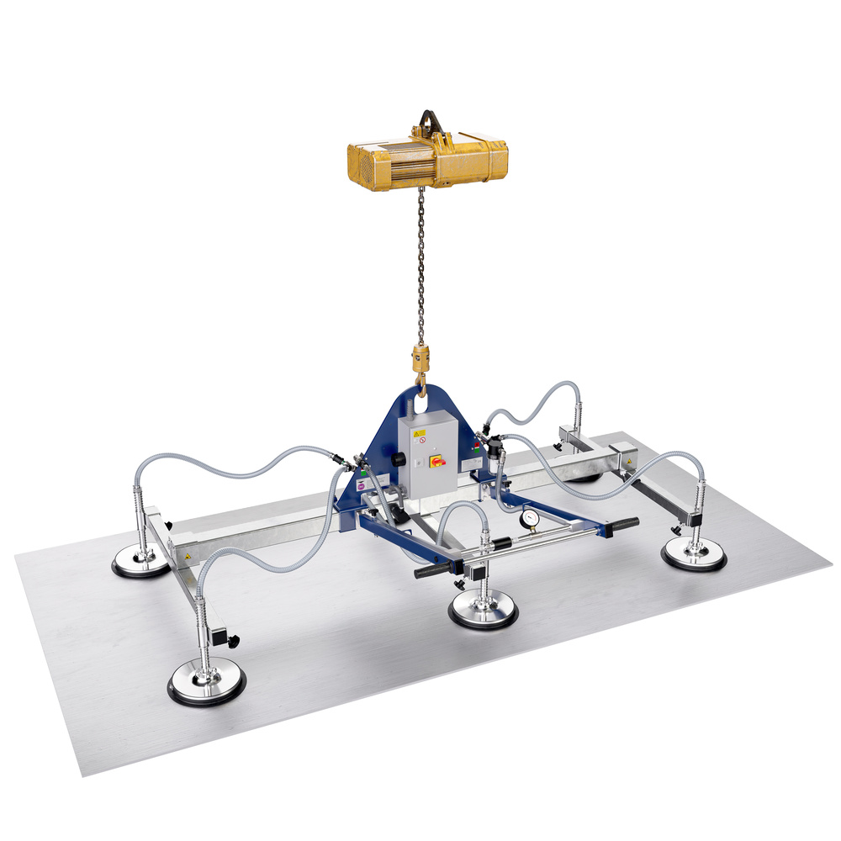
Assembly process - lifting variant-needed equipment
Essential equipment:
Assembly table, with reference elements.
Small crane with vacuum lifting tool
Vacuum lifting tool have to be able to lift plates with grooves, most probably, the development of a custom tool will be needed.

Slide 9

Compression frame
The FoCal detector absorber's stacked plate design, featuring precision-machined grooves, requires mechanical stabilization to prevent plate displacement. To address this, we propose implementing a controlled compressive load across the assembly. This method utilizes friction forces generated between plates to effectively lock their relative positions, ensuring structural integrity during detector operation.

Slide 10


Author:
Maciej Czarnynoga
Email:
maciej.czarnynoga@pw.edu.pl
maciej.marek.czarnynoga@cern.ch

Slide 11
Backup slides

Slide 12
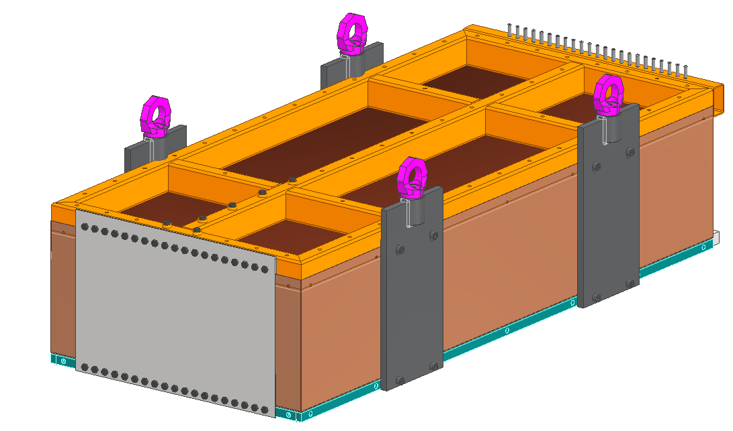
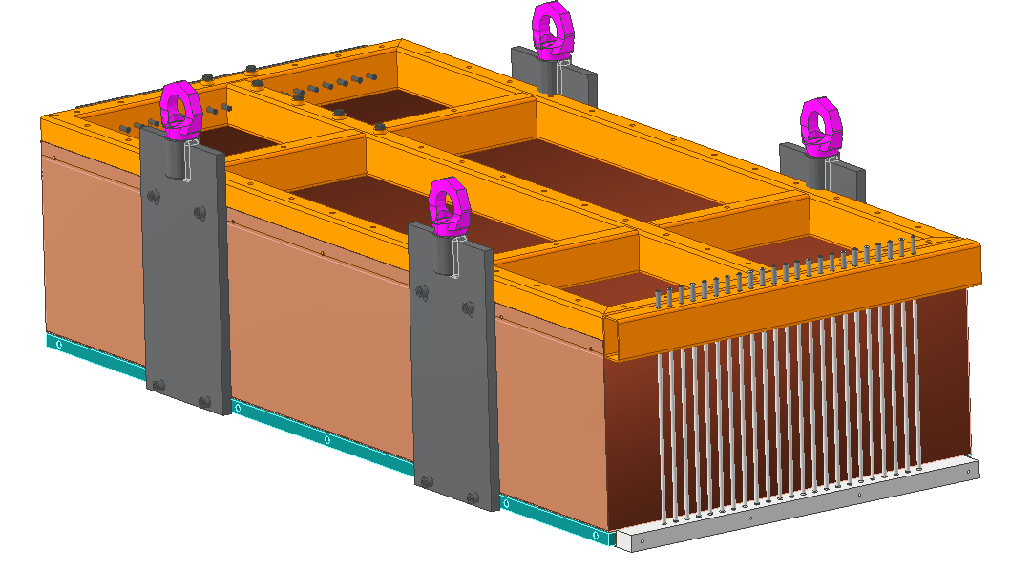
Current design idea
Interaction point
Carbon fiber composite plate
Thin threaded rods
M. Kucharski

Slide 13
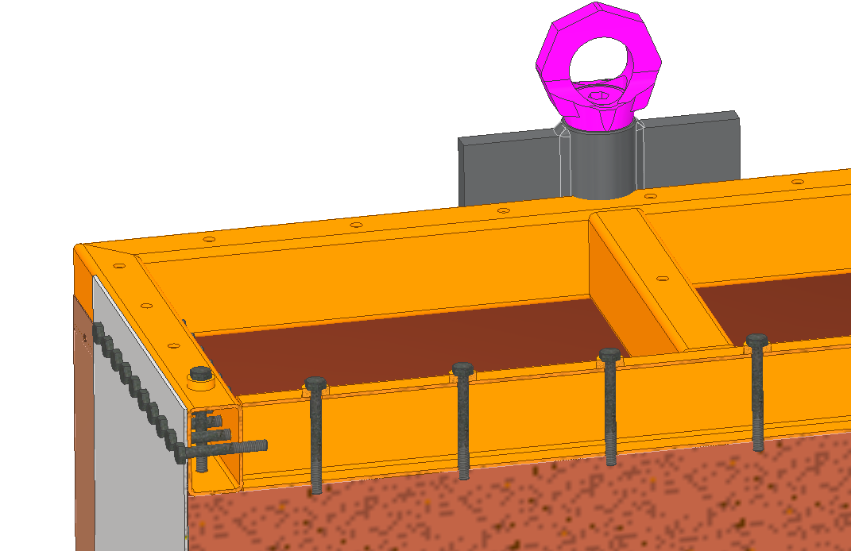
Current design idea
  The compression of the copper plates is to be achieved by a series of bolts that can be tightened and pushed into the plates. This will, in effect, ensure that the panels fit well and do not move.
  Front plate made of carbon fibre composite to fix the frame from the front of the detector. The low thickness and the chosen material will also ensure low material budget.
Carbon fiber composite plate
M. Kucharski

Slide 14
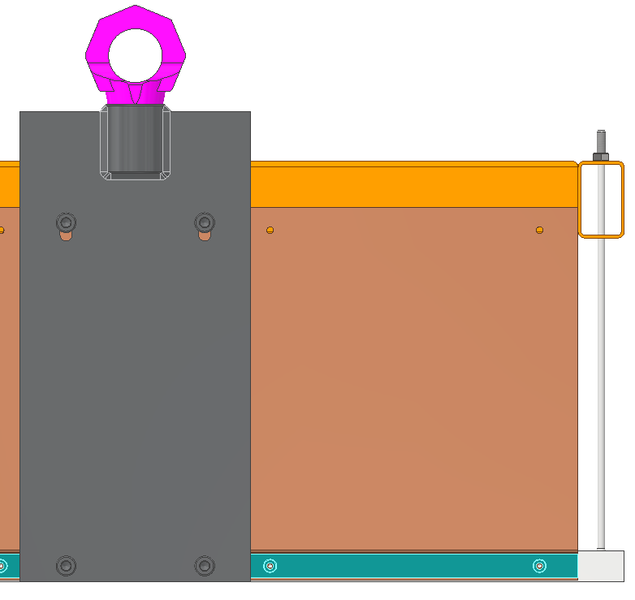
Current design idea
  At the back of the detector, the frame is to be attached by a series of thin threaded rods that will fit into the space created between the scintillation fibres.
  It will be possible to adjust the force on each rod by tightening the bolts at the top of the frame in such a way as to equalise the forces acting on each bar.
Thin threaded rods
M. Kucharski

