Slide 1

PixESL
An Open-Source Virtual Prototype Framework for Detector Electronics
Mahdi Zahedi, Francesco Brambilla, Jashandeep Dhaliwal,
Davide Ceresa, Xavi L. Cudie, Stefano Esposito, Kostas Kloukinas

Slide 2



Introduction to PixESL
Context:
  EP R&D Programme on Technologies for Future Experiments: IC Technology Work-Package (WP5)
  Development started in 2023 in the EP-ESE-ME section
Project:
  Name: PixESL (virtual Electronic System-Level prototyping framework for Pixel detectors)
  GitLab repository:
  Core: https://gitlab.cern.ch/iod/pixesl-group/core
      Project Template: https://gitlab.cern.ch/iod/pixesl-group/pixesl-project-template
      Tutorials: https://gitlab.cern.ch/iod/pixesl-group/pixesl-4-school
Publications:
  [2024] Paper: Virtual Prototyping Framework for Pixel Detector Electronics in High Energy Physics
  [2024] Paper: SystemC framework for architecture modelling of electronic systems in future particle detectors

Slide 3




Motivation
Design flow improvement
Time-consuming
(~years)
Specifications
guidelines
Hardware design
limitations
Time-consuming
(~years)
Physics simulation
Verification
NO structured feedback

Slide 4


Motivation
Design flow improvement
Fast (~months)
Specifications
guidelines
PixESL framework
guidelines
Hardware design
limitations
limitations
Validation
Verification
Physics simulation
Virtual prototype
Verification
ASIC limits
ref. model
Reference model
for verification and physical simulation

Slide 5


Motivation
End-to-end simulation flow
From the particle interaction
with the sensor
Simulation flow
Chip output
PixESL
Sensing element design
Charge deposition + collection (+ digitization)
Front-end architecture +
Readout architecture +
Post-processing
The emphasis of PixESL is:
Modelling the behaviour of pixel detector circuits and complementing TCAD and Allpix² by bridging the gap between charge collection and electronic signal processing.
Notes:
Allpix² focuses on simulating the physical processes in silicon detectors, from particle interaction to digitized hits.
However, it lacks detailed modelling of circuit-level behaviour (e.g., readout, analog front-end).

Slide 6
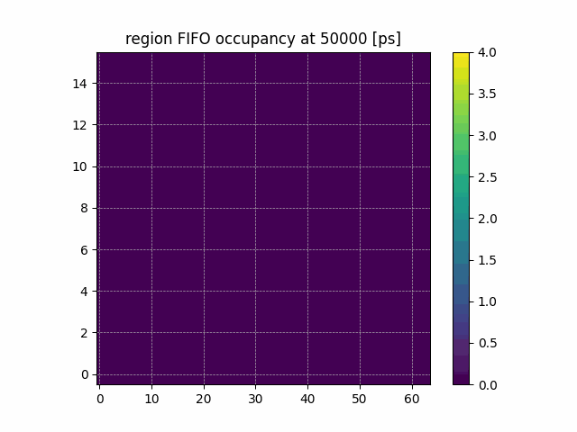
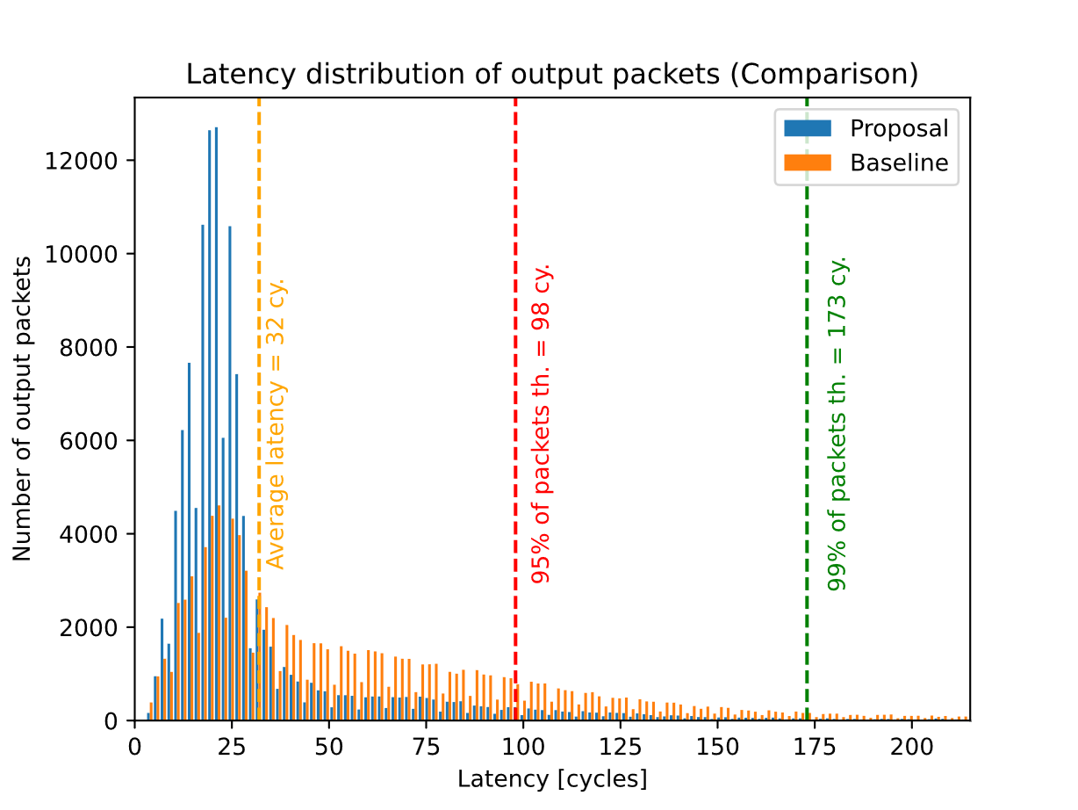
PixESL in CERN experiments
Example of design exploration for LHCb VELO Upgrade II
Baseline
Proposed
 | Velopix | Proposed
Pixel | 256x256 | 256x256
SP | 128x128 | 128x128
Regions | 64x8 | 128x8 *
EoC | 64 (8 ch.) | 128 (16 ch.)
Arbitration | Round-robin | Back-pressure
Readout eff. | 90 % | 99 %
Avg. latency | ~100 cy. | ~30 cy.

Slide 7
Conclusion
PixESL, Allpix2, and TCAD together provide an end-to-end simulation of pixel detectors.
PixESL provides a template and basic implementation of modeling the circuits in pixel detectors.
PixESL is designed in a modular way, helping user to easily integrate their own model.
PixESL provides the community with the opportunity to have a library of circuit models.
PixESL facilitates early design space exploration for the designers of pixel detector circuits.

