Slide 1
L4-PSB 2025 Start-up
Post Mortem @ BI TB
26-Jun-2025
F.Roncarolo

Slide 2
L4-PSB OP meetings
OP meetings 8.45: daily during commissioning → Mon and Thu during normal operation
Chaired by L4 and PSB coordinator of the week, normally in 15 minutes we cover all L4 and PSB status + plans
Weekly L4-PSB Machine Panel Committee (Tue 8.45) - Linac4/PSB Machine Performance Coordination · Indico
summary of the week, with relevant details of what will be presented at the FOM just after
Chaired by G.P. Di Giovanni, with minutes

Slide 3
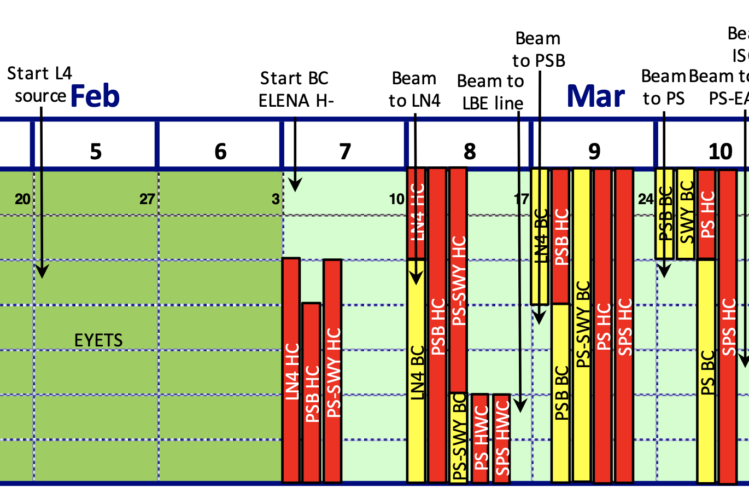
L4-PSB Schedule 2025
All went as planned , even with some advance in sending beam to PSB and then being ready for PS

Slide 4
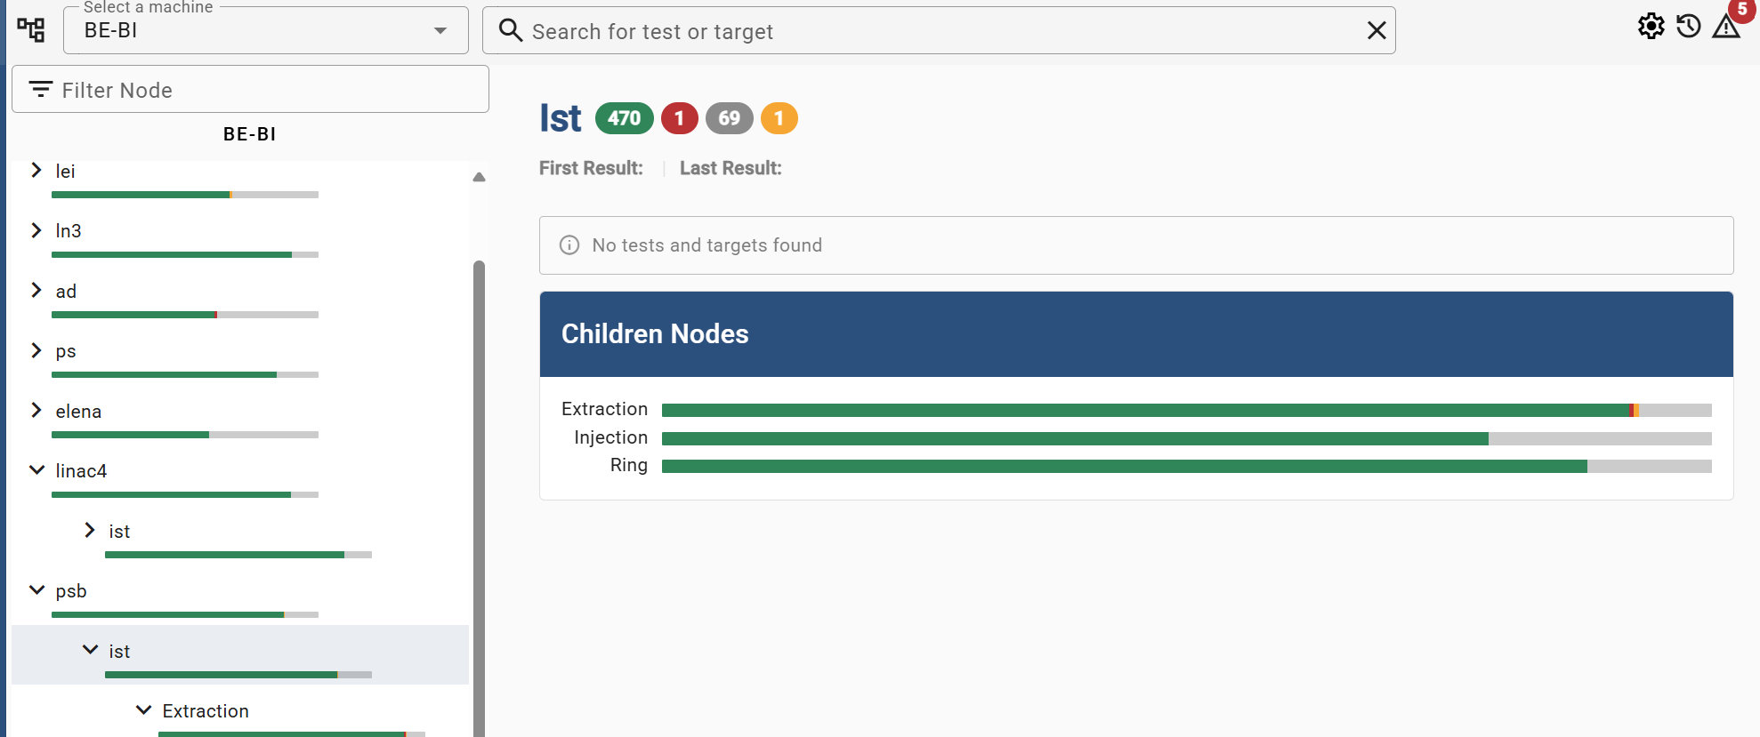
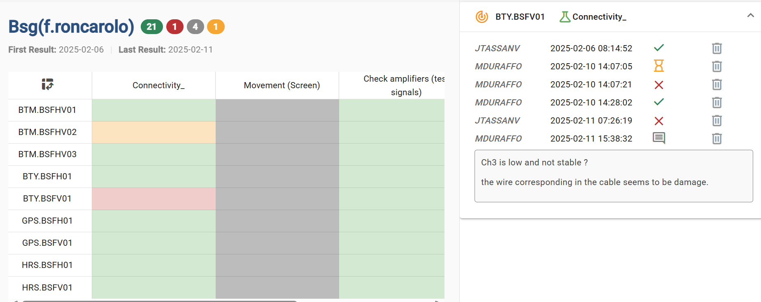
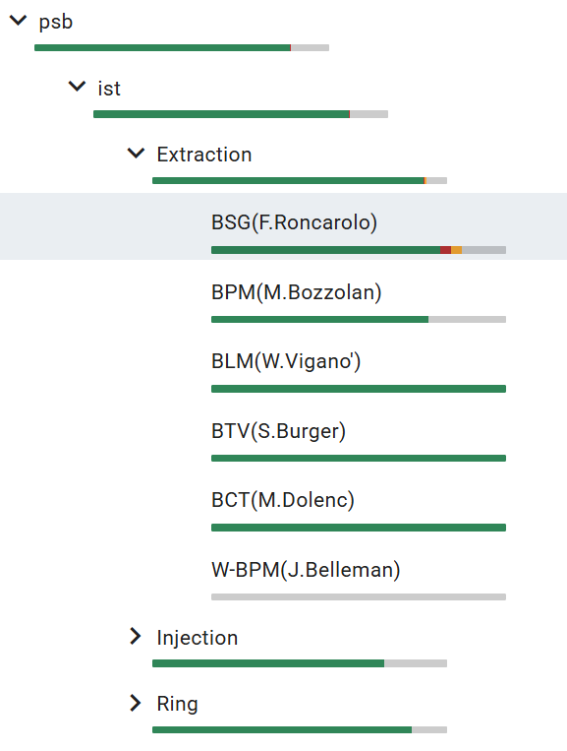
BI ISTs
ISTs performed in allocated time before HWC or in some cases during regular ‘YETS’ maintenance
Most of tests updated (thanks to all BI experts!) in OP Webtools → Check list, which is then used/checked by OP HWC team

Slide 5
L4-PSB HWC – BI systems
Also went smoothly.
HWC is well structured with OP responsible (Jose, Abdel, Fabrice)
BI experts either contacted before (it happens often with BTVs, Stephane in ccc when HWC planned) or called as needed.
Smooth this year

Slide 6
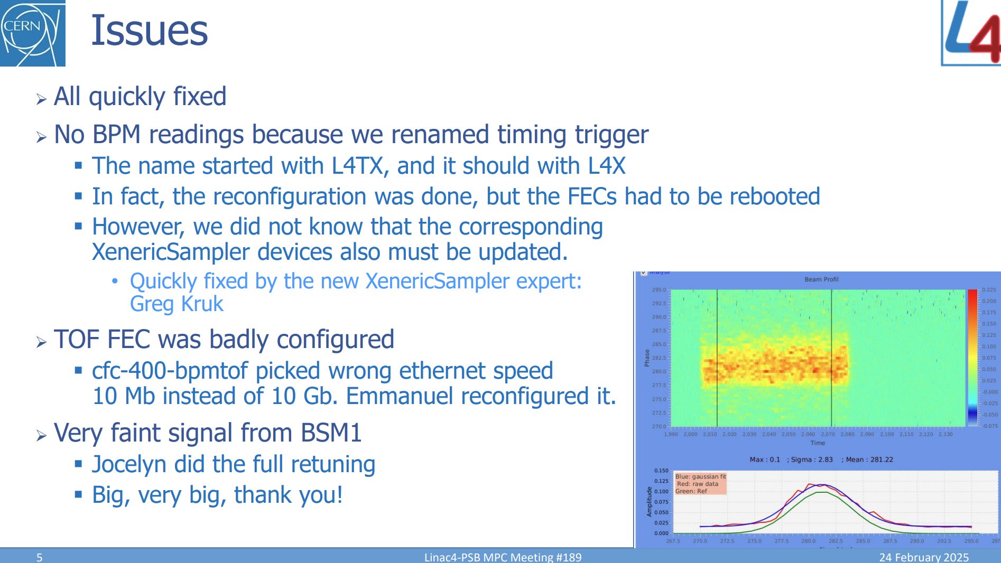
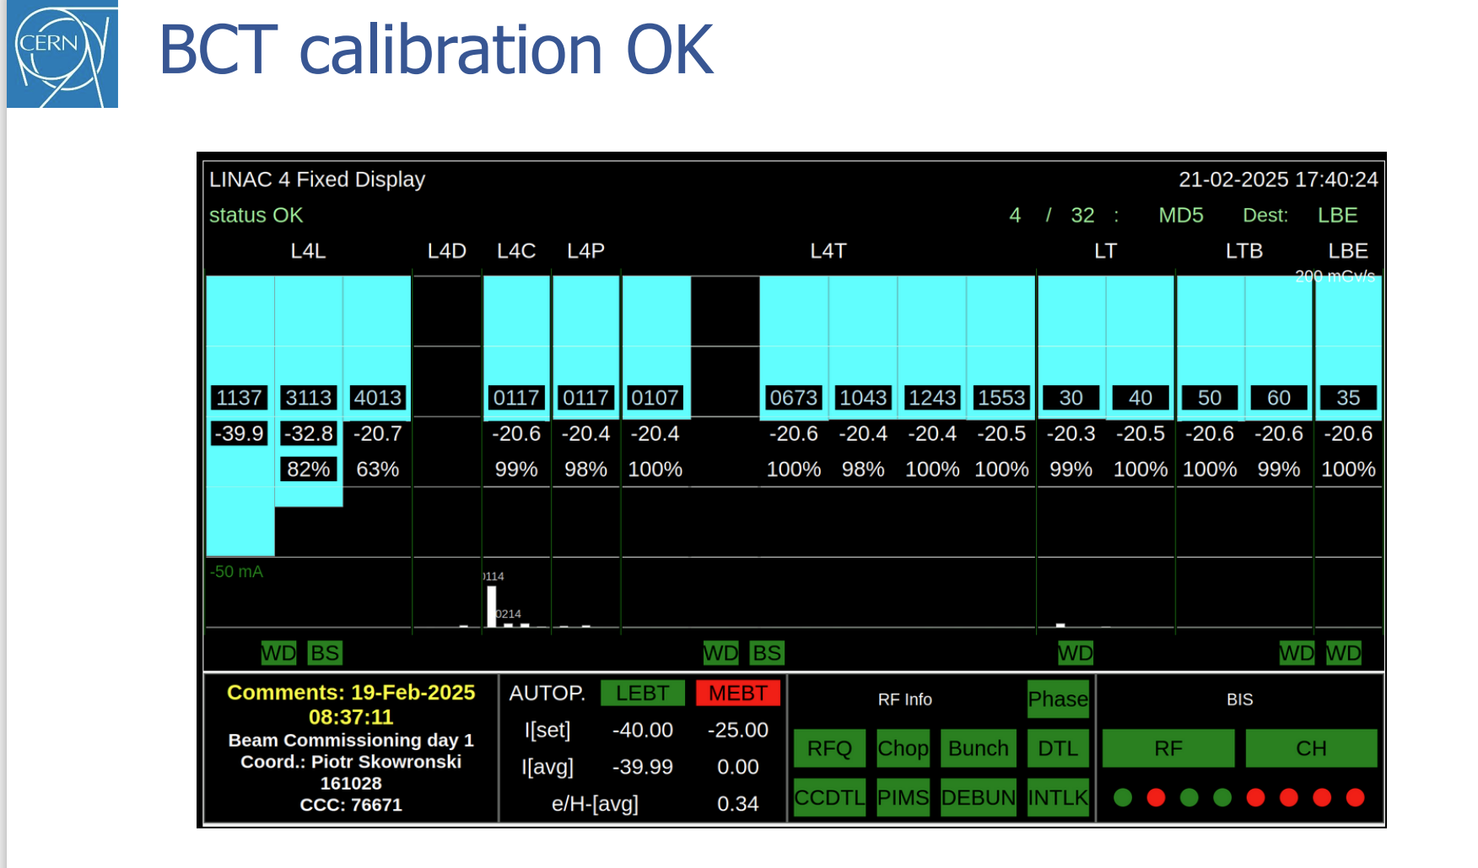
L4-PSB – BI during beam commissioning and operation so far
No major issues. Minor issues always promptly tackled by BI experts
First beams, Feb 20
xxx head amplifier changed in YETS

Slide 7
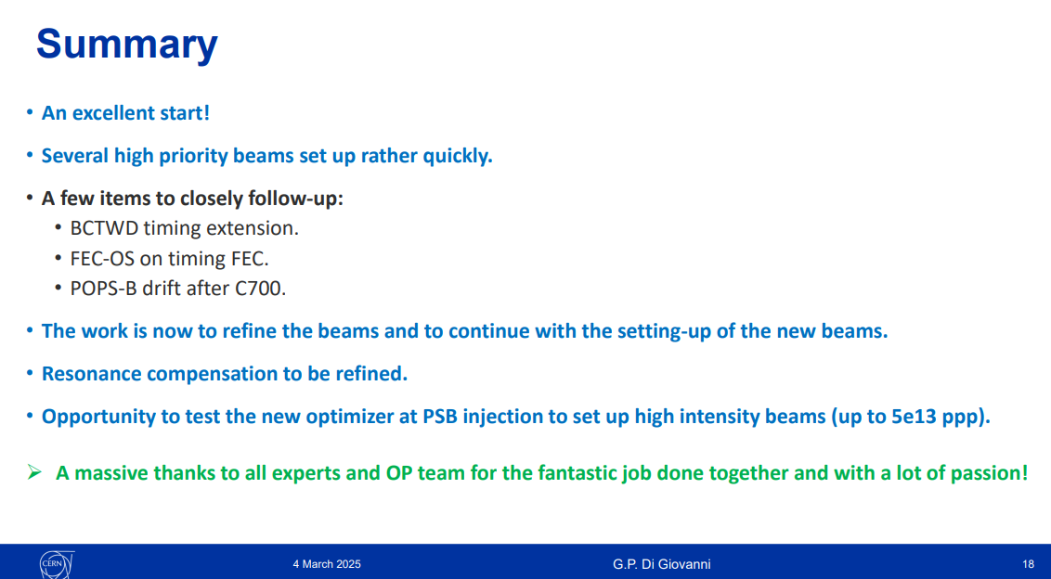
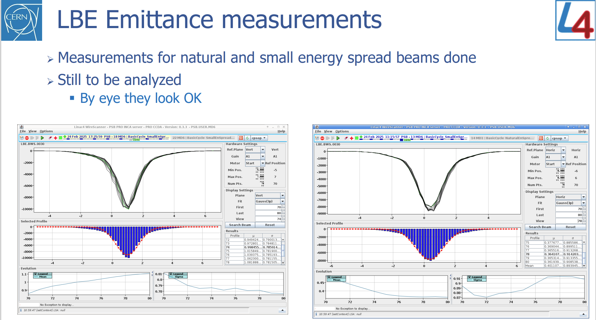
L4-PSB – BI during beam commissioning and operation so far
No major issues. Minor issues always promptly tackled by BI experts
First beams, Feb 20
MPC March 4, first beam in PSB

Slide 8
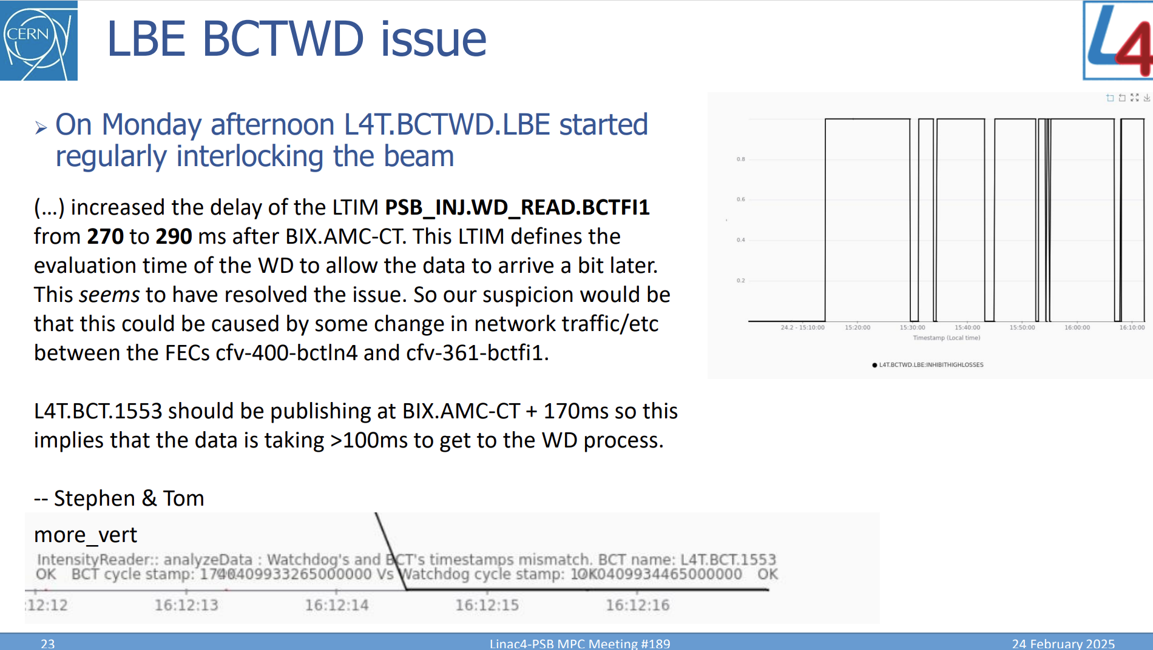
BCT WD during commissioning and xx weeks of operation
Delay in publishing BCT comparison, caused timeout and triggered interlocks, at few locations in PS complex.
Athanasios patched it successfully (increased acceptable delay, the important is to intervene before next cycle, 1.2s time available)
Plan to completely fix this in LS3

Slide 9
BPMs
PSB
BPM calibration error alarm: Previously appeared but has now disappeared (fixed by Michele, positive development)
(new ) Phase BPM in 1L5:
Michele installed cables for commissioning
This is to allow removing BPM in 14L4, to allow maintenance of BSW magnet without equipment interference
This type of BPMs are operated by RF as a phase pickup
Side note on L4 BPM (not critical)
There are many points digitized and published from BPM signals after the beam passages. Should we reduced them to make overall DAQ and data processing lighter ?

Slide 10
New BLM SW functionality
Key points about the new BLMINJ feature, to address lack of information of accumulated high losses cycles
Activated on PSB BR.BLM.A and BR.BLM.B in April – tested ok, being implemented now in all CPS
Monitors beam loss events with three new parameters:
  swinterlockRecurrenceCount: tracks number of bad shots
  swinterlockRecurrenceLimit: maximum allowed bad shots
  swinterlockRecurrencePeriod: monitoring time window
Current settings: 300-second window with 10 badshot limit
Raises LASER alarm if limit is exceeded (observation only, no beam interlock)
Requires MCS_PSBOP role to modify settings

Slide 11
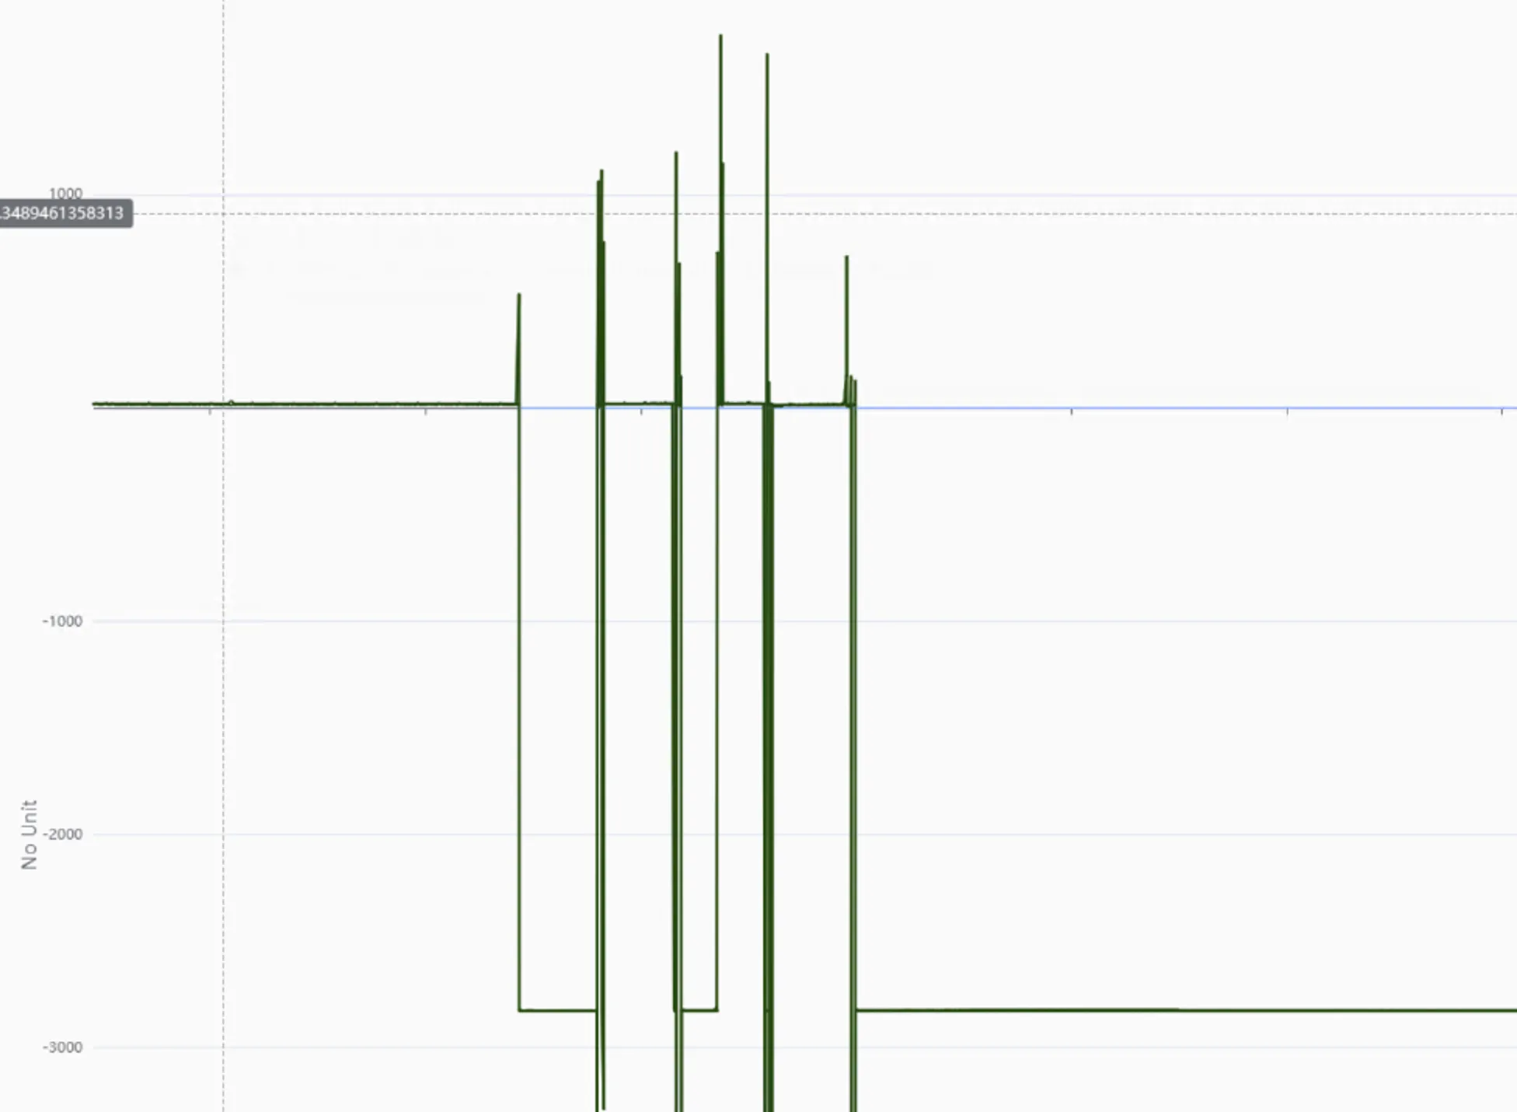
BWS
PSB - BR1.V C-wire temperature going up and down while wire integrity check during a scan
  https://its.cern.ch/jira/browse/BIBWSLIU-172
  Likely bad contact. Not affecting BWS functioning. To be monitored
BR4.V optical disk reading loosing references → published beam position jitters
  Need to retune optical disk laser power
  https://its.cern.ch/jira/browse/BIOP-1193 (ongoing)

Slide 12
Summary
All rather smooth in both L4-PSB commissioning in general and BI performance / support
Few hiccups listed in previous slides – nothing critical or blocking
Maybe useful to look at BI in AFT statistics – end of the year
Reminder:
  L4 BSM remains workhorse, especially during yearly commissioning or in case RF re-phasing needs
  With J.T. leaving it will be important to ensure support for after LS3 and review spares situation
  Can we also train OP experts (e.g. Piotr) to setup system ?

