Slide 1
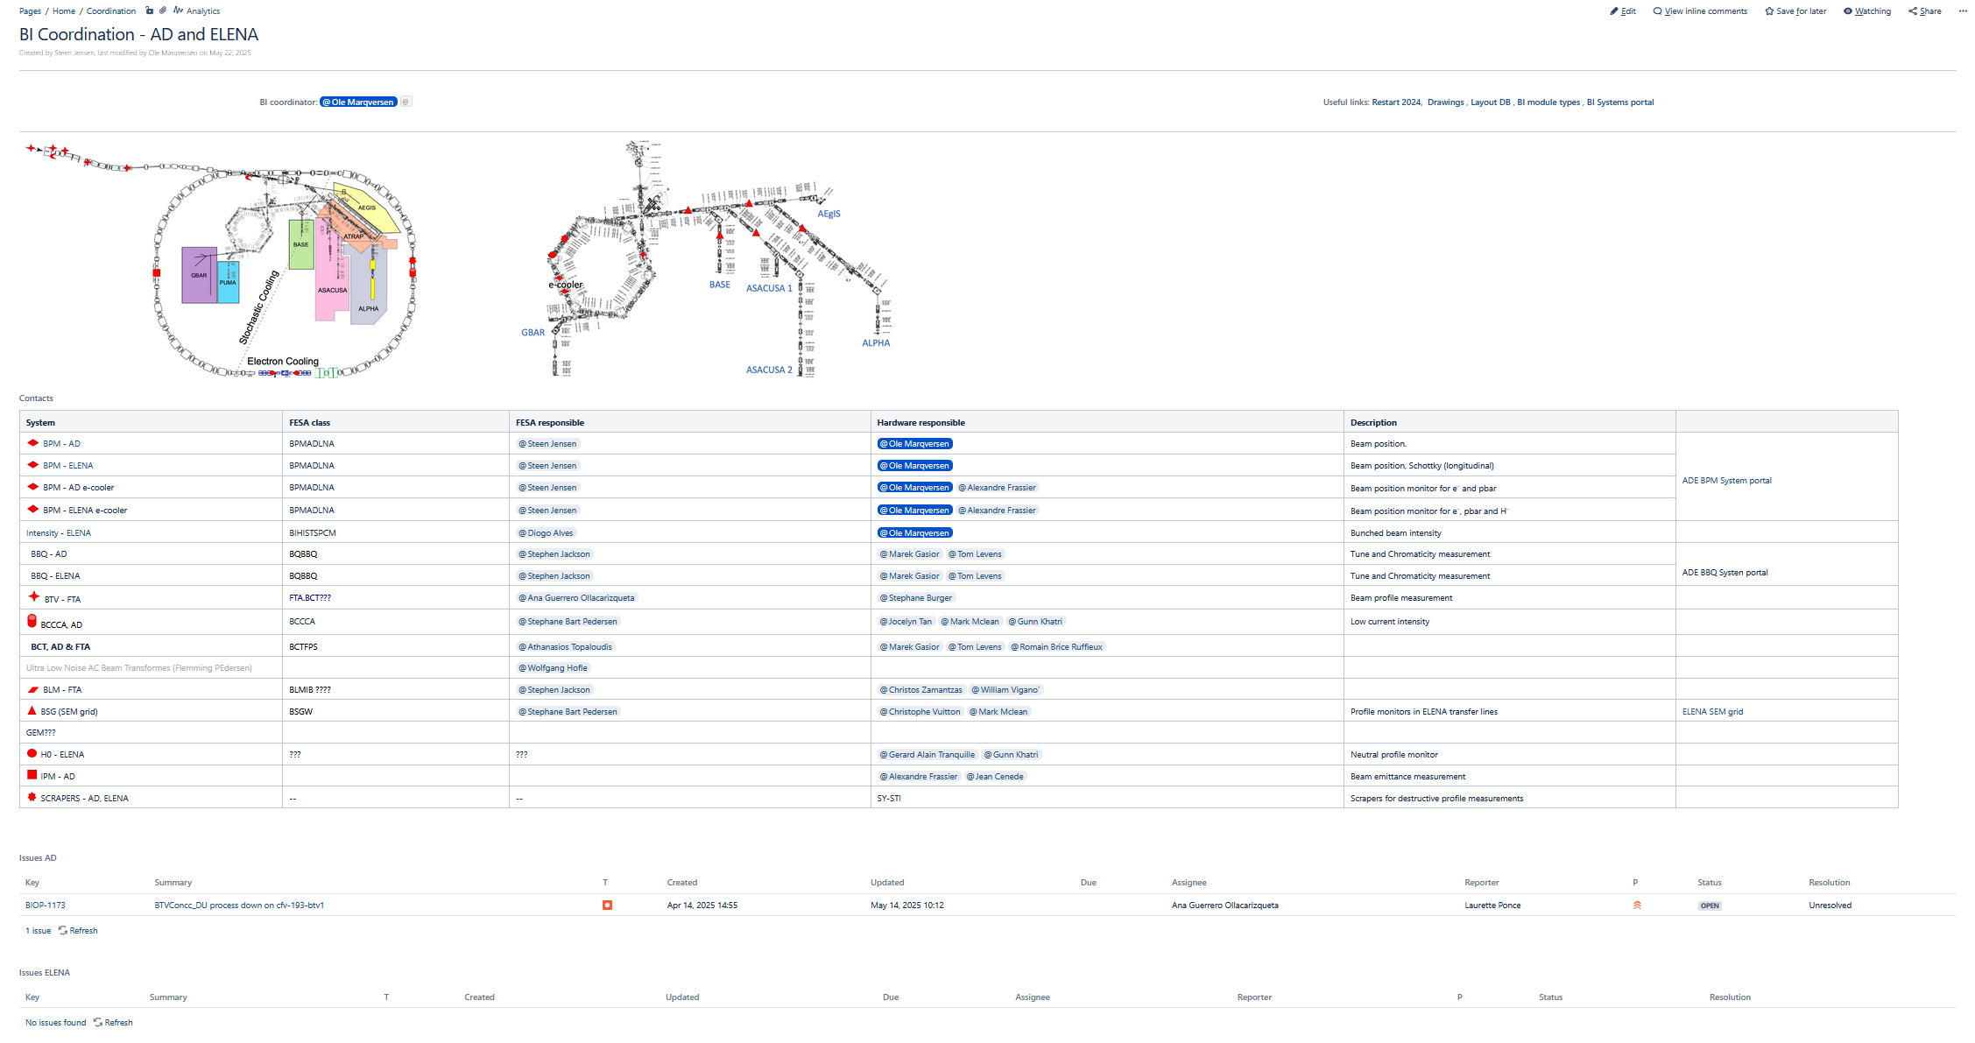
AD / ELENA start-up 2025
Ole Marqversen, TB 26/6-2025

Slide 2
AD / ELENA start-up 2025
Ole Marqversen, TB 26/6-2025

Slide 3
AD / ELENA start-up 2025
Ole Marqversen, TB 26/6-2025

Slide 4
AD / ELENA start-up 2025
Ole Marqversen, TB 26/6-2025

Slide 5
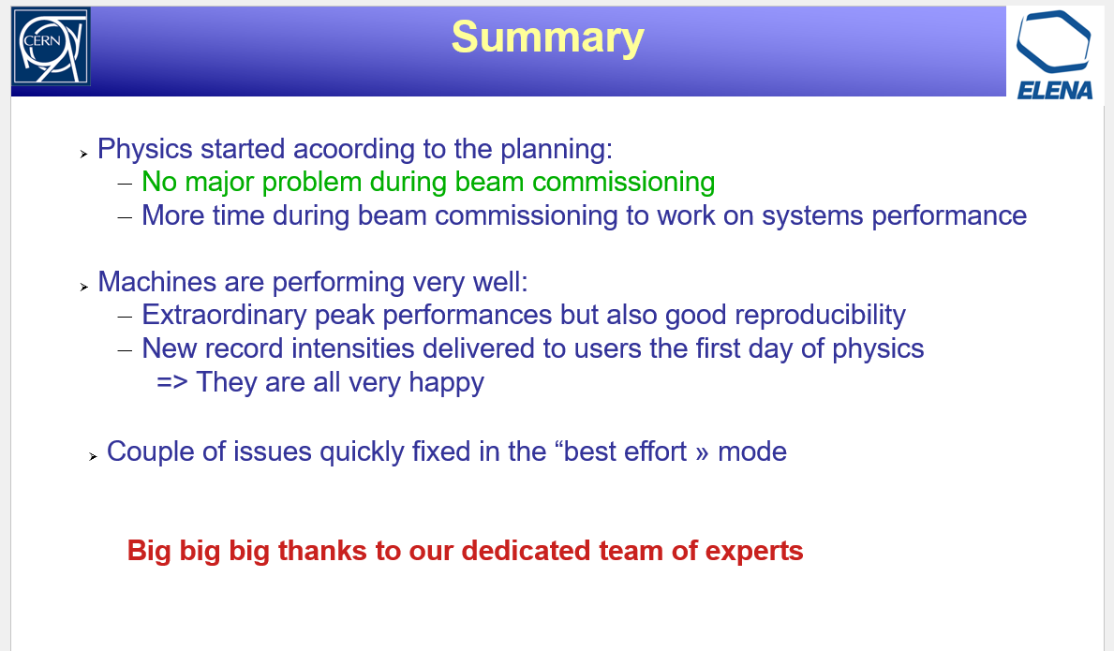
Curtesy of Laurette Ponce (presented 22/5-2025 ADTC)
Ole Marqversen, TB 26/6-2025

Slide 6
AD / ELENA start-up 2025
BCCCA (AD only):
  - New turbo pump installed; no leak found.
  - Added extra control and diagnostics to avoid a repeat of last year’s vacuum failure.
E-Cooler:
  - Maintenance on collector cooling water done
SEM-Grids:
  - All good
BBQ:
  - No change this YETS, All good
BCTs:
  - New filters installed, All Ok
  - New timing to allow for multi bunch ejection (new +100 mini bunches as “slow” extraction )
BTV:
  - A small application problem fixed.
BPMs:
  - Solved problem on electron trajectory measurement
Bunch beam intensity: (From electrostatic pick-up, ELENA only):
  - All OK
Ole Marqversen

Slide 7
Transverse beam profile ?, ELENA
Focus points:
“Recombination Monitor” aka “stripped H- monitor” ….. Or “H0 monitor” : (Gerard)
  Raspberry Pi based camera looking at a phosphor screen with a micro channel plate (MCP) ……… System presented at COOL23 and COOL25.
  The system will be ported to CERN control system during 2025 (Dixet Gerard)
Scrapers : (shared responsibility: BE-CEM, BI, OP ?)
  OP: Too noisy and too slow !! (OP has no confidence in this solution, now even with new MCPs!)
  Is this BI’s best “offer” for a transverse beam profile ??
    TB (19 Oct 2023): Call for a meeting ? ….. Should we meet “now”, in the BI-FT setup
      What is BI’s best “offer” ?
      Shared responsibility ?
      Should we replace the 4 MCPs during LS3 (25kCHF)
Ole Marqversen, TB 26/6-2025

