Slide 1
RF MDs for MD#1 2025
H. Timko, X. Buffat, A. Butterworth, R. Calaga, B. Karlsen-Baeck, I. Karpov,
S. Kostoglou, S. Lauber, S. Morales, K. Turaj, D. Valuch, M. Zampetakis
LSWG meeting, 12th May 2025

Slide 2
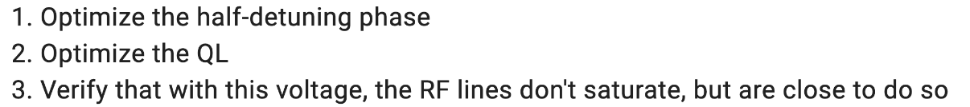
MD15423 (6 h)
RF capture and start of ramp with HL-LHC beams
In MD#1, stay at injection
  Beam:
    10 INDIVs of 2.3 x10¹¹ p/b for brightness studies, to be blown up with ADT to 3 um after injection
    2025 physics beam of 4x36b BCMS with HL-LHC intensities (2.3+-0.3)x10¹¹ p/b
  ADT to be put in high-intensity regime
Optimize capture with OTFB open (~6 MV) and later with OTFB closed (~5.5 MV)
  Leave 2 sets of settings for subsequent MDs and MD blocks
If time allows, perform a voltage scan
  Observe off-position population (FBCT vs DCBCT)

Slide 3
MD15425 (8 h)
Improved cleaning of de-bunched beam at LHC injection
ADT inter-batch cleaning
  ADT noise to be prepared/programmed to act between the batches
RF cleaning:
  Batch-by-batch set point blow-up in a frequency band that targets the de-bunched beam
Beam: operational 4x36b BCMS with 1.6x10¹¹ p/b
  Possibility to test ADT and RF cleaning in parallel, one on each beam
Methods to increase the de-bunching:
  Increased injection phase error
  Decreased capture voltage
  Opening the beam phase loop
  ”Regular” blow-up of the batched beam

Slide 4
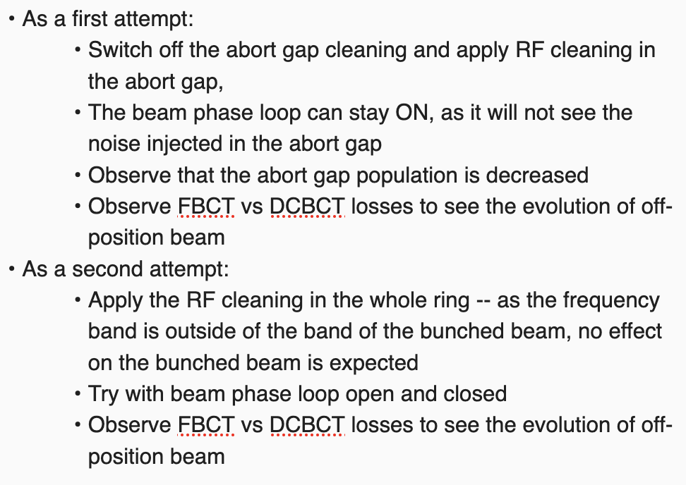
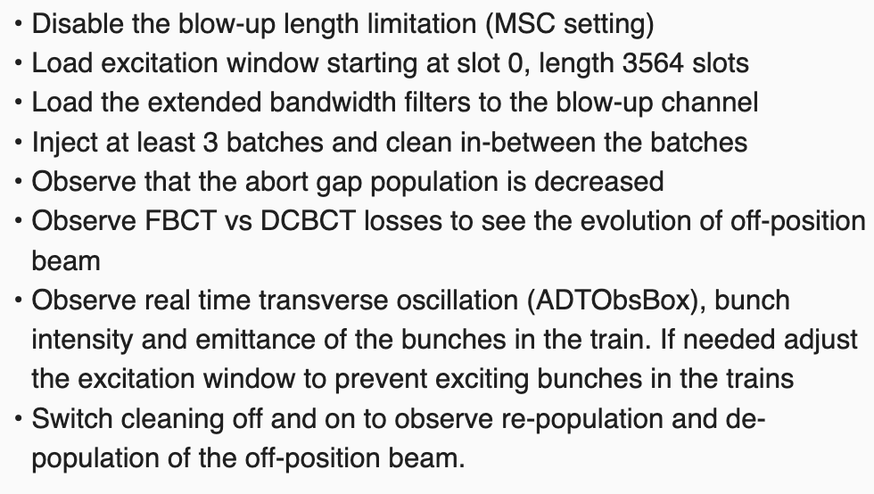
MD15425 (8 h)
Improved cleaning of de-bunched beam at LHC injection
ADT cleaning procedure
RF cleaning procedure

Slide 5
MD15424 (4 h)
Longitudinal loss of Landau damping
Not preselected; in case MD15425 can be done during commissioning
Same procedure as in 2024, but complementary data taking
Beam
  Single bunches in the intensity range of 5x10⁹ – 2.4x10¹¹ p/b, medium emittance of 0.2 eVs
Procedure
  Inject with close-to-matched voltage of 3.5 MV
  Let the bunch filament
  Open beam phase loop
  Apply a phase kick through the synchro loop
    Acquire in parallel the bunch oscillations (high-resolution profiles)
  Close the beam phase loop
  Dump

