Slide 1
BDF Target Cooling & Control needs
Target TCIW June 2025
Mike Parkin
12/06/2025

Slide 2
Introduction
2 target options: Water cooled (TDR) or Helium cooled (CDS) version:
  Decision date TBD (after TDR study – late 2026 onwards)
Helium cooled Option - Design is ongoing: TDR study is due late 2026.
  Number and location of cooling channels TBD
  Target core diameter TBD
  Type, thickness and Material of cladding. TBD
Water cooled option – Design study completed: https://e-publishing.cern.ch/index.php/CYRM/issue/view/106/pdf_7
  Studies so far assume nominal values for beam

Slide 3
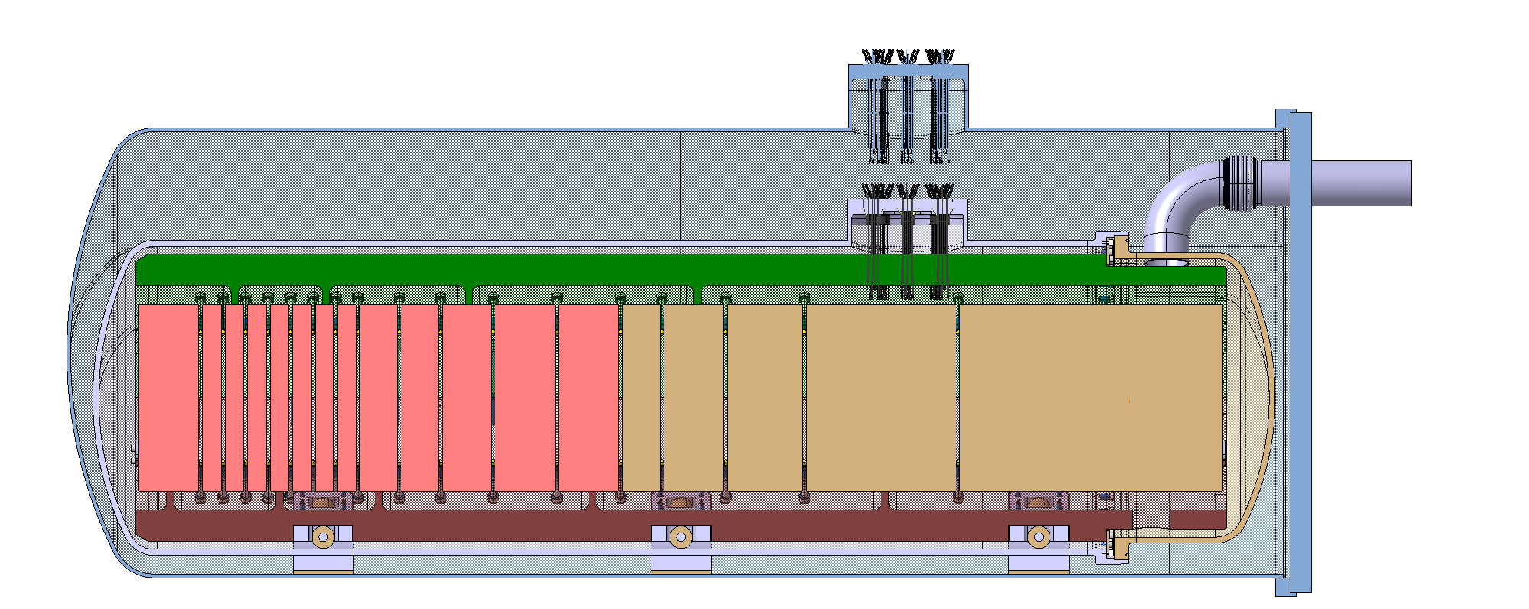
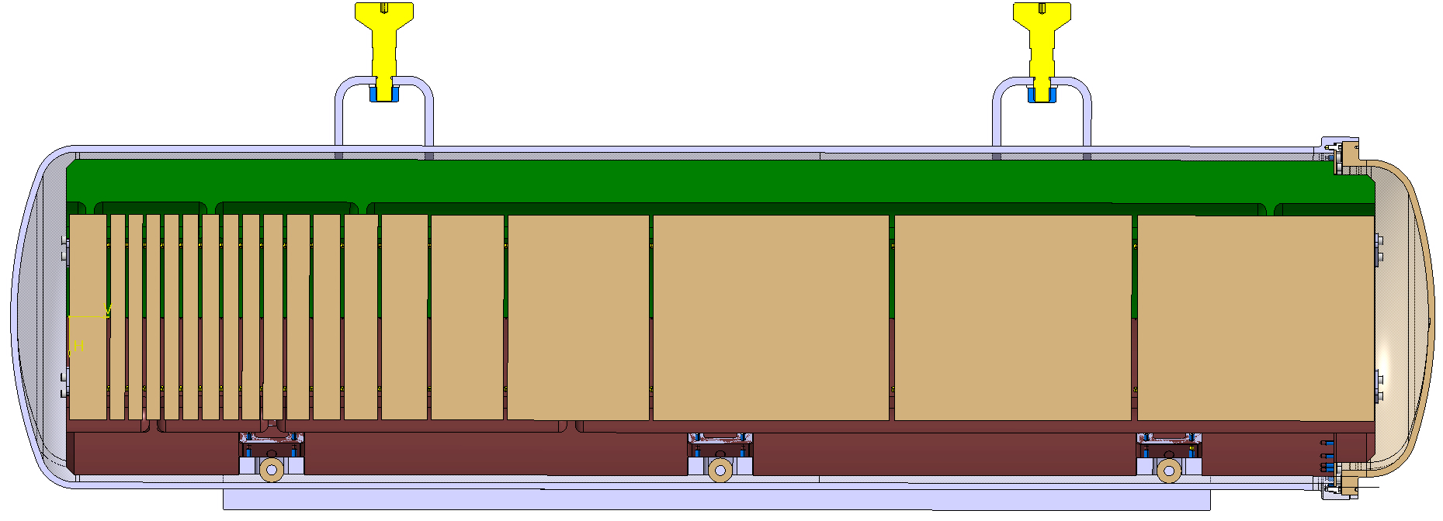
Water & Helium designs
Static He
D250 mm
13 x TZM blocks (Z=42, ρ=10.2g/cm³)
(580 mm)
5x W blocks (Z=74, ρ=19.3g/cm³)
(780 mm)
Water cooled
Helium cooled
https://doi.org/10.1103/PhysRevAccelBeams.22.113001
  Vacuum
  Vacuum
  Water
  Helium
  Static Helium
beam
beam
  TZM W
  W
  Water Cooling
  Inner vessel with circulated water (~ 22 bar )
  Outer vessel with static Helium (~ 1 bar)
  Dimensions and materials
  Mass: ~2 tons (~0.9 tons of blocs)
  TZM and W Blocks clad in Ta2.5W
  Helium Cooling
  Vessel with circulated Helium (~ 16 bar, 25/200 °K)
  Dimensions and materials
  Total Mass: ~2.3 tons (~1.3 tons of blocs)
  W Blocks, maybe clad Ta or Nb or other
Mike Parkin | Target Conceptual Design
3

Slide 4
Normal operation cooling needs - Target
Assumptions:
All parameters are at the nominal values
Parameter | Helium Helium cooled target version | Water Water cooled target version | Comments on Helium
Mass flow rate | 346g/s required 400g/s being delivered | 12 500 g/s | Depends on allowed inlet and outlet temperatures.
Heat to be removed | 305kW | 305kW | Fixed.
Inlet pressure | 16 bar (a) | 23 bar (a)
Pressure drop | <2bar (More, up to 2.5 would be beneficial to the target) | 3.2 bar | Depends on channel spacing estimated known end 2026.
Inlet Temperature | 30 °C ± 3K | 30 °C ± 3K
Outlet Temperature | ≤200 at steady state | 38°C | Transient outlet temperature not yet known. Estimate could be made in a few days if needed. Detailed simulation results will take a few weeks.
Purity level | Required purity level not known <1ppm being delivered | De-min water (conductivity <1μS/cm)

Slide 5
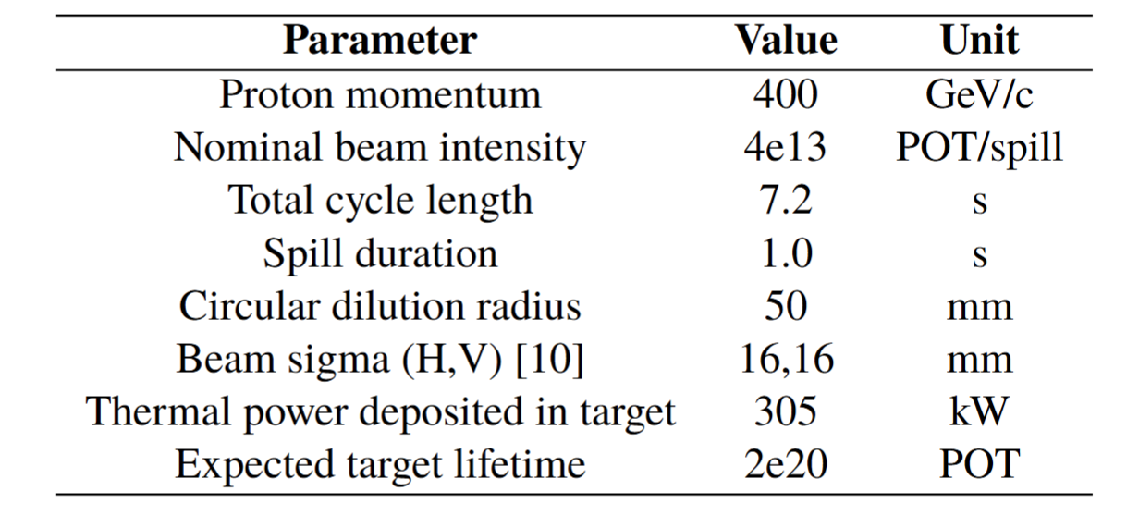
Beam inputs
←some push to increase this
A supercycle rep rate is being studied with increasing intensity to give same integrated power deposition
← May be changed.
← May be 15mm, 14mm etc.
← FIXED.

Slide 6
Loss Of Coolant Accident (LOCA)
What The beam to the target stops the Target continues to generate heat due to radioactive decay
When If the target heats up above certain temperatures (~700°C for Tungsten) the target can oxidise creating volatile WO₃
Depends on: The amount of heat released in the Helium version is highly dependent on what cladding material we use, and whether we use full, partial or no cladding
This depends on several R&D strands:
      2025 prototype test results
      HIPed blocks material testing
      LOCA simulation results
      2026 outgassing products
By late / end 2025
By end 2026
System | Time to reach critical temperatures, with no cooling | Comments
Helium Cooled version | Estimate time: 1 day to 1 week Estimate is based on water cooled version and difference in density of TZM and W. | Estimate will be improved when simulations are complete, estimated 3 months.
Water Cooled version | Critical temperatures not reached in tungsten. Further studies required if temperature of TZM and stress of Tantalum are acceptable (max temperature reached after 1 week, 350°C, block 15) | As per CDS report https://e-publishing.cern.ch/index.php/CYRM/issue/view/106/pdf_7

Slide 7
Control needs
Primary monitoring (direct)
Temperature of target.
TCs on Target Core Blocks
Secondary monitoring
(indirect)
Helium conditions:
Detrimental to target
Indicative of target damage
Beam monitoring
(monitored for multiple hardware)
Several beam parameters monitored
More details of control needs in Talk
“Target Instrumentation” from 1st TSAC:
https://indico.cern.ch/event/1488161/
Sensors near target:
~ 4× TCs & 4× pressure sensors.
Plus others in compressor room.
Monitored at beam upstream by WP2.
K type thermocouples location | Number required | Status
Thermocouples in target core blocks | 2 to 3 per block 18 to 40 blocks (~25 most likely) = 36 to 120 | Several months until will know number of blocks. No date set for decision on number of TCs per block.
Thermocouples in-target position monitoring array. | 8 to 12, or 0. | Undecided. Simulation is on the ‘ToDo’ list This array may not be used at all; then # TC=0.
TOTAL | 36 to 131
Formal FMEA being performed is foreseen to generate additional monitoring requirements or backups

Slide 8
Interfaces
Key interfaces
  Vacuum vessel (potential leaks. Some radiative heat assumed to be negligible from target point of view)
  Helium/water supply (heat & radioisoptopes)
  Beam (heat deposition in target)
  SHiP (experiment particles)
  TCs
At what point the responsibility changes to another group
  Helium: Flanges at target? / outside Vacuum vessel door?
  TCs: ?

Slide 9
Safety Considerations
Safety measures of the equipment
  LOCA – ongoing studies
  Pressure vessel – Pressure vessel calculations to show is PED compliant. Some Rmcmx calculations to be followed for reassurance where appropriate
  Active products - RP

Slide 10
Open Questions and Dependencies
Transient heat load & outlet temperature being studied
Beam supercycle and intensity being studied
Basic geometry of target undecided: core diameter, cooling channels, beam sweep size…

