Slide 1
Target Station Cooling System
Target Complex Infrastructure Workshop
F. Dragoni, EN/CV
12/06/2025
https://hiecn3.web.cern.ch

Slide 2
Agenda
Thermal Load Summary
Cooling P&ID
Water vs Helium
Loss of Coolant Accident
Target Cooling Station Functional Requirements
Interfaces
Maintenance Scenarios
Loads to the Building
Power Requirements
Noise Mitigation Measures

Slide 3
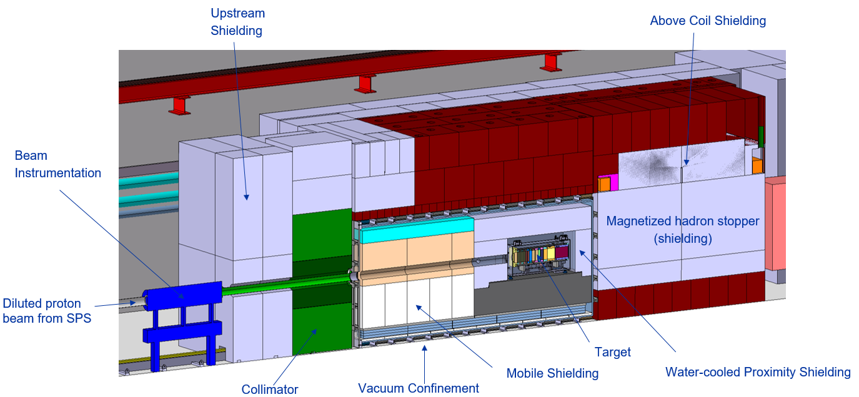
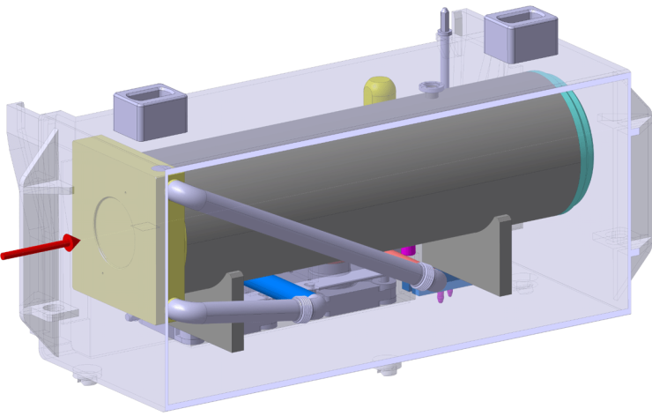
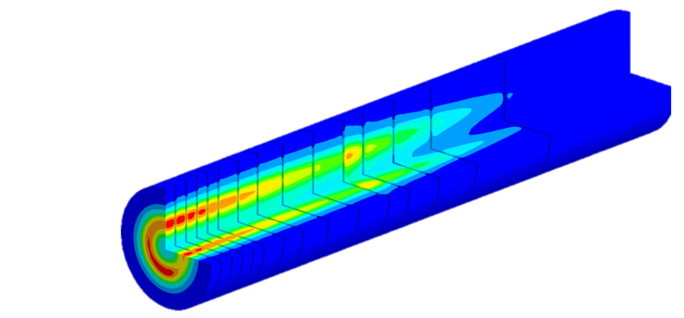
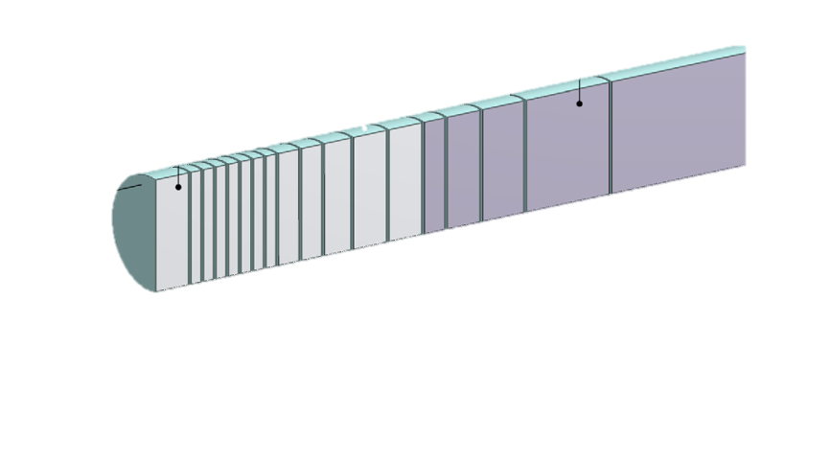
Thermal Loads Summary - Requirements
Target
  Target deposited power: 305 kW
  Cooling medium inlet temperature: 30 °C + 3 K
  Pressure rating: 10⁻⁴ mbar(a) to PN25
Proximity shielding
  Deposited power: 20 kW
  Cooling medium inlet temperature: 30 °C + 3 K
  Pressure rating: PN25
3. Hadron Stopper
  Deposited power: 20 kW
  Cooling medium inlet temperature: 27 °C + 3 K
  Pressure rating: PN25
Functional requirements
  Compressor redundancy (pending)
  Operation 24/7 for 365 days? – reduced mode during YETS
350 kW-class Target

Slide 4
Water vs Helium as cooling medium for target
Demineralised Water Cooling
Helium Gas Cooling
Main parameters
    Water supply temperature: 30 °C ± 3 K
    Water flow rate: 45 m³/h
    Pressure rating: PN25
  Characteristics
    Supply pressure: 23 bar(a)
    Differential temperature (after/before user): < 10K
    1 heat exchanger
    RP: water activation + tritium production + potential water contamination if cladding is damaged + water radiolysis
    6+1 ion exchanger cartridges
Main parameters
    He(g) supply temperature: 30 °C ± 3 K
    He(g) flow rate: 400 g/s (340 g/s needed)
    Pressure rating: PN25
    Helium purity: > 99.9999% (Helium N60)
  Characteristics
    Supply pressure: 16 bar(a)
    Differential temperature (after/before user): 170 K
    3 heat exchangers
    Tritium produced + possible outgassing (H₂O, CO, CO₂, O₂ , H₂)
    1+1 chemical getters (small size)

Slide 5
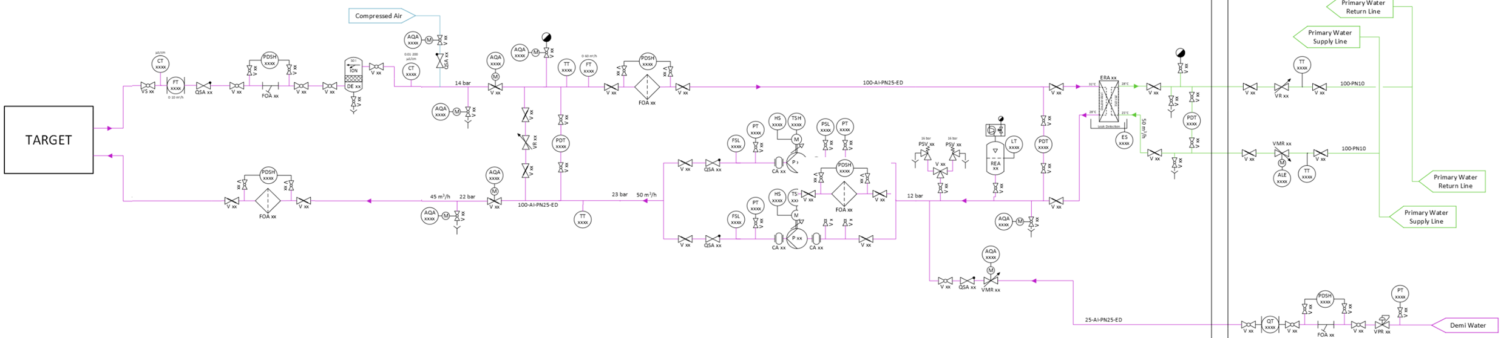
Water Cooling – P&ID
1 cooling circuit for target and 1 circuit for proximity shielding
Pumping group – 1+1 redundancy
1 Heat exchangers (Water/Water)
  Gasketed Plate Heat– safety type
  Demineralised water on primary side
Filtration
  Cartridge filters 20/50 µm
Ion Exchange Cartridge – 200 L
  6+1 cartridges (target)
  1+ 1 cartridges (proximity shielding)
  Nuclear grade resin
Filling and pressure maintenance system
  Helium bottle racks with precision pressure reducers

Slide 6
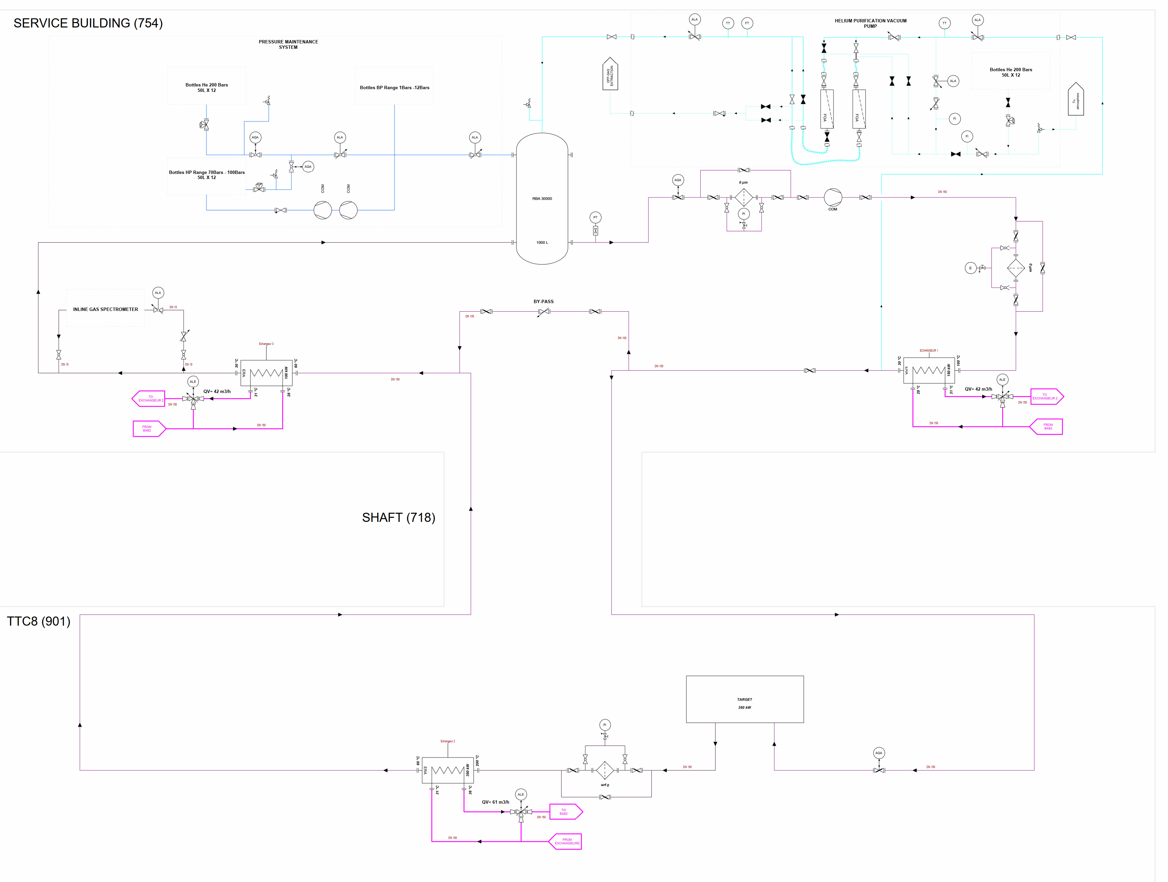
Helium Cooling – Technical Solution – P&ID
1 cooling circuit for target and proximity shielding
Compressor skids - 12/15 bar(g)
3 heat exchangers (Water/He_{(g)})
  Shell and tube construction – safety type
  Demineralised water on primary side
Filtration
  HEPA gas filters
  Chemical getters for impurities absorption
Filling and pressure maintenance system
  Helium bottle racks with precision pressure reducers
Inline gas spectrometer
  Continuous sampling machine
Vacuum pumps
  To remove air from the circuit for subsequent filling

Slide 7
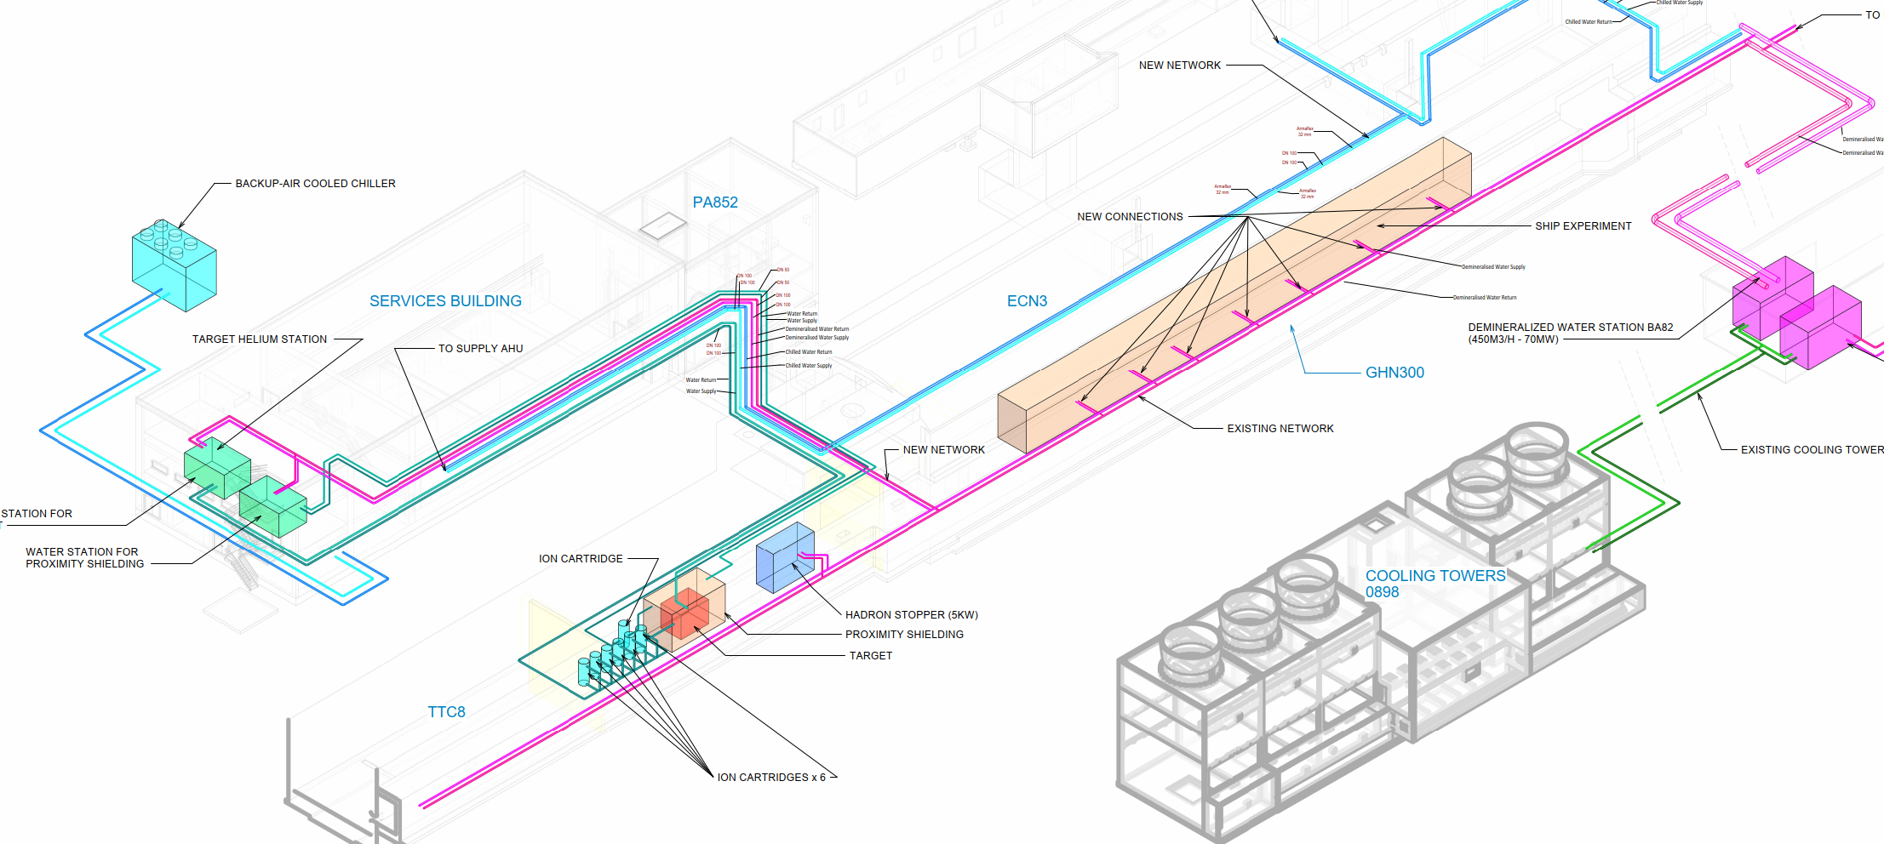
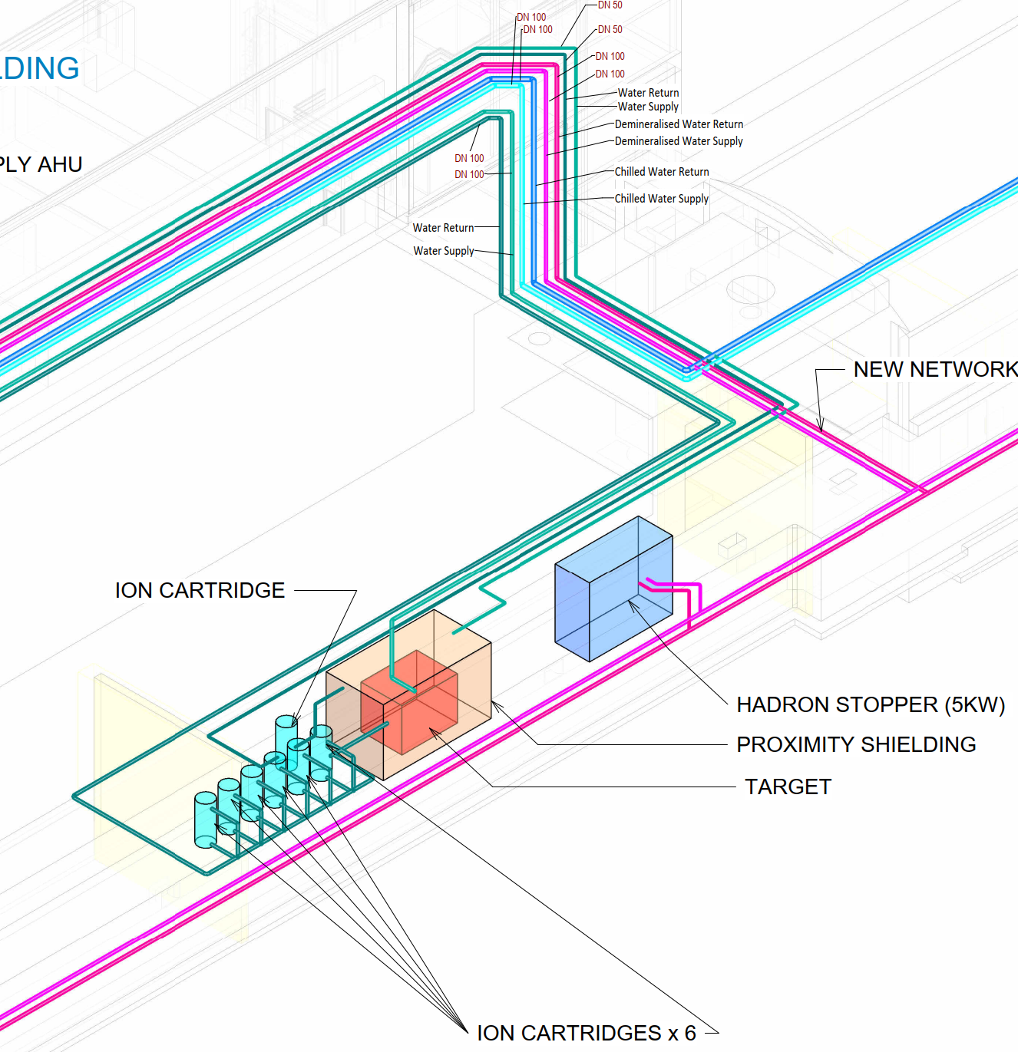
Cooling possibilities: 2 configurations
Configuration #1
Target: water cooled
Proximity shielding: water cooled
Hadron stopper: water cooled
Configuration #2
Target: helium cooled
Proximity shielding: water cooled
Hadron stopper: water cooled

Slide 8
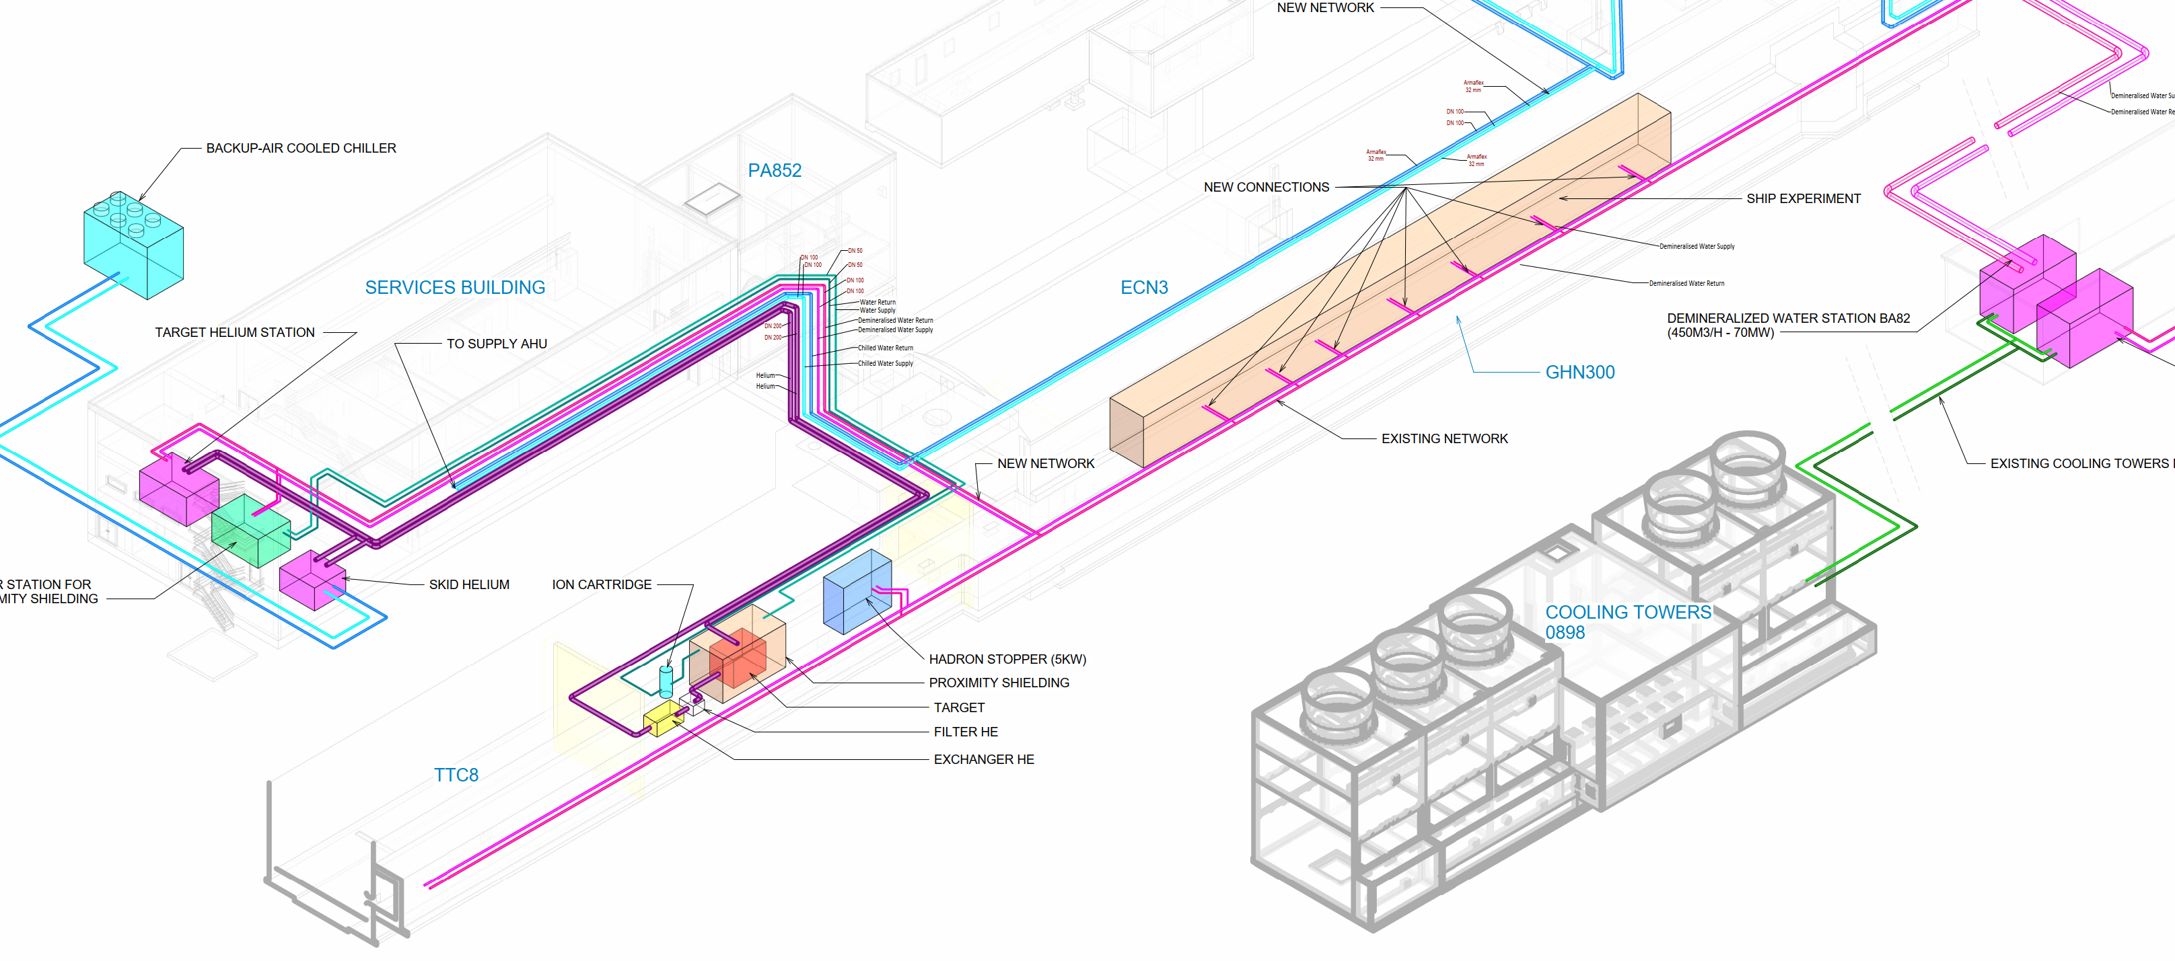
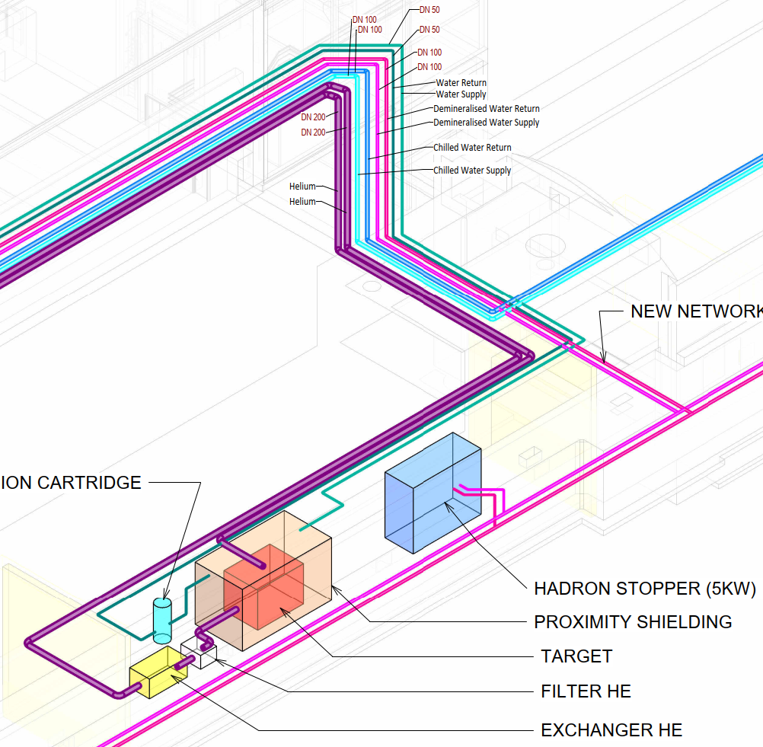
Cooling possibilities: 2 configurations
Configuration #1
Target: water cooled
Proximity shielding: water cooled
Hadron stopper: water cooled
Configuration #2
Target: helium cooled
Proximity shielding: water cooled
Hadron stopper: water cooled

Slide 9
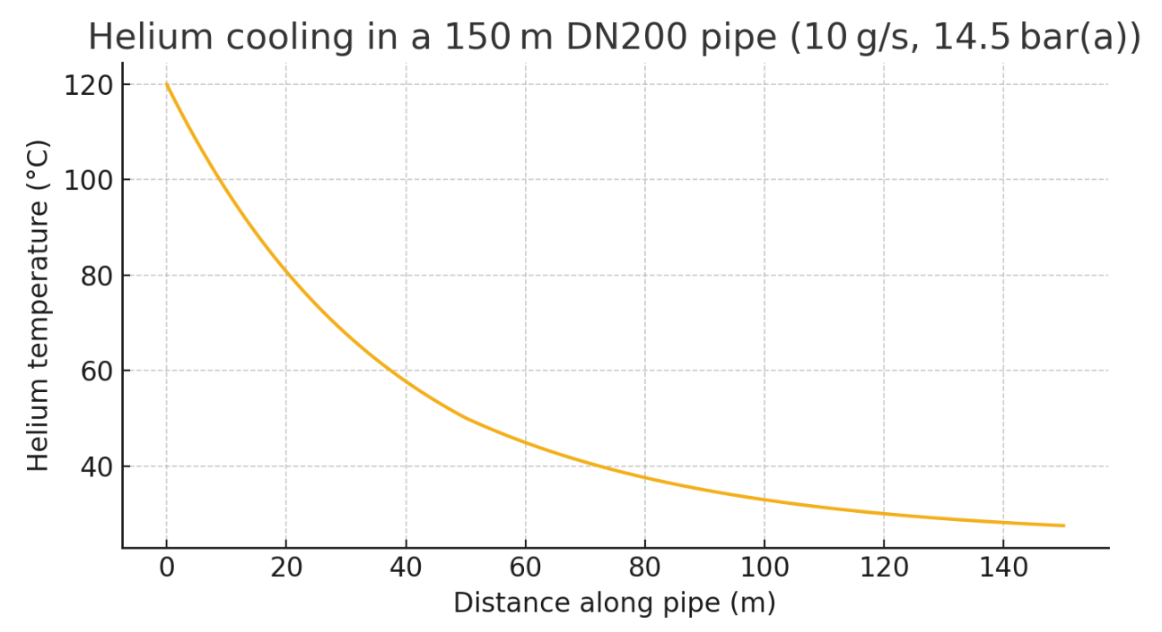
Loss of Coolant Scenarios
Scenarios | Helium cooling circuit | Proximity shielding | Helium skid – 10 g/s | Hadron stopper/ShIP | Comments
Power cut to service building | STOP | STOP | ON | ON
Power cut to BA82 building | STOP | STOP | (ON) | STOP | Possibly requiring alternative cold source
Helium compressor failure | STOP | ON | ON | ON
Proximity/BA82 pumps failure | ON | ON | STOP | ON | Redundant pumps on proximity shielding skid and BA82 station
Helium skid will require manual intervention to start
  Intervention length (1 day)
  10 g/s → low pipework speed → helium temperature will drop as it advances in the pipework
  Cold source could come from BA81 centralised chilled water production if CT2 are working

Slide 10
Interfaces
Helium cooling station: Supply/return DN150/DN200 flanges outside target shielding
Proximity shielding cooling station: Supply/return DN50 flanges outside target shielding
Control cubicles (Helium cooling station, proximity shielding, helium skid) –
  Connected to UNICOS and NXCALS
  Alarms propagated to CCC
  Hardwired interlock with beam
EN/EL – power supplies as described below
SCE – wall openings and sealing
IT/CS – RJ45 sockets for each switchboard and control cubicle

Slide 11
Target Cooling Station Functional Requirements

Slide 12
Maintenance Scenario
Scenarios | Helium cooling circuit | Proximity shielding | Helium skid | Hadron stopper/ShIP | Comments
CT2/BA82 annual maintenance | STOP | STOP | ON | STOP | 10 weeks
Cartridge exchange (Proximity shield and BA82) | ON | ON | STOP | ON | Using spare connections to exchange cartridges → no stop
Helium compressor maintenance | STOP | ON | ON | ON | Can be done during CT2 annual maintenance
Helium skid compressor maintenance | ON | ON | STOP | ON | 1 week – no impact if works in CV room are authorised during RUN

Slide 13
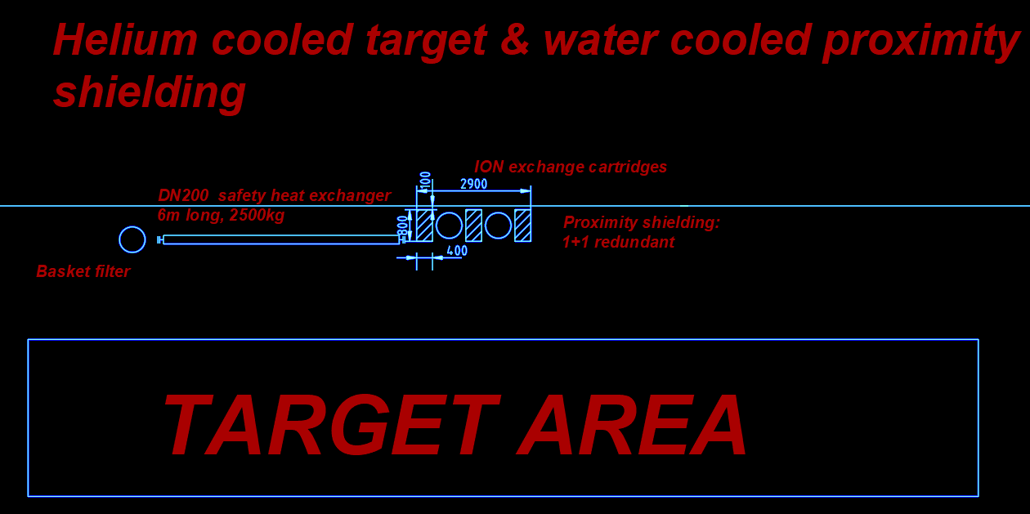
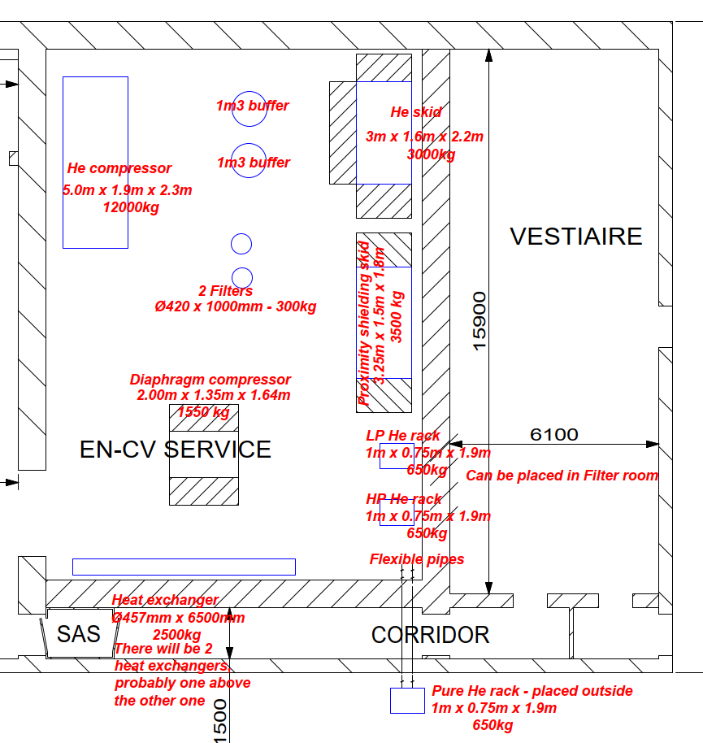
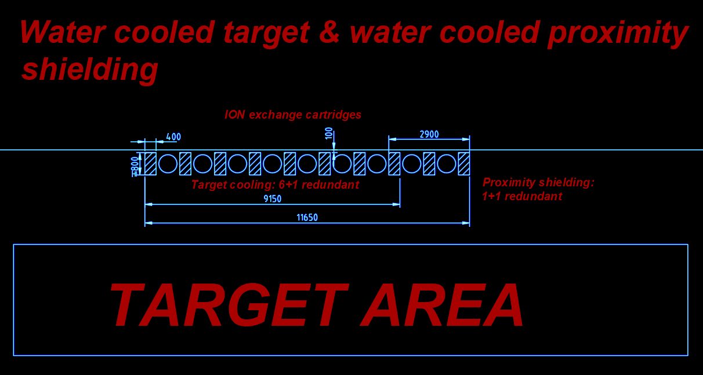
Loads to the building
Main loads in two areas:
  Service Building – need 10 t/m² – constraining equipment stacked heat exchangers
  Target area
Target area
Service building
600 kg/cartridge
600 kg/cartridge

Slide 14
Power requirements (preliminary)
General services – two possibilities:
  Multiple 3P+N+E supplies from EN/EL switchboard: 1 x 320 A + 1 x 63 A + 1 x 32 A
  One 3P+N+E to CV ABB Switchboard
Secure network: One 200 A 3P+N+E to CV ABB Switchboard (including ventilation)
Not including power needs in BA82 or back-up chiller
System | Stable network [kW] | Pulsed network [kW] | Secure network [kW] | UPS [kW]
Helium Compressor VSD | 160 | - | - | -
Helium cooling circuit – Control cubicle + vacuum pumps | 20 | - | - | -
Proximity shielding – Power cubicle | 15 | - | - | -
Helium skid – Power cubicle | - | - | 20 | -

Slide 15
Noise Mitigation Measures
All cooling equipment are in CV service room → noise insulation doors required
Inside the CV service room:
Equipment | L_{p-1m} – Sound pressure level at 1 m [db(A)] | Comments
Helium lobe compressor | 90-95 | Allowed unprotected exposure: 45 min Hearing protections required: Individual: Noise shield with SNR in 25-35 dB range Collective: Acoustic hood (option by manufacturer)
Helium skid compressor | < 85 | Running only when lobe compressor is off Hearing protections not needed
Proximity shielding pump | 57 | No concern

