Slide 1
Run 2b dismantling
19th of May 2025
Preparatory coordination meeting (19 mai 2025) · Indico

Slide 2
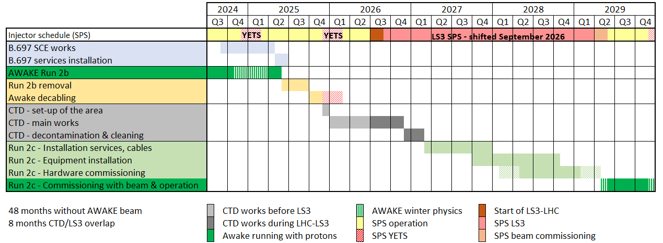
Global planning
Run 2b removal: 10th of June to mid-September 2025
Decabling: Mid-September to mid-November 2025
CTD: December 2025
AWAKE Run 2c installation: March 2026→ this date might be moved forward

Slide 3
General information
All generic impacts will be closed
Please create a dedicated impact for your activity / team
A transport team will be present on-site everyday from 17/07
A TREC station will be installed in TCV4 to facilitate RP measurements & an RP operator will be present on-site
Role | Contacts
RP | Sébastien Boucly – 165995 Dorian Estellon – 168502 Didier Alberto – 160649
Operational safety | Emmanuel Paulat – 163870
Coordination | Eloïse Guran – 165513 Ans Pardons – 163457
Transport team | Sylvain Fumey (Bleu) – 163041

Slide 4

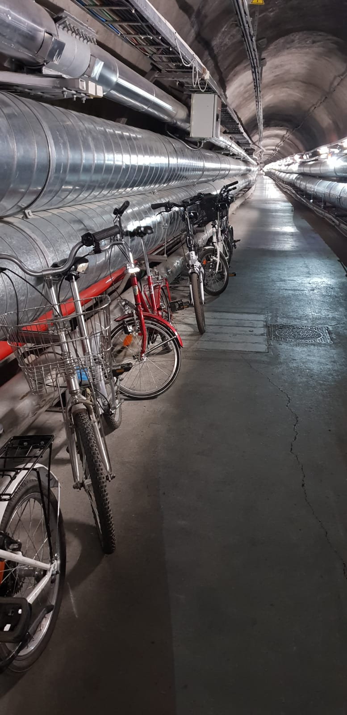
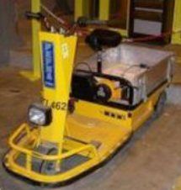
General information
Please sort correctly waste in the RP bins: incinerable, metallic waste, cables, etc
  RP bag not sorted correctly = RP operator has to empty it and sort it again
Bikes will be taken out of TAG41 and stored in ECA4
  → please report any issues on the bikes as soon as possible
Store the bikes neatly at the end of TAG41 to avoid disturbing transport operations
Do not use the Pefra tractor to open doors

Slide 5
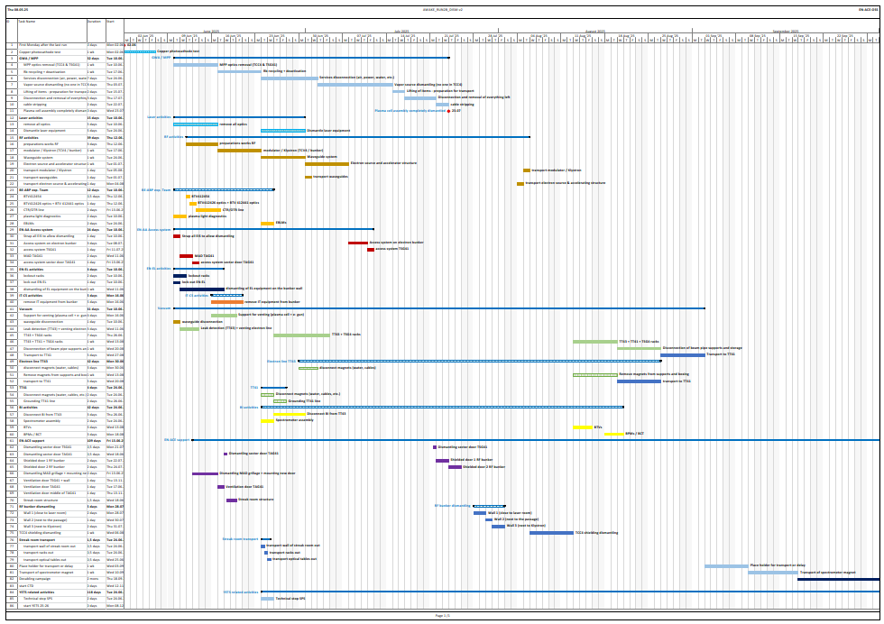
Run 2b dismantling - planning
Photocathode test: 02/06
Dismantling start = Tuesday 10th of June
End = 19th of September
Duration ~3.5months
Several co-activities to coordinate

Slide 6
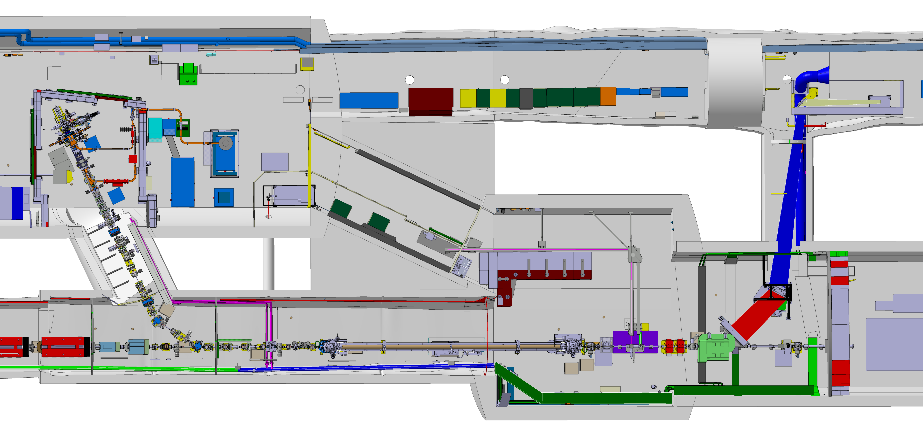
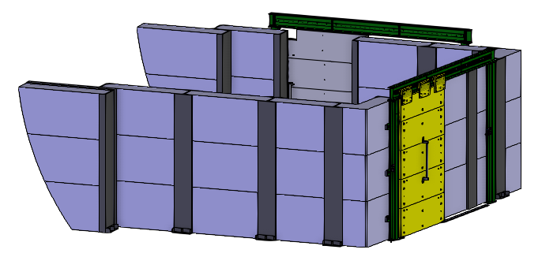
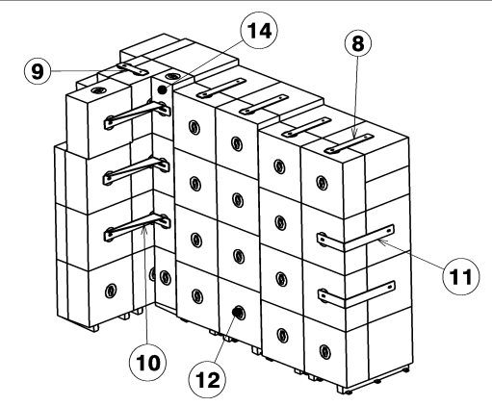
Run 2b dismantling - sequence
Main steps of the dismantling:
Optics removal + lockout + MAD + EL works on bunker - 1 week
Plasma cell + RF - 4 weeks
Removal of electron bunker and TCC4 shielding - 3 weeks
TT43 electron line removal (magnets, BI, girders) - 2 weeks
TT41/TCC4 proton line removal (magnets, BI, girders) - 2 weeks
Support from vacuum team during all steps (except step 3)

Slide 7
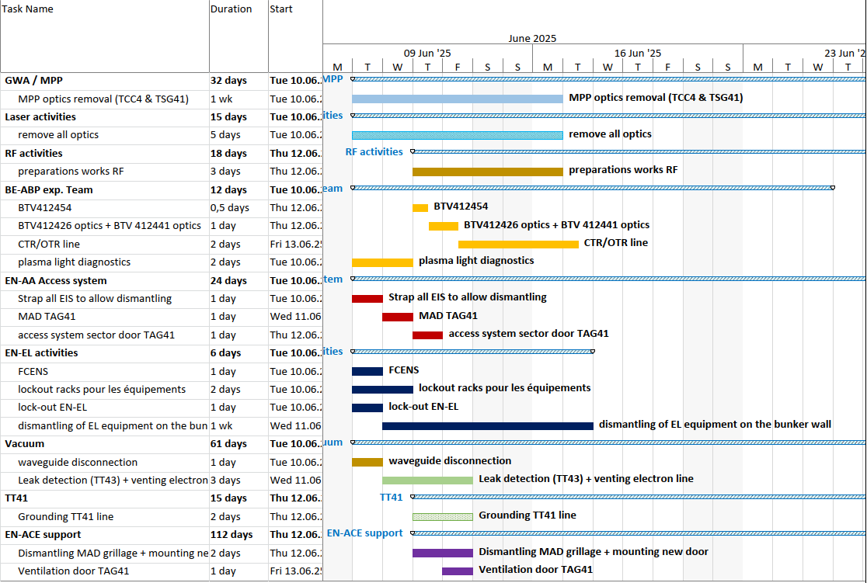
Run 2b dismantling – 02/06 to 16/06
Main activities on 1st week:
Optics removal (TCC4, streak room, etc)
MAD removal
Electrical lockout (partial)
Leak detection test (electron line)
/!\ Be careful → not everything will be locked out some equipment/cable will still be powered /!\

Slide 8
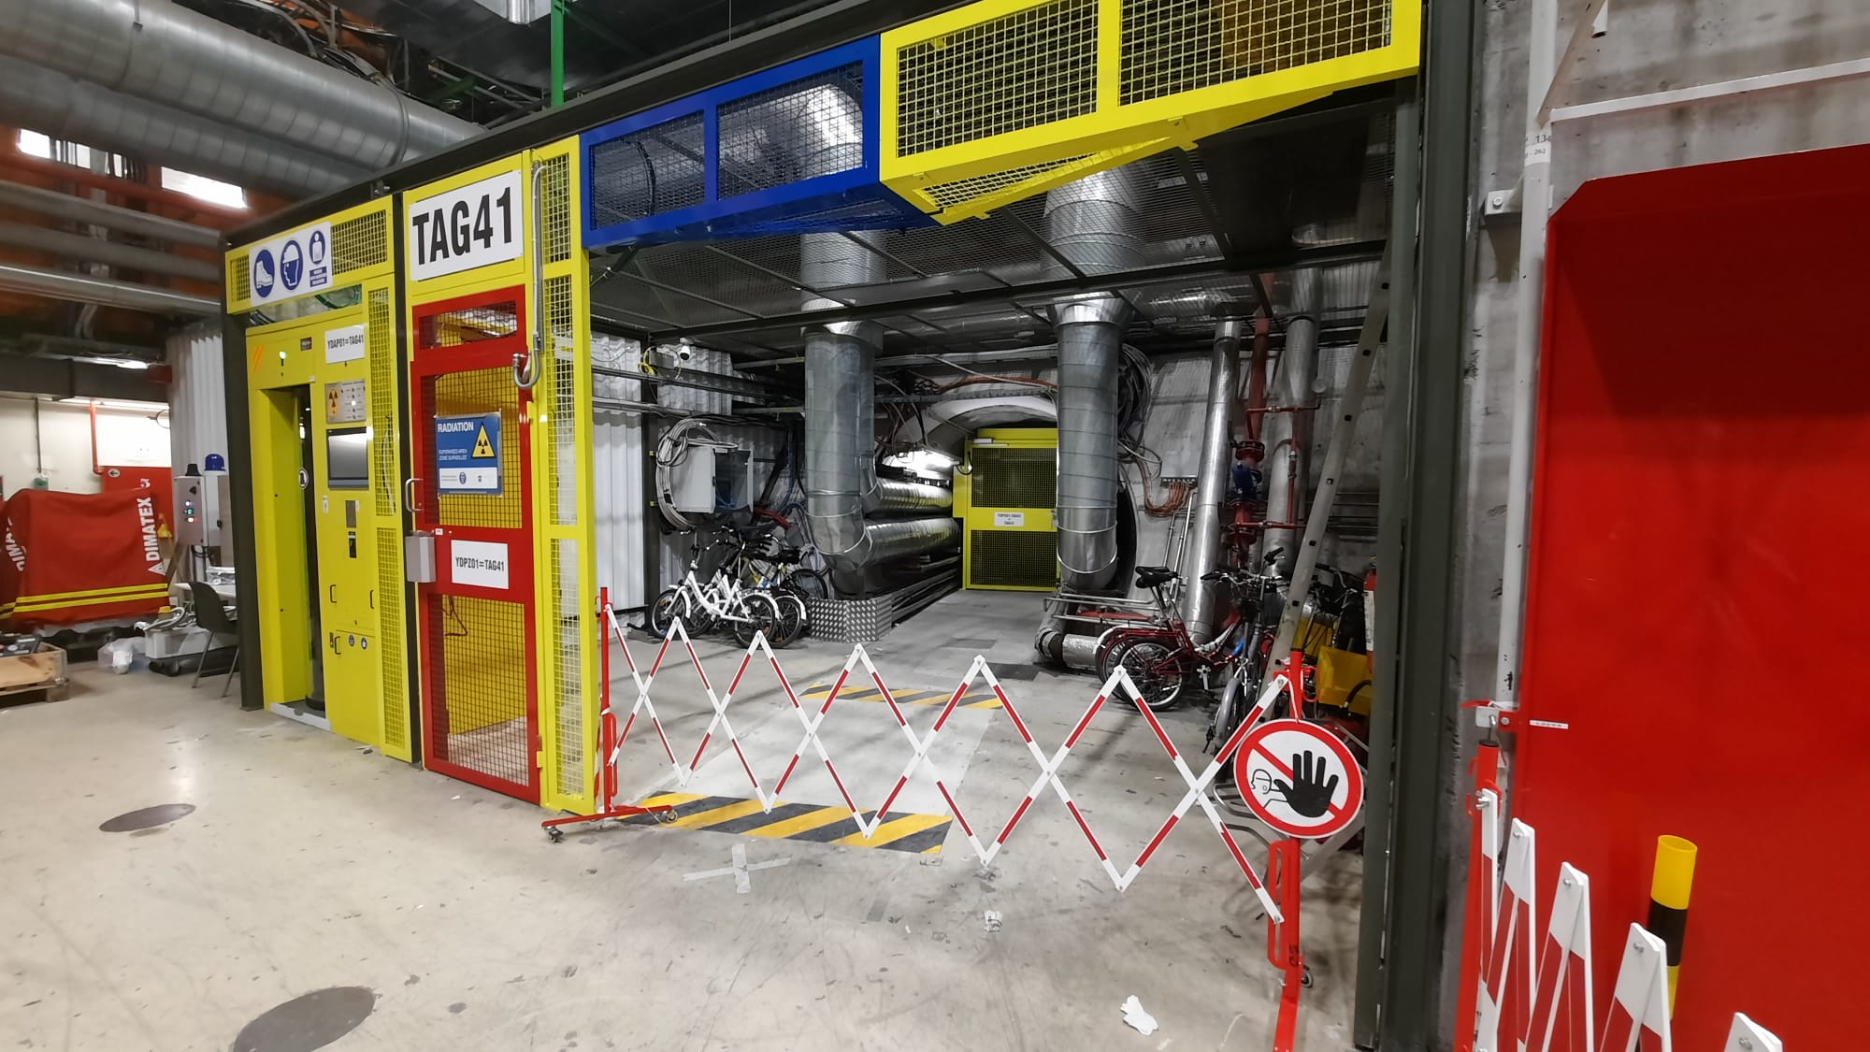
Removal of the MAD
MAD removed on Wednesday 11/06
New door installed on Thursday 12/06
New badge reader on the new door installed on Friday 13/06
No transport during those dates
Please continue accessing through the PAD every time

Slide 9
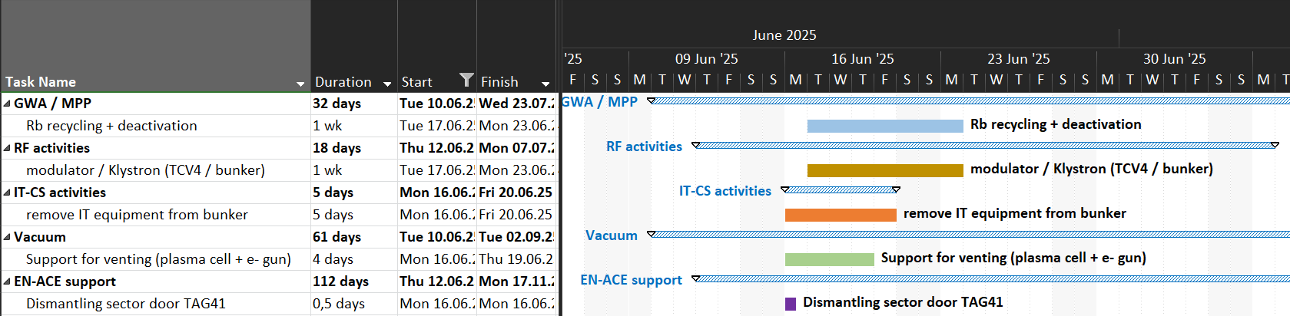
Run 2b dismantling – 16/06 to 23/06
Main activities:
Rubidium recycling in TCC4 → nobody in TCC4 except GWA team
RF work in TCV4
IT (TCV4 & streak room)
/!\ Access restricted only to those team /!\

Slide 10
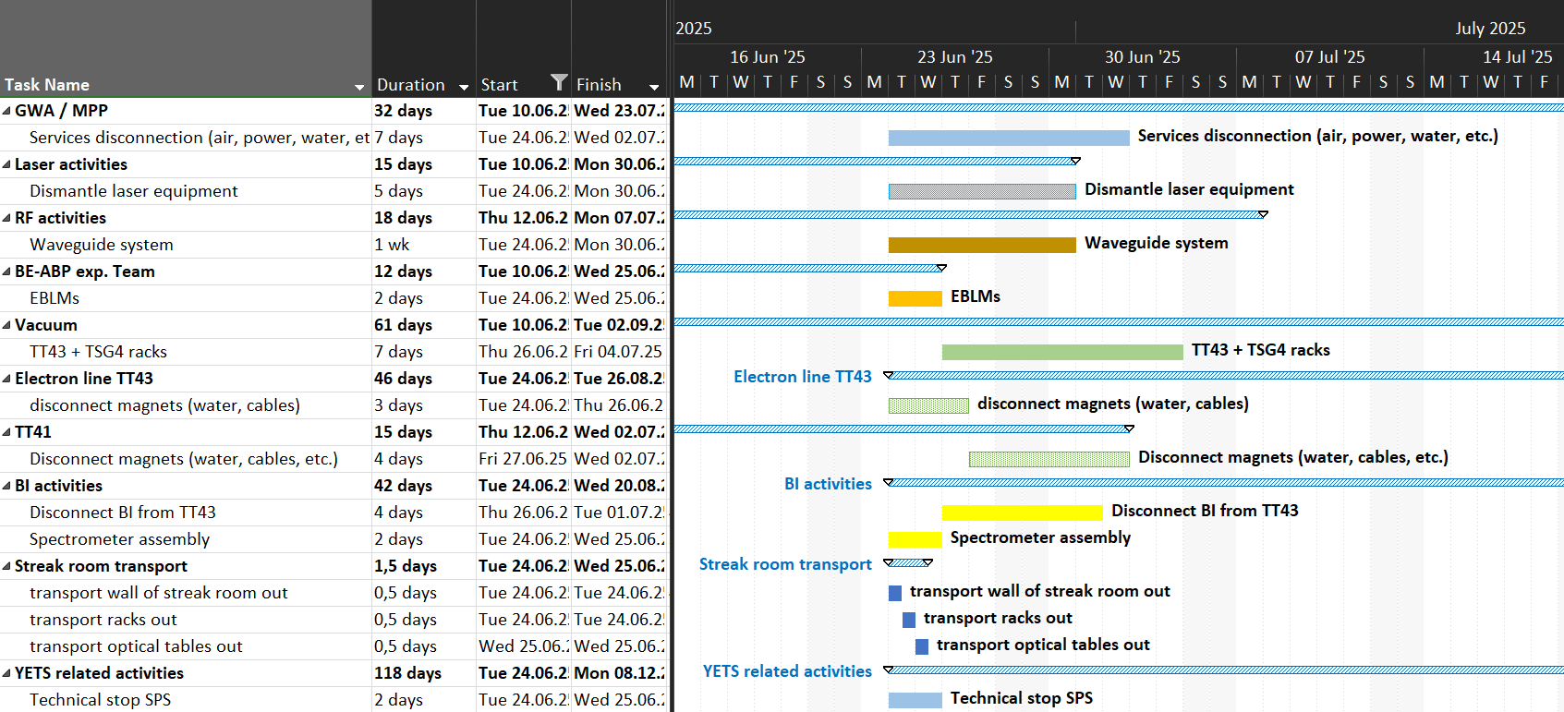
Run 2b dismantling – 16/06 to 30/06

Slide 11
Run 2b dismantling – preparations
Lockout → define what and when
Order ~30 metal pallets (+re-assess once dismantling starts)
Storage (racks streak room, optical tables, etc.)
START
Tuesday 10th of June
DAYS LEFT
22

Slide 12
Proposed organisation during dismantling
Briefing every Monday with teams that intervene in that week
-Status update sent by email (especially changes in planning)
-Dedicated meetings
VICs: - 1 VIC for IT (with GWA and RF)
Dates for on-site briefings:
1st = Wednesday 4th of June (09:00)
VIC (IT/GWA/RF) = Friday 13th of June (09:00)
Monday 23rd of June
Monday 30th of June
Monday 7th of July

Slide 13
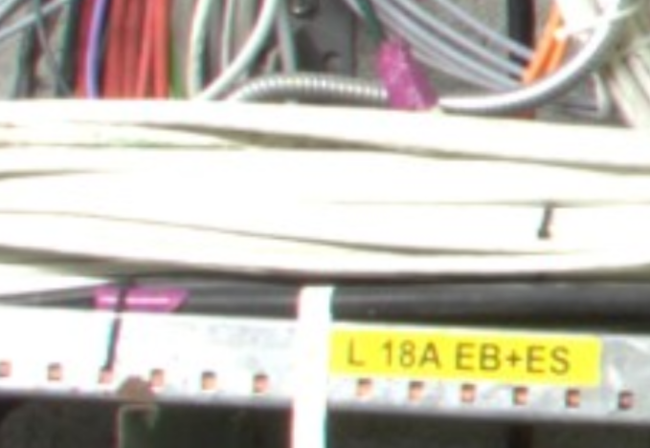
Run 2b decabling – Mid-Sept to mid-Nov 2025
START
Disconnect cables on both ends (equipment / rack)
Put the purple tape on both ends
NO access for decabling identification / disconnection (dates susceptible to evolve):
  17/06 to 23/06 (access restricted to GWA & RF)
  03/07 to 14/07 (access restricted to GWA & RF, but some flexibility)
  23/07 to 12/08 (access restricted to transport team)
Monday 22nd of Sept.

Slide 14
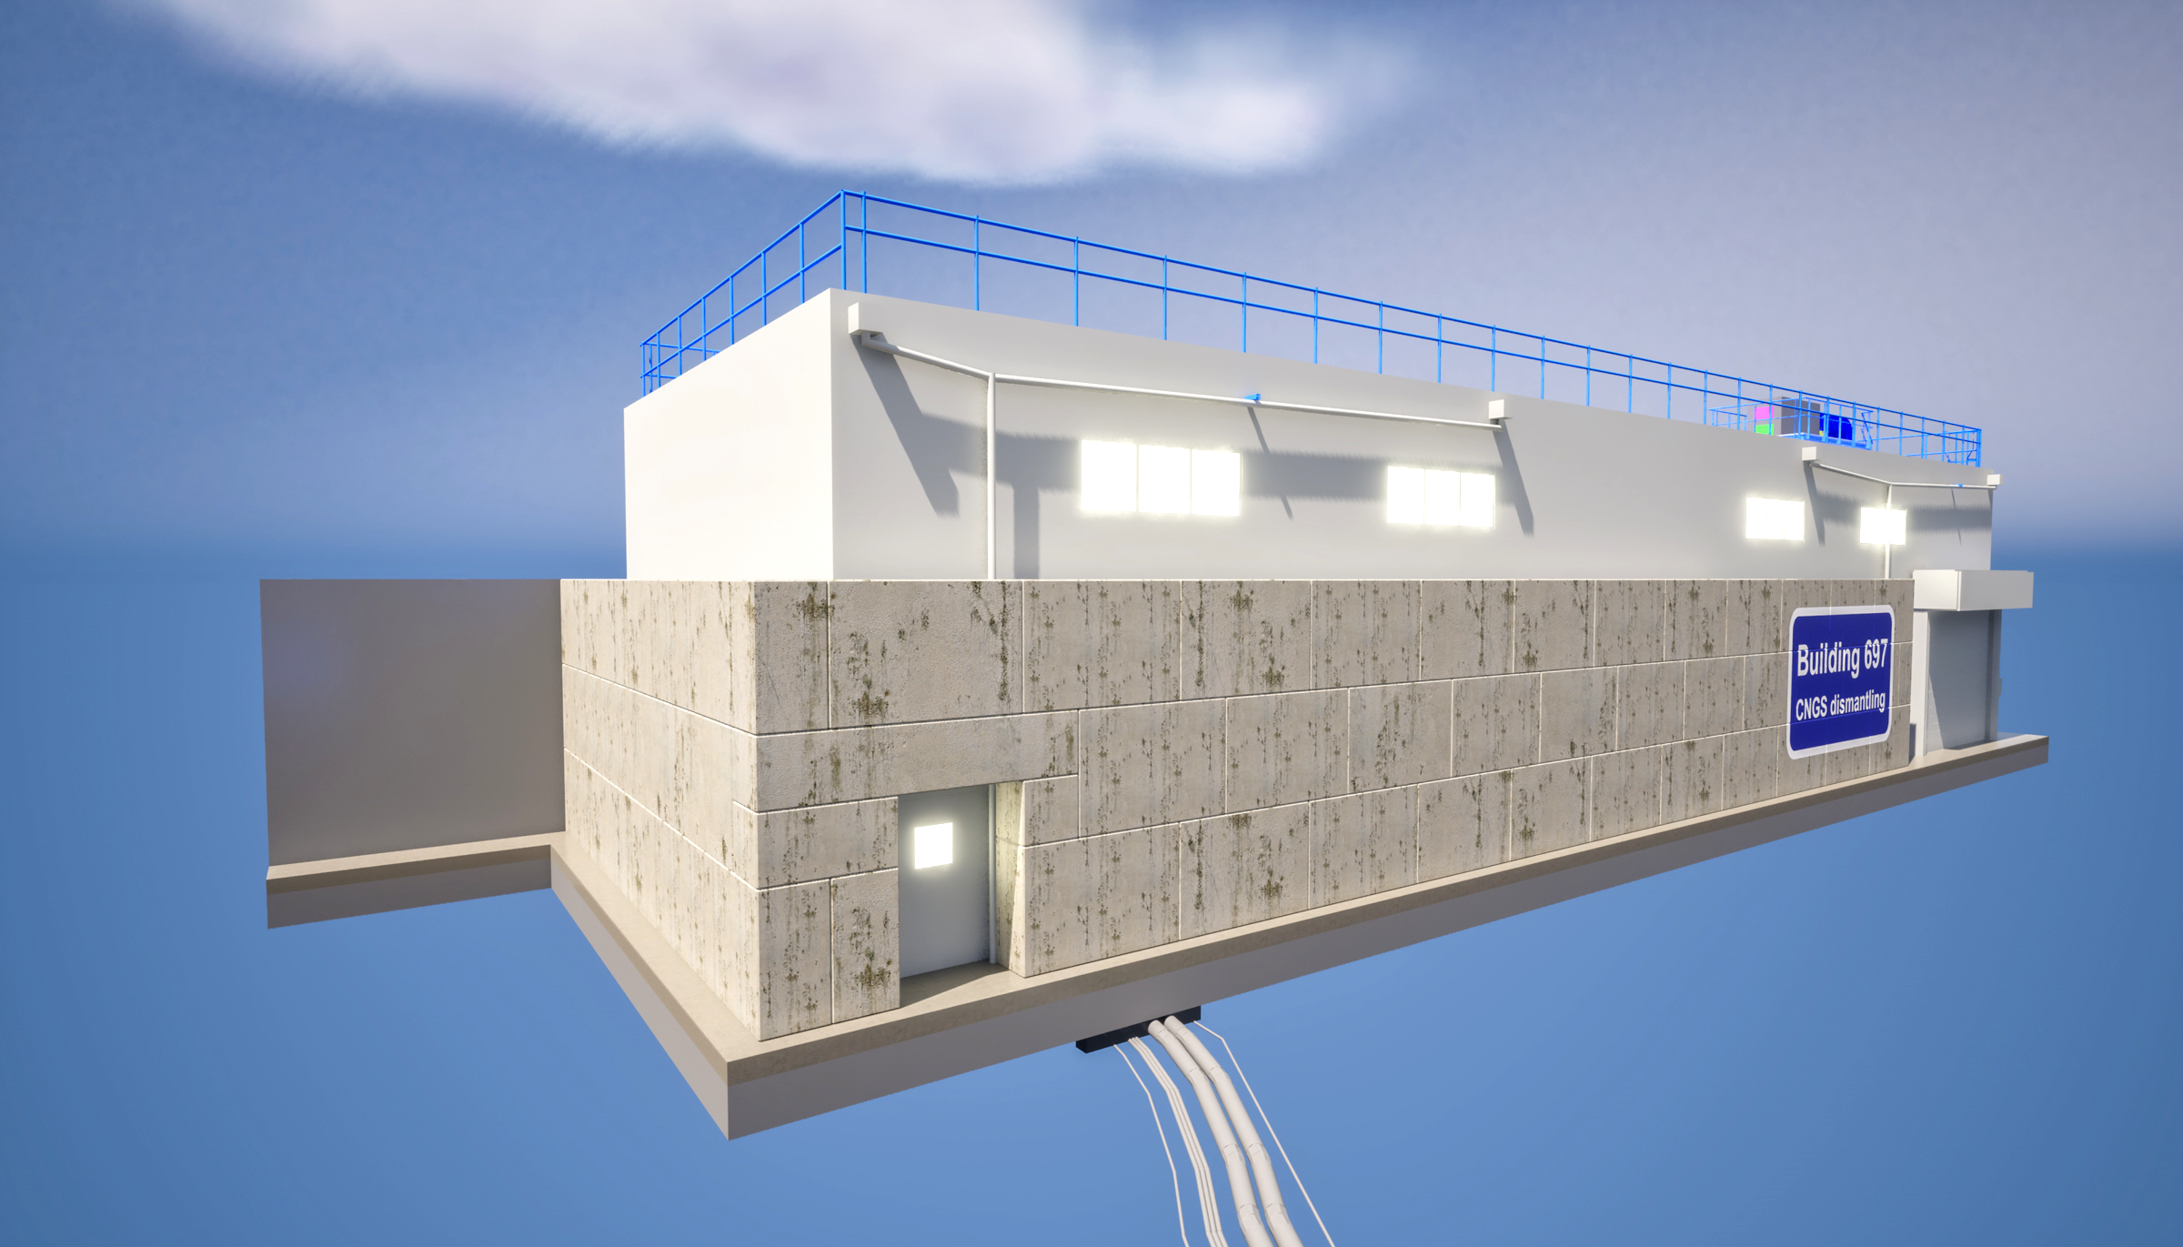
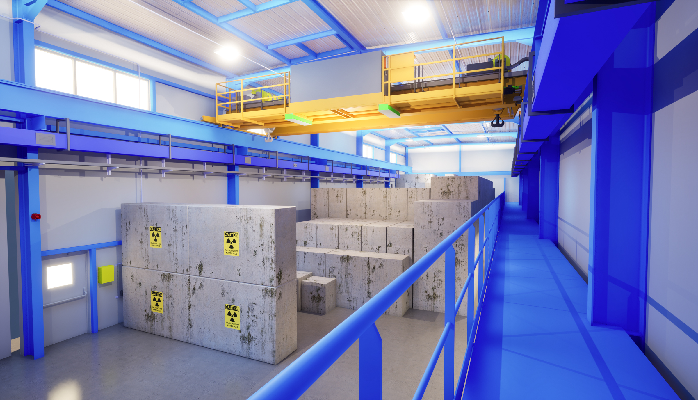
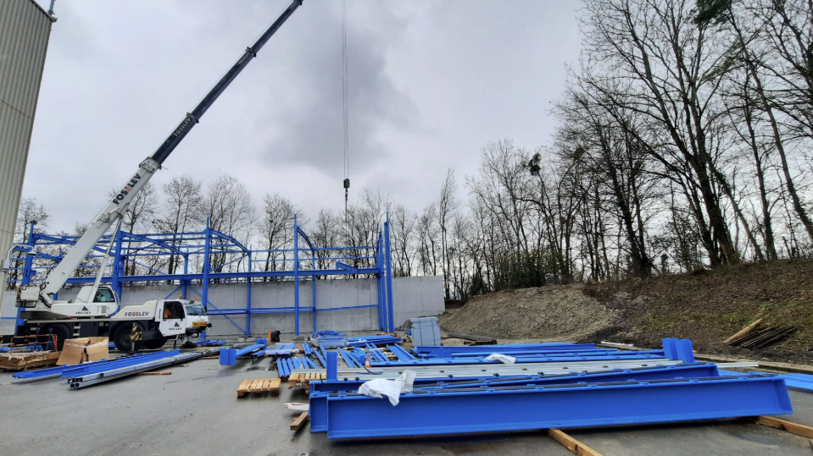
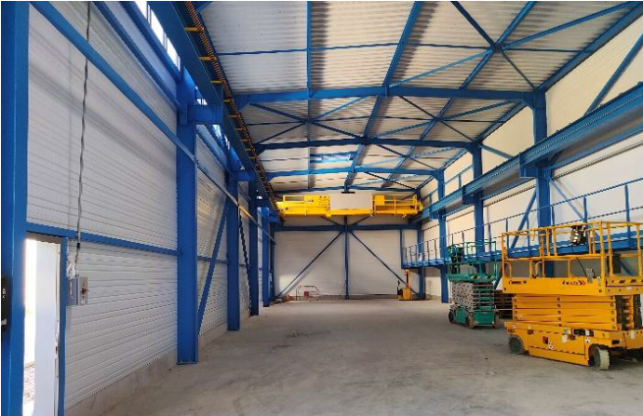
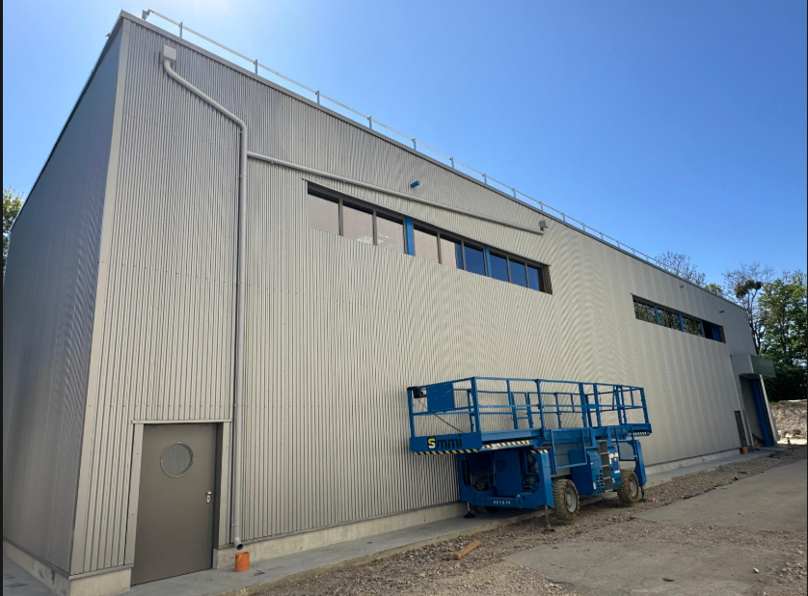
Surface building for CTD
Civil engineering completed
Building ready to use
  mid-July or end of July
  Crane is installed
  CV installation has started
  Parking spots should be available soon
3D rendering of building 697 (courtesy of Antoine Kosmicki)
26th February 2025
30th April 2025
12th of May 2025

Slide 15
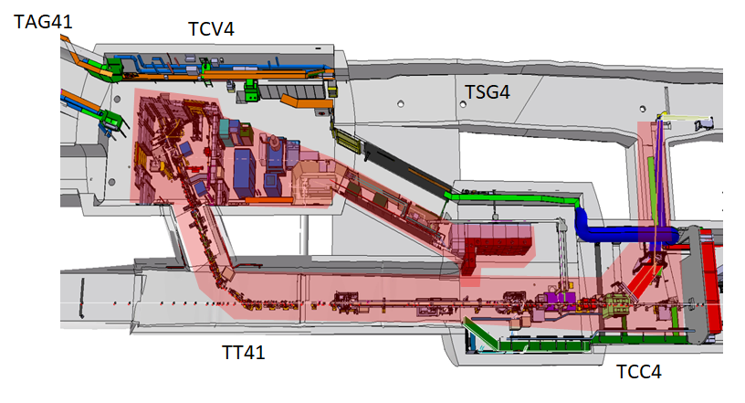
Summary
START
Run 2b dismantling starts on 10th of June
Run 2b decabling on track → briefing by EN-EL on 20th of June
1st on-site briefing = Wednesday 4th of June
Tuesday 10th of June
DAYS LEFT
22

