Slide 1

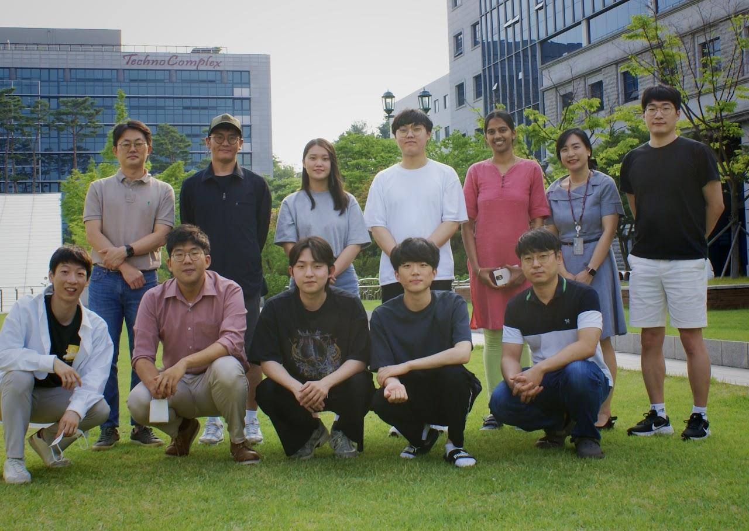
KUHepEx lab of Prof. JaeHyeok Yoo
LLP search
  Ntuplizer to produce flat root files from RAW/RECO (link). Access request needed
RPV SUSY
  Processing NanoAOD to group-formatted ROOT files (link) and analyzer (link)
3. ttbar CP violation study
  Ntuplizer for NANOAOD processing (link) and analyzer (link)
4. 4Top analysis
  Processor for NANOAOD ( link). Developed and maintained by CMU group
A few people are missing in this photo!
Opinions & comments
Well-satisfied overall
Thanks for taking care of my vegetarian food!
Haeyun Hwang wishes KCMS to make an LLM tool like chatGPT, wanting to contribute for that!

