Slide 1








Electron-Cloud Effects and Possible Mitigation Strategies
Sabato Luca¹
Mether Lotta², Tatiana Pieloni¹, Cantún Karla³, Maury Humberto⁴, Yaman Fatih⁵
FCC-ee Electron Cloud Meeting
16th May 2025
¹ ² ³ ⁴ ⁵ ⁶ ⁷
Acknowledgments: Bartosik Hannes², Carli Christian², Iadarola Giovanni², Oide Katsunobu⁷, Zimmermann Frank¹, Zobov Mikhail⁶
This work was performed under the auspices of, and with support from, the Swiss Accelerator Research and Technology (CHART) program (www.chart.ch).

Slide 2
Outline
Introduction
Mitigation Techniques
Non-Uniform Bunch Spacing
Conclusions and Outlooks

Slide 3
Outline
Introduction
Mitigation Techniques
Non-Uniform Bunch Spacing
Conclusions and Outlooks

Slide 4
E-Cloud Build-up Studies for Baseline
From Feasible Study Report
Bunch Intensity [x10¹¹ ppb] | Bunch Spacing [ns] | Number bunches / Train | Number Trains | Gap Length [ns] (gap/bunch spacing)
2.15 | 25 | 280 | 40 | 575 (23)
Important to understand the impact of lower bunch intensity (we will need to fill the ring)
The bunches are gradually filled from the booster at collision energy (top-up injection)
E-cloud becomes too severe with bunch spacing < 25 ns, more details in:
  “Electron cloud studies”, FCC week 2023
  “Update on the Electron Cloud Studies for FCC-ee”, FCC e-cloud meeting 12/09/2023

Slide 5
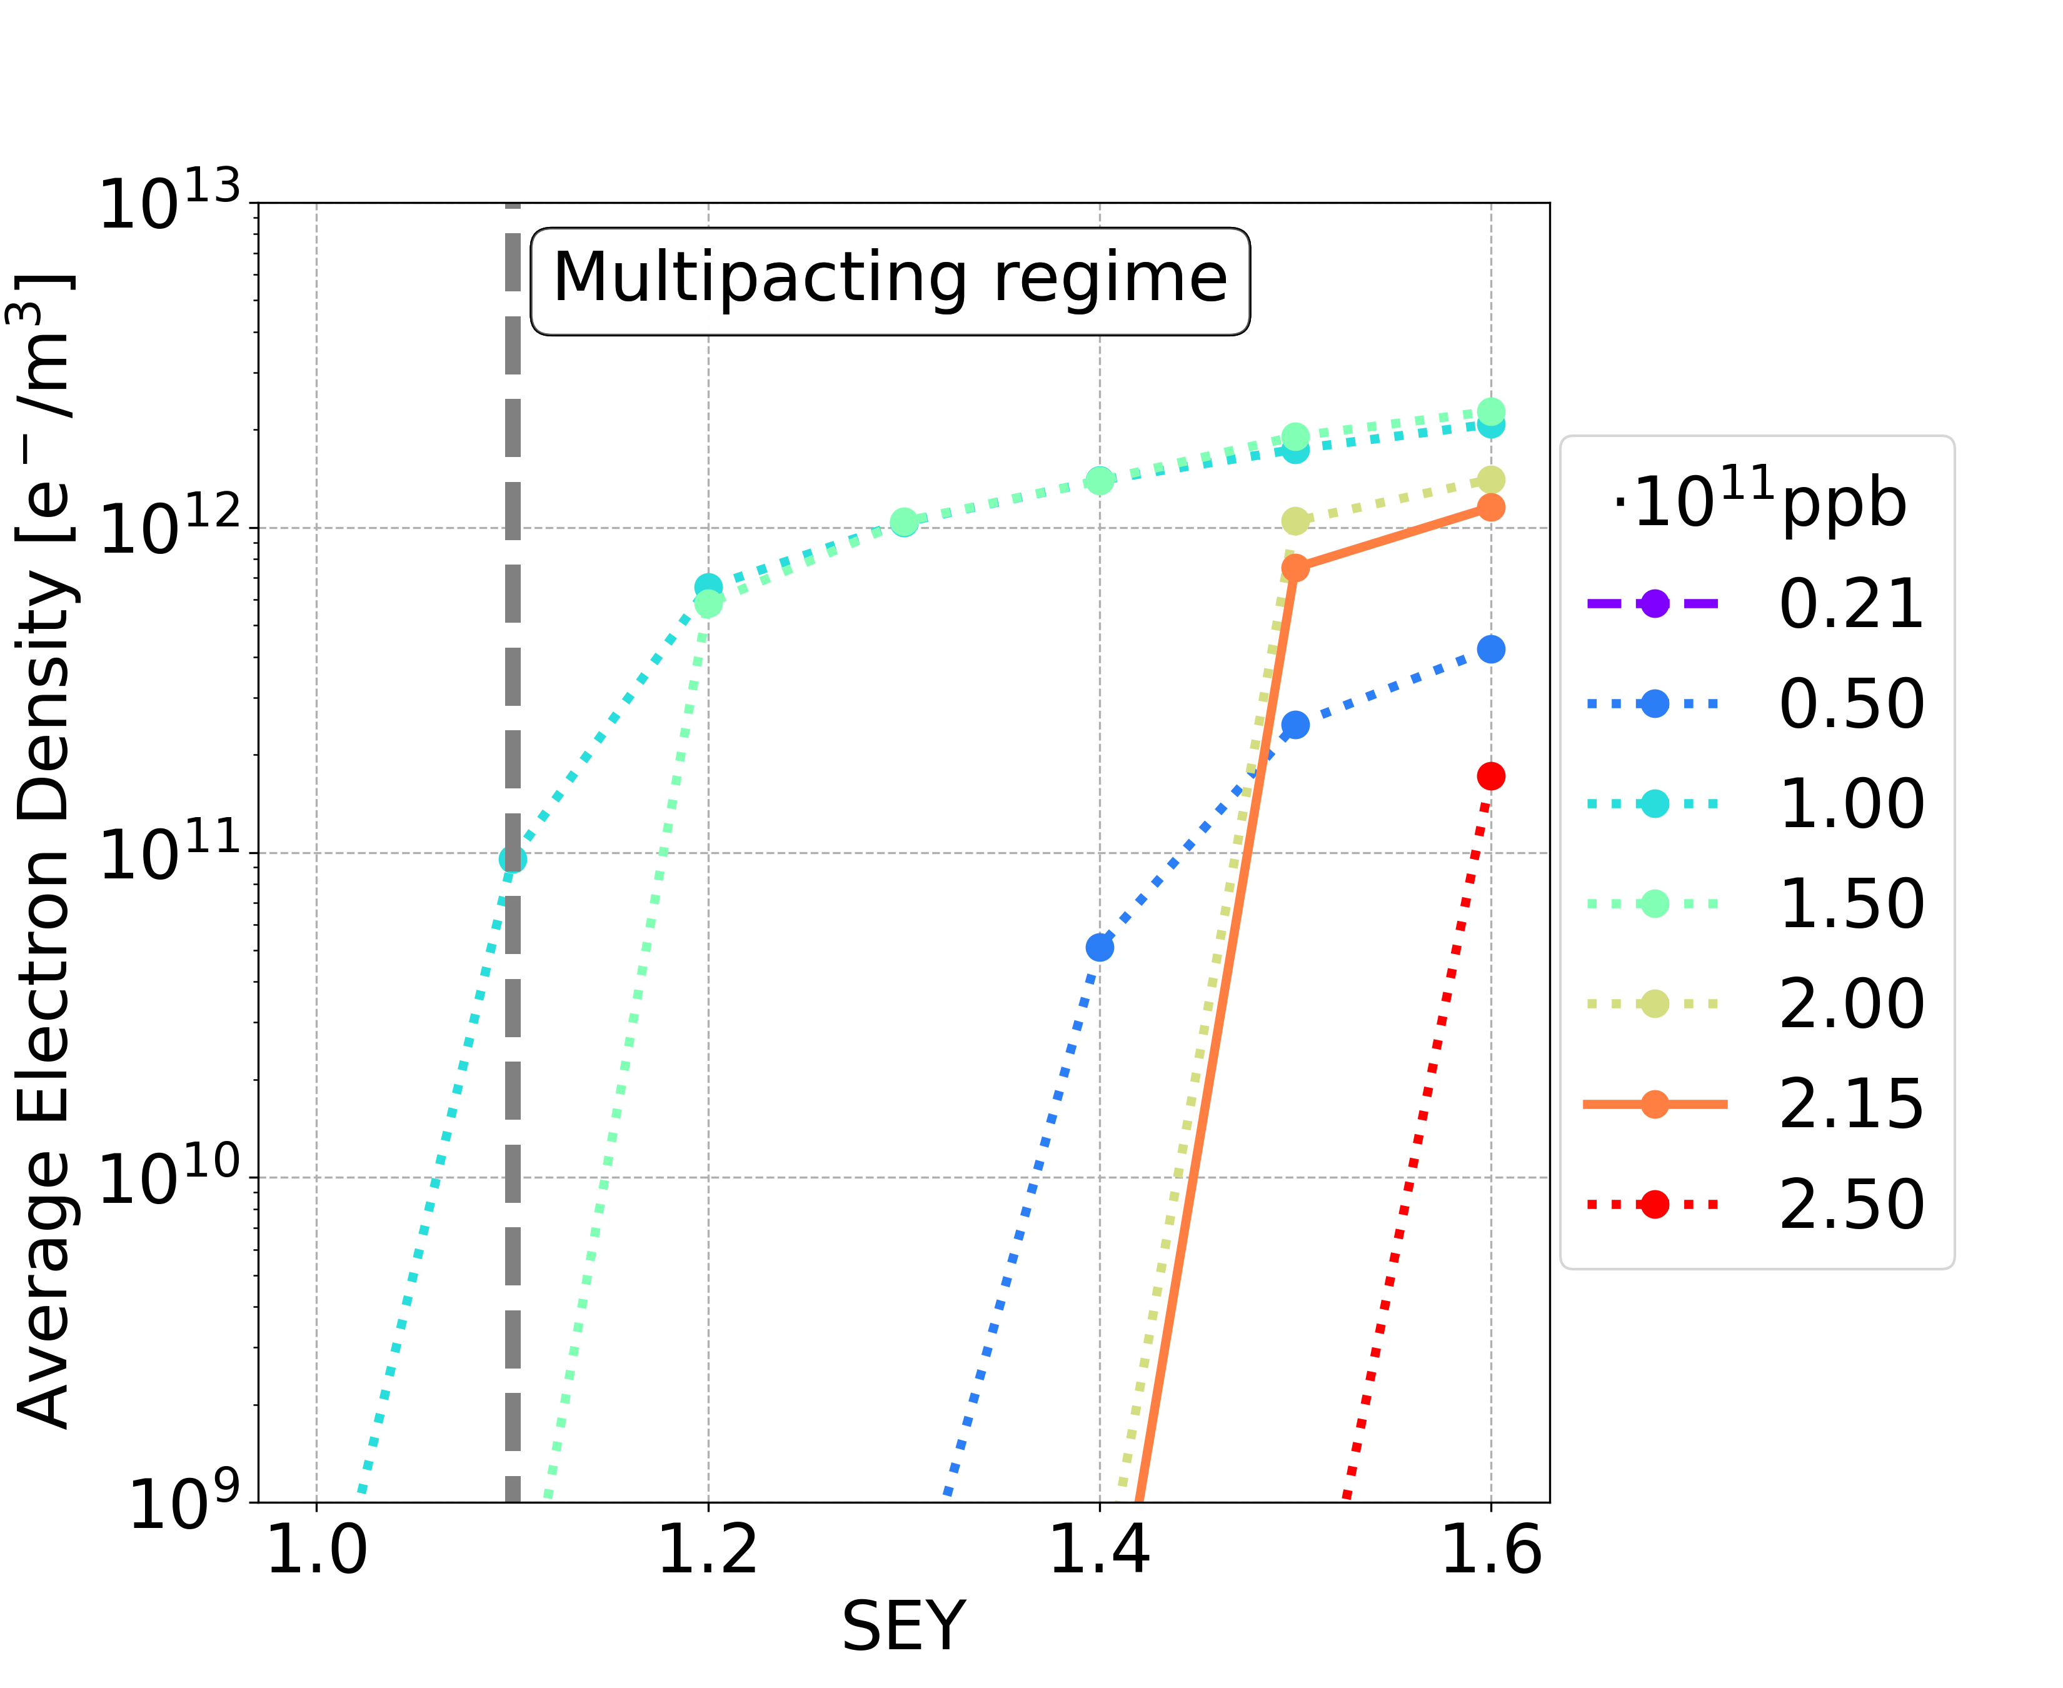
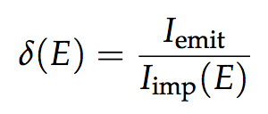
E-Cloud Build-Up Studies: Dipole
Secondary Emission Yield (SEY)
The bunch intensities 1.00 and 1.50 x 10¹¹ ppb are the most critical cases
Bunch population | SEY multipacting thresholds
nominal | 1.4
below nominal | 1.0

Slide 6
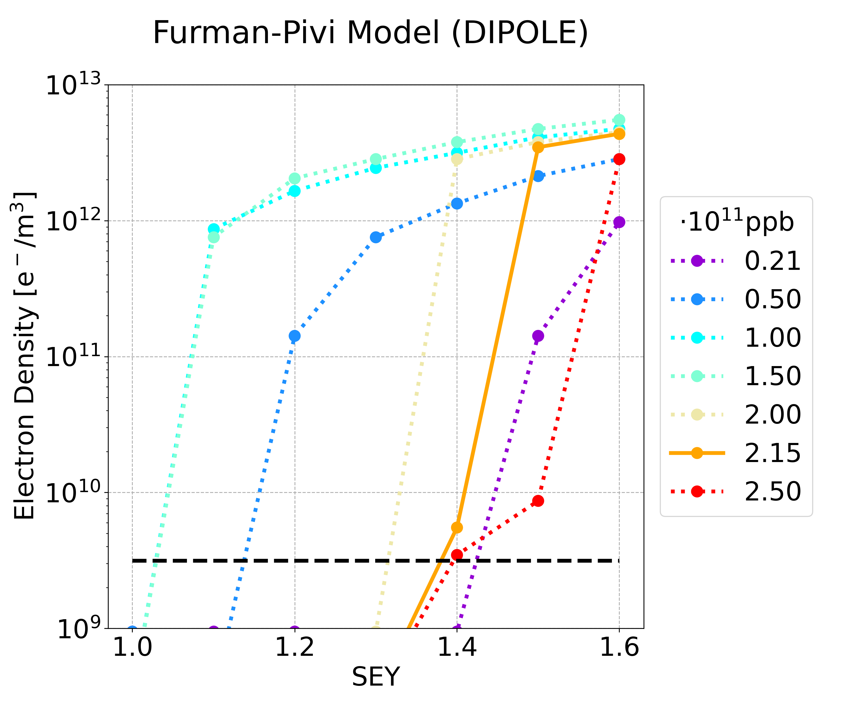
SEY Models
Simulations based on different parametrisations of the surface SEY
ECLOUD Model
Furman-Pivi Model
Courtesy of Fatih Yaman
Furman-Pivi model is more pessimistic:
  Multipacting occurs for lower SEY
  Larger e-cloud density
More details in: F. Yaman, “Electron cloud simulations using the Furman-Pivi model”, FCC-ee electron cloud meeting 18/03/2025

Slide 7
E-Cloud Build-Up Studies: Summary
The SEY multipacting thresholds are extremely tight for baseline parameters
Quadrupoles and sextupoles have the lowest SEY multipacting thresholds
Bunch intensities 1.00 and 1.50 x 10¹¹ ppb are the most critical cases
Element | Field | Bunch population | Thresholds
Drift Space | - | nominal | 1.4
 |  | below nominal | 1.2
Dipole | 15.2 mT | nominal | 1.4
 |  | below nominal | 1.0
Quadrupole | 1.45 T/m | nominal | 1.1
 |  | below nominal | 1.0
Sextupole | 72.5 T/m² | nominal | 1.1
 |  | below nominal | 1.0

Slide 8
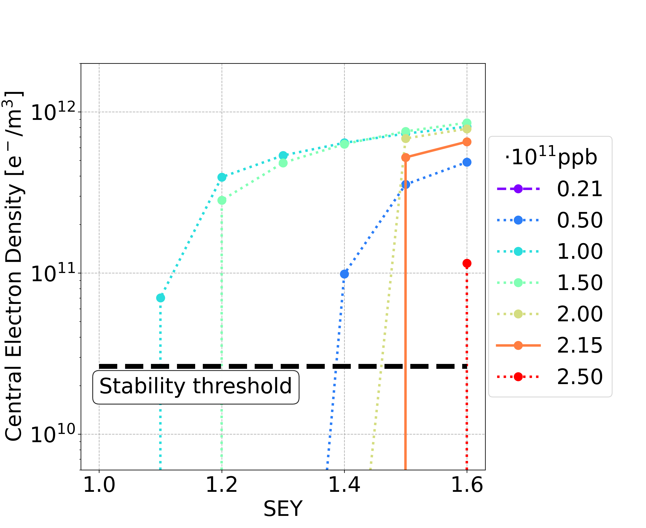


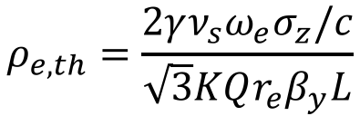

Stability
E-cloud multipacting has to be avoided
  Above the SEY multipacting threshold, the e-cloud leads to beam instabilities
  The central density is above the stability threshold
Theoretical stability threshold
$$ρ_{e,th}=\frac{2γν_{s}ω_{e}σ_{z}/c}{\sqrt{3}KQr_{e}β_{y}L}$$
$$ω_{e}=\sqrt{\frac{λ_{p}r_{e}c^{2}}{σ_{y}\left(σ_{x}+σ_{y}\right)}}$$
$$\begin{matrix}K=ω_{e}σ_{z}/c \\ Q=min⁡\left(K,7\right)\end{matrix}$$
$$λ_{p}=\frac{i_{b}}{{\sqrt{2π}σ}_{z}}$$
K. Ohmi et al., “Study of Electron Cloud Instabilities in FCC-hh”, Proc. of IPAC2015
  Theoretical threshold has been verified by means of PyECLOUD-PyHEADTAIL simulations, more details in:
  “Electron Cloud studies for the FCC-ee”, FCC week 2024

Slide 9
Outline
Introduction
Mitigation Techniques
Filling Pattern with Non-Uniform Bunch Spacing
Conclusions and Outlooks

Slide 10
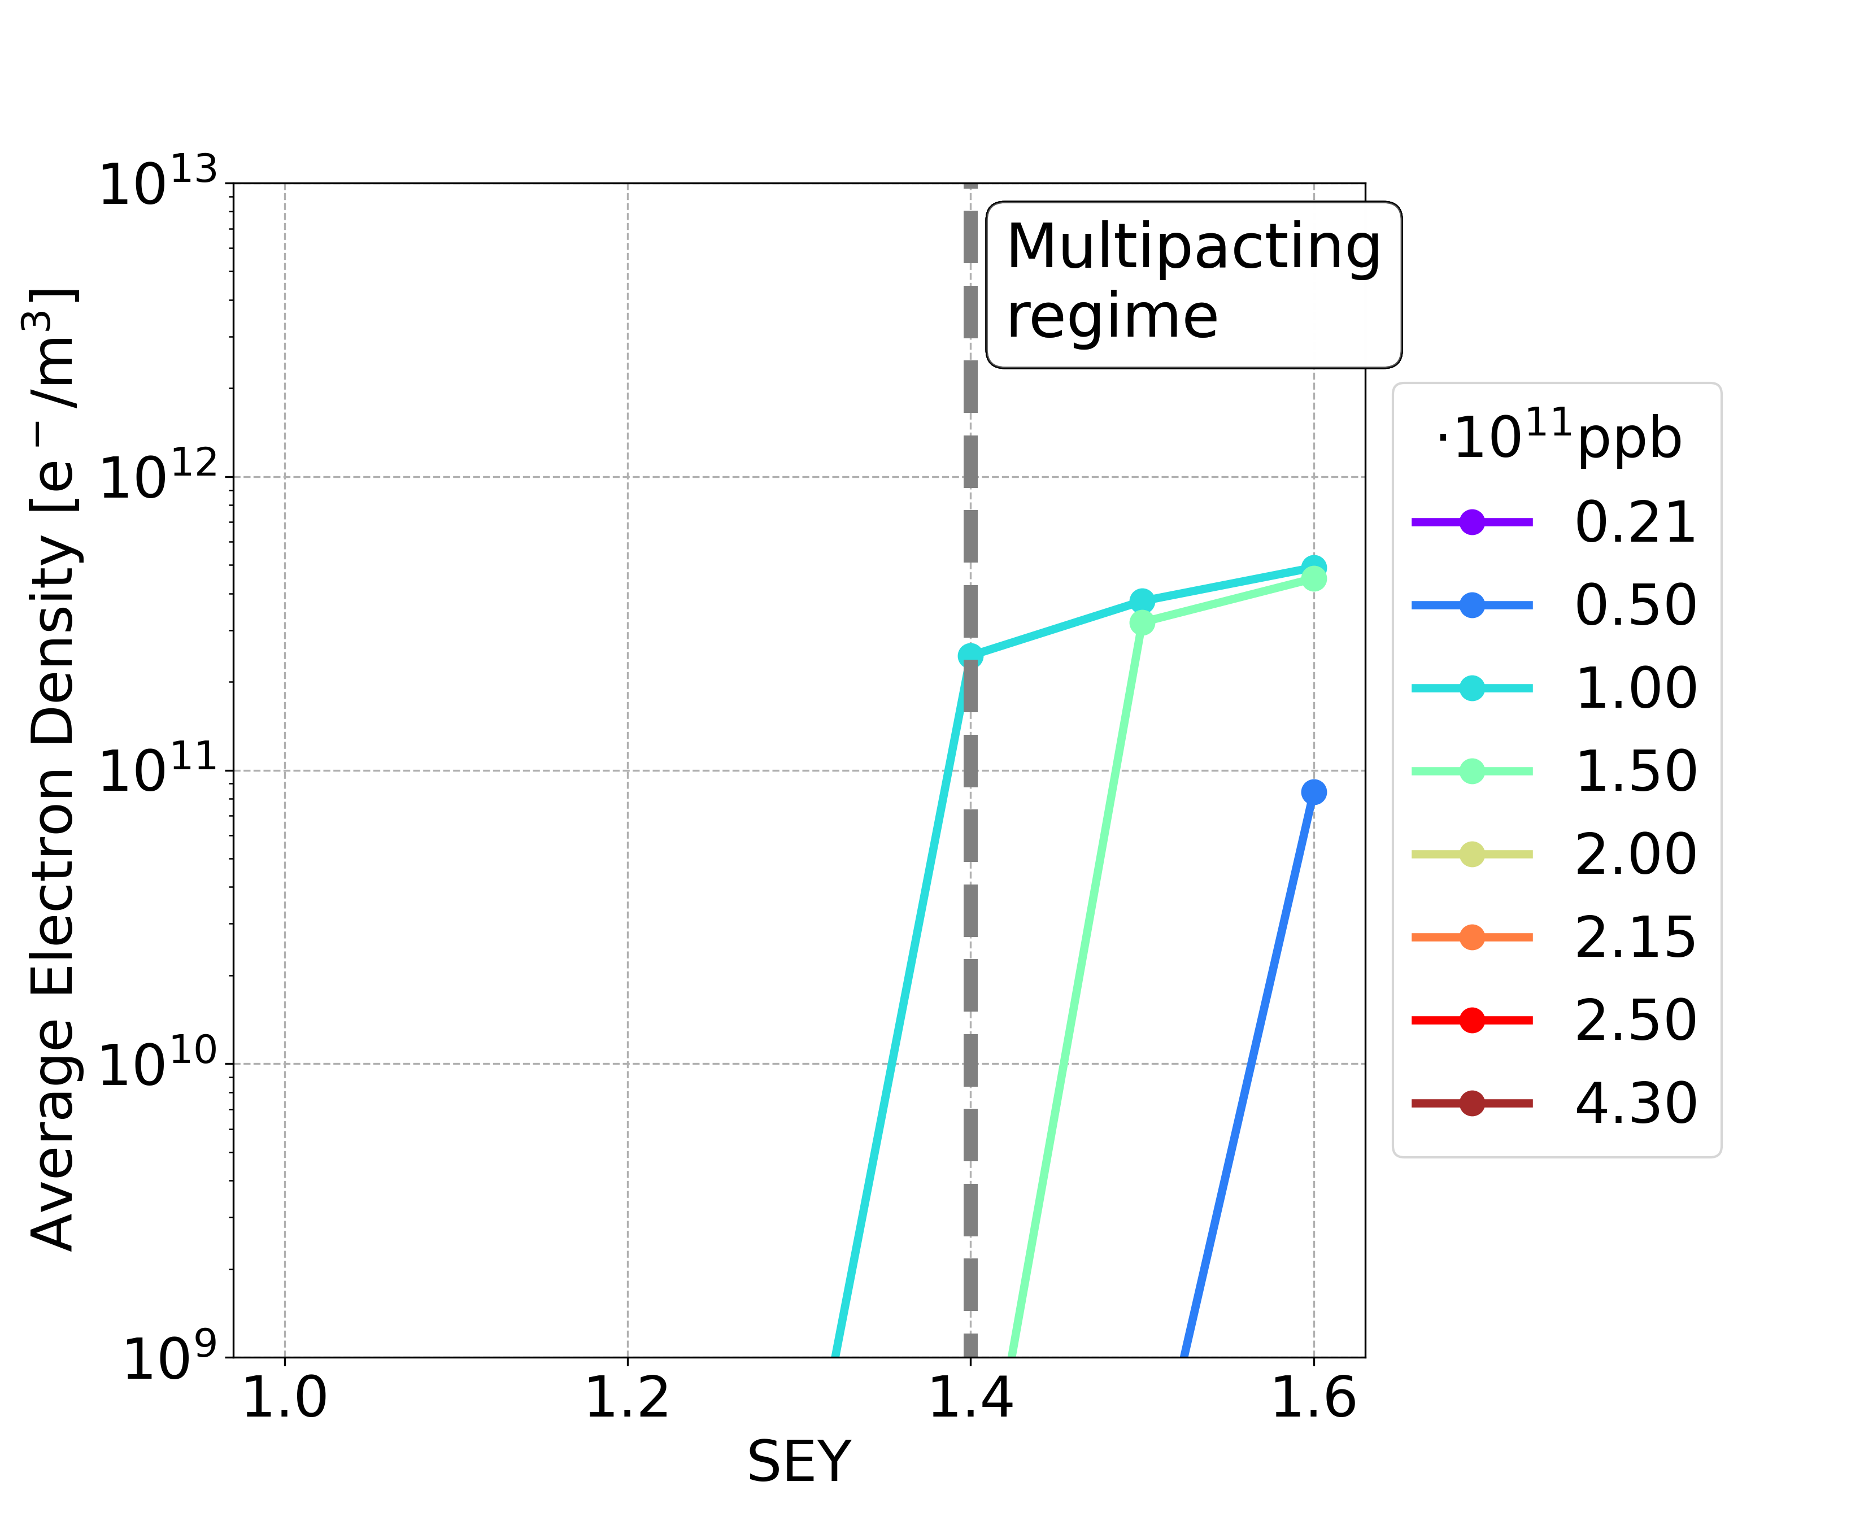
Mitigation: Bunch Spacing
The SEY multipacting thresholds are extremely tight for baseline parameters
E-cloud could be mitigated using larger bunch spacing
Larger bunch spacing
Dipole 50 ns
Element | 25 ns | 30 ns | 40 ns | 50 ns
Drift Space | 1.2 | 1.3 | 1.5 | > 1.6
Dipole (15.2 mT) | 1.0 | 1.1 | 1.2 | 1.3
Quadrupole (1.45 T/m) | 1.0 | 1.0 | 1.1 | 1.3
Sextupole (72.5 T/m²) | 1.0 | 1.1 | 1.3 | 1.4
If the bunch spacing is larger (e.g., 2 times: 25 ns -> 50 ns), in order to keep the beam current constant
larger bunch intensities are needed (e.g., 2 times: 2.15 x 10¹¹ ppb -> 4.30 x 10¹¹ ppb )
It could lead to issues with other collective effects (beam-beam, beam-coupling impedance), more details in:
  Mauro Migliorati, “FCC-ee single beam collective effects”, FCC week 2024
  Roxana Roos, “Xsuite simulations of beam-beam effects with impedance contribution”, FCC week 2024

Slide 11
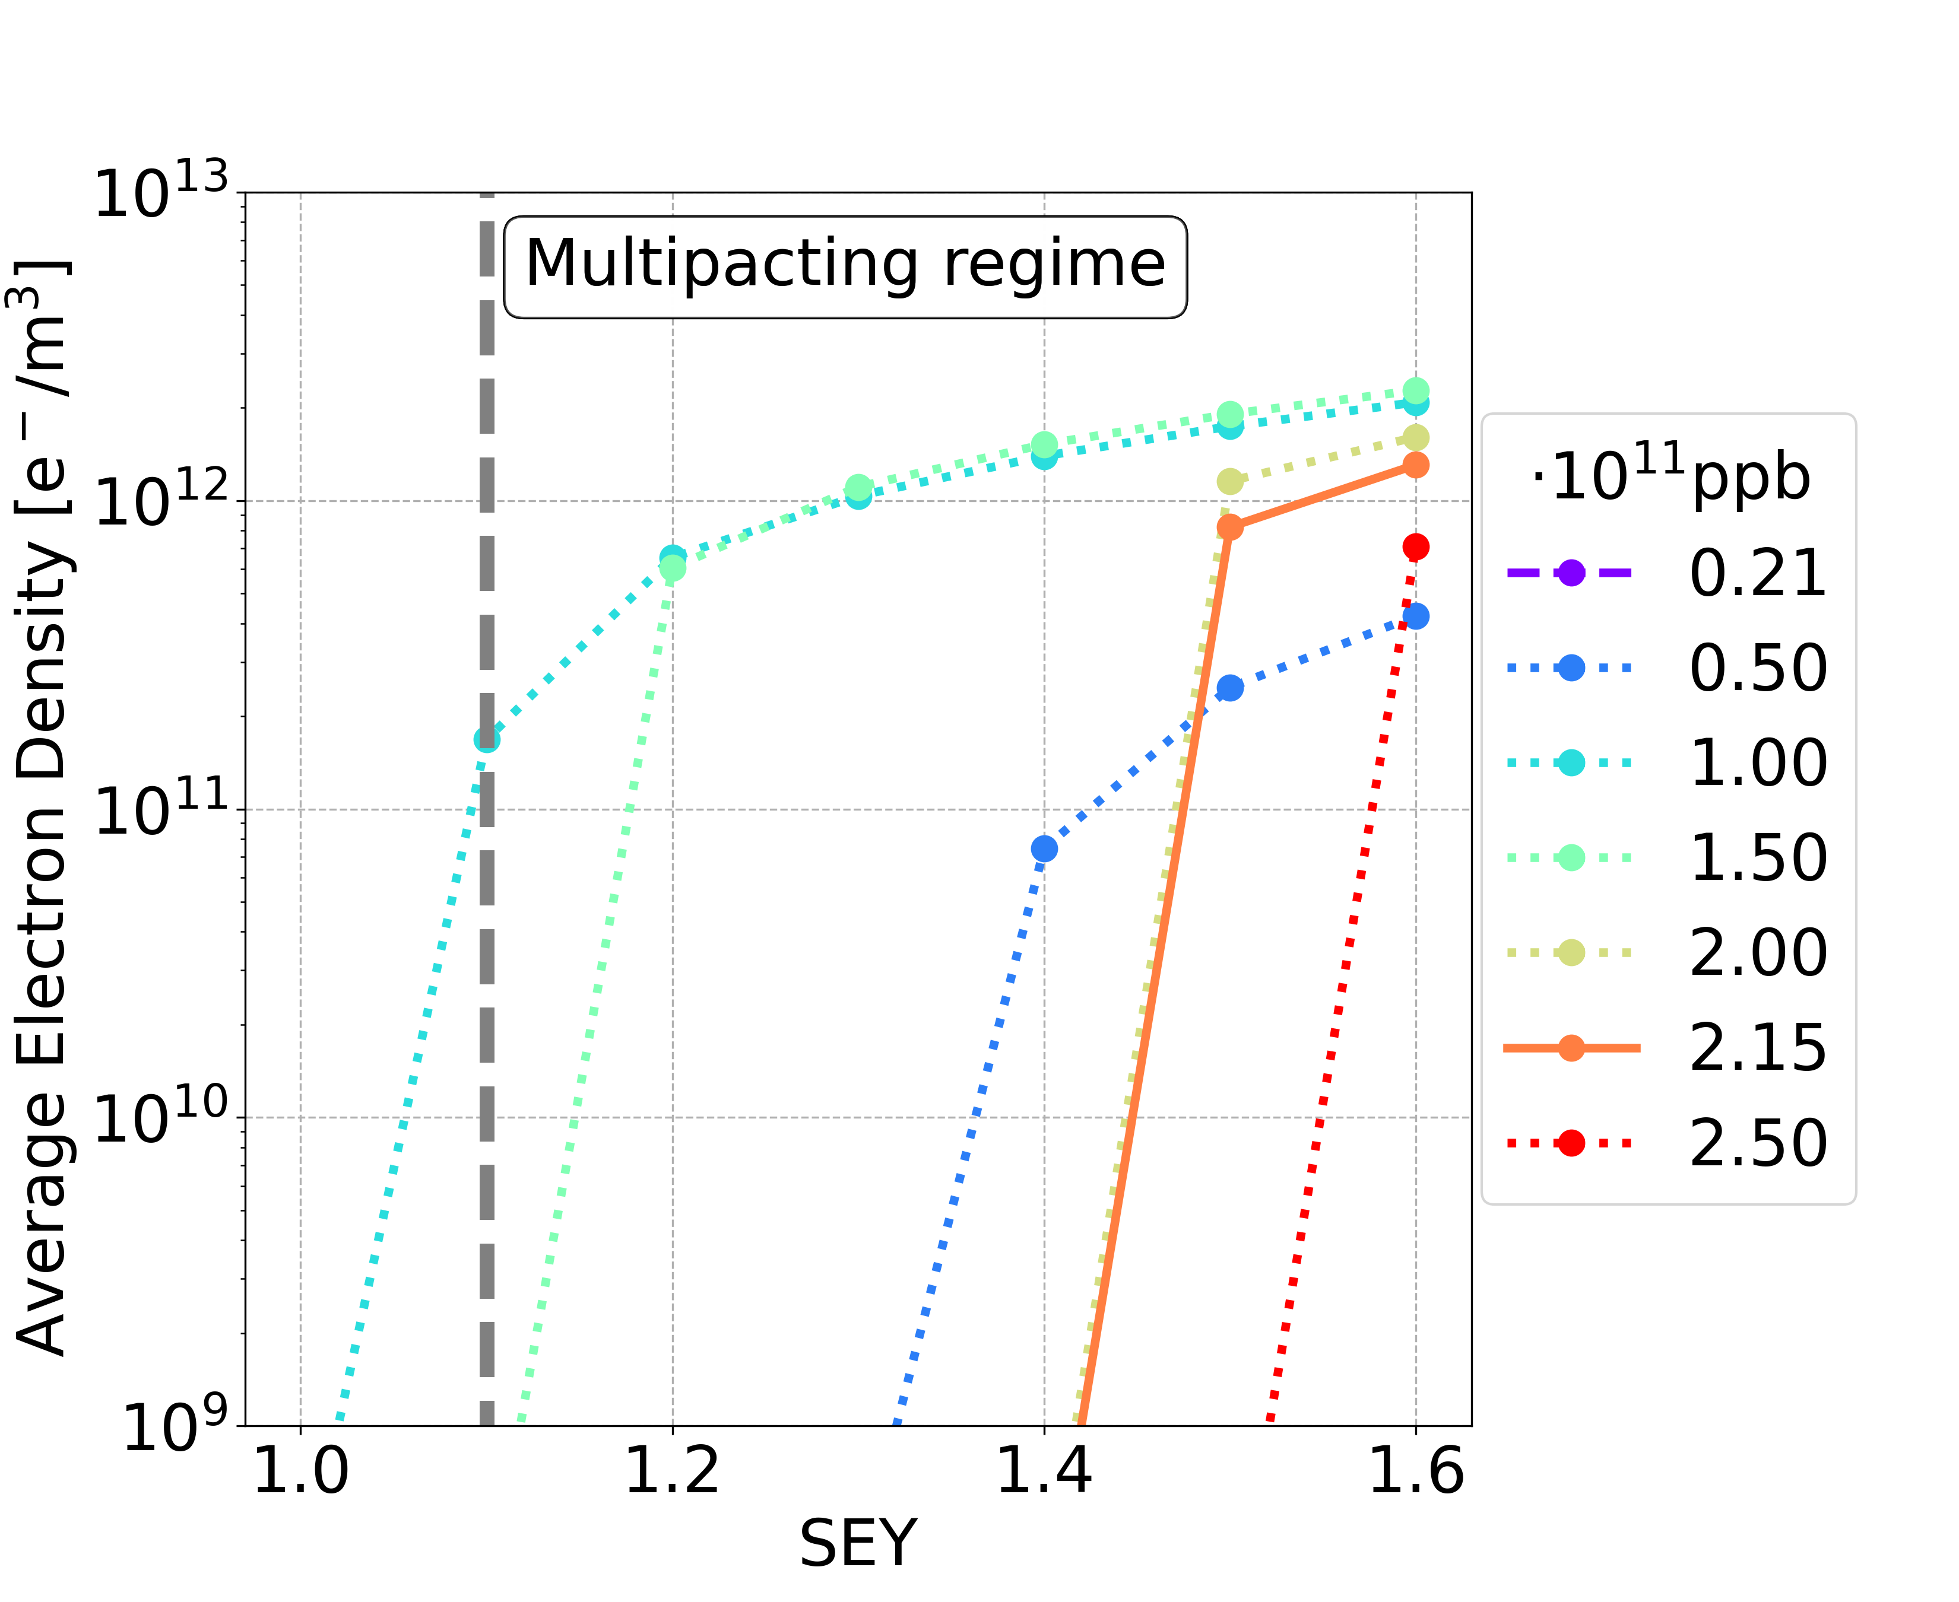
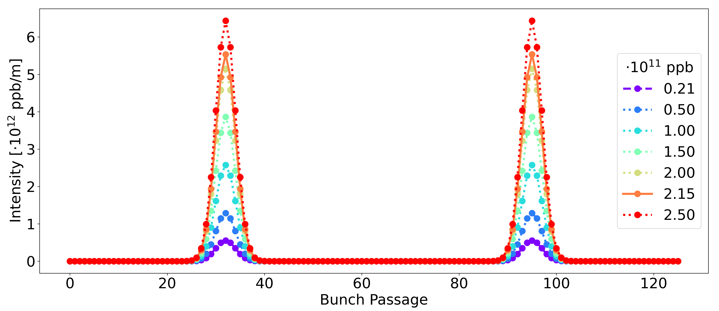
Mitigation: Charge Accumulation Phase
bunch intensities increase uniformly
100
101
The bunch intensities 1.00 and 1.50 x 10¹¹ ppb are the most critical cases
During the charge accumulation phase: do not fill the bunches of the train uniformly
In this way the critical bunch intensities will be reached with a larger bunch spacing
Two options were presented by Hannes Bartosik, “Booster and collider filling scheme”, FCC week 2024

Slide 12
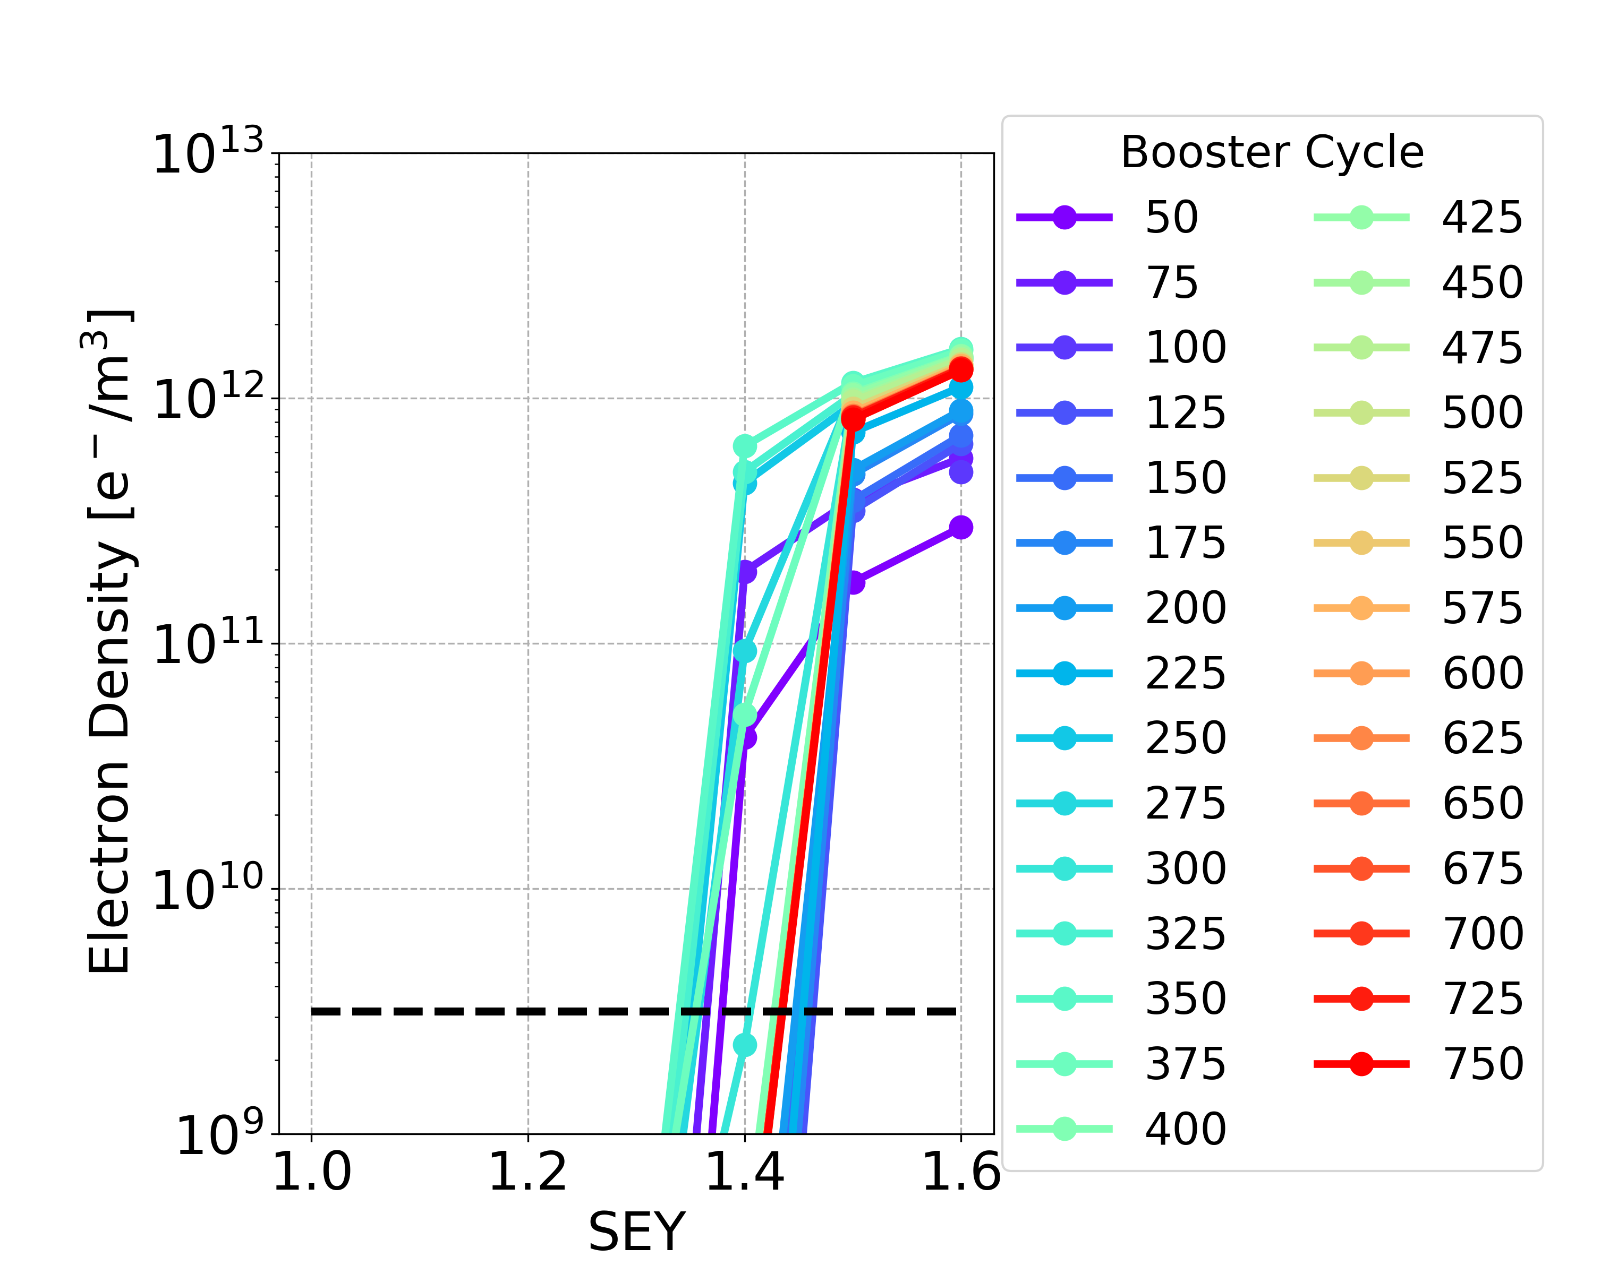
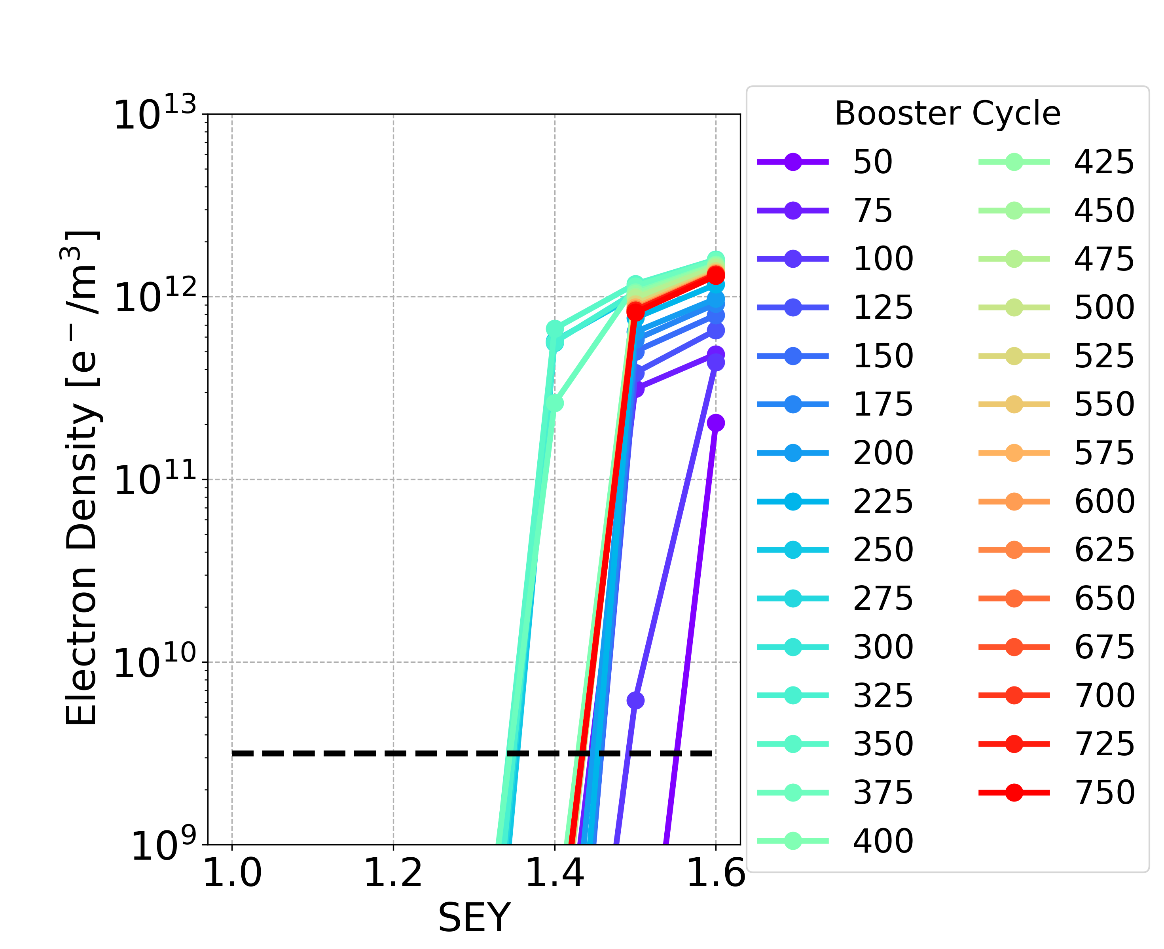
Charge Accumulation Phase: Dipole
Option 1 Option 2
Bunch population | SEY multipacting thresholds
nominal | 1.4
below nominal | 1.0
 | SEY multipacting thresholds
During charge accumulation | 1.3
Using the two options with special filling schemes during the charge accumulation phase, the SEY multipacting thresholds are higher and they tend to the SEY multipacting thresholds in the case of the nominal bunch intensity

Slide 13
Charge Accumulation Phase: Summary
The two options with special filling schemes are also effective for the other analysed elements
Quadrupoles and sextupoles have the lowest SEY multipacting thresholds
Element | Field | Special filling schemes during charge accumulation phase | Uniform 25 ns
Drift Space | - | 1.4 | nominal | 1.4
 |  |  | below nominal | 1.2
Dipole | 15.2 mT | 1.3 | nominal | 1.4
 |  |  | below nominal | 1.0
Quadrupole | 1.45 T/m | 1.1 | nominal | 1.1
 |  |  | below nominal | 1.0
Sextupole | 72.5 T/m² | 1.1 | nominal | 1.1
 |  |  | below nominal | 1.0
A potential concern with this approach is having bunches of significantly different intensities in the collider at the same time, which may make difficult to find a working point that ensures stability for all bunches
See Roxana Soos, “Beam-Beam and Wakefield-Induced Collective Instabilities and Mitigation Strategies in the FCC-ee at Z Energy”, FCC week 2025

Slide 14
Outline
Introduction
Mitigation Techniques
Non-Uniform Bunch Spacing
Conclusions and Outlooks

Slide 15
Trains with Non-Uniform Bunch Spacing
Analysed trains with uniform bunch spacing
Trains with 25 ns bunch spacing
Trains with smaller bunch spacing and with small gaps in order to mitigate the e-cloud (keeping the same train duration):
Trains with 10 ns bunch spacing (2 bunches + 3 empty bunches)
1 2 3 280
...
Time [ns]
0 25 50
1 2 3 280
...
e e e
Time [ns]
0 10 20 30 40 50

Slide 16
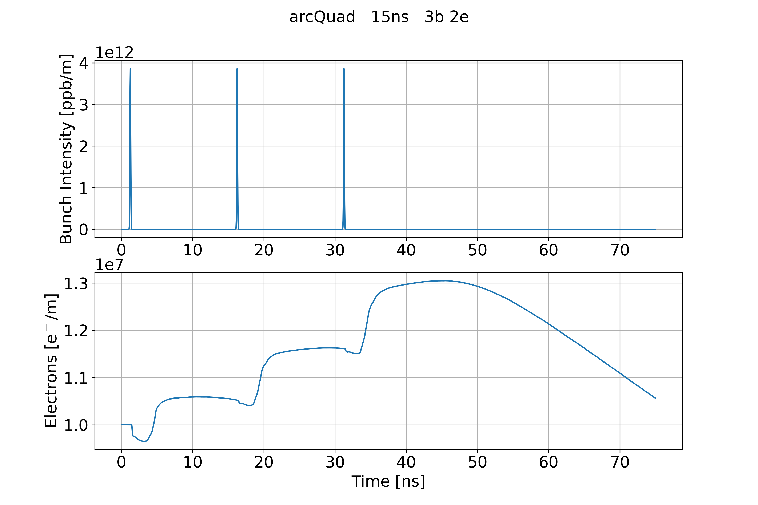
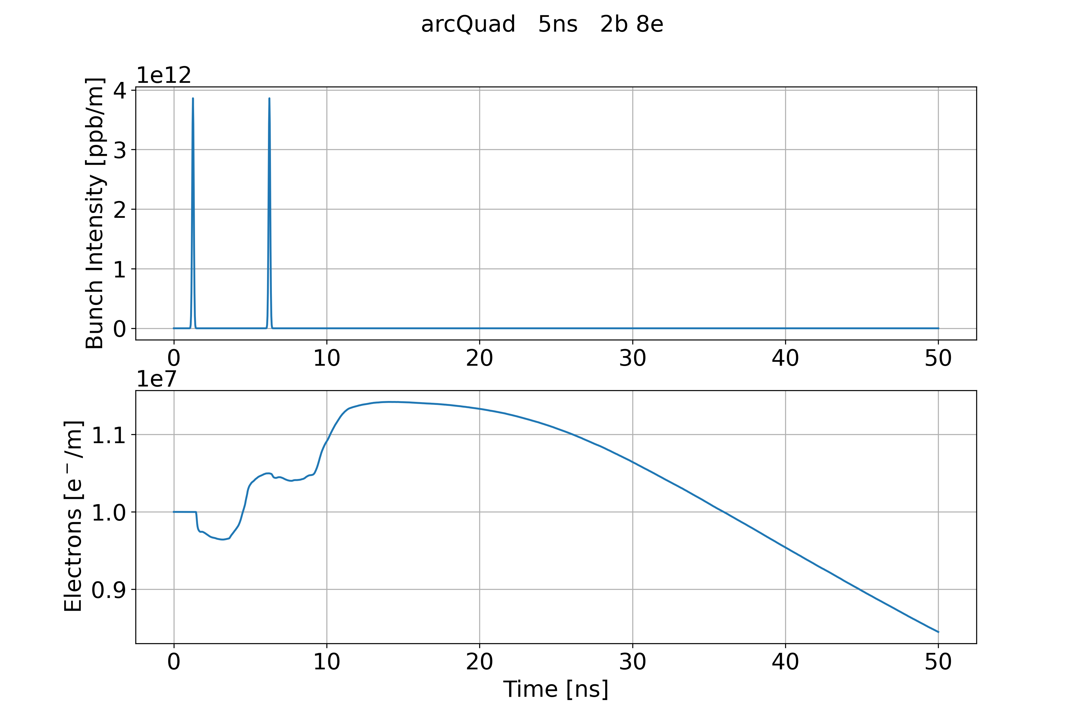
Bunch Spacing
Analysed some cases with few bunch passages and a small gap
Considering larger bunch spacing (20 ns and 15 ns), the small gap is not long enough to mitigate the e-cloud
  e-cloud after the bunch passages and the small gap is larger than the initial e-cloud density
Considering very small bunch spacing (10 ns and 5 ns), the small gap is long enough to mitigate the e-cloud
  e-cloud after the bunch passages and the small gap is smaller than the initial e-cloud density
Bunch spacing 15 ns with 3 bunches and 2 empty
Bunch spacing 5 ns with 2 bunches and 8 empty

Slide 17
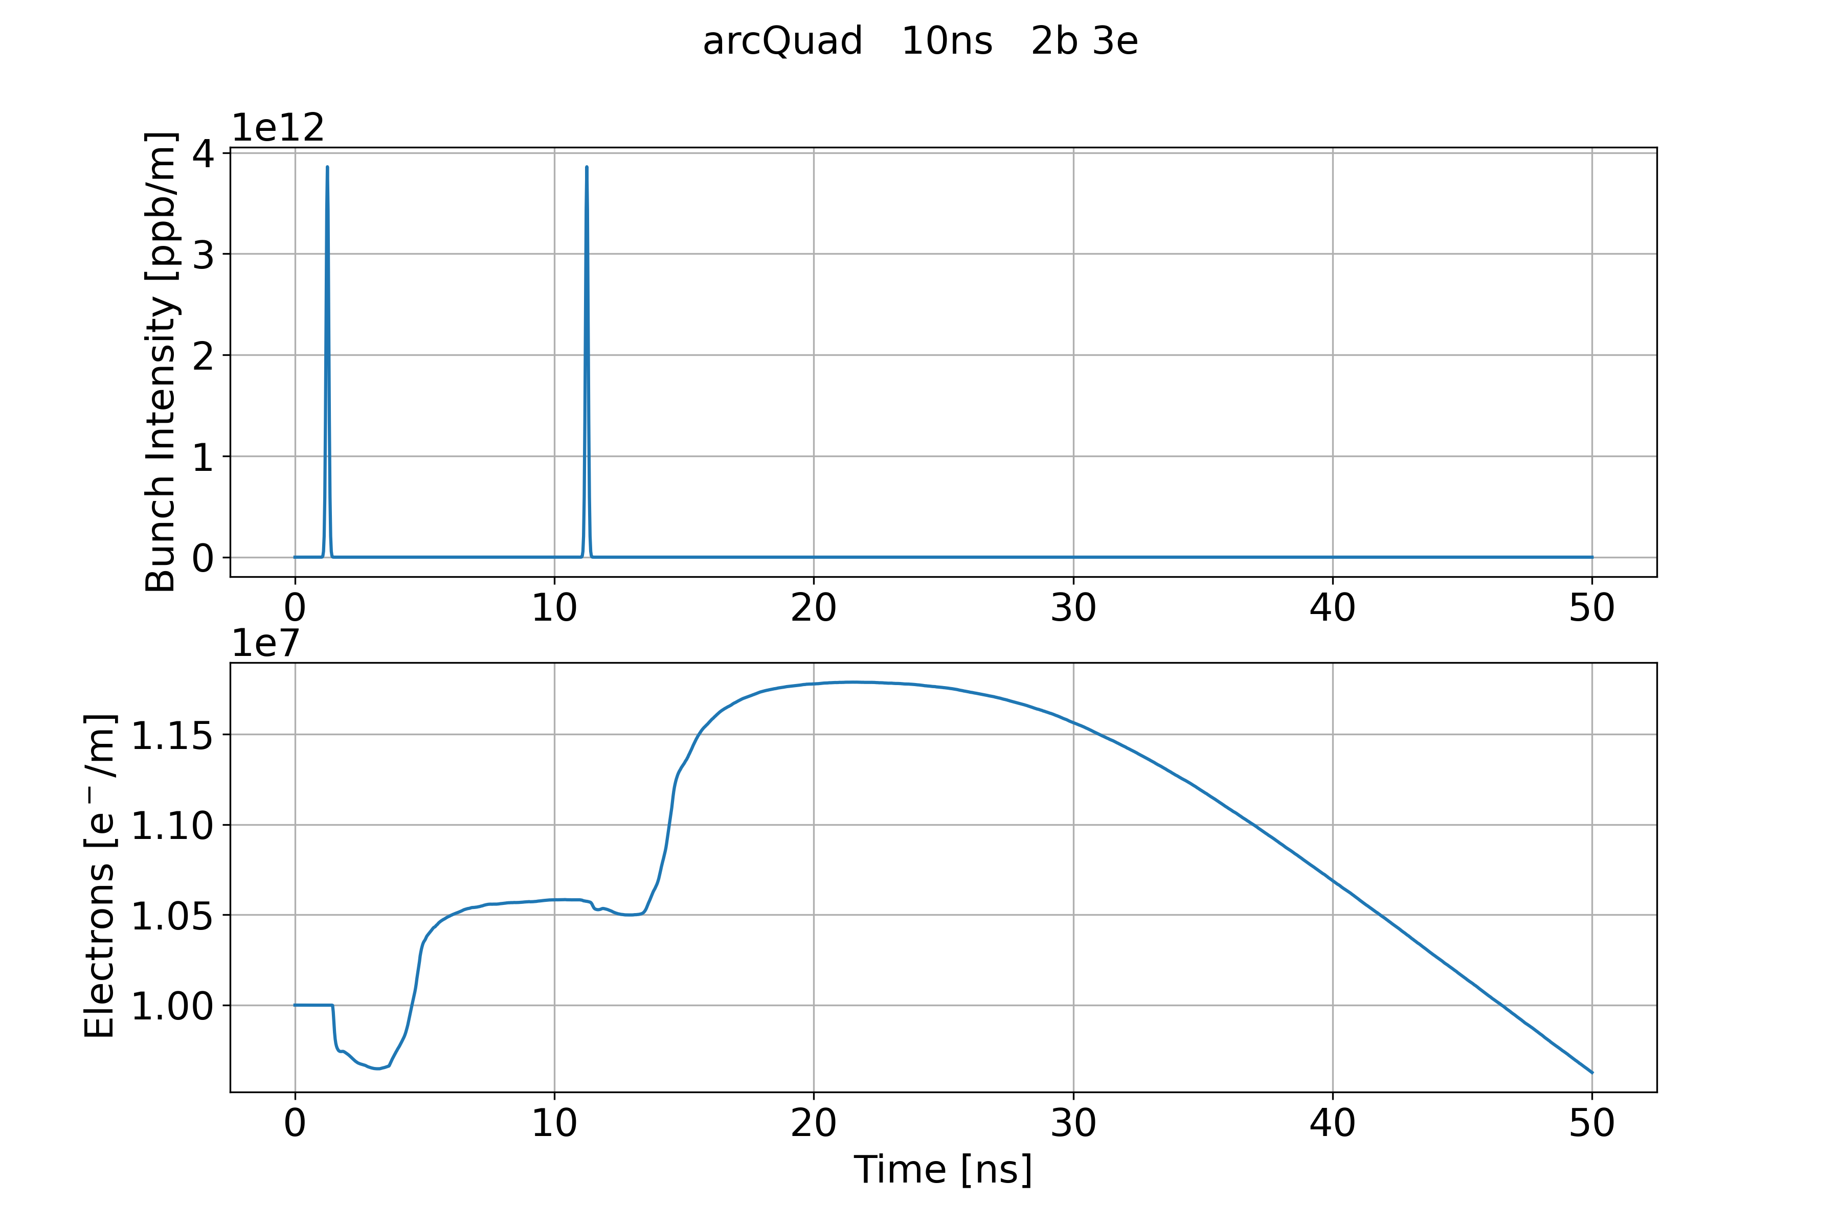
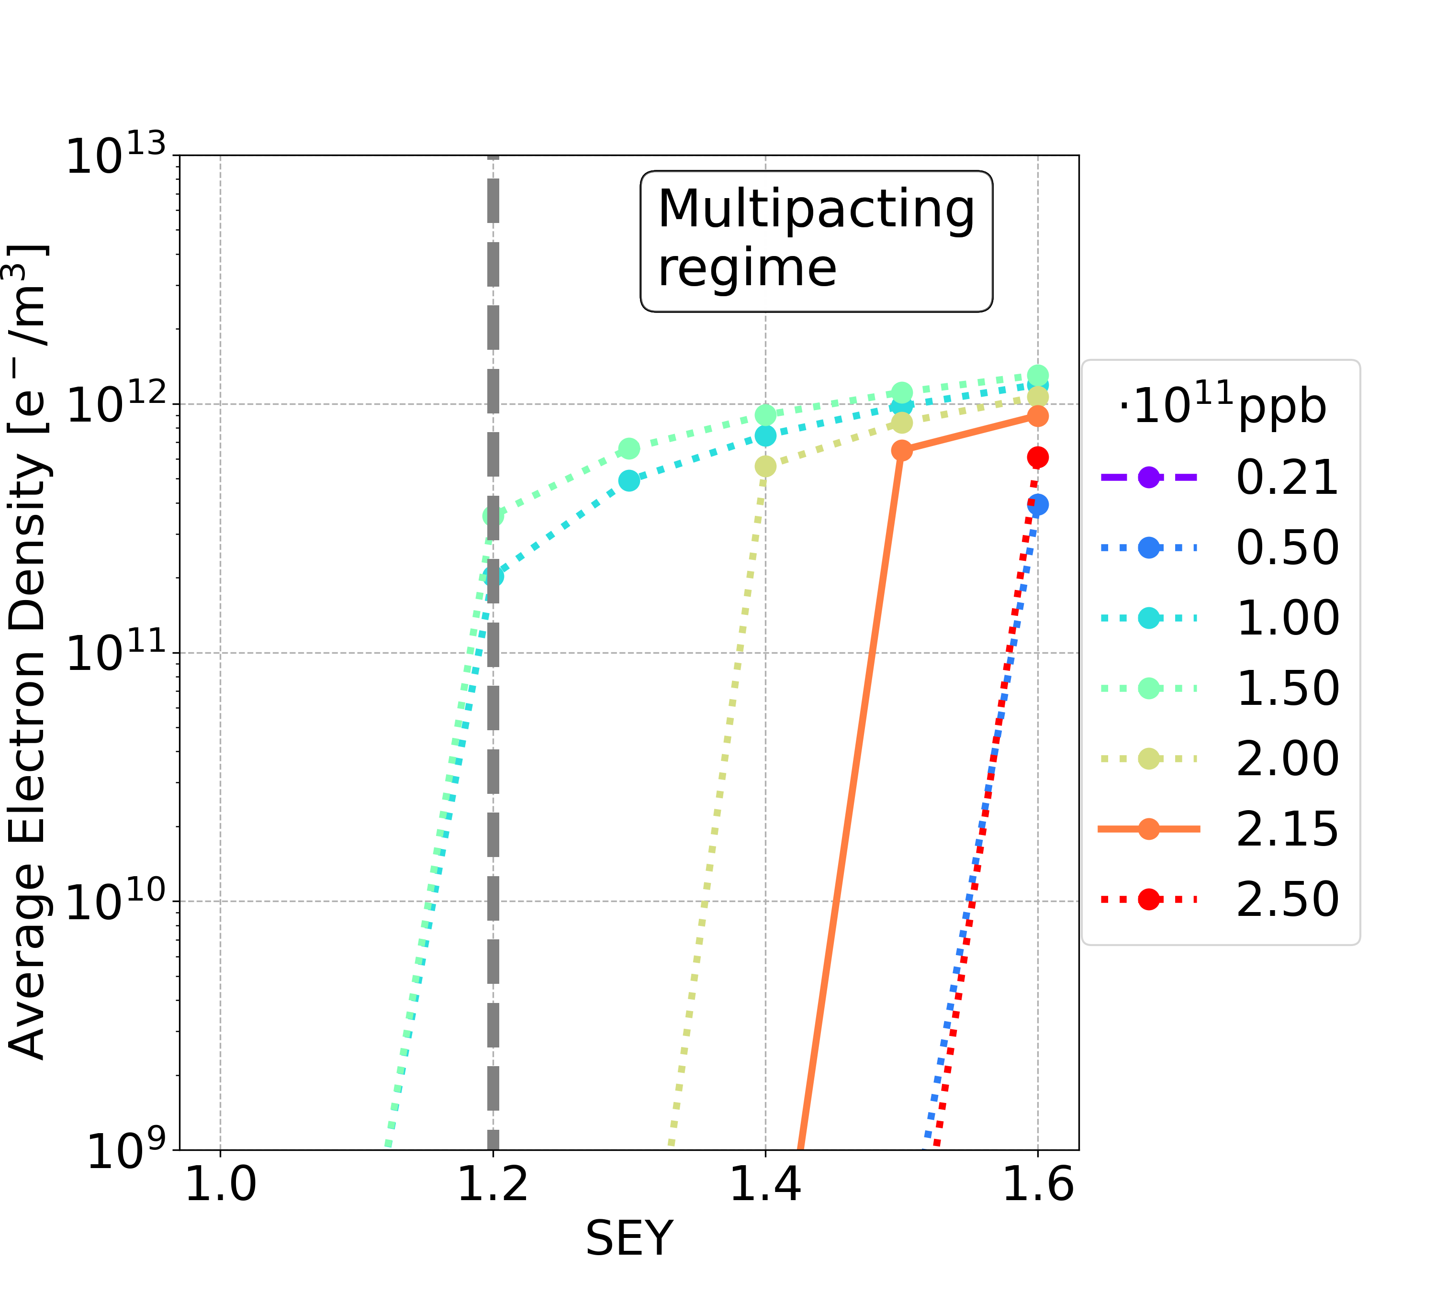
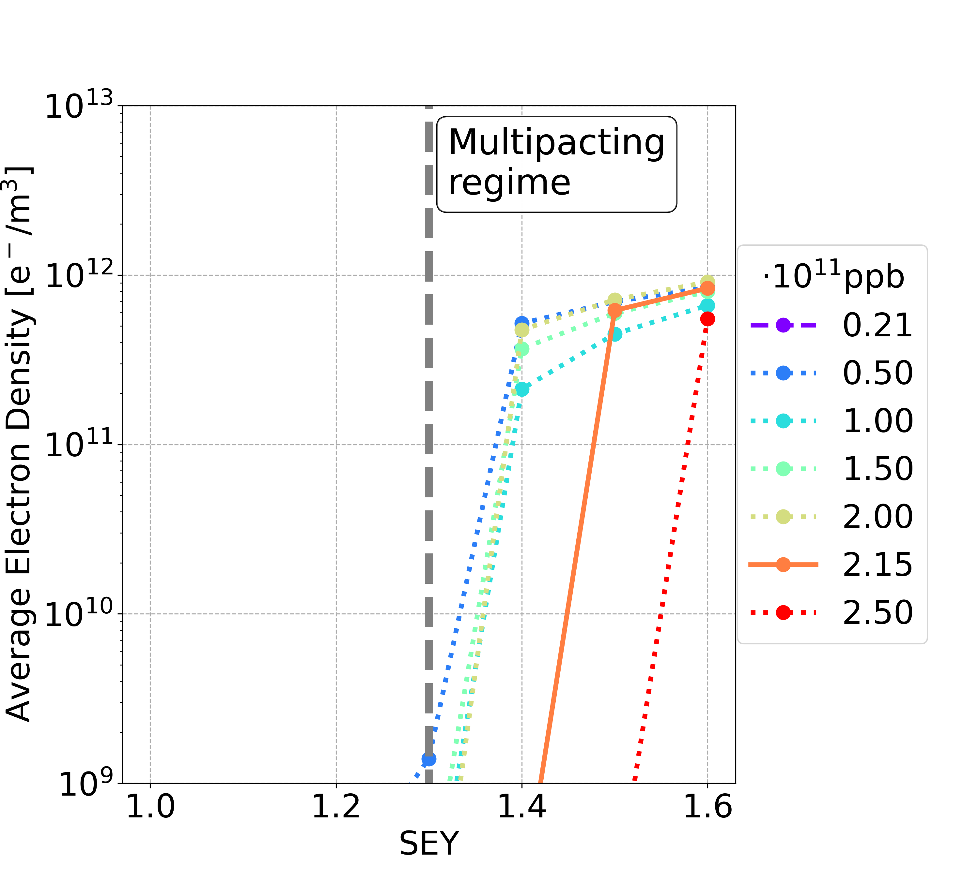
Short Bunch Spacing: 10 ns vs 5 ns
Considering the passage a full train of 280 bunches and the following train gap
A better e-cloud mitigation is obtained using filling schemes with 5 ns bunch spacing
Bunch spacing 10 ns with 2 bunches and 3 empty
Bunch spacing 5 ns with 2 bunches and 8 empty

Slide 18
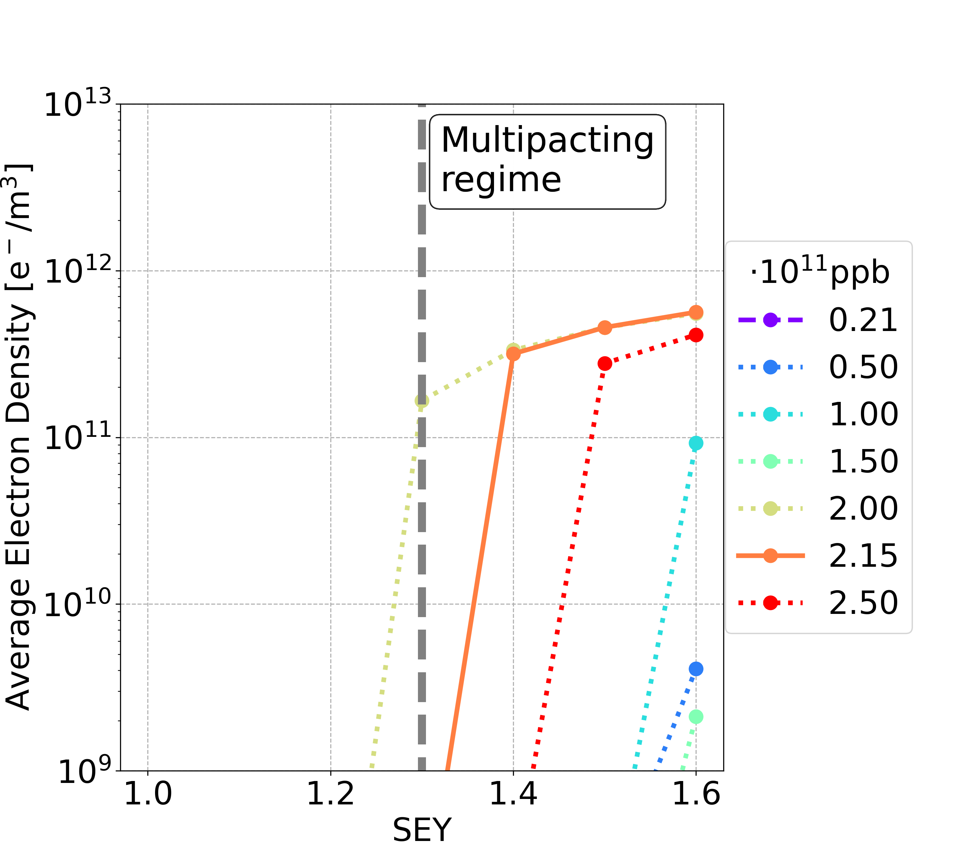
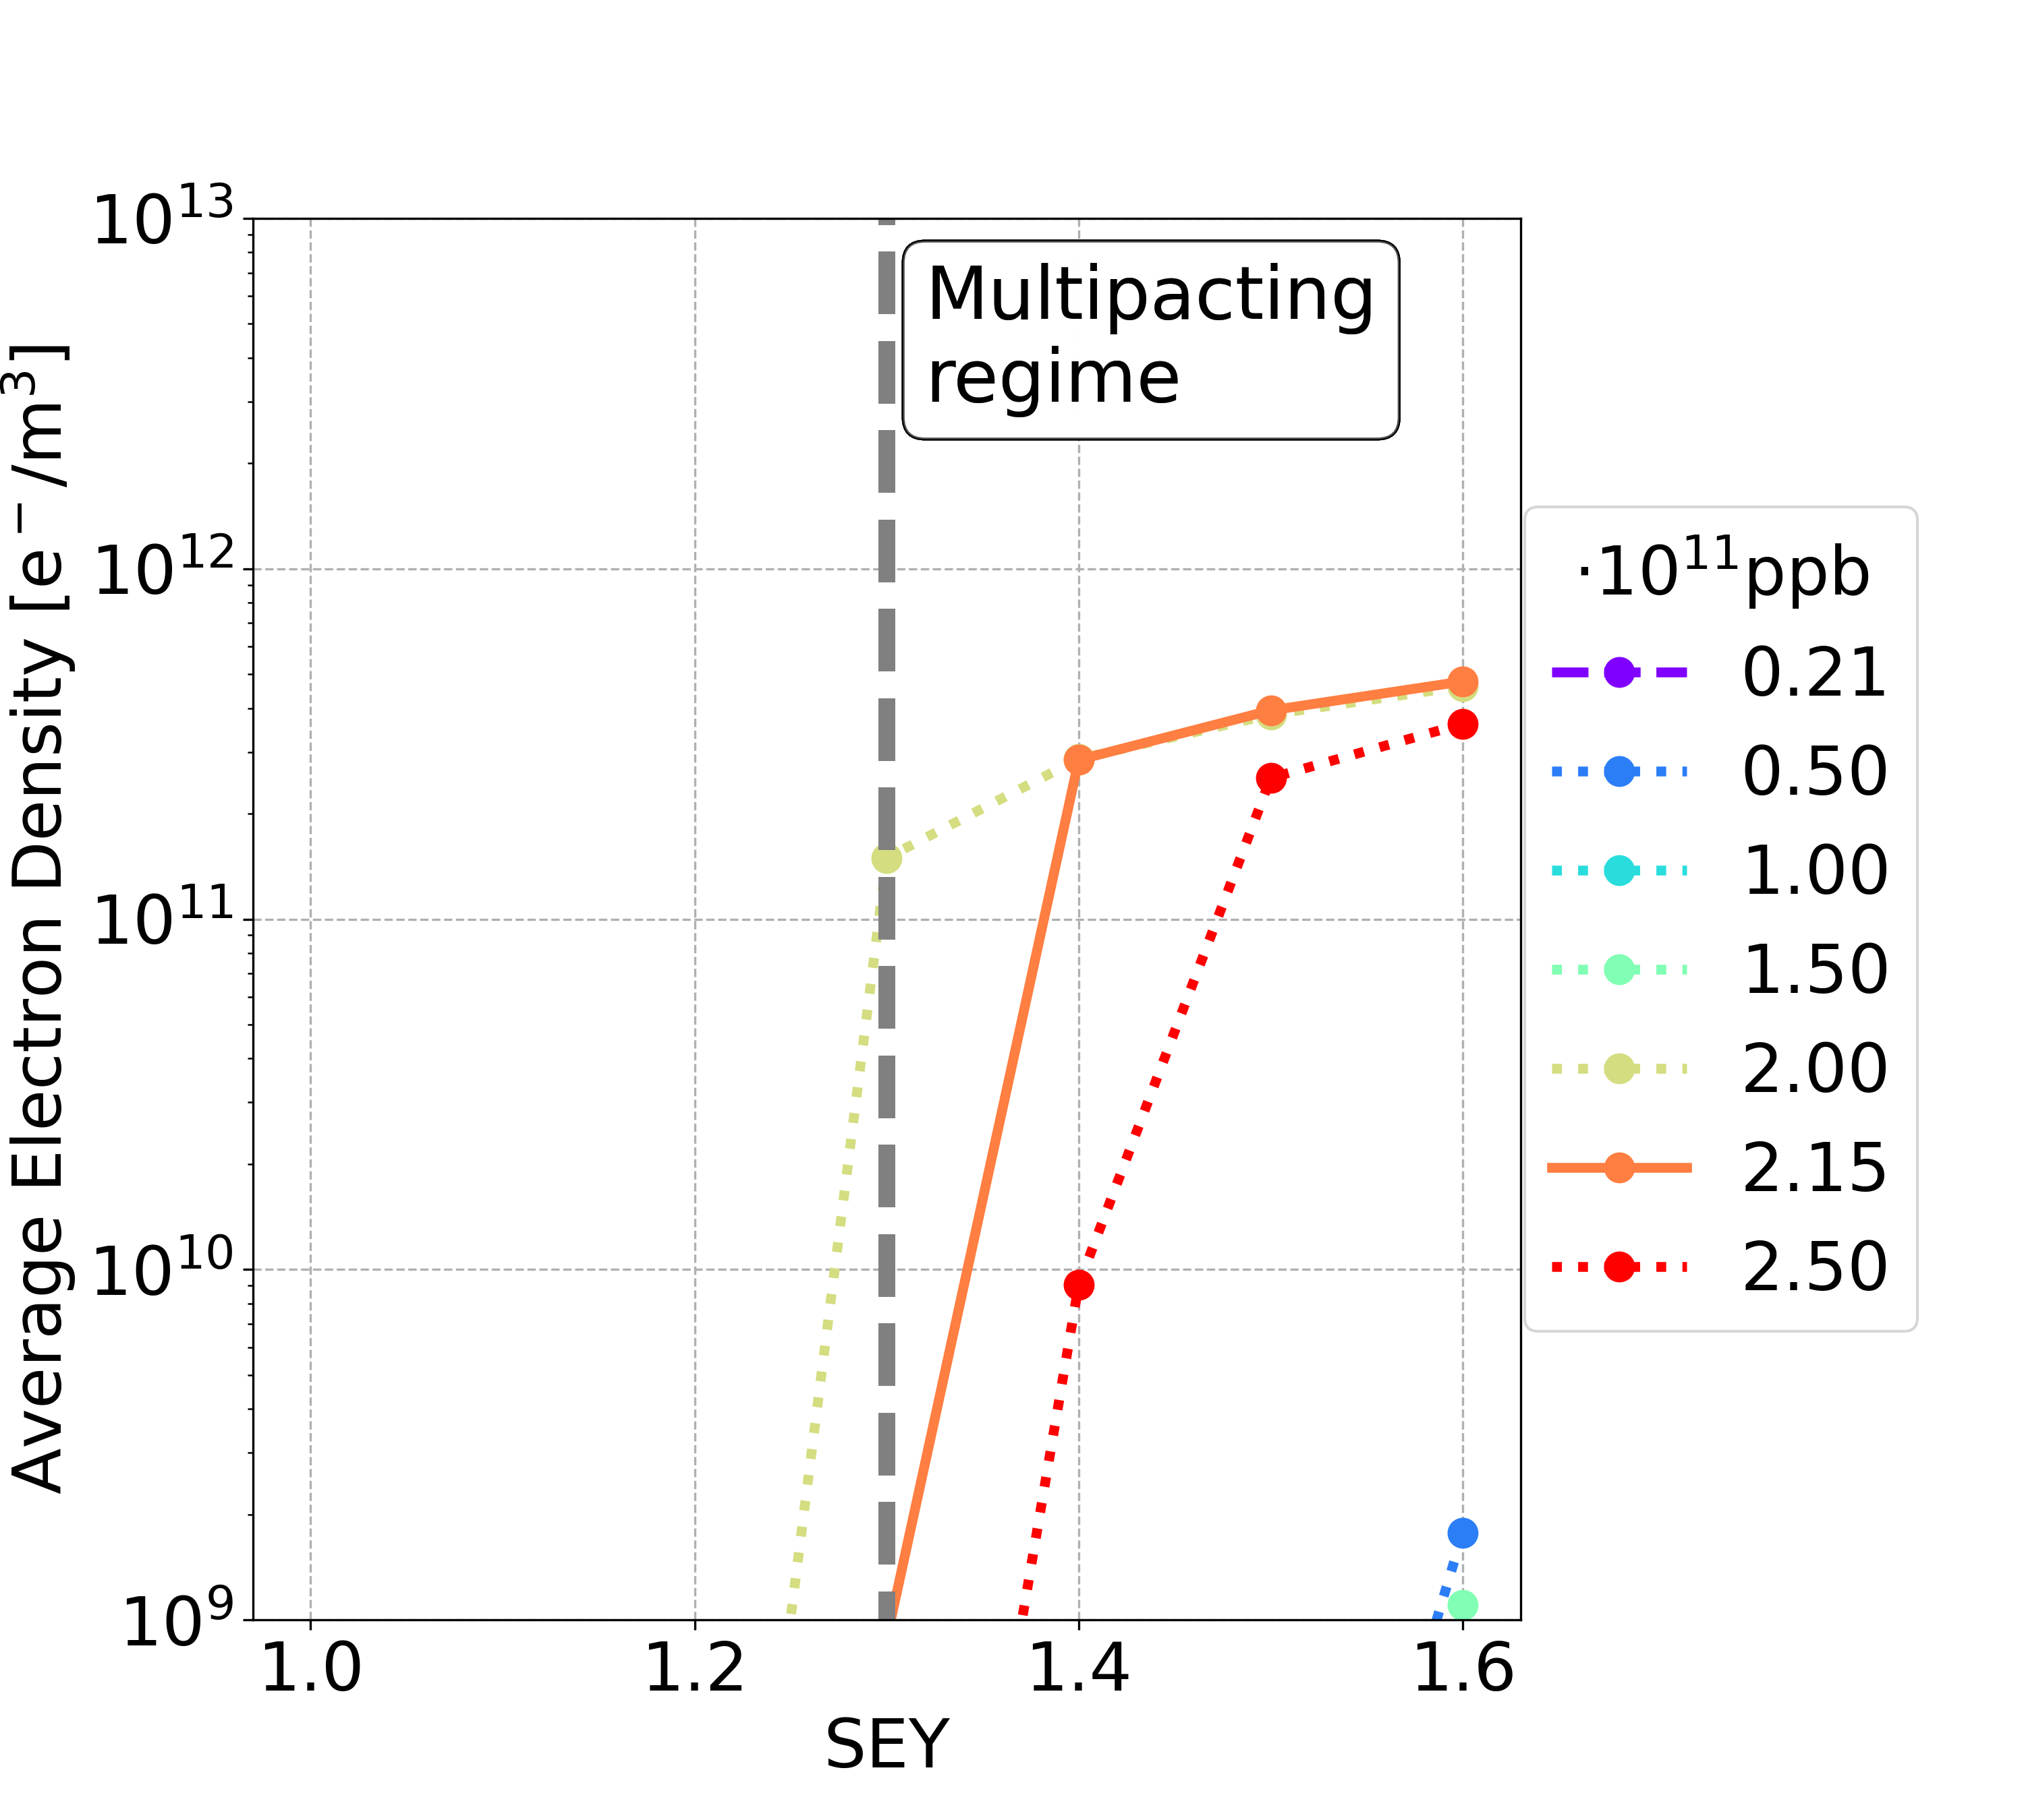
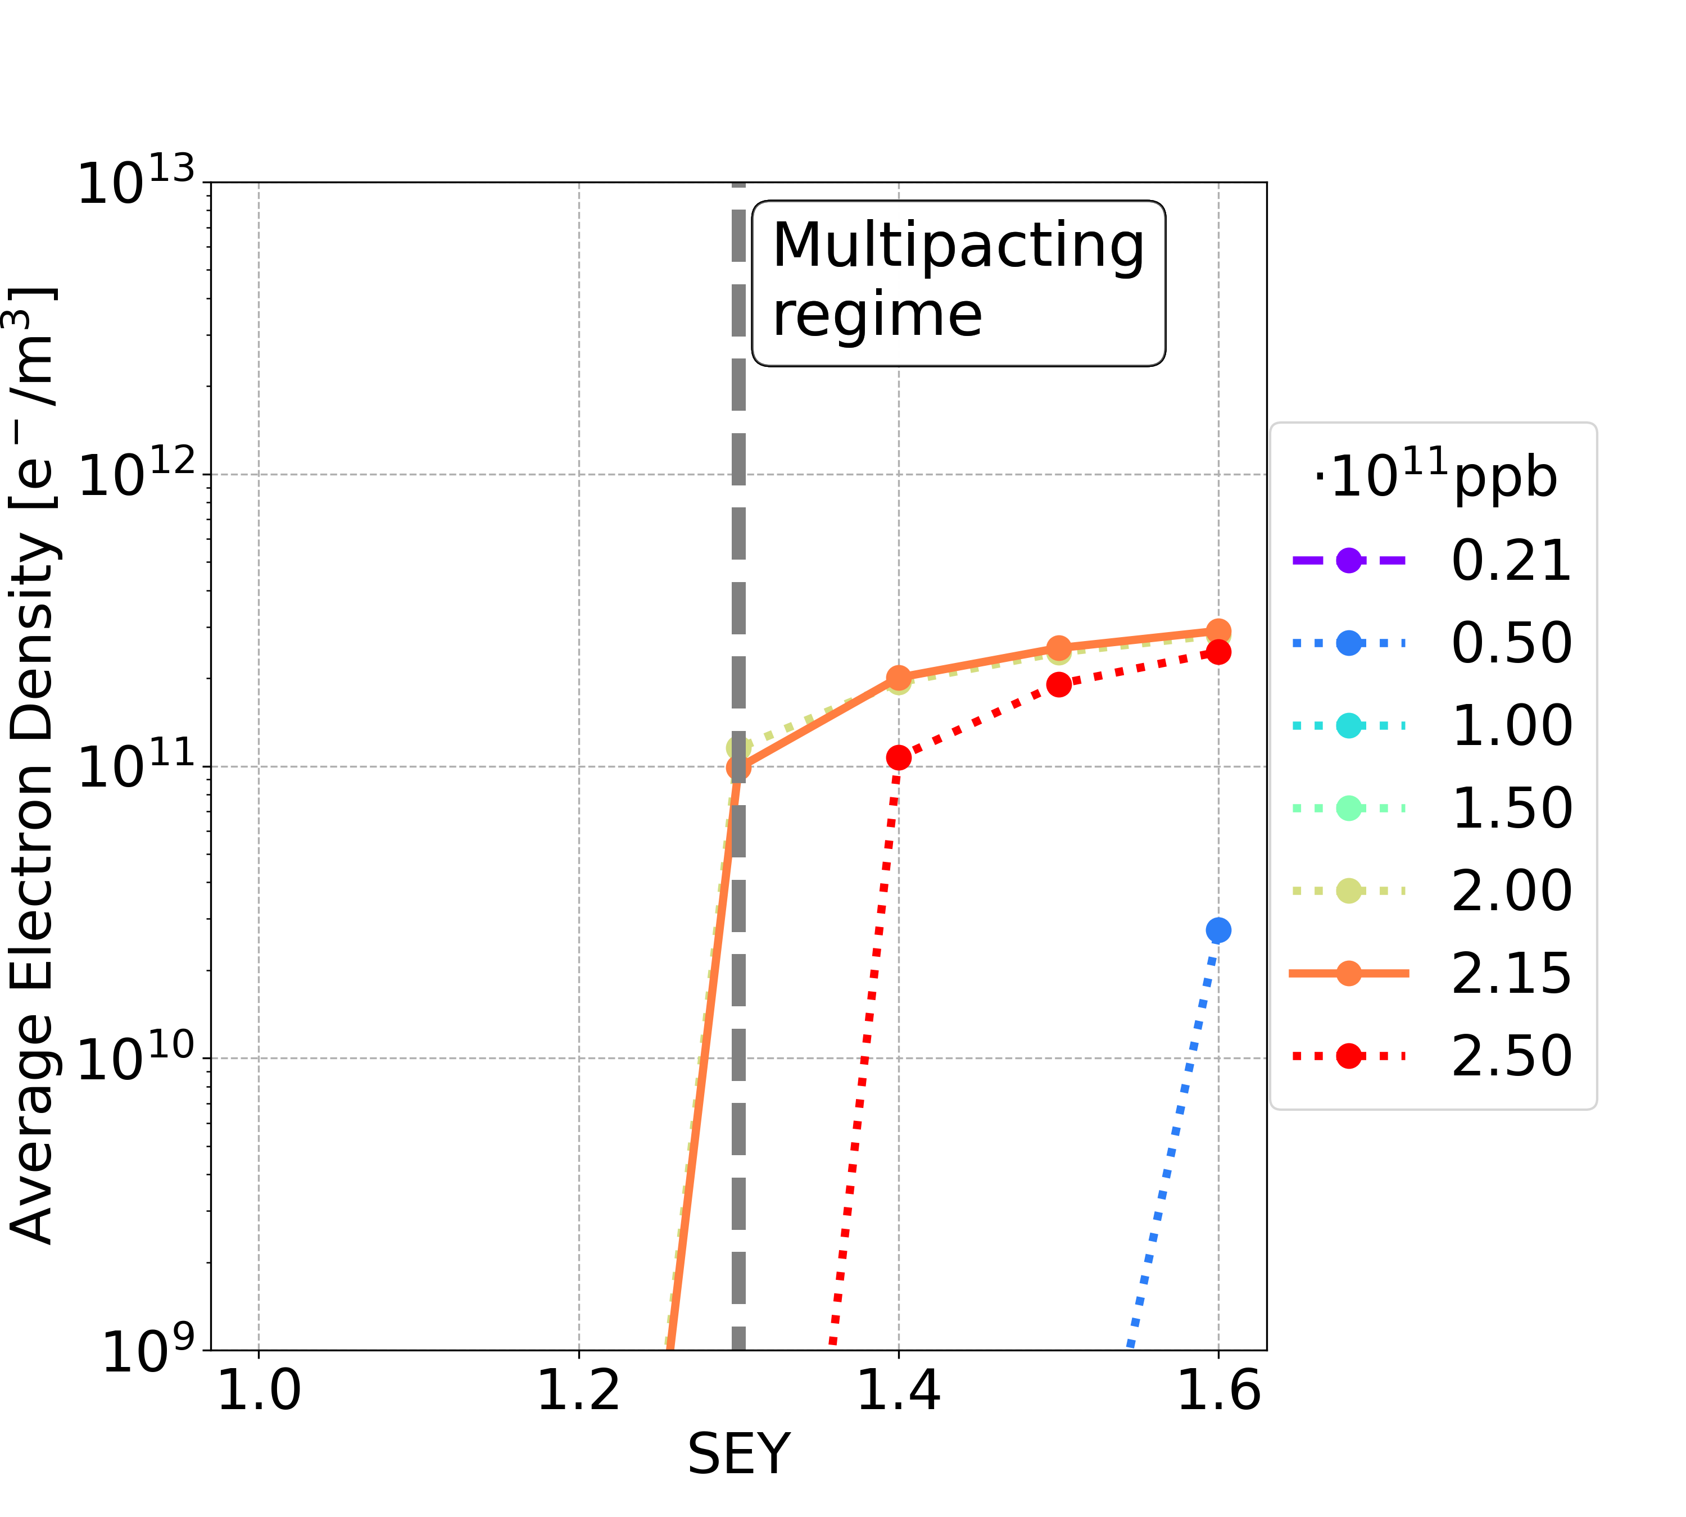
Short Bunch Spacing 5 ns: Dipole
Considering different filling patterns
2b+8e
4b+16e
5b+20e
8b+32e
Bunch population | Uniform 25 ns | 2b+8e | 4b+16e
nominal | 1.4 | 1.4 | 1.3
below nominal | 1.0 | 1.2 | 1.2
Bunch population | Uniform 25 ns | 2b+8e
nominal | 1.4 | 1.4
below nominal | 1.0 | 1.2
Bunch population | Uniform 25 ns | 2b+8e | 4b+16e | 5b+20e | 8b+32e
nominal | 1.4 | 1.4 | 1.3 | 1.3 | 1.2
below nominal | 1.0 | 1.2 | 1.2 | 1.2 | 1.2
Using filling schemes with non-uniform bunch spacing, the strict constraint on the SEY multipacting thresholds for critical bunch intensities could be mitigated

Slide 19
Short Bunch Spacing 5 ns: Summary
Element | Field | Bunch population | Uniform 25 ns | 2b+8e | 4b+16e | 5b+20e | 8b+32e
Drift Space | - | nominal | 1.4 | 1.4 | 1.4 | 1.4 | 1.3
 |  | below nominal | 1.2 | 1.4 | 1.4 | 1.4 | 1.3
Dipole | 15.2 mT | nominal | 1.4 | 1.4 | 1.3 | 1.3 | 1.2
 |  | below nominal | 1.0 | 1.2 | 1.2 | 1.2 | 1.2
Quadrupole | 1.45 T/m | nominal | 1.1 | 1.3 | 1.3 | 1.3 | 1.3
 |  | below nominal | 1.0 | 1.2 | 1.3 | 1.3 | 1.3
Sextupole | 72.5 T/m² | nominal | 1.1 | 1.4 | 1.5 | 1.5 | 1.4
 |  | below nominal | 1.0 | 1.3 | 1.5 | 1.5 | 1.4
Using filling schemes with non-uniform bunch spacing, the strict constraint on the SEY multipacting thresholds could be mitigated, for all the analysed magnetic elements
The filling schemes with the patterns 4b16e and 5b20e are the most promising

Slide 20
Higher Total Bunches
Having a larger number of bunches
  allows for a reduction in nominal bunch intensity while maintaining the same beam current
  reducing the severity of other collective effects (beam-coupling impedance and beam-beam)
The filling schemes with the patterns 5b20e has been analysed
Additional bunches are added, reducing the number of empty bunches that form the gap
Train 1
1
2
3
4
5
6
7
8
9
10
6
7
8
9
10
280
...
Train gap
0
10
20
30
40
50
60
70
80
90
100
110
120
130
140
Time [ns]
Filling pattern | 4b+16e | 6b+19e | 7b+18e | 8b+17e | 10b+15e
Total bunches | 11,200 | 13,440 | 15,680 | 17,920 | 22,400
Nominal bunch intensity [x10¹¹ ppb]​ | 2.15 | 1.79 | 1.54 | 1.34 | 1.08
Filling pattern | 4b+16e | 6b+19e
Total bunches | 11,200 | 13,440
Nominal bunch intensity [x10¹¹ ppb]​ | 2.15 | 1.79
Filling pattern | 5b+20e
Total bunches | 11,200
Nominal bunch intensity [x10¹¹ ppb]​ | 2.15

Slide 21
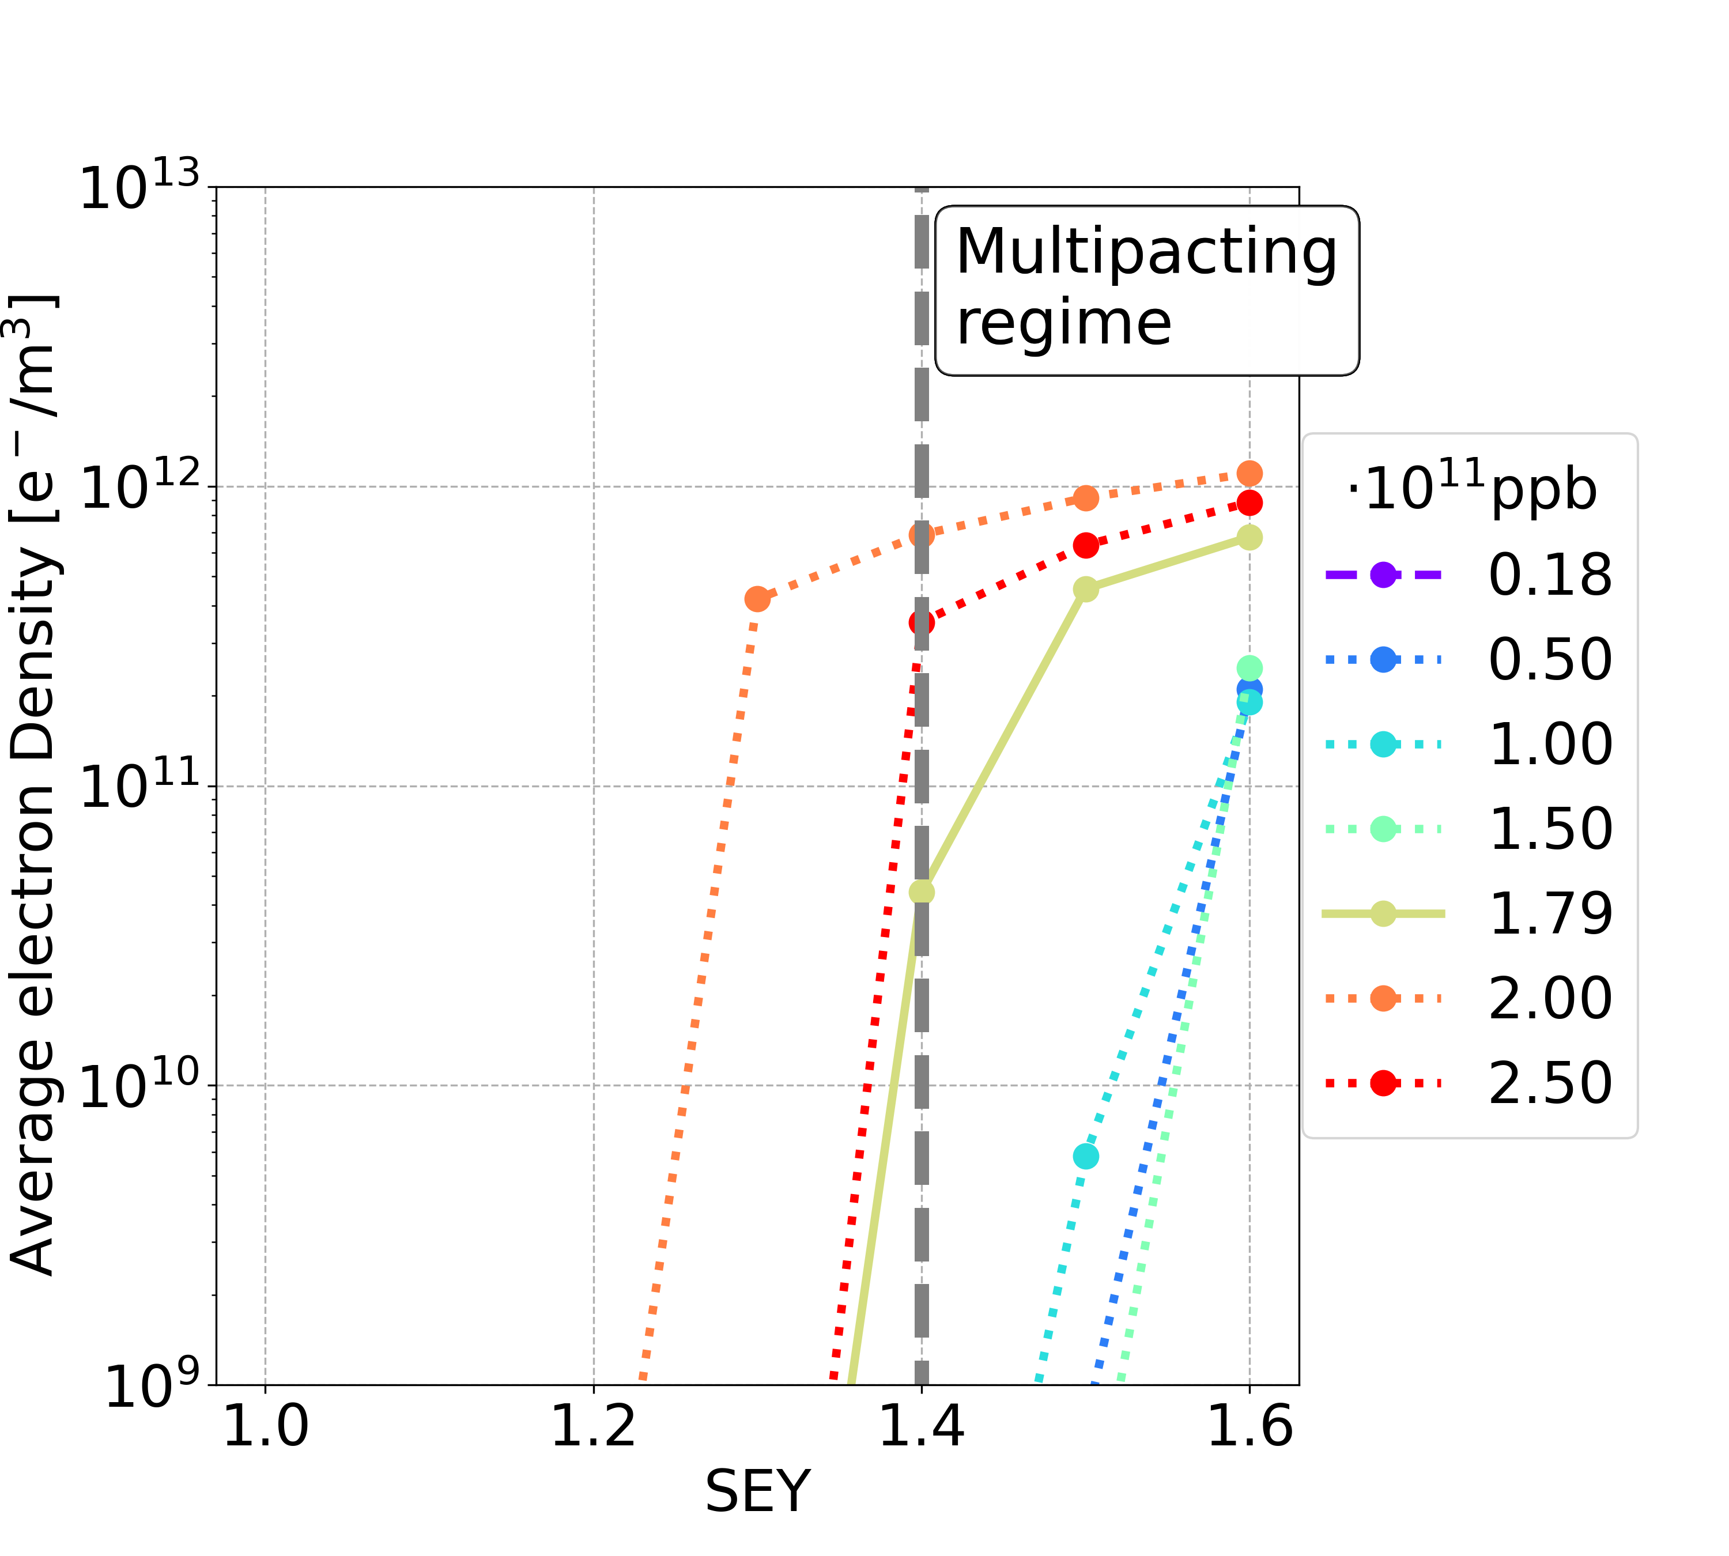
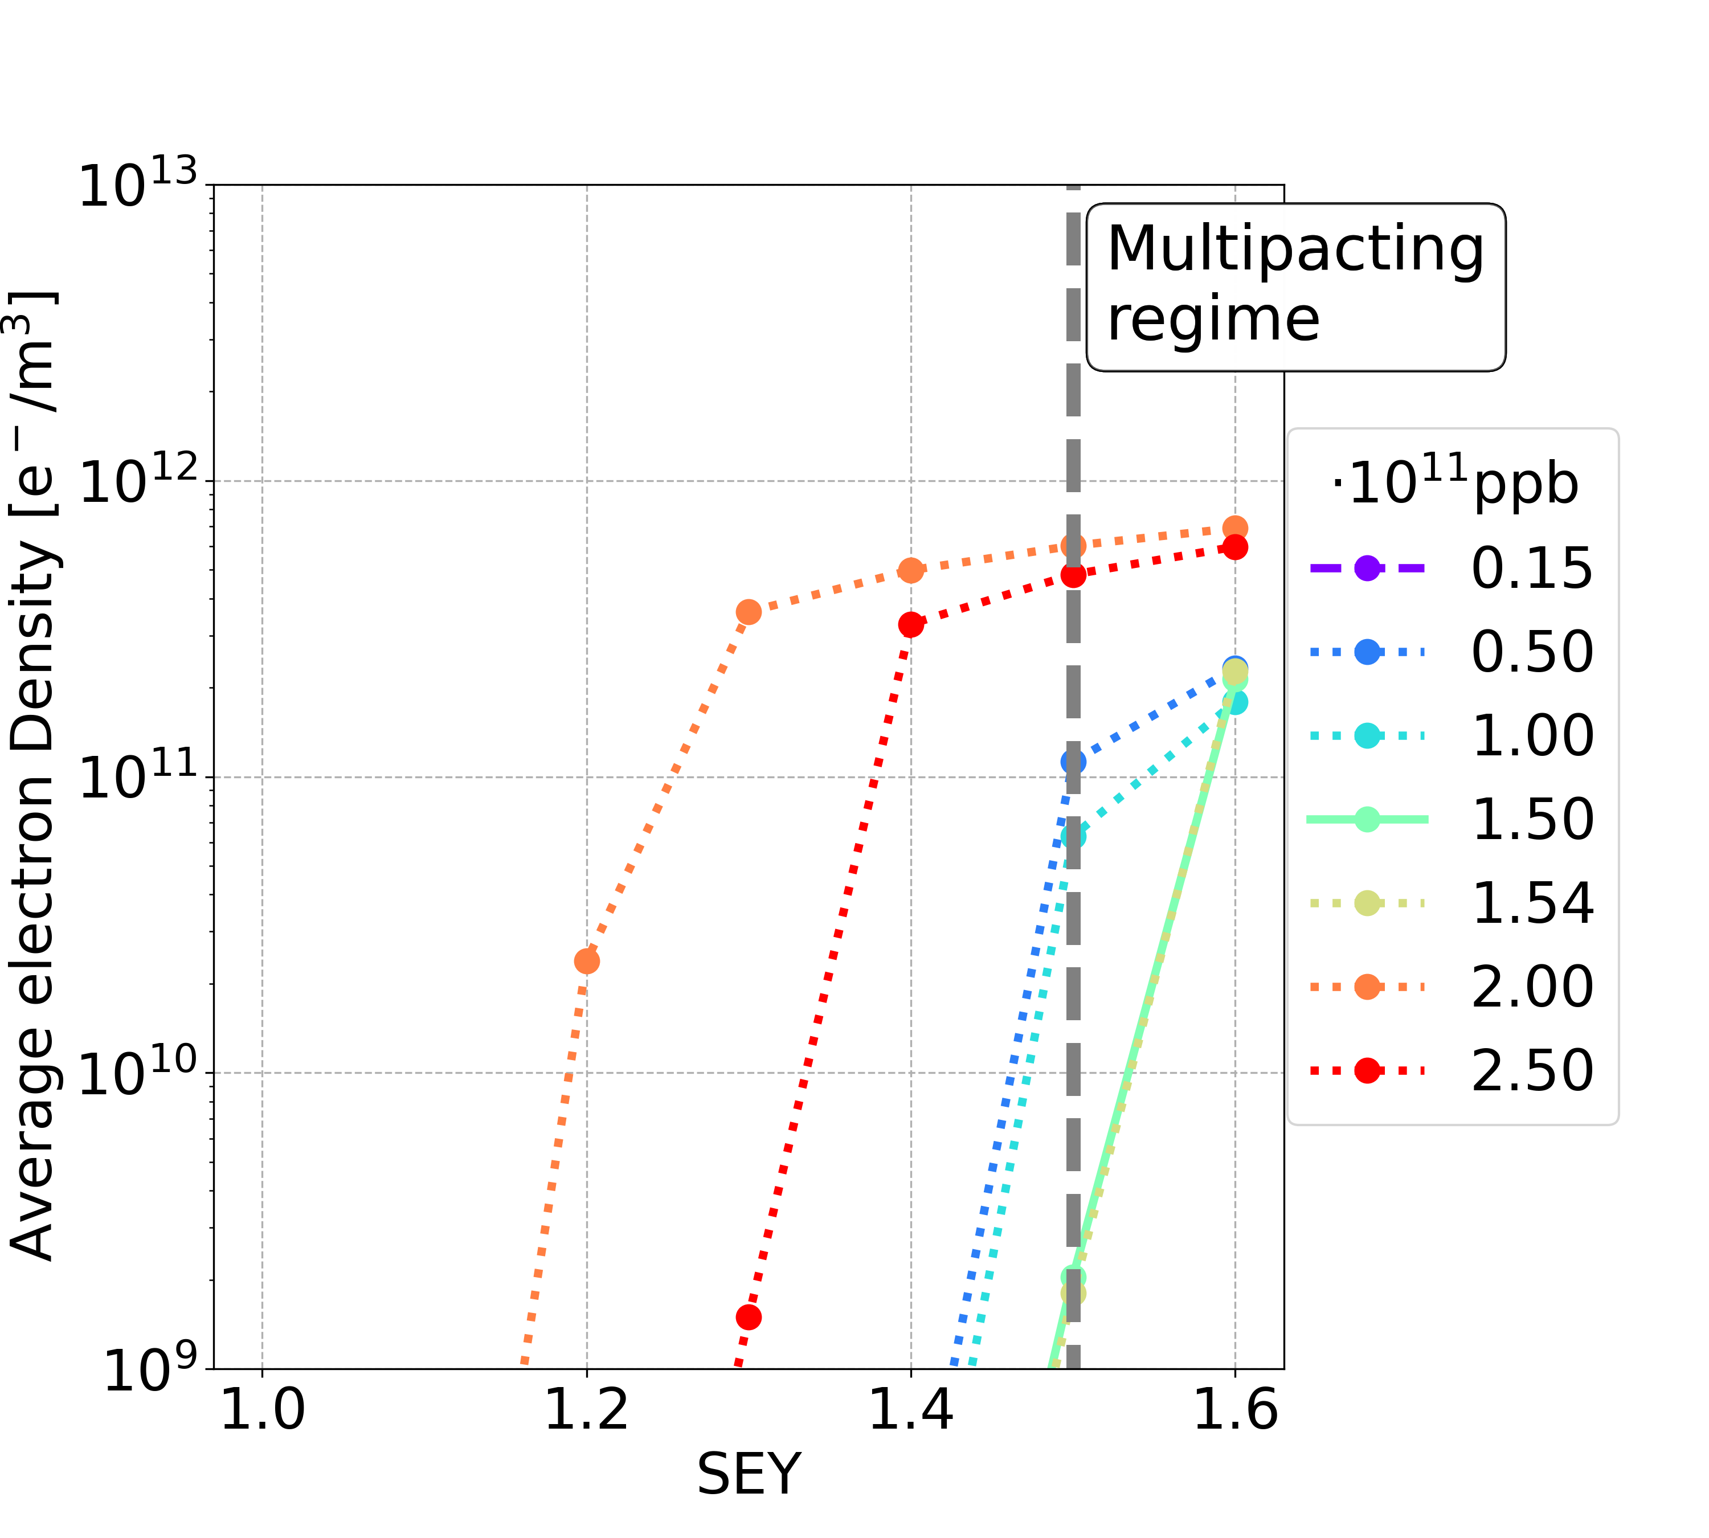
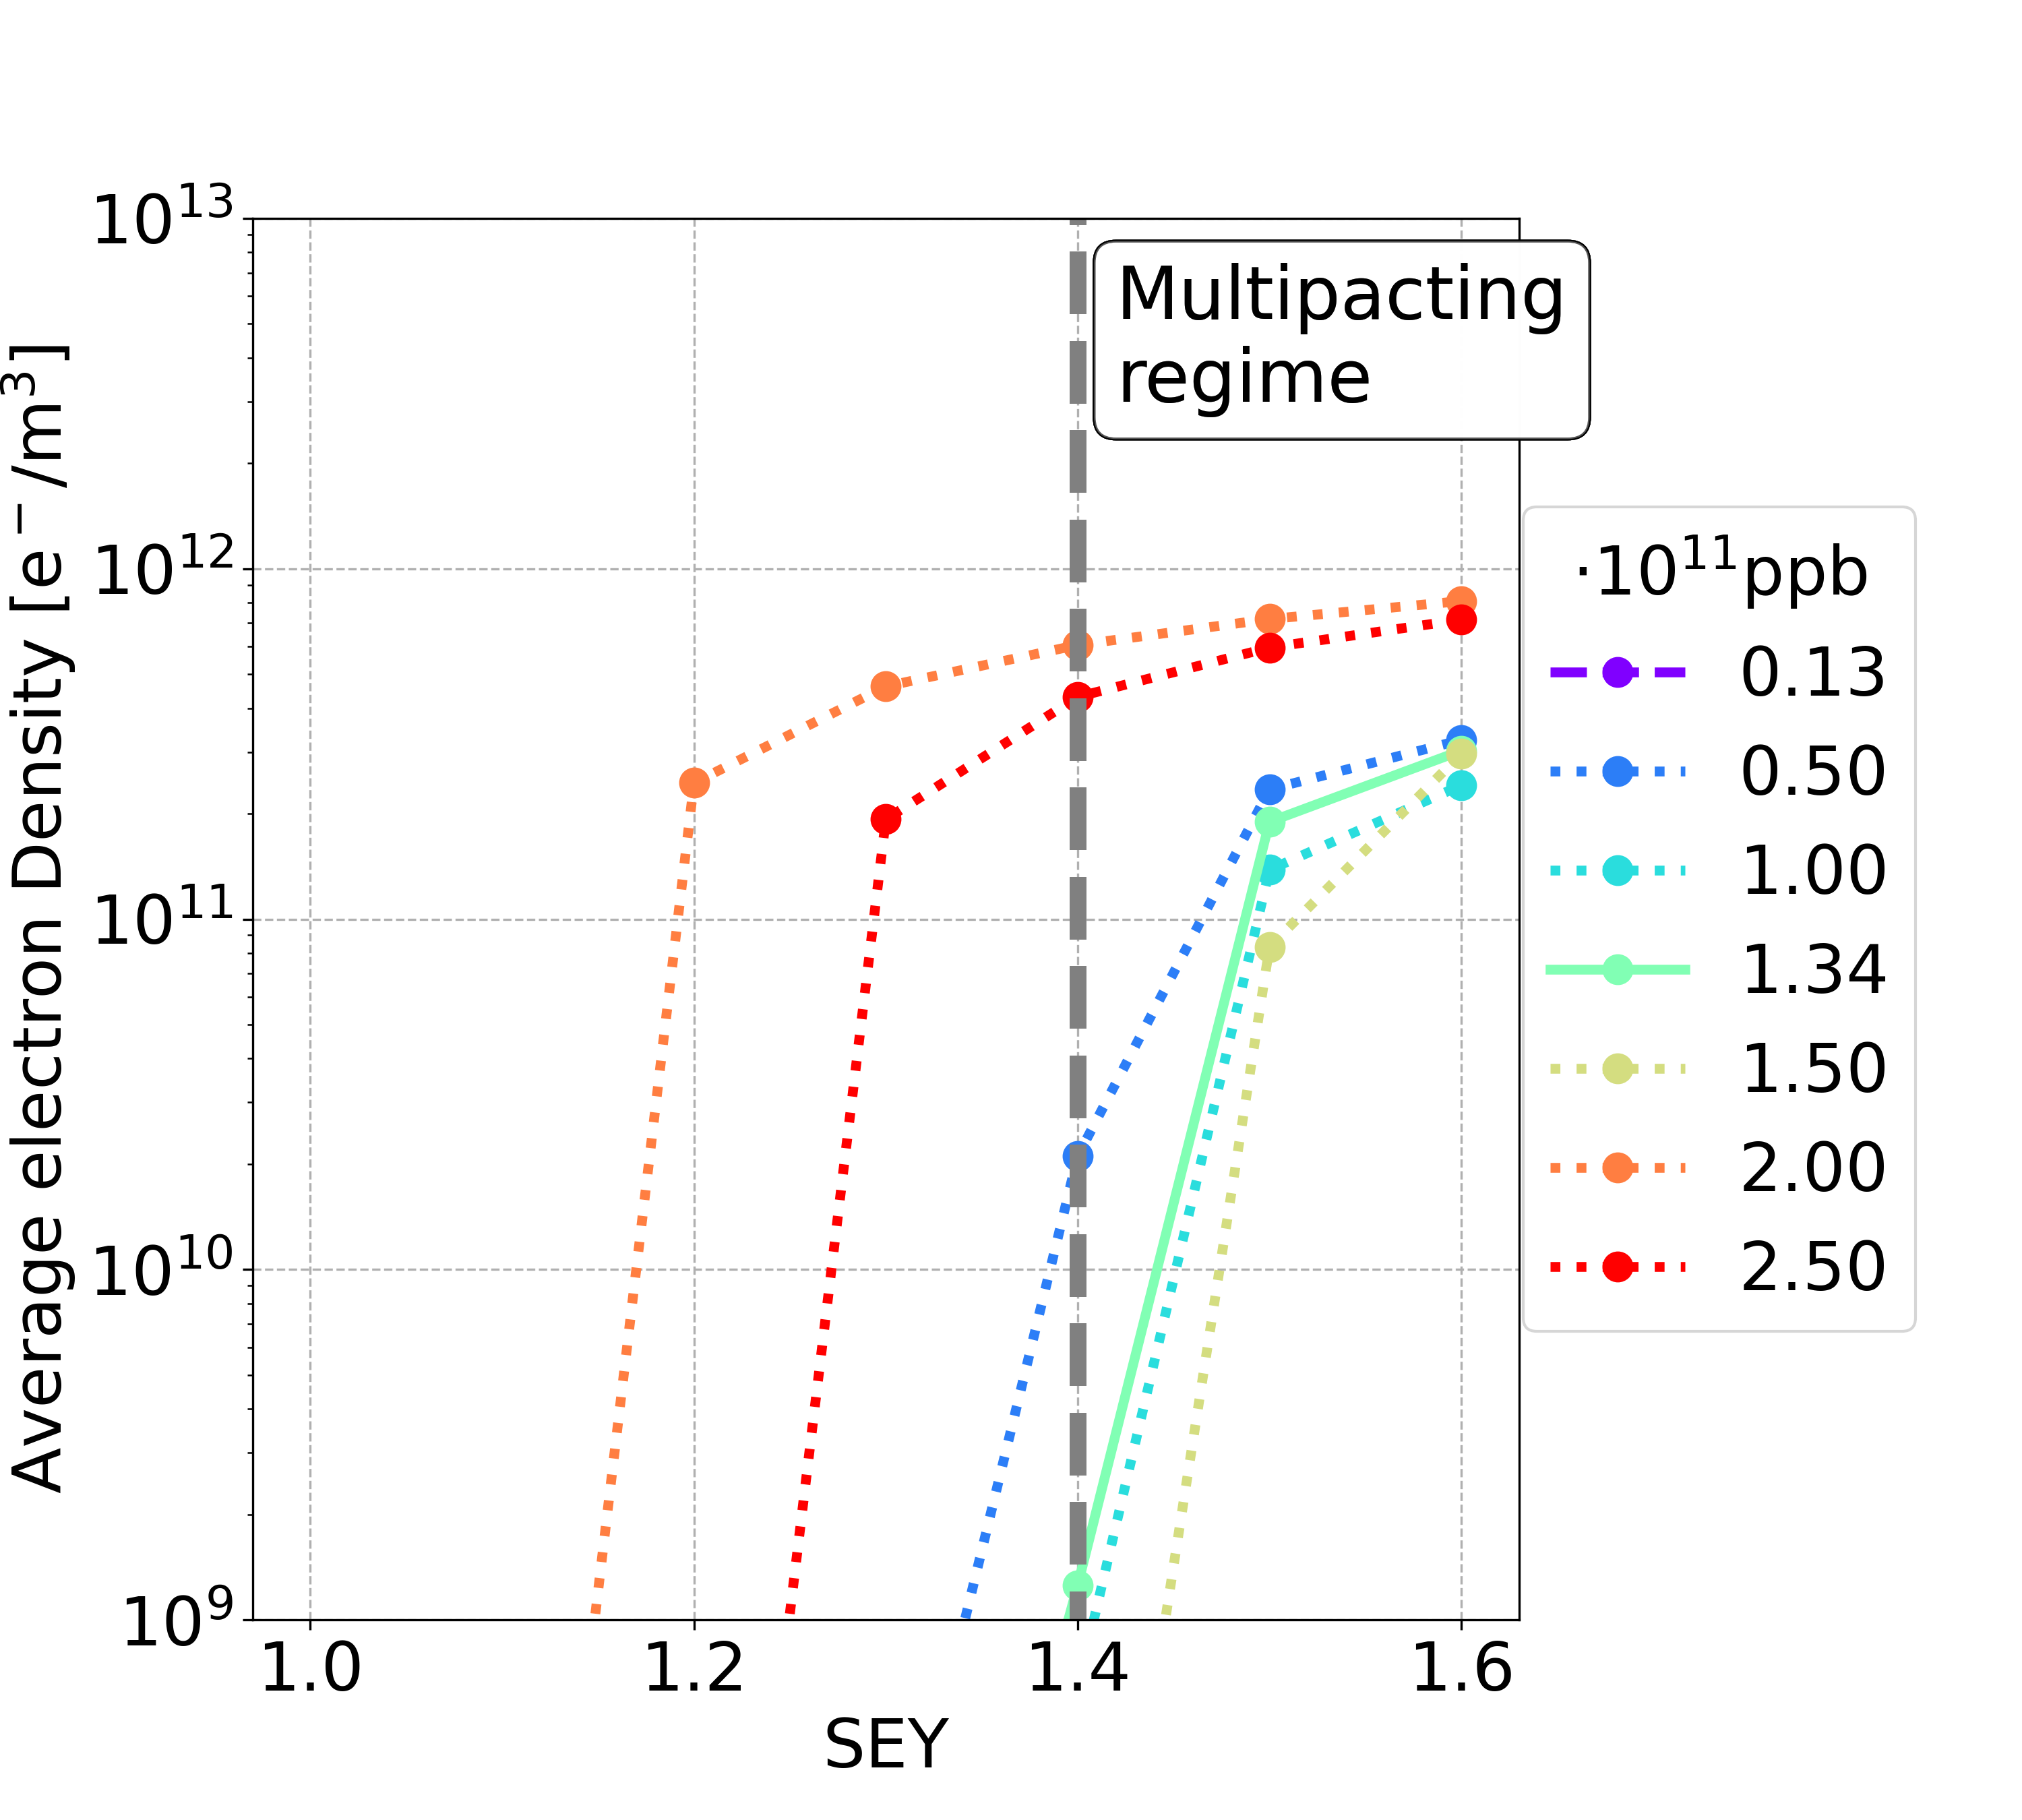
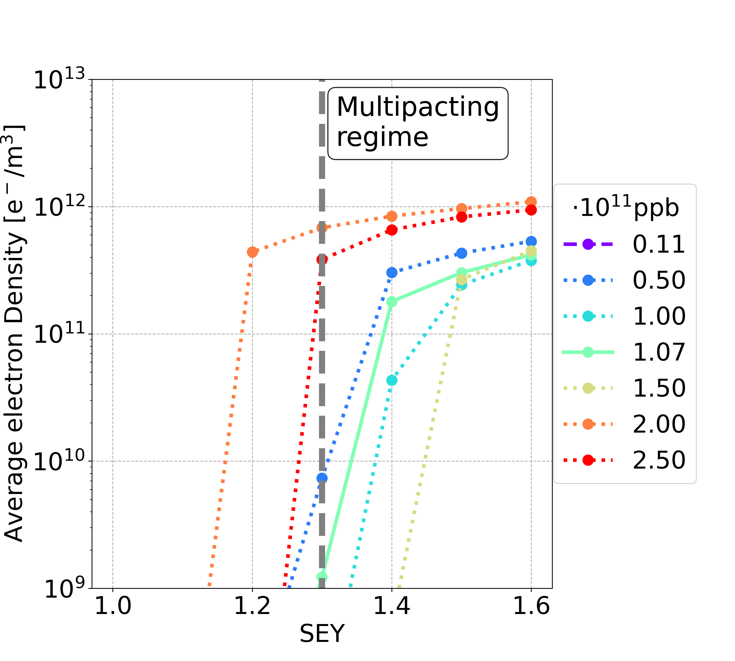
Higher Total Bunches: Dipole
Considering different filling patterns with a larger number of bunches
6b+19e
7b+18e
8b+17e
10b+15e
Bunch population | Uniform 25 ns | 5b+20e | 6b+19e | 7b+18e | 8b+17e | 10b+15e
nominal | 1.4 | 1.3 | 1.3 | 1.4 | 1.3 | 1.2
below nominal | 1.0 | 1.2 | 1.3 | 1.4 | 1.3 | 1.2
Bunch population | Uniform 25 ns | 5b+20e
nominal | 1.4 | 1.3
below nominal | 1.0 | 1.2
Bunch population | Uniform 25 ns | 5b+20e | 6b+19e
nominal | 1.4 | 1.3 | 1.3
below nominal | 1.0 | 1.2 | 1.3
Filling schemes with non-uniform bunch spacing and a higher total number of bunches remain effective in alleviating the stringent requirements on the internal surface material of the vacuum chamber

Slide 22
Higher Total Bunches: Summary
Element | Field | Bunch population | Uniform 25 ns | 5b+20e 11,200 2.15x10¹¹ ppb | 6b+19e 13,440 1.79x10¹¹ ppb | 7b+18e 15,680 1.54x10¹¹ ppb | 8b+17e 17,920 1.34x10¹¹ ppb | 10b+15e 22,400 1.08x10¹¹ ppb
Drift Space | - | nominal | 1.4 | 1.4 | >1.6 | >1.6 | >1.6 | 1.4
 |  | below | 1.2 | 1.4 | >1.6 | >1.6 | >1.6 | 1.4
Dipole | 15.2 mT | nominal | 1.4 | 1.3 | 1.3 | 1.4 | 1.3 | 1.2
 |  | below | 1.0 | 1.2 | 1.3 | 1.4 | 1.3 | 1.2
Quadrupole | 1.45 T/m | nominal | 1.1 | 1.3 | 1.2 | 1.2 | 1.2 | 1.2
 |  | below | 1.0 | 1.3 | 1.2 | 1.2 | 1.2 | 1.2
Sextupole | 72.5 T/m² | nominal | 1.1 | 1.5 | 1.4 | 1.3 | 1.2 | 1.2
 |  | below | 1.0 | 1.5 | 1.4 | 1.3 | 1.2 | 1.2
Filling schemes with non-uniform bunch spacing and a higher total number of bunches remain effective in alleviating the stringent requirements on the internal surface material of the vacuum chamber

Slide 23
Outline
Introduction
Mitigation Techniques
Non-Uniform Bunch Spacing
Conclusions and Outlooks

Slide 24
Conclusions
The material constraints in order to avoid e-cloud avalanche multiplication are extremely tight for baseline parameters
  E-cloud mitigation techniques are needed
Increase bunch spacing could alleviate the stringent constraints
  To keep the beam current constant, the bunch intensity has to be increased and it could lead to issues with other collective effects
Special filling schemes during the accumulation phase avoid tight constraints for the critical bunch intensities
  to find a working point that ensures stability may be difficult, having bunches of significantly different intensities in the collider at the same time
Using filling schemes with non-uniform bunch spacing the e-cloud formation process could be mitigated
  the total number of bunches could be increased, with a corresponding decrease of the bunch population, while keeping the surface requirements achievable
    reducing the severity of other collective effects (beam-coupling impedance and beam-beam)

Slide 25
Outlooks
Beam-beam
  With smaller bunch intensity, the beam-beam parameter is smaller
  With 5 ns bunch spacing, two long range beam-beam interactions per IP separations >100 sigma
Impedance
  Lower bunch intensities gives margin to the instability threshold
  Filling patterns with non-uniform bunch spacing have to be studied
  Two beams in common beam pipe needs an impedance evaluation
Transient beam loading
  The proposed filling schemes lead to a small change in the bunch-by-bunch effective RF voltage spread (∼10%)
    see Ivan Karpov, “FCC RF operation scenarios - new baseline”, FCC week 2025
Luminosity
  Increasing the number of bunches and reducing the bunch intensity, keeping a constant beam current -> reduction of luminosity performance (e.g. -17% for 6b+19e)
  The reduction could be compensated, for example, by decreasing the transverse beam size (e.g. -10% for 6b+19e)
Is it possible to generate the proposed filling schemes using the injector chain?

Slide 26
Thanks for your attention

Slide 28
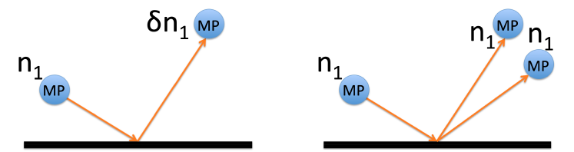
Furman-Pivi & ECLOUD SEY Models
ECLOUD Model:
resizes macroparticles (MP) upon impact.
elastically backscattered electrons are emitted with the same energy as the impact.
the redifussed SEY component is not included
Furman-Pivi Model:
does not rescale macroparticles (MP),and uses a Poisson distribution.
emitted energy distribution depends on the event type
the rediffused SEY component is included
E. Wullf, G. Iadarola, “The Furman-Pivi model in PyECLOUD Theory, code implementation and simulation results”

Slide 29
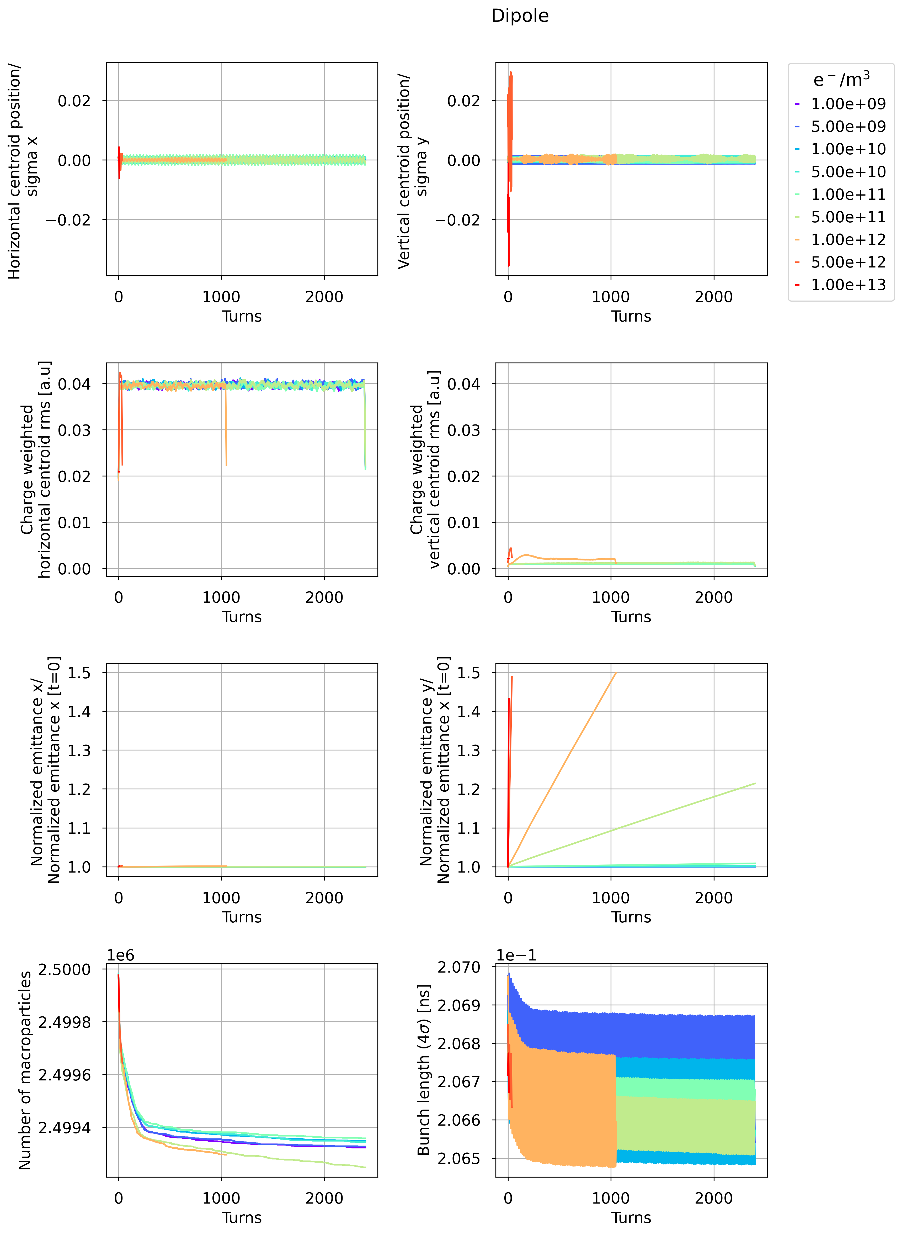
E-Cloud Stability Simulation Threshold: Dipole
  ⍴_{e,th} =2.42 ⋅10¹⁰ e⁻/m³ considering only the dipole length L_{dipole} = 62.8 km (L_{dipole} /L = 69.24%)
Horizontal
Vertical
B = 14.15 mT
Centroid/
Sigma
Stable
Unstable
Very unstable
y
Normalised emittance/
Normalised emittance [t=0]
  Theoretical and numerical e-cloud density stability threshold have the same order of magnitude
  Vertical motion is unstable

Slide 30
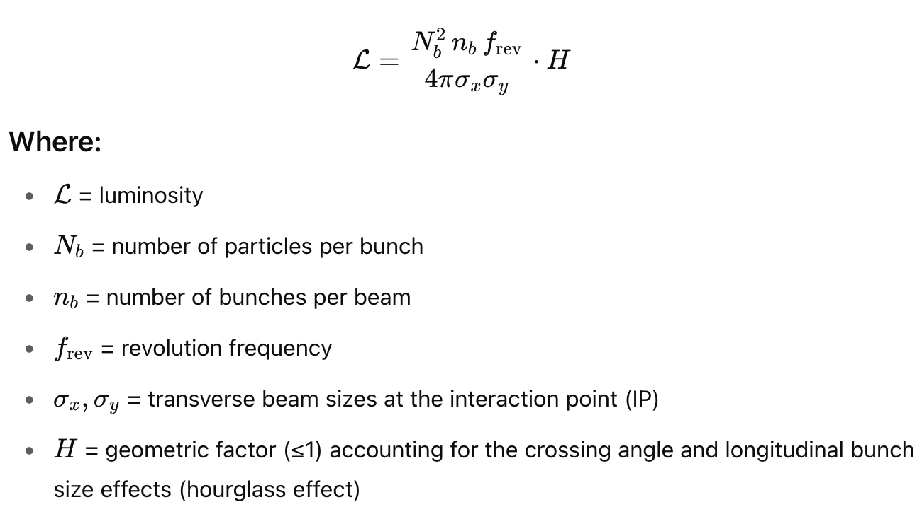

Slide 31
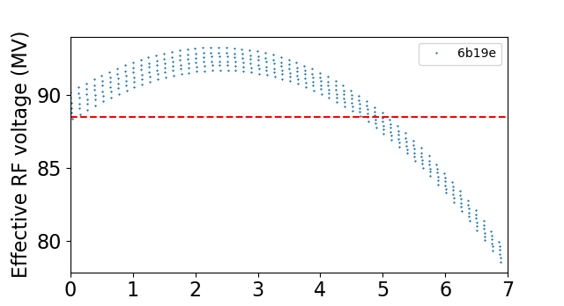
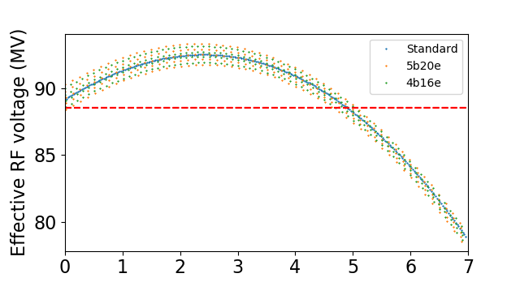
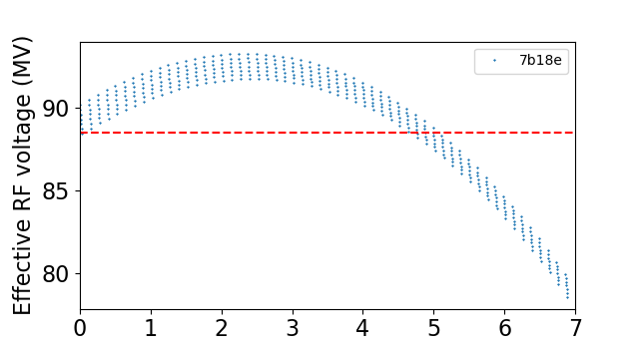
Courtesy of Ivan Karpov

