Slide 1
Masterclasses to New Countries Working Group Meeting
8-5-2025
Despina Hatzifotiadou

Slide 2
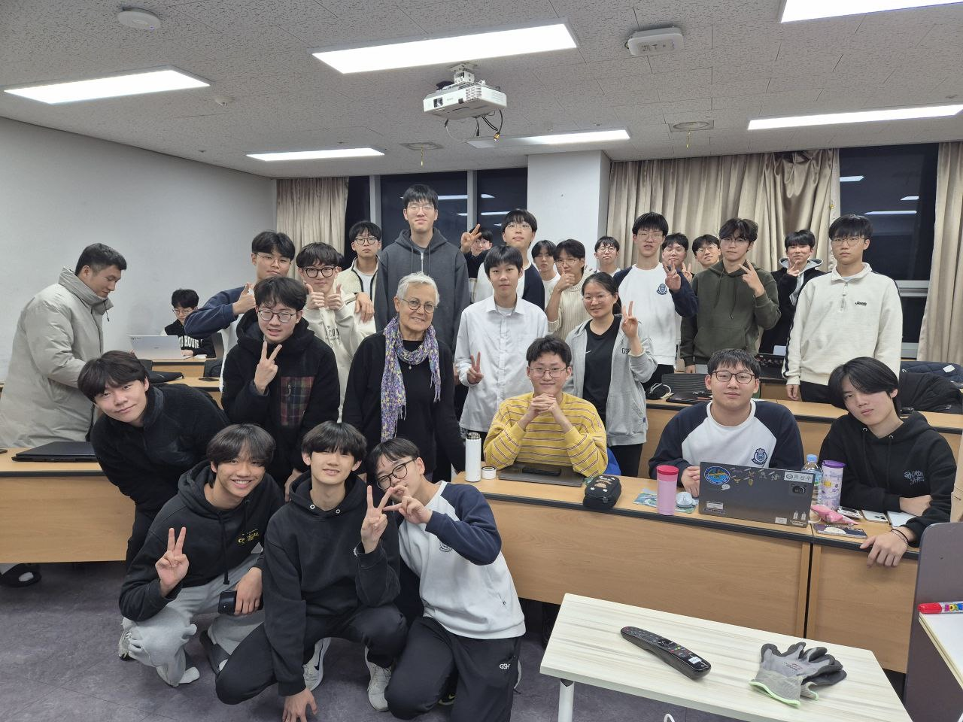
December 2024 : First ALICE Masterclass in Seoul, South Korea
at the “Gyeonggi Science High School for the Gifted”
Organised by Professor Jin-Hee Yoon
(national responsible for ALICE-Korea)
~ 30 high-school students and
5 teachers participated
Masterclass done after school hours,
17:00 – 21:00 (with break for supper)

Slide 3
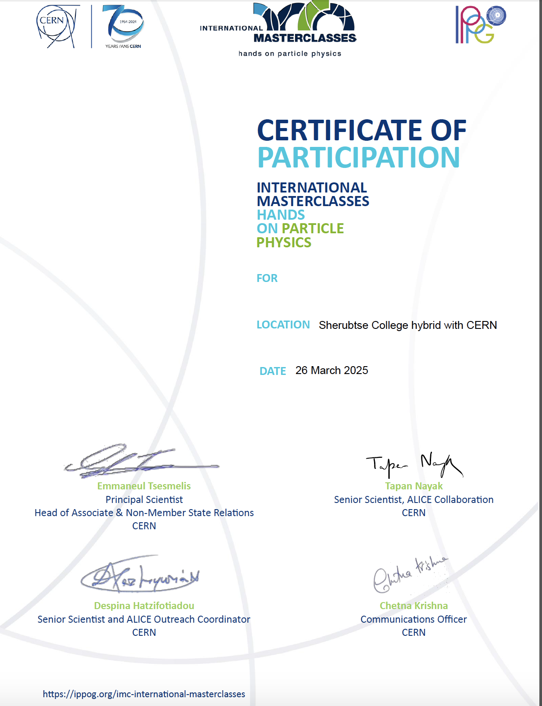
25 March 2025 : Online ALICE Masterclass for Royal University of Bhutan
Organised by Chetna Krishna
(who traveled to Bhutan for the occasion)
Introduction to CERN: International Collaboration and Opportunities
Emmanuel Tsesmelis
Particle physics, heavy ion physics, ALICE
Tapan Nayak
Virtual tour of ALICE cavern and control room
Hands-on data analysis
Despina Hatzifotiadou

Slide 4
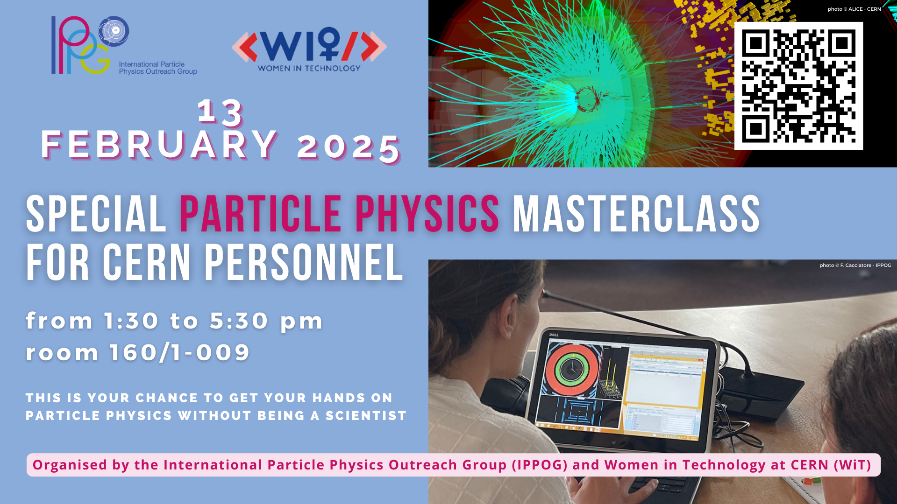
ALICE Masterclass – not in a new country but for new audience

