Slide 1
For discussion about FCC-ee injector synchronization

Slide 2
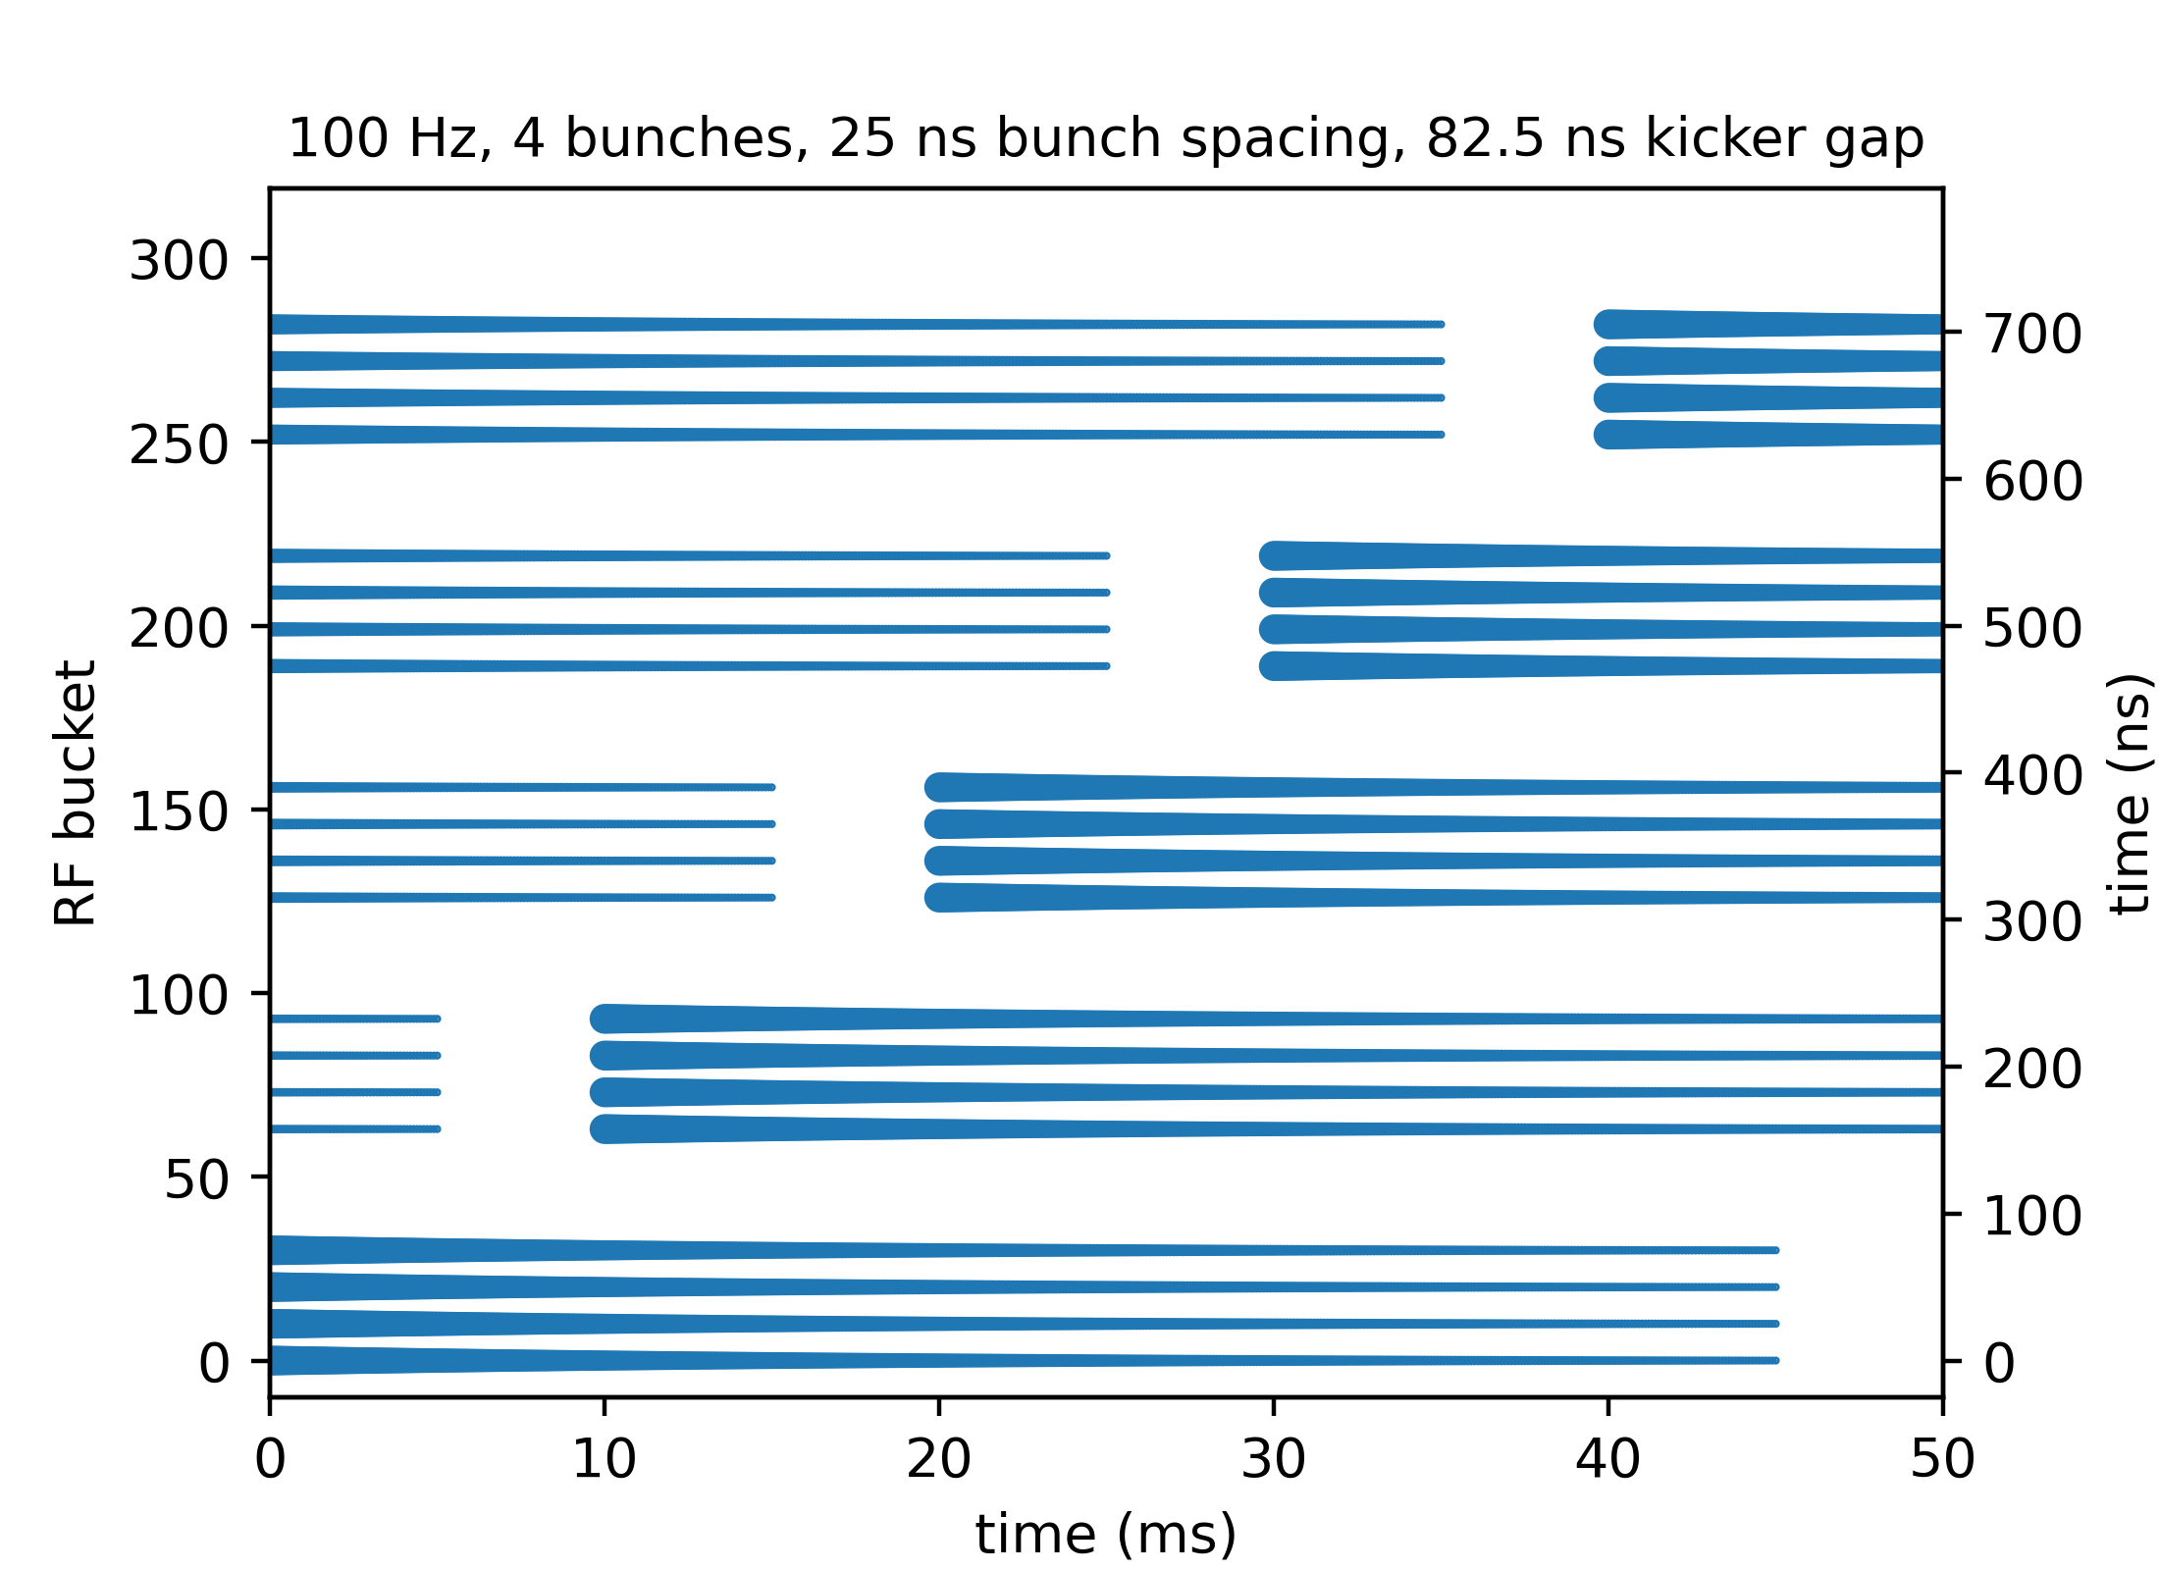
Pre-injector
Linac producing 4 bunches (25 ns spacing) at 100 Hz
  Damping ring at 2.86 GeV used for both e⁺ and e⁻
  First In First Out principle (continuous refilling after damped bunches are extracted)
* this plot is still showing the old damping ring parameters at 1.54 GeV

Slide 3
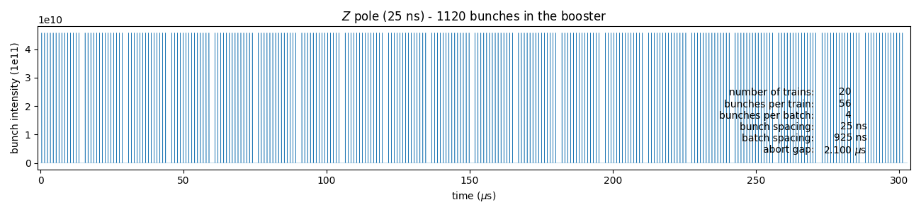
Booster filling pattern – example for the Z pole
Only 1/10th of all bunches for the Z pole are transferred from booster to collider (machine protection requirements and beam loading optimization in booster)
Example of one of the booster filling pattern (corresponding to one “family” of bunches)
Other filling schemes might be devised in the future or required for different reasons, need high flexibility in filling the booster from the pre-injector

Slide 4
How to synchronize pre-injector with booster?
Operational mode considers RF in booster and collider to be locked
  Pre-injector needs to provide the 4 bunches at the right time for injection into the booster
2 options for synchronising pre-injector with booster considered (are there others?)
  Pulsing low energy linac at fixed intervals (100 Hz) and do cogging in damping ring – this will require quite large frequency swing of RF cavity and large radial excursions, is this feasible?
  Special choice of damping ring to booster circumference with large variation of linac intervals (“jitter window”) to place bunches at the right booster azimuth, can this be compatible with the linac operation?
→ More details in slides of Heiko

Slide 5
BACK-UP

Slide 6
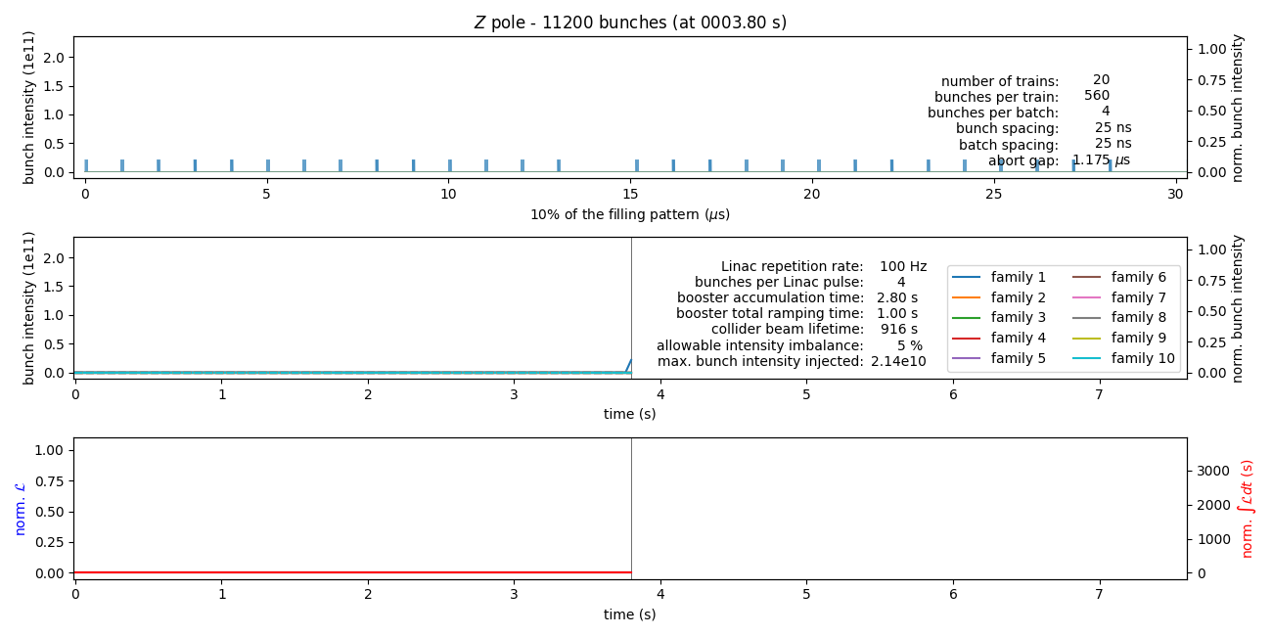
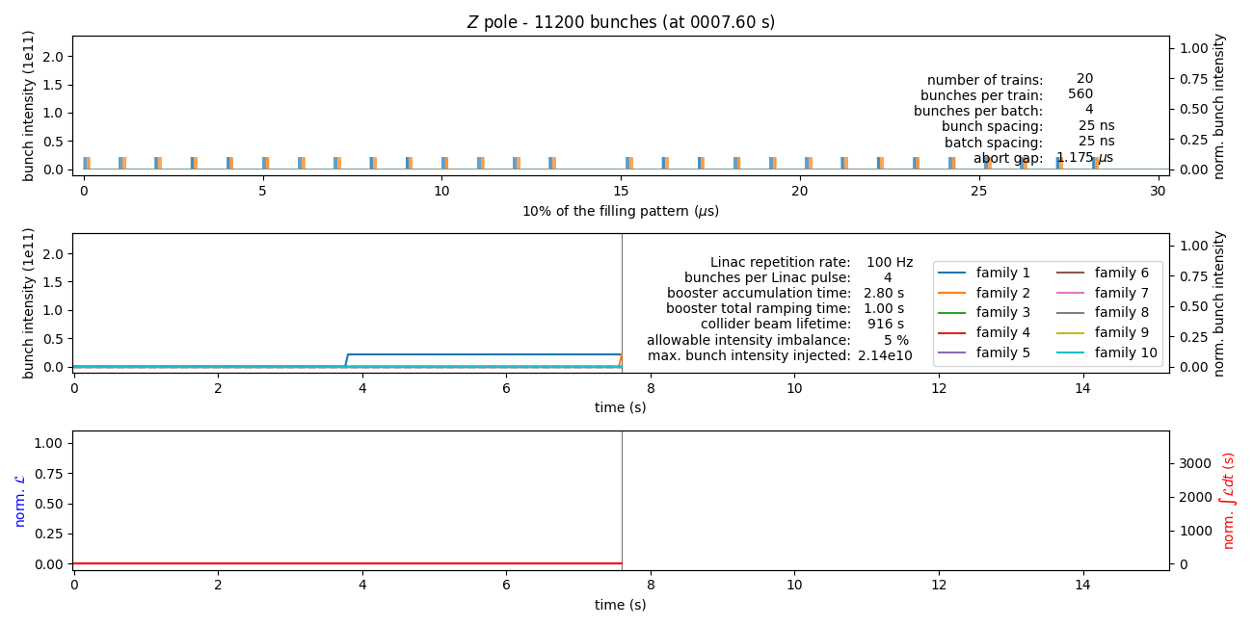
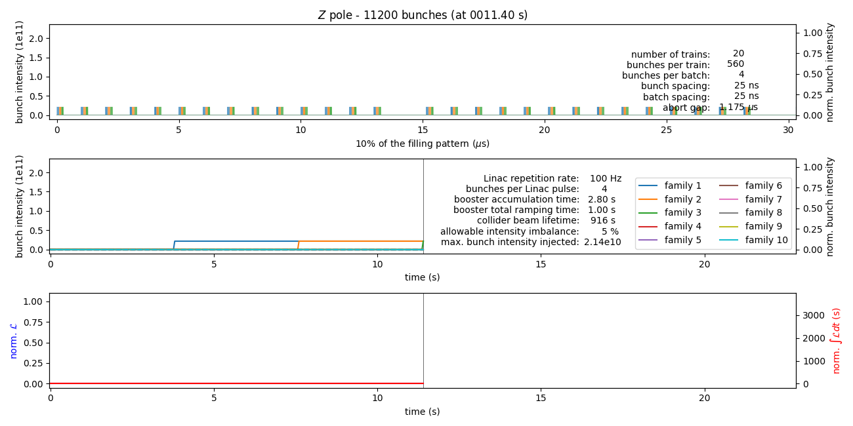
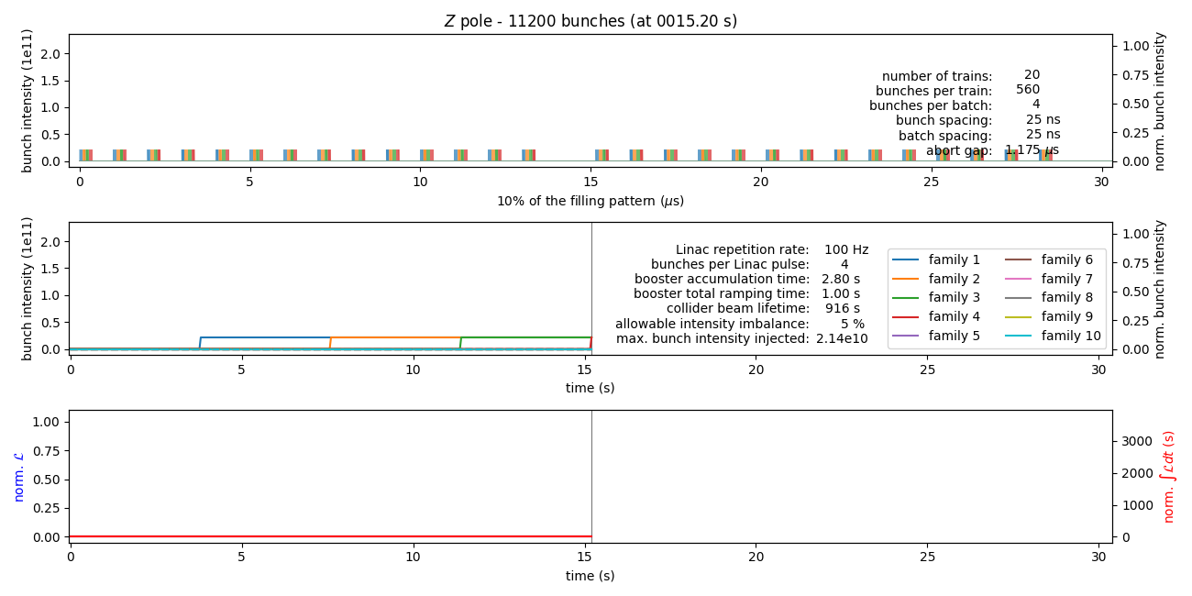
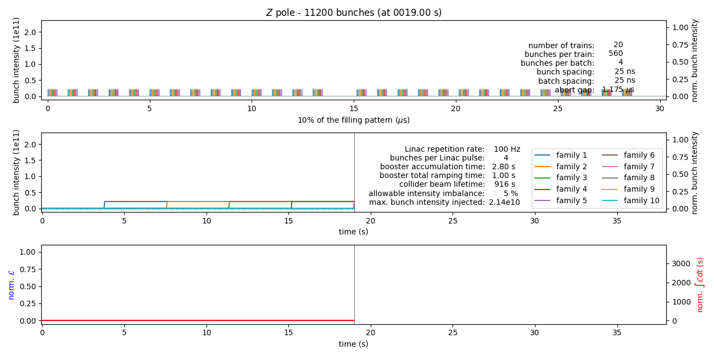
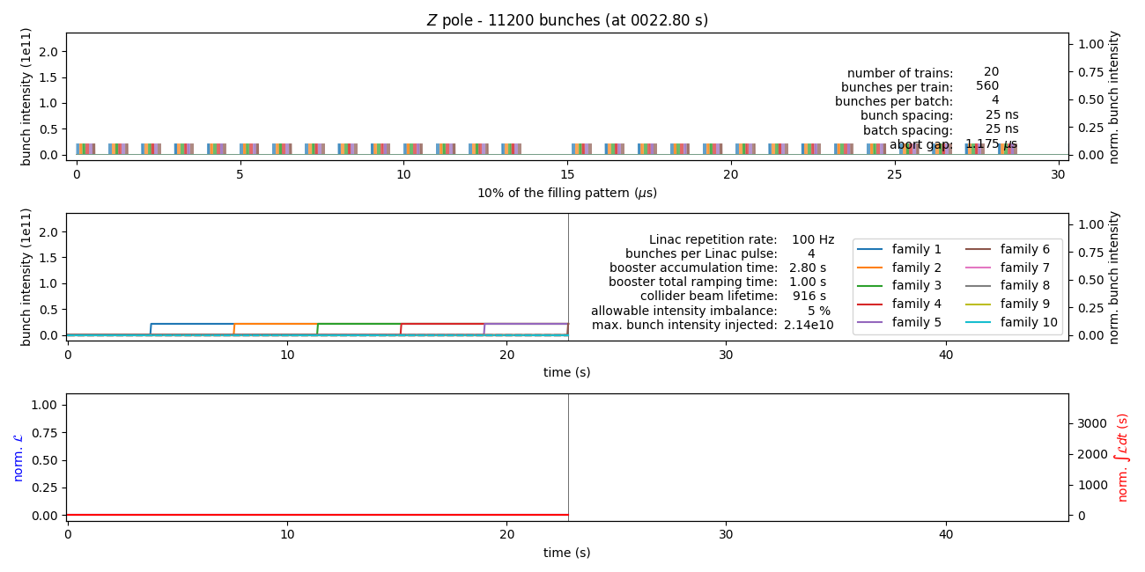
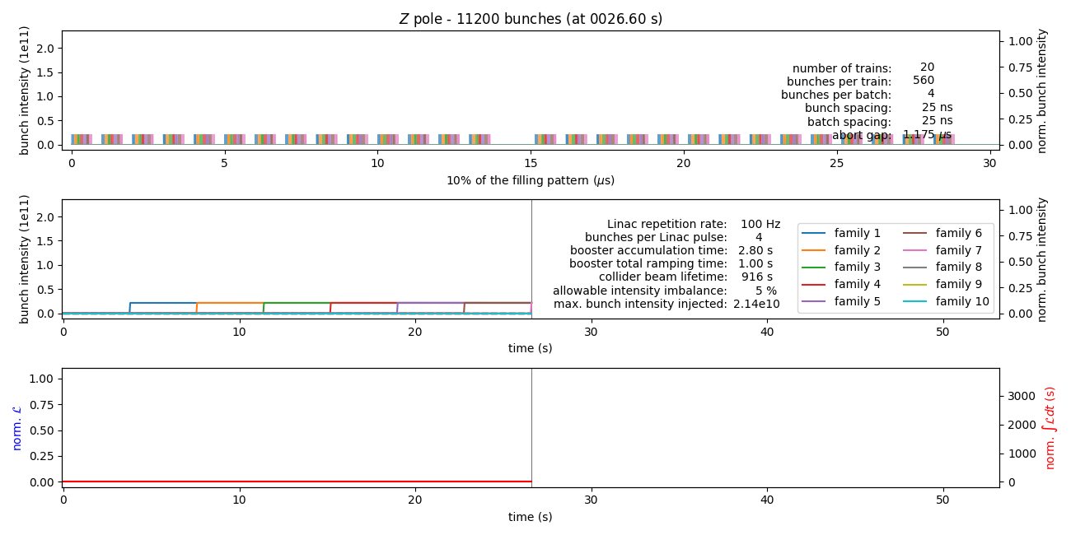
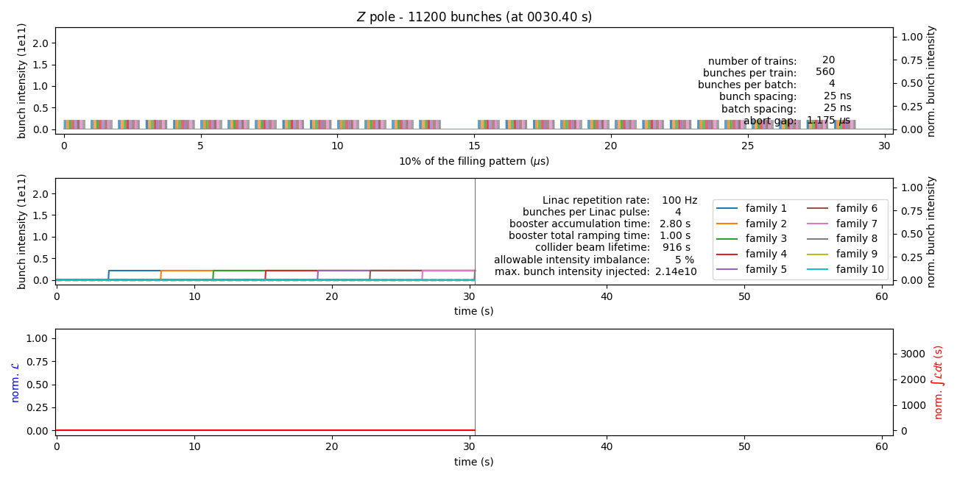
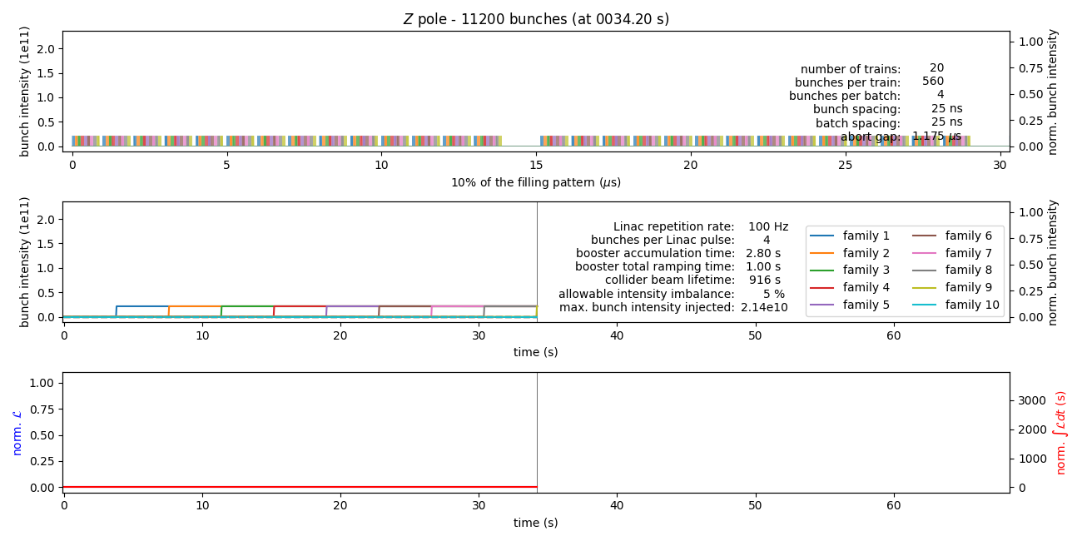
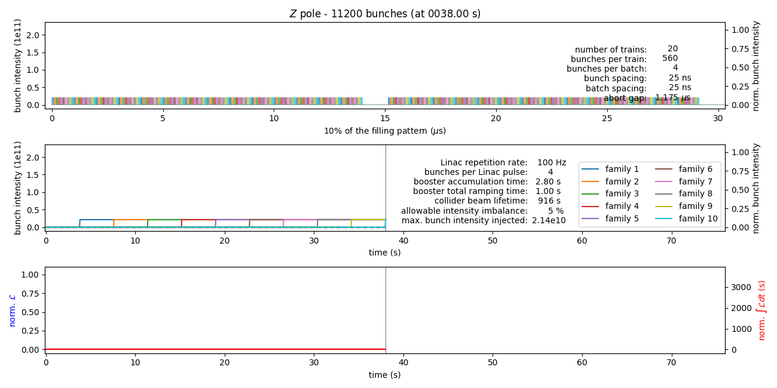
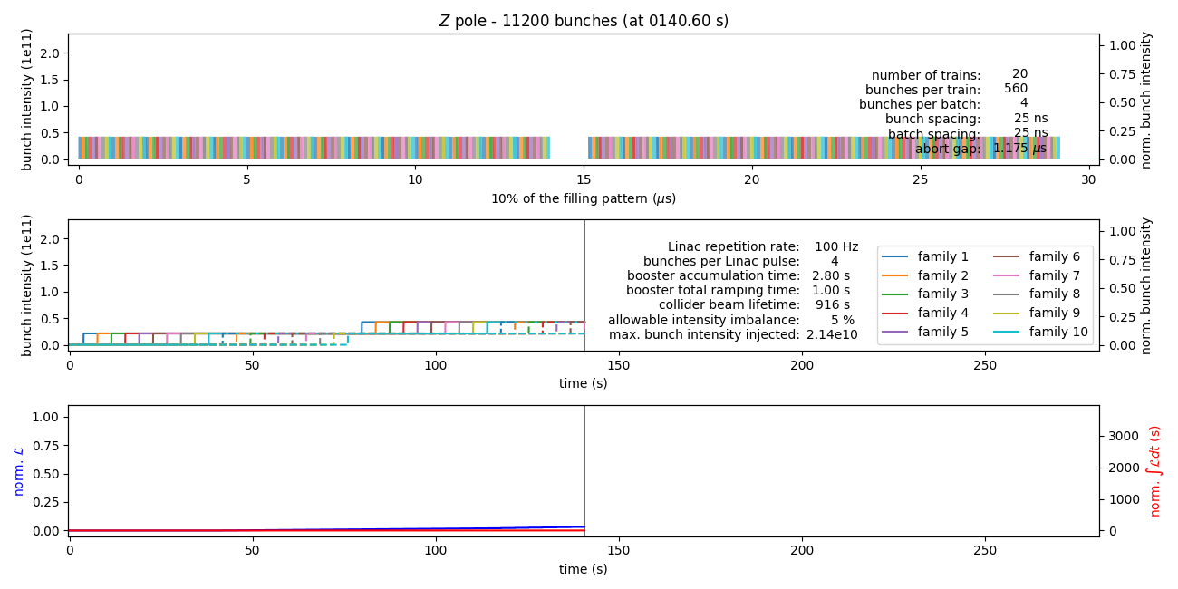
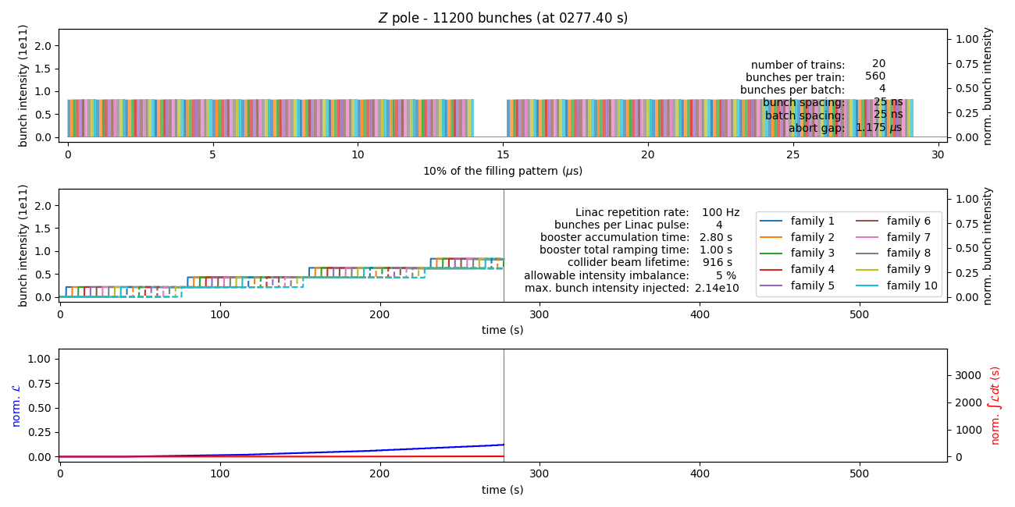
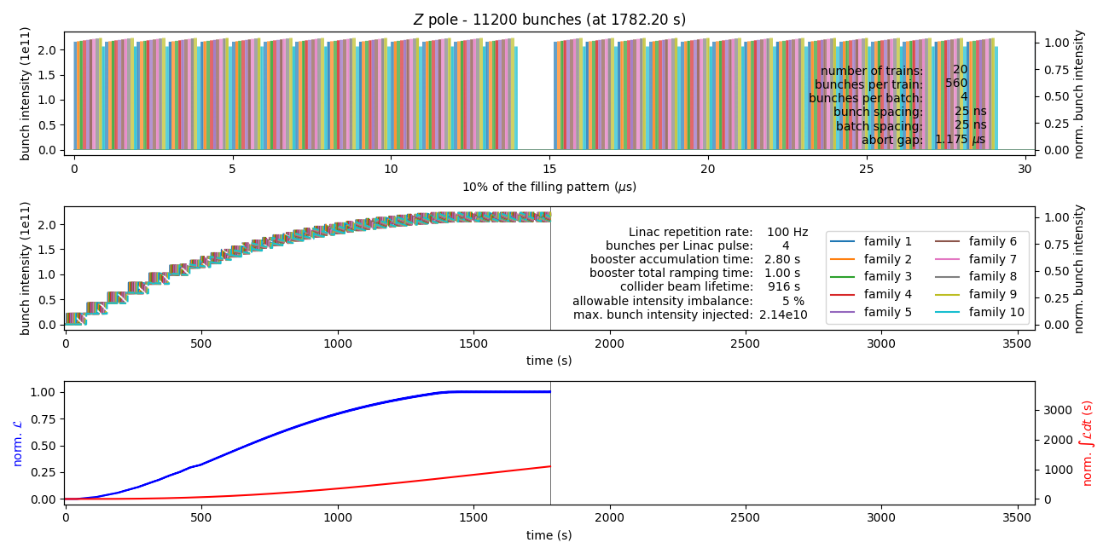
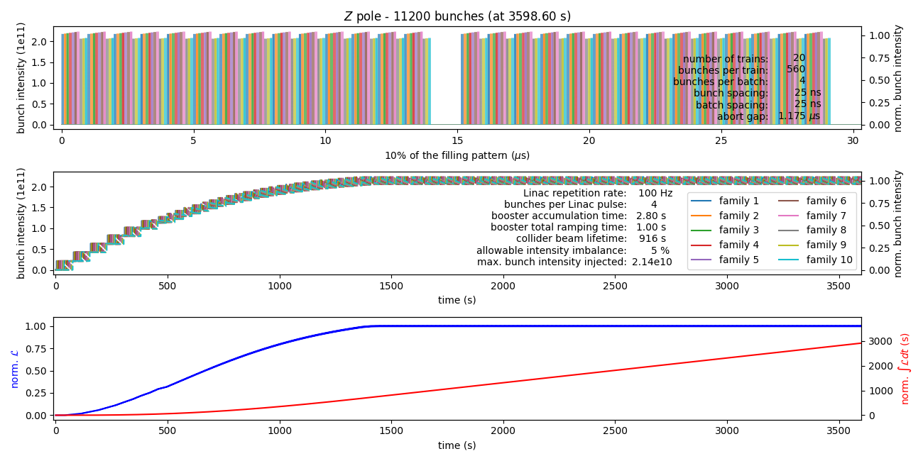
Transferring 1/10th of the bunches each time

Slide 7
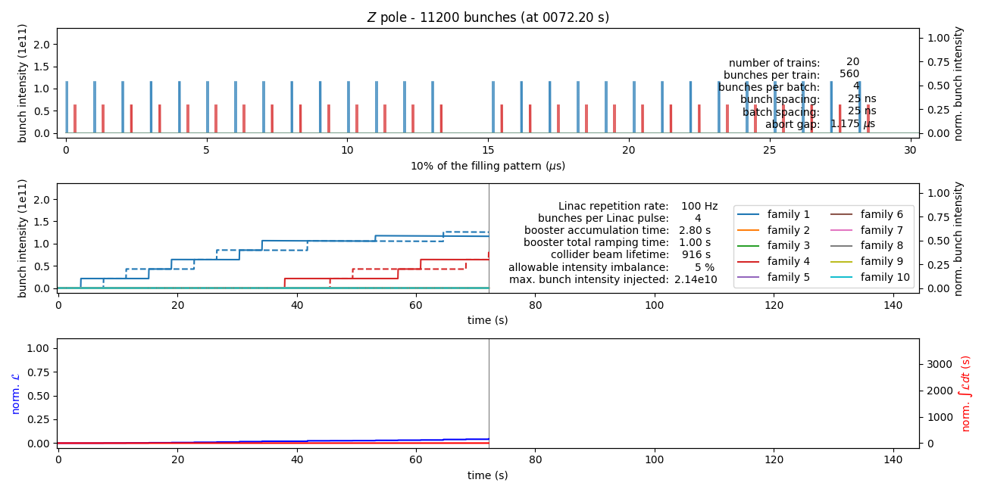
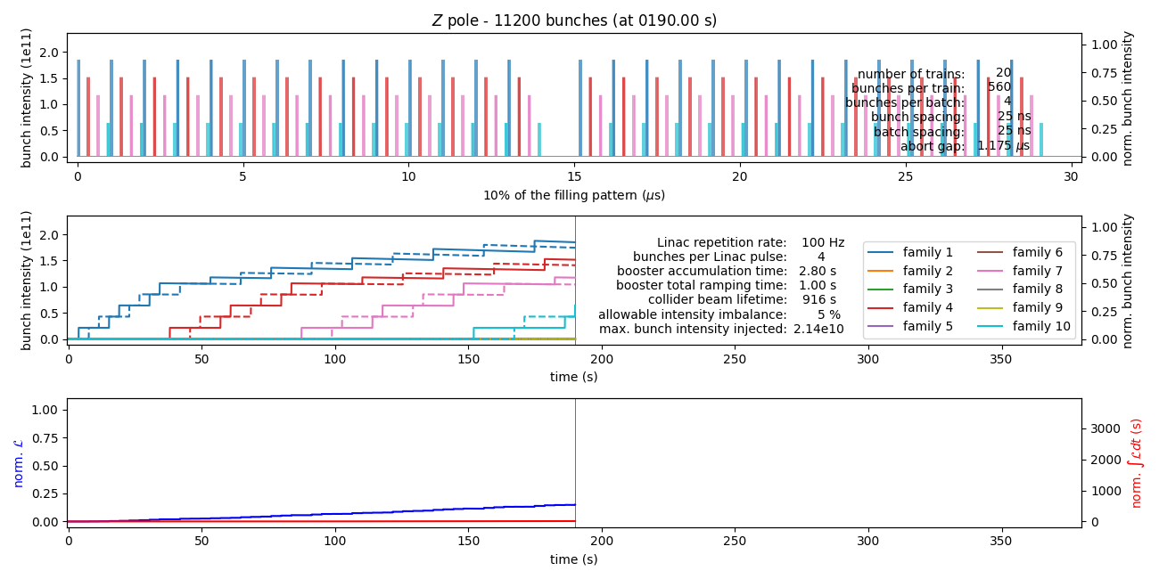
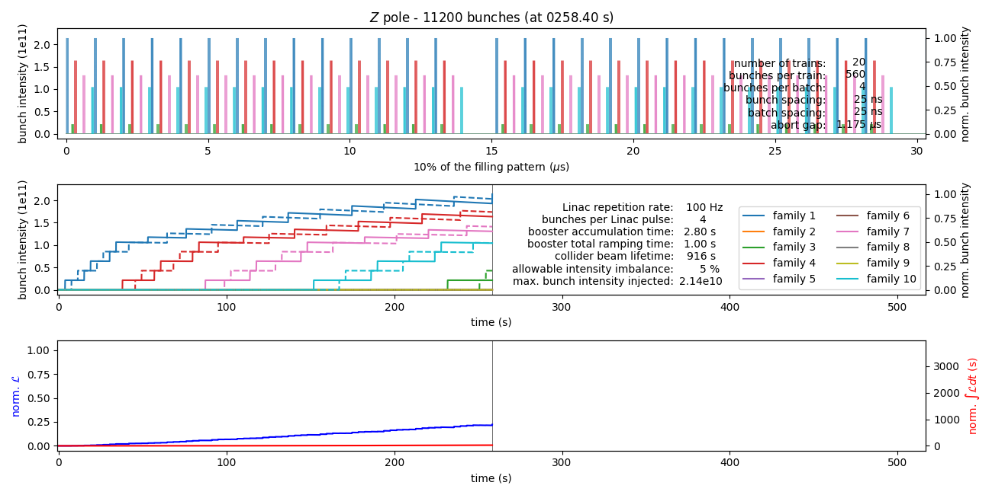
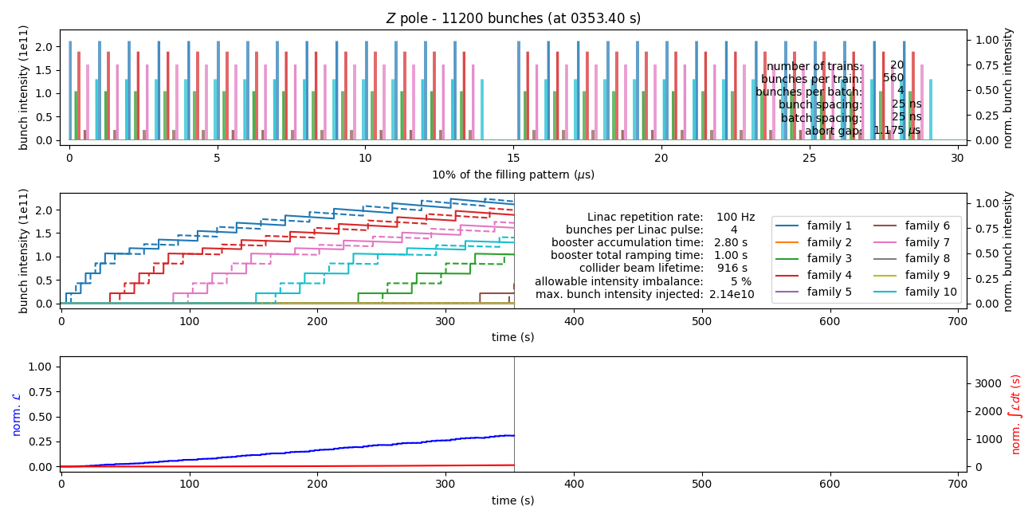
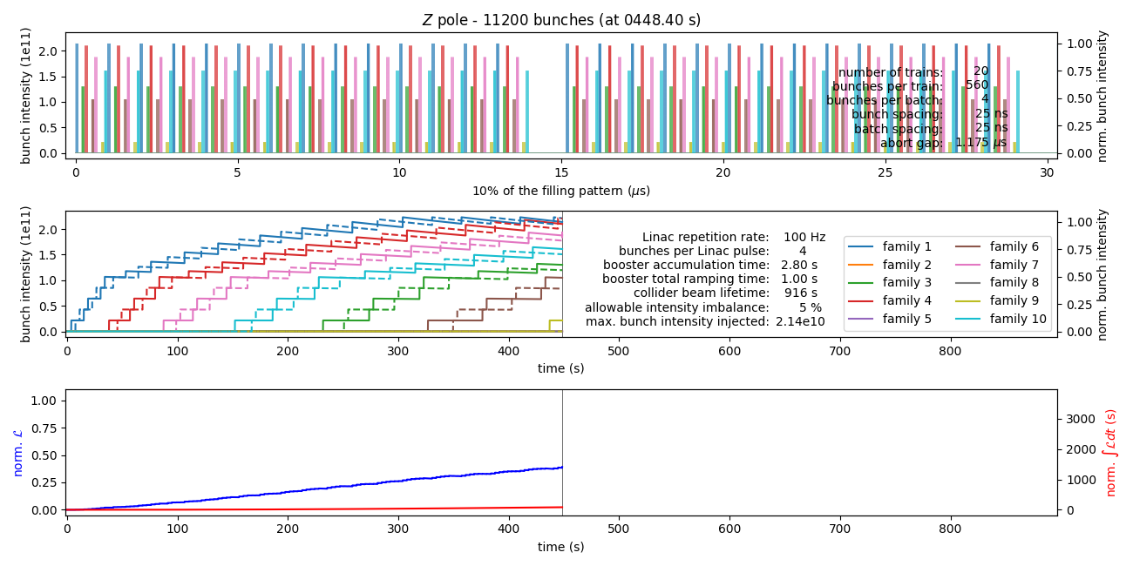
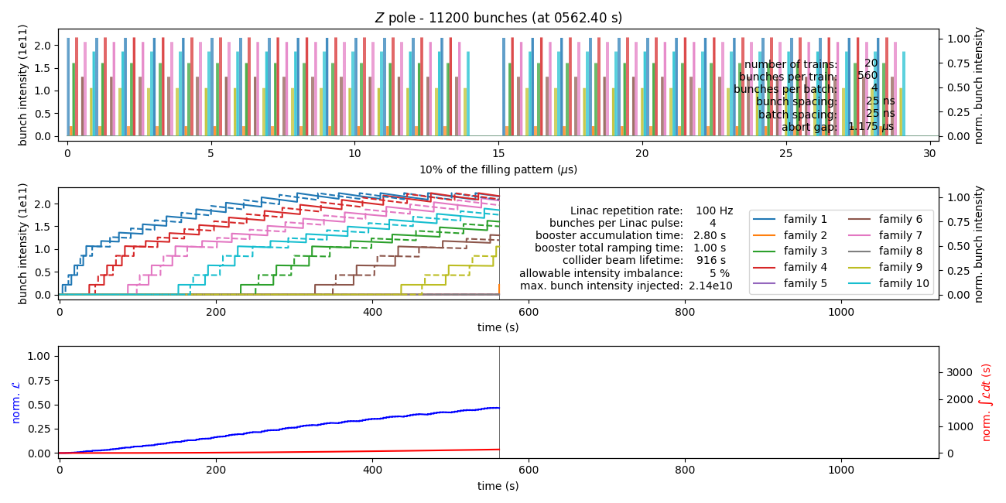
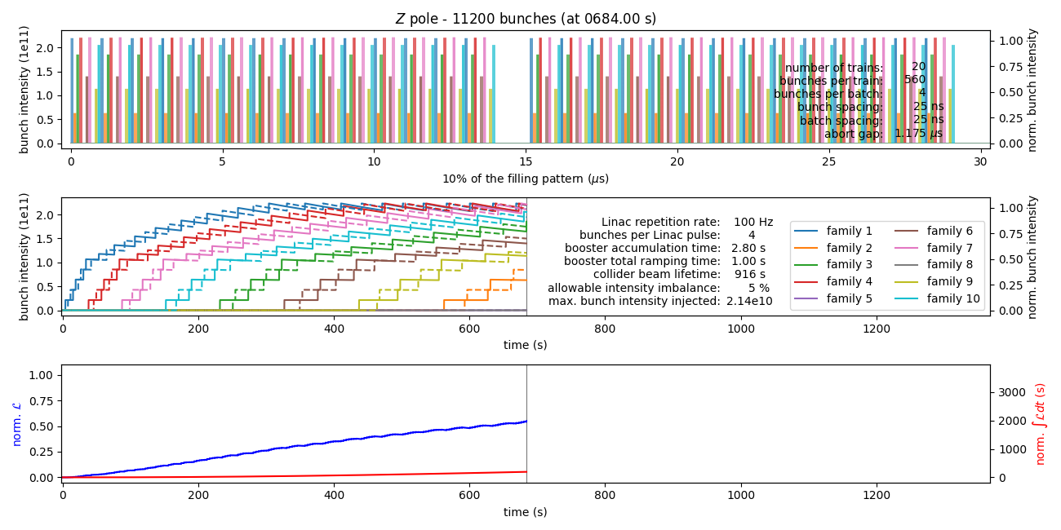
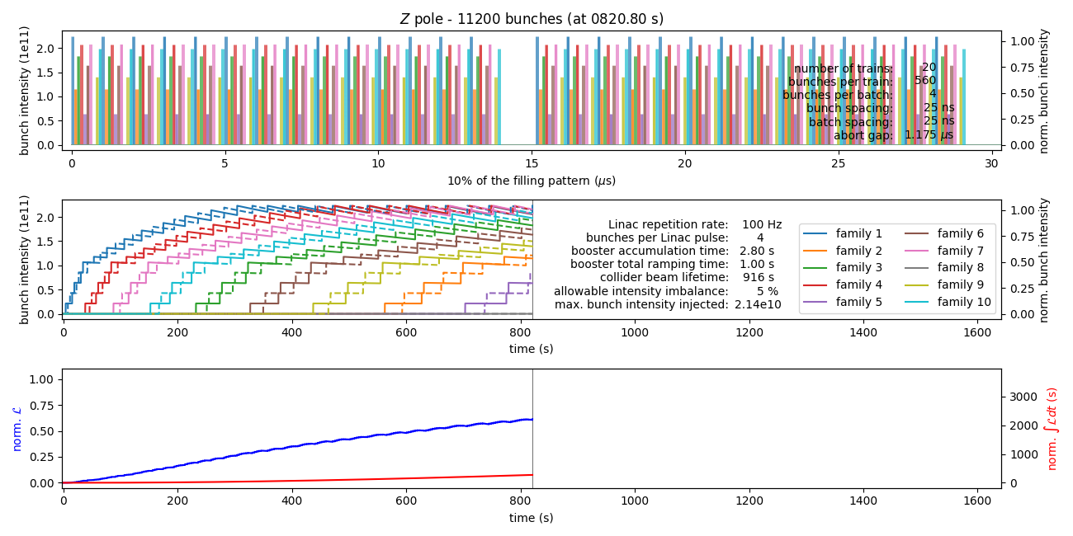
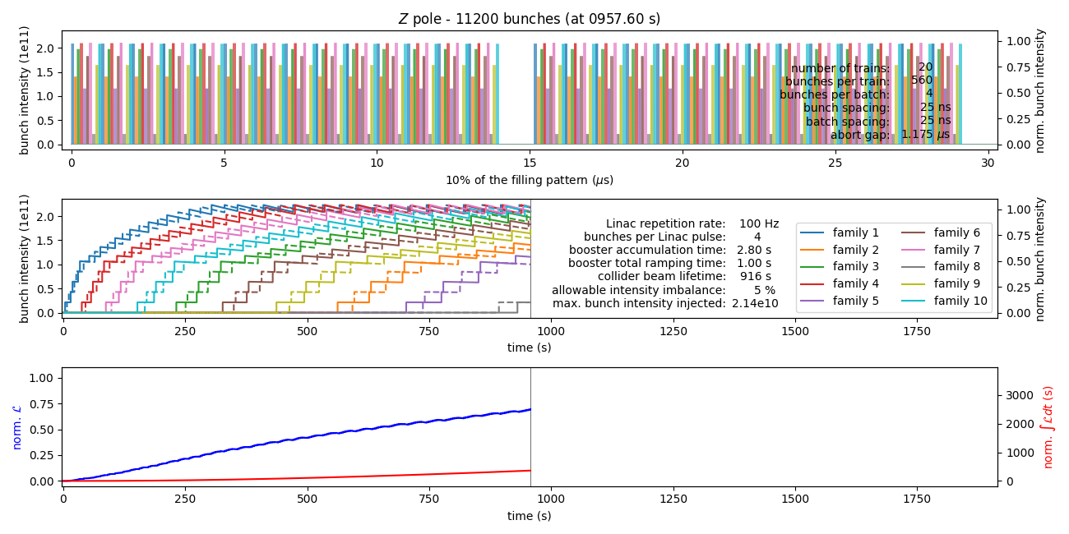
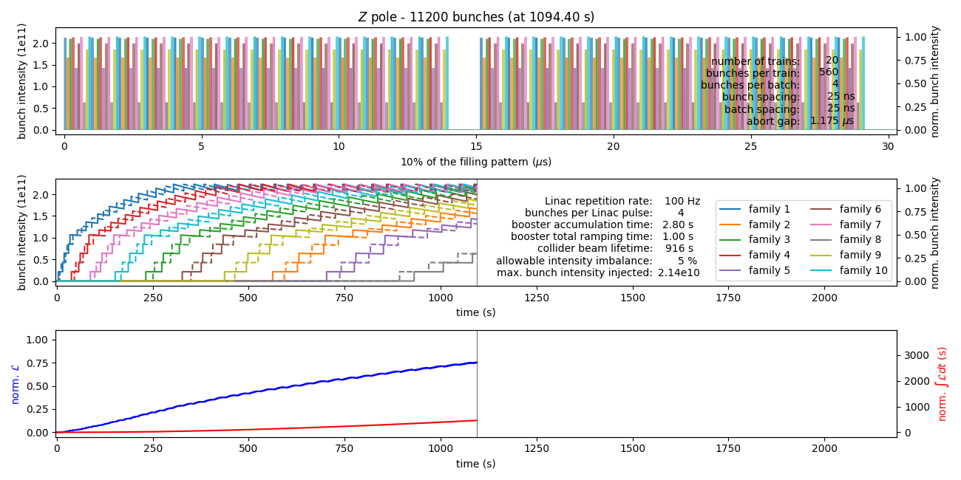
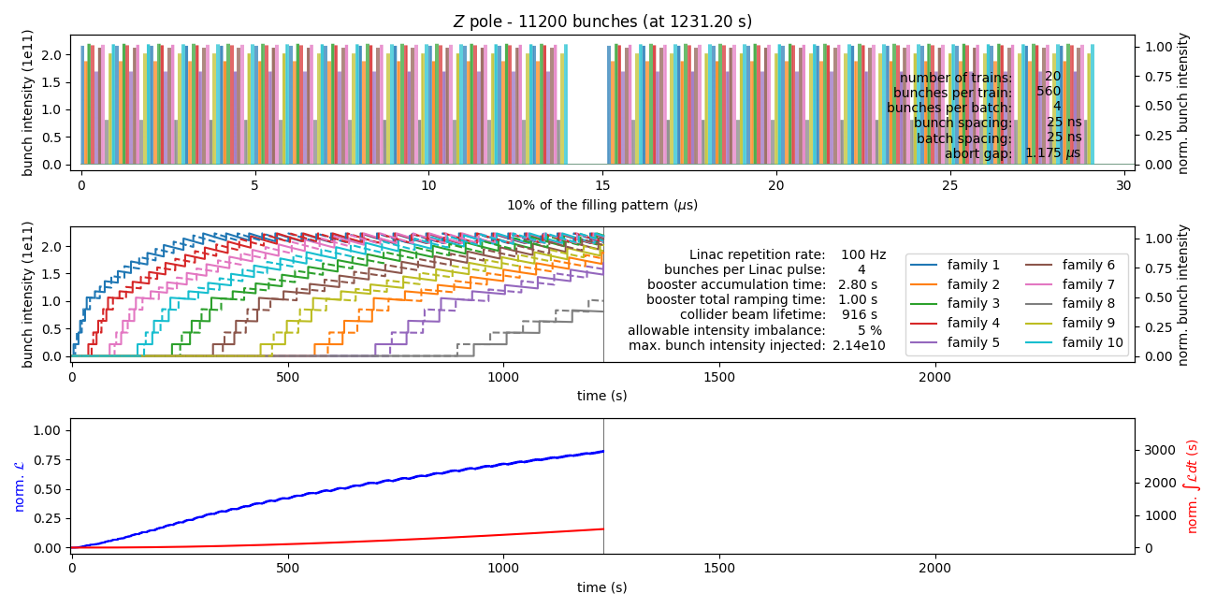
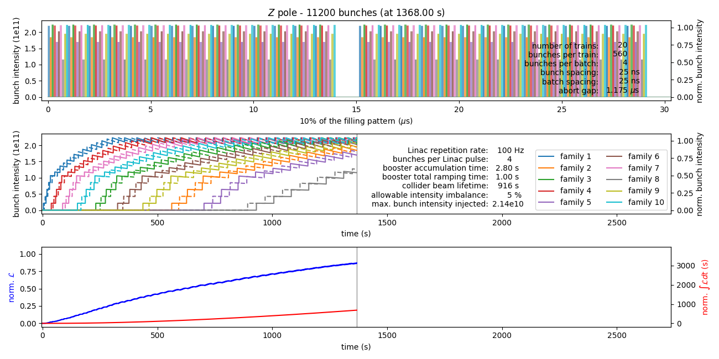
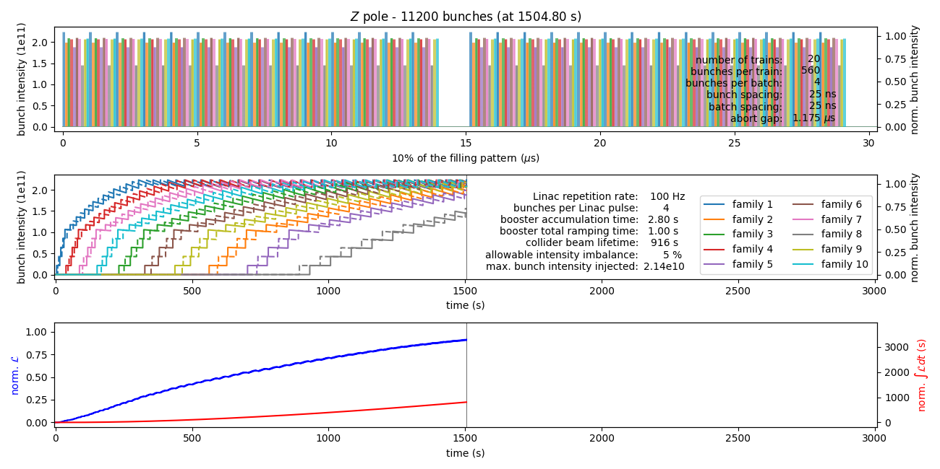
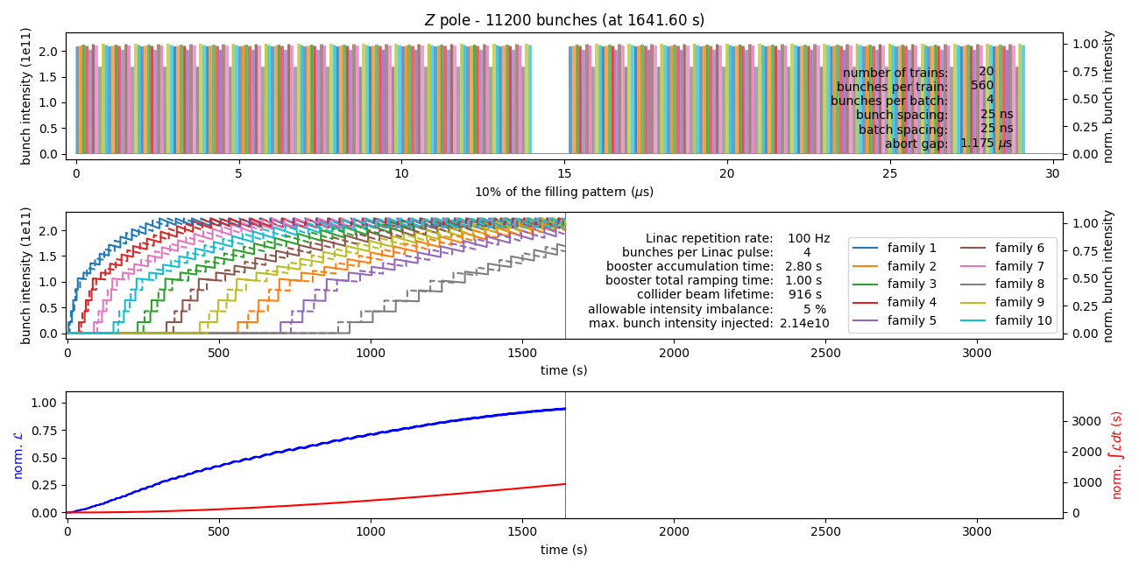
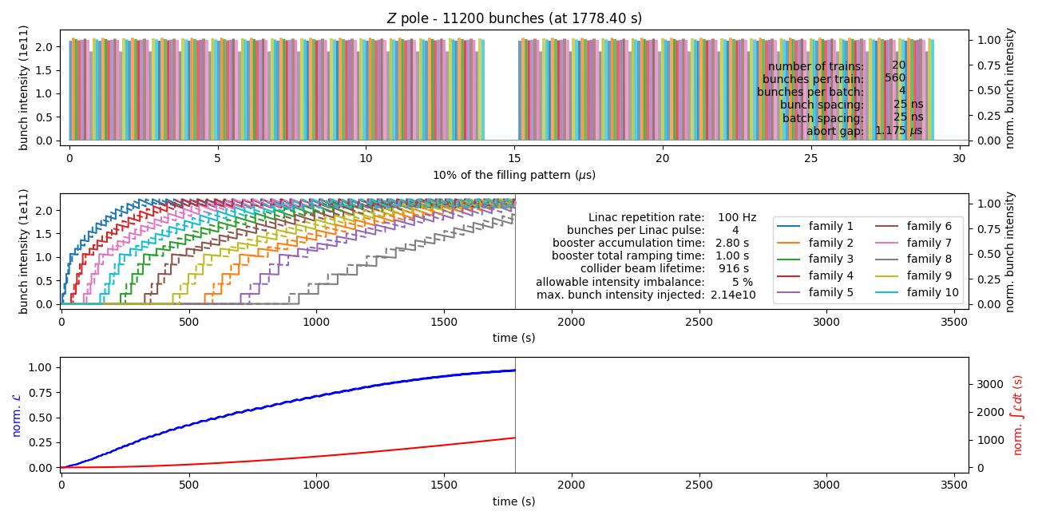
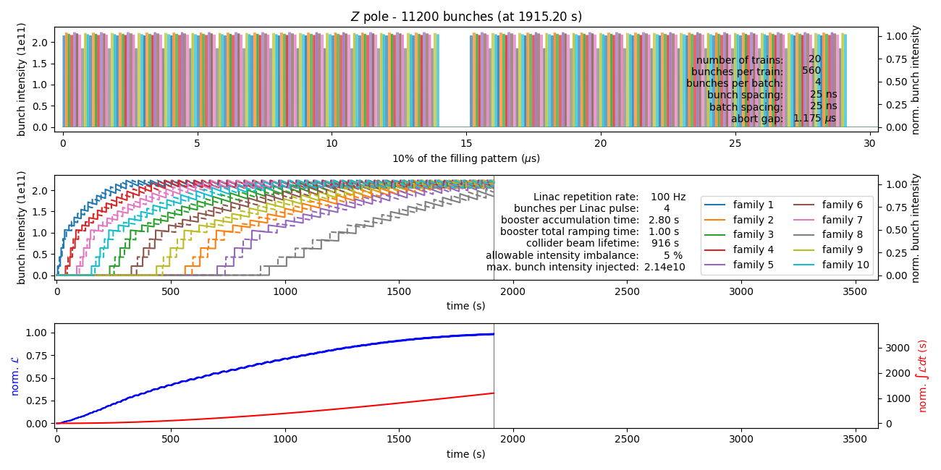
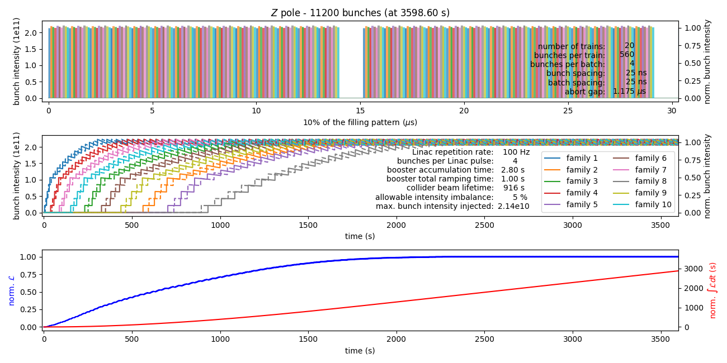
E-cloud mitigation scheme

