Slide 1
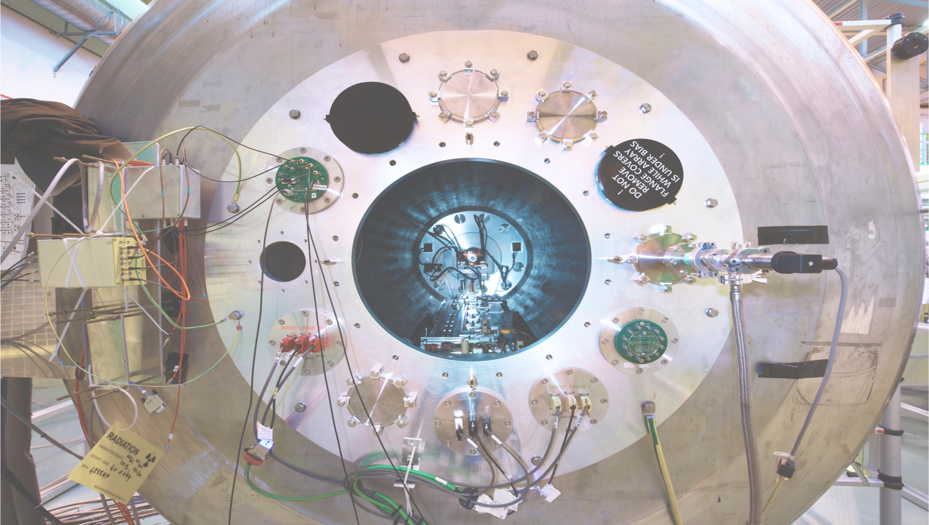





The ISOLDE Solenoidal Spectrometer – Status and updates for 2025
Liam Gaffney
University of Liverpool
ISS Workshop and Collaboration Meeting
Online + CERN, 11/06/2025
1
Notes:
1

Slide 2
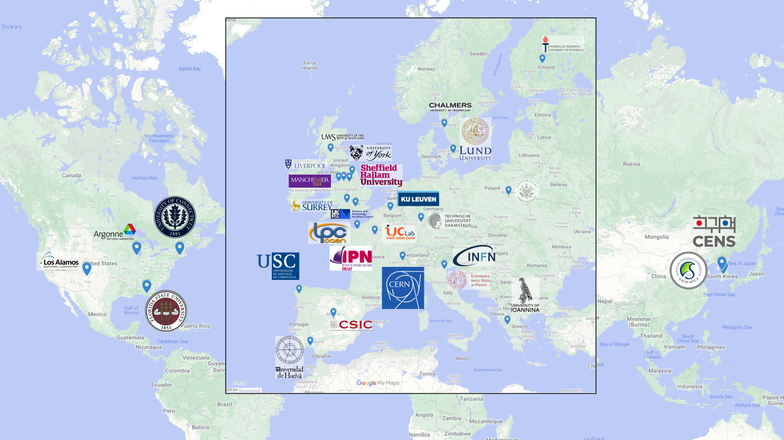
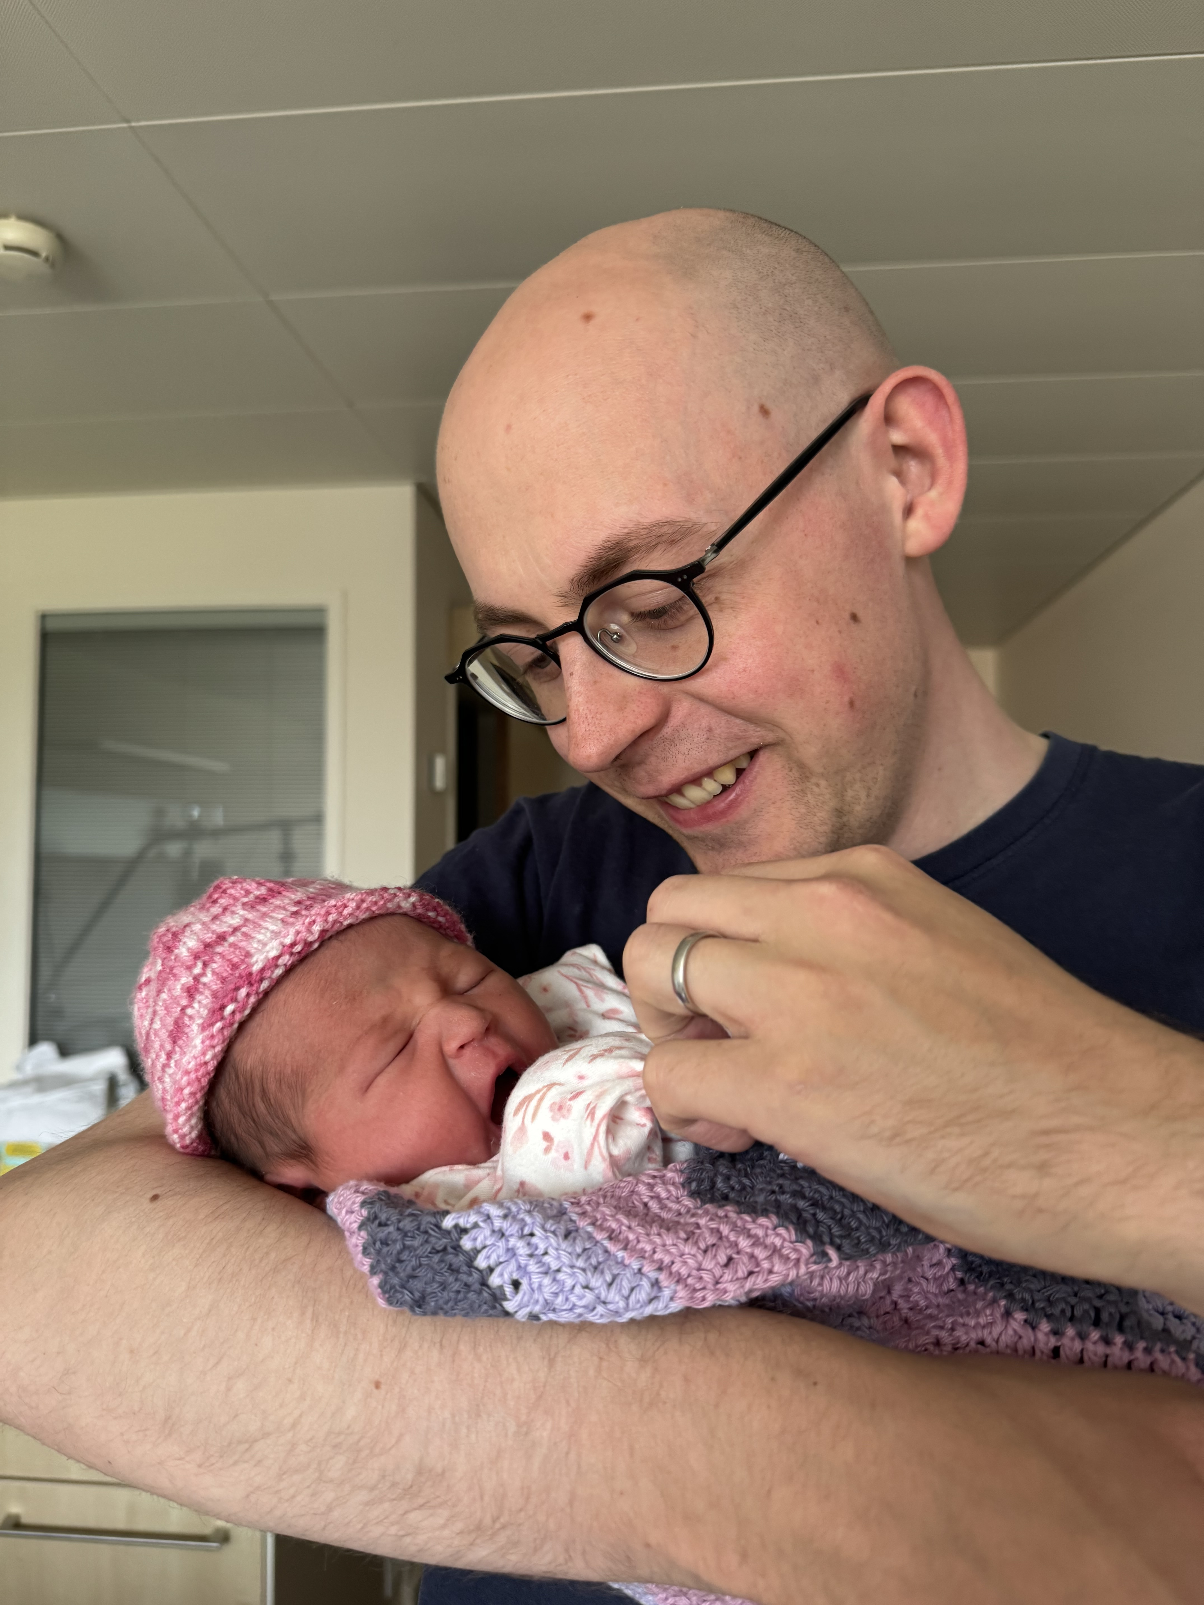








ISS operation so far
Fully commissioned in 2021, with 17 experimental beam times (plus more to come)
Users from 30+ institutions, in 12 countries participated in experiments so far…
11 institutions, are signatories of the MoU
Plus one new collaboration member since yesterday!
Congratulations to Patrick and Ally MacGregor

Slide 3

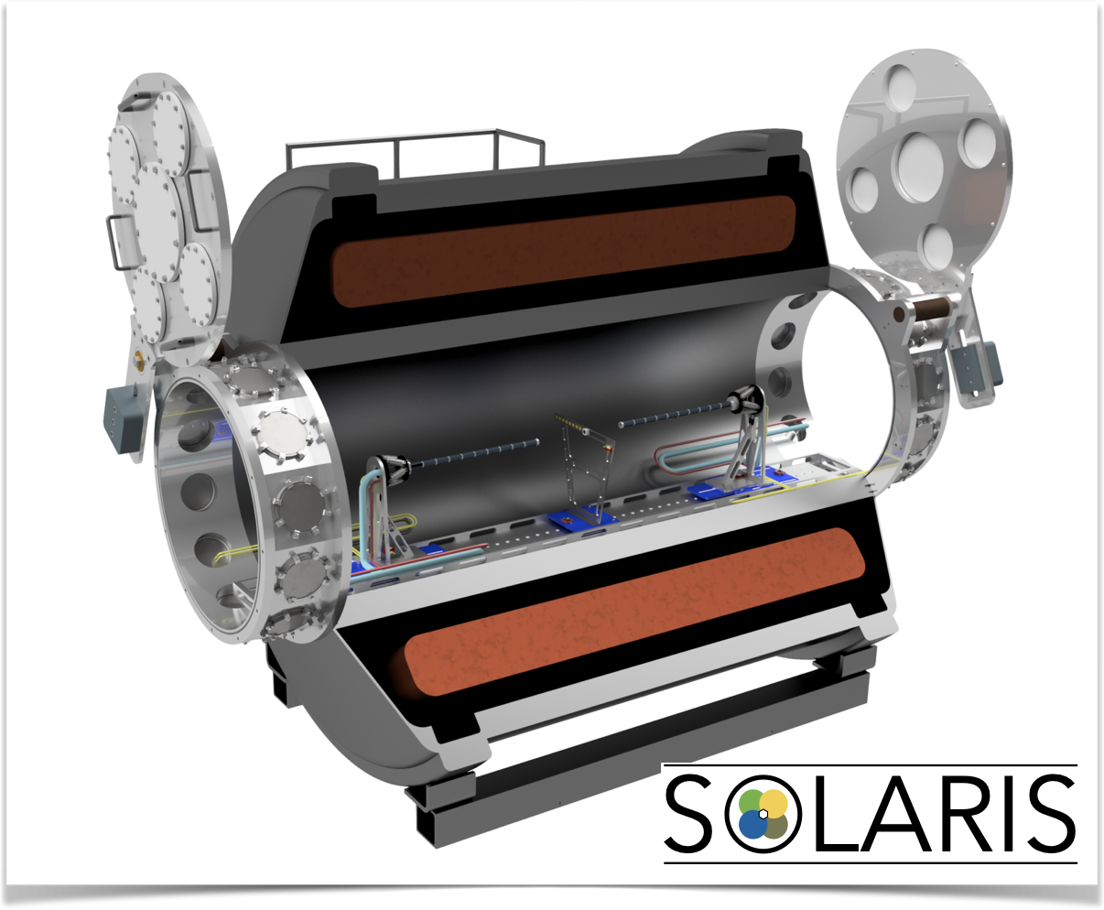
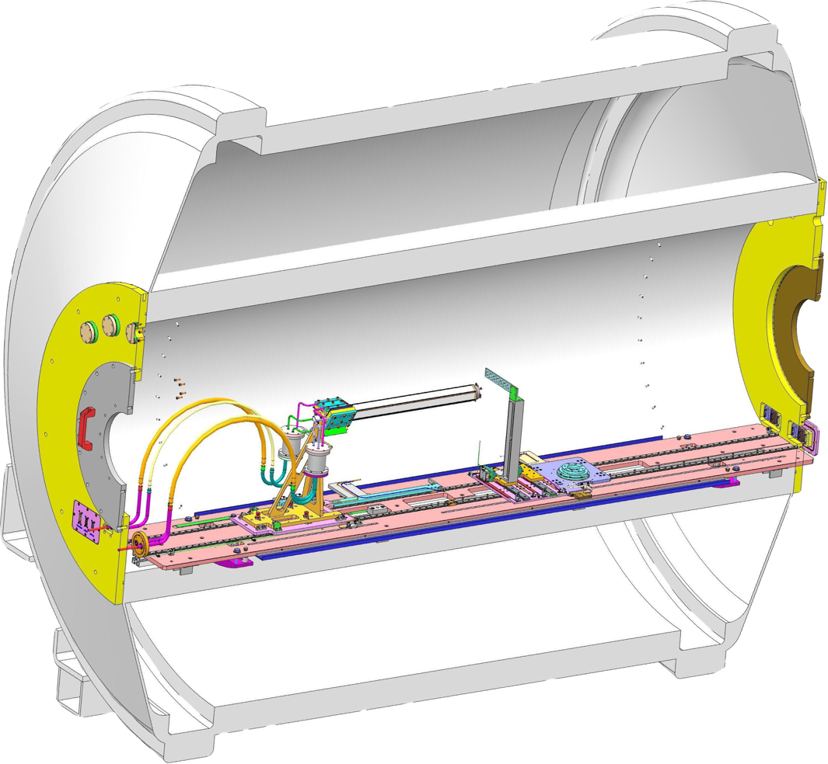

Solenoidal spectrometers around the world
HELIOS@Argonne
ISS@ISOLDE
SOLARIS@FRIB
“The pioneer” from 2008.
Stable beams, RAISOR and CARIBU.
3T MRI magnet.
Resistive-division Si array.
Since 2018 (LS2 2019-2021).
Post-accelerated ISOL beams.
Energies up to ~10 MeV/u.
Pre-LS2 with HELIOS on-axis array.
Post-LS2 double-sided Si strip array.
4T MRI magnet – clearance for 2.5 T.
Solenoidal spectrometer & SpecMAT.
From 2021 with initial configuration.
ReA6 beam line.
Early implementation using HELIOS array.
Building forward/backward dual array.
4T MRI magnet.
Solenoidal spectrometer & AT-TPC.

Slide 4
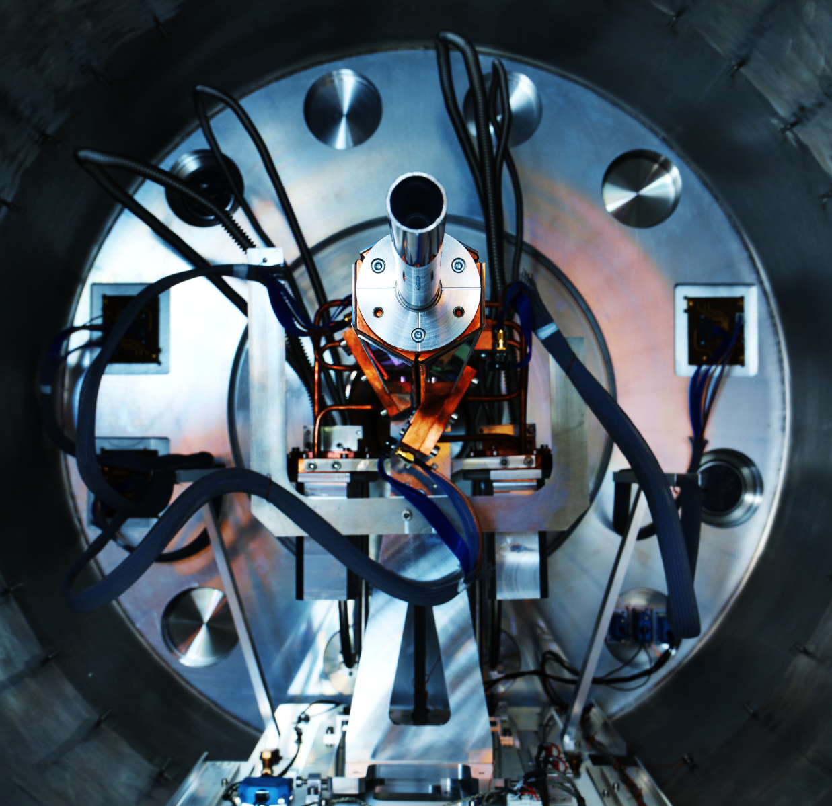
Solenoidal spectrometer technique
Recoiling nucleus detected downstream
Proton follows helical orbit in field of solenoid
Measure: z, E_{lab}
Deduce: θ_{cm}, E_{cm}
without kinematic compression
Beam ~10 MeV/u
Measure position of interaction

Slide 5
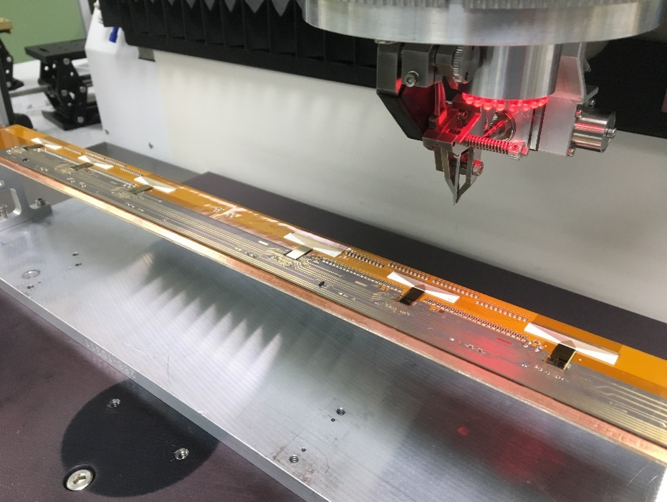
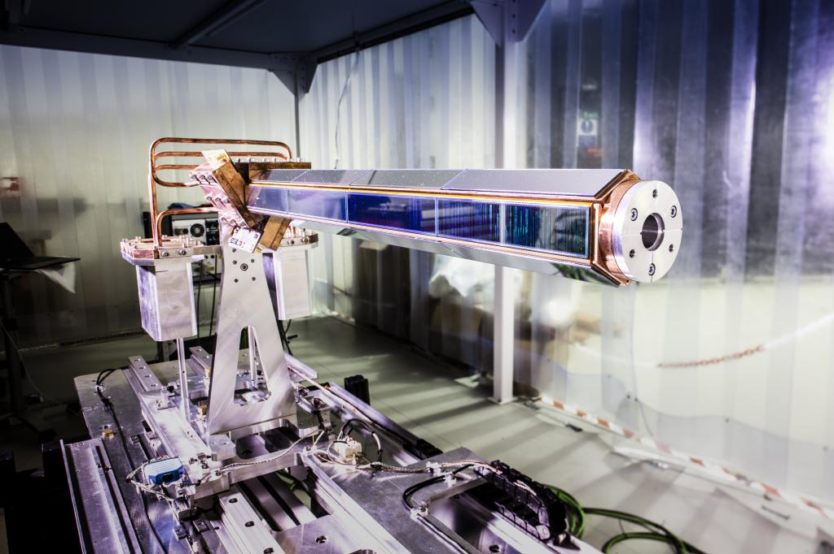

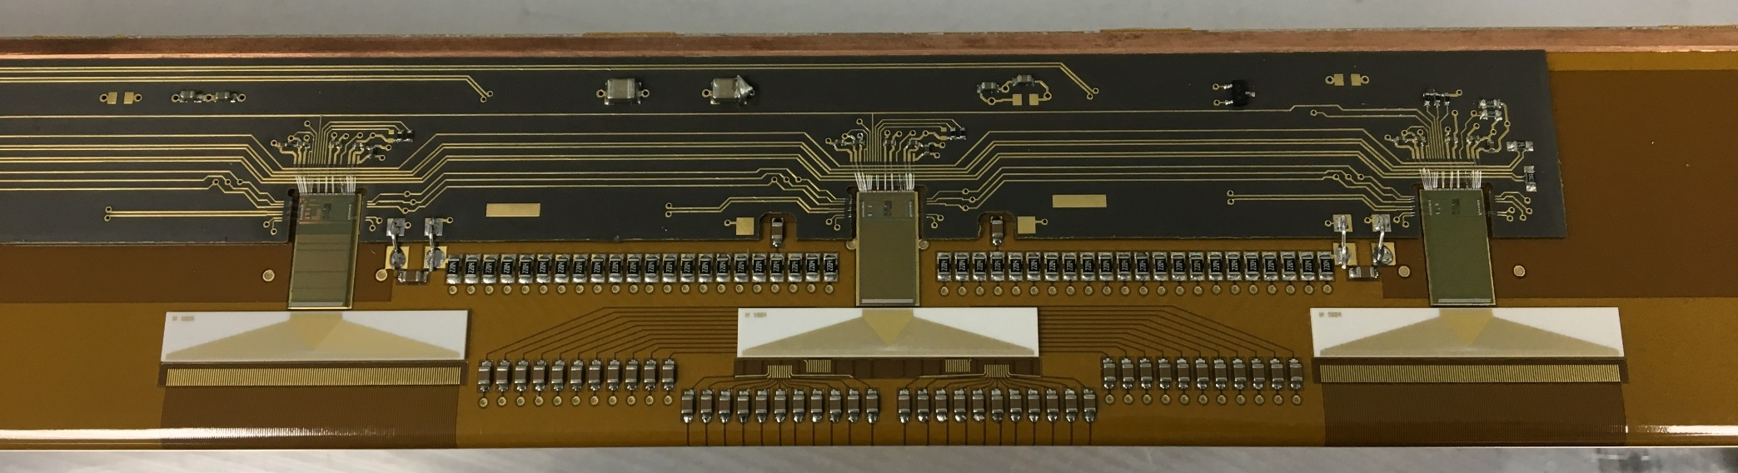
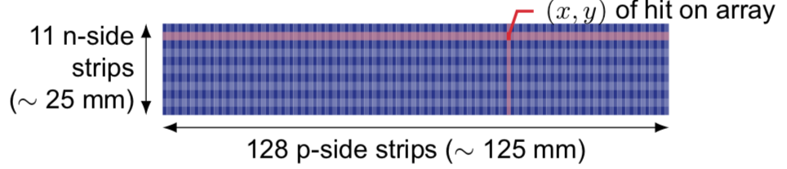
ISOLDE Solenoidal Spectrometer
~56 mm OD
~19 mm ID
~500 mm active length
On-axis silicon detector
Hexagonal array with four DSSSDs on each side.
  128 x 0.95 mm p-side strips along the length.
  11 x 2 mm n-side strips along the width
  1800 channels → R³B ASICs for readout
Total length of silicon = 510.4 mm.
  66% solid angle coverage.

Slide 6
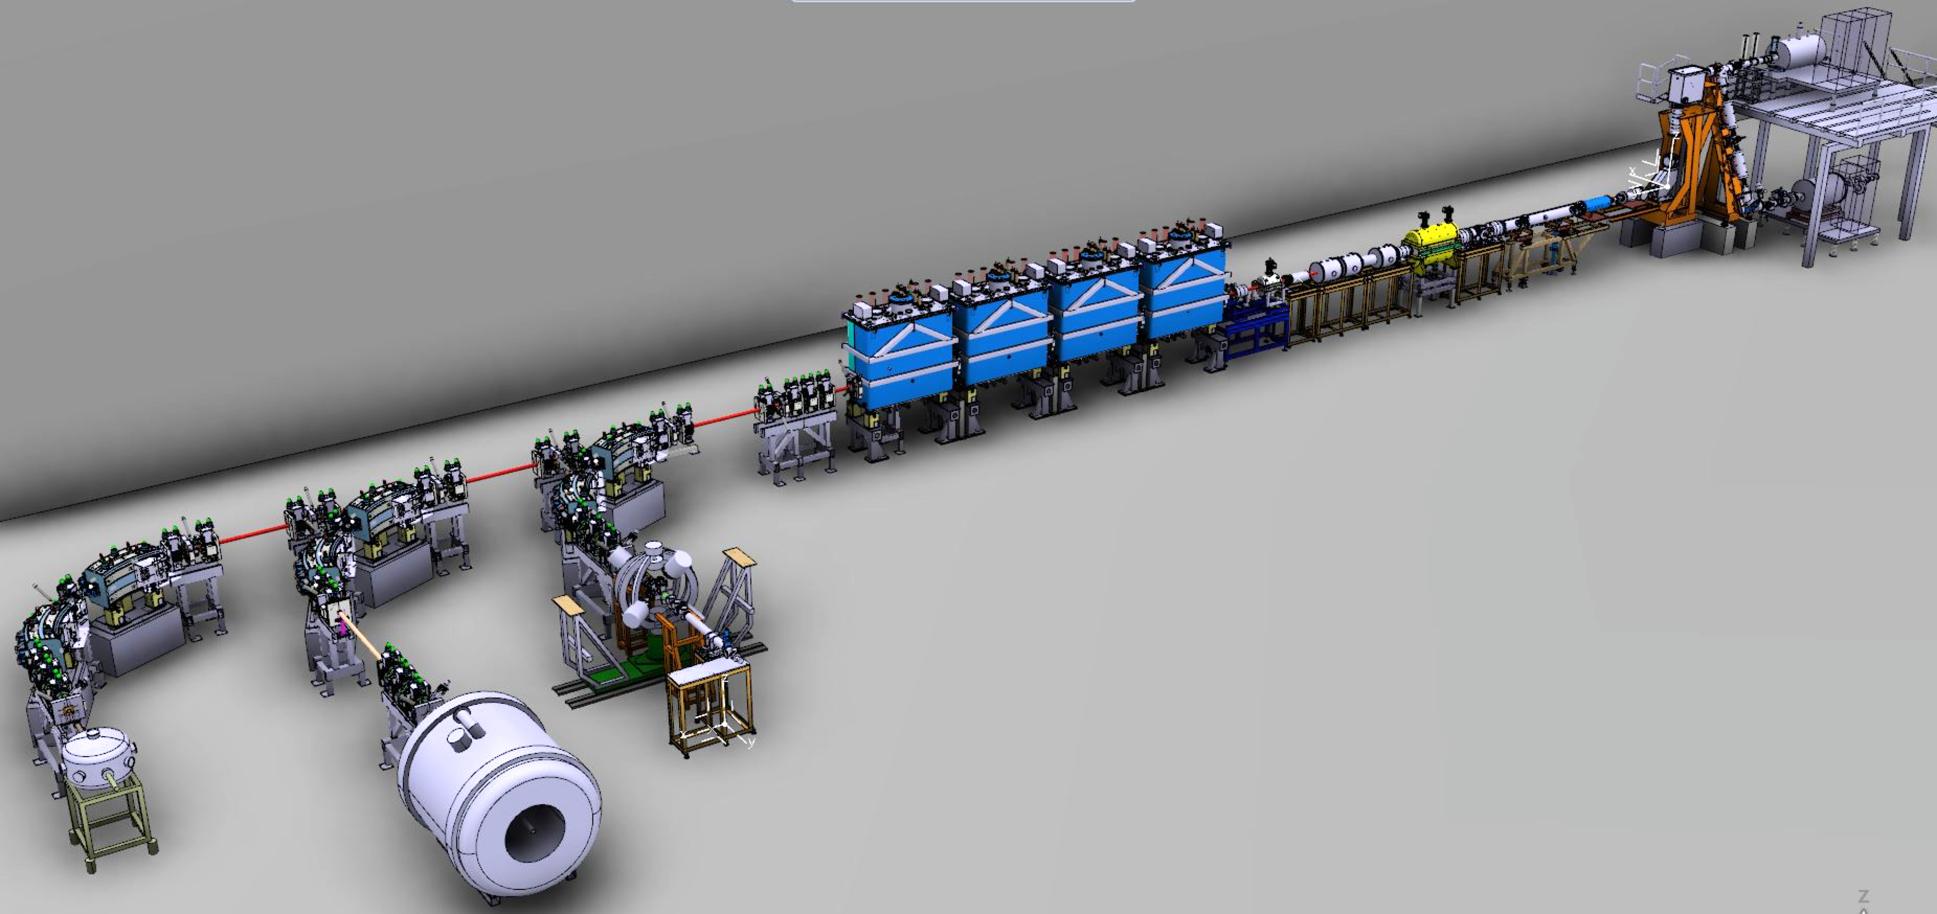
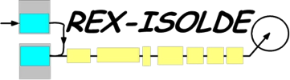


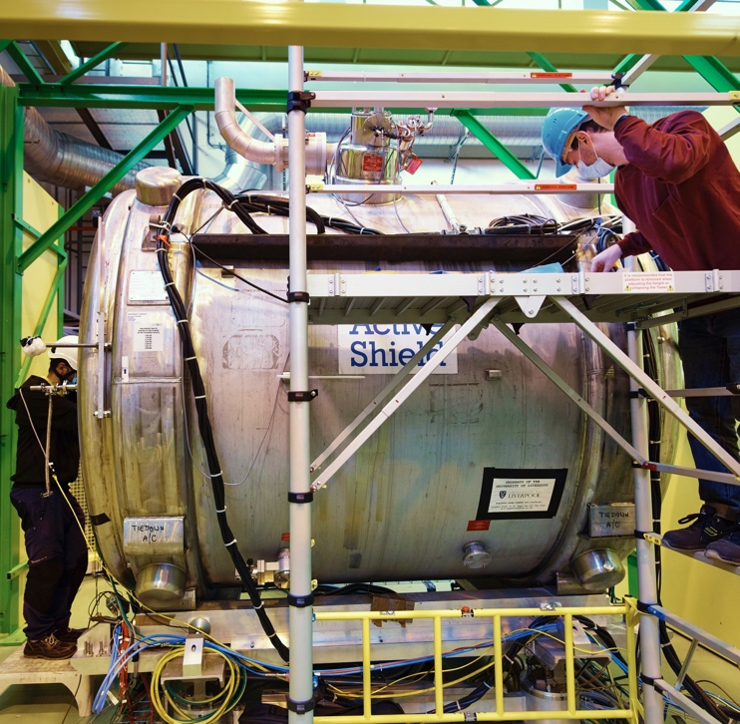

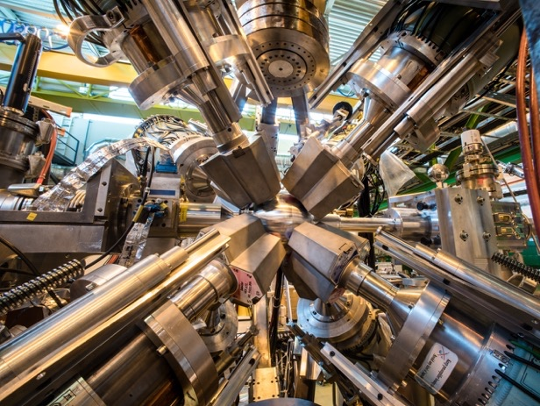

HIE-ISOLDE Phase 2 (2018)
2.83 MeV/u
10.0 MeV/u
RIB from ISOLDE
Moveable Setups (SEC)
Notes:
The largest amount of work in the proposal is based at HIE-ISOLDE, the post-accelerator of radioactive ion beams from ISOLDE.
Fundamentally, ISOLDE is the *ONLY* place worldwide where these isotopes can be produced and accelerated to the correct energy to determine their shapes.
This new upgrade, combing new superconducting cryomodules began it’s first physics experiments in 2016, when I was selected as a CERN research fellow to lead the first exploitation HIE-ISOLDE.
In the two operational campaigns since, experiments have been focused around the first experimental setup, Miniball, which I run.
I’ve successfully lead the setup and running of 13 experiments, including my own Coulomb excitation experiment on the octupole-deformed Barium isotopes.
However, the most exciting development that I have been working on is the ISOLDE Solenoidal Spectrometer, a former MRI magnet from a hospital in Australia being repurposed to perform nuclear reactions with radioactive ion beams.

Slide 7
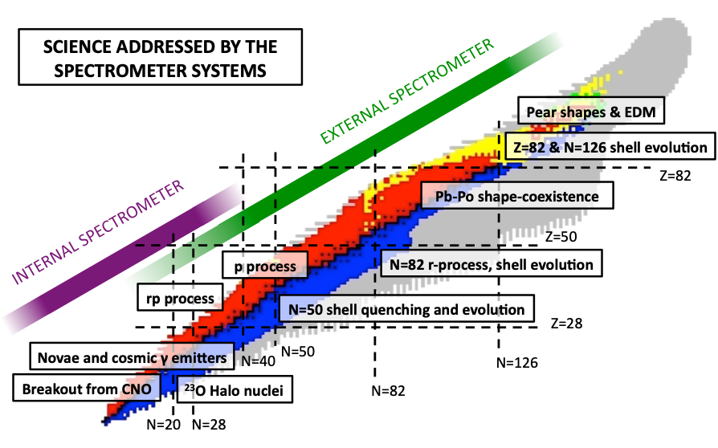
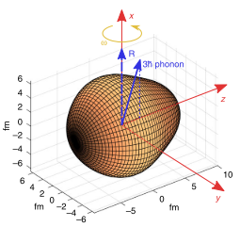
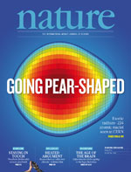

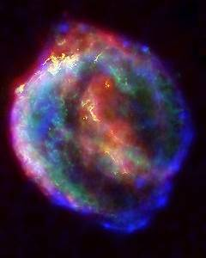
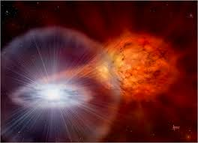
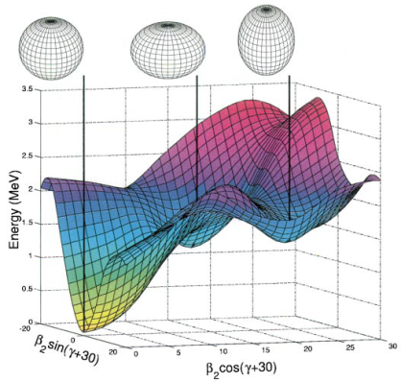

ISOL-SRS Project
CARME

Slide 8
ISOL-SRS Project
²⁰⁷Hg
CARME
²⁹Mg

Slide 9
ISOL-SRS Project
²¹³Rn
²⁰⁷Hg
CARME
¹⁴⁴Ba
^{109,111}Sn
¹³³Sn
⁹³Kr
⁶²Zn
⁶⁹Ni
³⁹K
^{50,51}Ca
²⁹Mg
³¹Mg
²⁸Na
⁸Be
¹²Be
LS2 → LS3
2021 → 2025

Slide 10
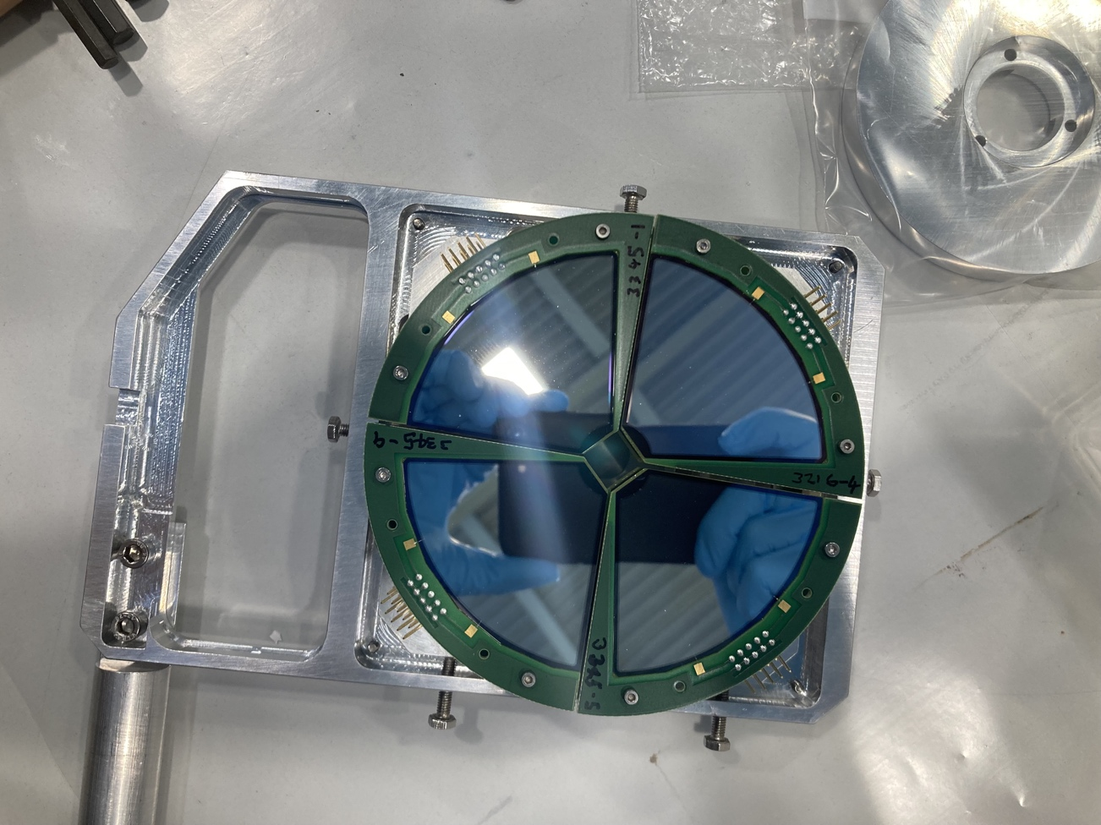
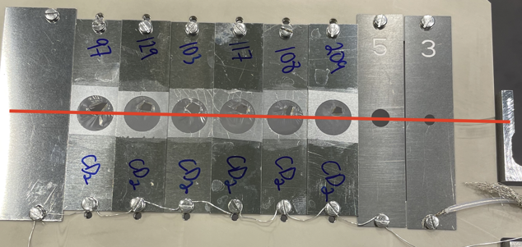
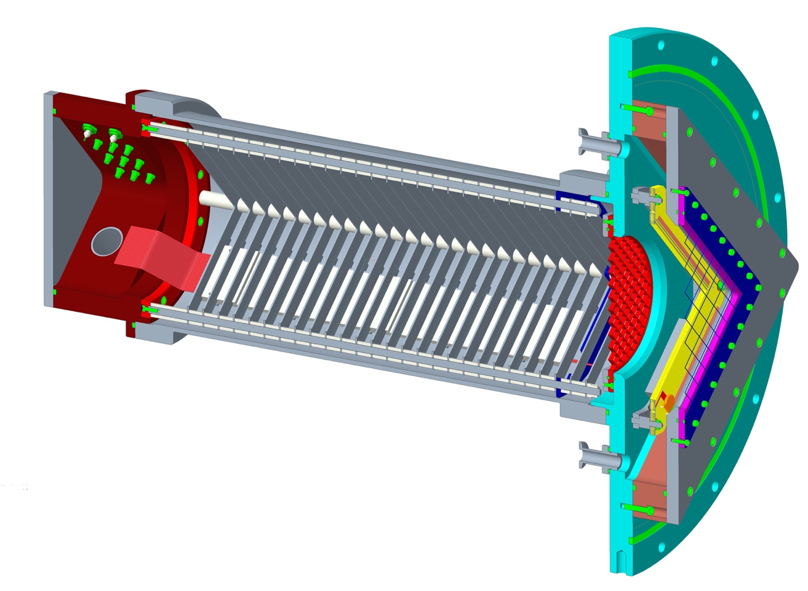
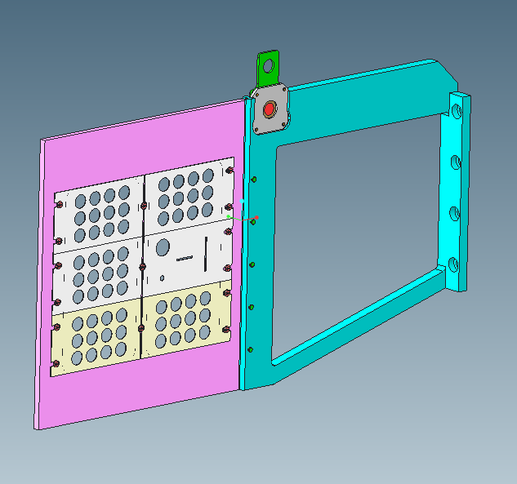
ISS modes of operation (so far…)
Si-recoil mode
Silicon ∆E-E for beam-like reaction partner; used for A < 50.
Clean selection of reaction channel; removes fusion on carbon and isobars in beam.
Gas-recoil mode
Fast-counting Bragg chamber and MWPC for medium-mass beams.
Used in beam just twice so far; fast pre-amps and zero-degree blocker being implemented for 2024.
Singles mode
High intensity or heavy beams.
FC at zero degrees, EBIS time structure to remove decay background.

Slide 11
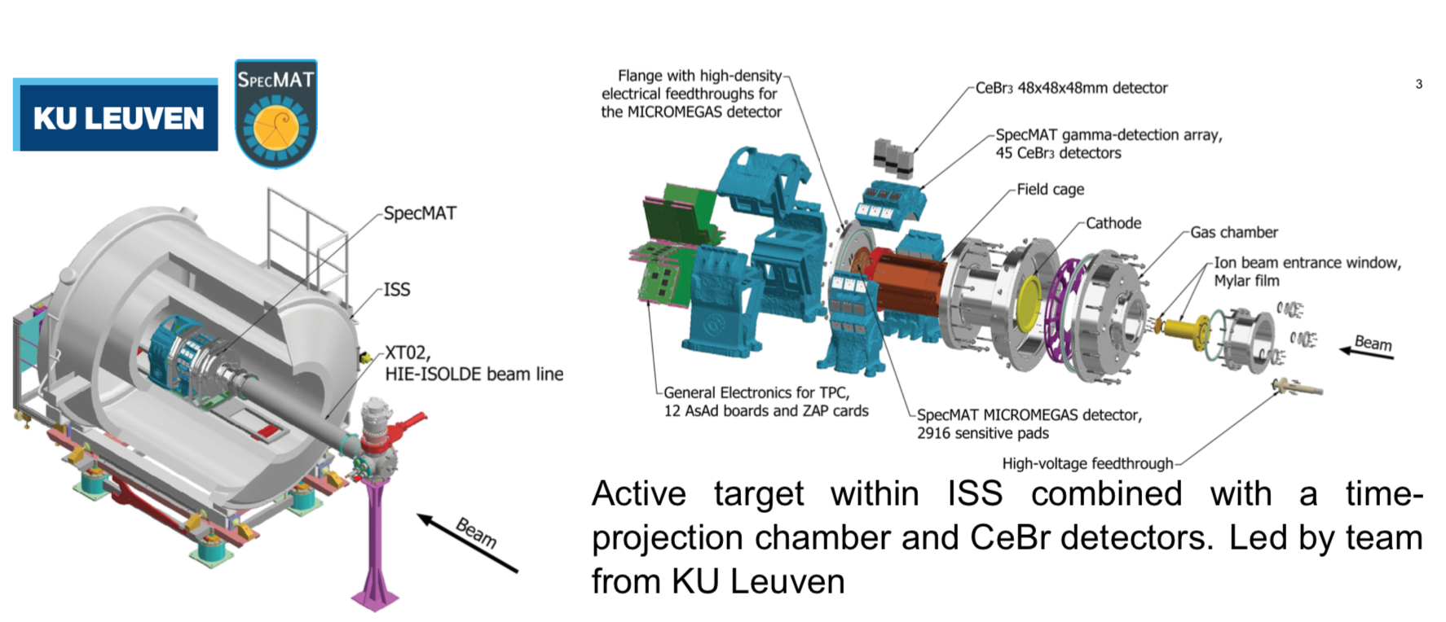
SpecMAT active target – first beam

Slide 12
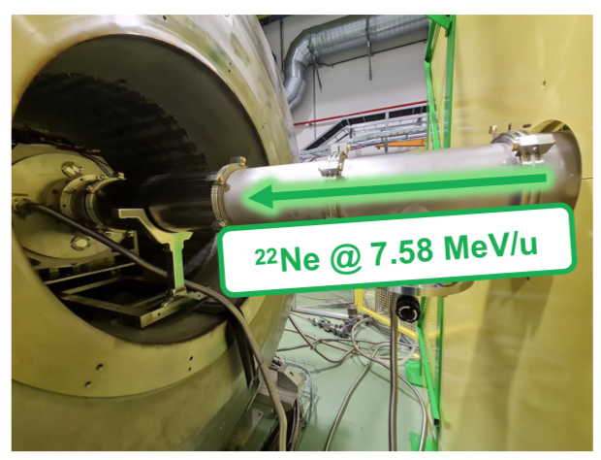
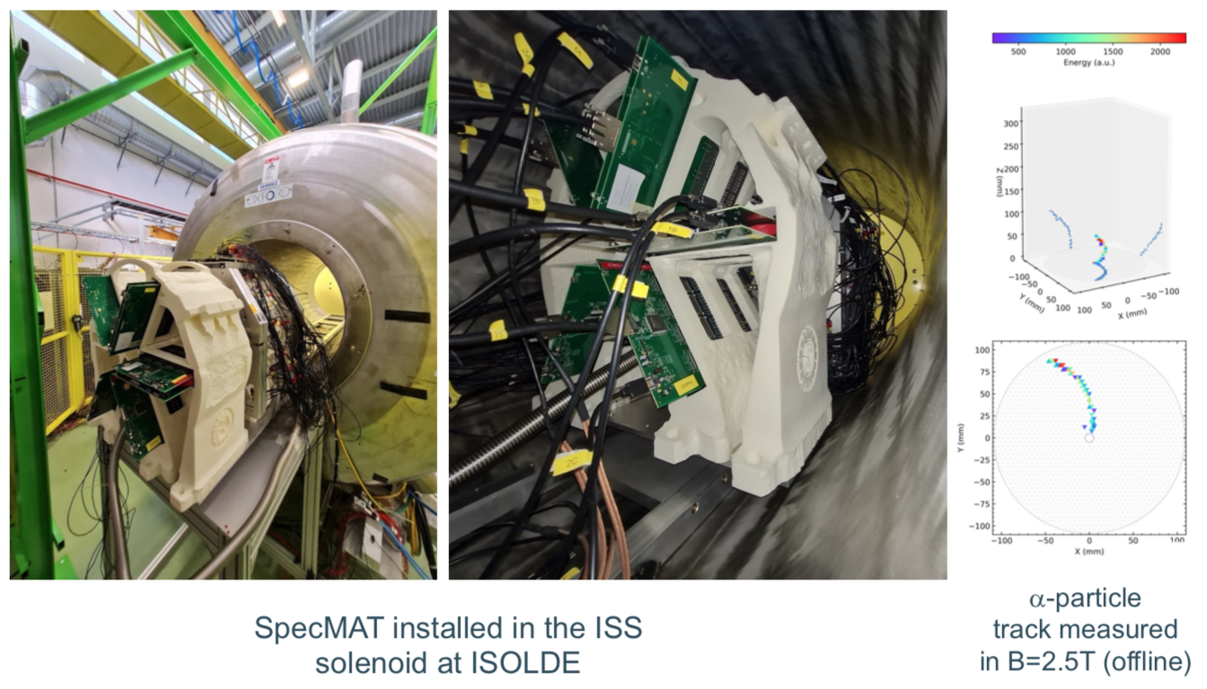
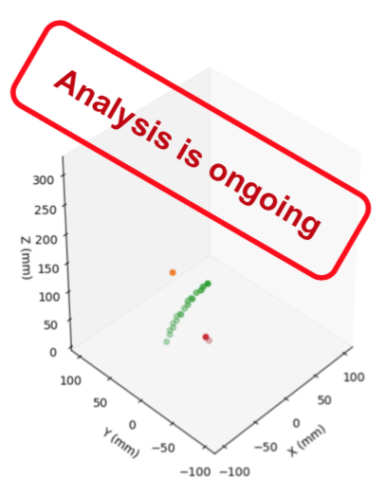
SpecMAT active target – first beam
June 2023
D₂ gas target
Thanks to Oleksii Poleshchuk (KU Leuven)

Slide 13
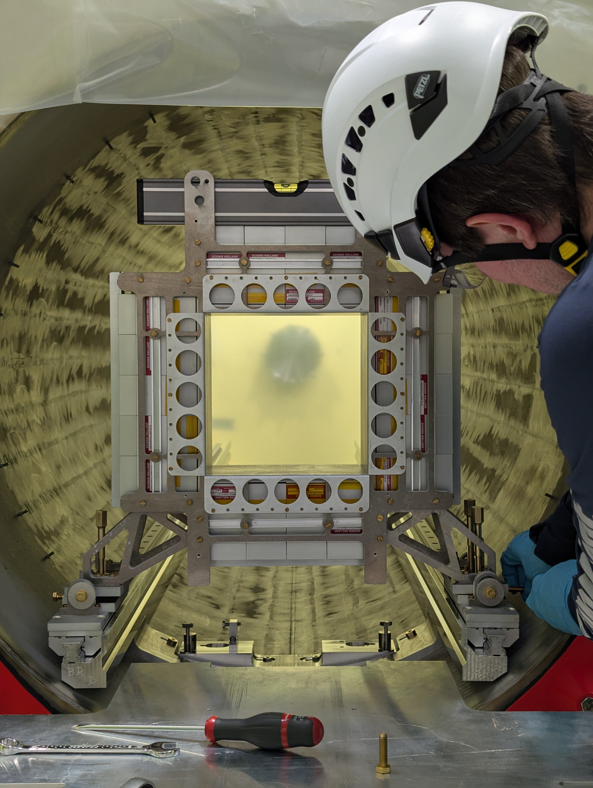
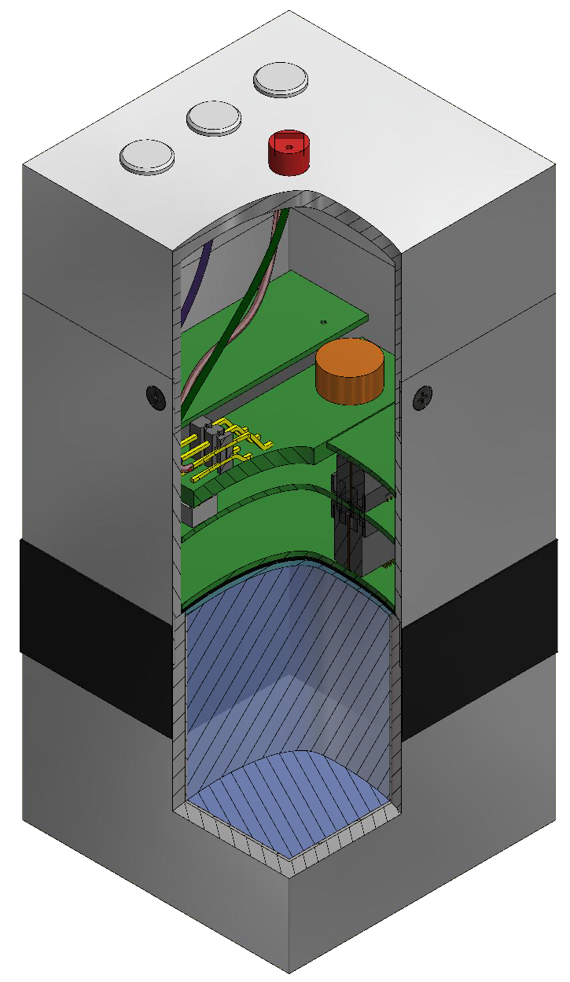
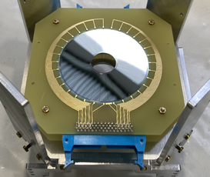
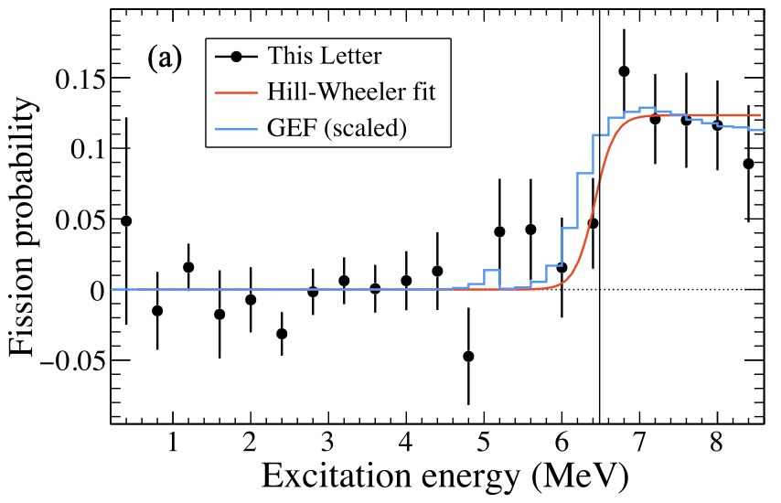

(d,p) fission setup – ²²⁹Ac
CeBr array at target position
Talk by Maria Vittoria Managlia today…
Proof-of-principle experiment at HELIOS.
Silicon dE-E for spectroscopy of forward-focussed fragments, plus CeBr array for γ-ray detection.
First RIB experiment of the year
Scheduled 10th – 19th July 2025
²³⁸U(d,pF)
S.A. Bennet, et al.
PRL 130, 202501 (2023)

Slide 14
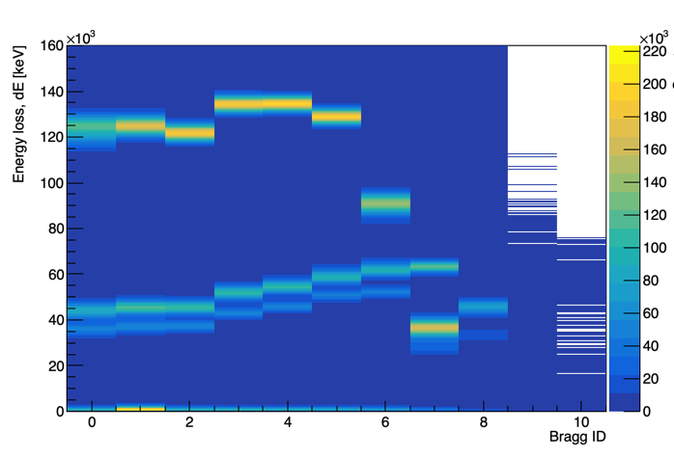
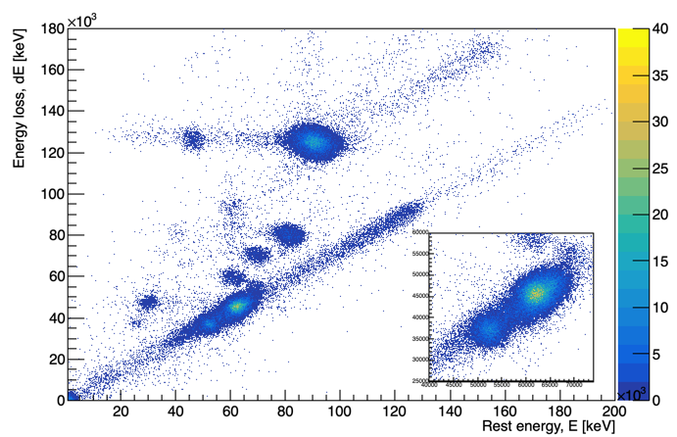
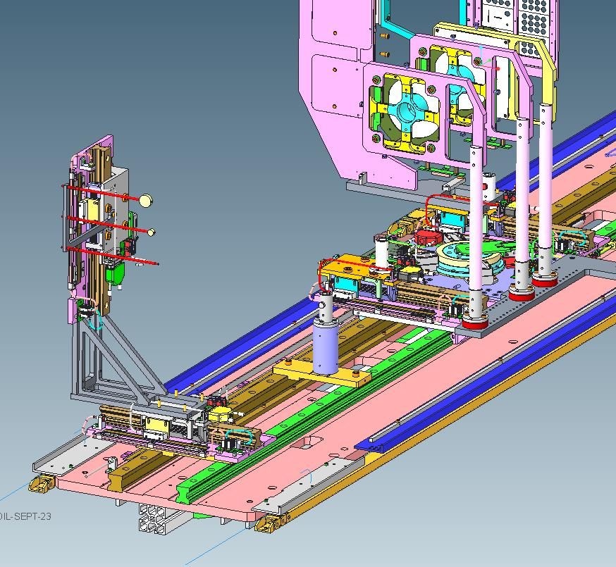
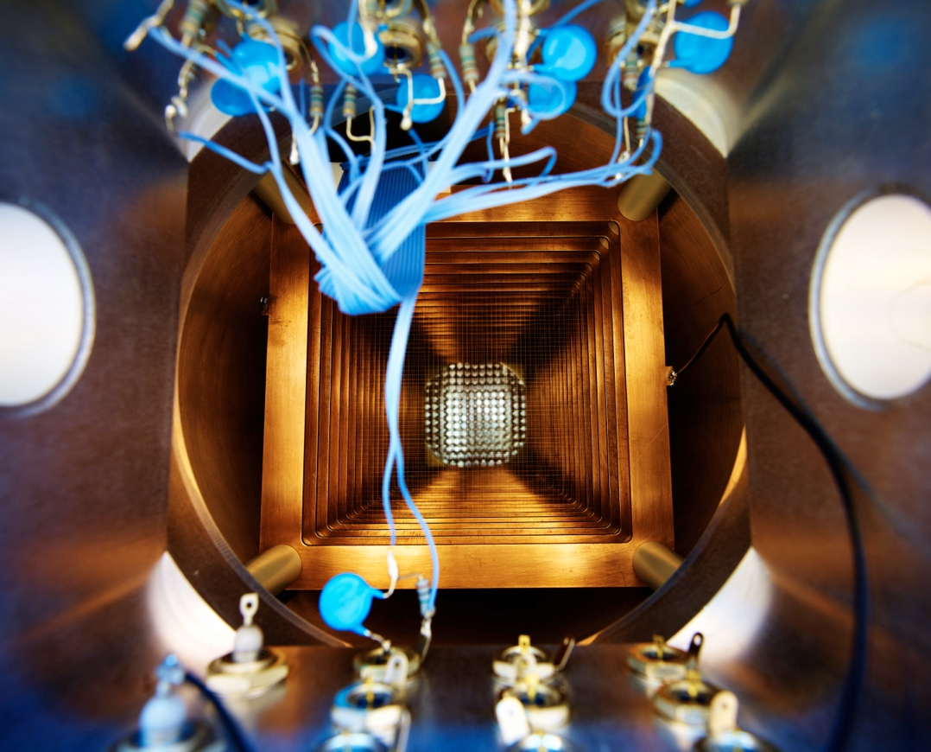
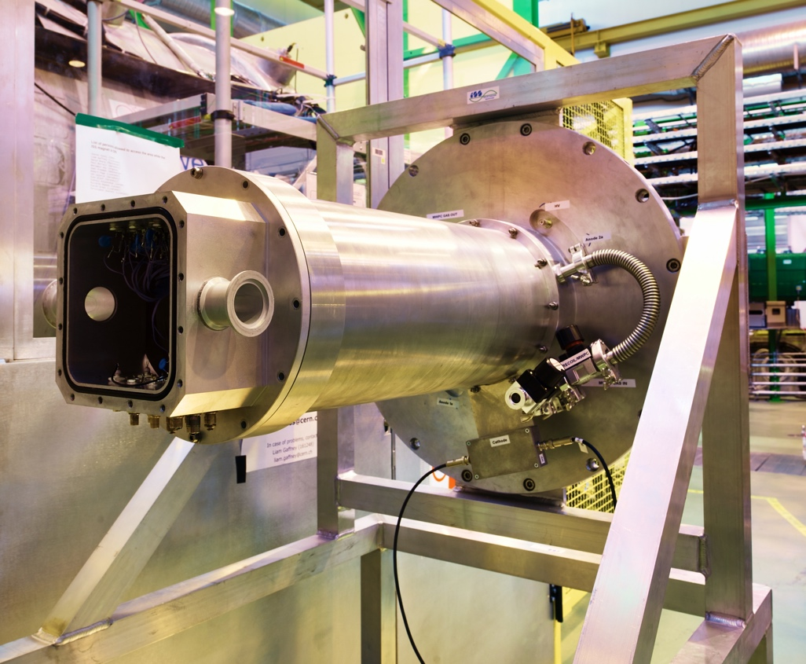

Bragg ionisation chamber for recoil detection
Fast-counting Bragg ionisation chamber used to diagnose beam composition in Kr experiments in 2022.
  Short T_{1/2} + charge breeding = in-trap decay (Rb daughter)
  Event-by-event selection wasn’t possible due to pileup.
  High instantaneous rates from EBIS + insufficient blocking of direct beam → output of preamps saturating.
  Faster preamps installed + 2D beam blocker mechanism.
  Improvements to Mylar windows to reduce leak rate.
¹⁸⁸Hg
⁹⁴Rb
⁹⁴Kr
Second RIB experiment of the year
Scheduled 15th – 20th August 2025
Work done in Manchester by Frank Browne and Michał Włodarczyk
¹⁸⁸Hg
⁹⁴Rb
⁹⁴Kr

Slide 15
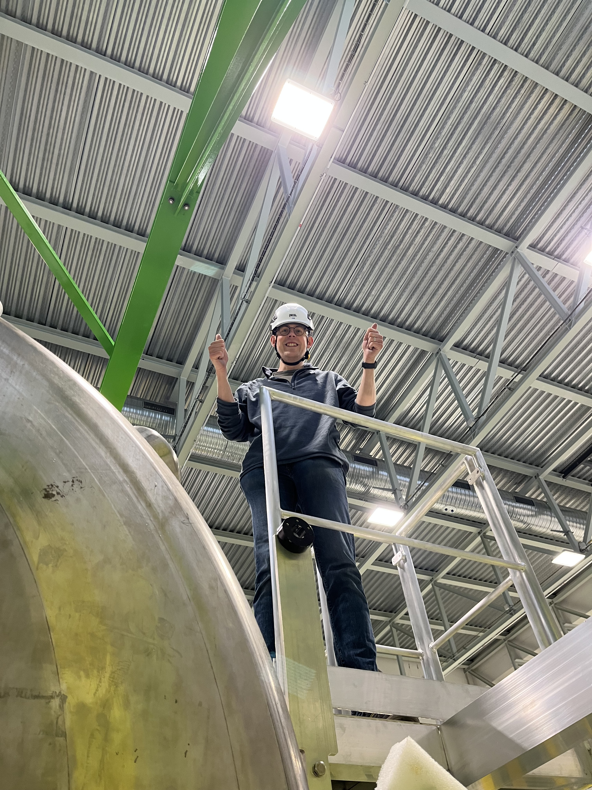
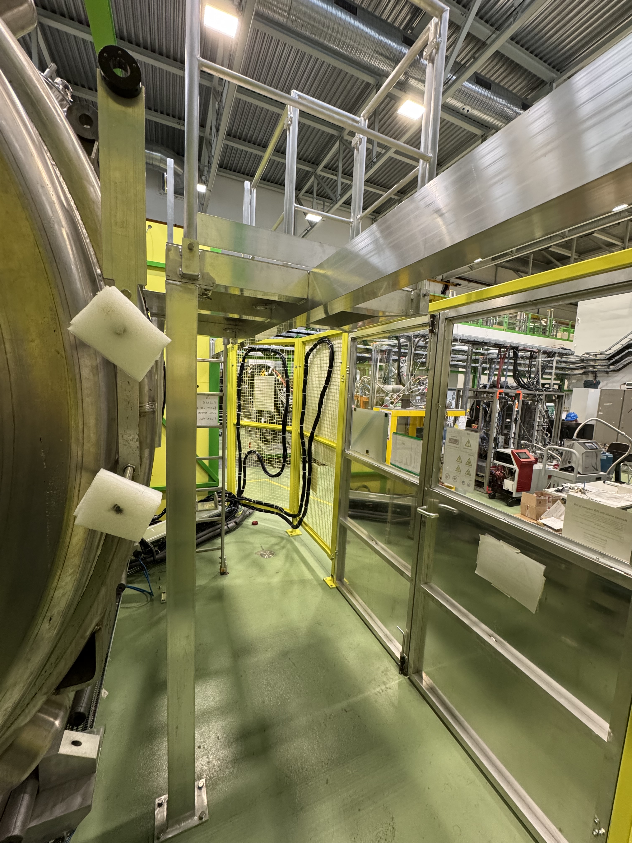
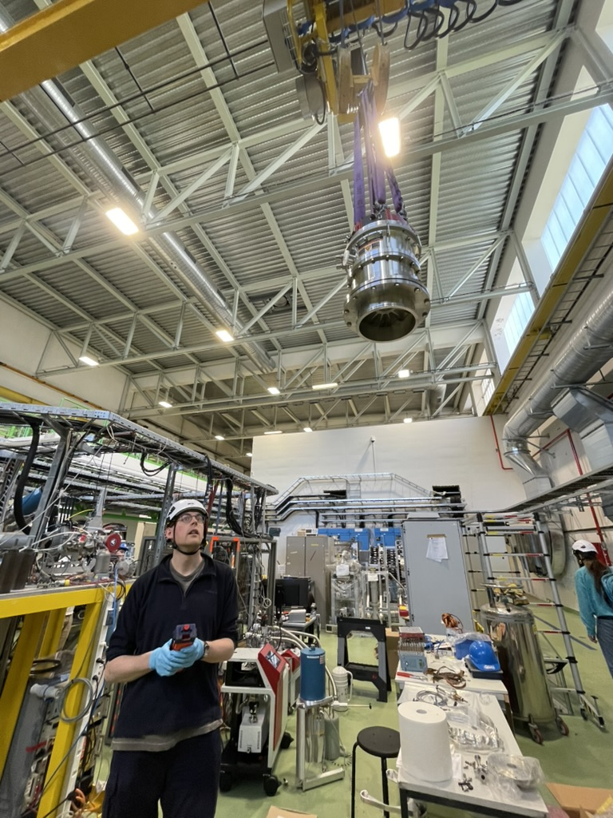
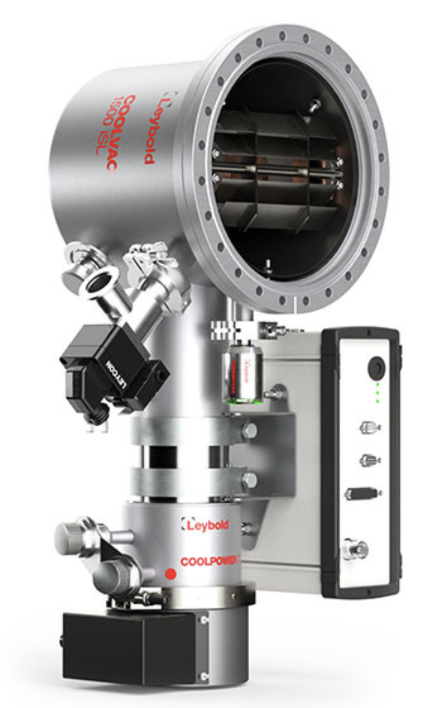
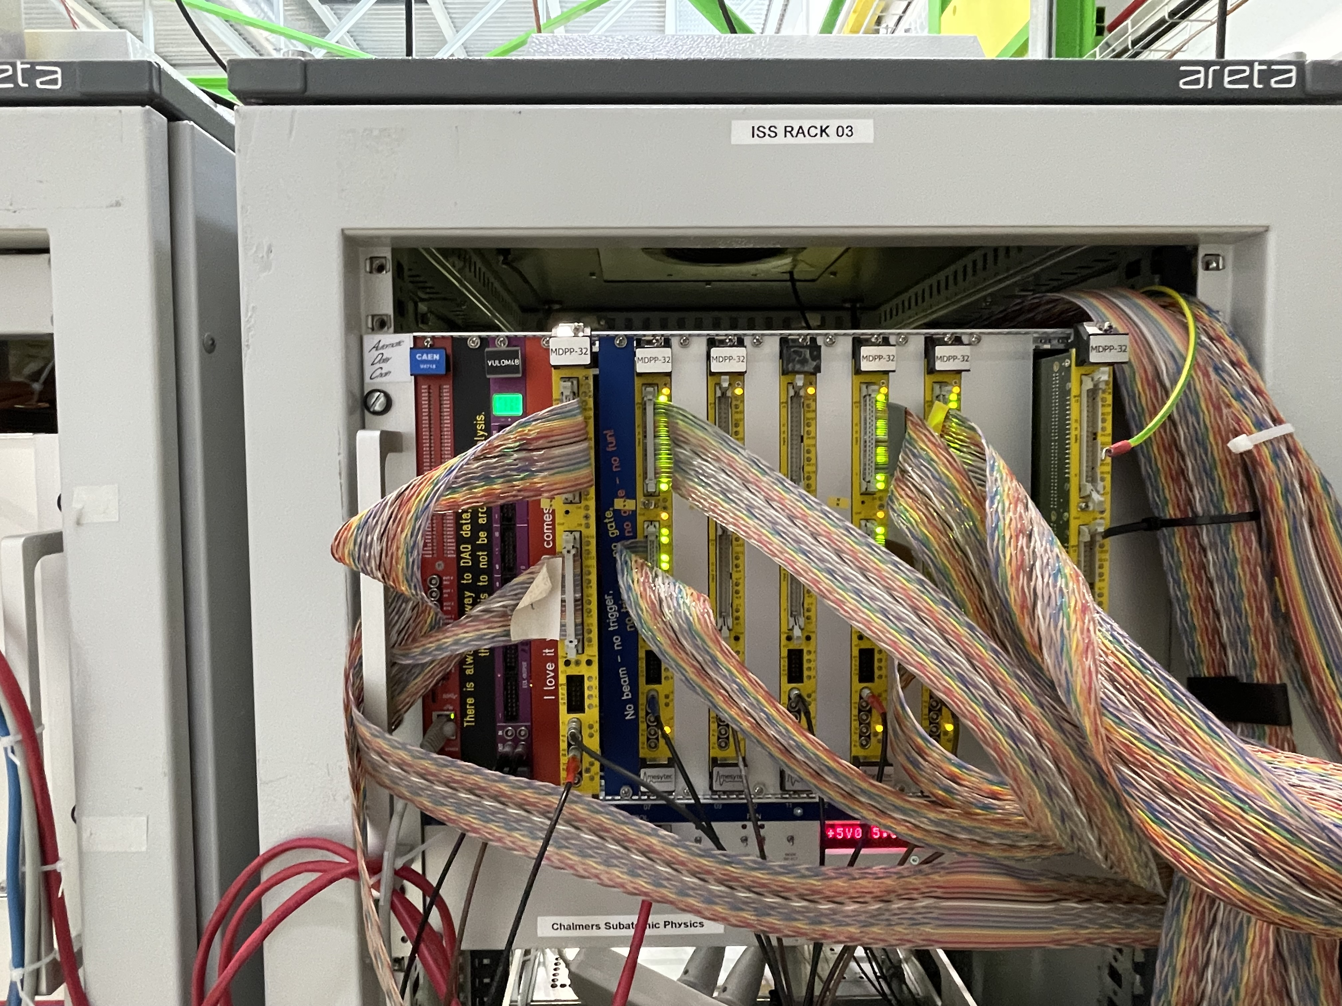
And some technical updates
Photo by Anna Kawecka
New safety platform installed for filling and energising the magnet.
  Financial contributions from EP Safety and ISOLDE for infrastructure [~6 kCHF].
  Future helium refills to be performed by collaboration, not CERN cryo group!
Strict vacuum requirements from HIE-ISOLDE (8 x 10⁻⁷ mbar) for 2025.
  New, bigger turbo pump (2200 l/s N₂) from STFC Daresbury [~25 kCHF]
  Cryogenic pump and compressor (4600 l/s H₂O) from Liverpool [~50 kCHF]
Implementation of additional 256+ digitiser channels.
  Mesytec-based DAQ developed by Chalmers [~150 kCHF].
  iSeg HV mainframe to cover all silicon biasing [~50 kCHF].
  Talk by Håkan Johansson later today on details.
Big Ted ->
<- Patrick MacGregor
Mesytec DAQ ->
<- Cryo pump

Slide 16
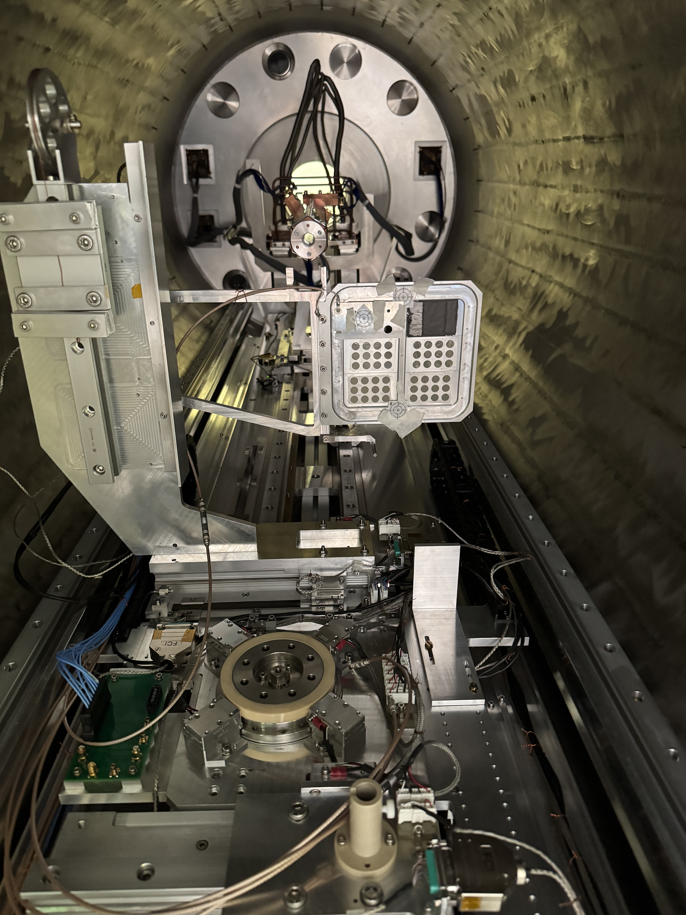
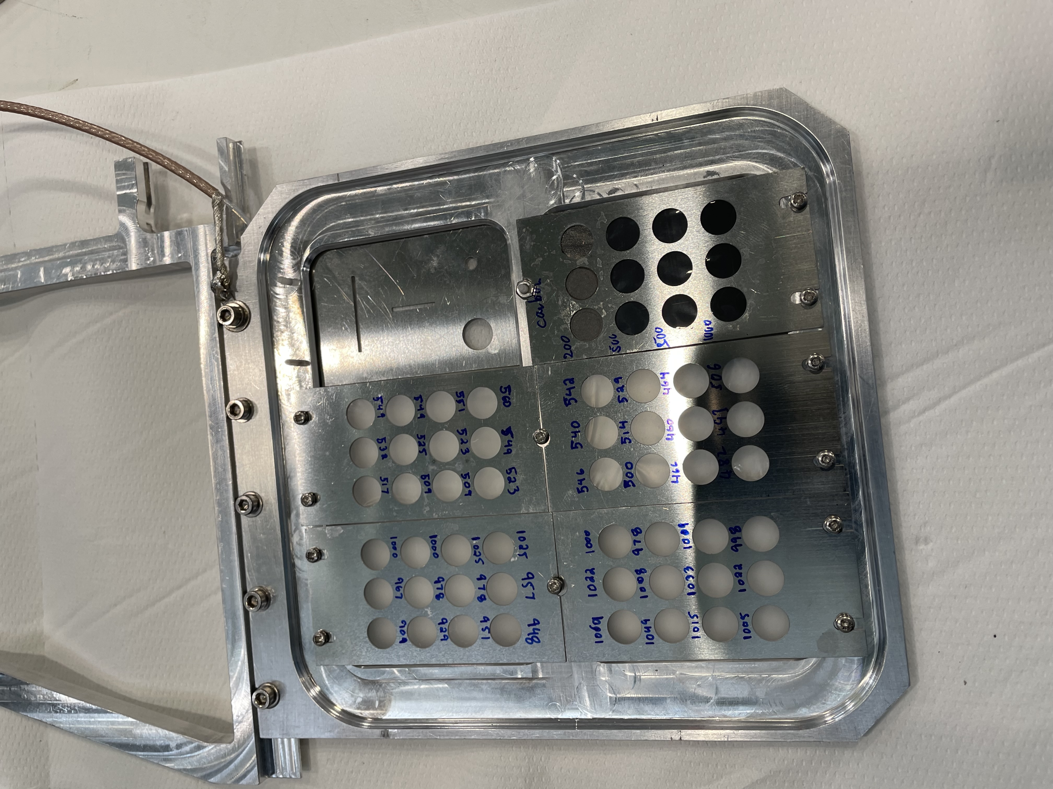
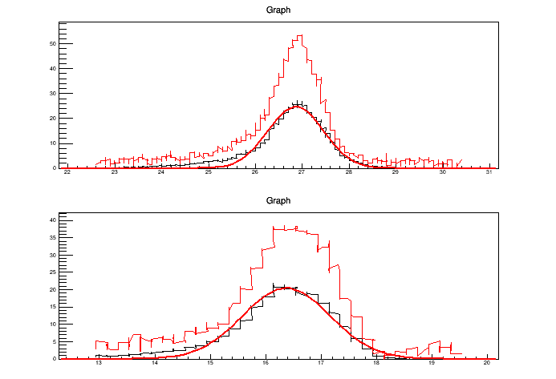
More technical updates
New 2-dimensional target ladder gives access to 60 target positions, as well as beam profile scans at target position.
  Funded by Manchester, designed and built in Daresbury [35 kCHF].
All safety files and procedures updated to CERN standards and approved for operation. Massive thanks to Patrick MacGregor!!
  Tasks on experiment must follow procedure and be conducted by a competent person, with correct training levels and PPE.
Vertical profile
FWHM = 1.9 mm
Horizontal profile
FWHM = 1.4 mm
Beam profile analysis by Hans Törnqvist

Slide 17
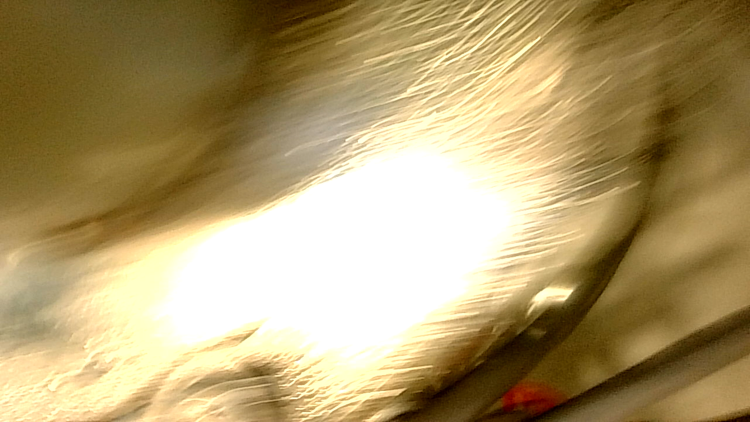
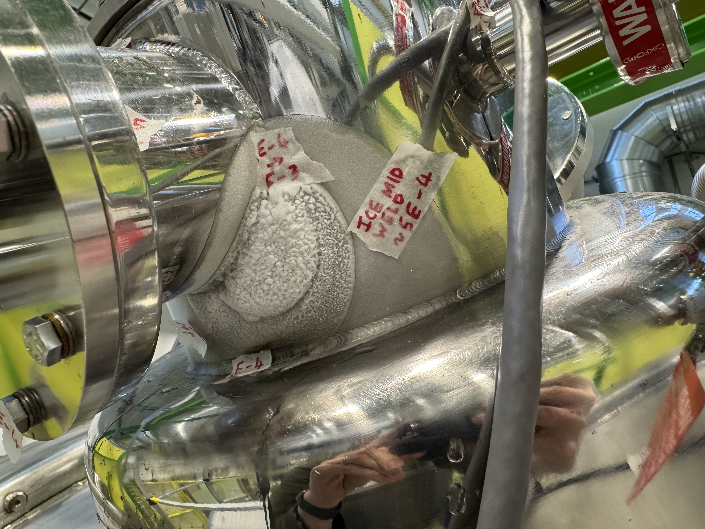
More technical updates
Some emerging issues with cold spots on magnet turret.
  Endoscopic camera revealed build up of ice inside of the cryostat, which can degrade performance.
  Possible issues with helium filling and energising.
Discussions on-going about consolidation and refurbishment actions to be taken in LS3.
  Avoid full warm-up cycle if at all possible!
  Use warm He gas through a lance to clear ice.
  Reconciliation of cold-head, switch from Leybold -> Sumitomo.
  Cost planned to be covered by ISS M&O [~40 kCHF].

Slide 18
Summary and outlook
Lots of physics done so far, but busy running periods mean learning “on the job”.
  5-7 experiments per year; local workforce: ~1 research fellow + ~1-2 PhD students on LTA.
  Collaboration sending people for maintenance, setup, beam time, is crucial to the on-going success of the experiment. It cannot run without an active collaboration to keep it alive and kicking.
  Big thanks to all who have contributed to setup and operations so far!
Building larger collaboration has been powerful to bring complementary tools:
  SpecMAT active target led by KU Leuven
  Fission fragment led by Chalmers University of Technology
  CeBr₃ γ-ray spectrometer from KU Leuven and Chalmers
  Tritium target purchased by CSIC-IEM and to be used in two (t,p) experiments
  we’re open to new ideas and willing to help with the integration of new equipment.
Long shutdown at ISOLDE for 2026-27; an opportunity to work on upgrades and reconciliation
  new silicon array, cryo system refurbishment, flammable gas systems, etc.
Physics opportunities exist for more than a decade when we return. If we are to take advantage of them, we need to grow the resources available (people, time, finance).

Slide 19
ISS Backup slides

Slide 20
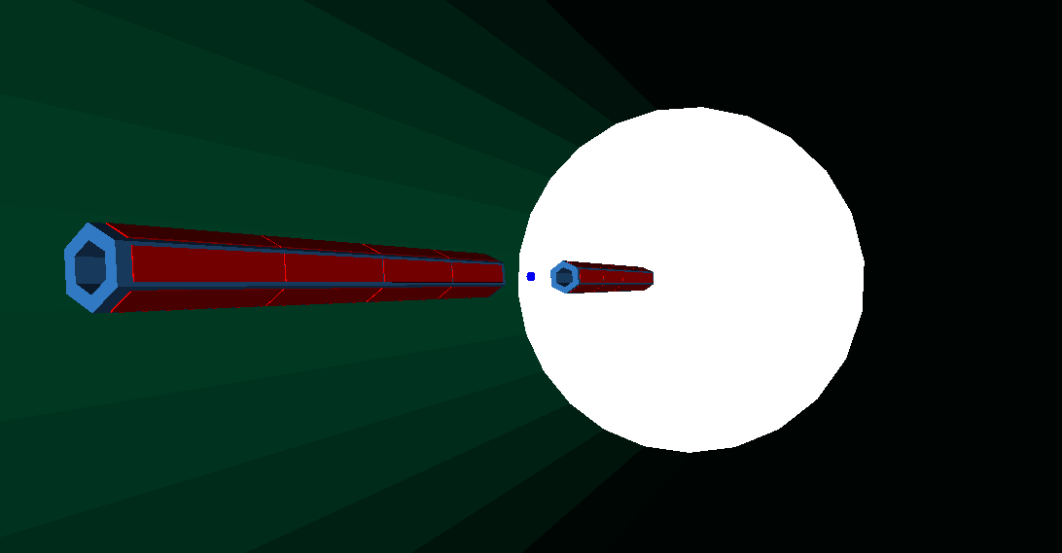

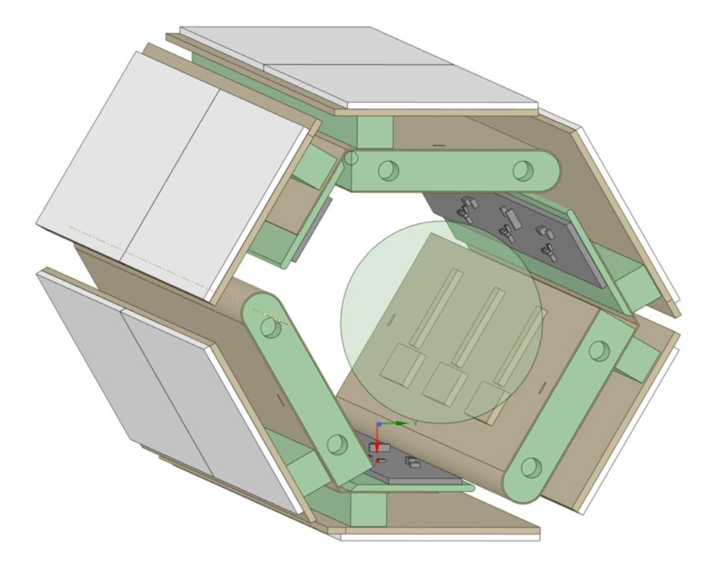


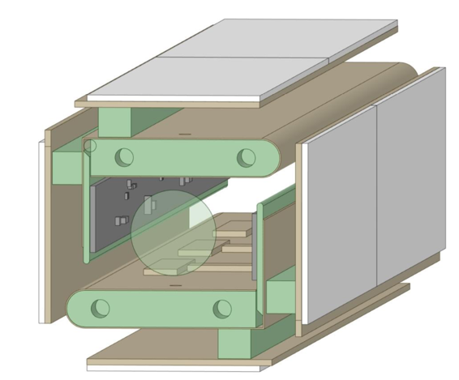
Dual array setup
M. Labiche (May 2015)
Sensitive reaction channel selection…
  Breakup following transfer, e.g. ⁷Be(d,p)⁸Be → 2α or 7Li+p
  Large angular coverage for 2α (forwards) and p (backwards)
Surrogate (n,p) and (n,α) reactions for astrophysics…
  Charge exchange with “extra” proton → (d,²He).
  Correlated protons in forward/backwards directions.
Demonstrator device to be built as proof-of-concept with stable beams during CERN’s LS3 (2026).
Royal Society grant (Liverpool) to test design options: nTD silicon (Micron) for PID; hybrid ASIC+digitiser for optimal timing/position/energy resolution.
Expandable to full array in the future with modular design (project bid).

Slide 21

Direct reactions around the Coulomb barrier
Access to variety of nuclear structure and nuclear astro information.
Single-particle states, E_{(Ex,SP)}, ℓ, spectroscopic factors, e.g. (d,p), (p,d)…
Pair-correlations, E_{(Ex)}, ℓ, e.g. (p,t), (t,p)…
Collective properties via e.g. (p,p$′$), (d,d$′$), ($α$,$α′$), Coulex…
Need for multiple spectrometers/facilities to cover range of isotopes and energies.
Figure courtesy of Ben Kay (ANL)
ISS @ CERN
FAUST @ FRIB
Beam energy (MeV)

Slide 22


Proof-of-principle experiment at ISS
Stable beam following CERN’s LS2 in 2021… ²²Ne at 6.05 MeV/u.
  Matching normal kinematics study with gas target! [H.F. Lutz et al. NPA 95 (1967) 591]
  Implementation of precise energy calibration, pulse-height corrections, energy loss corrections, kinematic reconstruction
²²Ne(d,p)²³Ne
²²Ne(d,p)²³Ne
4270 keV
3218 keV
3422 keV
FWHM ~110 keV
1017 keV
0 keV
0 keV
2315 keV
5185 keV
1822 keV
1017 keV
2315 keV
3218 keV
Full code available: https://github.com/ISOLDESolenoidalSpectrometer/ISSSort

Slide 23



Proof-of-principle experiment at ISS
Stable beam following CERN’s LS2 in 2021… ²²Ne at 6.05 MeV/u.
  Matching normal kinematics study with gas target! [H.F. Lutz et al. NPA 95 (1967) 591]
  Implementation of precise energy calibration, pulse-height corrections, energy loss corrections, kinematic reconstruction
²²Ne(d,p)²³Ne
Full code available: https://github.com/ISOLDESolenoidalSpectrometer/ISSSort

Slide 24


Onset of deformation at N=60 – ⁹²Kr(d,p)⁹³Kr
7 states populated up to ~1 MeV; known energy from β-decay studies.
  12 new states populated up to S_{n}.
Angular distributions give definitive ℓ assignments.
  Locate ℓ=4 strength to observe g_{7/2} evolution
Analysis by Annie Dolan (Liverpool)
⁹³Kr
S_{n}
⁹⁴Rb
1029 keV
⁹⁴Kr
1264 keV
805 keV
⁹³Kr
1103 keV
(3/2⁺,7/2⁺)
710 keV
(3/2⁺,7/2⁺)
359 keV
(7/2⁺)
355 keV
556 keV
(3/2⁺)
117 keV
355 keV
352 keV
g_{7/2}
1/2⁺
0 keV
⁹³Kr
117 keV
d_{3/2}
0 keV
0 keV
0 keV
s_{1/2}
⁹³Kr
⁹⁵Sr
⁹⁷Zr

Slide 25




Onset of deformation at N=60 – ⁹²Kr(d,p)⁹³Kr
7 states populated up to ~1 MeV; known energy from β-decay studies.
  12 new states populated up to S_{n}.
Angular distributions give definitive ℓ assignments.
Analysis by Annie Dolan (Liverpool)
⁹³Kr
S_{n}
¹⁸⁸Hg
⁹⁴Rb
DWBA analysis to extract SFs.
⁹⁴Kr
0 keV
Resolved doublet
νg_{7/2} strength found!
Cross section (mb/sr)
117 keV
355 keV
Centre of mass angle (˚)

Slide 26

Multi-turns and protons in CD₂
Plot courtesy of Kris Haverson (Sheffield Hallam)
Experiment IS692 ⁷Be(d,p)⁸Be* (PIs: R. Smith + M. Gai)

Slide 27

Transfer-induced fission

Slide 28

Transfer-induced fission

Slide 29



CeBr₃ detector for SpecMAT
Primary bias stabiliser
Temperature compensated secondary bias generator
Built-in preamplifier
8×8 6mm J-series SiPM array
(SiPM Silicone Photo Multiplier)
48×48×48mm cubic CeBr₃ scintillation crystal
All components can be used in a strong magnetic field

Slide 30


Physics so far
2018 Campaign achieved with HELIOS array + DAQ
Neutron states above N=126
Single-particle states along Z=50
rp-process
Onset of deformation in Kr isotopes
New magic numbers in Ca
Semi-magic ⁶⁸Ni
N=20 island of inversion
Rotational states in ⁸Be
Structure of ¹²Be

Slide 31

Onset of deformation at N=60 – ⁹²Kr(d,p)⁹³Kr
Sr and Zr show rapid and dramatic onset of deformation at N=60.
Smooth increase for the Kr isotopic chain¹.
Low-lying intruder configurations → shape coexistence^{2,3}
Proton excitations across Z = 40 to πg_{9/2}.
  Ground-state configuration at N = 60.
  Filling neutron orbitals lowers energy of πg_{9/2}.
  Large overlap of πg_{9/2} and νg_{7/2}…
  Tensor force⁴ → Type-II shell evolution⁵
Close proximity of νs_{1/2}, νd_{3/2}, νg_{7/2}, νh_{11/2} orbitals.
  Enhanced quadrupole interaction from coherent contributions → deformation
¹ M. Albers, et al., Phys. Rev. Lett. 108, 062701 (2012).
² J.E. García-Ramos and K. Heyde, Phys. Rev. C 100, 044315 (2019).
³ P.E. Garrett, M. Zielińska, and E. Clément, Prog. Part. Nucl. Phys. 163, 103931 (2021).
⁴ P. Federman and S. Pittel, Phys. Lett. B 69, 385 (1977).
⁵ T. Togashi, Y. Tsunoda, T. Otsuka, and N. Shimizu, Phys. Rev. Lett. 117, 172502 (2016).

Slide 32

Gamma-ray detection with CeBr scintillators

Slide 33

Module assembly (LSDC) – Oct 2018

Slide 34




Module assembly – June 2018

Slide 35

Completed module – Nov 2018

Slide 36
ISOLDE – FRIB/REA Comparison
RADIOACTIVE BEAM | NOW |  |  |  | LATER
 | HIGH ENERGY MEV/A |  | LOW ENERGY 10s KEV |  | HIGH ENERGY MEV/A |  | LOW ENERGY 10s KEV
 | HIE- ISOLDE RUN3 ACTUAL (pps) | FRIB PAC2 (pps) | ISOLDE low energy (pps) | FRIB PAC2 (pps) | HIE-ISOLDE RUN4 (pps) | FRIB Ultimate (pps) | ISOLDE low energy RUN4 (pps) | FRIB Ultimate 2033? (pps)
7Be | 3.00E+06 | 2.00E+04 | 6.00E+07 | 2.00E+04 | 6.78E+06 | 9.00E+05 | 1.36E+08 | 9.00E+05
11Be | 8.00E+05 | 2.40E+04 | 1.60E+07 | 2.40E+04 | 2.88E+06 | 9.60E+05 | 5.76E+07 | 9.60E+05
27Na | 8.00E+05 | 1.70E+05 | 1.60E+07 | 1.70E+05 | 2.88E+06 | 6.90E+06 | 5.76E+07 | 6.90E+06
30Mg | 5.00E+05 | 1.00E+05 | 1.00E+07 | 1.00E+05 | 1.70E+06 | 5.00E+05 | 3.40E+07 | 5.00E+05
49Ca | 3.00E+05 | 5.00E+06 | 6.00E+06 | 5.00E+06 | 8.10E+05 | 2.00E+08 | 1.62E+07 | 2.00E+08
50Ca | 6.00E+03 | 1.00E+04 | 1.20E+05 | 1.00E+04 | 1.36E+04 | 4.00E+05 | 2.71E+05 | 4.00E+05
61Zn | 4.00E+05 | 1.50E+06 | 8.00E+06 | 1.50E+06 | 8.00E+05 | 5.00E+07 | 1.60E+07 | 5.00E+07
68Ni | 3.00E+04 | 2.20E+06 | 6.00E+05 | 2.20E+06 | 6.00E+04 | 9.00E+07 | 1.20E+06 | 9.00E+07
94Kr | 1.00E+05 | 5.90E+02 | 2.00E+06 | 5.90E+02 | 2.40E+05 | 2.30E+04 | 4.80E+06 | 2.30E+04
110Sn | 1.00E+07 | 6.50E+06 | 2.00E+08 | 6.50E+06 | 3.40E+07 | 2.60E+08 | 6.80E+08 | 2.60E+08
206Hg | 8.00E+05 | 8.8 | 1.60E+07 | 8.8 | 1.60E+06 | 3.60E+02 | 3.20E+07 | 3.60E+02
212Rn | 5.00E+06 | 9.70E+04 | 1.00E+08 | 9.70E+04 | 1.00E+07 | 3.90E+06 | 2.00E+08 | 3.90E+06
Conclusion:
complementary facilities
Notes:
(i) ISOLDE Actual = measured rates at ISS during experiments 2021-23
(ii) FRIB PAC 2 = predicted FRIB rates with 5-10kW on target (FRIB Website 2023)
(iii) ISOLDE RUN 4 = predicted gain from 1.4 to 2 GeV with x2 proton intensity (N.B. Isotopes farthest from stability benefit most - not these ones!)
(iv) FRIB Ultimate = predicted rates with 400 kW on target in next decade? (FRIB Website 2023)
(v) assumed EBIS+LINAC efficiency is 5%
(vi) assumed same efficiency for FRIB stopping fragments and re-acceleration to tens keV and several MeV/A
(vii) if within a factor of two call it a draw

