Slide 1
WDP removal of TAN

Slide 2
P1
Two TAN to remove from P1 and to bring to P6
Road transport with the TAN inside of an IP2 container

Slide 3
Step | Description | Responsible | Work Teams | Workers | Number of participants | Working position | Dose rate [µSv/h] | Exposure time coefficient | Estimated expsure time [min] | Estimated total step exposure time [person.h] | Estimated dose [person.µSv/h] | Estimated total step dose [µSv] | Expected start date
10 | Preparation activities for the removal
11 | Bring the material to RI132/ RI171 from PM15 | EN-HE | EN-HE | Operator 1 Operator 2 Operator 3 | 3 | Transport corridor |  |  | 20

Slide 4
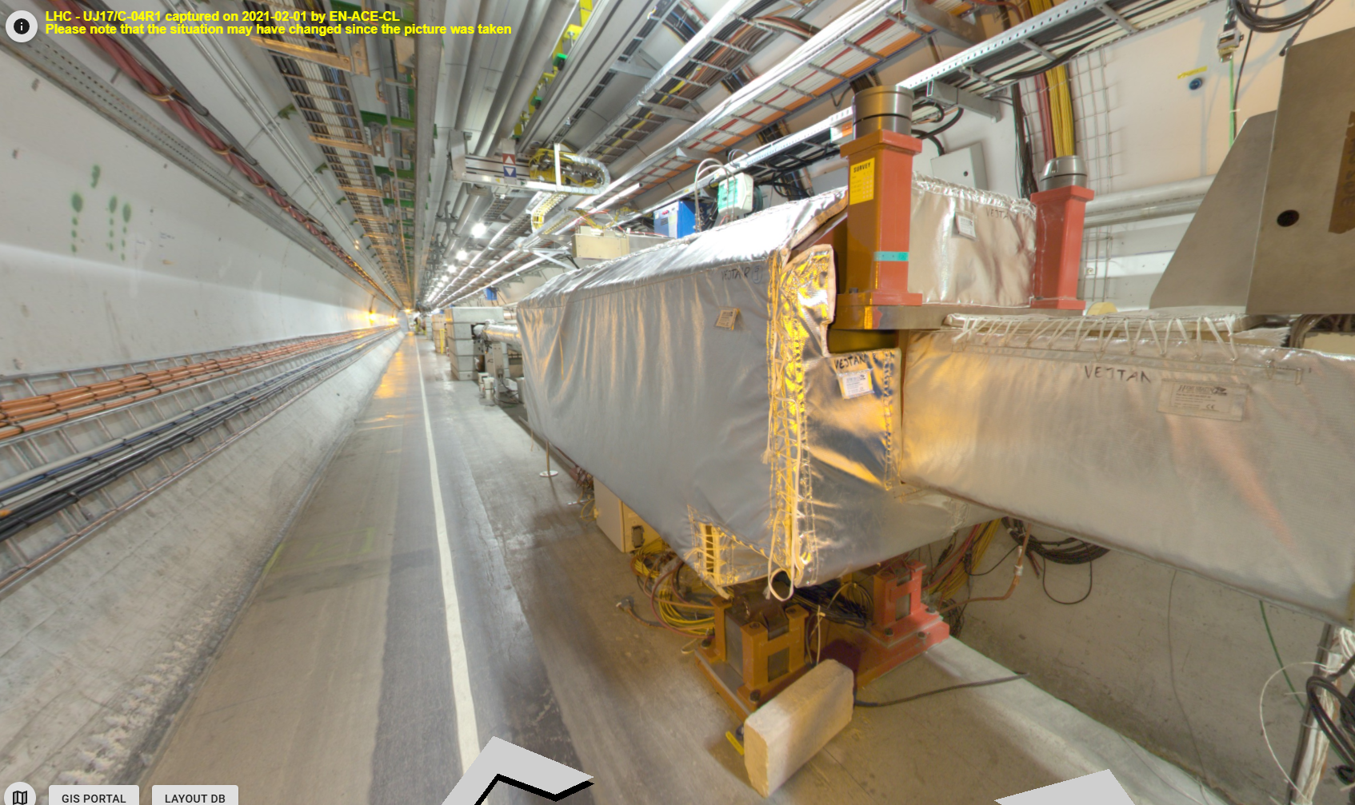
Step | Description | Responsible | Work Teams | Workers | Number of participants | Working position | Dose rate [µSv/h] | Exposure time coefficient | Estimated expsure time [min] | Estimated total step exposure time [person.h] | Estimated dose [person.µSv/h] | Estimated total step dose [µSv] | Expected start date
10 | Preparation activities for the removal
12 | Draw in the floor the location of the rails | EN-HE | EN-HE | Operator 1 Operator 2 | 2 | In front of the TAN and under the TAN |  |  | 5

Slide 5
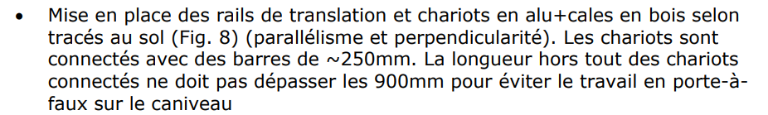
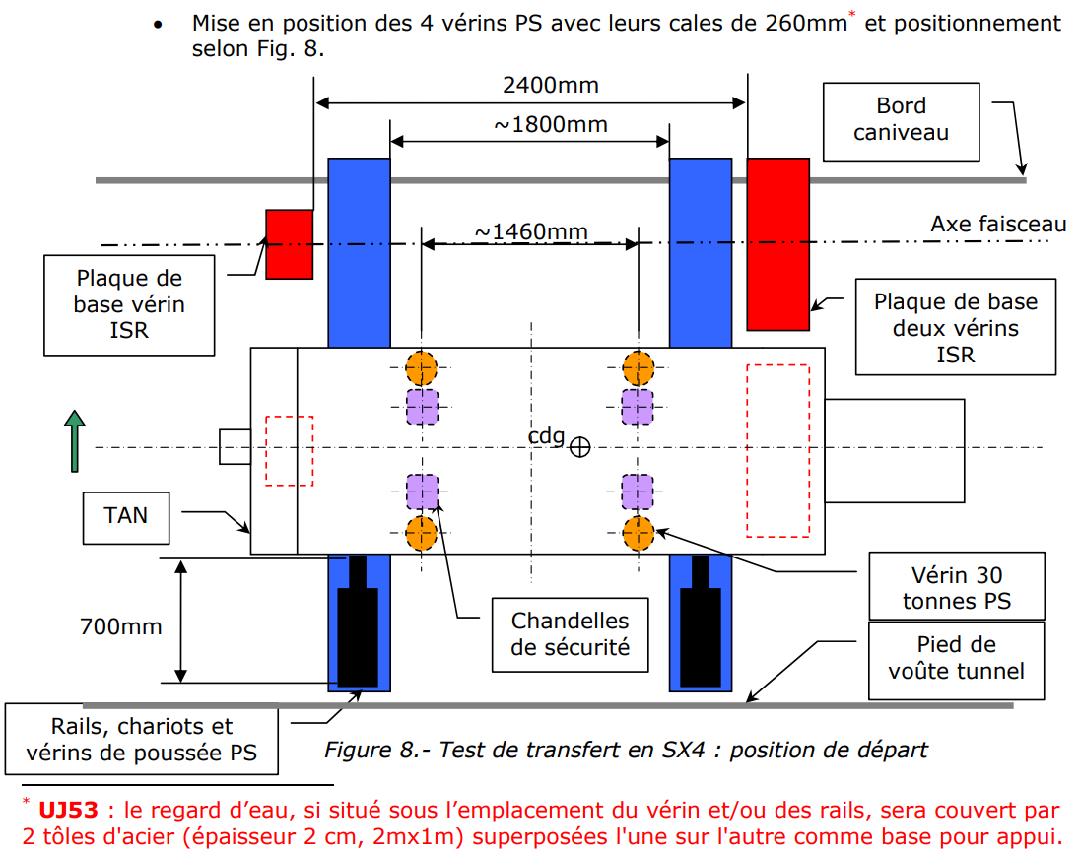
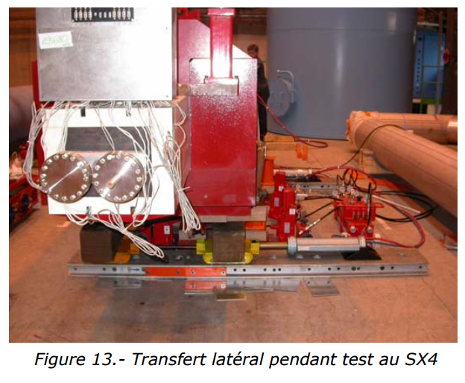
Step | Description | Responsible | Work Teams | Workers | Number of participants | Working position | Dose rate [µSv/h] | Exposure time coefficient | Estimated expsure time [min] | Estimated total step exposure time [person.h] | Estimated dose [person.µSv/h] | Estimated total step dose [µSv] | Expected start date
10 | Preparation activities for the removal
13 | Install the rails + trolleys | EN-HE | EN-HE | Operator 1 Operator 2 Operator 3 | 3 | In front of the TAN and under the TAN |  |  | 60 | 13 | Install the rails + trolleys | EN-HE | EN-HE

Slide 6
Step | Description | Responsible | Work Teams | Workers | Number of participants | Working position | Dose rate [µSv/h] | Exposure time coefficient | Estimated expsure time [min] | Estimated total step exposure time [person.h] | Estimated dose [person.µSv/h] | Estimated total step dose [µSv] | Expected start date
10 | Preparation activities for the removal
14 | Install the PS jacks + safety system | EN-HE | EN-HE | Operator 2 Operator 3 | 2 | In front of the TAN and under the TAN |  |  | 15

Slide 7

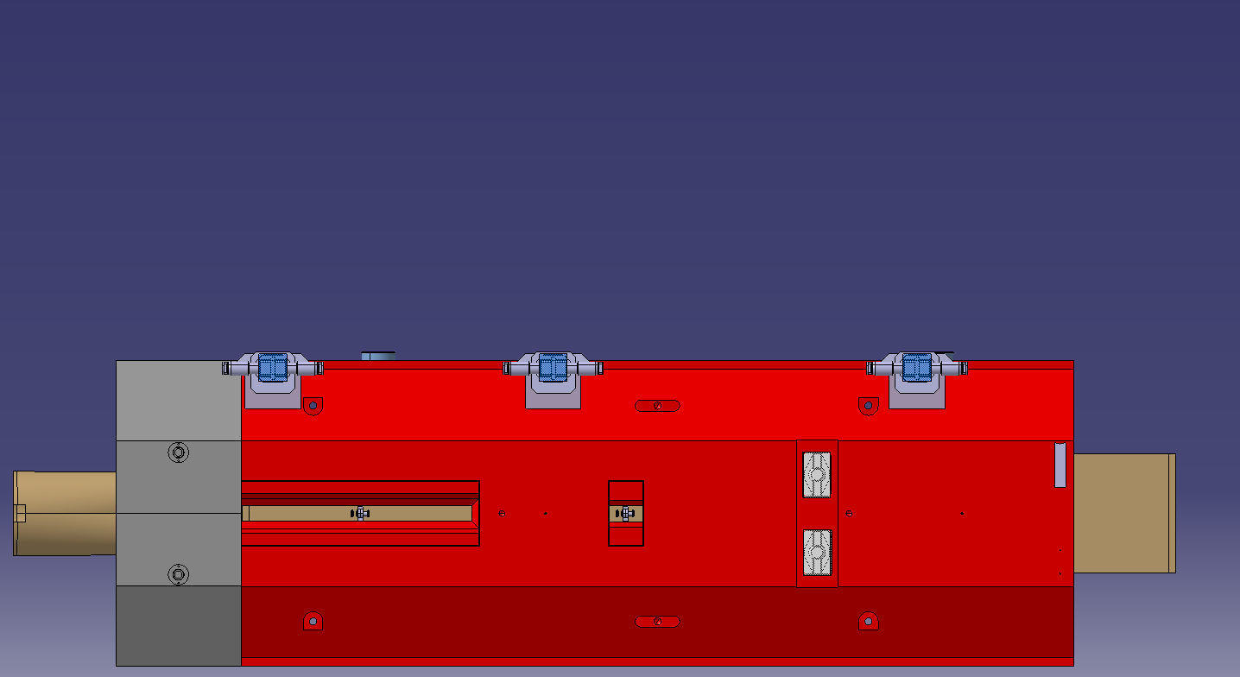

Step | Description | Responsible | Work Teams | Workers | Number of participants | Working position | Dose rate [µSv/h] | Exposure time coefficient | Estimated expsure time [min] | Estimated total step exposure time [person.h] | Estimated dose [person.µSv/h] | Estimated total step dose [µSv] | Expected start date
20 | Removal of TAN
21 | Lifting TAN with PS jacks (1) | EN-HE | EN-HE | Operator 1 Operator 2 Operator 3 Operator 4 | 4 | 1 Person in the transport side controlling the lifting 3 people in the lateral sides of the TAN actuating the jacks |  |  | 15

Slide 8
Step | Description | Responsible | Work Teams | Workers | Number of participants | Working position | Dose rate [µSv/h] | Exposure time coefficient | Estimated expsure time [min] | Estimated total step exposure time [person.h] | Estimated dose [person.µSv/h] | Estimated total step dose [µSv] | Expected start date
20 | Removal of TAN
22 | Introduction of the aluminium trolleys | EN-HE | EN-HE | Operator 1 Operator 2 Operator 3 | 3 | 2 operators under the Tan 1 operator in the transpor side |  |  | 10

Slide 9
Step | Description | Responsible | Work Teams | Workers | Number of participants | Working position | Dose rate [µSv/h] | Exposure time coefficient | Estimated expsure time [min] | Estimated total step exposure time [person.h] | Estimated dose [person.µSv/h] | Estimated total step dose [µSv] | Expected start date
20 | Removal of TAN
23 | Pass the weight from the PS jacks to the trolleys | EN-HE | EN-HE | Operator 1 Operator 2 Operator 3 Operator 4 | 4 | 1 Person in the transport side controlling the lifting 3 people in the lateral sides of the TAN actuating the jacks |  |  | 10

Slide 10
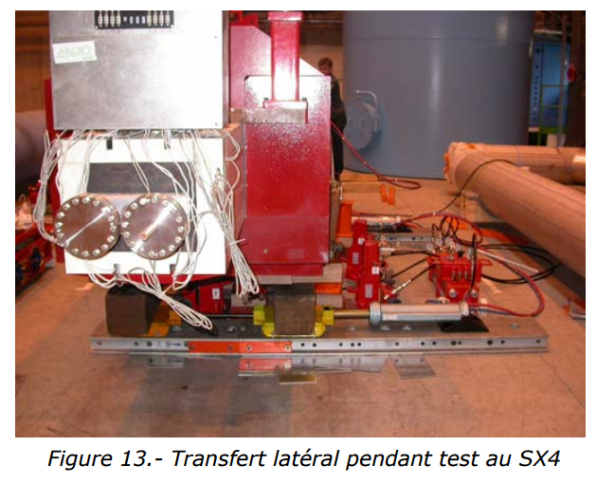
Step | Description | Responsible | Work Teams | Workers | Number of participants | Working position | Dose rate [µSv/h] | Exposure time coefficient | Estimated expsure time [min] | Estimated total step exposure time [person.h] | Estimated dose [person.µSv/h] | Estimated total step dose [µSv] | Expected start date
20 | Removal of TAN
24 | Lateral transfer of the TAN | EN-HE | EN-HE | Operator 1 Operator 2 Operator 3 | 3 | In the sides of the TAN |  |  | 20

Slide 11
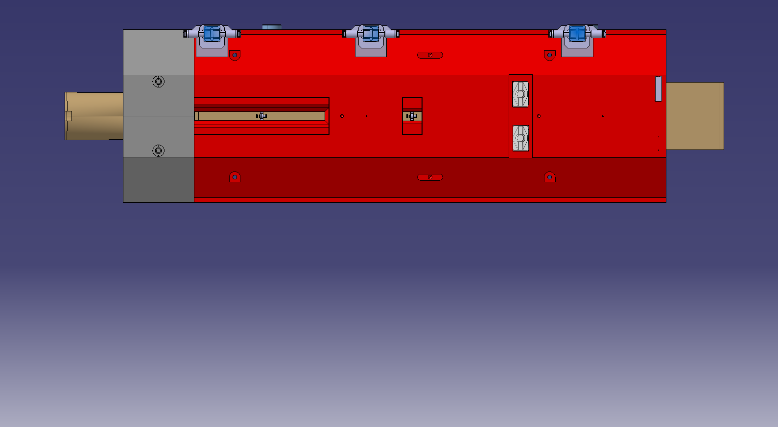
Step | Description | Responsible | Work Teams | Workers | Number of participants | Working position | Dose rate [µSv/h] | Exposure time coefficient | Estimated expsure time [min] | Estimated total step exposure time [person.h] | Estimated dose [person.µSv/h] | Estimated total step dose [µSv] | Expected start date
20 | Removal of TAN
25 | Installation of PS jacks | EN-HE | EN-HE | Operator 1 Operator 2 Operator 3 | 3 | In front of the TAN and under the TAN |  |  | 15 | 25 | Installation of PS jacks

Slide 12
Step | Description | Responsible | Work Teams | Workers | Number of participants | Working position | Dose rate [µSv/h] | Exposure time coefficient | Estimated expsure time [min] | Estimated total step exposure time [person.h] | Estimated dose [person.µSv/h] | Estimated total step dose [µSv] | Expected start date
20 | Removal of TAN
26 | Lifting TAN with PS jacks (2) | EN-HE | EN-HE | Operator 1 Operator 2 Operator 3 Operator 4 | 4 | 1 Person in the transport side controlling the lifting 3 people in the lateral sides of the TAN actuating the jacks |  |  | 15

Slide 13
Step | Description | Responsible | Work Teams | Workers | Number of participants | Working position | Dose rate [µSv/h] | Exposure time coefficient | Estimated expsure time [min] | Estimated total step exposure time [person.h] | Estimated dose [person.µSv/h] | Estimated total step dose [µSv] | Expected start date
20 | Removal of TAN
27 | Transfer to rolling system | EN-HE | EN-HE | Operator 1 Operator 2 Operator 3 | 3 | In the sides of the TAN |  |  | 20

Slide 14
Step | Description | Responsible | Work Teams | Workers | Number of participants | Working position | Dose rate [µSv/h] | Exposure time coefficient | Estimated expsure time [min] | Estimated total step exposure time [person.h] | Estimated dose [person.µSv/h] | Estimated total step dose [µSv] | Expected start date
20 | Removal of TAN
28 | Removal of rails and jacks from under the TAN | EN-HE | EN-HE | Operator 1 Operator 2 Operator 3 | 3 | In front of the TAN and under the TAN |  |  | 30

Slide 15
Step | Description | Responsible | Work Teams | Workers | Number of participants | Working position | Dose rate [µSv/h] | Exposure time coefficient | Estimated expsure time [min] | Estimated total step exposure time [person.h] | Estimated dose [person.µSv/h] | Estimated total step dose [µSv] | Expected start date
20 | Removal of TAN
29 | Connection to tractor | EN-HE | EN-HE | Operator 3 | 1 | In the sides of the TAN |  |  | 5

Slide 16

Step | Description | Responsible | Work Teams | Workers | Number of participants | Working position | Dose rate [µSv/h] | Exposure time coefficient | Estimated expsure time [min] | Estimated total step exposure time [person.h] | Estimated dose [person.µSv/h] | Estimated total step dose [µSv] | Expected start date
30 | Transport in the tunnel
31 | Rolling from RI132/ RI171 to PM15. Speed 1km/h. Distance 150 m | EN-HE | EN-HE | Operator 5 | 1 | In front of the TAN in a tractor |  |  | 10
Minimum distance 1m, we can implement longer shafts and a shielding in the back of the tractor

Slide 17
Step | Description | Responsible | Work Teams | Workers | Number of participants | Working position | Dose rate [µSv/h] | Exposure time coefficient | Estimated expsure time [min] | Estimated total step exposure time [person.h] | Estimated dose [person.µSv/h] | Estimated total step dose [µSv] | Expected start date
40 | Lifting to surface
41 | Bolting lifting points and attaching slings | EN-HE | EN-HE | Operator 4 | 1 | Next to the TAN |  |  | 5

Slide 18
Step | Description | Responsible | Work Teams | Workers | Number of participants | Working position | Dose rate [µSv/h] | Exposure time coefficient | Estimated expsure time [min] | Estimated total step exposure time [person.h] | Estimated dose [person.µSv/h] | Estimated total step dose [µSv] | Expected start date
40 | Lifting to surface
42 | Lifting with mobile crane |  |  |  | 0 | 1 Operator in the surface looking inside the shaft 1 Operator under |  |  | 60
43 | Location in rollers/tailer (it needs to be pulled with a tractor to be inserted it in the container) | EN-HE | EN-HE | Operator 1 Operator 2 | 2 | In front of the TAN and under the TAN |  |  | 10

Slide 19
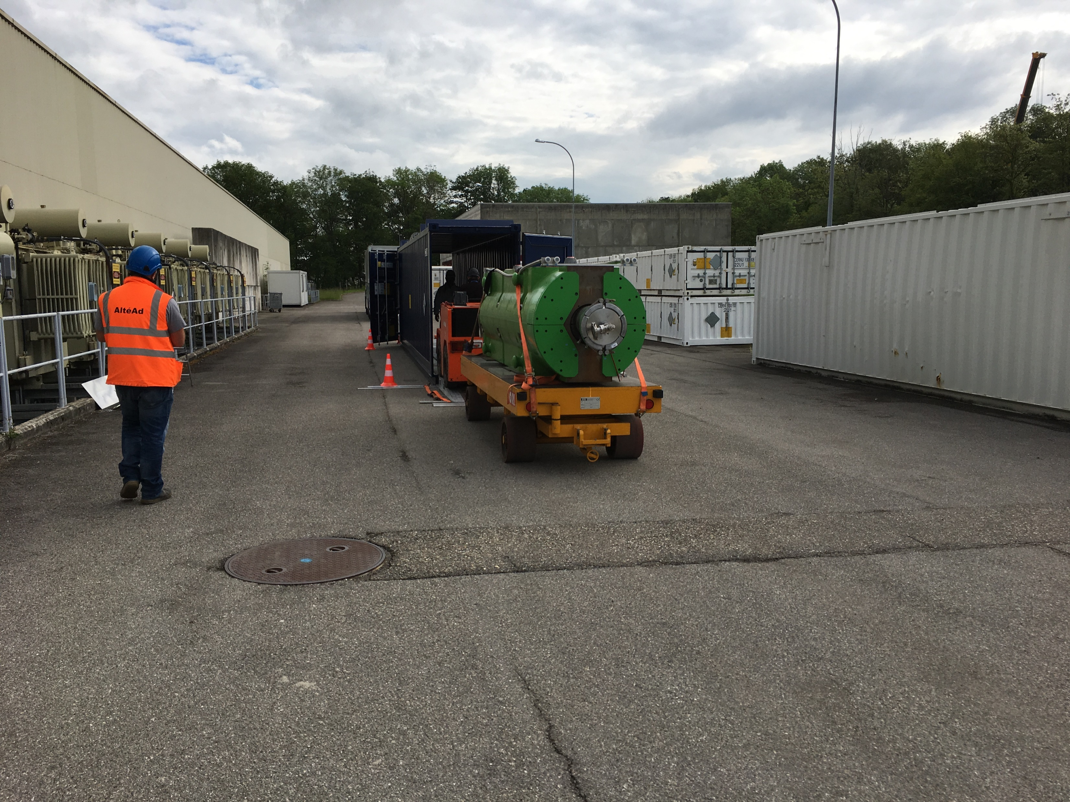
Step | Description | Responsible | Work Teams | Workers | Number of participants | Working position | Dose rate [µSv/h] | Exposure time coefficient | Estimated expsure time [min] | Estimated total step exposure time [person.h] | Estimated dose [person.µSv/h] | Estimated total step dose [µSv] | Expected start date
50 | Insertion in IP2 container
51 | Attachment of the TAN to a tractor | EN-HE | EN-HE | Operator 4 | 1 | In front of the TAN . Inside SD1 |  |  | 5
52 | Pull the TAN inside of the container, located in the parking | EN-HE | EN-HE | Operator 4 | 1 | In front of the TAN in a tractor. |  |  | 10
53 | De-attachment of the TAN from the tractor | EN-HE | EN-HE | Operator 4 | 1 | In front of the TAN . In the parking outside |  |  | 5

Slide 20
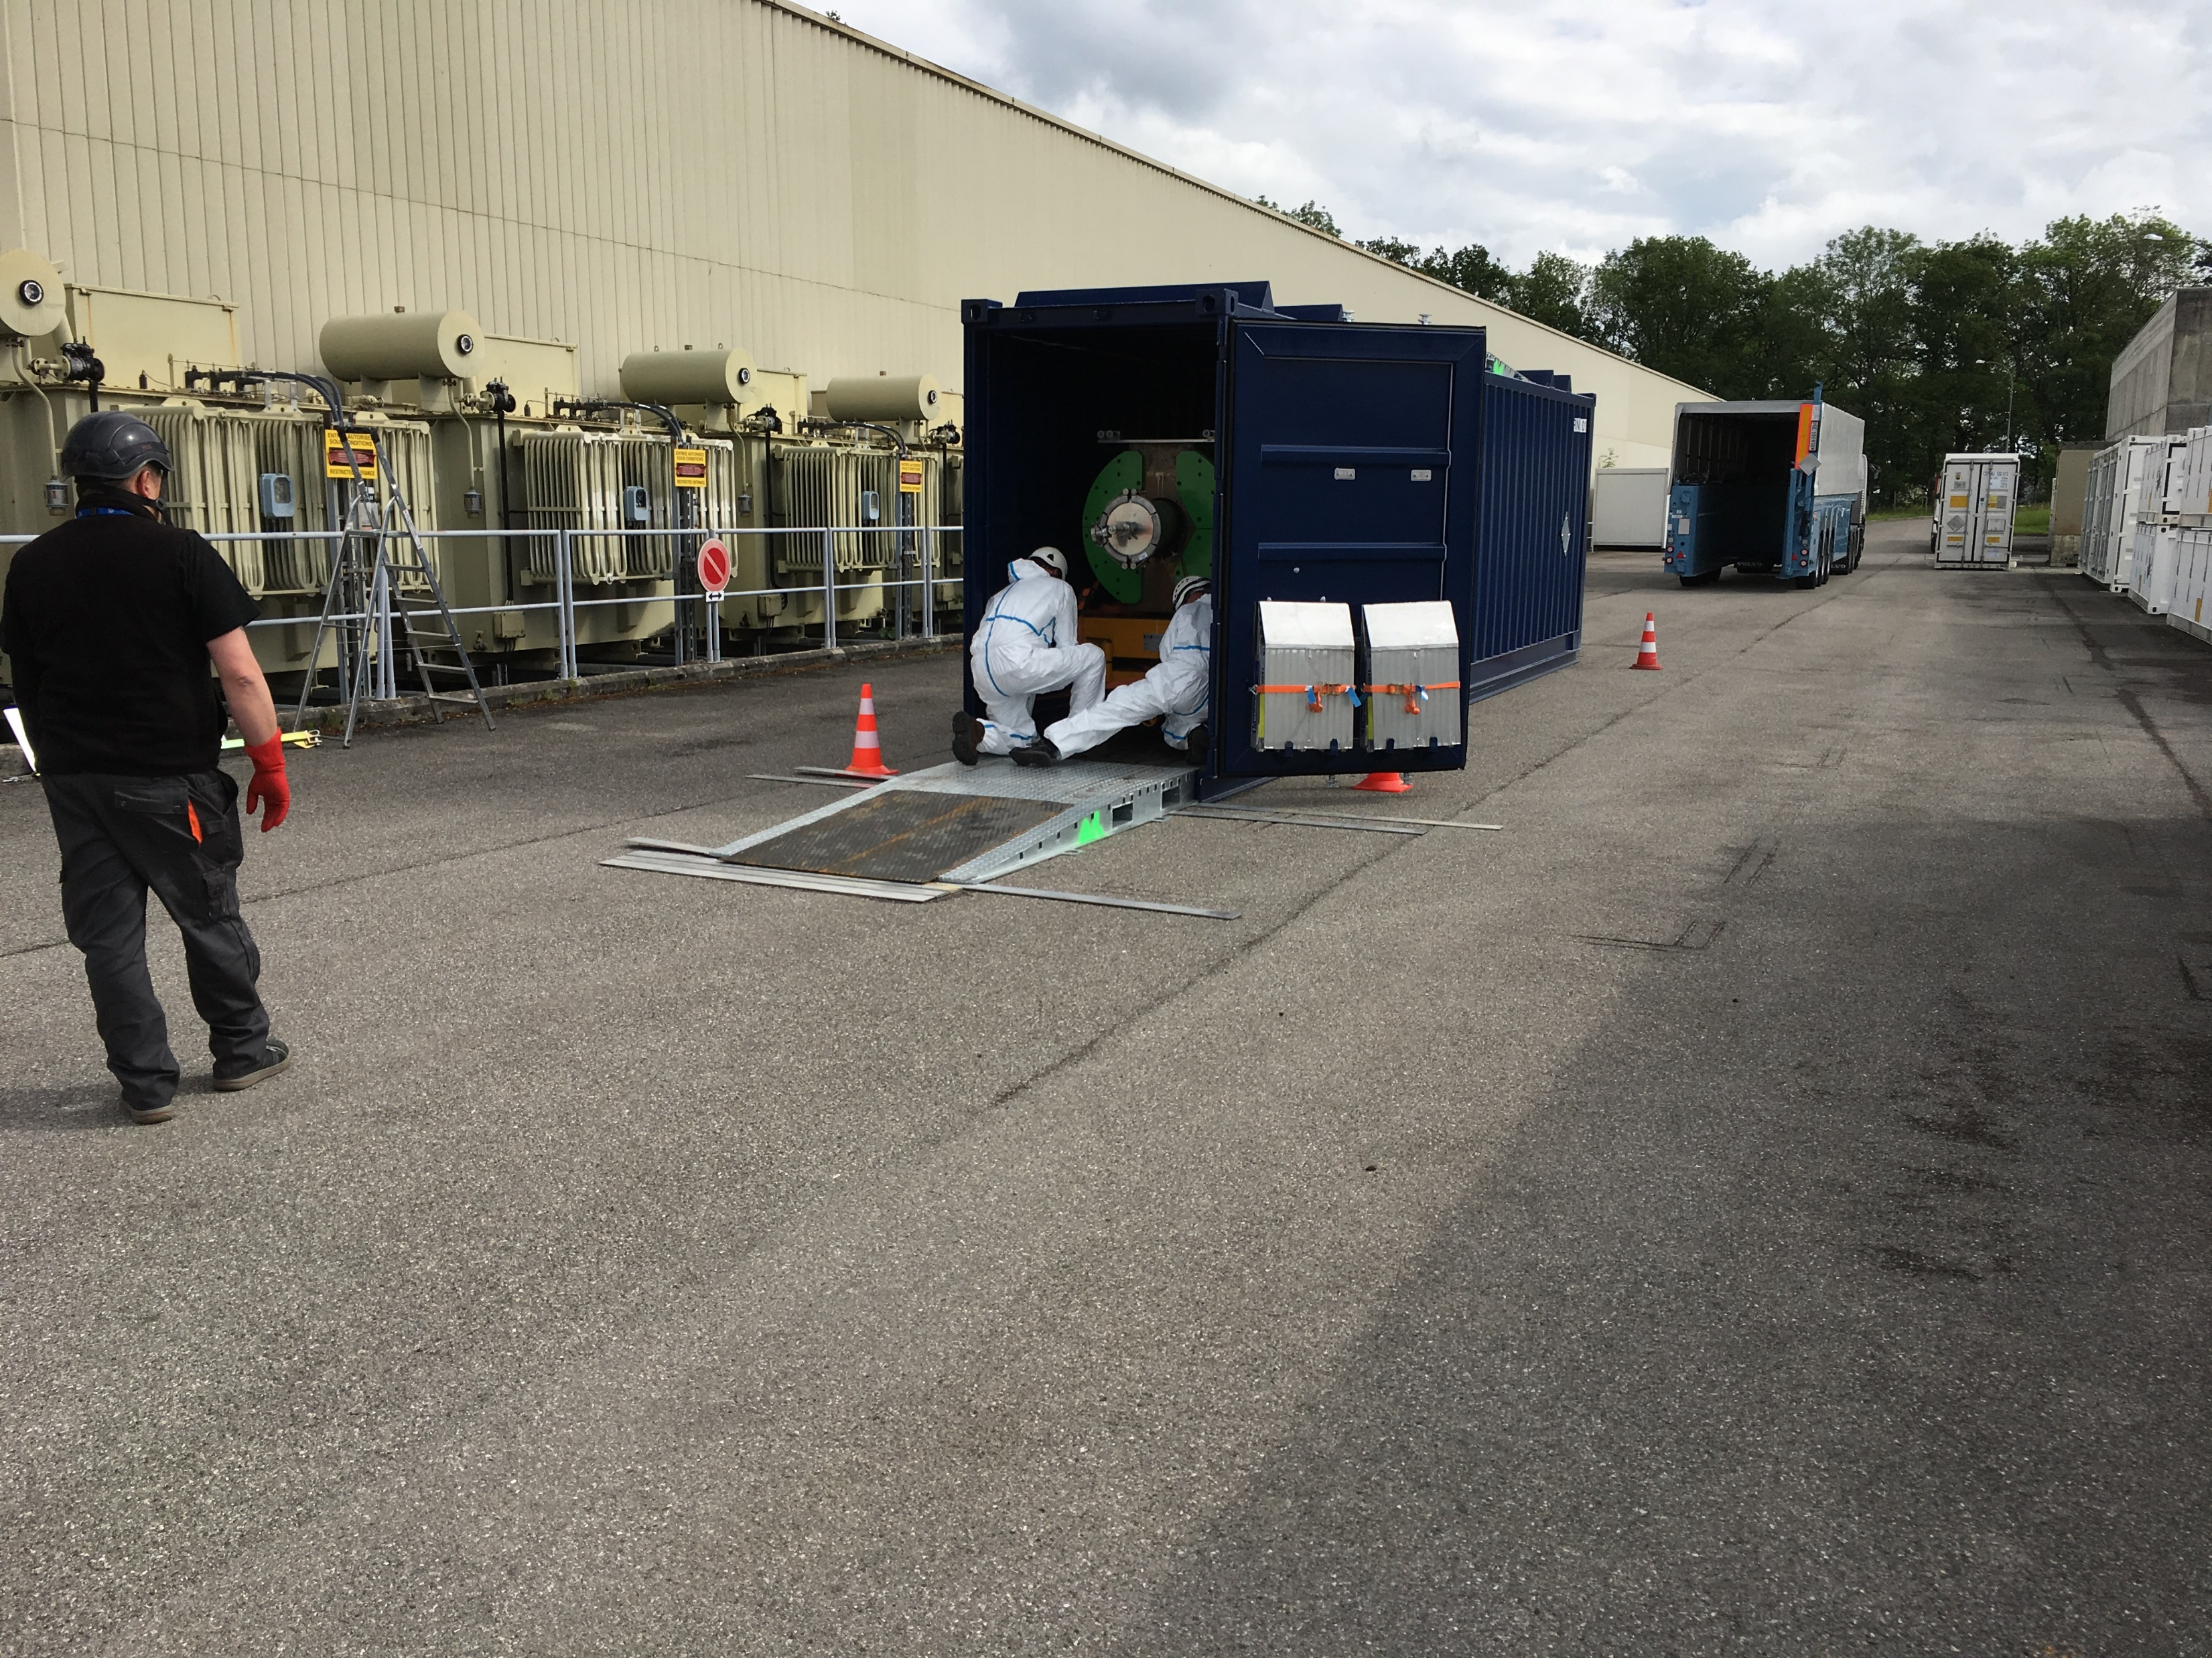
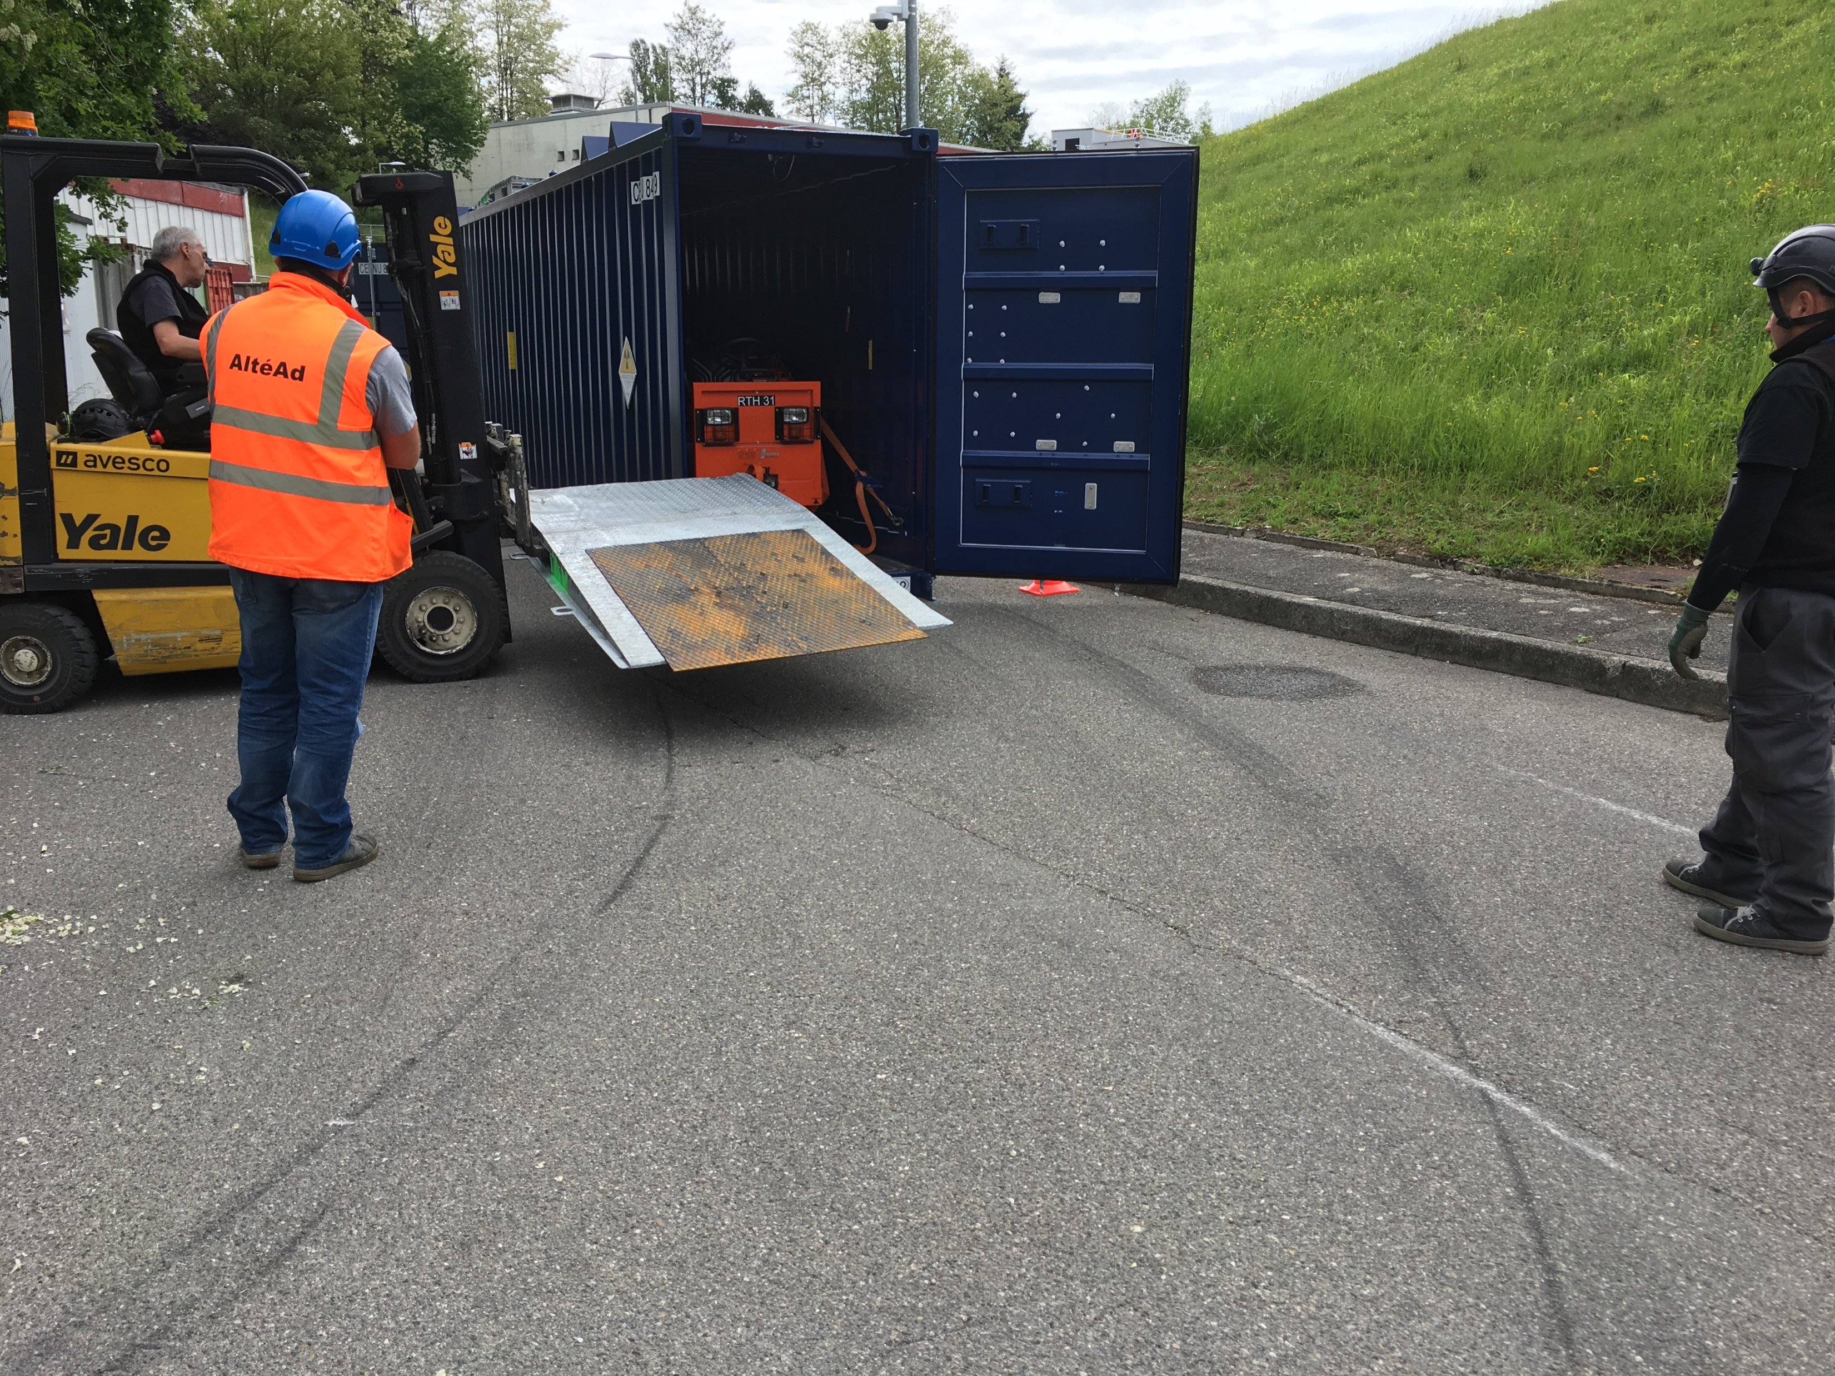
Step | Description | Responsible | Work Teams | Workers | Number of participants | Working position | Dose rate [µSv/h] | Exposure time coefficient | Estimated expsure time [min] | Estimated total step exposure time [person.h] | Estimated dose [person.µSv/h] | Estimated total step dose [µSv] | Expected start date
50 | Insertion in IP2 container
54 | Slash the TAN to the container | EN-HE | EN-HE | Operator 3 Operator 4 | 2 | Inside the container, next to the TAN |  |  | 15
55 | Remove the ramps, close teh container | EN-HE | EN-HE | Operator 1 Operator 4 | 2 | In front of the TAN in a forklift, in front of the door of the container |  |  | 15

Slide 21
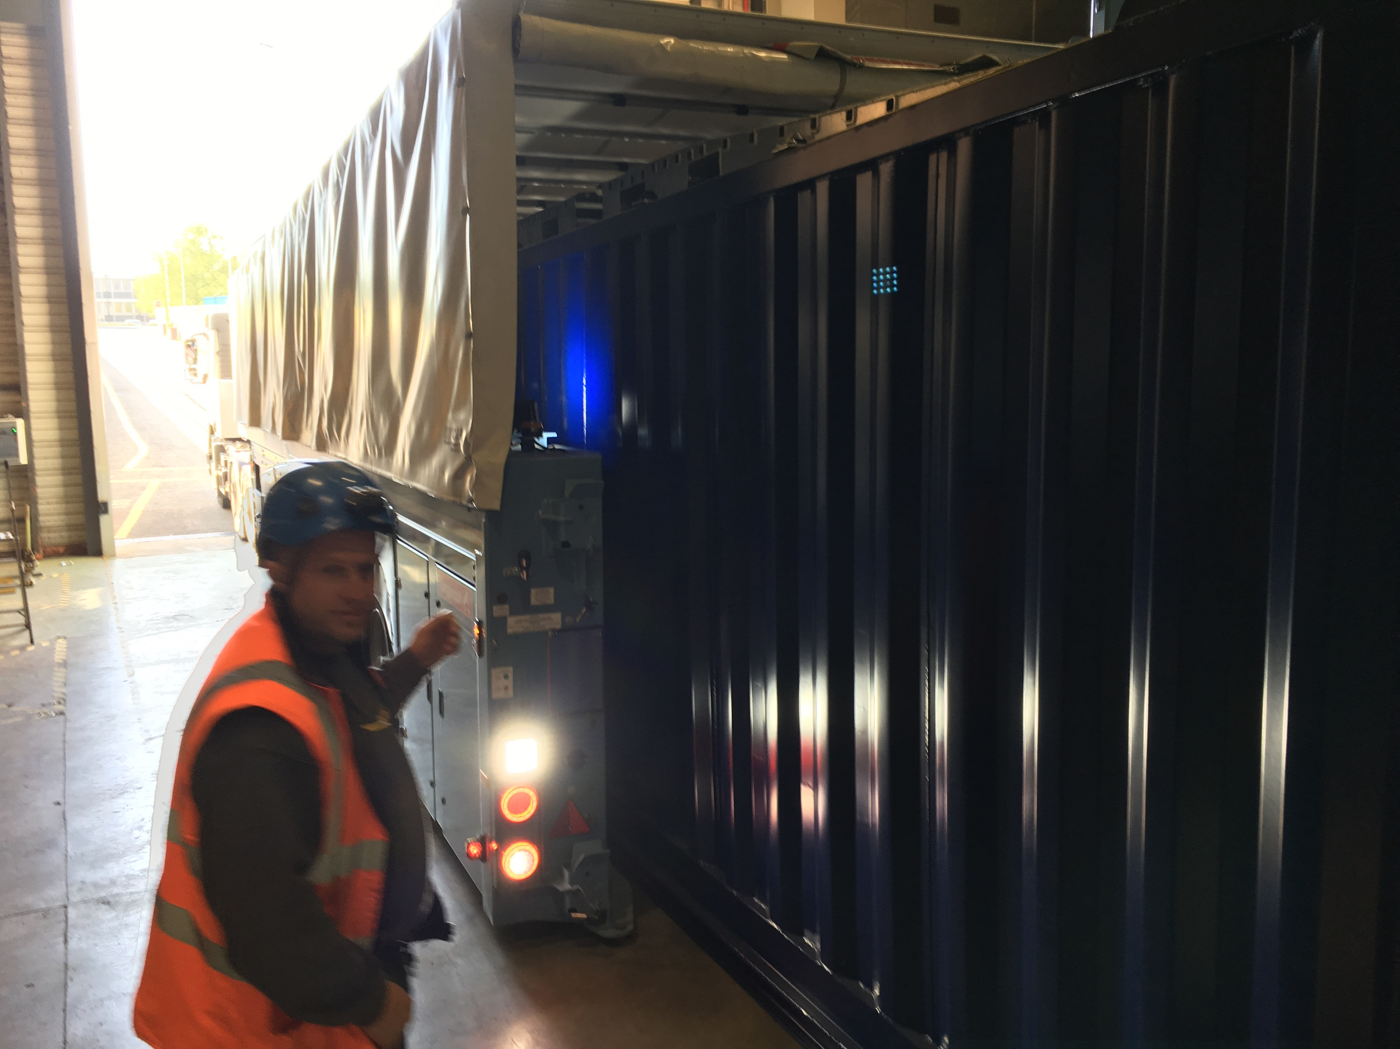
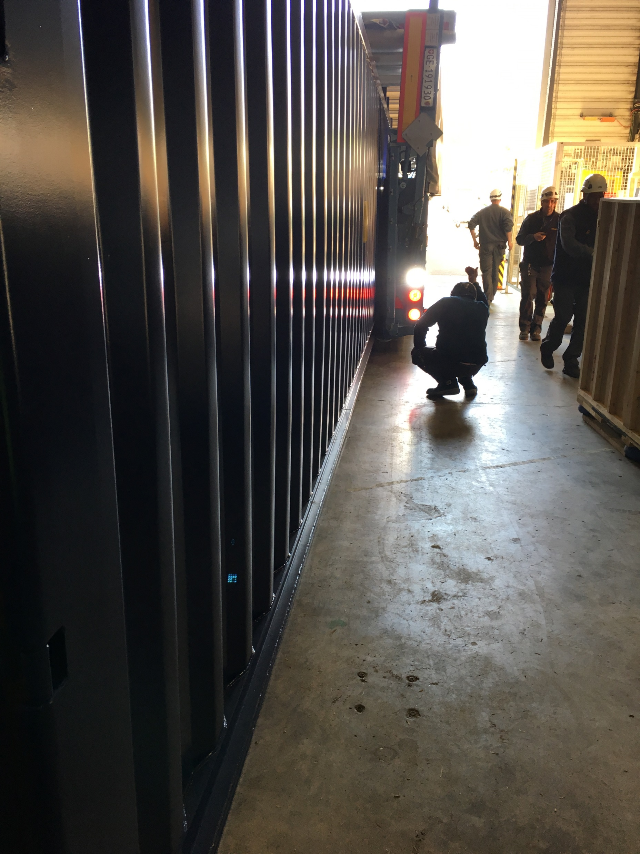
Step | Description | Responsible | Work Teams | Workers | Number of participants | Working position | Dose rate [µSv/h] | Exposure time coefficient | Estimated expsure time [min] | Estimated total step exposure time [person.h] | Estimated dose [person.µSv/h] | Estimated total step dose [µSv] | Expected start date
50 | Insertion in IP2 container
56 | Insert container in the truck | EN-HE | EN-HE | Driver 1 Operator 3 Operator 4 | 3 | Driver inside of the truck 2 operators, outside the container |  |  | 15

Slide 22
Step | Description | Responsible | Work Teams | Workers | Number of participants | Working position | Dose rate [µSv/h] | Exposure time coefficient | Estimated expsure time [min] | Estimated total step exposure time [person.h] | Estimated dose [person.µSv/h] | Estimated total step dose [µSv] | Expected start date
60 | Drive from P1 to P6 | EN-HE | EN-HE | Driver 1 | 1 | Inside of the truck cabin |  |  | 40

Slide 23

Step | Description | Responsible | Work Teams | Workers | Number of participants | Working position | Dose rate [µSv/h] | Exposure time coefficient | Estimated expsure time [min] | Estimated total step exposure time [person.h] | Estimated dose [person.µSv/h] | Estimated total step dose [µSv] | Expected start date
70 | Unloading of truck in P6
71 | Unload container in the parking | EN-HE | EN-HE | Driver 1 Operator 3 Operator 4 | 3 | Driver inside of the truck 2 operators, outside the container |  |  | 10
72 | Install ramps, open container | EN-HE | EN-HE | Operator 1 Operator 4 | 2 | In front of the TAN in a forklift, in front of the door of the container |  |  | 15
73 | Remove the slashs inside of the container | EN-HE | EN-HE | Operator 3 Operator 4 | 2 | Inside the container, next to the TAN |  |  | 15
74 | Attachment of the TAN to a tractor | EN-HE | EN-HE | Operator 4 | 1 | In front of the TAN . In the parking outside |  |  | 5
75 | Pull the TAN outside of the container and bring it inside SX6 | EN-HE | EN-HE | Operator 4 | 1 | In front of the TAN in a tractor. |  |  | 10

Slide 24
Step | Description | Responsible | Work Teams | Workers | Number of participants | Working position | Dose rate [µSv/h] | Exposure time coefficient | Estimated expsure time [min] | Estimated total step exposure time [person.h] | Estimated dose [person.µSv/h] | Estimated total step dose [µSv] | Expected start date
80 | Lowering down to UX65
81 | Attach the slings to the TAN | EN-HE | EN-HE | Operator 2 | 1 | Next to the TAN |  |  | 5
82 | Lowering down with the crane of UX65 | EN-HE | EN-HE |  |  | 1 Operator in the surface looking inside the shaft 1 Operator under |  |  | 40
83 | Location in transfer platform , removal of slings | EN-HE | EN-HE | Operator 2 | 1 | Next to the TAN |  |  | 5
Location of attachment of slings

Slide 25
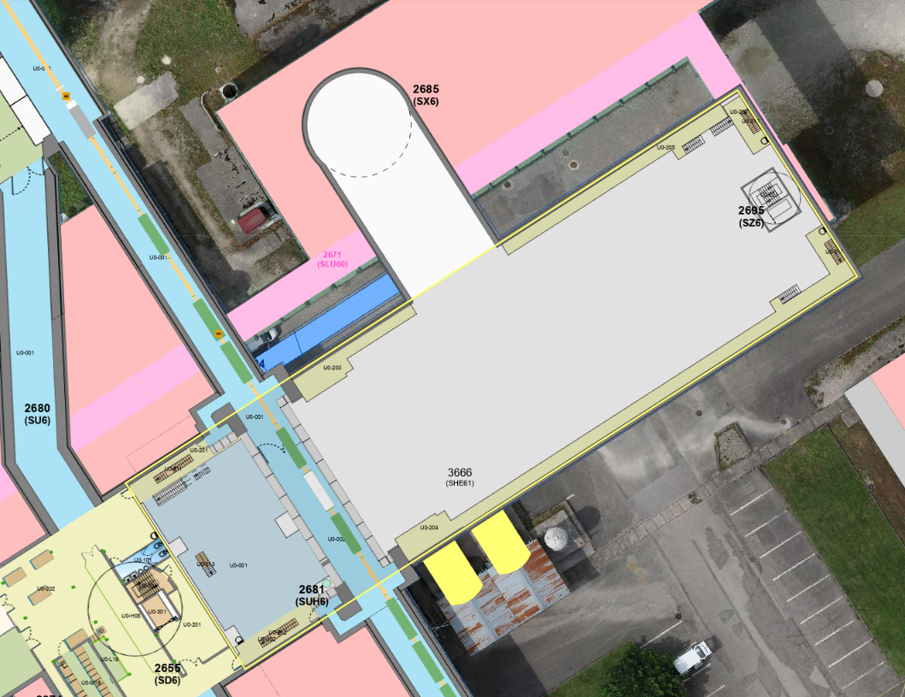
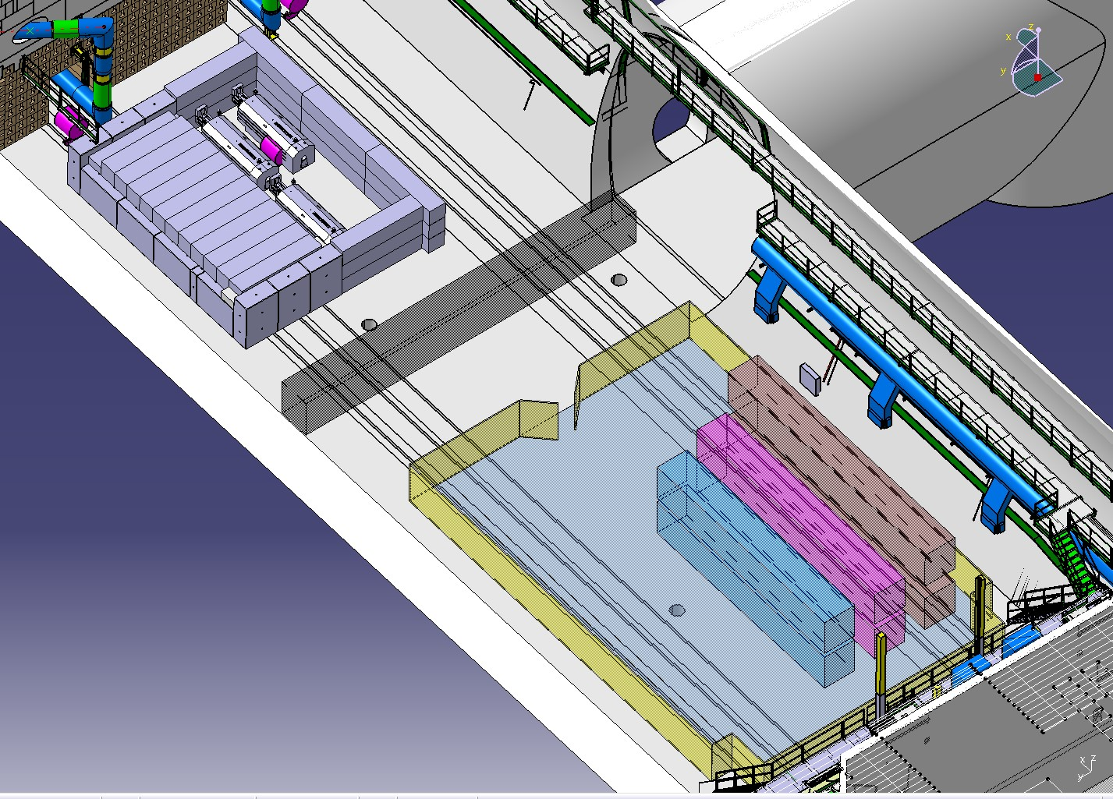
Step | Description | Responsible | Work Teams | Workers | Number of participants | Working position | Dose rate [µSv/h] | Exposure time coefficient | Estimated expsure time [min] | Estimated total step exposure time [person.h] | Estimated dose [person.µSv/h] | Estimated total step dose [µSv] | Expected start date
90 | Insertion in UX65 bunker for TAN
91 | Drive the transfer platform from under the shaft to the main cavern | EN-HE | EN-HE | Operator 2 | 1 | 1m from the TAN |  |  | 10
92 | Attach the slings to the TAN | EN-HE | EN-HE | Operator 2 | 1 | Next to the TAN |  |  | 5
93 | Lifting the TAN with the crane and inserting it in the bunker | EN-HE | EN-HE | Operator 2 Operator 3 | 2 | 5m from the TAN |  |  | 15
94 | De-attach the slings | EN-HE | EN-HE | Operator 3 | 1 | Next to the TAN |  |  | 5

Slide 26
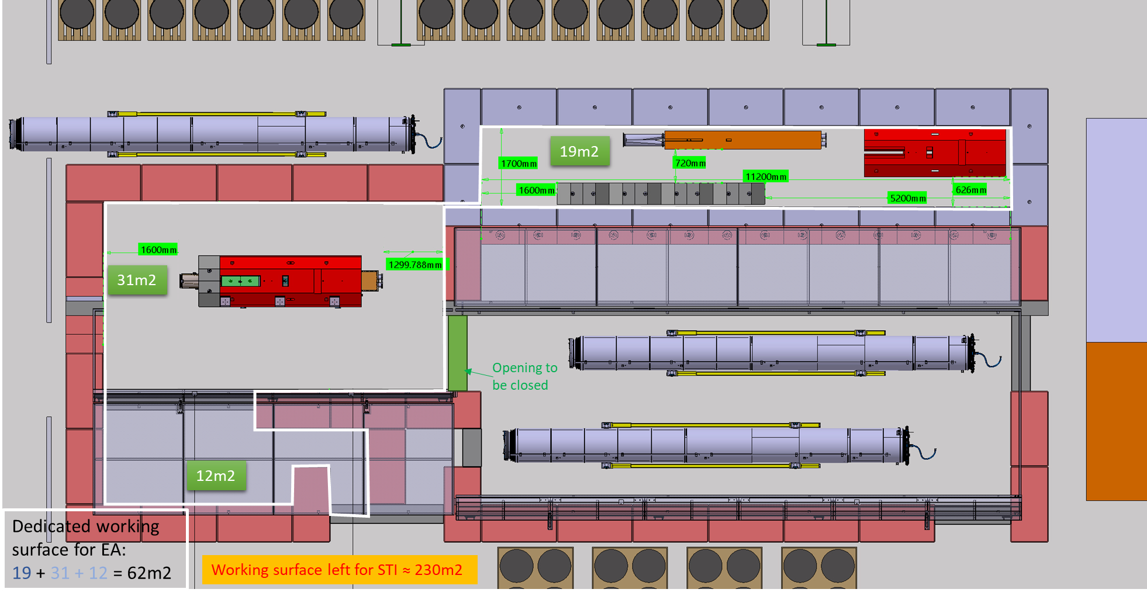
Step | Description | Responsible | Work Teams | Workers | Number of participants | Working position | Dose rate [µSv/h] | Exposure time coefficient | Estimated expsure time [min] | Estimated total step exposure time [person.h] | Estimated dose [person.µSv/h] | Estimated total step dose [µSv] | Expected start date
100 | Bring from UX65 to SX6
110 | Attach the slings to the TAN | EN-HE | EN-HE | Operator 2 | 1 | Next to the TAN |  |  | 5
111 | Lifting the TAN with the crane out of the bunker and puting it onthte transfer platform | EN-HE | EN-HE | Operator 2 Operator 3 | 2 | 5m from the TAN |  |  | 15
112 | Location in transfer platform , removal of slings | EN-HE | EN-HE | Operator 2 | 1 | Next to the TAN |  |  | 5
113 | Drive the transfer platform from the caver to the shaft | EN-HE | EN-HE | Operator 2 | 1 | 1m from the TAN |  |  | 10
114 | Attach the slings to the TAN | EN-HE | EN-HE | Operator 2 | 1 | Next to the TAN |  |  | 5
115 | Lift the TAN to SX6 | EN-HE | EN-HE |  |  | 1 Operator in the surface looking inside the shaft 1 Operator under |  |  | 40
116 | Locate the TAN inside of the bunker of SX6 | EN-HE | EN-HE | Operator 2 Operator 3 | 2 | 5m from the TAN |  |  | 15
117 | De-attach the slings | EN-HE | EN-HE | Operator 3 | 1 | Next to the TAN |  |  | 5

Slide 27
P5
Tasks 10 and 20 are the same than inP1

Slide 28
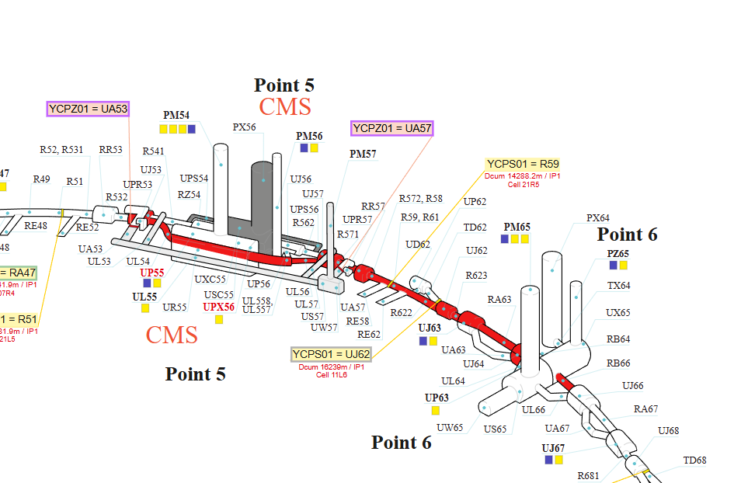
Step | Description | Responsible | Work Teams | Workers | Number of participants | Working position | Dose rate [µSv/h] | Exposure time coefficient | Estimated expsure time [min] | Estimated total step exposure time [person.h] | Estimated dose [person.µSv/h] | Estimated total step dose [µSv] | Expected start date
30 | Transport in the tunnel |  |  |  |  |  |  |  | 200
31 | Rolling from UJ53/UJ561 to P6. Speed 1km/h. Distance 3,3 km | EN-HE | EN-HE | Operator 4 | 1 | In front of the TAN in a tractor |  |  | 200

Slide 29
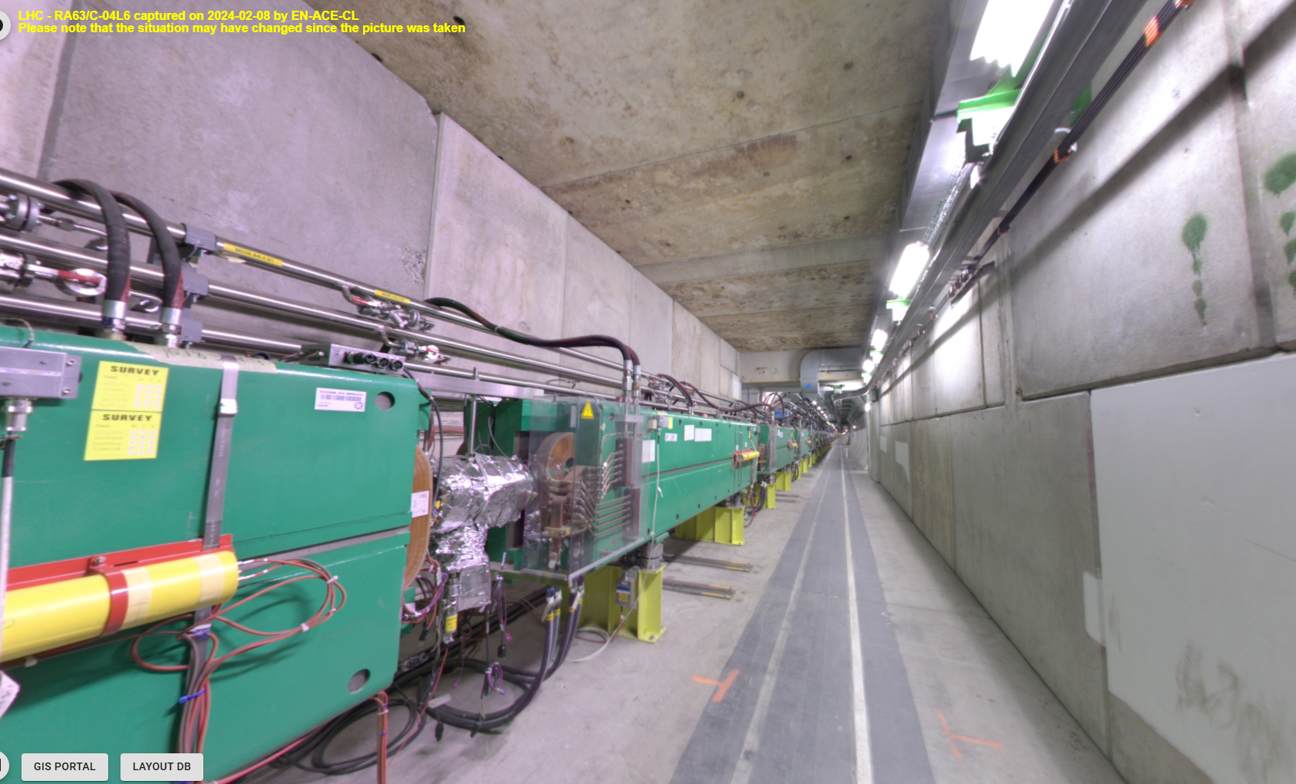
Step | Description | Responsible | Work Teams | Workers | Number of participants | Working position | Dose rate [µSv/h] | Exposure time coefficient | Estimated expsure time [min] | Estimated total step exposure time [person.h] | Estimated dose [person.µSv/h] | Estimated total step dose [µSv] | Expected start date
40 | Transfer from the tunnel to UX65 |  |  |  |  |  |  |  | 70
41 | Bolting lifting points and attaching slings | EN-HE | EN-HE | Operator 1 Operator 4 | 2 | Next to the TAN |  |  | 5
42 | Lifting with mobile crane and locating inside of the TAN bunker in UX65 | EN-HE | EN-HE | Operator 1 Operator 2 Operato 3 Operator 4 | 4 | 2 Operators in the sides of the TAN in the tunnel 1 Operator on top of hte blocks driving the crane 1 Operator in the bunker in UX65 |  |  | 35
43 | De-attach the slings | EN-HE | EN-HE | Operator 3 | 1 | Next to the TAN |  |  | 5

Slide 30
Step | Description | Responsible | Work Teams | Workers | Number of participants | Working position | Dose rate [µSv/h] | Exposure time coefficient | Estimated expsure time [min] | Estimated total step exposure time [person.h] | Estimated dose [person.µSv/h] | Estimated total step dose [µSv] | Expected start date
50 | Bring from UX65 to SX6 |  |  |  |  |  |  |  | 100
51 | Attach the slings to the TAN | EN-HE | EN-HE | Operator 2 | 1 | Next to the TAN |  |  | 5
52 | Lifting the TAN with the crane out of the bunker and puting it onthte transfer platform | EN-HE | EN-HE | Operator 2 Operator 3 | 2 | 5m from the TAN |  |  | 15
53 | Location in transfer platform , removal of slings | EN-HE | EN-HE | Operator 2 | 1 | Next to the TAN |  |  | 5
54 | Drive the transfer platform from the caver to the shaft | EN-HE | EN-HE | Operator 2 | 1 | 1m from the TAN |  |  | 10
55 | Attach the slings to the TAN | EN-HE | EN-HE | Operator 2 | 1 | 1m from the TAN |  |  | 5
56 | Lift the TAN to SX6 | EN-HE | EN-HE |  |  | 1 Operator in the surface looking inside the shaft 1 Operator under |  |  | 40
57 | Locate the TAN inside of the bunker of SX6 | EN-HE | EN-HE | Operator 2 Operator 3 | 2 | 5m from the TAN |  |  | 15
58 | De-attach the slings | EN-HE | EN-HE | Operator 3 | 1 | Next to the TAN |  |  | 5

