Slide 1
Electron gun & collector for the new AD e-cooler
Numerical assessment
Teresa Guillen Hernandez
24/04/2025

Slide 2
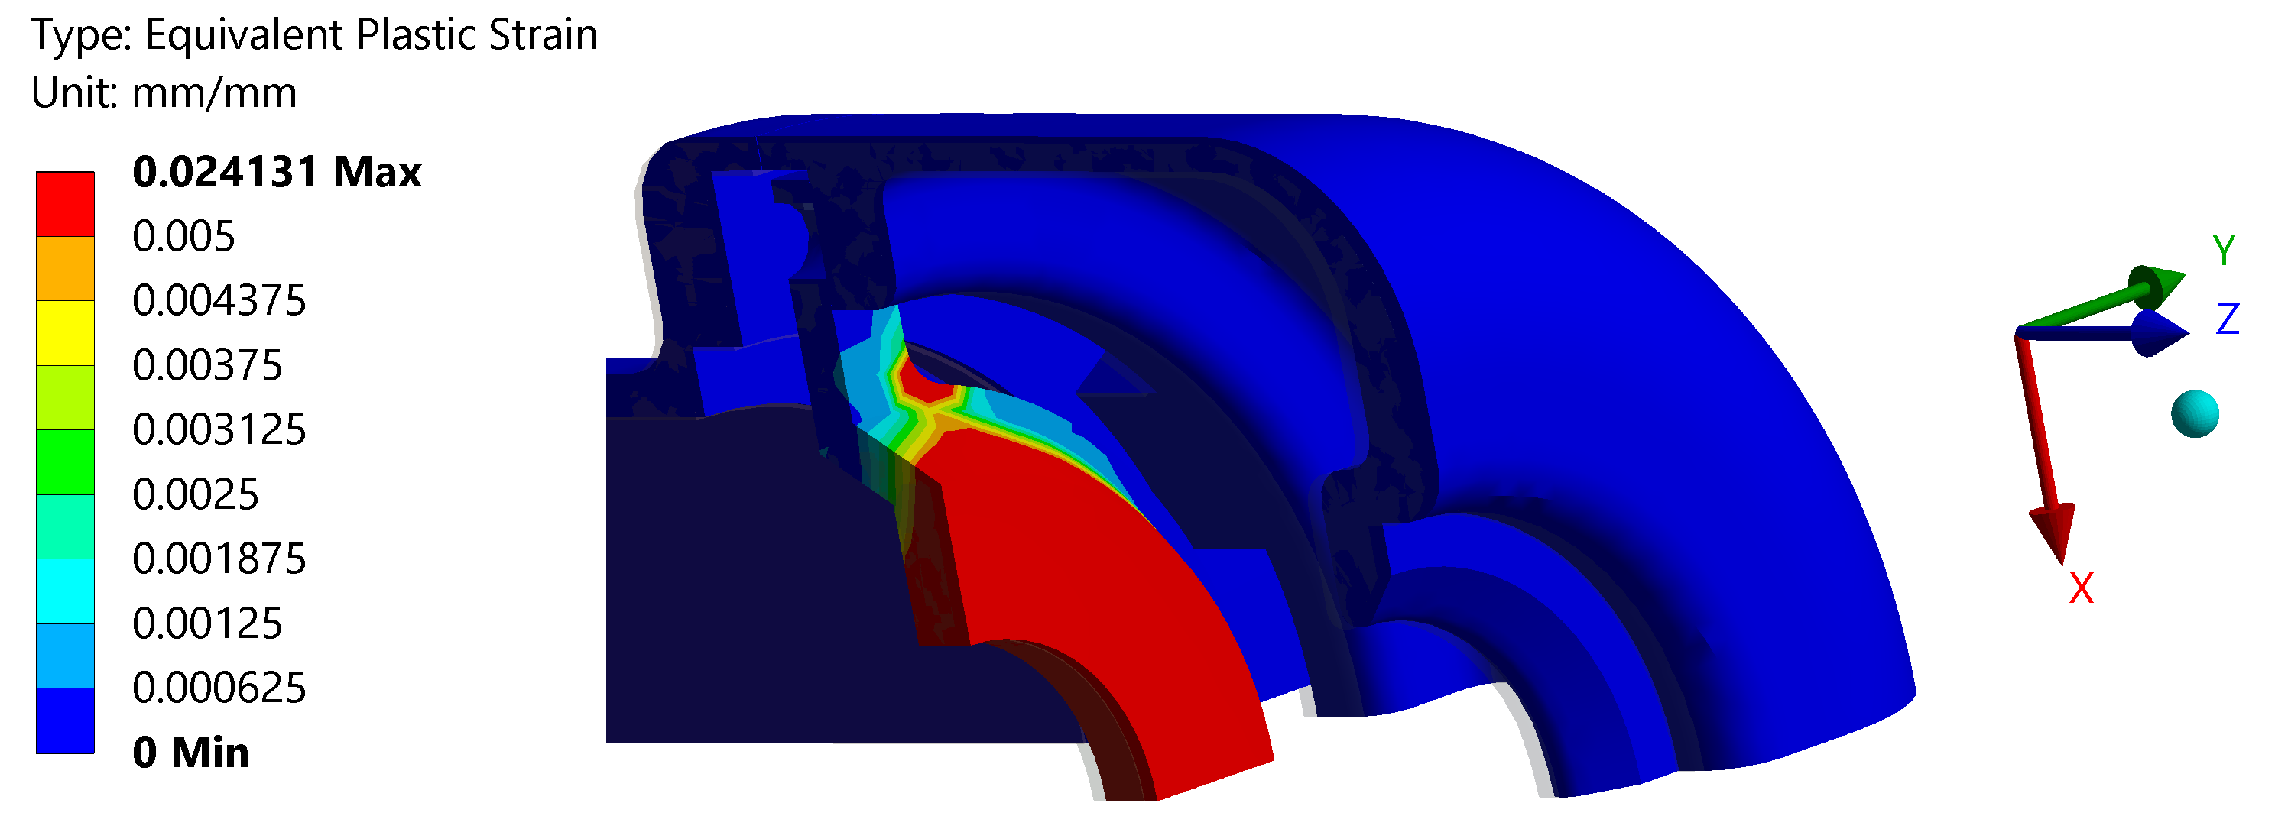
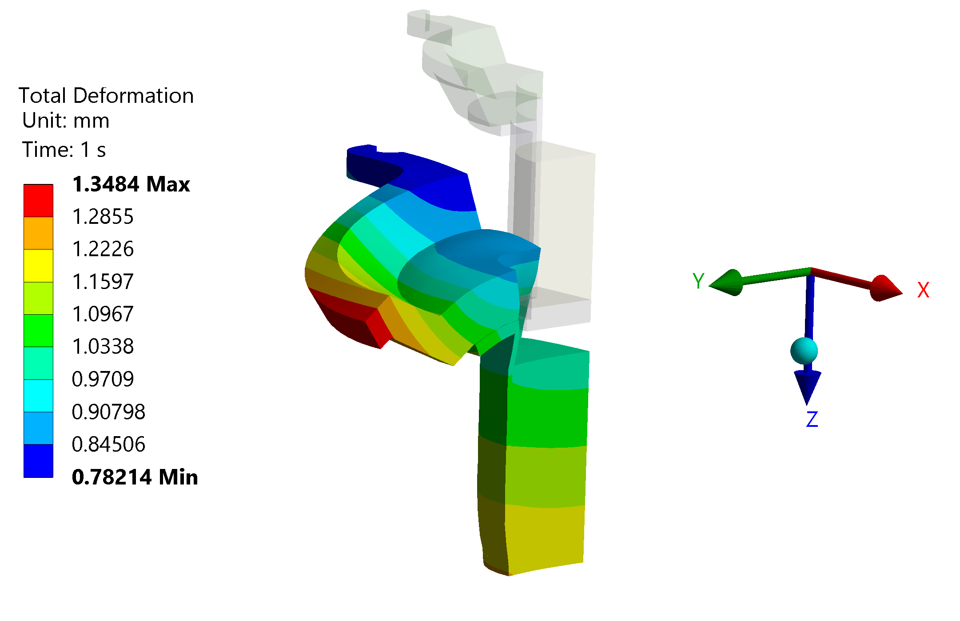
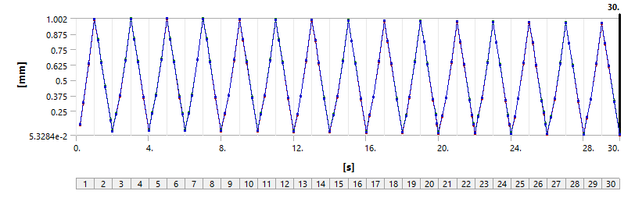
Thermo-mechanical analysis – No tantalum
stabilization
3 % < 304L elongation
Deformation along Z - 15 thermal cycles
First cycle
operation 1mm
shut down 0.087 mm
15 cycle
operation 0.96mm
shut down 0.061 mm
Total deformation first cycle (operation)
Bolted connections at 1000 °C and 700 °C ?
Stress relaxation
Self weight
Could we lose the position? Maybe use spot welds?
Notes:
Material elongation 40-58%

Slide 3
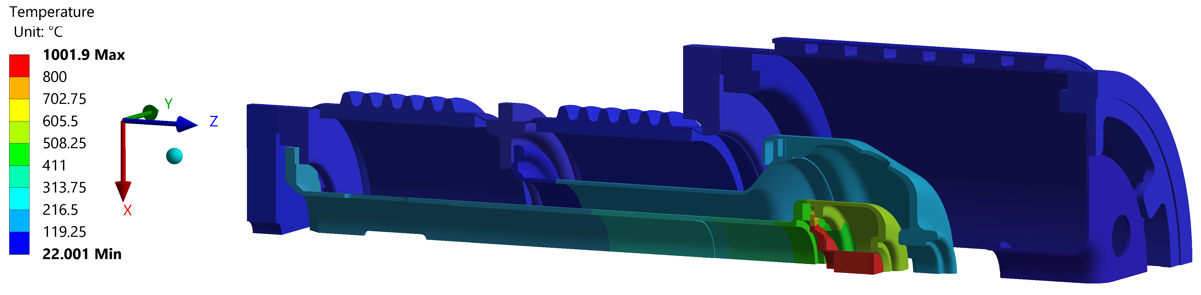
Thermo-mechanical analysis – No tantalum
St steel 304L
Material properties at high temperatures
Temperature [°C] | 24 | 38 | 93 | 149 | 204 | 260 | 316 | 371 | 427 | 482 | 538 | 593 | 649 | 704 | 760 | 816 | 871
Yield strength [MPa] | 175 | 170 | 149 | 135 | 122 | 114 | 108 | 105 | 101 | 98 | 93 | 87 | 79 | 70 | 68 | 54 | 35
After cooling down – carbide precipitation
  Lower material properties
Inconel ?
Notes:
At high temperatures, the grain size increases, so we reduce a lot the material properties.
When cooling down, carbides precipitates will form in the grain boundaries. This means that the material properties will decrease again.
And we have a lot cycles, right? 10 cycles/year during 20 or 40 years
Proposal – used Inconel

Slide 4
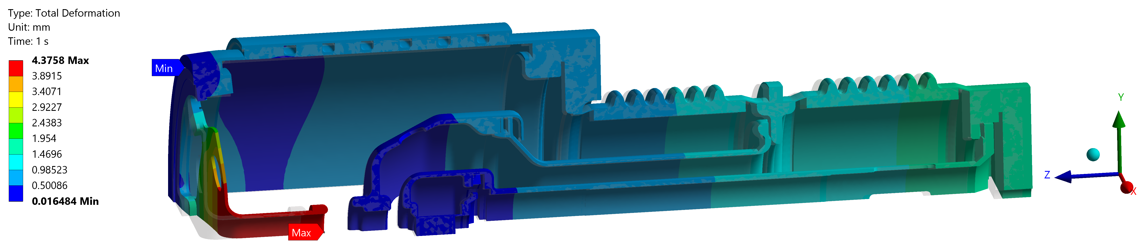
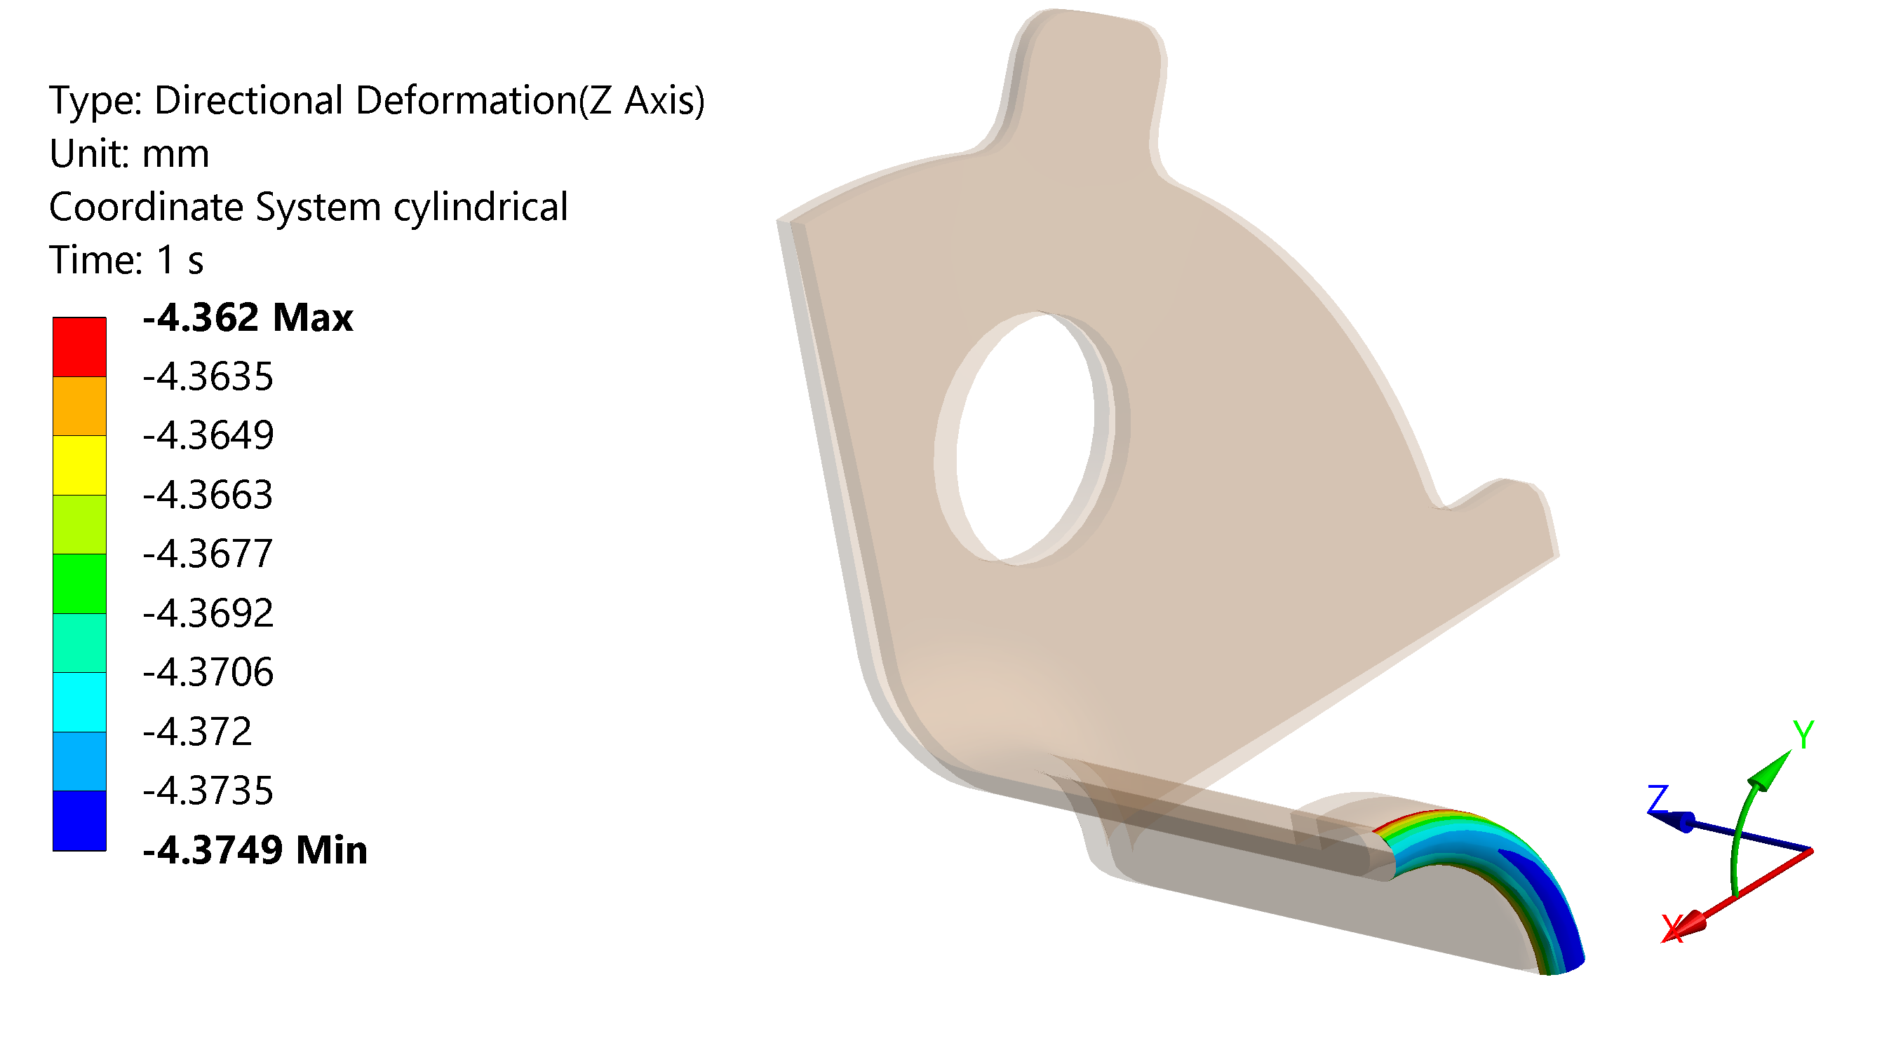
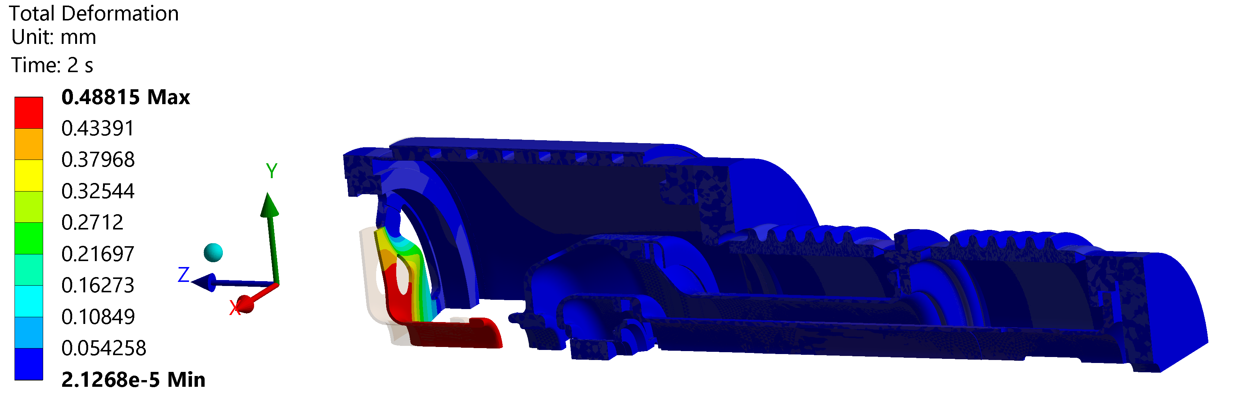
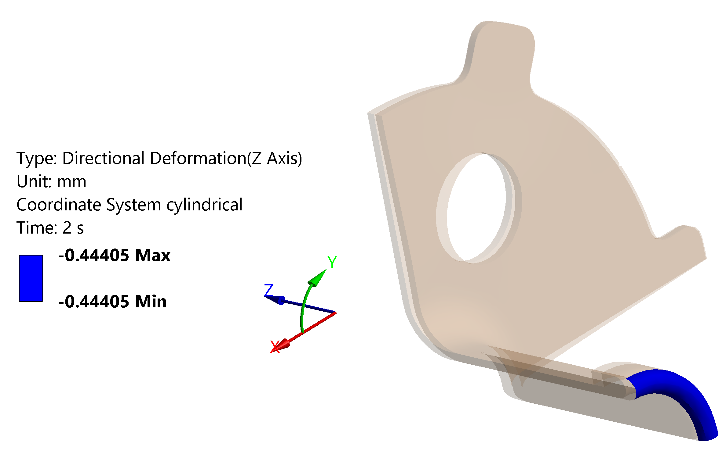
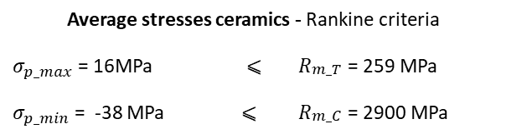
Bake out - 250 °C
While heating
Cool down
Average stresses ceramics - Rankine criteria
$σ_{p_max}$ = 16MPa | ⩽ | $R_{\begin{aligned}m_T \\ \end{aligned}}$ = 259 MPa
$σ_{p_min}$ = -38 MPa | ⩽ | $R_{\begin{aligned}m_C \\ \end{aligned}}$ = 2900 MPa
Critical areas ceramic – connections with the collars
Deeper analysis once the new design is finalized
Notes:
0.55 MPa on the ceramics due to gravity
Residual -15MPa, 20MPa

Slide 5
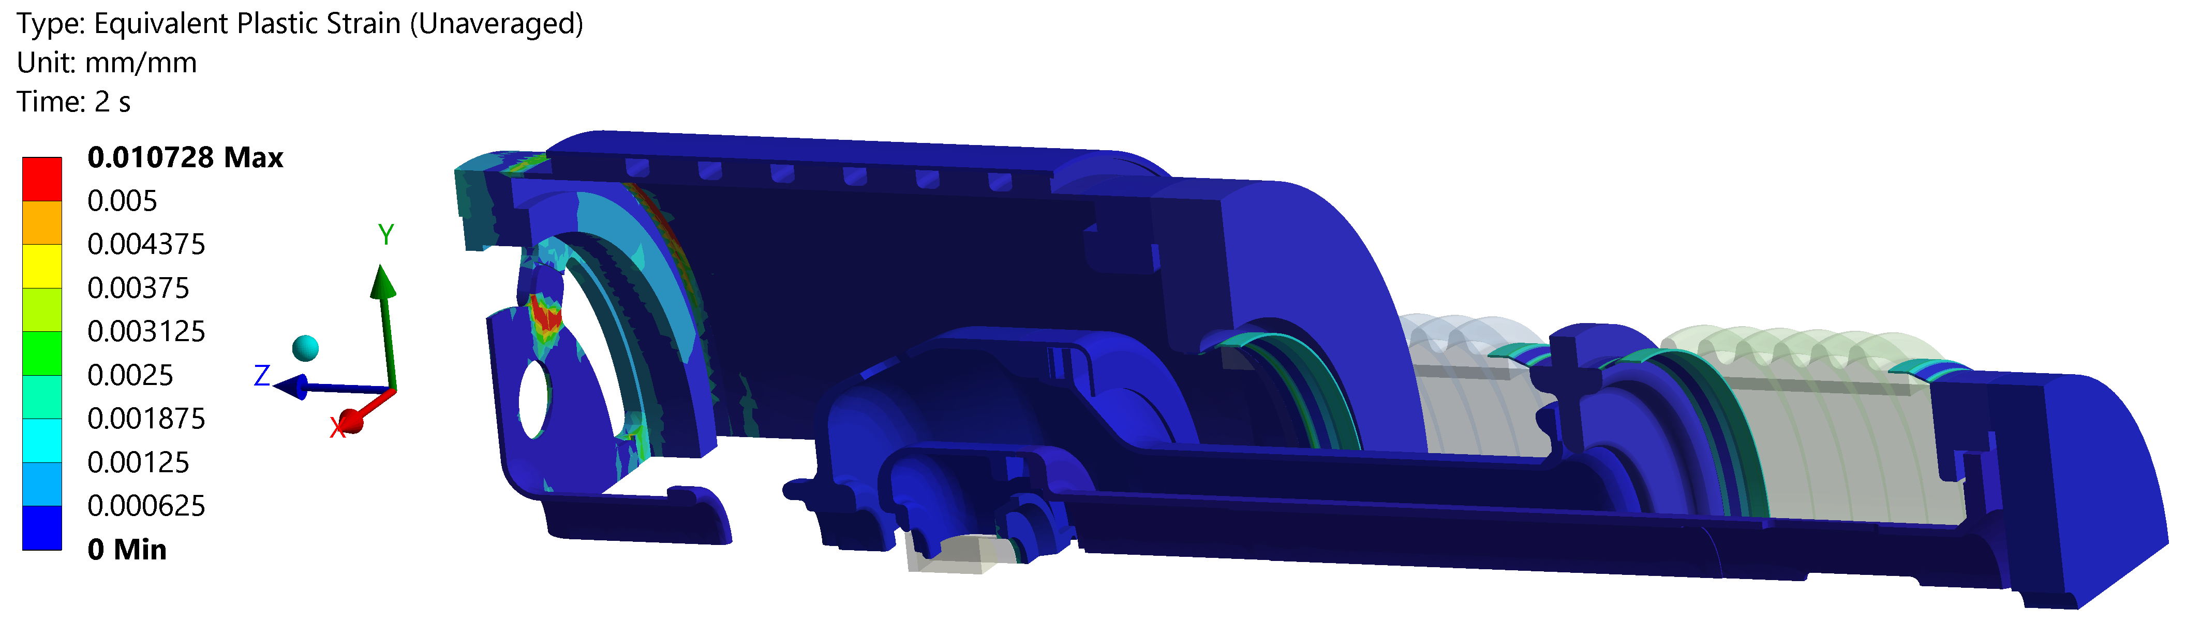
Bake out - 250 °C
Cool down

Slide 6
Conclusions
Operation
  We move 1mm in the longitudinal direction during the first cycle of operation and we don’t go back to the initial position after the cool down
  TOLERANCES ?
  We will not break due to plasticity.
  Bolted connections?
Bake out
  We move 0.44mm in the longitudinal direction after the bake out
  TOLERANCES ?
Steel at high temperatures
  Inconel were we have plasticity or very high temperatures?

